Slide 1


THE PROMISE THAT CHANGES EVERYTHING
改变一切的应许
14 Dec 2025

Slide 2


Slide 3


Slide 4


Slide 5


Slide 6
Is there a promise in life I can actually depend on?
人生真的有可靠的应许吗？

Slide 7
God gave humanity a promise
神向人类赐下一个应许

Slide 8
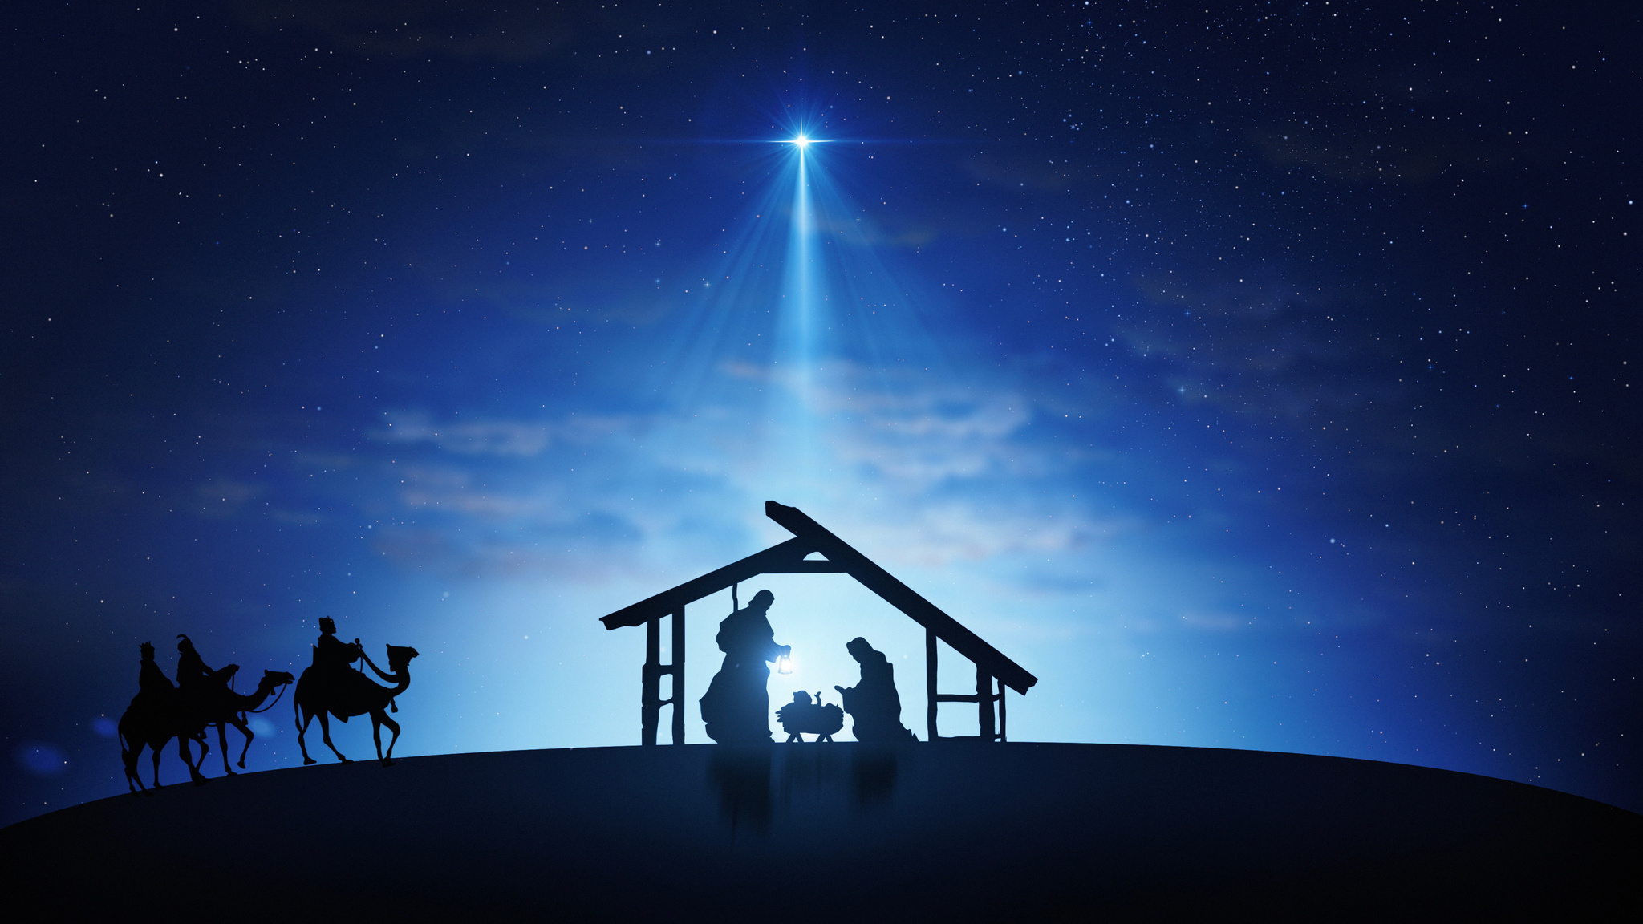
“Today in the town of David a Savior has been born to you; he is the Messiah, the Lord. “
Luke 2:11
“今 天 在 大 卫 的 城 里 ， 为 你 们 生 了 救 主 ， 就 是 主 基 督 。”
路加福音 2:11

Slide 9

“He will crush your head.”
Genesis 3:15
“他要伤你的头。”
创世记 3:15

Slide 10
The promise I made at the beginning — I am now keeping.
我起初所应许的，如今正在成就。

Slide 11
HOW DOES THIS PROMISE CHANGE EVERYTHING?
这应许如何改变一切？

Slide 12
“You raise me up, so I can stand on mountains…”
“You raise me up, to walk on stormy seas…”
你扶持我，使我站立在群山之巅；
你托住我，使我行走在风暴之海。

Slide 13
Who is the One who raises us up?
是谁把我们举起？

Slide 14
The One who raises us up is not just a source of strength —
He is a Saviour.
那位把我们举起的，
不只是力量的来源——
祂是一位救主。

Slide 15
Jesus didn’t just come to save us from something —
He came to bring us into something.
耶稣来，不只是“救我们脱离”，
祂更是“带我们进入”。

Slide 16
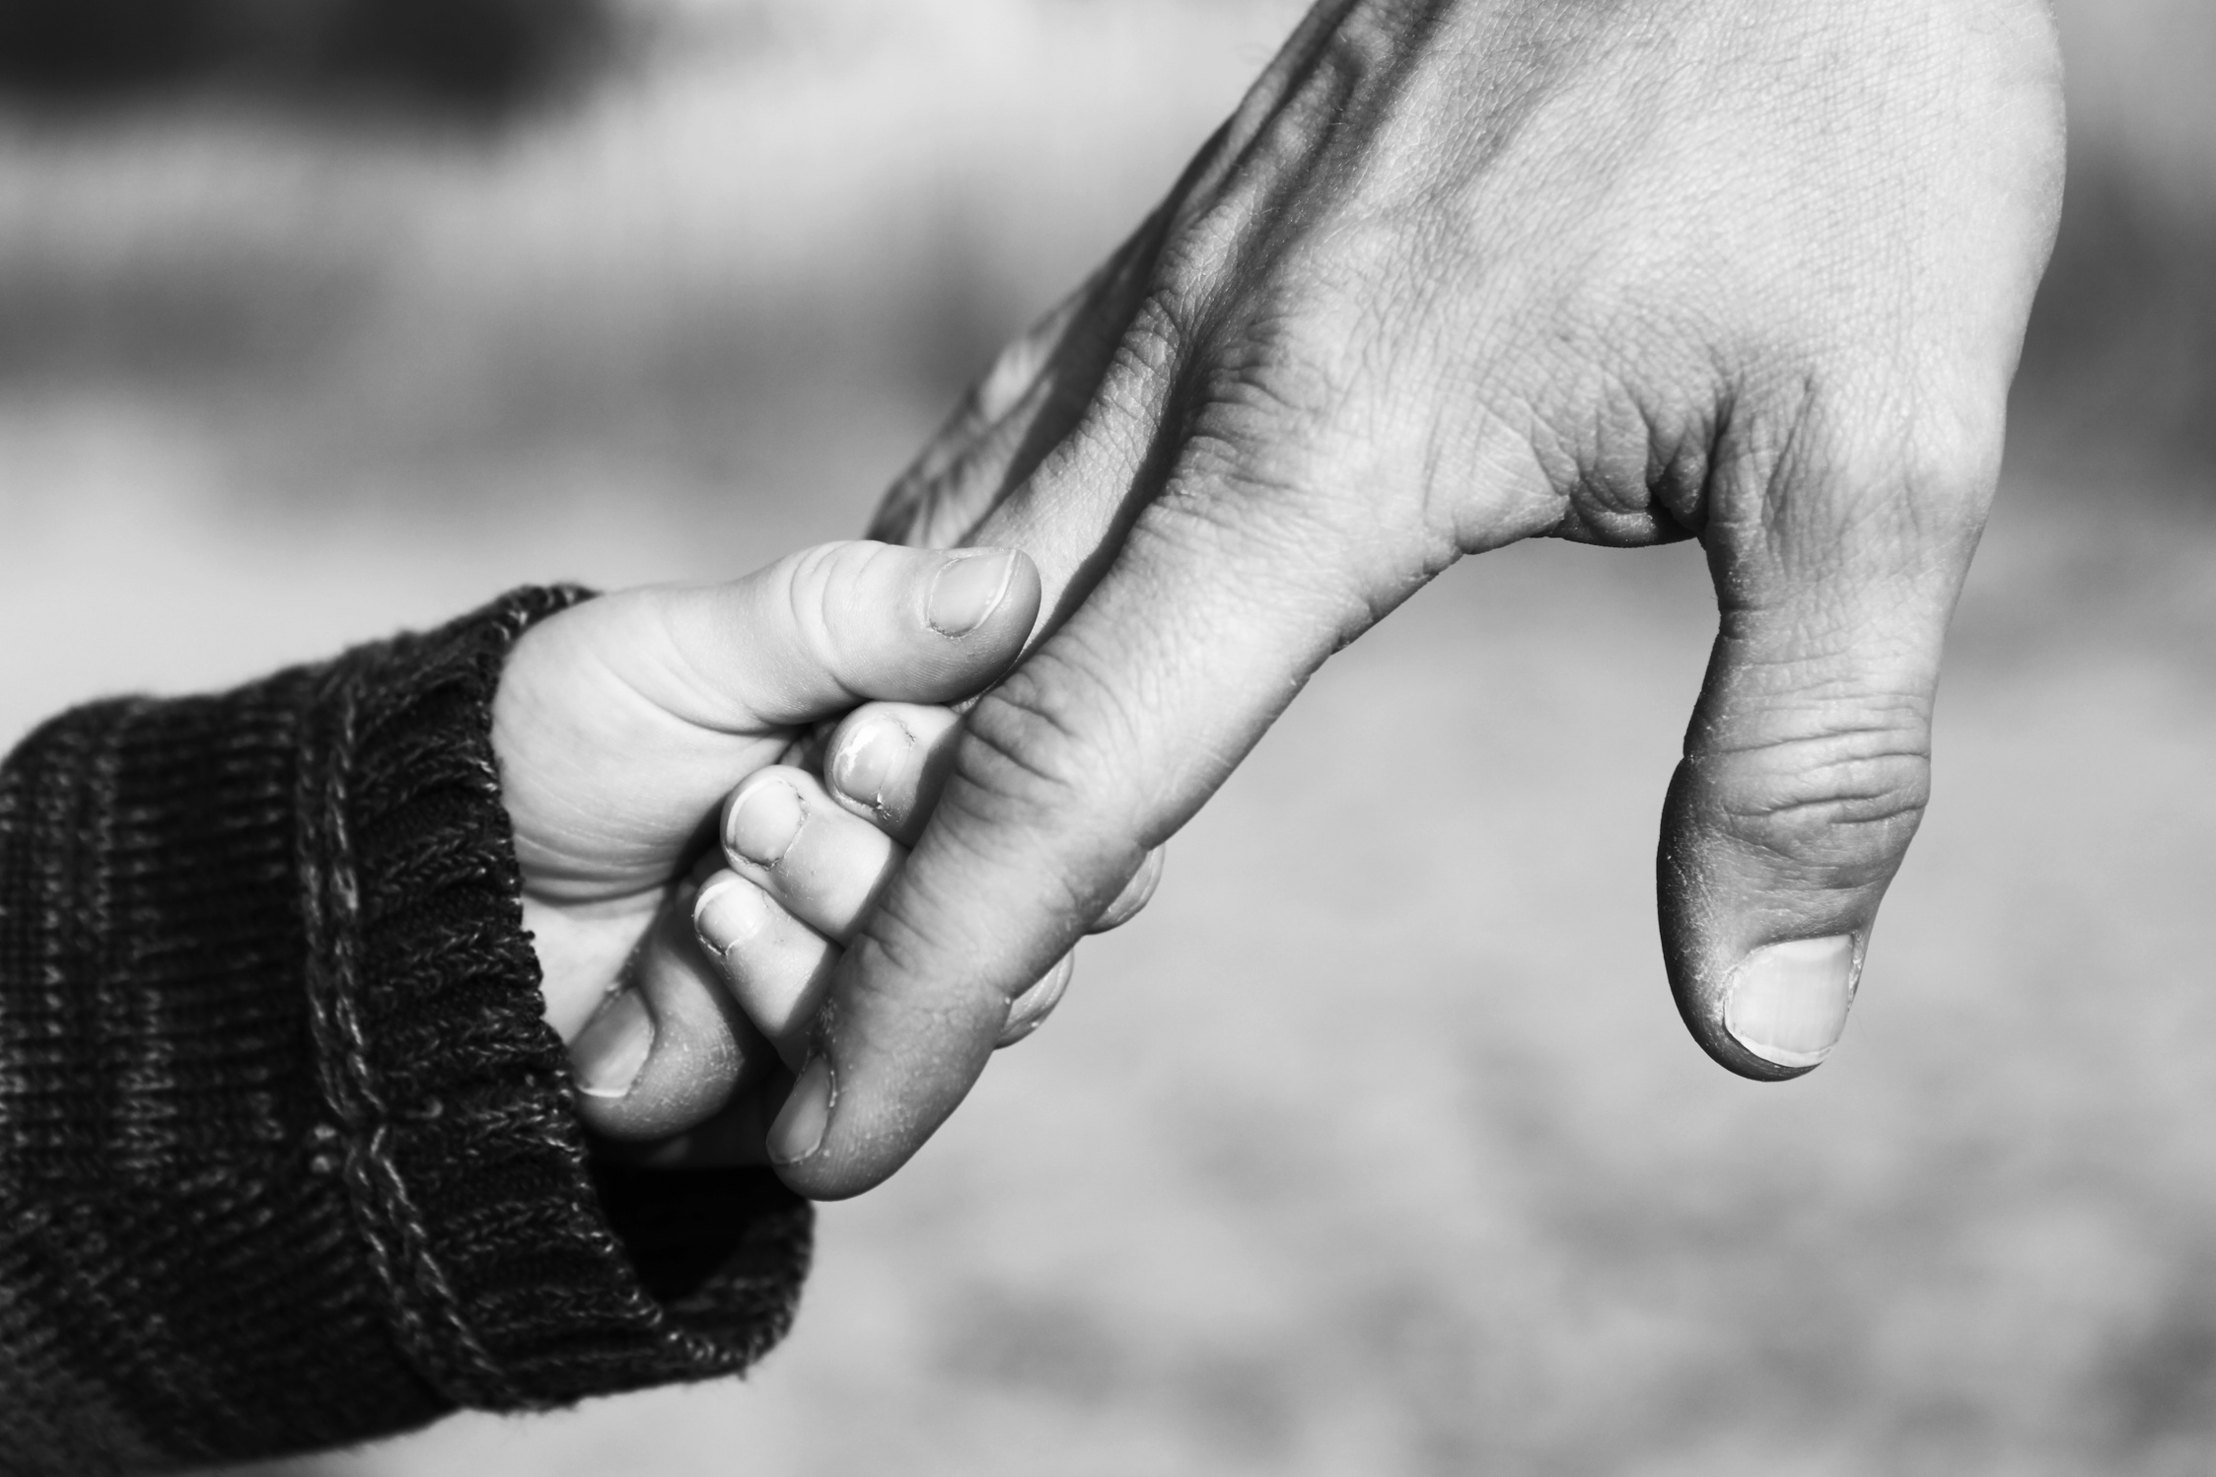
Saved into a relationship, given a new identity
得救，是进入关系，得着新身份

Slide 17
The promise of a Saviour leads to a new identity —
and that identity changes everything.
救主的应许带来新的身份，
而这个身份，改变了一切。

Slide 18
Why becoming God’s child changes everything
为什么成为神的儿女，会改变一切

Slide 19
Is this promise… for me?
这应许……是给我的吗？

Slide 20
Becoming a child of God
成为神的儿女
IS NOT SOMETHING YOU EARN
IS NOT BY BEING GOOD ENOUGH
不是靠努力赚取的
不是因为
“够好”

Slide 21
Becoming a child of God
成为神的儿女
IS NOT BY KNOWING ENOUGH
IS NOT BY BY FIXING YOUR LIFE FIRST
不是因为
“懂得够多”
不是先把人生整理好

Slide 22
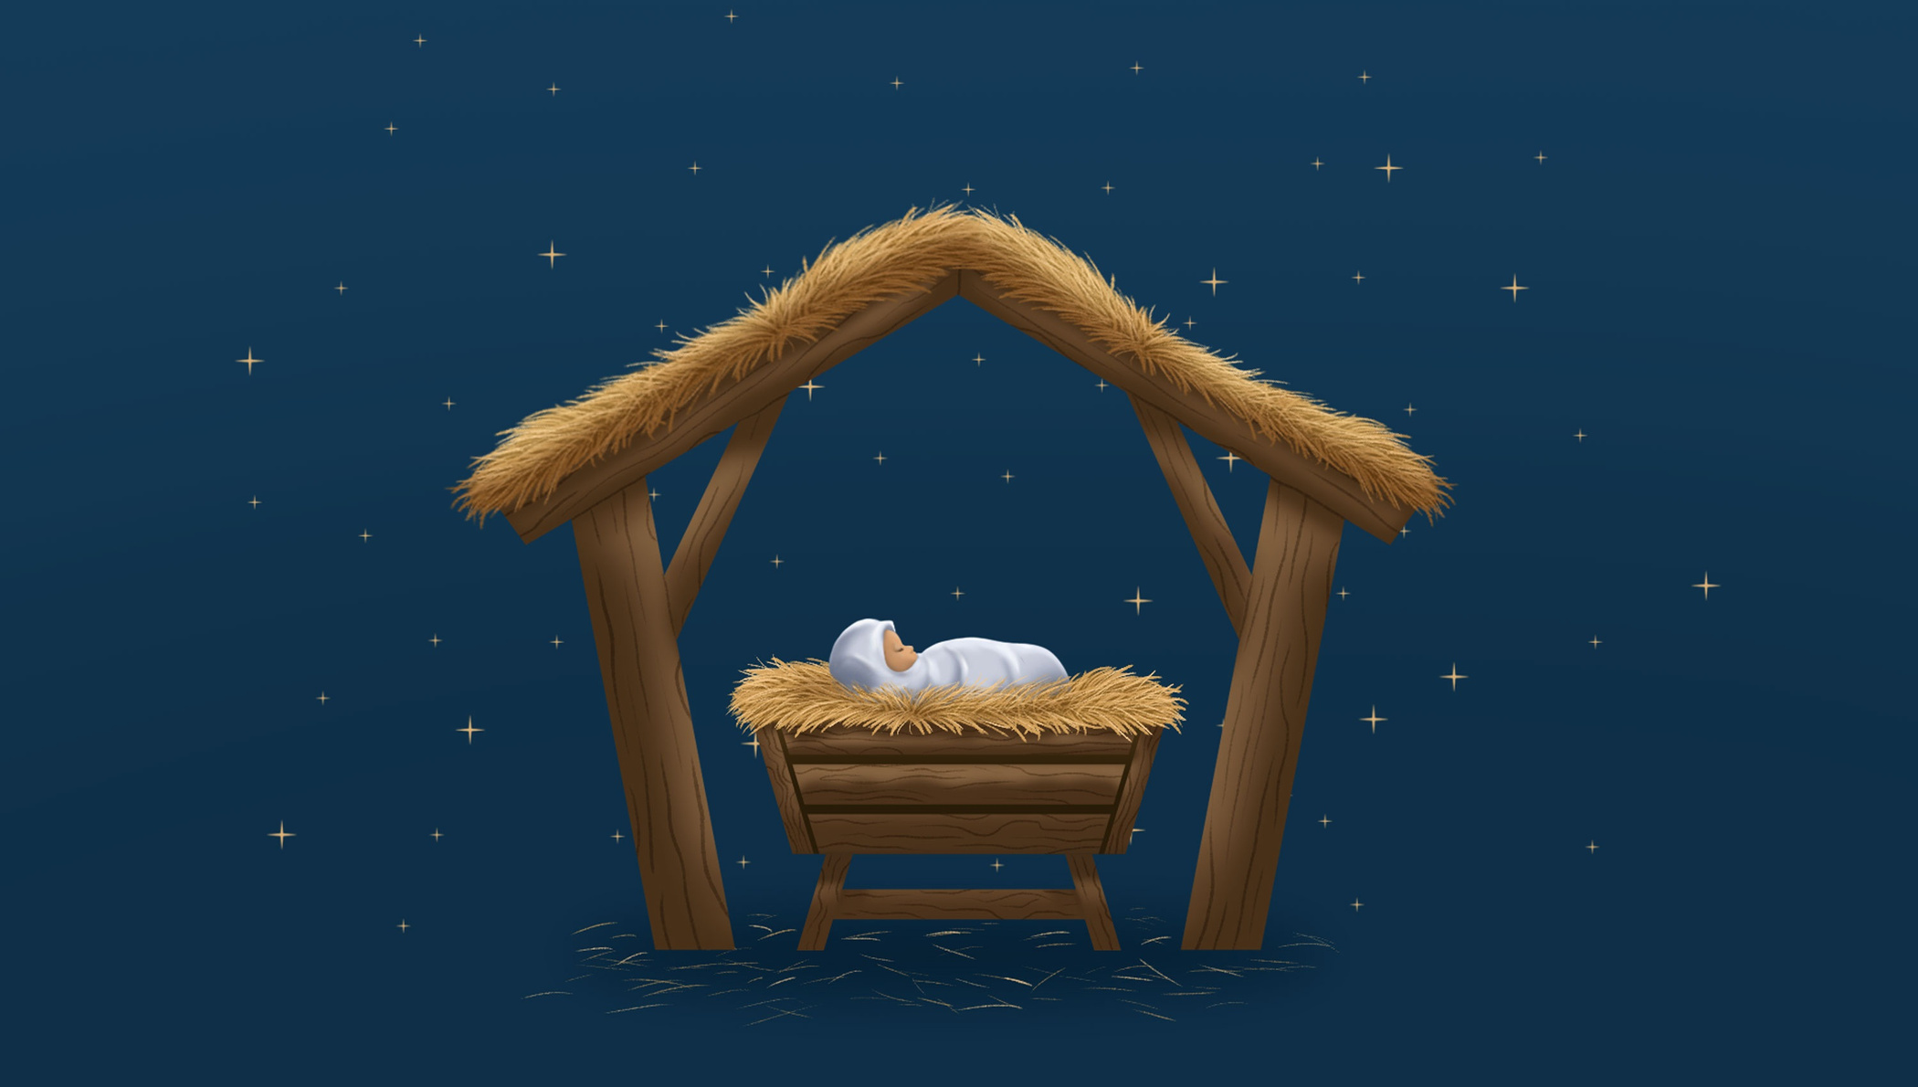
Yet to all who did receive him, to those who believed in his name, he gave the right to become children of God.
John 1:12
12 凡 接 待 他 的 ， 就 是 信 他 名 的 人 ， 他 就 赐 他 们 权 柄 ， 作 神 的 儿 女 。
約 翰 福 音 1:12

Slide 23
Receiving Jesus is not about joining a religion.
接受耶稣，不是加入一个宗教。

Slide 24
It’s about entering a relationship.
而是进入一段关系。

Slide 25
Is God willing to receive me?
神愿不愿意接纳我？

Slide 26
Am I willing to receive Him?
我愿不愿意接受祂？

Slide 27

“Come to Me, all who are weary and burdened, and I will give you rest.”
Matthew 11:28
“凡劳苦担重担的人，可以到我这里来，我就使你们得安息。”
马太福音 11:28

Slide 28
“Today in the town of David a Savior has been born to you; he is the Messiah, the Lord. “
Luke 2:11
“今 天 在 大 卫 的 城 里 ， 为 你 们 生 了 救 主 ， 就 是 主 基 督 。”
路加福音 2:11

