Slide 1
Intentional Prayer
Psalm 35:9-10
⁹Then my soul will rejoice in the Lord, exulting in his salvation. ¹⁰All my bones shall say, “O Lord, who is like you…”

Slide 2
Prayer Prompts
Lord, we praise you this morning because you are our salvation and our deliver. There is none like you!
Father, I say there is none like You because….
Because you delight in my welfare , I know I can trust You for….
I pray for (name) in their battle with…. Give them faith to trust You to fight for them.

Slide 3
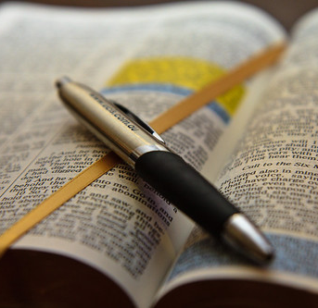
James
Ch 5:12-18

Slide 4
The man or woman of God should be trustworthy.

Slide 5
God is trustworthy

Slide 6
Believers shouldn't need anything to validate their truthfulness.

Slide 7
“There is never a time when we cannot draw near to the Lord.”
Calvin

Slide 8
Our is not always to remove the suffering.

Slide 9
He promises to be with us in the suffering.

Slide 10
He will always give us what we need to bear it.

Slide 11
We must fervently believe in the one we are praying to and what he can do.

Slide 12
Praying in faith also means we are trusting in his will

Slide 13
Prayer is the most powerful resource the believer has at their disposal.

Slide 14
God is not bound to our prayers; he is bound to his will.

Slide 15
God promises to give us the grace we need to persevere.

Slide 16
Prayer is the conduit God uses to unleash his power in our lives.

Slide 17
Followers of Jesus need to be in meaningful community with one another.

