Slide 1


Slide 2


Slide 4
² The people walking in darkness
have seen a great light;
on those living in the land of deep darkness
a light has dawned.
³ You have enlarged the nation
and
increased their joy;
Isaiah 9: 2-7 NIV

Slide 5
they rejoice before you as people rejoice at the harvest, as warriors rejoice when dividing the plunder.
⁴ For as in the day of Midian’s defeat,
you have shattered the yoke that burdens them,
the bar across their shoulders,
the rod of their oppressor.
Isaiah 9: 2-7 NIV

Slide 6
⁵ Every warrior’s boot used in battle
and every garment rolled in blood
will be destined for burning,
will be fuel for the fire.
Isaiah 9: 2-7 NIV

Slide 7
⁶ For to us a child is born,
to us a son is given,
and the government will be on his shoulders.
And he will be called
Wonderful Counselor, Mighty God,
Everlasting Father,
Prince of Peace.
Isaiah 9: 2-7 NIV

Slide 8
⁷ Of the greatness of his government
and peace
there will be no end.
He will reign on David’s throne
and over his kingdom,
establishing and upholding it
with justice and righteousness
from that time on and forever.
Isaiah 9: 2-7 NIV

Slide 9
The zeal of the Lord Almighty
will accomplish this.
Isaiah 9: 2-7 NIV

Slide 10
Peace
is a Knowing

Slide 11
¹³ Suddenly a great company of the heavenly host appeared with the angel, praising God and saying,
¹⁴ “Glory to God in the highest heaven,
and
on earth peace to those
on whom his favor rests.”
Luke 2: 13-14 NIV

Slide 12
³⁶ You know the message God sent to the people of Israel,
announcing the good news of peace through Jesus Christ,
who is Lord of all.
Acts 10:36 NIV

Slide 13
¹⁴ For he himself is our peace,
who has made the two groups one and has destroyed the barrier, the dividing wall of hostility…
His purpose was to create in himself one new humanity out of the two, thus making peace,
Ephesians 2: 14-15 NIV

Slide 14
Peace Manifests
Through
Jesus

Slide 15
²⁷ Peace I leave with you;
my peace I give you.
I do not give to you as the world gives. Do not let your hearts be troubled and
do not be afraid.
John 14:27 NIV

Slide 16
⁶ Do not be anxious about anything, but
in every situation, by prayer and petition, with thanksgiving, present your requests to God.
⁷ And the peace of God,
which transcends all understanding,
will guard your hearts and your minds
in Christ Jesus.
Philippians 4: 6-7 NIV

Slide 17
The mind governed by the flesh is death, but the mind governed by the Spirit
is life and peace.
Romans 8:6 NIV

Slide 18
Whatever you have learned or received or heard from me, or seen in me—
put it into practice.
And the God of peace will be with you.
Philippians 4: 9 NIV

Slide 19
Conclusion:
Jesus is our Prince of Peace.
He came to lead a broken and hostile world into wholeness and peace. That wholeness and peace become more evident as we grow more aware of who Jesus is and
His abiding presence in us.
Let us fix our gaze on our Prince of Peace.

Slide 20
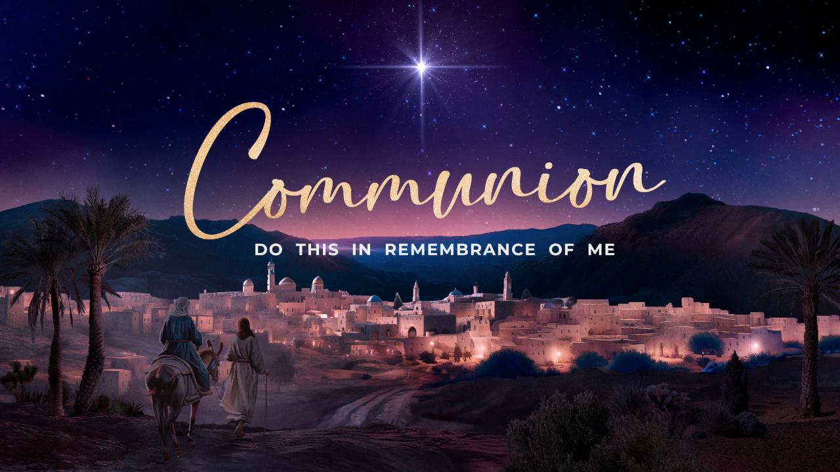

Slide 21


Slide 22


