Slide 1

The King of Righteousness
Michael Christie

Slide 2



Slide 3


Slide 4
For the kingdom of God is not a matter of eating and drinking, but of righteousness, peace and joy in the Holy Spirit.
- ROMANS 14:17

Slide 5
JEREMIAH 33:10-16
¹⁰ “This is what the Lord says: ‘You say about this place, “It is a desolate waste, without people or animals.” Yet in the towns of Judah and the streets of Jerusalem that are deserted, inhabited by neither people nor animals, there will be heard once more ¹¹ the sounds of joy and gladness, the voices of bride and bridegroom,

Slide 6
and the voices of those who bring thank offerings to the house of the Lord, saying, “Give thanks to the Lord Almighty, for the Lord is good; his love endures forever.” For I will restore the fortunes of the land as they were before,’ says the Lord.
¹² “This is what the Lord Almighty says: ‘In this place, desolate and without people or animals—in all its towns there will again be pastures for shepherds to rest their flocks.

Slide 7
¹³ In the towns of the hill country, of the western foothills and of the Negev, in the territory of Benjamin, in the villages around Jerusalem and in the towns of Judah, flocks will again pass under the hand of the one who counts them,’ says the Lord.
¹⁴ “‘The days are coming,’ declares the Lord, ‘when I will fulfill the good promise I made to the people of Israel and Judah.

Slide 8
¹⁵ “‘In those days and at that time I will make a righteous Branch sprout from David’s line; he will do what is just and right in the land.
¹⁶ In those days Judah will be saved and Jerusalem will live in safety. This is the name by which it will be called: The Lord Our Righteous Savior.’

Slide 9


Slide 10
Our Crisis
I will hide my face from this city because of all its wickedness… This is what the Lord says: ‘You say about this place, “It is a desolate waste, without people or animals.”
- JEREMIAH 33:5, 10

Slide 11
Ecclesiastes 7:20
There is no one on earth who is righteous, no one who does what is right and never sins.
Romans 3:23
For all have sinned and fall short of the glory of God.

Slide 12
… blot out my transgressions. Wash away all my iniquity and cleanse me from my sin. For I know my transgressions, and my sin is always before me.
- PSALM 51:1-3

Slide 13


Slide 14
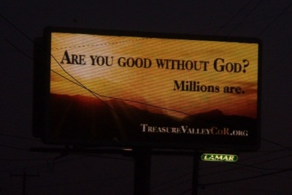

Slide 15
Our Christ
Nevertheless, I will bring health and healing to it; I will heal my people and will let them enjoy abundant peace and security. I will bring Judah and Israel back from captivity and will rebuild them as they were before. I will cleanse them from all the sin they have committed against me and will forgive all their sins of rebellion against me.
- JEREMIAH 33:6-8

Slide 16
In those days, and at that time I will make a righteous Branch sprout from David’s line; he will do what is just and right in the land.
- JEREMIAH 33:15

Slide 17
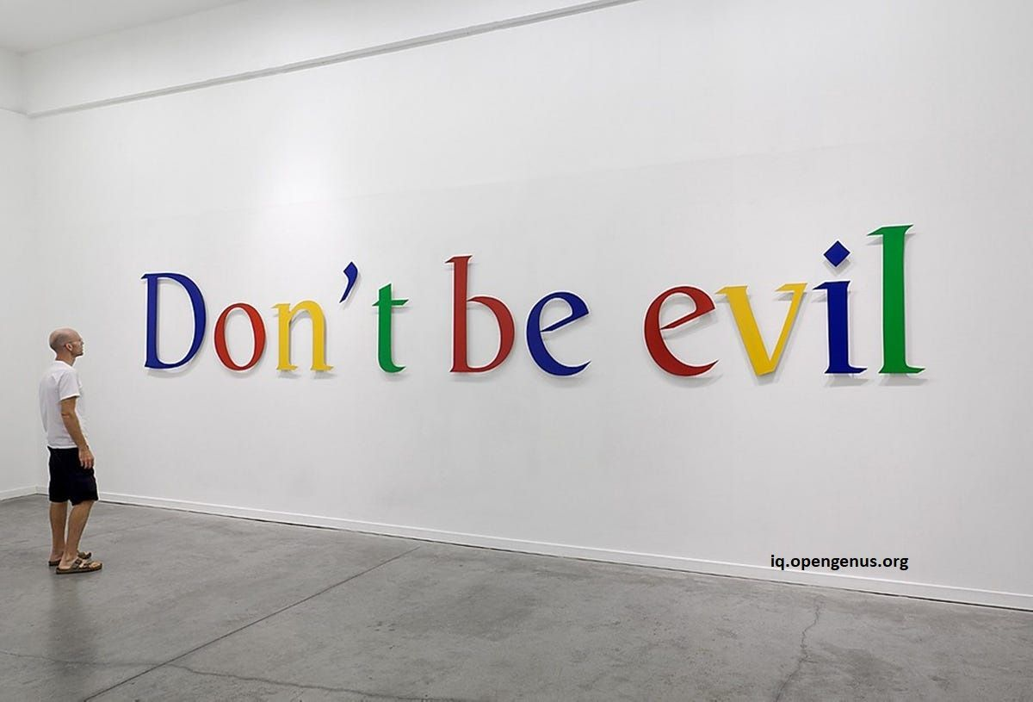

Slide 18
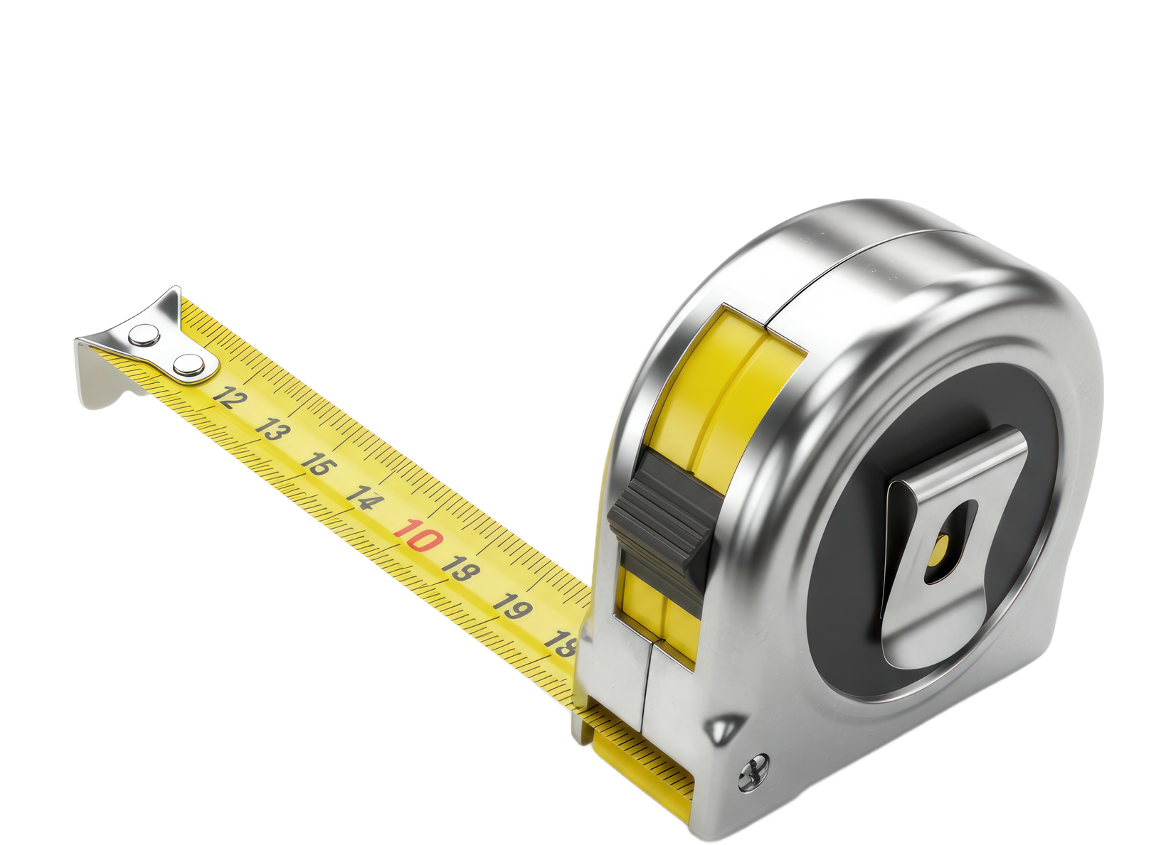
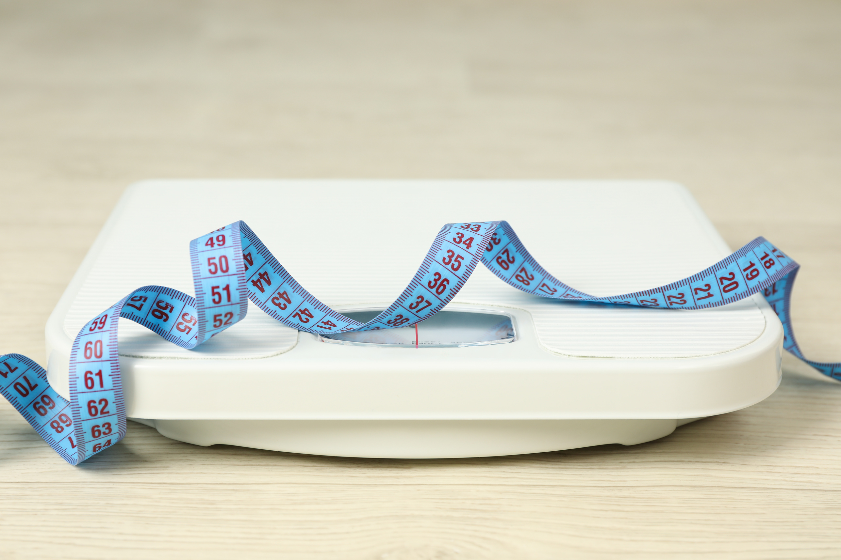

Slide 19
Our Consolation
In those days Judah will be saved and Jerusalem will live in safety. This is the name by which it will be called: The Lord Our Righteous Savior.
- JEREMIAH 33:16

Slide 20
But now apart from the Law, the righteousness of God has been made known… this righteousness is given through faith in Jesus Christ to all who believe.
- ROMANS 3:21-22

Slide 21
Be reconciled to God. God made him who had no sin to be sin for us, so that in him we might become the righteousness of God.
- 2 CORINTHIANS 5:20-21

Slide 22
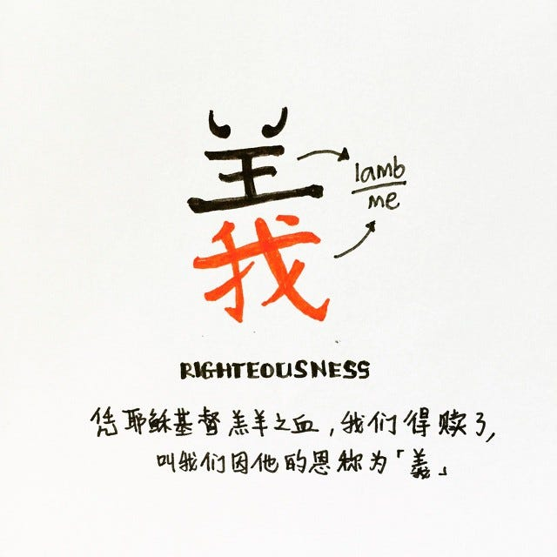

Slide 23
The wicked flee though no one pursues, but the righteous are as bold as a lion.
- PROVERBS 28:1

Slide 24
I delight greatly in the Lord; my soul rejoices in my God. For he has clothed me with garments of salvation and arrayed me in a robe of his righteousness, as a bridegroom adorns his head like a priest, and as a bride adorns herself with her jewels.
- ISAIAH 61:10

Slide 25
