Slide 1
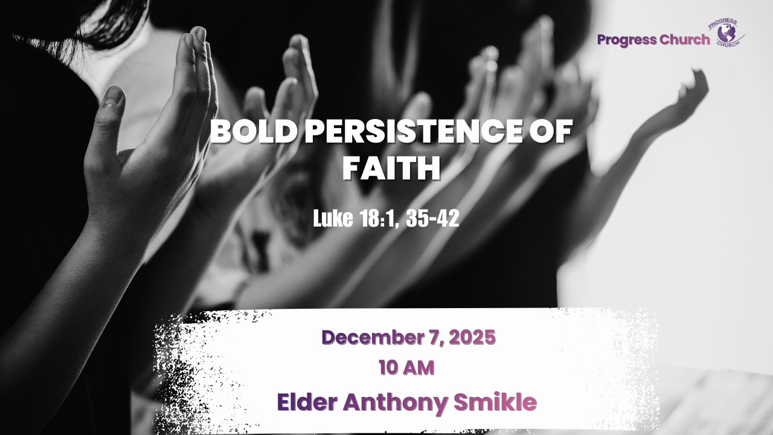

Slide 2




INTRODUCTION
Persistence is define as - firm or obstinate continuance in a course of action in spite of difficulty or opposition.
You could call this chapter in Luke18 the persistence chapter,..because two to the characters exhibit bold and persistence faith, the chapter started out with the persistence widow, and further down we have the man who would not be silence.

Slide 3
Now the reason for this parable:
Is to demonstrate the importance of praying continuously even when there is no perceived answer.
Push past in the face of difficult situations and trials, in some of these situations it will looks like, seems like,..there is not going to be a breakthrough but we must persevere.
Ephesians 6:18, pray always with all prayer and supplication in the Spirit, being watchful to this end with all perseverance and supplication for all the saints.

Slide 4
Not only are to persevere in prayer for ourselves, but more importantly we must persevere in prayer for all the saints, we must pray for each other.
We should not loose heart and be discouraged when we don’t see immediate result.
God is always working in our lives, even if you don’t feel like anything is happening, he is doing something.

Slide 5
God see us through the lens and perspective of eternity, he sees the whole picture of our lives from the beginning to end, his timeline is different from ours, but make no mistakee He is always on time.
We must patience and wait for his timing.
Only God see our time in its entirety and therefore knows what is good for us in the long run.

Slide 6
Since prayer is truly about the will and purpose of God ruling our life we will never grow weary in prayer, and our faith will never falter, if after we have offered to God our prayers and requests, we add the perfect prayer, Your will be done.
Jesus persevere in prayer in the garden of Gethsemane, and he prayed to the Father that the cup of the cross be taken away from him, but in the end, he add the perfect prayer “nevertheless not My will, but Yours, be done.”

Slide 7
Luke18:35 tells us that Jesus was on his way to Jerusalem, and he was coming near to Jericho.
One of the commonest ways for a Rabbi to teach was to discourse as he walked, and that was what Jesus was doing.
It was among the wayside crowd that Luke say the blind man was sitting.
When he heard the murmur of the approaching crowd, he was told that Jesus was passing by.

Slide 8
Immediately he cried out to Jesus for help and healing.
The scripture says everyone tried to silence him, be quiet!!
In verse 39,..it was desperation time.
He shouted again, that shout was the instinctive shout of unashamed emotion, a scream that shows the utter desperation of the man, it was a shout that was mixed with faith.

Slide 9
Jesus stopped, Faith will do that, Jesus stopped and the blind man found the healing he so passionately desired.

Slide 10
This story of Bartimaeus tells us two things.
He was determined to come face to face with Jesus, and nothing would stop him.
He refused to be silent, and he refused to be restrained.
His sense of need drove him relentlessly into the presence of Jesus.
Whoever wants a miracle must show that same spirit.

Slide 11
There is nothing wrong with a quiet and composed behaviour, but when one tap into the power of God with the passionate and intense desire of the very depths of the human heart, they will never be disappointed.

Slide 12
2 It tells us something about Jesus.
At that moment Jesus was teaching and Interacting with the crowd.
But at the blind man’s cry of need he stopped, the discourse forgotten.
For Jesus it was always more important to act than to talk.
Words always took second place to deeds.
When a soul is in need, speech must end and action begin.

Slide 13
Conclusion

