Slide 1
Welcome to Holy Hermits Online Worship
The 2nd Sunday of Advent A
“Peace”
Service Prep: Leonie | Chat Host: Viki | First Reader: Jeremy
Music: Wiggles 🐶 | Priest: N/A | Second Reader: Roselyn
Proof-reader: Kristine | Deacon: Lauren | Preacher: Lauren
Broadcaster: Barry | Welcomer: Chris | Fellowship: Julie
Backup Broadcaster: Lauren | Leader: Lauren | Safety Officer: Chris
Zoom Buttons: Paul | Cantor: Julie | Attendance: Viki

Slide 2


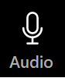



Hospitality
Leader: Please mute for the service unless invited to offer your voice as part of the service ministry
Have the video camera on or off and turn the volume and brightness up or down on your device if things are too loud 🔉🔊or too bright🔅🔆
Our Cantor acts as our voice, offering the responses, in Bold Text, which we say together
Feel welcome to use the chat and reaction emojis 👍
🙏 Please take care of yourself in this space. 🙏 Come and go as you need
😴 It is great to take rest in this space, so falling asleep is also OK 😴
👂️ Remember, pastoral care is available to all in the community, if you'd like to speak to someone about anything spiritual. ❤️ Visit the help page at the website to reach out 🌐
Our Being Together ethos and safeguarding practices can also be accessed on the website 🫶​
🙌 Come as you are – we are all here together! 🙌
Notes:
Used Lent 2022

Slide 3
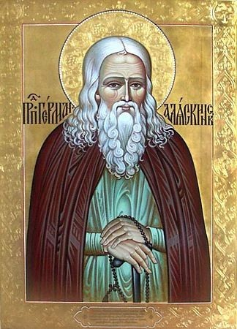
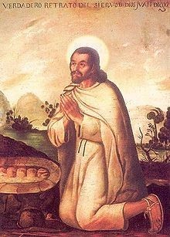
Leader: Our Holy Hermit Highlights for today
St Herman of Alaska was a Russian Orthodox monk who arrived as a missionary to Alaska in 1794. Along with other monks, he became a zealous defender of the native population. He is considered by many Orthodox Christians to be the patron saint of North America.
St Juan Diego of Mexico was a Nahua
peasant raised in the Aztec pagan religion.
He was one of the early converts to
Christianity and a Marian visionary. In
December 1531 he experienced four
apparitions of Our Lady of Guadalupe.
To read more about our Holy Hermits please click the link​​ in the send out or go to our web site

Slide 4
Invitation
Leader: As we settle into worship let your breath be soft, your mind be still, and your heart be open to the presence of God.
Music https://www.youtube.com/watch?v=j4QAQ2MIwjA

Slide 5
Leader and Cantor unmute
The Greeting
Leader: The Lord is coming! Prepare the way.
All: The Lord is coming! We are making ready,

Slide 6
Gathering Prayer
Leader: Come, open your ears to hear wise words from where you don’t expect them. Come, put aside your mistrust and pride, ignore your dislike of what is said and have the generosity to accept the wisdom we have been offered.
All: As we gather today to await your coming among us, help us to listen to the voices that we normally ignore. Give us grace and humility to learn from both young and old. Show us your way and help us to walk in it. Amen.

Slide 7
The Trisagion
All: Holy God,
holy and mighty,
holy and immortal,
have mercy on us.

Slide 8
Sentence
Leader: I invite our Cantor to proclaim the sentence for today.
Cantor: The time is fulfilled, and the kingdom of God has come near; repent, and believe in the good news.
Mark 1.15

Slide 9
Prayer of Approach
All: Come, Jesus, show us the way, lead us to greater depths of faith, with stronger ties that bind us to your way. Come, Jesus, show us the way, amid the chaos and Christmas busyness, turmoil and panic, parcels and paper and presents and tape, come, Jesus, show us the way. Amen.

Slide 10
Leader unmutes
Our first hymn is
Come Jesus, Prince of Peace
https://www.youtube.com/watch?v=UaWX-k11GWo
​We stay on mute
Leader and Cantor mute

Slide 11
Preparing for confession
Leader: Compassionate God, sometimes we make our world too small and look inwards, not outwards.
All: Forgive us when we lack confidence to care and courage to act.
Leader: Sometimes our hearts are too small
and we miss opportunities to make a difference.
All: Forgive us when we lack confidence to care and courage to act.
Continue…

Slide 12
Leader: Sometimes our lives are too full and we are oblivious
to those who feel empty.
All: Forgive us when we lack confidence to care and courage to act.
Leader: Sometimes we don’t look after ourselves enough
and cause others to fret and worry.
All: Forgive us when we lack confidence to care and courage to act.

Slide 13
The Deacon Introduces Confession​
The Lord comes, bringing to light things now hidden in darkness, and disclosing the purposes of the heart.
​​
Silence may be kept.​..
​
Let us open our hearts and prepare for his coming, confessing our sins in penitence and faith.

Slide 14
All: ​Merciful God, our maker and our judge, ​
we have sinned against you ​in thought, word, and deed, ​and in what we have failed to do: ​
we have not loved you with our whole heart; ​
we have not loved our neighbours as ourselves; ​
we repent, and are sorry for all our sins.​
Father, forgive us. Strengthen us to love and obey you in newness of life; ​through Jesus Christ our Lord. ​Amen.​

Slide 15
Words of Assurance offered by the Deacon
These words of assurance from the First Letter of John declare that:
If anyone sins, we have an advocate with the Father, Jesus Christ the righteous. He is the perfect offering for our sin, and not for ours only, but for the sins of the whole world.
(1 John 2: 1-2)
In this is love, not that we loved God, but that he loved us and sent his Son to be the perfect offering for our sins.
(1 John 4:10)

Slide 16
Collect
Leader: God of all peoples, whose servant John came baptising and calling for repentance: help us to hear his voice of judgement, that we may also rejoice in his word of promise, and be found pure and blameless in that glorious Day when Christ comes to rule the earth as Prince of Peace; who lives and reigns with you and the Holy Spirit, one God, now and for ever.
Amen.

Slide 17
Prayer for sustainability
Leader: Generous God, we hold before you the financial stability and future sustainability of Holy Hermits Online. Guide us as we seek to grow our community’s giving, so we may continue the work you have called us to – being together in this digital space. Show us where to place our energy as we explore new funding sources and fresh opportunities. Be present with us and those we meet at we reach out to charitable trusts and foundations, inviting their support for our outreach – especially to those unable to get to Church in person.
Continue…

Slide 18
Stir the hearts of all who believe in this mission to greater generosity, creativity, and commitment. We thank you for the partnerships you have already blessed us with, especially our home base at St John’s Cathedral. We pray in the name of Jesus, who lived on mission and said,
If in my name you ask me for anything, I will do it.
Amen.

Slide 19
The 1st Reader unmutes
Leader: I invite the 1st Reader to unmute and offer the 1st reading when ready.
Reader 1: The 1st Reading is from Isaiah 11.1-10
¹ A shoot shall come out from the stock of Jesse, and a branch shall grow out of his roots. ² The spirit of the Lord shall rest on him, the spirit of wisdom and understanding, the spirit of counsel and might, the spirit of knowledge and the fear of the Lord .
Continue…

Slide 20
.
³ His delight shall be in the fear of the Lord . He shall not judge by what his eyes see, or decide by what his ears hear; ⁴ but with righteousness he shall judge the poor, and decide with equity for the meek of the earth; he shall strike the earth with the rod of his mouth, and with the breath of his lips he shall kill the wicked. ⁵ Righteousness shall be the belt around his waist, and faithfulness the belt around his loins.
Continue…

Slide 21
.
⁶ The wolf shall live with the lamb, the leopard shall lie down with the kid, the calf and the lion and the fatling together, and a little child shall lead them. ⁷ The cow and the bear shall graze, their young shall lie down together; and the lion shall eat straw like the ox. ⁸ The nursing child shall play over the hole of the asp, and the weaned child shall put its hand on the
adder’s den.
Continue…

Slide 22
.
⁹ They will not hurt or destroy on all my holy mountain; for the earth will be full of the knowledge of the Lord as the waters cover the sea. ¹⁰ On that day the root of Jesse shall stand as a signal to the peoples; the nations shall inquire of him, and his dwelling shall be glorious.
Hear the word of the Lord. Thanks be to God.​

Slide 23
Leader: We now say the psalm antiphonally, I invite the 1st Reader to lead, and we will all respond with the Response in Bold along with our cantor as our voice.
Psalm
72.1-7,
72.18-21
¹ Give the king your judgement, O God:
and your righteousness to the son of a king,
² That he may judge your people rightly:
and the poor of the land with equity.
³ Let the mountains be laden with peace
because of his righteousness:
and the hills also with prosperity for his people.
Continue…

Slide 24
⁴ May he give justice to the poor among the people:
and rescue the children of the needy,
and crush the oppressor.
⁵ May he live while the sun endures:
and while the moon gives light,
throughout all generations.
⁶ May he come down like rain upon the new-mown fields: and as showers that water the earth.
Continue…

Slide 25
⁷ In his time shall righteousness flourish:
and abundance of peace, till the moon shall be no more.
¹⁸ Let his name live for ever:
and endure as long as the sun.
¹⁹ Let all peoples use his name in blessing:
and all nations call him blessed.
²⁰ Blessed be the Lord God, the God of Israel:
who alone does great wonders.
²¹ Blessed be his glorious name for ever:
and let the whole earth be filled with his glory.
.

Slide 26
The 2nd Reader unmutes
Leader: Thank you, 1st reader. I invite the 2nd Reader to unmute and offer the 2nd reading when ready.
Reader 2: The 2nd Reading is from Romans 15.4-13
⁴ For whatever was written in former days was written for our instruction, so that by steadfastness and by the encouragement of the scriptures we might have hope. ⁵ May the God of steadfastness and encouragement grant you to live in harmony with one another, in accordance with Christ Jesus, ⁶ so that together you may with one voice glorify the God and Father of our Lord Jesus Christ.
Continue…

Slide 27
⁷ Welcome one another, therefore, just as Christ has welcomed you, for the glory of God. ⁸ For I tell you that Christ has become a servant of the circumcised on behalf of the truth of God in order that he might confirm the promises given to the patriarchs, ⁹ and in order that the Gentiles might glorify God for his mercy. As it is written, ‘Therefore I will confess you among the Gentiles, and sing praises to your name’;
Continue…

Slide 28
¹⁰ and again he says, ‘Rejoice, O Gentiles, with his people’; ¹¹ and again, ‘Praise the Lord, all you Gentiles, and let all the peoples praise him’; ¹² and again Isaiah says, ‘The root of Jesse shall come, the one who rises to rule the Gentiles; in him the Gentiles shall hope.’ ¹³ May the God of hope fill you with all joy and peace in believing, so that you may abound in hope by the power of the Holy Spirit.
Hear the word of the Lord. Thanks be to God.

Slide 29
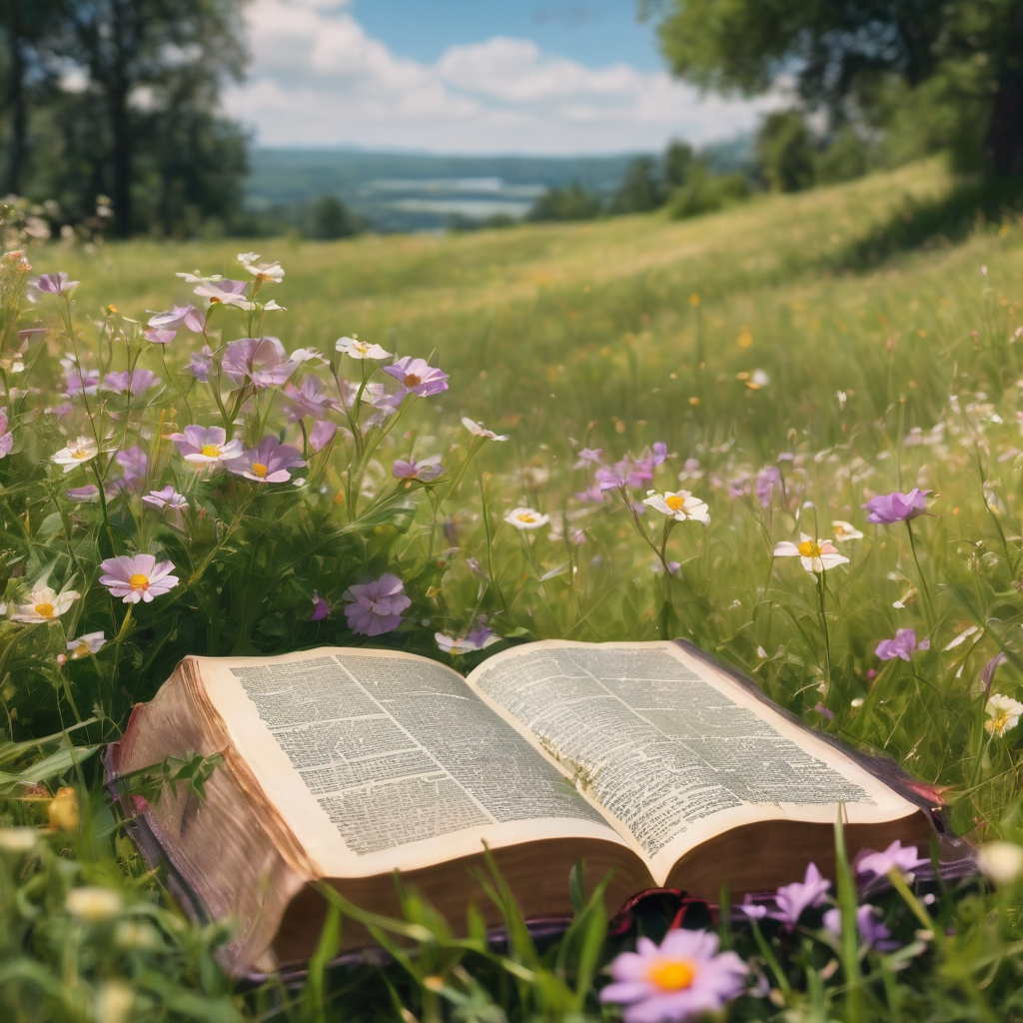
We pause before
​the Gospel ​​

Slide 30
Deacon: The Gospel of our Lord Jesus Christ according to St Matthew Chapter 3 beginning at the 1st verse.
All: Glory to you Lord Jesus Christ.
¹ In those days John the Baptist appeared in the wilderness of Judea, proclaiming, ² ‘Repent, for the kingdom of heaven has come near.’ ³ This is the one of whom the prophet Isaiah spoke when he said, ‘The voice of one crying out in the wilderness: “Prepare the way of the Lord, make his paths straight.” ’
Continue…

Slide 31
⁴ Now John wore clothing of camel’s hair with a leather belt around his waist, and his food was locusts and wild honey. ⁵ Then the people of Jerusalem and all Judea were going out to him, and all the region along the Jordan, ⁶ and they were baptized by him in the river Jordan, confessing their sins. ⁷ But when he saw many Pharisees and Sadducees coming for baptism, he said to them, ‘You brood of vipers! Who warned you to flee from the wrath to come? ⁸ Bear fruit worthy of repentance.
Continue…

Slide 32
⁹ Do not presume to say to yourselves, “We have Abraham as our ancestor”; for I tell you, God is able from these stones to raise up children to Abraham. ¹⁰ Even now the axe is lying at the root of the trees; every tree therefore that does not bear good fruit is cut down and thrown into the fire. ¹¹ ‘I baptize you with water for repentance, but one who is more powerful than I is coming after me; I am not worthy to carry his sandals. He will baptize you with the Holy Spirit and fire. ¹² His winnowing-fork is in his hand, and he will clear his threshing-floor and will gather his wheat into the granary; but the chaff he will burn with unquenchable fire.’
This is the Gospel of the Lord. All: Praise to you Lord Jesus Christ.

Slide 33
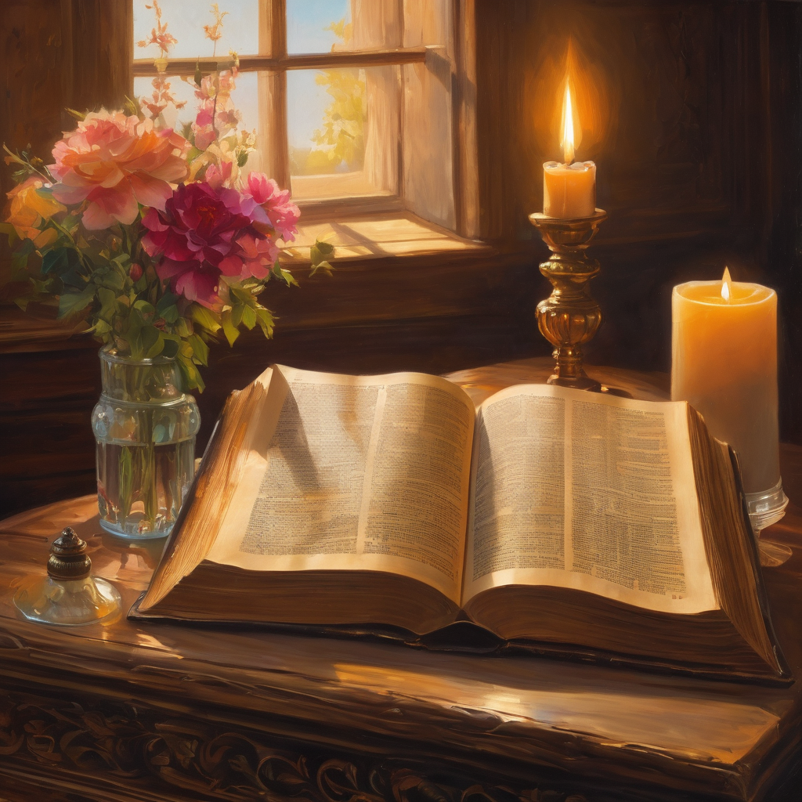
We pause
after ​the Gospel ​​

Slide 34
Leader: The Sermon is recorded to YouTube for sharing later.
Only the preacher's video and audio will be recorded.
The chat and other participants' feeds remain out of sight of the recording.
Leader and Cantor mute
Broadcaster exits screenshare
Preacher unmutes
Zoom buttons ”pins” preacher’s screen + selects “record to the cloud”
Sermon

Slide 35
Leader unmutes
Our next song is
Let There Be Peace on Earth
https://www.youtube.com/watch?v=_AMvzan3EKM
​We stay on mute
Leader and Cantor mute

Slide 36
The Leader and Cantor unmute
The Greeting of Peace
Leader: We are the body of Christ
All: God’s Spirit is with us
Leader: The peace of the Lord be always with you.
All: And also with you.
Leader: A sign of peace may be exchanged
You may like to type 'Peace' into the chat, use the 'raise hand’ or other reaction buttons, or just simply wave via the screen with your video turned on
(Broadcaster exits shared screen for a few moments for the exchange of peace)

Slide 37
Reflection Leader: We pause to reflect on Peace How do we experience God's peace? Are there areas of our lives into which we could invite more peace? Pause…

Slide 38
Prayer of Thanksgiving before Intercessions
Leader: We give thanks, this Advent season, that you move among us, inspiring us to greater depths so that we are eager to say again, ‘Come, Lord Jesus, come’. We look forward to Christmas, the giving and sharing, the trimmings and trifles, but most of all to welcoming you, Lord Jesus, the one who shows us a better way to live. We give thanks for the witnesses to you who have gone before us and we are grateful to stand in that lineage and to pass on faith to those who will come after us. With praise and thanksgiving in our hearts we journey this Advent in eager expectation of your coming among us. Come Jesus, show us the way. Amen.

Slide 39
2nd Reader unmutes Intercessions
Reader 2: We pray for creation and communities we share our lives with. We pause for a few moments to name either in our hearts, or out loud, or in the chat, those environments and communities we bring to the Lord in prayer.
PAUSE…
We entrust to you the community of Holy Hermits Online and our ministry partners:
Prosper the work of our hands and show us the way to your new creation.
Creator God, Hear our prayer.
St John's Cathedral Brisbane The Anglican Diocese of Southern Queensland St Gabriel’s, Carindale Benedictus Contemplative Church, Canberra Anglican Focus and Tithe.ly

Slide 40
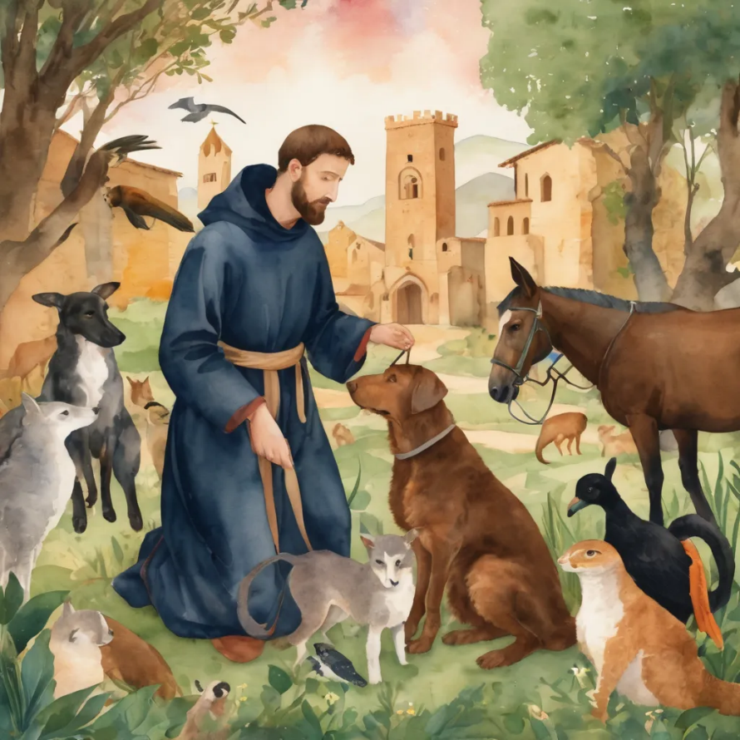
Reader 2: Loving Creator, we entrust to you all animals, especially those who are sick, anxious, ageing, lost, at risk, lonely, sad, hungry, in pain, homeless, abused, living in fear, encountering violence of any kind, in need of comfort, rehabilitation or transformation.
We invite your loving compassion for:
We name in our hearts, out loud or in the chat,
the animals we bring to the Lord in prayer. PAUSE…
Jasmine, ​
Leese(y), ​
Sid, Toots and Lulu​
Polly and Suki​
Fred, George and Percy​
Koshka ​
Lambert ​​
Kala, Nigel and Little One ​​
Toby​​
Taco​​
Paddy and Jax​​
Rosie​

Slide 41
Reader 2: Eternal Trinity of Love, we uphold to you the people we love and carry cares for:
We name in our hearts, out loud or in the chat, those we bring to the Lord in prayer. PAUSE… Lord in your mercy, Hear our prayers. Amen.
Kerry and Les, Jake,​​ Dr Julie, ​​ Julie and Ray, Tracey, Shane Jess and Leah ​​ May ​​ Kirsten, Greg, Daphne & Beau​​ Tanya​ Matthew & Nicholas​ Alan & Gaylene​ Susan | Barry​​ Dilys and Tony, Paul and Darhon Judy and Mary​​ Mark, Desley and Bob ​​ Ruth​​ Phil​ Rachel, Mervyn & Gillian Liz’s Godchildren Bonnie and girls | Bill and Marjorie​​ Rev'd Shane & Janette​​ Alecia, Martin and Aidan​​ Aaron and Andrea ​​ Neva​ Bob and Di​ Steven, Vanessa and Craig Miriam Barry and Gwen Pat and Julie

Slide 42
Pray Daily Cycle of Prayer
Leader: Loving God, joining with the Church in our cycle of prayer, we ask your blessings on:
The Church of Bangladesh
The Diocese of Brisbane: †Jeremy; Assistant Bishops – †Cameron, †John, †Sarah; Clergy and People
The Parish of Bulimba: Paul, Sharon, Greg
Southern Queensland Correctional Centre:
Hillbrook Anglican School, Enoggera: Principal – Mark; Chaplain - David; Chair of School Council – David; members of School Council; staff & students

Slide 43
Prayer for Companion Animal Ministry
Leader: Creator God, we give thanks for your call to develop a Companion Animal Ministry at Holy Hermits Online.
We ask for your presence to be with us, as we build this ministry together.
Holy Spirit we ask your presence to be with us as we continue to develop resources together in this new season.
Provide us with wisdom and with compassion and with a sense of fun as we celebrate our companion animals and live this mission to outreach.
Alongside Holy Hermit St. Francis, we ask you Lord Jesus Christ, to enliven us in this ministry space.
All: Amen.

Slide 44
Leader: Let us pray together the prayer which Jesus gave us saying:
All: Our Father in heaven,
hallowed be your name,
your kingdom come, your will be done,
on earth as in heaven.
Give us today our daily bread.
Forgive us our sins
as we forgive those who sin against us.
Save us from the time of trial
and deliver us from evil.
For the kingdom, the power,
and the glory are yours
now and for ever.
Amen.

Slide 45
Devotions

Slide 46
Hermit
Wisdom

Slide 47
Leader: Teachings from Holy Hermits St Herman of Alaska and St Juan Diego
St Herman of Alaska
“From this day, from this hour, from this minute, let us strive to love God above all, and fulfill His holy will.”
St Juan Diego of Mexico
“I am a nobody, I am a small rope, a tiny ladder, the tail end, a leaf.”

Slide 48

Leader: ​As we enter a few minutes of silence together, you are invited to pray this prayer of adoration and/or spend this time in contemplation. ​
The Spiritual Communion prayer follows
on the next slide. Let us be still.
Leader and Cantor mute
​
Lord Jesus, you show us the way to live together in peace and harmony. Help us to be people who share peace with others and live in harmony with everyone and your beautiful world.
Amen

Slide 49
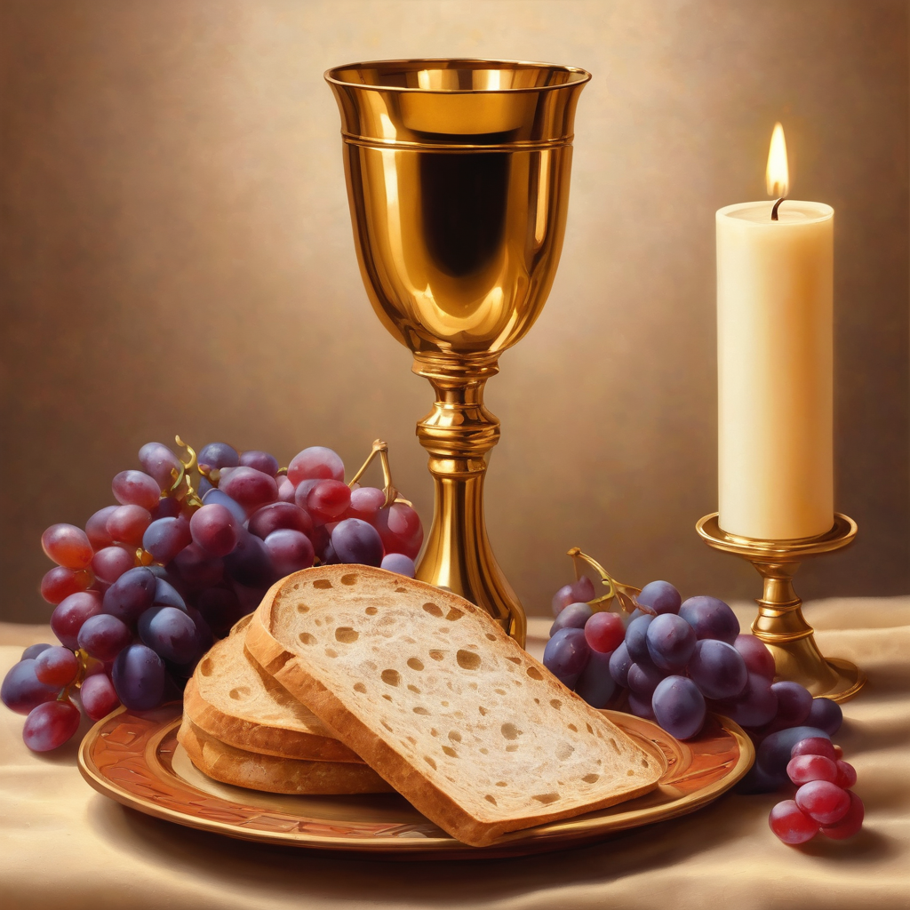
Oh, my Lord Jesus I turn to you present at the Altar and in the Tabernacle. I believe that you are present in the Holy Sacrament of your most Sacred Body and Blood.
I love you above all things and I desire to receive you into my Soul. I cannot at this moment receive you Sacramentally in Holy Communion. Come spiritually into my heart. Purify it, Sanctify it. Render my heart like your own heart. I embrace you as if you were already there and unite myself wholly with you. Never permit me to be separated from you. Lord, I am not worthy to receive you, but only say the word and I shall be healed. Amen
Making a
Spiritual Communion
(Prayed in silence)

Slide 50
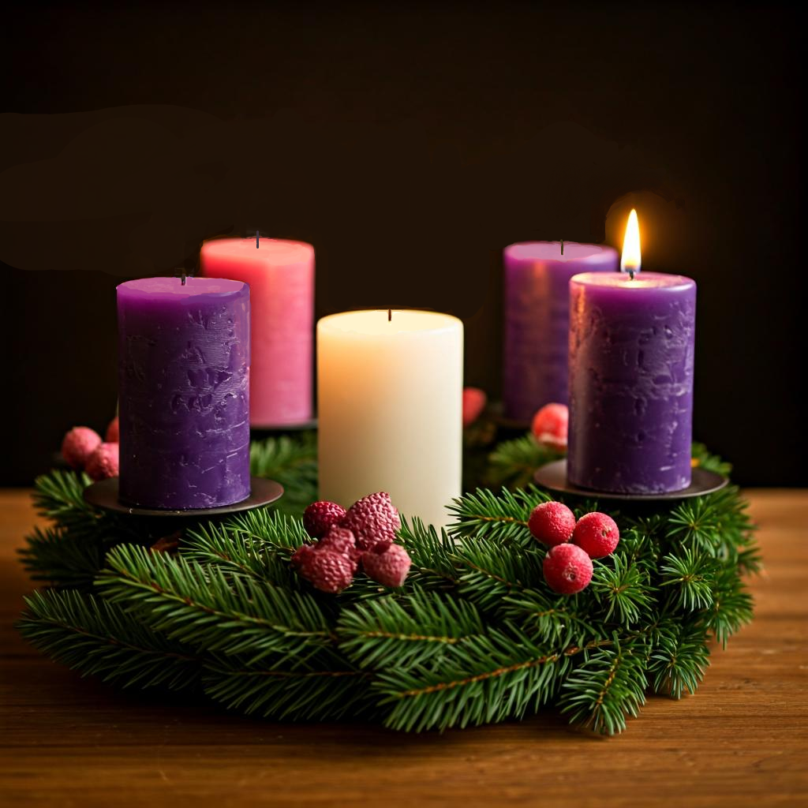

Lighting The Advent Wreath: PEACE
Leader: In a world of unrest, where war and oppression are rife, where destruction and hate are the norm and peace is far from us, Lord, we call upon you to come.
All: Come, Lord Jesus, Come.
Leader: We long for hope, and pray for peace, as we await the God of Love in the promised child, Lord we call upon you to come.
All: Come, Lord Jesus, Come.
Leader: We long for hope, and pray for peace, as we await the God of Love in the promised child, Lord we call upon you to come.
All: Come, Lord Jesus, Come, and bring us your hope.

Slide 51
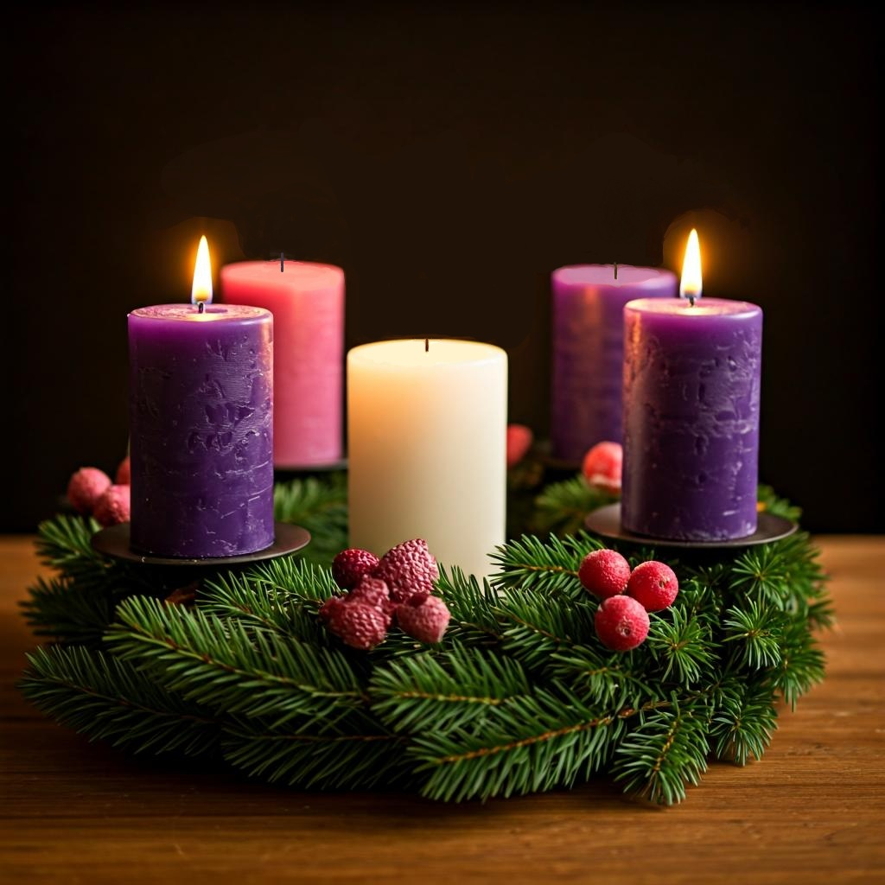

Light the second purple (Peace) candle.
Leader: Let us Pray,
All: God of hope, who brought love into this world,
be the love that dwells between us.
God of hope, who brought peace into this world,
be the peace that dwells between us.
God of hope, who brought joy into this world,
be the joy that dwells between us.
God of hope, the rock we stand upon,
be the light, and focus of our lives. Amen.

Slide 52
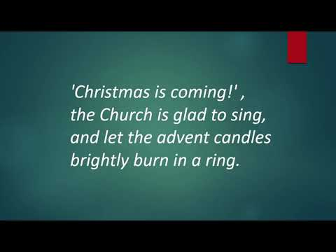
Notes:
Link for video: https://www.youtube.com/watch?v=a9Q4YeEH7I4 (just in case ☺)

Slide 53

A Personal Prayer for each of us in the silence
Lord, may the whole world come to know about your love.
May all the people of the whole world praise you.
And, just as the water covers the sea, may the whole world be covered with your glory.
Lord, may we care for the world and for each other, as people who know your love. Amen.

Slide 54
Leader unmutes
Our final song is
Peace, Be Still
https://www.youtube.com/watch?v=fqQ6dyr2eQ0
​We stay on mute
Leader and Cantor mute

Slide 55
Sending Prayer
All: God for whom we wait, we thank you that you have fed us with the bread of life
and the cup of salvation. As we joyfully await your Son, keep us ever watchful
that we may be ready to stand before him
on the day of his coming.
Amen.

Slide 56
The Benediction
Leader: Let us all invite God’s blessings together,
All: May the Lord bless us and keep us.
May the Lord’s face shine upon us and be gracious to us. May the Lord’s countenance be lifted upon us, and bring us peace. Amen

Slide 57
Notices
A call out for broadcasters, zoom button, chat host, cantor, readers, welcomer and attendance for HHO Christmas Eve service and Christmas Day contemplative service
Our Advent study based on The Muppet Christmas Carol continues Thursday @6pm The Muppet Christmas Carol
Purchase of Christmastide subscriptions is now open. Christmastide Subscription 2025
Next Sunday 14th Dec our Christmastide workshop meeting @11am
Next week we remember Holy Hermit Thomas Merton
See HHO Events page for further upcoming events HHO Events
Notes:
Xmas Eve: 2 readers, Cantor, Zoom buttons, chat host and attendance.
Xmas Day: Cantor and 2 readers

Slide 58

Offerings: Thank you for your regular gifts to this ministry
Offerings are most welcome via
The HHO App
Direct Debit
International Direct Debit
Please consider a one-off donation
or leaving a legacy in your Will
For further information go to HHO give page
https://holyhermits.com.au/give

Slide 59
The Dismissal
Leader: I invite everyone to unmute for the Dismissal
Leader: Go in peace to love and serve the Lord.
All: In the name of Christ, Amen.

Slide 60
Serving next week 14th December
3rd Sunday of Advent
9:00 am AEST
Service Prep: Paul | Chat Host: Lauren | First Reader: Helen
Music: Paul | Priest: N/A | Second Reader: Liz
Proof-reader: Chris | Deacon: Lauren | Preacher: Lauren
Broadcaster: Paul | Welcomer: Julie | Fellowship: Leonie
Backup Broadcaster: Lauren | Leader: Lauren | Safety Officer: Leonie
Zoom Buttons: call out | Cantor: Jeremy | Attendance: Leonie
Thank you for your ministry gifts
New Servers always welcome!
Please email Rev’d Lauren to get involved
holyhermits@anglicanchurchsq.org.au

Slide 61
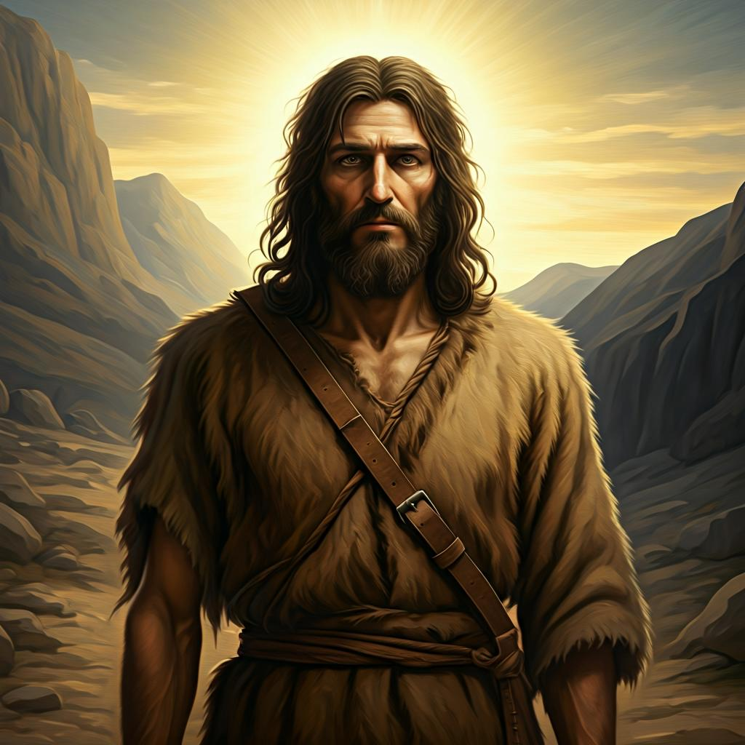
Fellowship time
Thank you, Julie for leading Fellowship
Please feel welcome to linger or pop a message in the chat and head off when you are ready.​
Extra resources developed
by Roots on the Web
All artwork by Padlet

