Slide 1
Intentional Prayer
Ps 130:5
    “I wait upon the Lord, my soul waits, and in his word, I Hope;”

Slide 2
Prompts
God your word gives hope, and You are worthy of our waiting.
I confess that I have grown impatient as I have been waiting on You for…
Help me to wait expectantly for You when…
When I am….remind me that You are my hope.

Slide 3
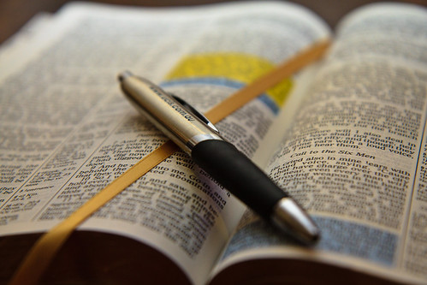
James
Ch 5:7-11

Slide 4
Patience is and attribute of God

Slide 5
God dispenses patience to His people through His Spirit.

Slide 6
Preserving and self-restraining kind of patience.

Slide 7
It’s the word of God that encourages us to keep seeking patience.

Slide 8
Knowing that Jesus is coming to make all things right, is encouragement to our patiently waiting souls.

Slide 9
We must trust the Lord with the things we cannot control and seek his wisdom and discernment in everything else.

Slide 10
Grumbling against one another is the opposite of patient.

Slide 11
“we must be careful not to push Christ’s return so far into the uncertain future that it has no significant bearing on our present.”

Slide 12
Live like Jesus is coming back at any moment.

Slide 13
God does not preserve those he has called from suffering, instead He preserves those he has called in the suffering.

Slide 14
Patient endurance does not require and explanation or an understanding of why, but a simple trust in the who and his will.

Slide 15
Because God is who he is you can trust him with your story.

Slide 16
The call to patience is not a call to passivity.

