Slide 1
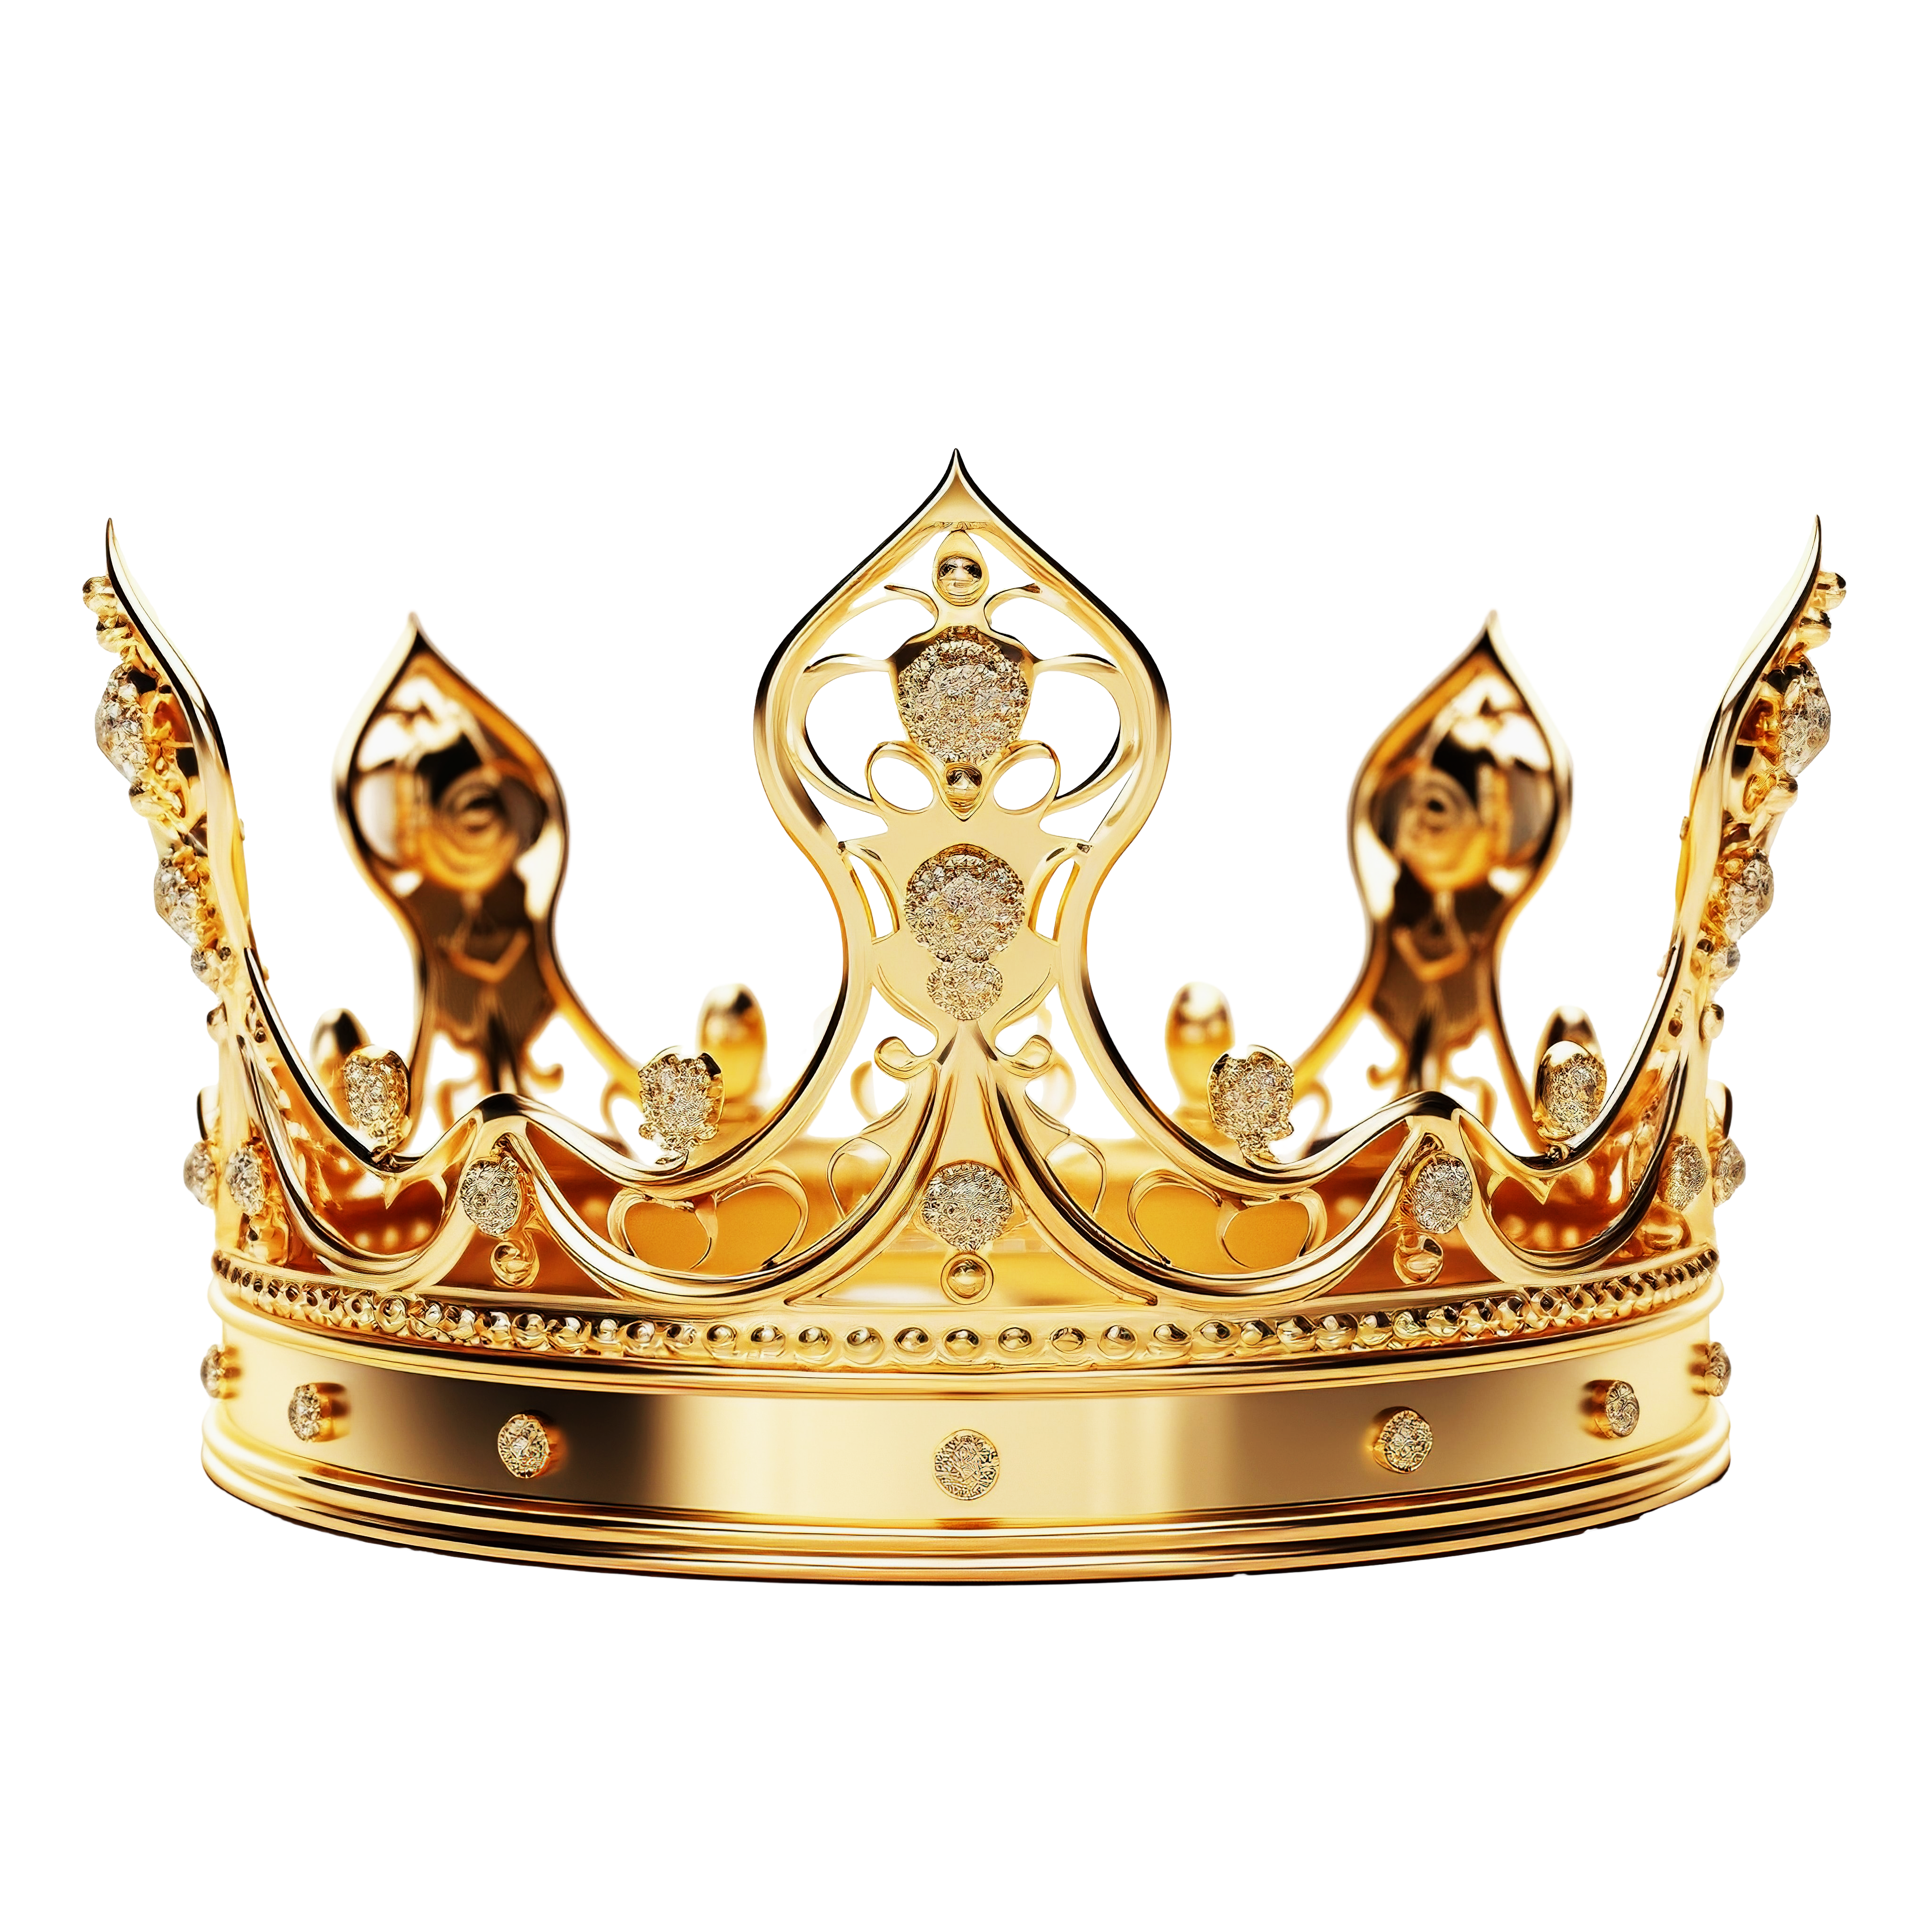

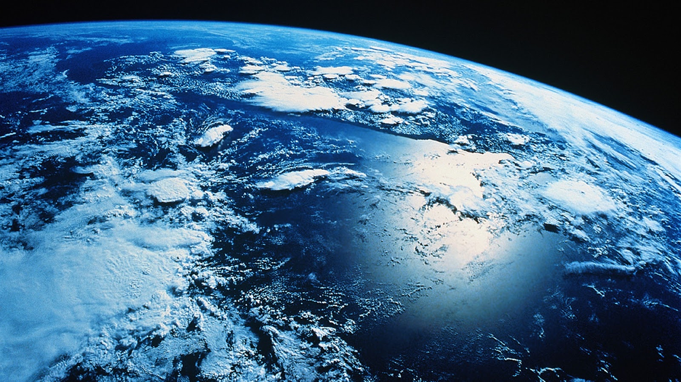
Kingdom Relationship

Slide 2
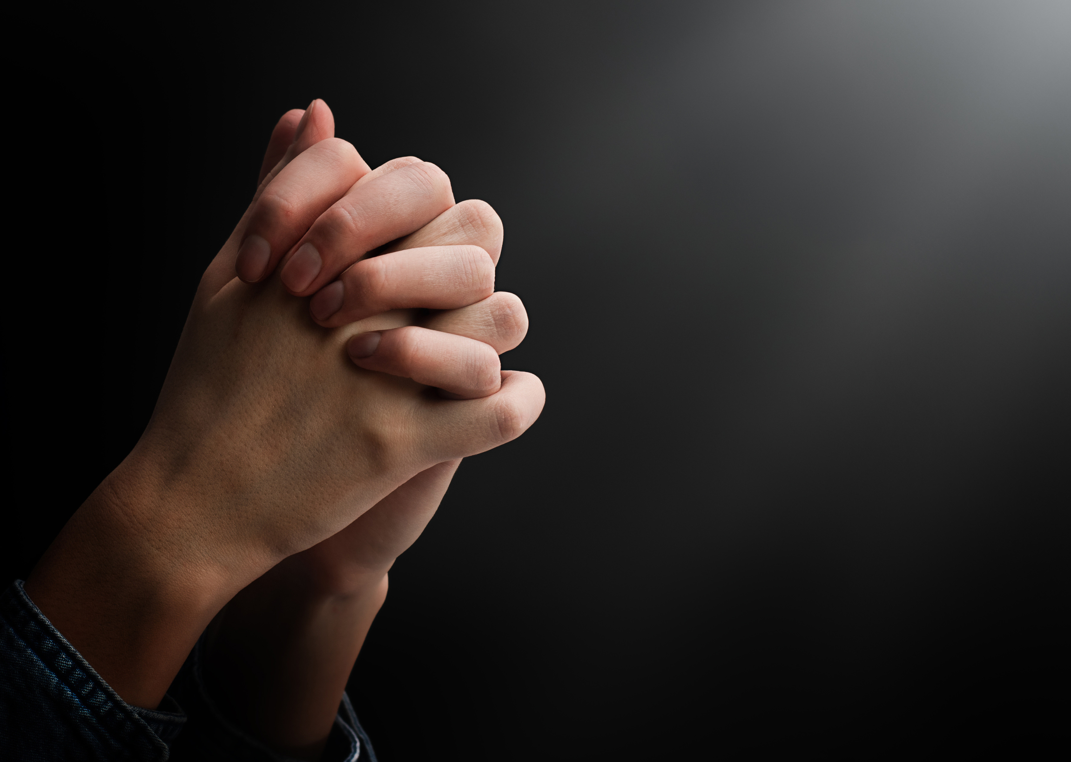
“‘Our Father in heaven, hallowed be your name, ¹⁰ your kingdom come, your will be done, on earth as it is in heaven. ¹¹ Give us today our daily bread. ¹² And forgive us our debts, as we also have forgiven our debtors. “And do not lead us into temptation, But deliver us from the evil one. For Yours is the kingdom and the power and the glory forever. Amen.”
Matthew 6:13 nkjv

Slide 3
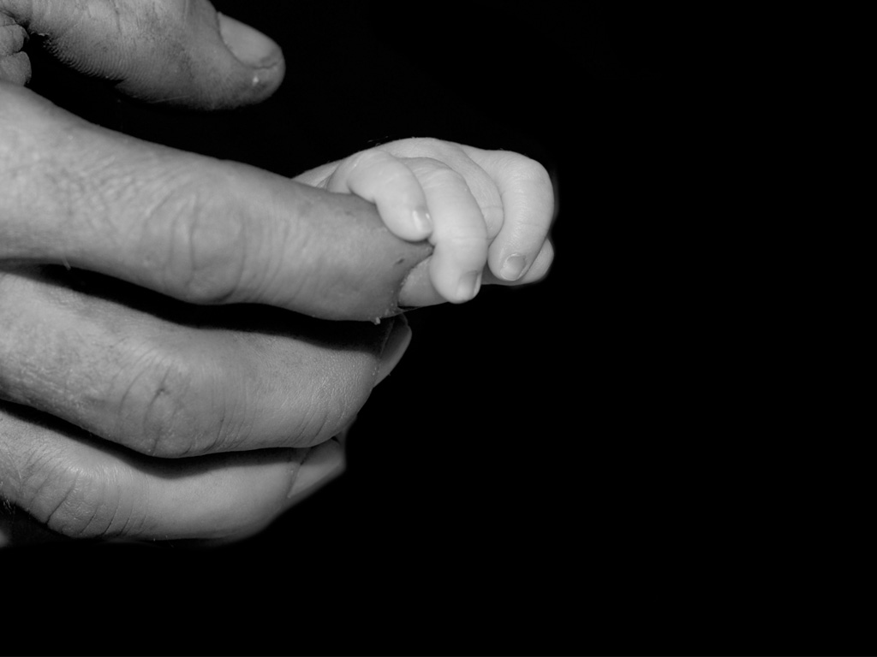
Firstly:
Our Good Father in Heaven

Slide 4
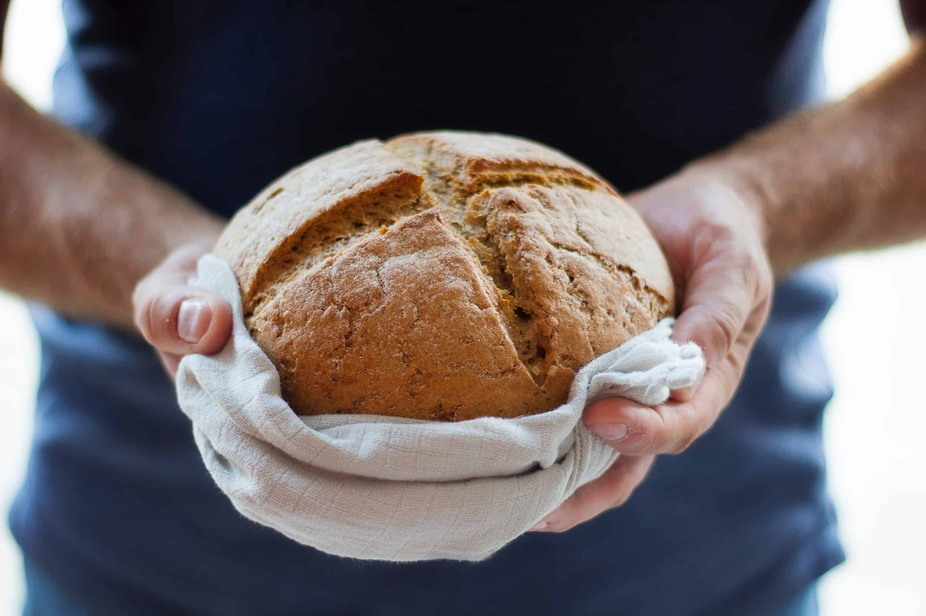
Secondly:
Give us today our daily bread

Slide 5

THIRDLY:
THE BREAD OF FORGIVENESS
Give us today our daily bread. ¹² And forgive us our debts, as we also have forgiven our debtors.
Matthew 6:11-12 nkjv

Slide 6
¹²And forgive us our debts,
As we forgive our debtors.¹³ And do not lead us into temptation, But deliver us from the evil one. For Yours is the kingdom and the power and the glory forever. Amen.
¹⁴ “For if you forgive men their trespasses, your heavenly Father will also forgive you. ¹⁵ But if you do not forgive men their trespasses, neither will your Father forgive your trespasses.
Mathew 6:12-15 nkjv

Slide 7
LET US OFFER THE BREAD OF FORGIVENESS TO ONE ANOTHER

Slide 8
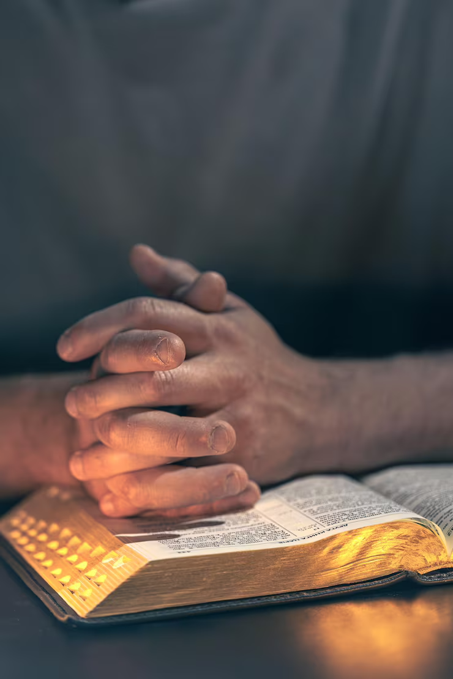

1. “Lead Us Not Into Temptation”
-A Prayer of Humble Dependence

Slide 9
Let no one say when he is tempted, “I am tempted by God”; for God cannot be tempted by evil, nor does He Himself tempt anyone. James 1:13 nkjv

Slide 10
No temptation has overtaken you except what is common to mankind. And God is faithful; he will not let you be tempted beyond what you can bear. But when you are tempted, he will also provide a way out so that you can endure it.
1 Corinthians 10:13 niv

Slide 11
Not a prayer for the defeated—it is a prayer for the wise!
Therefore let the one who thinks he stands watch out
that he does not fall. 1 Corinthians 10:12 nasb

Slide 12

Jesus teaches us to pray before the battle begins.
Keep watching and praying, so that you do not come into temptation; the spirit is willing, but the flesh is weak.”
Matthew 26:41 nasb

Slide 13
2. “But Deliver Us From Evil”
– A Cry for Protection and Victory

Slide 14
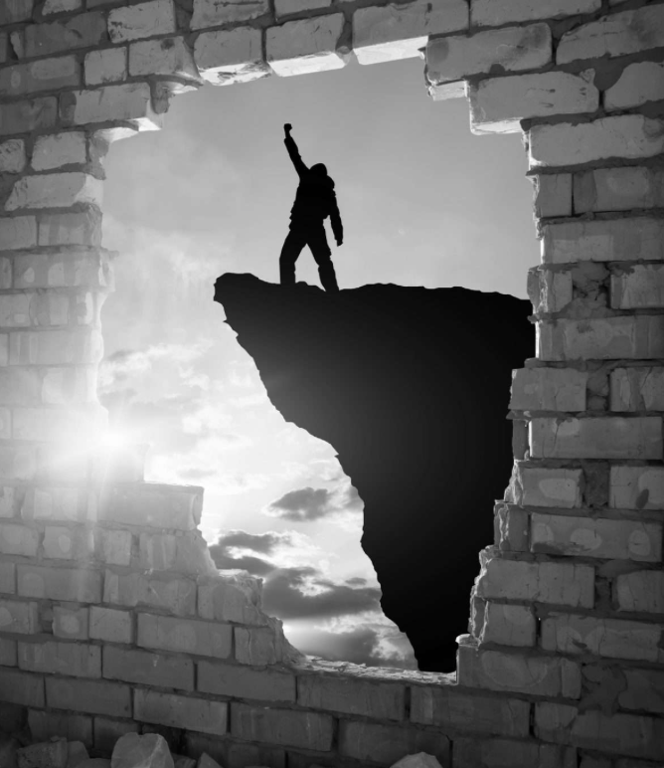
The word “deliver” means to snatch away, to pull out, to rescue with force
For he has rescued us from the dominion of darkness and brought us into the kingdom of the Son he loves,
Colossians 1:13 niv

Slide 15
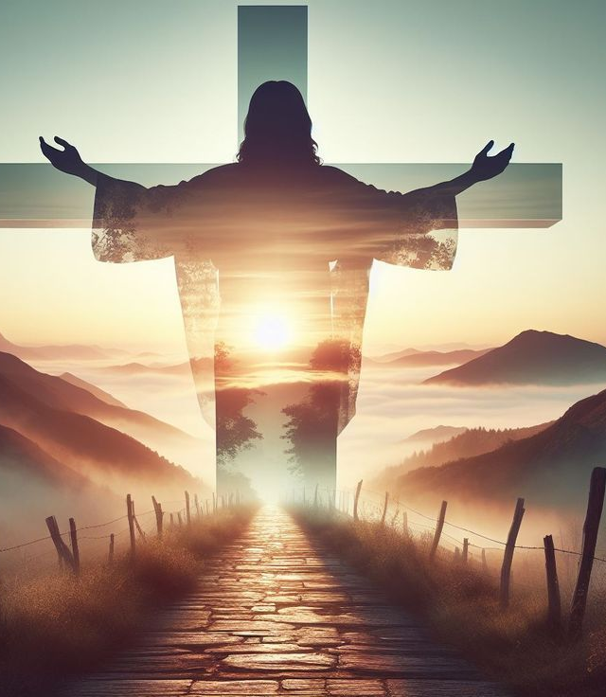
Our Deliverance Already Provided
Through the cross, Jesus broke the power of sin.
Through His resurrection, He conquered death.
Through the Spirit, He empowers us to walk in holiness.
When we pray, “Deliver us from evil,” we are stepping into the victory Christ has already won.

Slide 16
3. “For Yours Is the Kingdom…”
– A Declaration of God’s Sovereignty

Slide 17
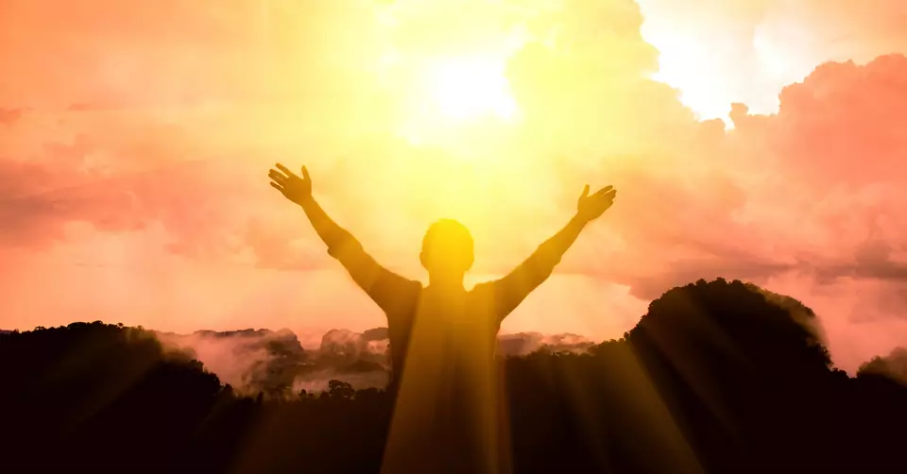
“For yours is the kingdom…”
Prayer starts with worship and ends in worship
The final words shift our eyes from the battle to the Throne!
God rules over every power.
His kingdom is unshaken by the forces of evil. No temptation is stronger than His authority.

Slide 18
“Yours is the power…” – God is able
“Yours is the glory…” – God gets the praise
“Forever. Amen.” – The eternal certainty of
God’s reign

Slide 19
• The kingdom is His — He rules over all.
• The power is His — Nothing is too hard for Him.
• The glory is His — Every answer to prayer reveals His greatness.
• Forever — His reign and faithfulness are eternal.

