Slide 1

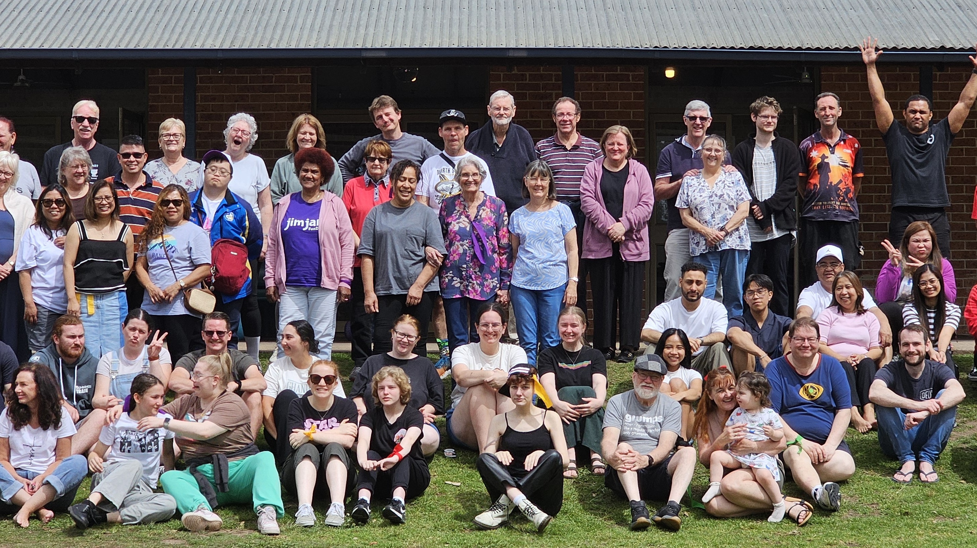
Instructions For Christian Homes
Colossians 3v18-25; 4v1

Slide 2

Aim:- Living for Christ
Understand Grace 1v6
Be filled with the HS 1v8
Know Jesus Christ 1v9-10
1v27 CHRIST is Living in YOU
We are to show that Jesus is at work in us,
through our everyday relationships.

Slide 3

Wives & Husbands - 2 to 1
Submit - As is Fitting in the Lord
Love – Sacrificially
Your partner will not complete you
Only Christ will truly fulfill you
Acknowledge each other’s strengths
Keep short accounts
Notes:
2 becoming one Gen 2:18 Mark 10:7-8

Slide 4

Parents & Children
Obey – It Pleases God
With respect & the right attitude
Don’t provoke them -
But Encourage them
train & instruct them in the Lord.
Provide, guide, protect,
Place limits
discipline
Notes:
Child Psychologist Parents are not friend to their children! Different dynamic

Slide 5

Slaves & Masters
Obey – As Serving the Lord. He will reward you
Provide for your workers – be just & Fair
Notes:
Philemon & Onesimus Col 4:9

Slide 6
For since our friendship with God
was restored by the death of his Son
while we were still his enemies,
we will certainly be saved through the life of his Son.
So now we can rejoice in our wonderful
new relationship with God,
because our Lord Jesus Christ
has made us friends of God.
^{Romans 5v10-11}

