Slide 1

A Fool (Trusting God) Psalm 53

Slide 2
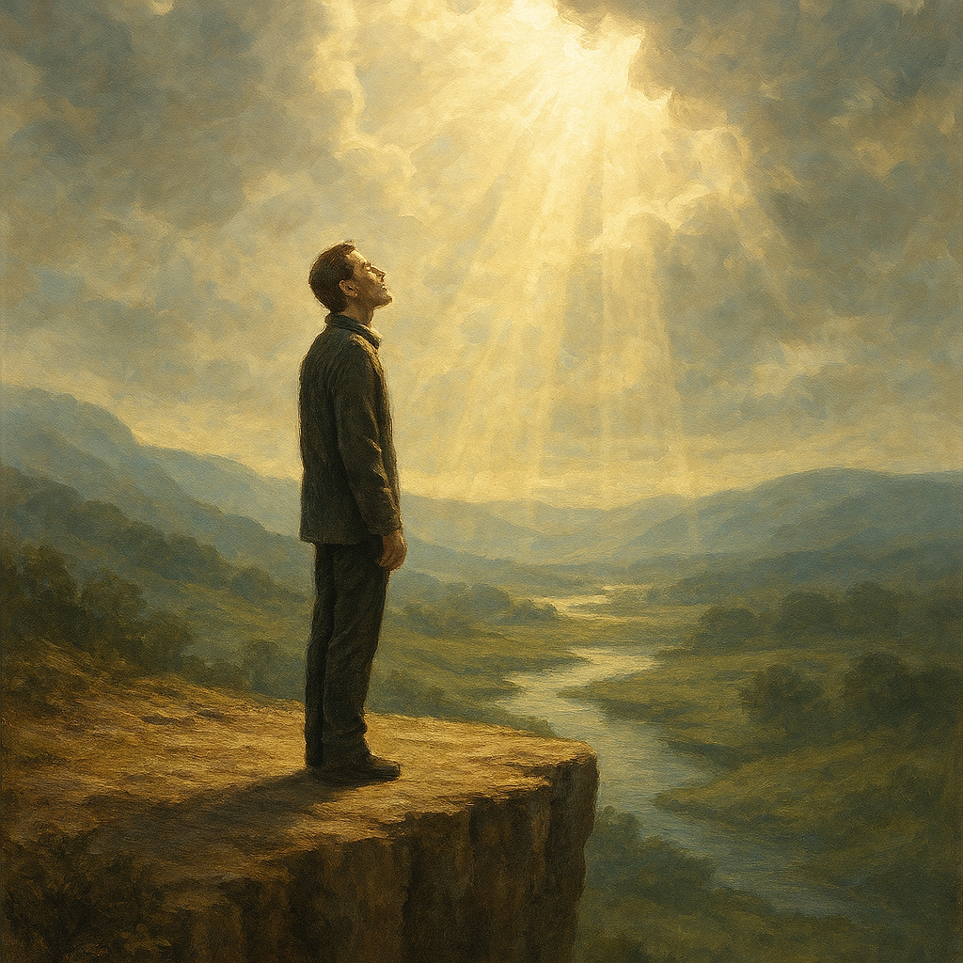
Psalm 53 (NIV)
2
¹ The fool says in his heart, “There is no God.” They are corrupt, and their ways are vile; there is no one who does good.
² God looks down from heaven on all mankind to see if there are any who understand, any who seek God. ³ Everyone has turned away, all have become corrupt; there is no one who does good, not even one.

Slide 3
Psalm 53 cont.
⁴ Do all these evildoers know nothing?
They devour my people as though eating bread; they never call on God. ⁵ But there they are, overwhelmed with dread, where there was nothing to dread. God scattered the bones of those who attacked you; you put them to shame, for God despised them.
⁶ Oh, that salvation for Israel would come out of Zion! When God restores his people, let Jacob rejoice and Israel be glad!
⁴

Slide 4
Psalm 53 (NIV)
4
¹ The fool says in his heart, “There is no God.” They are corrupt, and their ways are vile; there is no one who does good.
² God looks down from heaven on all mankind to see if there are any who understand, any who seek God. ³ Everyone has turned away, all have become corrupt; there is no one who does good, not even one.

Slide 5
Psalm 53 cont.
⁴ Do all these evildoers know nothing?
They devour my people as though eating bread; they never call on God. ⁵ But there they are, overwhelmed with dread, where there was nothing to dread. God scattered the bones of those who attacked you; you put them to shame, for God despised them.
⁶ Oh, that salvation for Israel would come out of Zion! When God restores his people, let Jacob rejoice and Israel be glad!
⁴

Slide 6
Psalm 14 (NIV)
6
The fool^{[a]} says in his heart, “There is no God.” They are corrupt, their deeds are vile; there is no one who does good.
² The Lord looks down from heaven on all mankind to see if there are any who understand, any who seek God. ³ All have turned away, all have become corrupt; there is no one who does good, not even one.
.

Slide 7
A Fool
A…….Fool is defined as someone who lacks wisdom, understanding, and reverence for God. Characteristics of a fool include:
Disregarding God's Word: Fools often ignore God's teachings and commandments (Proverbs 1:7).
Lack of Discernment: They make unwise decisions and fail to learn from their mistakes (Proverbs 14:16).
Rejection of Knowledge: Fools despise wisdom and instruction, leading to moral decay (Proverbs 1:7).
Creating Strife: They engage in foolish talk and incite conflict within communities (Proverbs 10:23).
Denial of God: Ultimately, a fool may say in their heart, "There is no God" (Psalm 14:1).

Slide 8
Psalm 20:7 (NIV)
8
⁷ Some trust in chariots and some in horses, but we trust in the name of the Lord our God.

Slide 9
Psalm 20:7 (NIV)
9
⁷ Some trust in chariots and some in horses, but we trust in the name of the Lord our God.

Slide 10
Proverbs 3:5-6 (NIV)
10
⁵ Trust in the Lord with all your heart and lean not on your own understanding; ⁶ in all your ways submit to him, and he will make your paths straight.^{[a]}.

