Slide 1
Welcome to Holy Hermits Online Worship
1st Sunday of Advent A
“Hope”
Commissioning of Leaders & Servers
Service Prep: Lauren | Chat Host: Viki | First Reader: Liz
Music: Lauren | Priest: N/A | Second Reader: Bob
Proof-reader: Kerrie-Anne | Deacon: Lauren | Preacher: Lauren
Broadcaster: Lauren | Welcomer: Julie | Fellowship: Lauren
Backup Broadcaster: Barry | Leader: Jeremy | Safety Officer: Chris
Zoom Buttons: Viki | Cantor: Margo | Attendance: Viki

Slide 2


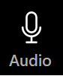



Hospitality
Leader: Please mute for the service unless invited to offer your voice as part of the service ministry
Have the video camera on or off and turn the volume and brightness up or down on your device if things are too loud 🔉🔊or too bright🔅🔆
Our Cantor acts as our voice, offering the responses, in Bold Text, which we say together
Feel welcome to use the chat and reaction emojis 👍
🙏 Please take care of yourself in this space. 🙏 Come and go as you need
😴 It is great to take rest in this space, so falling asleep is also OK 😴
👂️ Remember, pastoral care is available to all in the community, if you'd like to speak to someone about anything spiritual. ❤️ Visit the help page at the website to reach out 🌐
Our Being Together ethos and safeguarding practices can also be accessed on the website 🫶​
🙌 Come as you are – we are all here together! 🙌
Notes:
Used Lent 2022

Slide 3
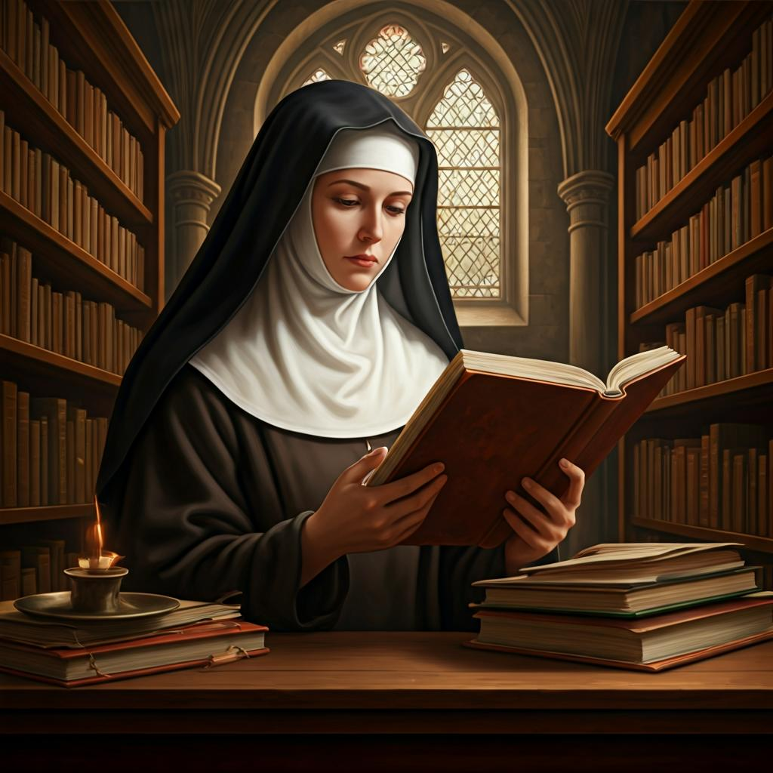
Leader: Our Holy Hermit Highlights for today
Sr Maria Boulding was an English nun, writer and translator. In 1947 she joined Stanbrook Abbey in Worcester, taking solemn vows in April 1952.
She published a number of books on monastic life. Although rarely appearing in public, she made a conference tour of the Holy Land, Australia and Japan in 1980, then lived as a hermit from 1985 to 2004 with her dog and her cat.
From 2004 until her death in 2009 she travelled and continued translating and revising. She insisted that no Latin be read at her funeral in 2009.
To read more about Sr Maria Boulding please click the link​​ in the send out

Slide 4
Invitation
Leader: As we settle into worship let your breath be soft, your mind be still, and your heart be open to the presence of God.
Church of the Advent, Boston, MA, Sunday Bells Ringing

Slide 5
Leader and Cantor unmute
The Greeting
Leader: The Lord is coming! Prepare the way.
All: The Lord is coming! We are making ready,

Slide 6
Gathering Prayer
Leader: Come to the mountain of the Lord, to receive God’s teaching and to walk in his paths. Come to seek his justice and peace, as we await his coming among us.
All: As we gather today as your holy people, help us do right by one another and love one another. May we push away from our hearts and minds all that is unpeaceful, unfair and unloving. Amen.

Slide 7
The Trisagion
All: Holy God, holy and mighty, holy and immortal, have mercy on us.

Slide 8
Sentence
Leader: I invite our Cantor to proclaim the sentence for today.
Cantor: Come, let us go up to the mountain of the Lord, to the house of the God of Jacob; that he may teach us his ways and that we may walk in his paths.
Isaiah 2.3a

Slide 9
Prayer of Approach
All: Advent God, we are on a journey with you, a journey to discover, to seek, to find. We’ve come to your house, to greet and to meet. We’ve come to pray, to hear, to see, to feel, to know, to learn and understand. We’ve come to prepare for the joys and challenges to come. Advent God, be our guide. Amen.

Slide 10
Leader unmutes
Our first song is
Come Now O Prince of Peace
Come Now O Prince of Peace
​We stay on mute
Leader and Cantor mute

Slide 11
Preparing for confession
Leader: We sometimes want to rush to Christmas, not taking time to value the journey of Advent. All: Forgive us, God.
Leader: We sometimes forget to prepare as we ought,
to reflect and to seek,
and to offer to help and support
those who need it. All: Forgive us, God.

Slide 12
Leader: We sometimes get wrapped up in things that we want, but they aren’t always right or just or fair.
All: Forgive us, God.
Leader: We sometimes get all wrapped up like a gift, with tape so tight and secure that we can’t see the needs of the world. All: Forgive us, God. Amen.

Slide 13
The Deacon Introduces Confession​
The Lord comes, bringing to light things now hidden in darkness, and disclosing the purposes of the heart.
​​
Silence may be kept.​
​
Let us open our hearts and prepare for his coming, confessing our sins in penitence and faith.

Slide 14
All: ​
Merciful God, our maker and our judge, ​
we have sinned against you ​in thought, word, and deed, ​
and in what we have failed to do: ​
we have not loved you with our whole heart; ​
we have not loved our neighbours as ourselves; ​
we repent, and are sorry for all our sins.​
Father, forgive us. Strengthen us to love and obey you
in newness of life; ​through Jesus Christ our Lord. ​
Amen.​

Slide 15
Words of Assurance offered by the Deacon
These words of assurance from the First Letter of John declare that:
If anyone sins, we have an advocate with the Father, Jesus Christ the righteous. He is the perfect offering for our sin, and not for ours only, but for the sins of the whole world.
(1 John 2: 1-2)
In this is love, not that we loved God, but that he loved us and sent his Son to be the perfect offering for our sins.
(1 John 4:10)

Slide 16
Collect
Leader:
Faithful God,
whose promises stand unshaken through all generations:
renew us in hope,
that we may be awake and alert
watching for the glorious return of Jesus Christ,
our Judge and Saviour,
who lives and reigns with you in the unity of the Holy Spirit,
one God, for ever and ever.
All: Amen.

Slide 17
The 1st reader unmutes
Leader: I invite the 1st Reader to unmute and offer the 1st reading when ready.
Reader 1: The 1st Reading is from Isaiah 2.1-5
¹ The word that Isaiah son of Amoz saw concerning Judah and Jerusalem. ² In days to come the mountain of the Lord ’s house shall be established as the highest of the mountains, and shall be raised above the hills; all the nations shall stream to it. ³ Many peoples shall come and say,
Continue…

Slide 18
‘Come, let us go up to the mountain of the Lord , to the house of the God of Jacob;
that he may teach us his ways and that we may walk in his paths.’
For out of Zion shall go forth instruction,​ and the word of the Lord from Jerusalem.
⁴ He shall judge between the nations, and shall arbitrate for many peoples; they shall beat their swords into ploughshares, and their spears into pruning-hooks;
Continue…

Slide 19
nation shall not lift up sword against nation, neither shall they learn war any more.
⁵ O house of Jacob, ​ come, let us walk ​ in the light of the Lord !
For the word of the Lord. Thanks be to God.​

Slide 20
Leader: We now say the psalm antiphonally, I invite the first reader to lead and we will all respond with the Response in Bold along with our cantor as our voice.
Psalm 122
¹ I was glad when they said to me:
‘Let us go to the house of the Lord.’
² And now our feet are standing:
within your gates, O Jerusalem;
³ Jerusalem which is built as a city:
where the pilgrims gather in unity.
⁴ There the tribes go up, the tribes of the Lord:
as he commanded Israel,
to give thanks to the name of the Lord.
Continue…

Slide 21
⁵ There are set thrones of judgement:
the thrones of the house of David.
⁶ O pray for the peace of Jerusalem:
may those who love you prosper.
⁷ Peace be within your walls:
and prosperity in your palaces.
⁸ For the sake of my kindred and companions:
I will pray that peace be with you.
⁹ For the sake of the house of the Lord our God:
I will seek for your good.

Slide 22
The 2nd reader unmutes
Leader: Thank you, 1st reader. I invite the 2nd Reader to unmute and offer the 2nd reading when ready.
Reader 2: The 2nd Reading is from Romans 13.9-14
⁹ The commandments, ‘You shall not commit adultery; You shall not murder; You shall not steal; You shall not covet’; and any other commandment, are summed up in this word, ‘Love your neighbour as yourself.’ ¹⁰ Love does no wrong to a neighbour; therefore, love is the fulfilling of the law. ¹¹ Besides this, you know what time it is, how it is now the moment for you to wake from sleep. For salvation is nearer to us now than when we became believers;
Continue…

Slide 23
¹² the night is far gone, the day is near. Let us then lay aside the works of darkness and put on the armour of light; ¹³ let us live honourably as in the day, not in revelling and drunkenness, not in debauchery and licentiousness, not in quarrelling and jealousy. ¹⁴ Instead, put on the Lord Jesus Christ, and make no provision for the flesh, togratify its desires.​
For the word of the Lord. Thanks be to God.

Slide 24

We pause before
​the Gospel ​​

Slide 25
Deacon: The Gospel of our Lord Jesus Christ according to St Matthew Chapter 24 beginning at the 36th verse.
All: Glory to you Lord Jesus Christ.
³⁶ ‘But about that day and hour no one knows, neither the angels of heaven, nor the Son, but only the Father. ³⁷ For as the days of Noah were, so will be the coming of the Son of Man. ³⁸ For as in those days before the flood they were eating and drinking, marrying and giving in marriage, until the day Noah entered the ark, ³⁹ and they knew nothing until the flood came and swept them all away, so too will be the coming of the Son of Man. ⁴⁰ Then two will be in the field; one will be taken and one will be left.
Continue…

Slide 26
⁴¹ Two women will be grinding meal together; one will be taken and one will be left. ⁴² Keep awake therefore, for you do not know on what day your Lord is coming. ⁴³ But understand this: if the owner of the house had known in what part of the night the thief was coming, he would have stayed awake and would not have let his house be broken into. ⁴⁴ Therefore you also must be ready, for the Son of Man is coming at an unexpected hour.​
For the word of the Lord. Thanks be to God.

Slide 27
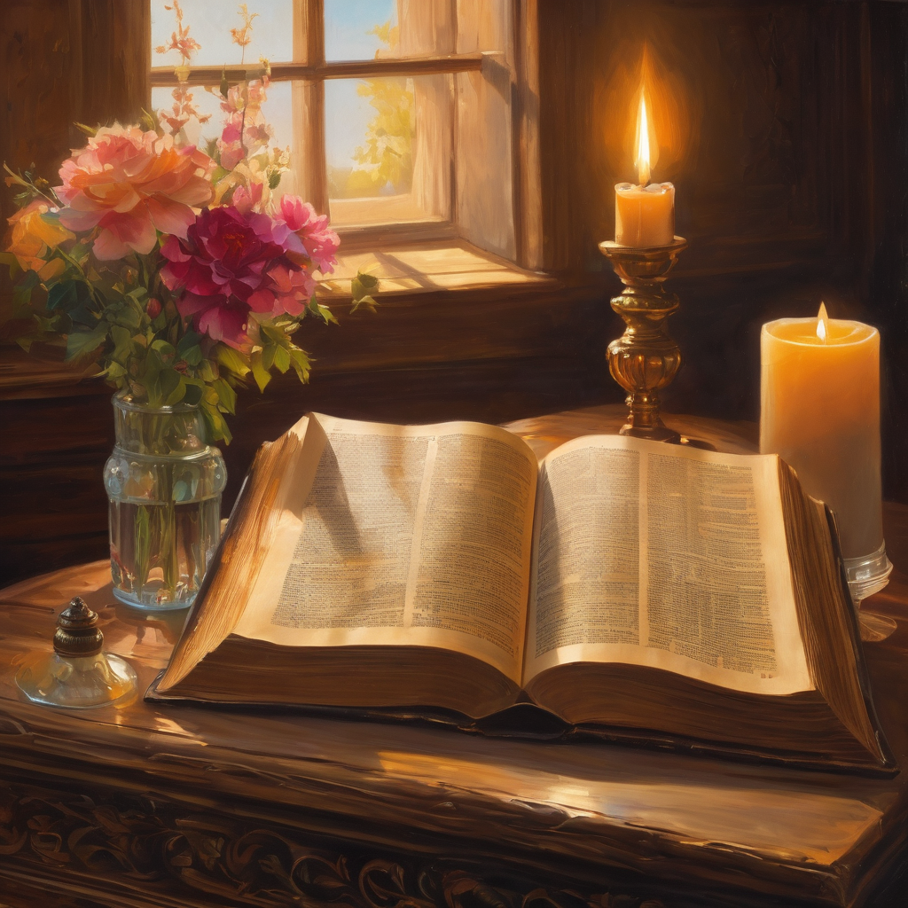
We pause
after ​the Gospel ​​

Slide 28
Leader: The Sermon is a Flashback sermon.
Leader and Cantor mute
Broadcaster exits screenshare
Flashback Sermon
Be alert! The world needs more ‘lerts’!
Be alert! The world needs more ‘lerts’!

Slide 29
Leader unmutes
Our next song is
When God Almighty Came To Be One Of Us
When God Almighty Came To Be One Of Us
​We stay on mute
Leader and Cantor mute

Slide 30
The Leader and Cantor unmute
The Greeting of Peace
Leader: We are the body of Christ
All: God’s Spirit is with us
Leader: The peace of the Lord be always with you.
All: And also with you.
Leader: A sign of peace may be exchanged
You may like to type 'Peace' into the chat, use the 'raise hand’ or other reaction buttons, or just simply wave via the screen with your video turned on
(Broadcaster exits shared screen for a few moments for the exchange of peace)

Slide 31
Prayer of Thanksgiving before Intercessions
God of the journey, thank you for walking with us. Thank you for: visions and dreams that reveal more of your purposes; hope in the future, expectation and exploration; the guidance you’ve given and the hand that leads us; the chance to turn things around and make good what is bad, to make right what is wrong, to make light out of darkness, to make peace out of war, to make hope out of despair, to make meaning and purpose where none has been found. God of the journey, thanks be to you. Amen.

Slide 32
Intercessions
Reader 2: We pray for creation and communities we share our lives with. We pause for a few moments to name either in our hearts, or out loud, or in the chat, those environments and communities we bring to the Lord in prayer.
PAUSE…
We entrust to you the community of Holy Hermits Online and our ministry partners:
Prosper the work of our hands and show us the way to your new creation.
Creator God, Hear our prayer.
St John's Cathedral Brisbane The Anglican Diocese of Southern Queensland St Gabriel’s, Carindale Benedictus Contemplative Church, Canberra Anglican Focus and Tithe.ly

Slide 33
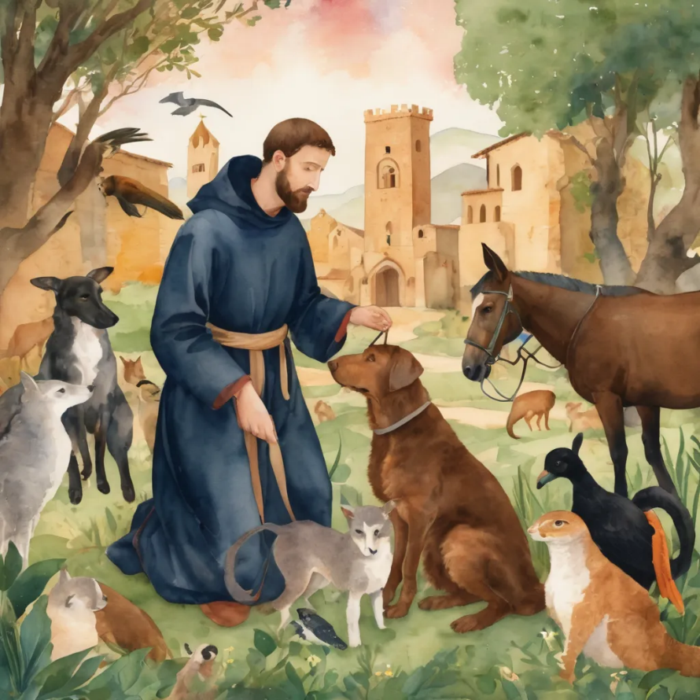
Reader 2: Loving Creator, we entrust to you all animals, especially those who are sick, anxious, ageing, lost, at risk, lonely, sad, hungry, in pain, homeless, abused, living in fear, encountering violence of any kind, in need of comfort, rehabilitation or transformation.
We invite your loving compassion for:
We name in our hearts, out loud or in the chat,
the animals we bring to the Lord in prayer. PAUSE…
Lambert ​​
Kala, Nigel and Little One ​​
Toby​​
Taco​​
Paddy and Jax​​
Rosie​
Jasmine, ​
Leese(y), ​
Sid, Toots and Lulu​
Polly and Suki​
Fred, George and Percy​
Koshka ​

Slide 34
Reader 2: Eternal Trinity of Love, we uphold to you the people we love and carry cares for:
We name in our hearts, out loud or in the chat, those we bring to the Lord in prayer.
PAUSE… Lord in your mercy, Hear our prayers.
Amen.
Kerry and Les, Jake,​​ Dr Julie, ​​ Julie and Ray, Tracey, Shane Jess and Leah ​​ May ​​ Kirsten, Greg, Daphne & Beau​​ Tanya​ Matthew & Nicholas​ Alan & Gaylene​ Susan | Barry​​ Dilys and Tony, Paul and Darhon Judy and Mary​​ Mark, Desley and Bob ​​ Ruth​​ Phil​ Rachel, Mervyn & Gillian Liz’s Godchildren Bonnie and girls | Bill and Marjorie​​ Rev'd Shane & Janette​​ Alecia, Martin and Aidan​​ Aaron and Andrea ​​ Neva​ Bob and Di​ Steven, Vanessa and Craig Miriam Barry and Gwen Pat and Julie

Slide 35
Pray Daily Cycle of Prayer
Leader: Loving God, joining with the Church in our cycle of prayer, we ask your blessings on:
The Anglican Church of Australia
The Parish of Brisbane Mar Thoma Church: †Gregorios Mar Stephanos Episcopa
Anglicare SQ Out of Home Care, Central Region – Fraser & Gympie Residential

Slide 36
Prayer for People in Need
Leader:
God who gives shelter, we give thanks for opportunities to offer support and prayers for those that are struggling at this time to put a permanent roof over their heads and to shelter those they love.
Please shine a light on homelessness for the people and animals experiencing this and provide a way for homes to be found and others to help, especially governments and churches.
Please protect all living rough and give safety and security to families and young people, and those who are supporting them.
Continue…

Slide 37
Please help us channel and inspire the hospitality that Jesus and his followers sought and encouraged in their day, and especially strengthen those already offering this ministry.
Awaken compassion in the hearts of all people to reach out with a loving hand. When we feel disheartened by this unfolding situation, please refocus our energies to keep praying and finding small ways to help so we don't feel so overwhelmed.
Usher in a wave of change for systems to be transformed and ways made for large scale transformation.
All: Amen.

Slide 38
Leader: Let us pray together the prayer which Jesus gave us saying:
All: Our Father in heaven,
hallowed be your name,
your kingdom come, your will be done,
on earth as in heaven.
Give us today our daily bread.
Forgive us our sins
as we forgive those who sin against us.
Save us from the time of trial
and deliver us from evil.
For the kingdom, the power,
and the glory are yours
now and for ever.
Amen.

Slide 39
Devotions

Slide 40
Hermit Wisdom

Slide 41
Leader: Teachings from Sr Maria Boulding
“Prayer is a listening to the creative, life-giving word that loves us into being.”
“In today's world silence is in short supply; this is a serious problem for our society, and anything we can do to help people recover a sense of silence as a necessary and positive element in human life is a contribution to the general sanity.”

Slide 42

Leader: ​As we enter a few minutes of silence together, you are invited to pray this prayer of adoration and/or spend this time in contemplation. ​
The Spiritual Communion prayer follows
on the next slide. Let us be still.
Leader and Cantor mute
​
Lord, help us to keep you at the center of our prayers,​ our worship and our lives.​ Turn to face outwards​ Lord, help us to trust you enough to look out for others.​ Amen.​

Slide 43
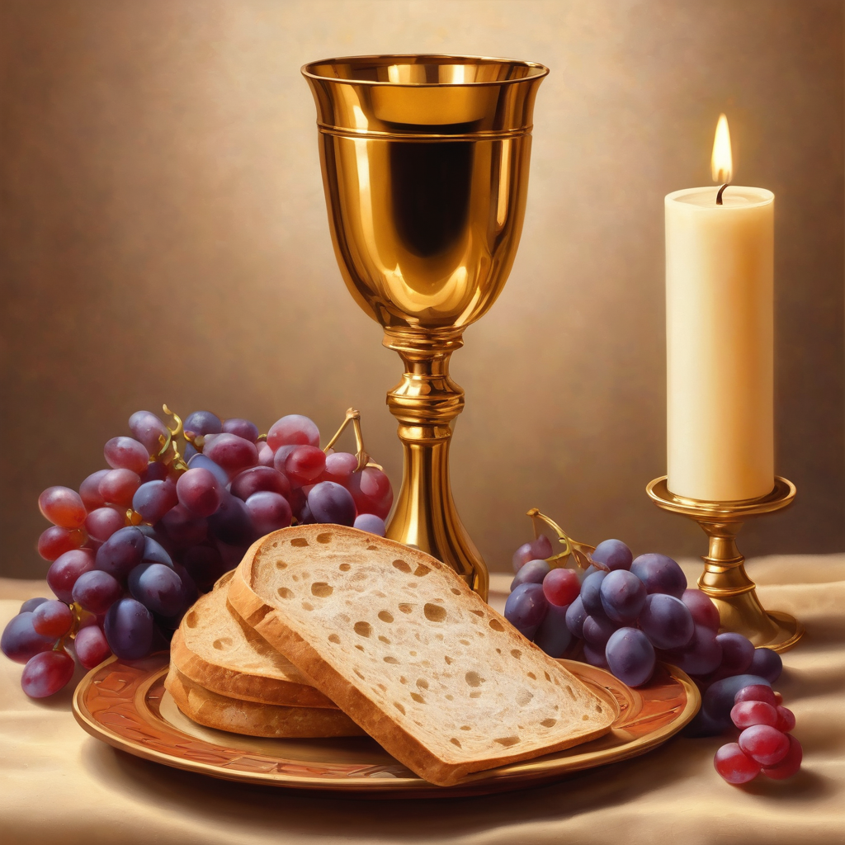
Oh, my Lord Jesus I turn to you present at the Altar and in the Tabernacle. I believe that you are present in the Holy Sacrament of your most Sacred Body and Blood.
I love you above all things and I desire to receive you into my Soul. I cannot at this moment receive you Sacramentally in Holy Communion.
Come spiritually into my heart.
Purify it, Sanctify it. Render my heart like your own heart.
I embrace you as if you were already there and unite myself wholly with you.
Never permit me to be separated from you.
Lord, I am not worthy to receive you, but only say the word and I shall be healed. Amen
Making a
Spiritual Communion
(Prayed in silence)

Slide 44
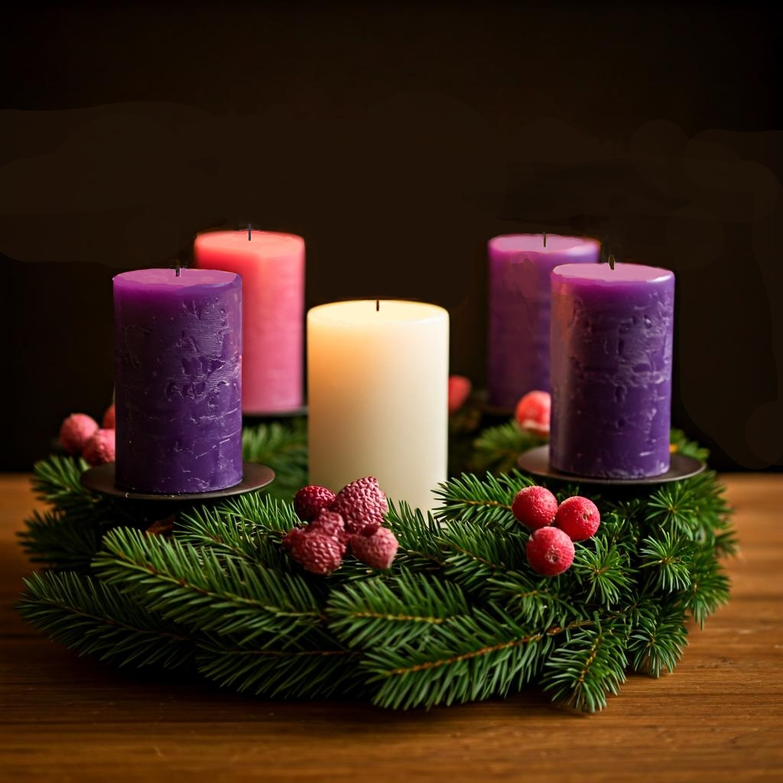
Prayer of the Advent Wreath
Deacon: This is the season of Advent, we prepare for the coming of Christ.
We create this Advent Wreath and light its candles to remind us of your precious gift, Jesus Christ, the light who dispels all darkness.
As we light this wreath, we remember that Jesus is the Alpha and Omega, the beginning and the end, the one who is, who was, and who is to come. The circular shape of our wreath symbolizes this eternal truth.

Slide 45
The five candles represent Christ's gifts to us:
hope, peace, joy, love,
and the presence of Christ himself, symbolised by the white Christ candle.
The light from these candles dispels darkness and reminds us of Christ's light in the world.

Slide 46
May you bless us, O Lord, and bless this wreath of light. ​
May its growing brightness be a sign of your Son's approaching ​nearness.
Help us to prepare with joy for his humble birth and to be ready to receive him when he comes again in glory.
Through Jesus Christ our Lord, who lives and reigns with you and the Holy Spirit, one God, now and forever. Amen.

Slide 47
Lighting The Advent Wreath: HOPE
Leader: In a world of war, famine, and disease, where children grow up as orphans, where families go hungry and entire regions face destruction by illness and oppression, in a world where many have lost hope, or never had it to begin with, we call upon you Lord to come.
All: Come, Lord Jesus, Come.
Leader: In this season of Advent, we await the coming of Hope into our world. We await the birth of the Christ - child; hope realised, the promise of God, come to us in a new way.
All: Come, Lord Jesus, Come, and bring us your hope.

Slide 48
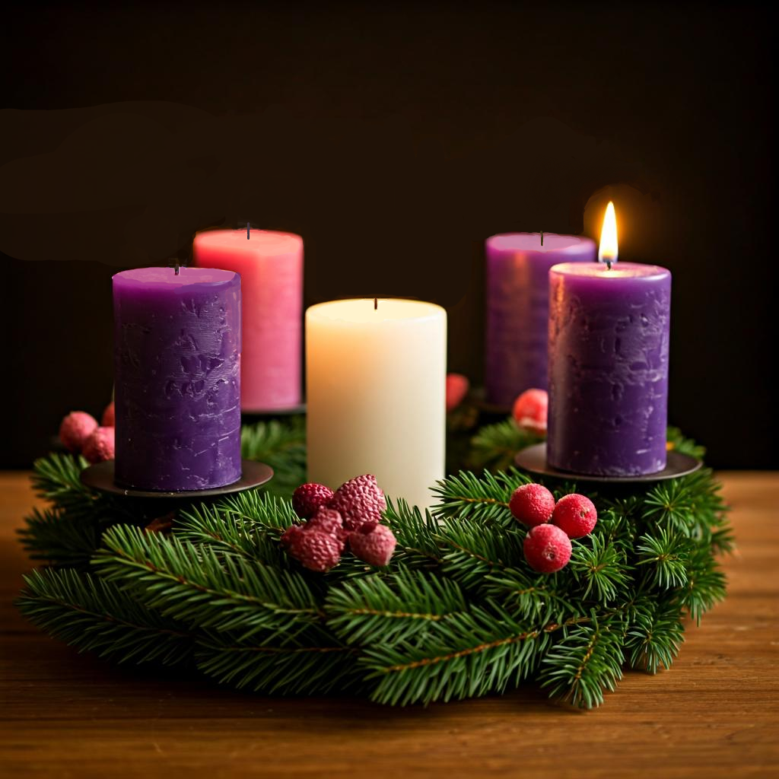
Light the first purple candle.
Leader: Let us Pray,
All: God of hope, who brought love into this world, be the love that dwells between us.
God of hope, who brought peace into this world, be the peace that dwells between us.
God of hope, who brought joy into this world, be the joy that dwells between us.
God of hope, the rock on which we stand, be the light, and focus of our lives. Amen.

Slide 49
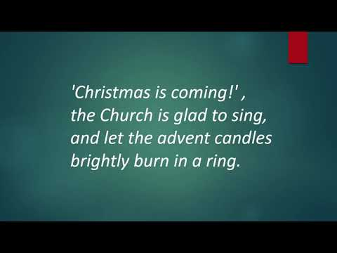

Slide 50
Commissioning our Leaders

Slide 51
Deacon: Leadership at HHO is a developing space. Four of our community members have entered that space as leaders, responding to a vocational call to be part of our governing team and contribute their ministry gifts and energy to further building our community alongside us all.
I welcome our Governance leaders Chris and Leonie and our Liturgical Assistants Julie and Jeremy to the roles of leadership which they have been called to explore with us and invite us all to uphold them in this commissioning.
Brothers and Sisters in Christ Jesus, we are all baptised by one Spirit into one Body, and given gifts for a variety of ministries for the common good. Our purpose is to commission these persons in the Name of God and of this community to a special ministry to which they are called.

Slide 52
The Examination of leaders
Deacon: These persons are presented to us for leadership having been prepared by their commitment to Jesus Christ as Lord, regular attendance at worship, acknowledgement of their vocational call, and their willingness to step forward to exercise their ministry to the honour of God, and the well-being of this community.
Leaders Unmute
You have been called to a ministry in this community and taken it up.
Will you, as long as you are engaged in this work, perform it with prayerful diligence, to the honour of God and the benefit of the members of this community?
Leaders: I will with God's help.

Slide 53
The Commissioning of Leaders
Deacon: The Lord gives wisdom; from God's mouth come knowledge and understanding
Leaders: I am your servant; grant me understanding that I may know your wisdom.
All: O Eternal God, the foundation of all wisdom and the source of all courage: Enlighten with your grace our Leaders, and so rule their minds, and guide their counsels, that in all things they may seek your glory and promote the mission of your Church; through Jesus Christ our Lord. Amen.

Slide 54
Deacon: In the name of God and of this community we commission you Chris, Julie, Leonie and Jeremy as leaders of Holy Hermits Online.
All: We acknowledge and uphold our leaders in their ministries and will seek to support them as long as they choose to exercise this ministry in our midst.
Deacon: Eternal God, who by the Holy Spirit presided at the council of the apostles to guide them in all knowledge and truth: be present with our leadership team. In the passions of discernment and dialogue give them a quiet spirit, in the complexities of the choices they are called to make give them clear minds, and in the moments of decision give them courageous hearts. Guide them in all things to seek only your glory and the good of your Church: Through Jesus Christ our Lord. Amen.

Slide 55
Commissioning our Servers

Slide 56
Deacon: Many of our members have begun exercising ministry for and at worship each Sunday as part of the serving team.​
​
I welcome all who serve at worship to bring themselves forward as part of this commissioning to intentionally recognise God's call on their lives.
Including: LAs, readers, service prep team, tech-support, chat host, zoom buttons, broadcasters, music curators, proof-readers, prayer writers, welcomers, fellowship leaders, attendance recorder, safety officer.

Slide 57
The Examination of Servers
I present to you our servers who have begun in earnest to explore online worship alongside the Holy Spirit.
Servers unmute
You have been called to a ministry in this community and begun exercising it at worship. Will you, as long as you are engaged in this work, perform it with prayerful diligence, to the honour of God and the benefit of the members of this community?
Servers: I will with God's help.

Slide 58
The Commissioning of Servers
Deacon: You are my witnesses, says the Lord, and my servants whom I have chosen.
Servers: Give thanks to the Lord and call upon the name of Jesus, make known Christ's deeds among the people.
Servers mute again
All: O gracious lord, confirm with your heavenly benediction your servants commissioned to minister in your Church, that with sincere devotion of mind, body and soul they may offer acceptable service to you; through Jesus Christ our Lord. Amen.
In the name of God and of this community we commission our servers for their various ministries and recognise the call God has placed on their lives to serve at worship online.

Slide 59
All: O Lord, without whom our labour is lost: we beseech you to prosper all works in your Church undertaken according to your holy will. Grant to your workers a pure intention, a patient faith, sufficient success on earth, and the blessedness of serving you in heaven; through Jesus Christ our Lord. Amen.

Slide 60
Farewell to Kerrie-Anne

Slide 61
Farewell to Kerrie-Anne
Deacon: Loving God, with heavy hearts we acknowledge the redundancy of our Admin Officer. We are saddened by this change and the absence her departure will leave in our community. We give thanks for Kerrie-Anne’s dedicated service and the countless ways she has enriched our lives and community.
As she moves forward into new opportunities, we ask for your presence to guide and comfort her. May she find strength and hope in the days ahead, and may we, as a community, support one another through this time of transition. Through Jesus Christ our Lord.
All: Amen.

Slide 62
Leader unmutes
Our final song is
O Come, O Come, Emmanuel
https://www.youtube.com/watch?v=utpZAIycWFU
​We stay on mute
Leader and Cantor mute

Slide 63
Sending Prayer
All: We have worshipped you here today, Lord. Now we go out, with hope and confidence, to love and to serve. Help us to worship you out there, just as we do here. Amen.

Slide 64
The Benediction
Leader: Let us all invite God’s blessings together,
All: May the Lord bless us and keep us.
May the Lord’s face shine upon us and be gracious to us.
May the Lord’s countenance be lifted upon us,
and bring us peace. Amen

Slide 65
Notices
Today @ 5:30pm 3D Dialogue's November at home retreat, for more information go to https://holyhermits.com.au/ministries/3d-dialogue
Week 2 of our Advent study based on The Muppet Christmas Carol Thursday 4th Dec @6pm The Muppet Christmas Carol
Submissions for Christmastide content are closing 14th Dec. Please email to Holy Hermit inbox or Rev'd Lauren
Purchase of Christmastide subscriptions is also now open. Christmastide Subscription 2025
Next week we remember Holy Hermits St Herman of Alaska and St Juan Diego
A call out for broadcasters, readers and servers for HHO Christmas Services
See HHO Events page for further upcoming events HHO Events

Slide 66
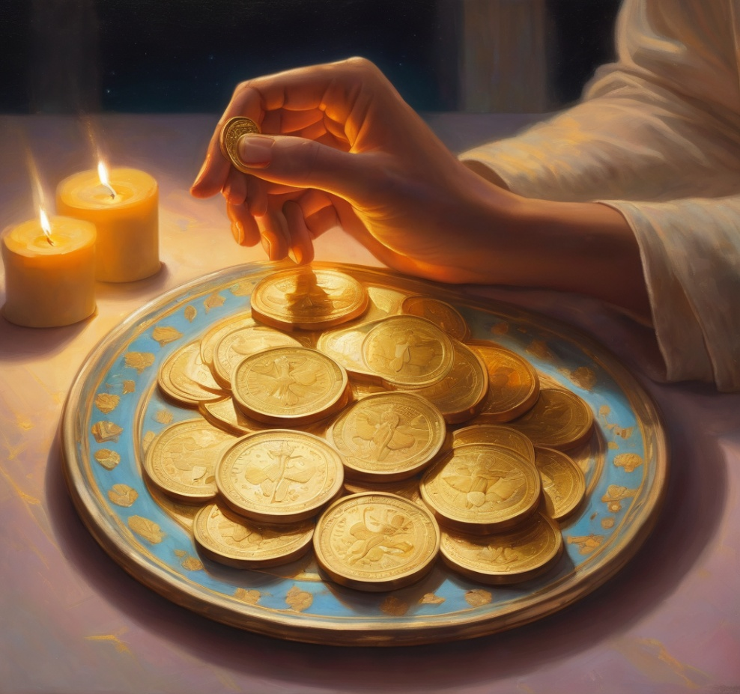
Offerings: Thank you for your regular gifts to this ministry
Offerings are most welcome via
The HHO App
Direct Debit
International Direct Debit
Please consider a one-off donation
or leaving a legacy in your Will
For further information go to HHO give page
https://holyhermits.com.au/give

Slide 67
The Dismissal
Leader: I invite everyone to unmute for the Dismissal
Leader: Go in peace to love and serve the Lord.
All: In the name of Christ, Amen.

Slide 68
Serving next week 7th December
2nd Sunday of Advent
9:00 am AEST
Service Prep: Leonie | Chat Host: Viki | First Reader: Jeremy
Music: Wiggles | Priest: N/A | Second Reader: Roselyn
Proof-reader: Kristine | Deacon: Lauren | Preacher: Lauren
Broadcaster: Barry | Welcomer: Chris | Fellowship: Julie
Backup Broadcaster: Lauren | Leader: Lauren | Safety Officer: Chris
Zoom Buttons: Paul | Cantor: Julie | Attendance: Viki
Thank you for your ministry gifts
New Servers always welcome!
Please email Rev’d Lauren to get involved
holyhermits@anglicanchurchsq.org.au

Slide 69
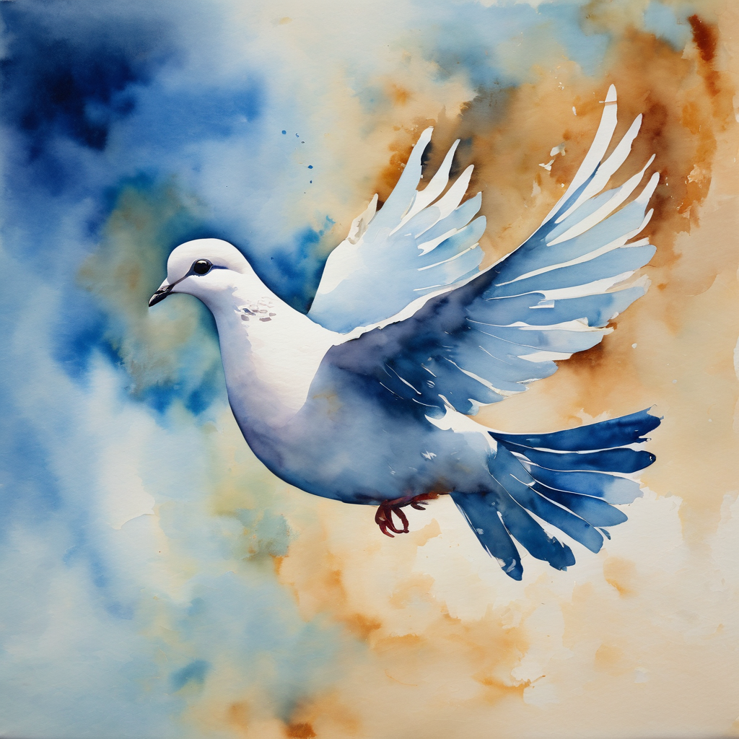
Fellowship time
Thank you, Lauren for leading Fellowship
Please feel welcome to linger or pop a message in the chat and head off when you are ready.​
Extra resources developed
by Roots on the Web
All artwork by Padlet

