Slide 1

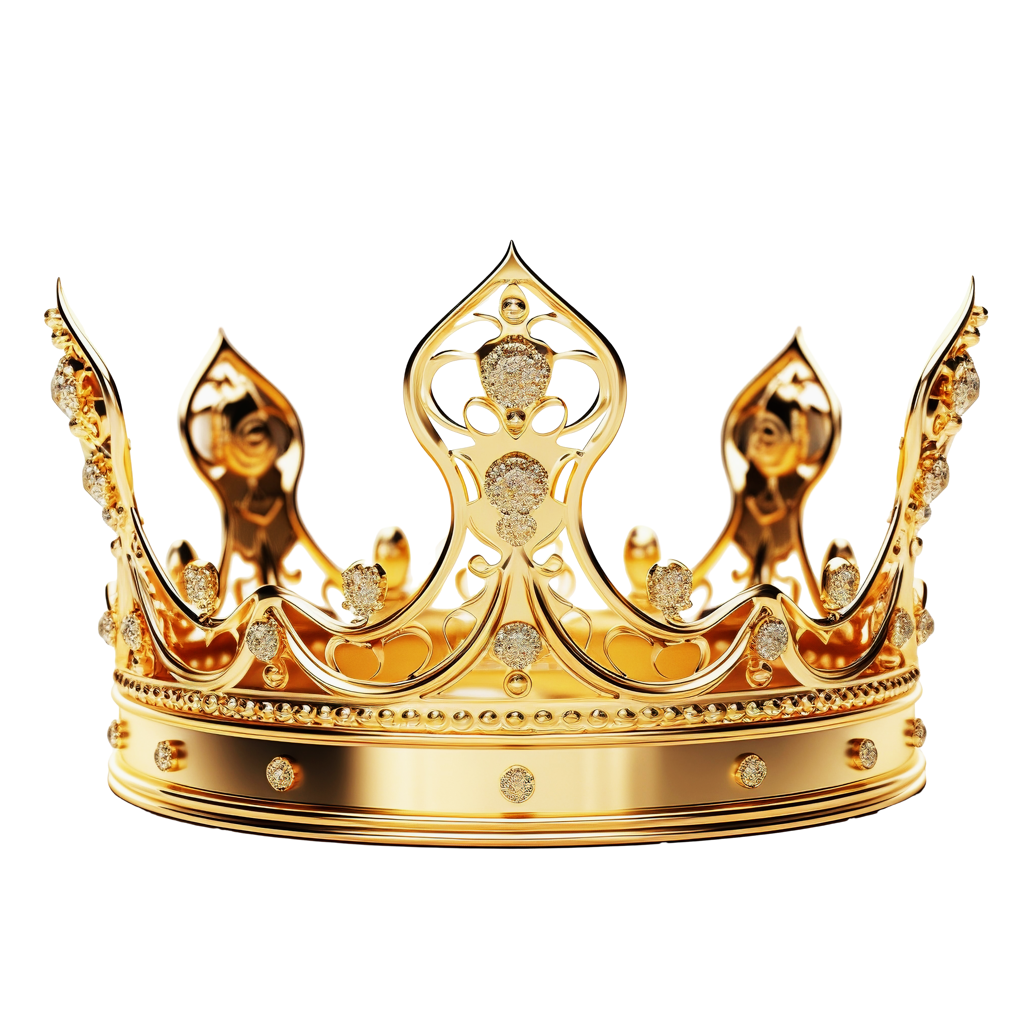
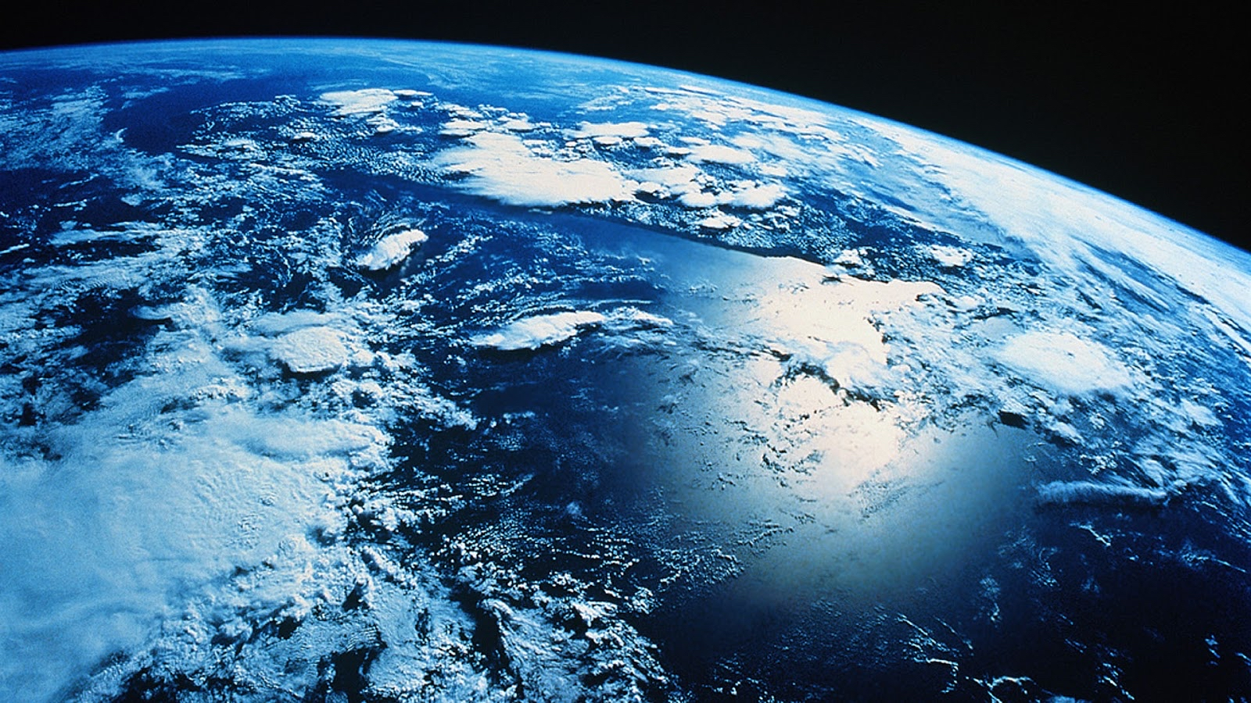
Kingdom Relationship

Slide 2
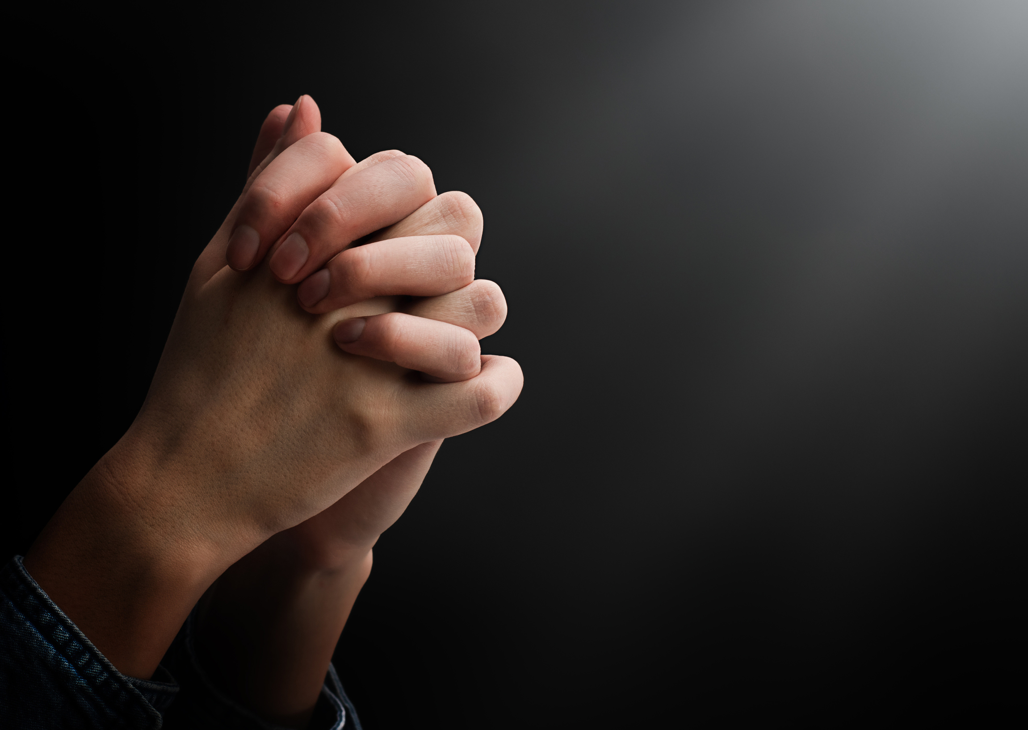
“This, then, is how you should pray:
“‘Our Father in heaven, hallowed be your name, ¹⁰ your kingdom come, your will be done, on earth as it is in heaven. ¹¹ Give us today our daily bread. ¹² And forgive us our debts, as we also have forgiven our debtors.
Matthew 6:9-12

Slide 3
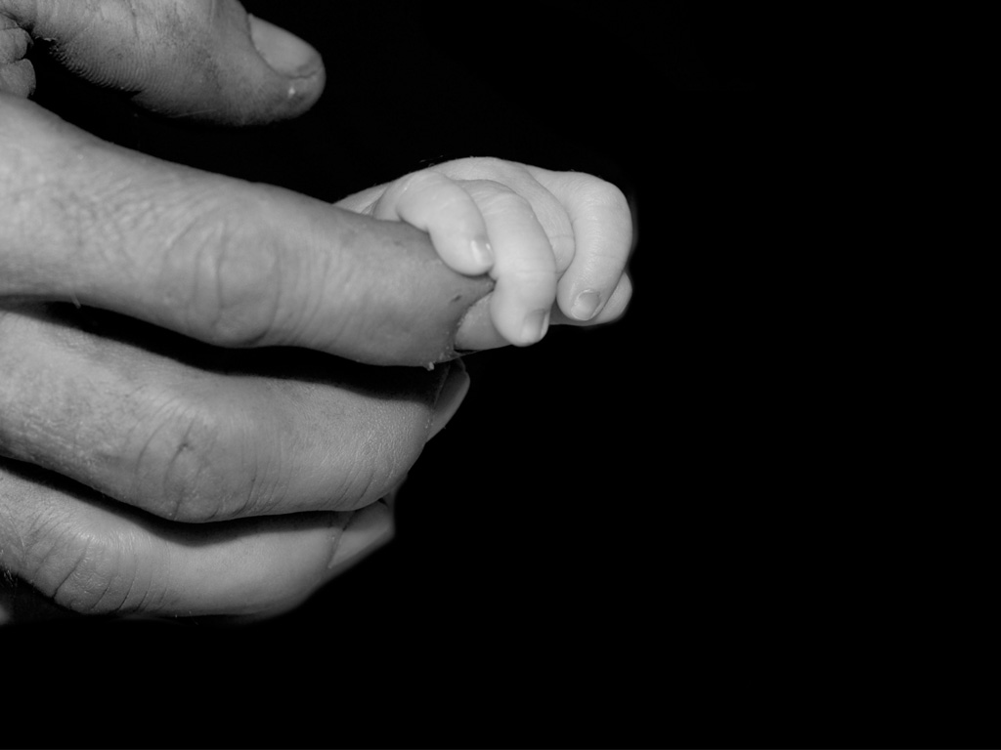
Firstly: Our Good Father in Heaven

Slide 4
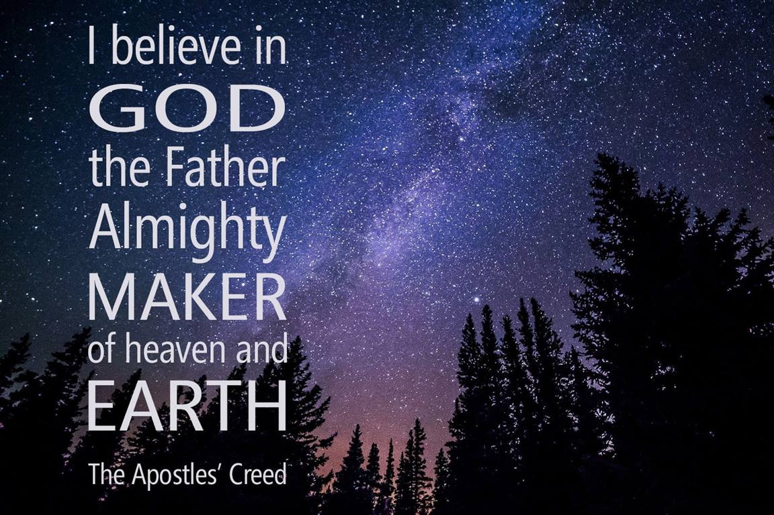

Slide 5
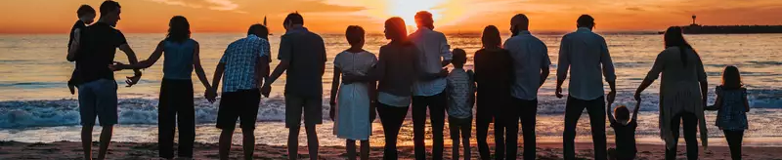
Even before he made the world, God loved us and chose us in Christ to be holy and without fault in his eyes. ⁵ God decided in advance to adopt us into his own family by bringing us to himself through Jesus Christ. This is what he wanted to do, and it gave him great pleasure.
Ephesians 1:4-5 NLT
The Church the Family of God.

Slide 6

But to as many as did receive and welcome Him, He gave the right [the authority, the privilege] to become children of God, that is, to those who believe in (adhere to, trust in, and rely on) His name— who were born, not of blood [natural conception], nor of the will of the flesh [physical impulse], nor of the will of man [that of a natural father], but of God [that is, a divine and supernatural birth—they are born of God—spiritually transformed, renewed, sanctified].
John 1:12-13 Amp

Slide 7
Our Identity as sons and daughters of God is the anchor for our relationship with God our Loving Father in Heaven.

Slide 8
Kingdom Family on the Kingdom Business of our Father
“your kingdom come, your will be done, on earth as it is in heaven” v10
And He said to them, How is it that you had to look for Me? Did you not see and know that it is necessary [as a duty] for Me to be in My Father’s house and [occupied] about My Father’s business? Luke 2:49 AMPC

Slide 9
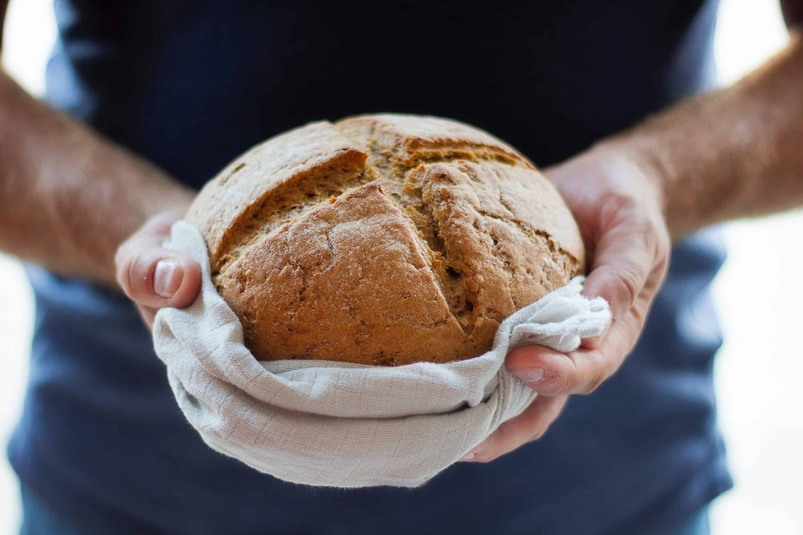
Secondly:
Give us today our daily bread

Slide 10
“Which of you, if your son asks for bread, will give him a stone? ¹⁰ Or if he asks for a fish, will give him a snake? ¹¹ If you, then, though you are evil, know how to give good gifts to your children, how much more will your Father in heaven give good gifts to those who ask him!
Matthew 7:9-11 niv

Slide 11
And my God will meet all your needs according to the riches of his glory in Christ Jesus.
Philippians 4:19

Slide 12

THIRDLY:
THE BREAD OF FORGIVENESS
Give us today our daily bread. ¹² And forgive us our debts, as we also have forgiven our debtors.
Matthew 6:11-12

Slide 13
Forgiveness is essential for healthy relationships in the Family of God.
Make allowance for each other’s faults, and forgive anyone who offends you. Remember, the Lord forgave you, so you must forgive others.
Colossians 3:13 NLT

Slide 14
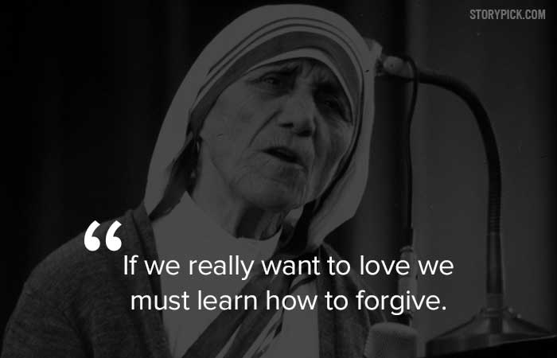

Slide 15
Jesus connects Bread and Forgiveness.
Give us this day our daily bread,¹² and forgive us our debts (sins), as we also have forgiven our debtors.
Matthew 6:11-12 esv
Jesus said to them, “I am the bread of life; John 6:35a esv

Slide 16
Hebrew is alphabetic numeral system, that means that every letter has a numerical value.
Jesus was born in Bethlehem, in Hebrew “Bet Leḥem” (“House of Bread”)
Bethlehem (Bet Leḥem) House of bread has a numerical value of 490
Nativity (moladati) associated with the numerical value 490
The Hebrew for “perfect, or complete, whole, sound, healthful” and “having integrity” is “Tamim” and equals to the numerical value 490

Slide 17
This is significant because:
Jesus born in Bethlehem “Bet Leḥem” (“House of Bread”) =490
Was the perfect “Tamim” sacrificed =490

Slide 18
Then Peter came up and said to Him, “Lord, how many times shall my brother sin against me and I still forgive him? Up to seven times?” ²² Jesus *said to him, “I do not say to you, up to seven times, but up to seventy-seven times. Matthew 18:21-22
Seven times? and Jesus say, 70 X 7 = 490. Why did He pick that number?
You can't be perfect or complete unless you extend the bread of forgiveness.

Slide 19
We finish well when we forgive
Stephen : “Lord, do not hold this sin against them.” When he had said this, he fell asleep. Acts 7:60 niv
Paul: “no one came to my support, but everyone deserted me. May it not be held against them.” 2 Timothy 4:16 niv
Jesus: “Father, forgive them, for they do not know what they are doing.” Luke 23:34 niv

Slide 20
LET US OFFER THE BREAD OF FORGIVENESS TO ONE ANOTHER

