Slide 1
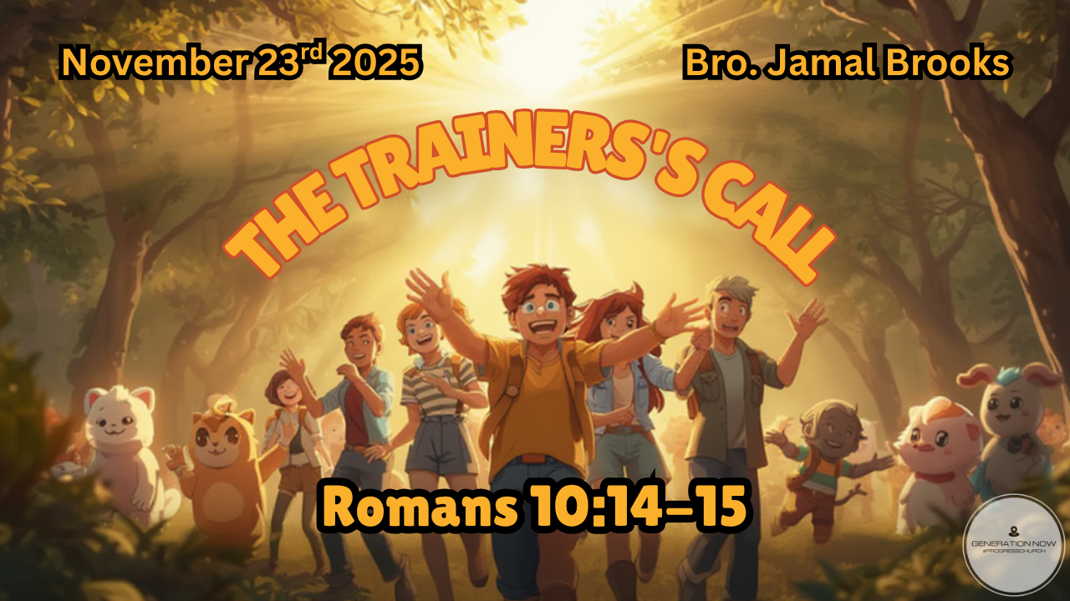

Slide 2
14 But how can they call to him for help if they have not believed? And how can they believe if they have not heard the message? And how can they hear if the message is not proclaimed? 15 And how can the message be proclaimed if the messengers are not sent out? As the scripture says, “How wonderful is the coming of messengers who bring good news!”
Romans 10:14-15 GNT

Slide 3


We are about to talk about Pokémon in Church
Why?

Slide 4

Guide and Provide

Slide 5
Poke-xplanation
  Wild before caught
  Once caught - cared for and trained
  Nourished until they level up

Slide 6
15 When they had finished eating, Jesus said to Simon Peter, “Simon son of John, do you love me more than these?” “Yes, Lord,” he said, “you know that I love you.”
Jesus said, “Feed my lambs.” 16 Again Jesus said, “Simon son of John, do you love me?” He answered, “Yes, Lord, you know that I love you.” Jesus said, “Take care of my sheep.”
John 21: 15-16 NIV

Slide 7
17 The third time he said to him, “Simon son of John, do you love me?” Peter was hurt because Jesus asked him the third time, “Do you love me?” He said, “Lord, you know all things; you know that I love you.” Jesus said, “Feed my sheep.
John 21:17 NIV

Slide 8
  Jesus’ intention was to restore Peter from the three times that he had denied Him
  He shows Peter His grace so that Peter can get back to his purpose
  This also outlines how we should work with others in love

Slide 9
From Lambs to Sheep - Spiritual Maturity
You don’t just walk with Jesus — you walk with others toward Him

Slide 10
  How do we feed others:
    Give them the word
    Give them a good example
    Pray with them
    Walk with them through doubt and growth
    Encourage them when they’re weak
    Equip them to help someone else

Slide 11
2 Be shepherds of God’s flock that is under your care, watching over them—not because you must, but because you are willing, as God wants you to be; not pursuing dishonest gain, but eager to serve; 3 not lording it over those entrusted to you, but being examples to the flock.
1 Peter 5:2-3 NIV

Slide 12

Walk the Talk

Slide 13
Poke-xplanation
  Build relationship/trust
  Live together
  Travel together
  Battle together

Slide 14
They spent their time in learning from the apostles, taking part in the fellowship, and sharing in the fellowship meals and the prayers. 43 Many miracles and wonders were being done through the apostles, and everyone was filled with awe. 44 All the believers continued together in close fellowship and shared their belongings with one another.
Acts 2:42-44 GNT

Slide 15
45 They would sell their property and possessions, and distribute the money among all, according to what each one needed. 46 Day after day they met as a group in the Temple, and they had their meals together in their homes, eating with glad and humble hearts, 47 praising God, and enjoying the good will of all the people. And every day the Lord added to their group those who were being saved.
Acts 2:45-47 GNT

Slide 16
  They learned about God more together
  They shared life together
  They shared meals together
  They seeked God together

Slide 17
  Community: They lived life together — not just on Sundays but every day
  Generosity: Their faith showed up in how they cared for one another
  Worship: Their hearts stayed focused on God through prayer, praise, and gratitude
  Growth: Their unity and love made the Gospel attractive — people wanted to be part of it

Slide 18
Making an INVESTMENT

Slide 19
People learn from one another, just as iron sharpens iron.
Proverbs 27:17 GNT

Slide 20

Grow and Go

Slide 21
Take the teachings that you heard me proclaim in the presence of many witnesses, and entrust them to reliable people, who will be able to teach others also. 3 Take your part in suffering, as a loyal soldier of Christ Jesus. 4 A soldier on active duty wants to please his commanding officer and so does not get mixed up in the affairs of civilian life.
2 Timothy 2: 2-4 GNT

Slide 22
5 An athlete who runs in a race cannot win the prize unless he obeys the rules. 6 The farmer who has done the hard work should have the first share of the harvest. 7 Think about what I am saying, because the Lord will enable you to understand it all.
2 Timothy 2: 5-7 GNT

Slide 23
  The last part is sending them out
  Taking the investment and adding value
  Sending them out with a purpose - multiplying/reproducing

Slide 24
A Soldier — stays focused and doesn’t get tangled up in distractions. He lives with purpose and loyalty to his commander — just like we should stay focused on Jesus.
An Athlete — trains hard and competes by the rules to win the prize. Following Jesus takes discipline and consistency — it’s not about shortcuts but about staying faithful.

Slide 25
A Farmer — works hard, plants faithfully, and patiently waits for the harvest. Ministry and disciple-making take effort and time — but the reward comes when people’s lives bear fruit.

Slide 26
Follow my example, as I follow the example of Christ.
1 Corinthians 11:1 NIV

Slide 27

Two Keys Going Forward

Slide 28
6P’s of Disciple Making

Slide 29
Patience
Prayer
Persistence

Slide 30
POUR
What Jesus pours into you is meant to flow through you.

Slide 31
PRAISE
Like the early church, live your faith out loud

Slide 32
PASS
Like Paul told Timothy, pass it on. Encourage, mentor, and invest in others.

Slide 33

Stay PLUGGED in

Slide 34
“I am the vine. You are the branches. Those who live in me while I live in them will produce a lot of fruit. But you can’t produce anything without me.
John 15:5 GWT

Slide 35
Everything starts with following Him.
Like the disciples, growth doesn’t come from knowing all the answers, it comes from staying connected to the SOURCE.

Slide 36
Spend time in His presence.
Learn His voice.
Let Him shape your character while you chase your calling.

Slide 37
But continue to grow in the grace and knowledge of our Lord and Savior Jesus Christ. To him be the glory, now and forever! Amen.
2 Peter 3:18 GNT

Slide 38
Instead, as we lovingly speak the truth, we will grow up completely in our relationship to Christ, who is the head.
Ephesians 4:15 GWT

Slide 39
And so I am sure that God, who began this good work in you, will carry it on until it is finished on the Day of Christ Jesus.
Philippians 1:6 GNT

