Slide 1
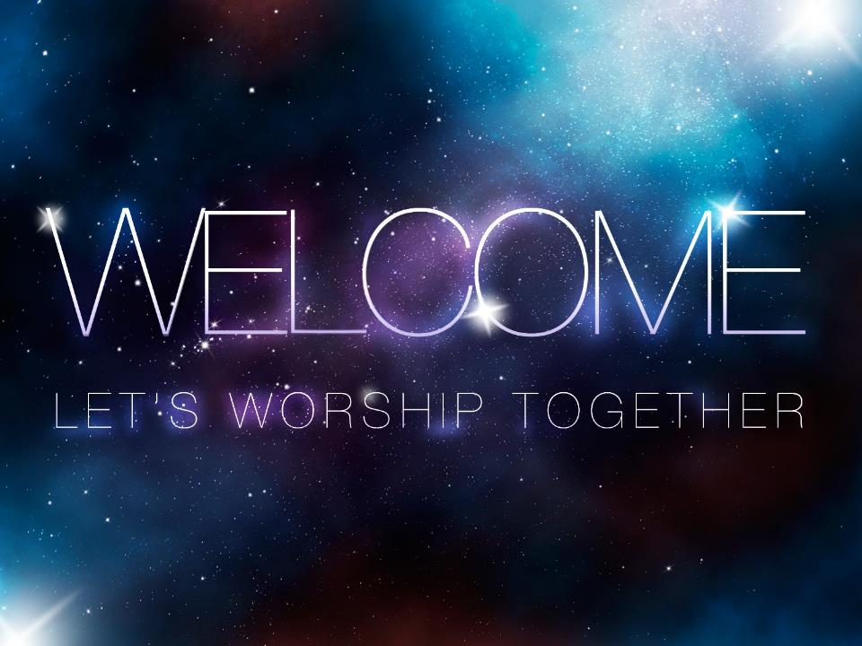

Slide 2
Isaiah 40

Slide 3
¹⁰ See, the Sovereign Lord comes
with power,
and he rules with a mighty arm.
See, his reward is with him,
and his recompense accompanies him.
¹¹ He tends his flock like a shepherd:
He gathers the lambs in his arms
and carries them close to his heart;
he gently leads those that have young.
Isaiah 40: 10-14, 18, 25 NIV

Slide 4
¹² Who has measured the waters in the
hollow of his hand,
or with the breadth of his hand marked
off the heavens?
Who has held the dust of the earth in a basket,
or weighed the mountains on the scales
and the hills in a balance?
¹³ Who can fathom the Spirit of the Lord,
or instruct the Lord as his counselor?
Isaiah 40: 10-14, 18, 25 NIV

Slide 5
¹⁴ Whom did the Lord consult to
enlighten him,
and who taught him the right way?
Who was it that taught him knowledge,
or showed him the path of understanding?
Isaiah 40: 10-14, 18, 25 NIV

Slide 6
¹⁸ With whom, then, will you
compare God?
To what image will you liken him?
Isaiah 40: 10-14, 18, 25 NIV

Slide 7
²⁵ “To whom will you compare me?
Or who is my equal?”
says the Holy One.
Isaiah 40: 10-14, 18, 25 NIV

Slide 8
I AM
Holy

Slide 9
“There is no one holy like the Lord;
there is no one besides you;
there is no Rock like our God.
1 Samuel 2:2 NIV

Slide 10
³⁴ I will not violate my covenant
or alter what my lips have uttered.
³⁵ Once for all, I have sworn by
my holiness—
and I will not lie to David—
³⁶ that his line will continue forever
and his throne endure before me
like the sun;
Psalm 89: 34-36 NIV

Slide 11
Holiness is
to Live Set Apart

Slide 12
²⁶ You are to be holy to me because
I, the Lord, am holy,
and I have set you apart
from the nations to be my own.
Leviticus 20:26 NIV

Slide 13
³⁶ what about the one whom the Father
set apart as his very own and sent into the world?
Why then do you accuse me of blasphemy because I said, ‘I am God’s Son’?
John 10: 36 NIV

Slide 14
Jesus is
the Holy One
Who Makes
Us Holy

Slide 15
³⁵ The angel answered, “The Holy Spirit will come on you, and the power of the Most High will overshadow you.
So the holy one to be born
will be called the Son of God.
Luke 1:35 NIV

Slide 16
²⁸ God chose the lowly things of this world and the despised things—and the things that are not—to nullify the things that are, ²⁹ so that no one may boast before him.
³⁰ It is because of him that you are in Christ Jesus, who has become for us wisdom from God—
that is, our righteousness, holiness
and redemption.
1 Corinthians 1: 28-30 NIV

Slide 17
⁸ First he said, “Sacrifices and offerings, burnt offerings and sin offerings you did not desire, nor were you pleased with them”—though they were offered in accordance with the law. ⁹ Then he said, “Here I am, I have come to do your will.”
He sets aside the first to establish the second. ¹⁰ And by that will,
we have been made holy through the sacrifice of the body of Jesus Christ
once for all.
Hebrews 10: 8-10 NIV

Slide 18
Our Response:
Receive and Revere

Slide 19
¹⁵ But just as he who called you is holy, so be holy in all you do; ¹⁶ for it is written:
“Be holy, because I am holy.”
1 Peter 1: 15-16 NIV

Slide 20
¹⁶ Do you not know that you are a temple of God and that the Spirit of God dwells in you? ¹⁷ If anyone destroys the temple of God, God will destroy that person;
for the temple of God is holy,
and that is what you are.
1 Corinthians 3: 16-17 NASB

Slide 21
²² You were taught, with regard to your former way of life, to put off your old self, which is being corrupted by its
deceitful desires;
²³ to be made new in the attitude of
your minds;
²⁴ and to put on the new self, created to be like God in true righteousness and holiness.
Ephesians 4: 22-24 NIV

Slide 22
⁸ Each of the four living creatures had six wings and was covered with eyes all around, even under its wings.
Day and night they never stop saying:
“‘Holy, holy, holy
is the Lord God Almighty,’
who was, and is, and is to come.”
Revelation 4:8 NIV

Slide 23
Conclusion:
God is holy, set apart from all creation. Yet through His Son Jesus, He invites us to live in His holiness, also set apart, so all the world might see the riches of His grace and the depths of His love through us.
Holiness is an automatic manifestation when abiding in Christ, who is the Holy One.

Slide 24


Slide 25


