Slide 1
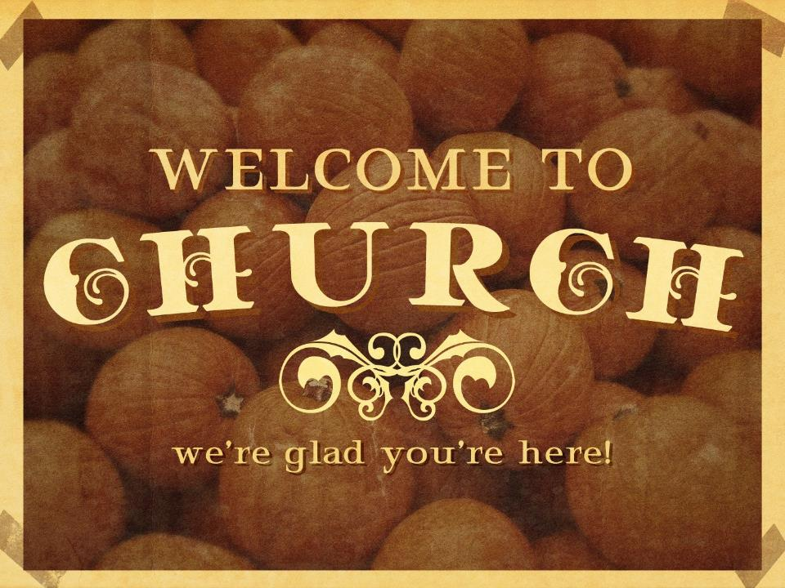

Slide 2
Prayer

Slide 3
Then Jesus told his disciples a parable to show them that they should always pray and not give up.
² He said: “In a certain town there was a judge who neither feared God nor cared what people thought. ³ And there was a widow in that town who kept coming to him with the plea, ‘Grant me justice against my adversary.’
Luke 18: 1-8 NIV

Slide 4
⁴ “For some time he refused. But finally he said to himself, ‘Even though I don’t fear God or care what people think, ⁵ yet because this widow keeps bothering me, I will see that she gets justice, so that she won’t eventually come and attack me!’”
Luke 18: 1-8 NIV

Slide 5
⁶ And the Lord said, “Listen to what the unjust judge says. ⁷ And will not God bring about justice for his chosen ones, who cry out to him day and night?
Will he keep putting them off?
Luke 18: 1-8 NIV

Slide 6
^{8 “}I tell you, he will see that they get justice, and quickly. However, when the Son of Man comes,
will he find faith on the earth?”
Luke 18: 1-8 NIV

Slide 7
Persistent & Righteous Prayers
Move God

Slide 8
¹⁶ ¹⁸ Pray in the Spirit at all times and on every occasion. Stay alert and
be persistent in your prayers
for all believers
everywhere.
Ephesians 6:18 NLT

Slide 9
¹⁶ ⁶ But in my distress I cried out to the Lord;
yes, I prayed to my God for help.
He heard me from his sanctuary;
my cry to him reached his ears.
Psalm 18:6 NLT

Slide 10
¹⁸ Give ear, our God, and hear; open your eyes and see the desolation of the city that bears your Name.
We do not make requests of you because we are righteous, but
because of your great mercy.
Daniel 9:18 NIV

Slide 11
God is
Righteous, Just, Love,
and
Sovereign

Slide 12
¹⁴ Righteousness and justice are the foundation of your throne;
love and faithfulness go before you.
Psalm 89:14 NIV

Slide 13
¹⁴ Yet Jerusalem says, “The Lord has deserted us;
the Lord has forgotten us.”
¹⁵ “Never! Can a mother forget her nursing child?
Can she feel no love for the child she has borne?
But even if that were possible,
I would not forget you!
¹⁶ See, I have written your name on the palms of my hands.
Always in my mind is a picture of Jerusalem’s walls in ruins.”
Isaiah 49: 14-16 NLT

Slide 14
⁶ Humble yourselves, therefore, under God’s mighty hand, that he may lift you up in due time. ⁷ Cast all your anxiety on him
because he cares for you.
1 Peter 5: 6-7 NIV

Slide 15
God Works All Things
for Good

Slide 16
⁷ Jesus replied, “You don’t understand now what I am doing, but someday you will.”
John 13:7 NLT

Slide 17
^{7 “}The Lord will fight for you;
you need only to be still.”
Exodus 14:14 NIV

Slide 18
²⁸ And we know that
in all things God works for the good of those who love him,
who have been called according to his purpose.
Romans 8:28 NIV

Slide 19
¹⁶ Always be joyful.
¹⁷ Never stop praying. ¹⁸ Be thankful in all circumstances, for this is God’s will for you who belong to Christ Jesus.
1 Thessalonians 5: 16-18 NLT

Slide 20
Conclusion:
No matter the length of time, may we know our God hears, our God cares, and our God is sovereignly working on our behalf.
Let us persevere with faithful prayers and
let us not lose hope!
Rejoice in the Lord!

Slide 21


Slide 22


