Slide 1

Transforming Community Health Care
“We do not have to see eye to eye, in order to walk hand in hand”
David MacDonald, DO
Embrace Virginia
Notes:
The goal for today’s session is to provide insights regarding why health care costs are perceived as being “out of control.” Liberty Health Group is an information-based company. Our primary mission to develop access to affordable, high-quality health care portals, while rewarding innovation.

Slide 2
CEI Goals/Objectives
Exit Government Education – Healthcare
Transform Educational System (Romans 12:1,2) vs. Reformation
Education on Biblical Principles (Genesis 1:26; Proverbs 25:2)
Hebraic vs. Greek method of teaching (mentoring)
Help those with limited finances – Psalm 82:3,5

Slide 3
Leviticus 26 – blessings/curses
No other God before me!
? Nabu – Egyptian god of education
? Mammon – government accreditation needed?
Luke 2:49 – Wist (Eido) – Vertical awareness; Father’s business – Horizontal.
Non violent resistance effectiveness
5 will chase 100 (5%)
10 will chase 10,000 (1%)
Chenoweth – 3.5% (Harvard Researcher)

Slide 4
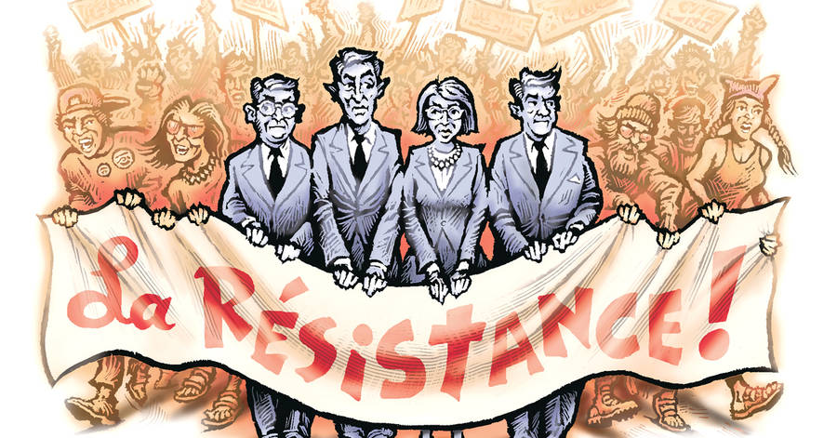
The Conservative ‘Resistance’ Is Futile
The right has never made one significant move against the liberal culture machine.
WSJ – David Galernter
July 5, 2017
By
David Gelernter
July 5, 2017 7:18 pm ET

Slide 5


David and Saul’s Armor
I Samuel 17:32-40
Prov. 3:5,6 – trust, lean, acknowledge in all ways.
Prov. 14:12 - death

Slide 6
Overview- Health Care
Health Care Dollars > 20% of economy
Responsible community economic stability
A healthy middle class (economically) promotes a vibrant economy
Leverage point for socialism/control
Insurance Premiums are not the same as Medical Costs
Transparency & Free Market Forces- control costs & increase access to care
Community Transformation – Your role…?
Notes:
Health care dollars are a powerful force in any economy. Because health care dollars are a major percentage of any economy, those in control of these dollars can influence a community.

Slide 7
The Government’s role?
Do you have prior/proven experience?
Don’t just do something, stand still and prioritize the problem(s) at hand
Address the most pressing challenge first
Build the foundation for long-term “success” - affordable health care portals with ongoing innovation.
Consider the advances in technology – better products that are less expensive/time.
Notes:
During a time of crises…whether real, or apparent, many believe that the government should resolve societal challenges. We are hearing the mantra…”We cannot afford to do nothing,” regarding health care. My concern is that the “something” that may be done could have devastating effects on the stability of our economy for decades. On the other hand, there are immediate needs in segments of society that need to be addressed.
An employer hiring someone to do a job would ask basic questions…”Do you have prior experience running health care?” The failed examples in Massachusetts, Maine, and Tennessee should be enough to conclude the answer is “No.”
So, what should the government do…if anything? There are Biblical models for addressing community needs –
Psalm 82 -How long will you watch the injustices continue?
Proverbs 29:2 – When the righteous are in authority the people rejoice.
Proverbs 11:1 – a false scan is an abomination to God.
So, what are the problems the government should address?
1. The false scales in health care
2. The injustices in health care
How does a community develop affordable health care portals? We will talk about options at the end of this presentation.

Slide 8

What is the problem?
Emergency Room Visits?
Insurance Premiums?
Administration Fees?
Technology & Pharmacy?
Physicians’
Fees?
Notes:
There are many causes for the increase in health care costs.
Someone once asked, “How do you eat an elephant?” The answer is, “One bite at a time.”
If we look at the suspects regarding health care costs, one of the main reason for distorted health care costs is that the health care products and services are not transparent, and not exposed to free market forces.
We welcome the opportunity to help you eat an elephant! There are solutions available that could be implemented immediately, and they do not require legislation to implement.
There are a couple of areas in which legislation is needed.

Slide 9
HealthINFLATION News – Health Care Inflation (2/28/09; Vol. 18, No. 2)
Annual Inflation Health Care Indexes | February 2008 | January 2009 | Net Increase in inflation
Non-prescription drugs | 1.0 | 2.3 | 1.3
Physician Care | 2.1 | 2.8 | 0.7
Misc. Professional Care | 3.6 | 3.8 | 0.2
Medical Equipment & Supplies | 1.5 | 1.4 | -0.1
Eye Care | 1.6 | 0.7 | -0.9
Nursing Home Care | 4.7 | 3.7 | - 1.0
Health Care | 4.5 | 2.6 | - 1.9
Prescription Drugs | 3.5 | 1.4 | - 2.1
Dental Care | 5.9 | 3.6 | - 2.3
Inpatient Hospital Care | 8.1 | 5.3 | - 2.8
Outpatient Hospital Care | 9.8 | 6.6 | - 3.2
Notes:
Most of us have been led to believe the reason for increasing insurance premiums is “because everything is so much more expensive.” This is not true!
Look at the various aspects of health care and you will see the actual inflation is actually flat/negative comparing February 2008 to January 2009.
It is time to stop listening to distortions of reality.

Slide 10
Health Care Theories
Gov’t Health Care:
Insurance for everything
System defines needs
Innovation is bad
Cost control from without
Increased taxpayer liability
Individual Directed Care:
Insurance – major needs only
Individual defines needs
Innovation is good
Costs controlled from within
Decreased taxpayer liability
Medicare
Medicaid
Managed Care
U.S.
Health Care
System
Consumer
Directed
Health Care
Today
National Health Care
Free Market
Notes:
There basically two theories of health care in any community…one that is controlled from without (government) and the other is controlled from within (Free Market). There are inherent forces in each approach that determines failure or success.
In order for government health care success, there must be “imposed” rationing. If insurance is going to be used for everything, then costs will continue to be inflated.
There are few waving the banner of free market. It takes too much energy for some to consider a shift away from socialized medicine. The lure of a single payer system is that the administrative burden will be lessened.
We should learn from countries (Sweden, Germany, United Kingdom, Canada) that are moving away from a single payer system. Despite exorbitant taxes, they are unable to sustain the costs for their health care system.
Canada – Insurance options allowed (June 2005)
U.K. – “The end of British NHS” – Patricia Hewett, Health Secretary (The Lancet 2005; 366:1239)
Consumer Directed Health Care (CDHC) – allows the individual to define their health care needs. Instead of “mandating” what insurance should cover; the individual determines what is important (maternity, etc) and then insurance is purchased to cover their needs.
When free market forces are allowed to operate – costs are controlled, quality will increase, and access to care will increase.

Slide 11
Insurance Premiums exposed to Free Market Forces
Premiums Parallel
Medical Inflation
Source: Kaiser/HRET Survey of Employer-Sponsored Health Benefits, 1999-2001;
KPMG Survey of Employer-Sponsored Health Benefits, 1988, 1993, 1996.
Notes:
The black line is health insurance inflation. The blue line represents medical inflation. As you can see, medical inflation has been stable for the past several years. The disparity between premium inflation and medical inflation is because the employee is not acting like a consumer.
The CDHC model has successfully controlled administrative costs, diagnostic tests, premium costs that are not consistent with medical inflation, and enhanced employee retirement options.
Unless you change, what does the future look like?

Slide 12
Political Civil War- “D” vs. “R”
“Invasion from the North” – The government should fix health care
Government run health care is needed to answer our uninsured needs (will the poor always exist?)
“States Rights” – leave individuals alone and let them solve their problems
47% of bankruptcies due to medical bills (73% have insurance)
Notes:
Unfortunately, the politics regarding health care polarize discussions politically to a non-productive endpoint. Like the Civil war…there are two basic camps fighting with zeal for different things.
In general…the Democratic party portrays the “fight for the uninsured” and leans towards socialistic solutions to resolve the problem. The Republicans resist socialism but do not have solutions for the uninsured.
In my opinion, they are both right and both wrong…
- The uninsured need help…but mandated insurance is not the option. Legislation is needed for transparency regarding prices and health care exposed to free market forces.
- 80% of those with insurance are not dissatisfied
- Failed attempts at “mandated” insurance (Tennessee, Mass, and Maine) should be enough to show that the government should not run health care.

Slide 13

Where are the Gideons?
3,100 year-old inscription bearing the name Jerubbaal, a name of Gideon, a Biblical Judge

Slide 14
Leviticus 26 – blessings/curses
No other God before me!
? Nabu – Egyptian god of education
? Mammon – government accreditation needed?
Luke 2:49 – Wist (Eido) – Vertical awareness; Father’s business – Horizontal.
Non violent resistance effectiveness
5 will chase 100 (5%)
10 will chase 10,000 (1%)
Chenoweth – 3.5% (Harvard Researcher)

Slide 15
Questions?
“We do not have to see eye to eye, in order to walk hand in hand”
David MacDonald, DO
Embrace Virginia
Notes:
The goal for today’s session is to provide insights regarding why health care costs are perceived as being “out of control.” Liberty Health Group is an information-based company. Our primary mission to develop access to affordable, high-quality health care portals, while rewarding innovation.

Slide 17
Health Care - Reformation vs. Transformation
Re-arranging the deck chairs on the Titanic.
CPR on managed care principles that have failed.
Increasing co-pay; switching insurance carriers; formularies; more gov’t oversight
Employers are less involved in health care decisions!
Employee has control regarding their benefit dollars.
Unspent money may accumulate for retirement.
Notes:
Reformation means you simply re-arrange things on the table. Health Care reformation is like re-arranging the chairs on the Titanic. Or, performing CPR on managed care principles that have not been successful.
The usual attempts (increasing the co-pay; switching insurance carriers; implementing flawed pre-tax accounts [cafeteria plan, FSA]; have only resulted in frustration and confusion)
Transformation is needed. What does this involve? Engaging the employee so they have control regarding their benefit dollars. The latest buzz words to describe this is the Consumer Directed Health Care model.
Employers may give employees control of a portion of their benefit dollars without fear that the employee will abuse/lose this money. This is because there are checks and balances in place to prevent abuse.
The retirement benefits are dramatically improved by giving employees control of a portion of their benefit dollars.

Slide 18



Consumer Directed Health Care
Insurance: Group or Individual
#1
Personal Medical Account
Employer
Benefit Dollars
Patient Choice
Long Term Care
#2
Medical Account
HealthCare
Employee
Notes:
The Consumer Directed Health Care Model shifts the direction of the Benefit Dollars. The employer takes money current being spent and directs it through the employee. The employer/employee can make the decision regarding the insurance option that best meets their needs.
This is a win-win solution.
Employer wins – they give employees decision making authority with money currently being spent. They can “vest” good employees with this method.
Employee wins – healthy lifestyles are rewarded. They are more likely to pursue options for elimination of the need for medication vs. trying to find a way to “pay for medications.” Money not spent can accumulate for unpredictable medical needs (remember that $11,000 is the average out of pocket expenses for those in medical bankruptcy)
Physician/Health Care provider win – They can “charge less and make more” because they eliminate billing overhead
Society wins –innovation is rewarded, costs are controlled, and the fear of not having access to affordable health care is minimized. This will eventually decrease the taxpayer burden needed to fund Medicaid/ Medicare.

Slide 19
Insurance Premiums vs. Medical Inflation
Source: Kaiser/HRET Survey of Employer-Sponsored Health Benefits, 1999-2001;
KPMG Survey of Employer-Sponsored Health Benefits, 1988, 1993, 1996.
Notes:
The black line is health insurance inflation. The blue line represents medical inflation. As you can see, medical inflation has been stable for the past several years. The disparity between premium inflation and medical inflation is because the employee is not acting like a consumer. This is why the greatest increase in the number of visits to the ER are patients with insurance. Most likely, this is because the patient is not acting like a consumer and does not appreciate the increased costs associated with an ER visit compared to a clinic visit.
The Consumer Directed Model resolves the tension regarding ER visits vs. Clinic visits by allowing the individual to determine the most appropriate place to receive their health care. Some may prefer the more expensive ER visit while others opt for the clinic visit. The employer is removed from potential liability associated with barriers to health care by imposed penalties for ER visits.

Slide 20
Free Market Forces & Health Care
“Normal” Market
“Medical” Market
Consumers spend their own money
Search for ways to reduce costs
Diverse products
Innovation and technology are good
Advertise price savings
Consumers spend others’ money
Search for convenient access to care (ER)
Co-pay costs are the focal point
Innovation is the enemy
Prices unknown
Notes:
Whenever the consumer spends their own money, they spend it differently.
They will look for the most efficient way to spend their money, they look for ways to save money. For example: If you give a per diem rate for business trips and let them keep unspent money, employees often decide to stay in a less expensive hotel and eat less expensive food. Conversely, when they are given a per diem rate and not able to keep unspent money, they will live up to their maximum.
Innovation and technology bring down the costs while improving quality in most normal markets. Consider computers – without mandates, we get less expensive computers with markedly improved quality and advanced technology.
When health care products and services are sheltered from normal market forces, “apparent health care costs” will escalate beyond true medical inflation. Instead of innovation bringing down costs, innovation is used as the cause for increased costs. All new, innovative products will be more expensive when they are first introduced to the market. However, with time, innovative technology/products/services should become less expensive.
Let’s look at the disparity between medical inflation and premium inflation; then, some examples of cost control when the consumer is in control of the health care dollar… next slide

Slide 21
Health Care Expenses
4 Scenarios (3 months) | January Office visit | February Lab ($350) | March Procedure - CT Scan | Ins. Premiums Co-pays ____ Total Costs Medical Savings
Company A –$1,000/month Zero deductible $10 Co-pay | $10 All $ spent monthly | $10 | CT scan = $2,500 Co-pay = 20% of $2,500 = $500 | Insurance $3,000 Co-pay/CT $520 Total = $3,520 Savings -$ 520
Company B -$500/month $2,500 deductible $10 Co-pay Medical Savings | $10 $500/Med. Savings | $10 $500/Med. Savings | CT Co-pay= $500 (20% of $2,500) $500/Med. Savings | Insurance $1,500 Co-pay/CT $520 Total = $2,020 Savings $ 980
Company C – No insurance; Not educated re: costs | $120 $1,000 (Ins $ not spent) | $350 $1,000 | CT Scan Retail Price = $2,500 $1,000 | Insurance zero CT scan $2,500 Office/lab $ 470 Total = $2,970 Savings $ 30
Company D – No insurance; Educated re: costs/access | $75 $1,000 (Ins $ not spent) | $100 $1,000 | Wholesale price = $250-300 $1,000 | Insurance zero CT scan $250 Total = $425 Savings $2,575
Notes:
Here are four examples to show how the health care dollars flow:
Company A & B are comparisons between a plan with no deductible and a higher deductible. They both spend $1,000/month for benefits. In the worst case scenario, they both spend all of their money and have nothing left over.
The best case scenario, there is unspent money available at the end of 20 years ($500/month X 12 years = $6,000 X 20 years = $120,000)
Company C& D are two companies without insurance. Company C does not have knowledge or access to health care portals. Company D is educated and has access to health care portals.

Slide 22
Consumer Directed
Health Care
Determine prices for payment at time of service
Consider this model for your “benefits.”
Divide this money as follows:
High-deductible policy
Pre-tax savings option (HRA/HSA/FSA/VEBA)
Educate/Empower employees
Focus on prevention and effective disease management.
This will help those without insurance
Notes:
Employers vary regarding what they want to provide for their employees. Some employers are more interested in a “disease management” process for the major medical illnesses (Hypertension, Diabetes, High Cholesterol, and Digestive diseases). For this group of employers, the disease management programs can be included in the options (described in their summary plan description)
Other companies would prefer to let the employee make the decisions regarding their health care dollars. There is so much information available on the internet and to physicians’ offices regarding disease management. Implementation of healthy lifestyle changes and dietary changes can alter the course of many diseases.
When the employee has the incentives to keep a portion of the unspent health care dollars, they are more likely to alter destructive behaviors.

Slide 23
Health Care Transformation – Marketplace Leaders
Pastors – Town Hall Meeting to Educate & Empower parishioners
Walk the talk – Romans 12:1,2
Attending church is a risk factor for obesity
Business owners – Health Savings Acccount
Uninsured needs (Psalm 82)
Develop affordable health care portals
Hospital CEOs – evaluate billing practices
Politicians – change unfair billing practices
Membership to information portal (www.Liberty HealthGroup.com)
Notes:
Reformation means you simply re-arrange things on the table. Health Care reformation is like re-arranging the chairs on the Titanic. Or, performing CPR on managed care principles that have not been successful.
The usual attempts (increasing the co-pay; switching insurance carriers; implementing flawed pre-tax accounts [cafeteria plan, FSA]; have only resulted in frustration and confusion)
Transformation is needed. What does this involve? Engaging the employee so they have control regarding their benefit dollars. The latest buzz words to describe this is the Consumer Directed Health Care model.
Employers may give employees control of a portion of their benefit dollars without fear that the employee will abuse/lose this money. This is because there are checks and balances in place to prevent abuse.
The retirement benefits are dramatically improved by giving employees control of a portion of their benefit dollars.

Slide 24
Conclusions…
Insurance Premium inflation is not the same as Medical Inflation
Transformation is needed …Transparency & Exposure to Free Market forces
Cost controlled
Increased access to affordable care
Innovation rewarded
What can you do…?
Host a Town Hall Meeting (Isaiah 1:16-20)
Employ Biblical guidance ( Prov. 11:1, Prov. 29:2, Psalm 82:4-6; I Tim 5:3)
Notes:
Reformation means you simply re-arrange things on the table. Health Care reformation is like re-arranging the chairs on the Titanic. Or, performing CPR on managed care principles that have not been successful.
The usual attempts (increasing the co-pay; switching insurance carriers; implementing flawed pre-tax accounts [cafeteria plan, FSA]; have only resulted in frustration and confusion)
Transformation is needed. What does this involve? Engaging the employee so they have control regarding their benefit dollars. The latest buzz words to describe this is the Consumer Directed Health Care model.
Employers may give employees control of a portion of their benefit dollars without fear that the employee will abuse/lose this money. This is because there are checks and balances in place to prevent abuse.
The retirement benefits are dramatically improved by giving employees control of a portion of their benefit dollars.
Marketplace leaders could/should be part of the solution…or else, they are part of the problem!

Slide 25
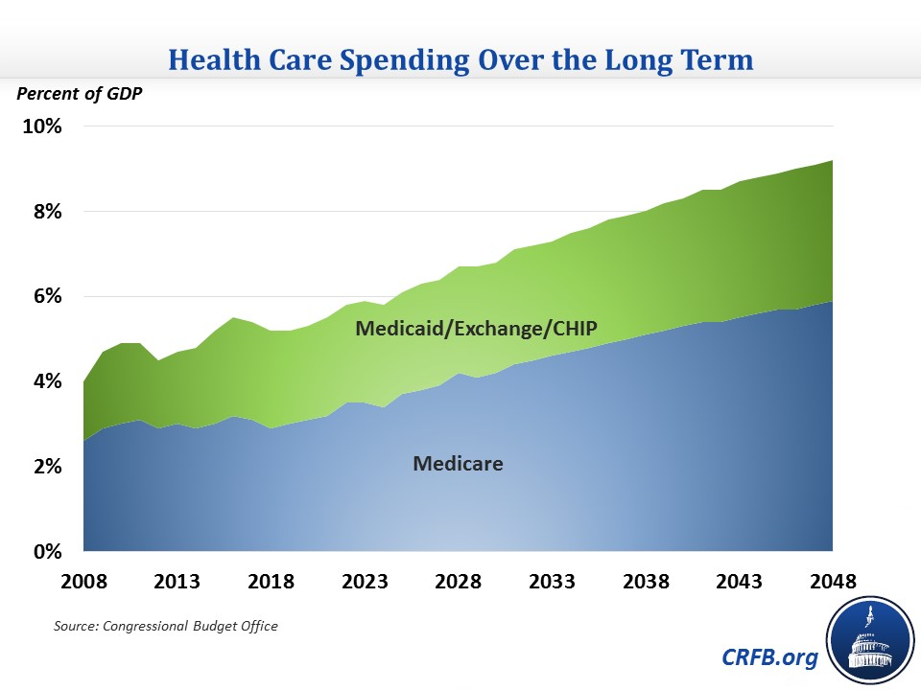

Slide 26
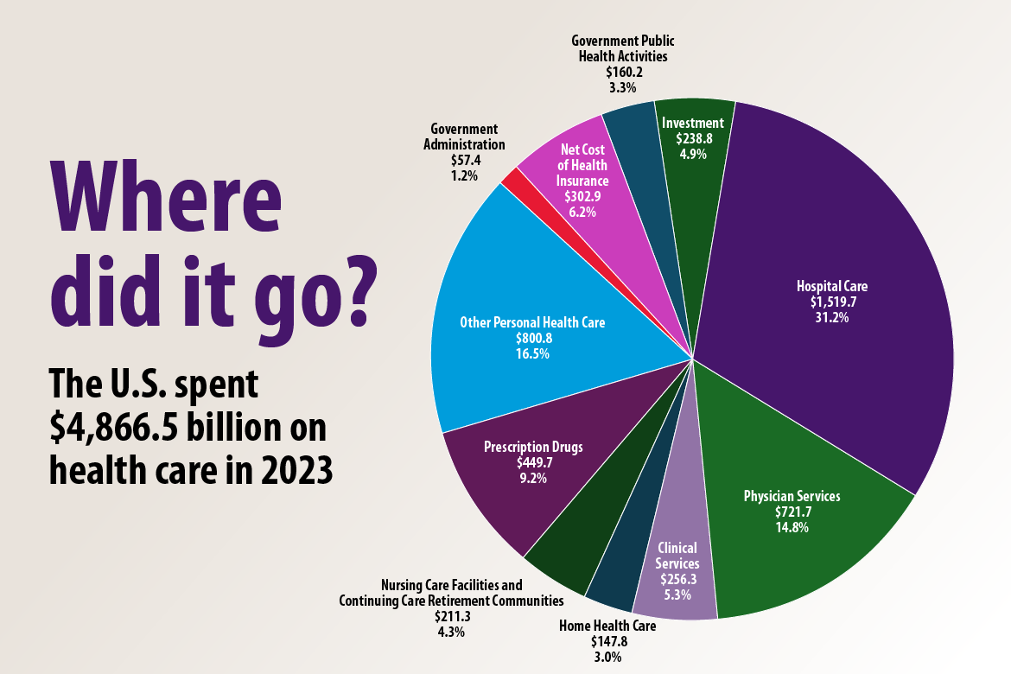

Slide 27


Do People Want Medical Savings Accounts? (Zogby Poll, 1006 likely voters)
80% Democrats
89% Republicans
77% Independents
91% 18-29 year olds
71% > 65 year olds
81% Hispanics
79.6% African/Americans
Notes:
This poll should erase concerns that this is a political agenda by one party or socioeconomic group. People want the option to have control of their health care dollars.

Slide 28
Administrative Costs
During 2000, an average 68% of the total revenue generated in a Washington state medical practice was consumed by non-medical expenses. Non-medical expenses are defined as those expenses not directly related to actual patient care, including overhead costs and personnel.
[Washington’s Ailing Health Care System: Continued Decline, Guarded Prognosis, Washington State Medical Association, 2002]
Notes:
For many reasons, physicians are less satisfied with health care as a profession.
When physicians move towards payment at time of service, expensive administrative costs are eliminated. This allows the physicians the option to spend more time with their patients. When physicians must “earn their business,” they are more likely to listen to patients’ requests.

Slide 29
Access To Care
Is mandating insurance the answer?
Depression – 15% with Insurance seek care
Birth Control – 5% with Insurance pursued birth control pills before an abortion
Prenatal care - <15% sought care, despite having insurance/coverage
Car Insurance – despite mandates, 15% do not have car insurance
Health Insurance is not a “good deal”
Notes:
Providing insurance does not mean we are providing health care. “Health insurance for all remains to be health care for some.”
The uninsured are not buying insurance because it is not a good deal. May of the 52 million uninsured are simply wise shoppers.
Medicare/Medicaid are facing major financial challenges. The administrative costs for Medicare are much greater than the 2% previously reported (Matthews, CAHI study).

Slide 30
Liberty Health Group Model
The Nuts and Bolts
High Deductible Group Insurance and HRA
High Deductible
Group Plan $1,500+
Employer - Less money for insurance; more money to employees. Inflation rate is applied only to the insurance portion!
Employer - Regular deposits into their Health Reimbursement Account (HRA).
Employees - Incentive to spend their health care dollars wisely. Inappropriate utilization declines.
Employees – Financial reserves for health care needs during a catastrophic event, retirement, or termination of employment.
Employee Responsibility
$1,000 – 1,500
(The Speed Bump)
Health Reimbursement Arrangement (HRA)
$0 – 1,000
Notes:
It is possible for the employer, employee, and health care provider to win with this scenario.
The employer can remove themselves from being intimately involved in health care decisions. Their liability for “arranging for health care services” is less likely with this arrangement. They can attract/retain high-caliber employees because they have a benefit package with real benefits. Control health care costs.
Regular deposits into the Health Reimbursement Arrangement (HRA) from which the employee can pay for routine, qualified medical expenses. The high-deductible policy is more affordable and helps to control escalating premium costs.
The employee can pay for routine medical expenses with “first dollar coverage.” Some employees are initially reluctant to engage in this scenario. There is an 80-90% satisfaction rate when patients are in control of their health care dollars. Unspent money can accumulate for qualified medical expenses at retirement/termination of employment
School teachers in Wisconsin could have more than $50,000 in their retirement package by implementing this model. The school district would win while the teachers win!

Slide 31
Case Study: Union Group
 | Fully Insured Trust | Self-Insured Model
Deductible | $50.00 | $1,000
Co-pay | $0.00 | Money from HRA
Maximum Out of Pocket | $475.00 | $1,500
Medical Retirement (HRA) | None | $2,400/year
Notes:
This was a very interesting group to present to. They were concerned about those on their plan with numerous medications. A common concern is for the sickest ones on the plan. Usually, they do not pay more than they are paying with their current plan. It is easy to forget that the majority of people are not ill.
Instead of spending all of your benefit dollars on everyone monthly, consider the CDHC model as way to reward those who do not abuse the system and take care of themselves.

Slide 32
Case Study: Union Group (continued)
NOTE:
Fixed Cost Savings of $850/employee/first year.
Projected $1,500/employee/year over-funding of self-insured plan!
We are confident that there are more adjustments for next year!
Notes:
While the savings noted are dramatic, we are confident that we will be able to save more in the future.

Slide 33
Case Study: Financial Services
 | Fully Insured Trust | Self-Insured Model
Deductible | $200.00 | $1,000.00
Co-pay | $15.00 | $15.00
Maximum Out of Pocket | $1,000.00 | $1,000.00
Medical Retirement (HRA) | None | $1,200/year
Notes:
This was a very interesting group to present to. They were concerned about those on their plan with numerous medications. A common concern is for the sickest ones on the plan. Usually, they do not pay more than they are paying with their current plan. It is easy to forget that the majority of people are not ill.
Instead of spending all of your benefit dollars on everyone monthly, consider the CDHC model as way to reward those who do not abuse the system and take care of themselves.

Slide 34
Case Study: Financial Services (continued)
NOTE:
Fixed Cost Savings of $1,460/employee/first year! (Admin., Pharmacy, Stop-loss insurance costs)
We analyze the plans yearly. We are confident that we will be able to find more savings to pass on to this company.

