Slide 1
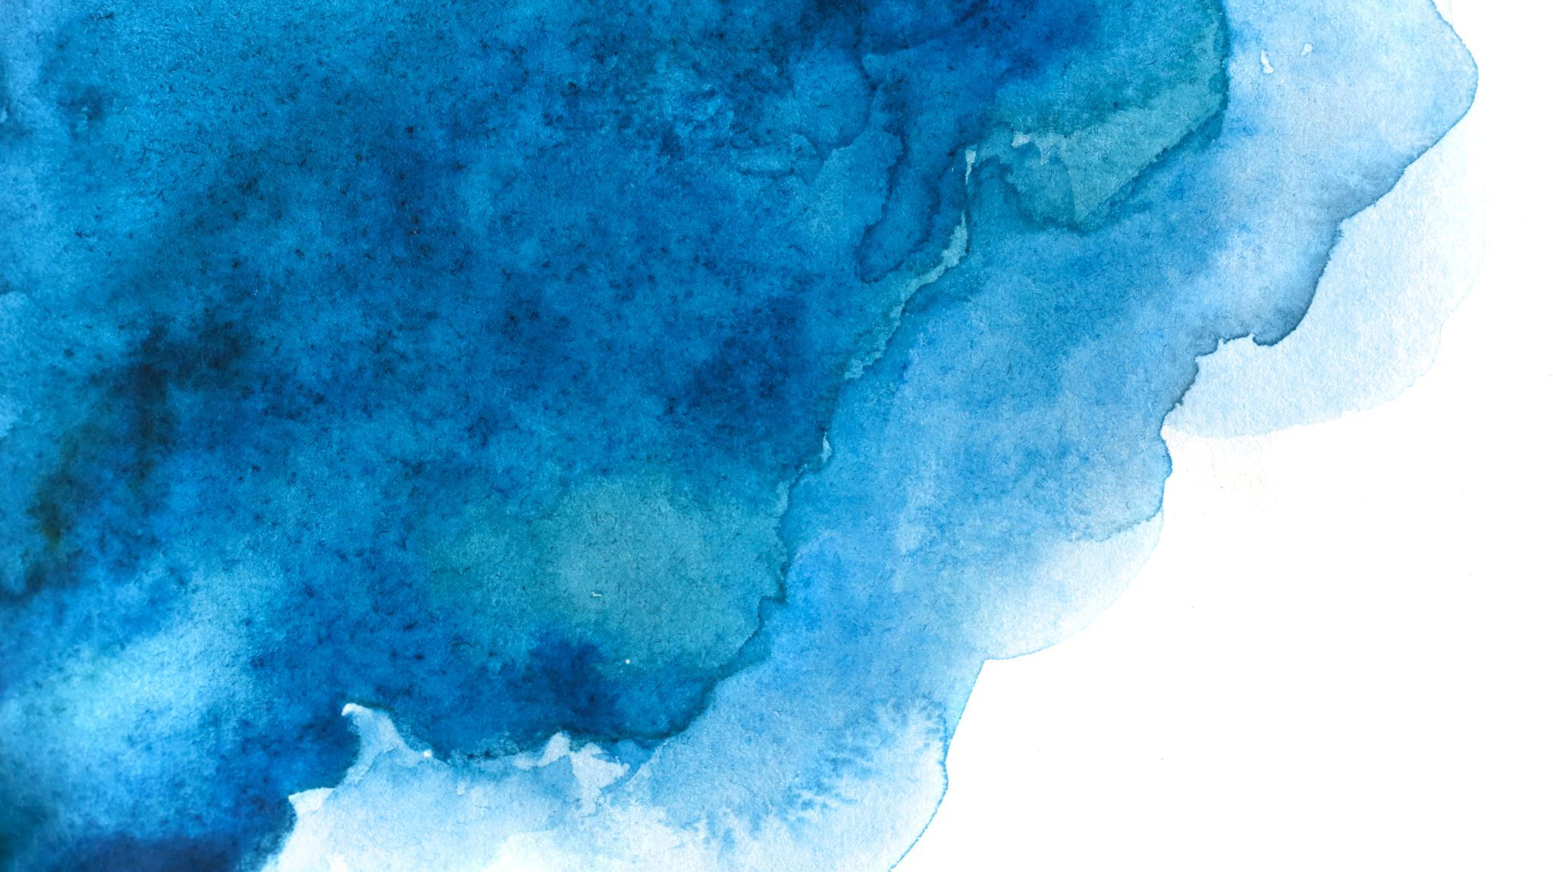
Colossians 2:6-23
Human tradition Vs Freedom in Christ

Slide 2
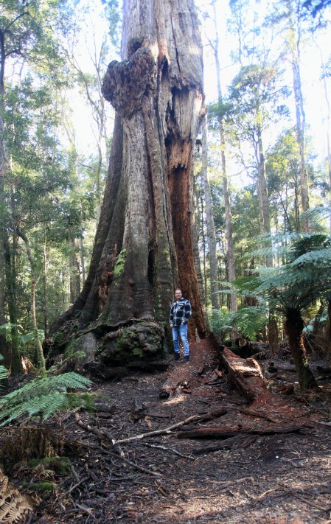

Slide 3
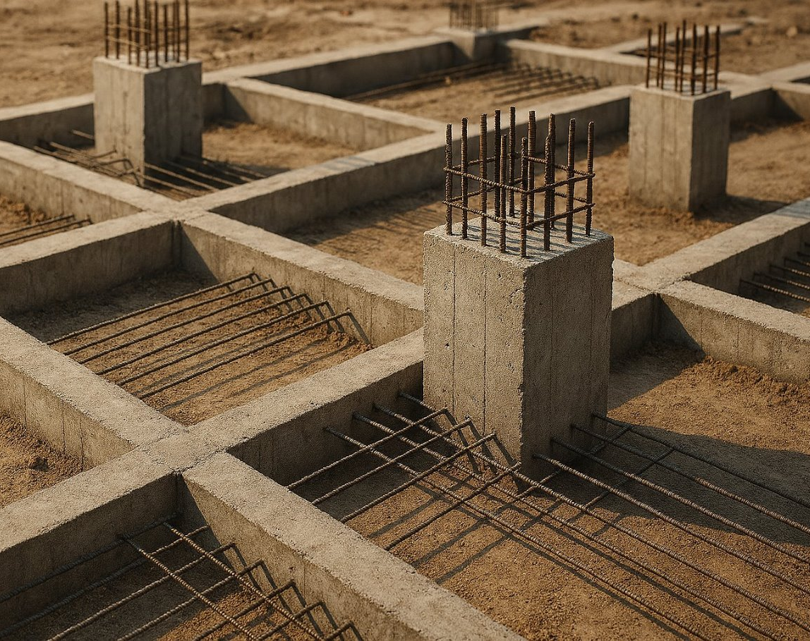
Point 1
Christ Is our foundation

Slide 4
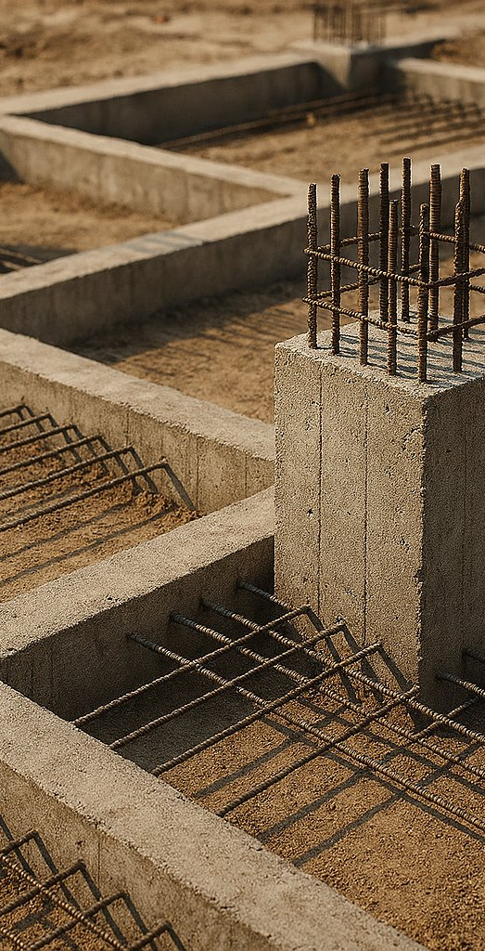
Christ Is our foundation
Colossians 2:6
And now, just as you accepted Christ Jesus as your Lord, you must continue to follow him.

Slide 5
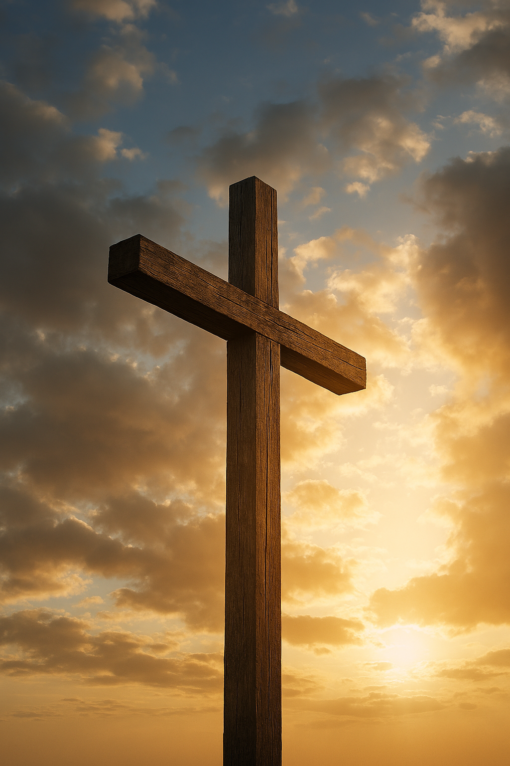
Christ Is our foundation
Colossians 1:22
Yet now he has reconciled you to himself through the death of Christ in his physical body. As a result, he has brought you into his own presence, and you are holy and blameless as you stand before him without a single fault.

Slide 6
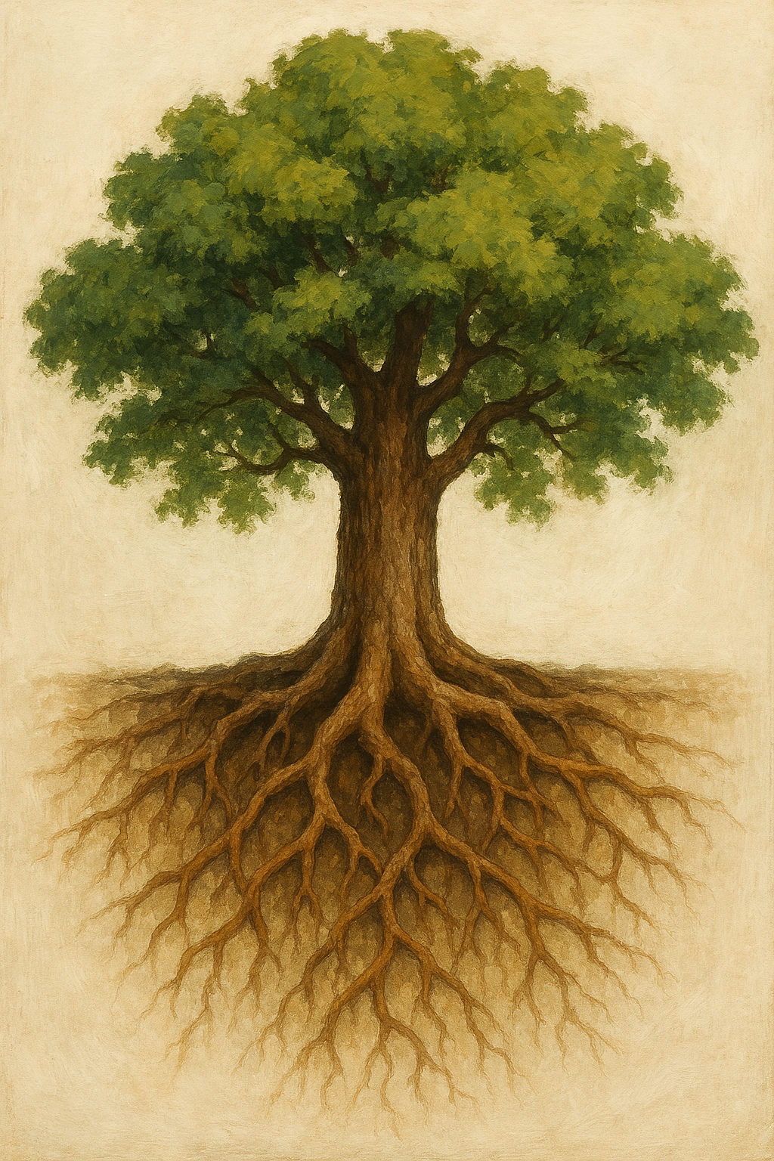
Christ Is our foundation
Verses 7
Let your roots grow down into Him

Slide 7
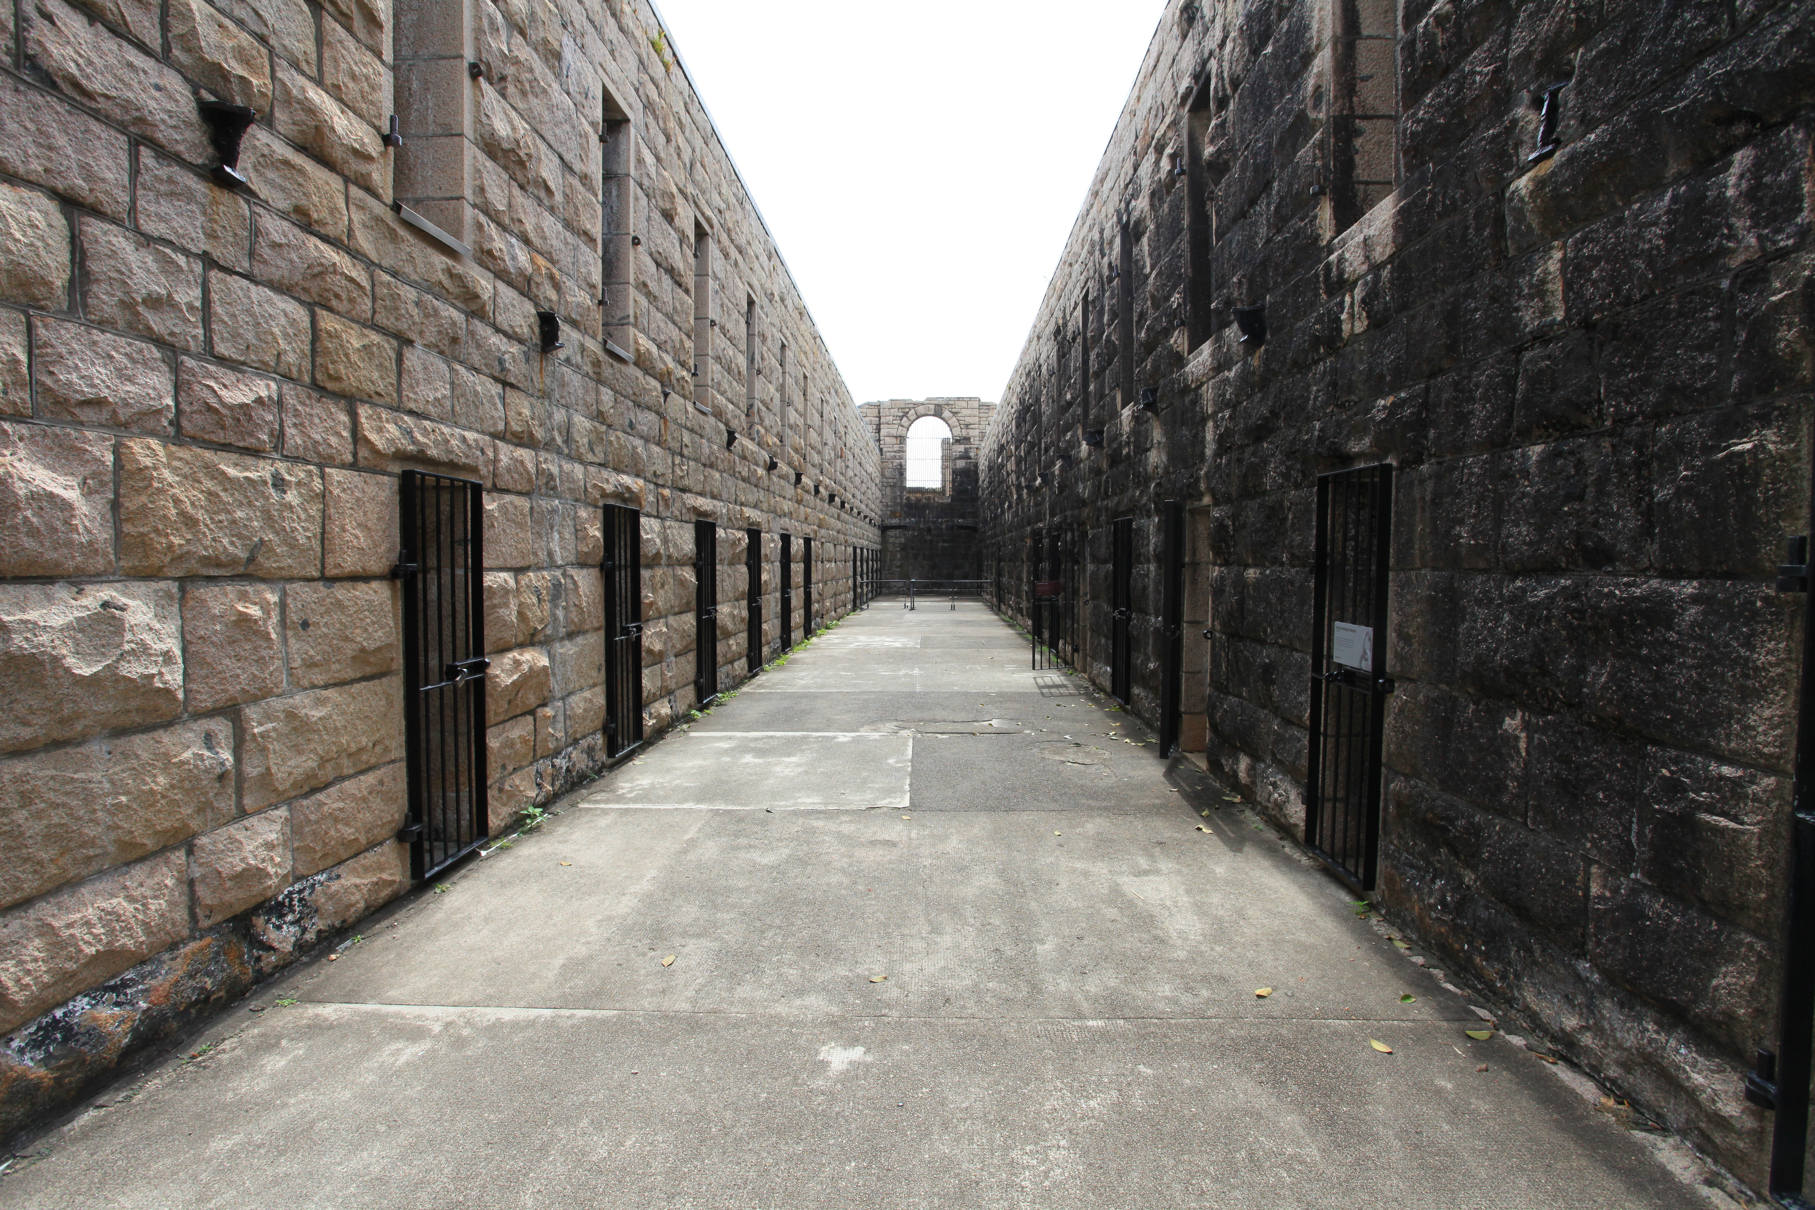
Point 2
Imprisoned By human Tradition

Slide 8
Imprisoned by human traditions
Col 2:8
Don’t let anyone capture you with empty philosophies and high-sounding nonsense that come from human thinking and from the spiritual powers (Basic Principles) of this world, rather than from Christ.

Slide 9
Imprisoned by human traditions
Col 2:16-18
So don’t let anyone condemn you for what you eat or drink, or for not celebrating certain holy days or new moon ceremonies or Sabbaths. ¹⁷ For these rules are only shadows of the reality yet to come. And Christ himself is that reality. ¹⁸ Don’t let anyone condemn you by insisting on pious self-denial or the worship of angels, saying they have had visions about these things. Their sinful minds have made them proud, ¹⁹ and they are not connected to Christ, the head of the body.

Slide 10
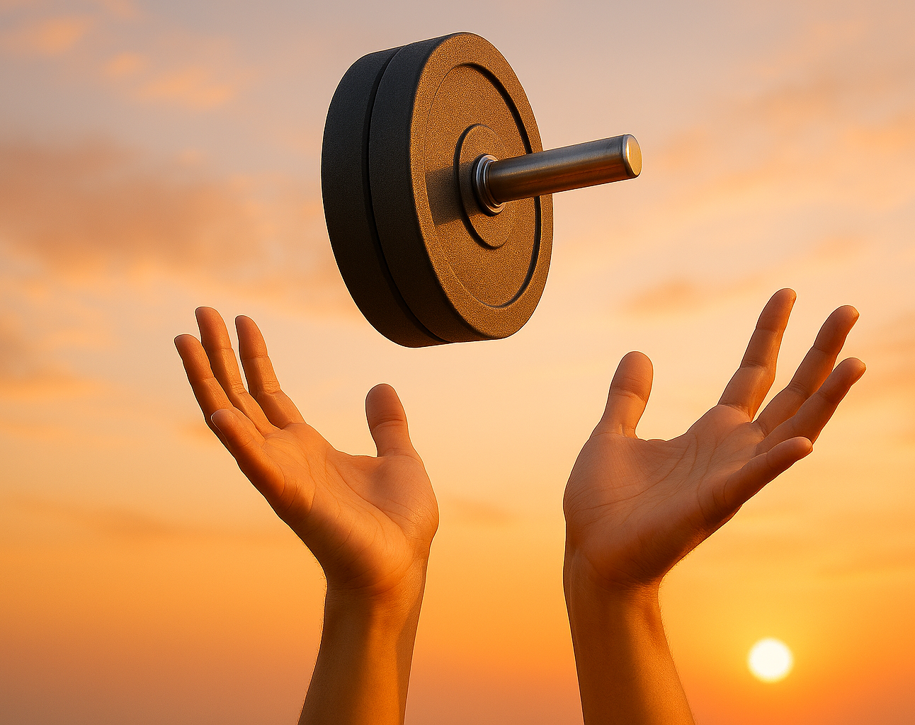
Point 3
Freedom In Christ

Slide 11
Freedom in Christ
You are complete through you union with Christ vs 10
You have been spiritually Circumcised vs 11

Slide 12
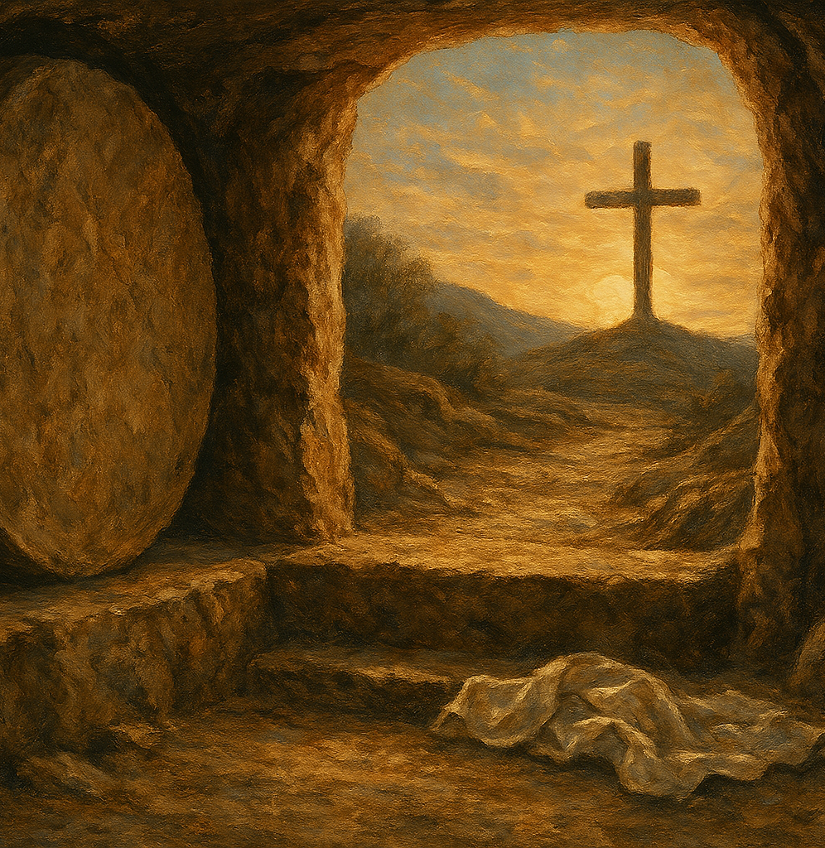
Freedom In Christ
We have been buried and raised with Christ vs 12

Slide 13

Freedom in Christ
He has forgiven our sin vs 13
He has cancelled our record, the charges against us v 14

Slide 14
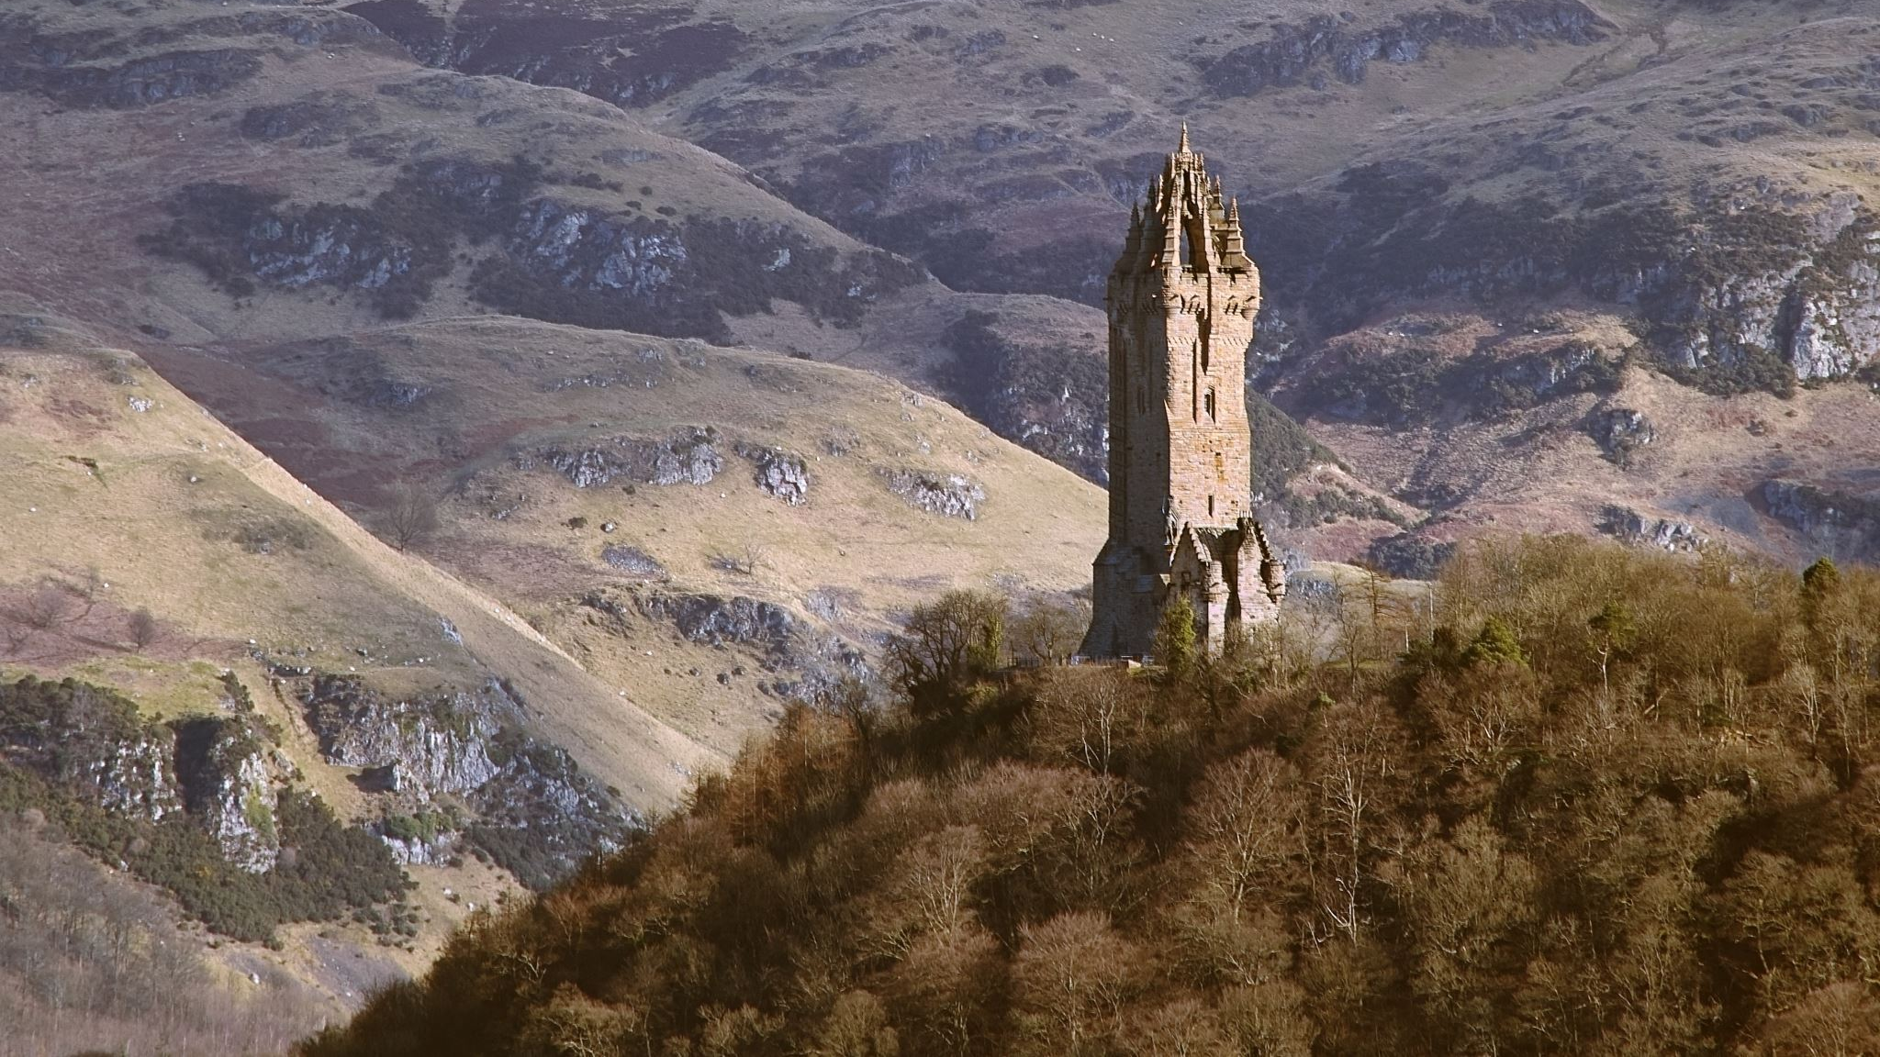
Rock of Ages
Not the labor of my hands
Can fulfill Thy law’s demands;
Could my zeal no respite know,
Could my tears forever flow,
All could never sin erase,
Thou must save, and save by grace.
Nothing in my hands I bring,
Simply to Thy cross I cling;
Naked, come to Thee for dress,
Helpless, look to Thee for grace:

Slide 15
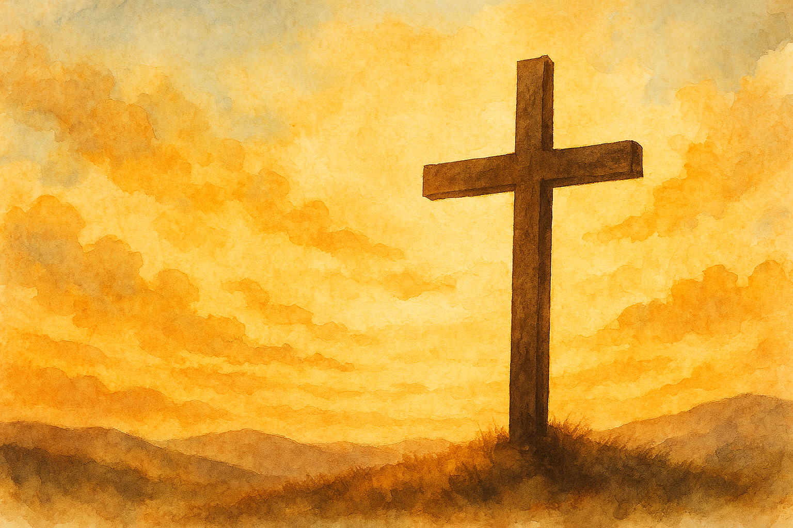
In Christ alone
In Christ alone, my hope is found
He is my light, my strength, my song
This Cornerstone, this solid ground
Firm through the fiercest drought and storm
What heights of love, what depths of peace
When fears are stilled, when strivings cease
My Comforter, my All in All
Here in the love of Christ I stand
No guilt in life, no fear in death
This is the power of Christ in me
From life's first cry to final breath
Jesus commands my destiny
No power of hell, no scheme of man
Can ever pluck me from His hand
Till He returns or calls me home
Here in the power of Christ I'll stand

Slide 16
FREEDOM IN CHRIST
Vs 20-23
You have died with Christ, and he has set you free from the spiritual powers of this world. So why do you keep on following the rules of the world, such as, ²¹ “Don’t handle! Don’t taste! Don’t touch!”? ²² Such rules are mere human teachings about things that deteriorate as we use them. ²³ These rules may seem wise because they require strong devotion, pious self-denial, and severe bodily discipline. But they provide no help in conquering a person’s evil desires.

Slide 17
Questions to reflect on
What is the foundation your life is built on?
Is your relationship with God based on trying to earn his approval or of gratitude for what he has done for you
Are you certain of your salvation in Christ
Do you follow Jesus with freedom and gratitude?

