Slide 1




Slide 2

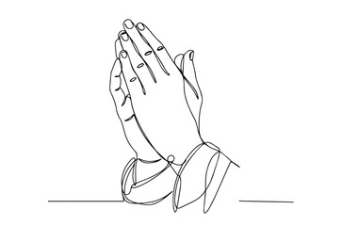
A PRAYER OF APPRECIATION FOR OUR QUIET
HEROES OF THE FAITH

Slide 3
LORD, WE THANK YOU FOR THESE QUIET HEROES
WHO FREELY GIVE OF THEIR TIME TO SERVE IN YOUR COURTS,
FATHER, WE THANK YOU FOR THESE,
YOUR SERVANTS, WHO STAND IN YOUR PRESENCE
WHO HAVE BEEN TOUCHED BY THE MASTER’S HAND
MAY YOU BLESS THEM AS THEY SERVE
OFTEN QUIETLY & UNNOTICED
THEY MAY NOT TOTALLY UNDERSTAND WHAT YOU HAVE CALLED THEM TO,
BUT YET THEY FOLLOW WHERE YOU LEAD AS THEY TRUST
IN YOUR SOVEREIGN LOVE & GUIDING HAND.
MAY YOU GRANT THEM MUCH GRACE AS THEY PERSEVERE
IN SERVICE GREAT OR SMALL
MAY THEY KNOW THAT YOU SEE THEIR LABOUR
MAY THEY KNOW THAT THEIR SERVICE IS NOT IN VAIN
MAY THEY BRING GLORY TO YOUR NAME ALWAYS.
IN JESUS NAME.

Slide 4
主啊，我们感谢祢， 感谢这些默默无声的英雄们， 他们甘心乐意奉献时间，在祢的殿中事奉。
天父，我们感谢祢的这些仆人， 他们常常站立在祢面前，被主亲手触摸、改变。
愿祢在他们服事时赐下祝福—— 纵然他们常常安静无声、不为人知， 纵然他们未必完全明白祢的呼召， 却仍愿顺服祢的带领， 信靠祢那至高的爱与引导的手。
求祢赐他们丰盛的恩典， 在大小的事奉中持守不懈； 让他们深知祢看见他们的劳苦， 他们的服事并非徒然； 愿他们一生都荣耀祢的名。
奉主耶稣的名祷告，阿们。

Slide 5

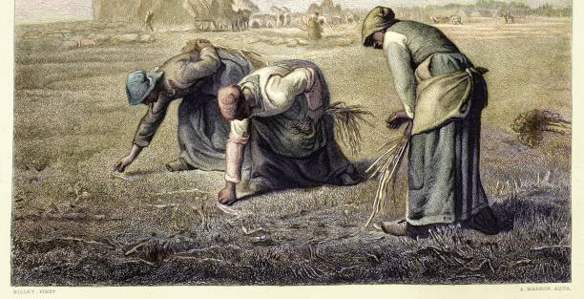
THE GLEANERS BY JEAN-FRANCOIS MILLET
https://www.istockphoto.com/

Slide 6
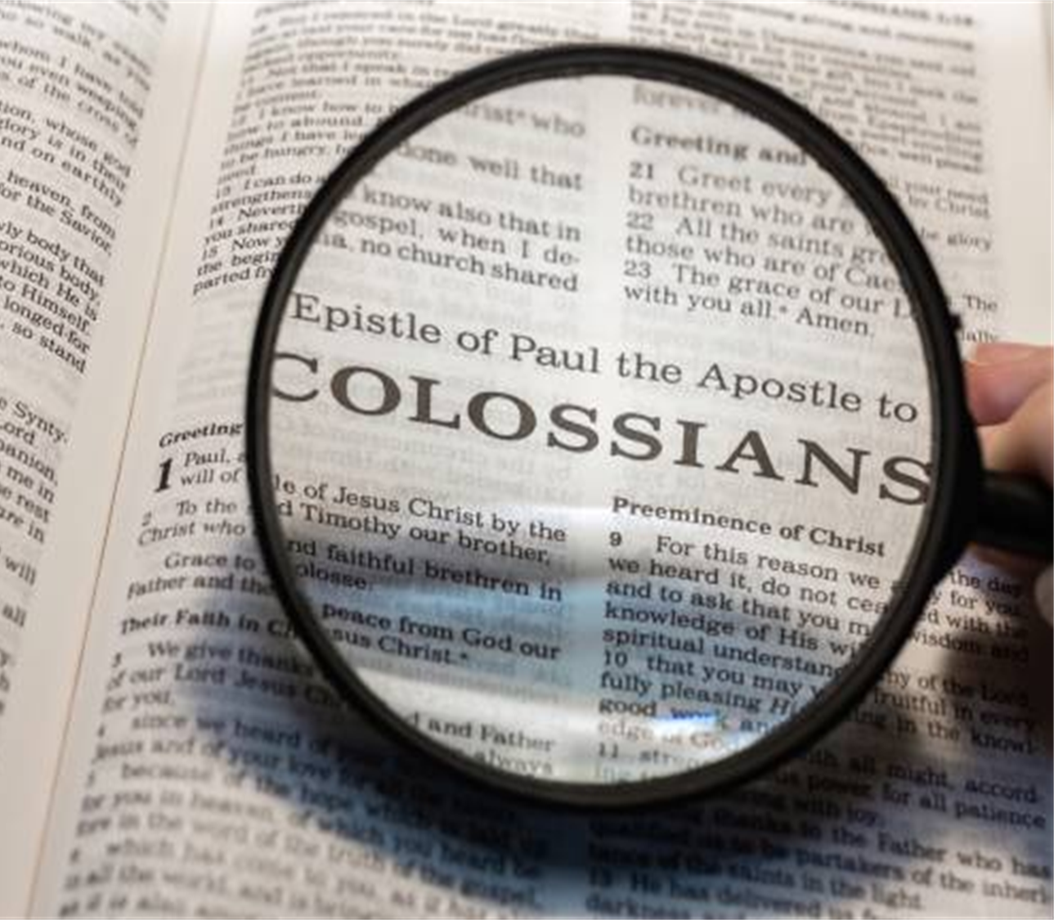

GLEANINGS FROM
THE QUIET HEROES OF THE FAITH
COLOSSIANS
4: 7 - 18
Message 12 of 12 in series “Encountering Christ through Colossians”
CLIC @ FEDERATION UNI BERWICK
9th NOVEMBER 2025

Slide 7
THE TOUCH OF THE MASTER’S HANDS WORDS & MUSIC BY JOHN KRAMP ©1980 PARAGON MUSIC CORP.
Well it was battered and scared And the auctioneer felt it was hardly worth his while To waste much time on the old violin but he held it up with a smile Well it sure ain't much but its all we got left I guess we aught to sell it to Oh, now who'll start the bid on this old violin? Just one more and we'll be through And then he cried one give me one dollar Who'll make it two only two dollars who'll make it three Three dollars twice now that's a good price Now who's gonna bid for me? Raise up your hand now don't wait any longer the auctions about to end Who's got four Just one dollar more to bid on this old violin? Well the air was hot and the people stood around as the sun was setting low From the back of the crowd a gray haired man Came forward and picked up the bow He wiped the dust from the old violin then he tightened up the strings Then he played out a melody pure and sweet, sweeter than the Angels sing And then the music stopped and the auctioneer With a voice that was quiet and low he said now what am I bid For this old violin and he held it up with a bow
And then he cried out one give me one thousand Who'll make it two only two thousand who'll make it three Three thousand twice you know that's a good price Common who's gonna to bid for me? And the people cried out what made the change we don't understand Then the auctioneer stopped and he said with a smile It was the touch of the Master's hand
You know there is many a man with his life out of tune Battered and scared with sin and he's auctioned cheap To a thankless world much like that old violin Oh, but then the Master comes And that old foolish crowd they never understand The worth of a soul and the change that is rought Just by one touch of the Masters hand
And then he cried out one give me one thousand Who'll make it two only two thousand who'll make it three Three thousand twice you know that's a good price Common who's gonna bid for me? And the people cried out what made the change we don't understand Then the auctioneer stopped and he said with a smile It was the touch, that's all it was; it was the touch of the Master's hand It was the touch of the Master's hand; oh, it was the touch of the Master's hand

Slide 8
HAVE YOU EXPERIENCED THE TOUCH OF THE MASTER’S HANDS?
DO YOU UNDERSTAND THE WORTH OF THE MASTER’S TOUCH?

Slide 9

HOW MANY PEOPLE WHO HAD EXPERIENCED THE MASTER’S TOUCH ARE MENTIONED BY PAUL IN THIS CHAPTER?

Slide 10
THOSE WHO HAD EXPERIENCED THE TOUCH OF THE MASTER’S HAND (COLOSSIANS 4: 7 – 18)
TYCHICUS (v. 7 – 9) | EPAPHRAS (v. 12)
ONESIMUS (v. 9) | Dr. LUKE (v.14)
ARISTARCHUS (v. 10) | DEMAS (v.14)
MARK (BARNABA’S COUSIN) (v.10) | NYMPHA (& HER HOUSE CHURCH) (v. 15)
JESUS (JUSTUS) (v. 11) | ARCHIPPUS (V. 17)
THE BRETHREN WHO ARE IN LAODICEA (v.15)

Slide 11
#1
A MAN WHO
LEFT NO WRITINGS THAT WE KNOW;
PERFORMED NO GREAT FEATS OR MIRACLES WORTH RECORDING;
APPARENTLY WAS NO GREAT THINKER OR ORATOR

Slide 12
#1
A MAN WHO
PERFORMED A SIMPLE UNROMANTIC TASK, A MUNDANE JOB OVER & OVER.
HE DELIVERED LETTERS FOR PAUL

Slide 13
TYCHICUS (lit. CHANCE HAPPENING)
#1
ASIAN CHRISTIAN & A TRAVELLING COMPANION TO PAUL - ACTS 20: 4
TRUSTED BY PAUL TO CARRY HIS LETTER TO THE COLOSSIANS - COLOSSIANS 4:7
CARRIED LETTER TO EPHESIANS – EPHESIANS 6: 21, 22
ACCOMPANIES ONESIMUS BACK TO HIS MASTER – COLOSSIANS 4:9
SENT BY PAUL TO EPHESUS – 2 TIMOTHY 4: 12
MENTIONED BRIEFLY BY PAUL IN HIS LETTER TO TITUS – TITUS 3:12
BELOVED BROTHER
FAITHFUL MINISTER /SERVANT
FELLOW BOND-SERVANT IN THE LORD
COLOSSIANS 4: 7 -9

Slide 14
THERE IS GREATNESS IN THE SMALLEST THINGS DONE FOR CHRIST
GLEANING #1
WHAT WOULD BE THE USE OF A LETTER IF THERE WAS NO ONE TO DELIVER IT?
WHAT WOULD BE THE POINT OF ALL OF PAUL’S DEEP INSIGHTS AND PRACTICAL APPLICATION OF HIS TEACHINGS IF NO ONE EVER READ IT?
NEVER UNDERESTIMATE THE APPARENTLY SMALL, UNNOTICED THINGS THAT YOU DO FOR CHRIST!
SOME OF THEM ARE ABSOLUTELY INDISPENSIBLE TO THE WORK OF GOD – BUT YOU WILL NEVER FIND OUT UNTIL YOU GET TO HEAVEN

Slide 15

For want of a nail the shoe was lost.
For want of a nail, the horseshoe
was lost
For want of a horseshoe, the
horse was lost. For want of a horse, the rider
was lost. For want of a rider, the message
was lost. For want of a message, the battle
was lost. For want of a battle, the
kingdom was lost.
And all for the want of a nail.
https://www.istockphoto.com/

Slide 16
MOMENTARY THINGS DONE FOR CHRIST ARE ETERNAL
GLEANING #2
WHO WOULD HAVE REALISED THEN THAT THE LETTERS THAT TYCHICUS CARRIED WOULD OUTLAST THE ROMAN EMPIRE AND BE READ EVEN TODAY?
THE CHURCH AT COLOSSAE DOES NOT EXIST TODAY.
BUT THE BIBLICAL TRUTHS OF THE SUPREMACY OF CHRIST STILL FLOURISH TODAY.
THE CHURCH OF TODAY IS SO MUCH RICHER BECAUSE OF A COMMON, NOT PARTICULARLY GIFTED, MAN WHO LOYALLY SERVED CHRIST AND HIS BROTHER PAUL - TYCHICUS.

Slide 17
#2
A MAN WHO
WAS A SLAVE & WHO HAD RUN AWAY FROM HIS MASTER ALL THE WAY TO ROME IN AN ATTEMPT TO LOSE HIMSELF IN THE CROWD THERE

Slide 18
#2
A MAN WHO
WAS ONCE CONSIDERED USELESS BUT WHO PAUL NOW CONSIDERED TO BE VERY DEAR TO HIMSELF.

Slide 19
ONESIMUS (lit. USEFUL)
#2
A SLAVE WHO HAD STOLEN FROM HIS MASTER IN COLOSSAE
A SLAVE WHO HAD RUN AWAY TO ROME WHERE HE WAS TRANSFORMED BY THE GOSPEL OF JESUS CHRIST BY PAUL (Philemon : 10)
A MAN WHO PAUL NOW SENDS BACK TO COLOSSAE AND HIS FORMER MASTER TO MAKE RESTITUTION
HELPS TYCHICUS CARRY PAUL’S LETTERS TO COLOSSAE AS WELL AS TO PHILEMON.
A REDEEMED, TRANSFORMED MAN WHO WOULD SHAKE THE COLOSSIAN CHURCH OUT OF ITS COMPLACENT ATTITUDE – AS HIS RETURN WOULD FORCE THEM TO SIT UP AND DEMONSTRATE TO THE WHOLE CITY HOW DEEP AND WIDE THE RIVER OF GRACE FLOWED THROUGH THEIR ENTIRE CONGREGATION.
FAITHFUL & BELOVED BROTHER
USEFUL
NO LONGER A SLAVE BUT…
COLOSSIANS 4: 10,11;
PHILEMON: 10 -18

Slide 20
GOD IS STILL IN THE LIFE-CHANGING BUSINESS
GLEANING #3
A RESTLESS INSOLENT MAN CHANGED TO BEING CLEAR EYED & STRAIGHT FORWARD.
ONCE UNGRATEFUL & UNLOVING; NOW ABOUNDING IN LOVE.
PREVIOUSLY DISHONEST, NOW WILLING TO MAKE RESTITUTION.
ONCE MOROSE, NOW JOYFUL & ACTIVE IN THE PERSECUTED CHURCH IN ROME.
ONESIMUS LIFE HAD BEEN REVOUTIONISED BY GOD’S GRACE.
HIS EMPTINESS HAD NOW BEEN FILLED BY GOD’S FULLNESS.
MEANINGLESSNESS HAD BEEN REPLACED WITH PURPOSE.

Slide 21
IN GOD’S HANDS WE CAN BECOME SOMEONE THAT HAS BOTH BEAUTY AND USEFULNESS
GLEANING #4
FULL TRANSFORMATION
AWAITS THOSE OF US WHO INVITE THE MASTER’S TOUCH.
FULL OVERFLOWING SERVICE
IS THE CHARACTERISTIC OF LIFE IN CHRIST

Slide 22





#3
SIX INDIVIDUALS:
THREE WHO WERE JEWS
THREE WHO WERE GENTILES

Slide 23
ARISTARCHUS, MARK, JESUS (also called JUSTUS)
#3
THESE 3 WERE “THE ONLY MEN OF THE CIRCUMCISION” (LIT. ‘THE ONLY JEWISH BELIEVERS’) WORKING WITH PAUL.
THEY WERE THE ONLY JEWISH BELIEVERS IN ROME WHO HAD WELCOMED PAUL & WHO HAD RECOGNISED HIS MISSIONARY CALL.
THEY HAD UNDERSTOOD GRACE – THEIR HEARTS HAD BEEN RECEPTIVE & LOVING - & THAT IS WHY THEY COULD SEND THEIR GREETINGS TO THE COLOSSIAN BELIEVERS.
THEY HAD EXPERIENCED FULLNESS WITH THE FATHER AND WITH HIS SON, JESUS CHRIST. IT WAS OUT OF THIS FULLNESS THAT THEY COULD EXPERIENCE FELLOWSHIP (& FRIENDSHIP) WITH ONE ANOTHER (IRRESPECTIVE OF UPBRINGING,LANGUAGE, ETHNICITY OR QUALIFICATION).
COLOSSIANS 4: 10,11

Slide 24
EPAPHRAS, LUKE, DEMAS
#3
3 GENTILE BELIEVERS WHO SHARED THE SAME VISION AS THE JEWISH BELIEVERS ON THE TEAM.
THEY HAD NEVER BEEN TO COLOSSAE BUT THEY UNDERSTOOD THAT THEY WERE PART OF THE CHURCH THERE & THEY LOVED THEM
EPAPHRAS LOVED THE COLOSSIAN BRETHREN SO MUCH THAT HE AGONISED FOR THEM IN PRAYER THAT THEY MIGHT BE STRONG & PERFECT & KNOW GOD’S WILL FOR THEM. EPAPHRAS CARED – HIS CONCERN FOR HIS FELLOW BROTHERS & SISTERS WAS DEEP (lit. PAIN OR DISTRESS)
LUKE WAS (& IS) THE ONLY GENTILE WRITER OF ANY BOOK IN THE NT. HE WAS “A MUCH LOVED” PHYSICIAN, DEVOTED FRIEND & CAREFUL HISTORIAN
AND THEN, THERE WAS DEMAS….
COLOSSIANS 4: 12-14

Slide 25
OUR LORD ACCEPTS EVEN THOSE WHO DISAPPOINT AND HURT
GLEANING #5
“FOR DEMAS HAVING LOVED THIS PRESENT WORLD HAS DESERTED ME”
( 2 TIMOTHY 4:10)
FULLNESS IN FELLOWSHIP INCLUDES THOSE WHO LIVE ON THE “MARGINS”
CHRISTIAN FELLOWSHIP TEACHES US TO DEVELOP A GREATER CAPACITY FOR JOY – BUT ALSO FOR SORROW.

Slide 26
CHRISTIAN FELLOWSHIP MEANS HAVING A LARGE HEART
GLEANING #6
CHRISTIAN FELLOWSHIP IS MEANT TO STRETCH US.
WHAT WE PROCLAIM TO THE WORLD IS
FIRST
FELLOWSHIP (NOT JUST KNOWLEDGE BUT A RELATIONSHIP) WITH GOD
& SECOND
FULLNESS OF FELLOWSHIP WITH ONE ANOTHER
(1 JOHN 1:3)

Slide 27
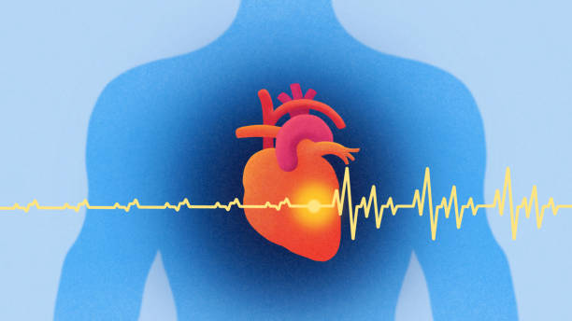

Slide 28
ARE WE WILLING TO LOVE AS CHRIST LOVED?
QUESTION
THE LOVE OF GOD ENCOMPASSES EVERYONE – incld.
THOSE WHO CHOOSE TO EXCLUDE OTHERS ON
THE BASIS OF RACE & POSITION,
THOSE WHO DISAPPOINT AND HURT,
THOSE WHO HAVE BEEN DISLOYAL,
THOSE WHO HAVE COMMITTED ACTS OF BETRAYAL IN THE COMMUNITY OF BELIEVERS
ARE WE PREPARED TO LOVE AS CHRIST LOVED ?

Slide 29
WITHIN THE FAMILY OF CHRIST, THOSE WHO NEED FORGIVENESS ALL WEAR THE IMAGE OF CHRIST
LESSON
IF
PAUL IS IN CHRIST,
&
ONESIMUS IS IN CHRIST
&
PHILEMON IS IN CHRIST,
THEN
PAUL, ONESIMUS & PHILEMON ARE ALL IN CHRIST
AND ARE SPIRITUALLY EQUAL

Slide 30
WITHIN THE FAMILY OF CHRIST, THOSE WHO NEED FORGIVENESS ALL WEAR THE IMAGE OF CHRIST
LESSON
IF WE ARE ONE IN CHRIST’S FAMILY
HOW THEN SHOULD WE BEHAVE TOWARDS OUR SPIRITUAL BROTHERS AND SISTERS?
IF LOVE IS THE CLIMATE THAT ENCOURAGES FORGIVENESS,
THEN
FAMILY RELATEDNESS IS THE SOIL IN WHICH FORGIVENESS FLOURISHES

Slide 31
TRUE HAPPINESS COMES FROM BEING WHO YOU WERE MADE TO BE, NOT WHAT YOU HAVE
FINALLY
“TAKE HEED TO THE MINISTRY
WHICH YOU HAVE RECEIVED FROM THE LORD, THAT YOU MAY FULFILL IT”
Or
literally
‘BE SURE TO DO ALL THAT THE LORD HAS TOLD YOU TO DO’
COLOSSIANS 4: 17 (NASB, TLB)

Slide 32
TRUE HAPPINESS COMES FROM BEING WHO YOU WERE MADE TO BE, NOT WHAT YOU HAVE
FINALLY
IF YOU BELONG TO CHRIST,
THEN YOU BELONG TO HIS MISSION.
WHAT DO YOU CARE ABOUT MOST?
YOUR LIFESTYLE GOALS OR YOUR DIVINE CALLING?

Slide 33
WWW.CLICHURCH.COM

Slide 34
