Slide 1
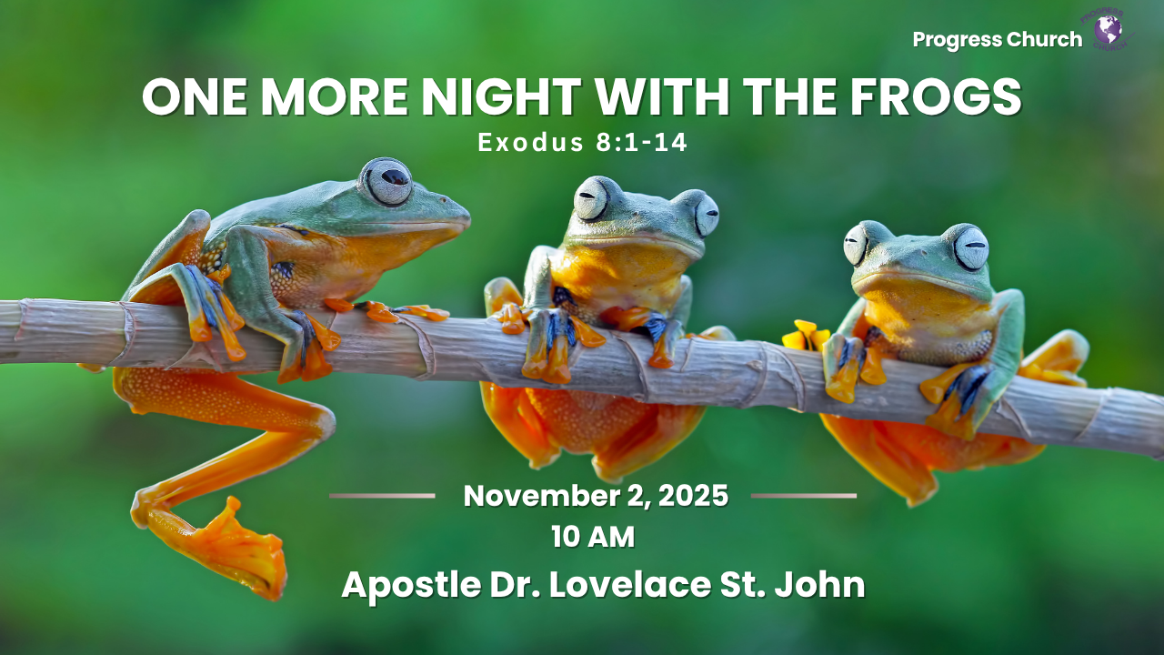

Slide 2



SCRIPTURE
EXODUS 8: 1 – 14

Slide 3
INTRODUCTION
There is something strange about the human heart, it can cry out for help yet resist the very help it needs.
Frogs filled his palace, his ovens, his beds, and even the kneading bowls of his servants.
The land was covered with the stench of judgment.
Moses offered him a way out.

Slide 4
The Offer from God.
Moses, God’s servant, extended an offer of mercy: “I will pray for you.” (v.9)
Despite Pharaoh’s rebellion, God offered him mercy.
Moses said, “I’ll let you set the time.”

Slide 5
The Offer from God cont
But Pharaoh delayed his response. Instead of saying, “Do it now,” he said, “Tomorrow.”
His hesitation turned a moment of mercy into another night of misery.
God’s mercy opens doors, but we must step through today.

Slide 6
2. The Indecision of Pharaoh
Pharaoh’s response: “Tomorrow.”
He wanted relief, but not repentance.
He wanted the frogs gone, but not God’s rule.
He delayed what should have been immediate

Slide 7

3. The Immediate Power of God
When we act in faith immediately, God moves immediately.
God is ready to take them away, but He’s waiting for your “Yes, Lord, today.”
Don’t let the comfort of delay rob you of the freedom of obedience.

Slide 8
3. The Immediate Power of God cont
The moment you say “Yes, Lord,” freedom begins.
Deliverance doesn’t wait for tomorrow; it begins today.
The power of “now faith” activates “now miracles.”

Slide 9
CONCLUSION
Pharaoh said “Tomorrow,” but God is calling us to say “Today.”
Why spend another night with what God is ready to remove?
Whatever your “frogs” are, sin, worry, bitterness, addictions in all forms, don’t postpone your deliverance.
Don’t spend one more night with what God is ready to remove.

