Slide 1
Intentional Prayer
Psalm 30:1-3- ¹I will extol you, O Lord, for you have drawn me up and have not let my foes rejoice over me. ² O Lord my God, I cried to you for help, and you have healed me^{. 3} O Lord, you have brought up my soul from Sheol; you restored me to life from among those who go down to the pit.

Slide 2
Prompts
Lord thank you for hearing my cry when….
I confess that my heart is broken over… and I trust You to restore my joy.
Lord, we cry to You to deliver us from….

Slide 3
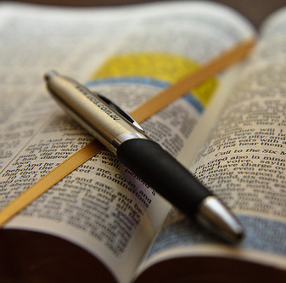
James
Chapter 3:13-18

Slide 4
Wisdom is knowledge applied.

Slide 5
The follower of Jesus should be walking in Godly wisdom instead of the wisdom of the world.

Slide 6
Godly wisdom is validated by the character in which the believer carriers out good works.

Slide 7
Where there is no meekness true wisdom is absent.

Slide 8
Godly wisdom is having knowledge of God’s will and commands and then understanding how to apply them to your life.

Slide 9
The heart filled with bitter jealousy is zealous for self.

Slide 10
Selfish ambition is the idea that one is willing to do whatever it takes to move their agenda forward.

Slide 11
Godly wisdom is God and others focused. Worldly wisdom is “me” focused.

Slide 12
Worldly wisdom causes factions and disorder. Godly wisdom produces unity.

Slide 13
True wisdom is the embodiment of Christ.

Slide 14
A life guided by Godly wisdom shows the depth of our understanding of Jesus.

Slide 15
Where there is peace there is Godly wisdom.

