Slide 1
Welcome to Holy Hermits Online Worship
All Hallowtide 2025
Halloween, All Saints, and All Souls
Service Prep: Lauren​ | Chat Host: Kerrie-Anne​ | Preacher: Lauren​
Music: Lauren​ | Welcomer: Julie​ | Priest: N/A​
Proof-reader: Kerrie-Anne​ | Leader: Julie​ | Deacon: Lauren​
Broadcaster: Lauren​ | Cantor: Vanessa​ | Fellowship: Lauren​
Backup Broadcaster: Paul​ | First Reader: Margo​ | Safety Officer: Chris​
Zoom Buttons: Kerrie-Anne​ | Second Reader: Barry​ ​ | Attendance: Viki​

Slide 2






Hospitality
Leader: Please mute for the service unless invited to offer your voice as part of the service ministry
Have the video camera on or off and turn the volume and brightness up or down on your device if things are too loud 🔉🔊or too bright🔅🔆
Our Cantor acts as our voice, offering the responses, in Bold Text, which we say together
Feel welcome to use the chat and reaction emojis 👍
Please take care of yourself in this space. 🙏 Come and go as you need
It is great to take rest in this space, so falling asleep is also OK 😴
Remember, pastoral care is available to all in the community, if you'd like to speak to someone about anything spiritual. ❤️ Visit the help page at the website to reach out 🌐
Our Being Together ethos and safeguarding practices can also be accessed on the website 🫶​
🙌 Come as you are – we are all here together! 🙌
Notes:
Used Lent 2022

Slide 3
Leader: We settle into worship with bells
from St Mary’s Cathedral, Melbourne, curated by Paul.
So as we come into worship let’s take a few deep breaths,
Let go of anything that isn’t serving us,
And become aware of God’s presence here with us.
https://www.youtube.com/watch?v=qnLOn-lunRQ

Slide 4
[Leader and Cantor unmute]
The Greeting
Leader:
The Grace of the lord Jesus Christ,
and the love of God,
and the fellowship of the Holy Spirit,
be with you all.
All: And also with you.

Slide 5
Gathering Invitation
Leader: See, the home of God is among mortals.
He will dwell with them;
they will be his peoples,
and God will be with them;
he will wipe away every tear from their eyes.
All: Death will be no more;
mourning and crying and pain will be no more,
for the first things have passed away.

Slide 6
Sentence
Cantor:
Those who have clean hands and pure hearts, who do not lift up their souls to what is false; they will receive blessing from the Lord, and vindication from the God of their salvation. Psalm 24.4, 5
Notes:
ePray

Slide 7
Centering Prayer
At all times we are called to bless God’s name. Our lips are drenched with praises, our hearts exult in God.
The proud will bend knees in worship, the humble will lift glad songs. We are free from our fears, we have searched for God and been found.
Our faces glow with thanksgiving, our spirits overflow with grace. God has wiped away our tears, God has fed us from the storehouses of hope.
Notes:
Roots: Prayer of Approach

Slide 8
Prayer of Adoration
God of community, you gaze upon your children on earth, and are overcome with love. Love that reaches out to touch even the most faraway soul.
God the Father, who made all creation, and shares all good gifts with us. We adore you.
God the Son, just as you walked on earth with your friends, you are always here with us. We adore you.
Notes:
Roots: Prayer of Adoration

Slide 9
God the Spirit, though we don’t see you with our eyes, we know you are deep within our hearts. You make sense of our place in your world. We adore you. Amen.
Notes:
Roots: Prayer of Adoration

Slide 10
[Leader unmutes]
Leader: Our next Hymn is
"When the Saints Go Marching In"
By Louis Armstrong
https://youtu.be/2ZWZf0EF4RE
Let us sing together or allow the music to nourish us.
We stay on mute.
[Leader and Cantor mute]

Slide 11
Preparing for Confession
Leader: God calls us all to live lives that are different from those around us, just like the saints did. That means being different at school, at work, at home and on our streets. We should shine like lights, and people should notice that we are different.
Call to mind the past and what prevents us from moving forward in communion with the saints…
As we stand facing the past, we remember times in the past few days when we have not been saints, when we have not brought light to the world around us. We remember things we have done, things we have not done, and things we regret saying.
Notes:
Roots: Prayer of Confession

Slide 12
All: Loving God, we are sorry. Please forgive us and help us.
Leader: Let us bring to mind the future, the unknown we enter with God’s grace…
As we stand facing the future, we think of the challenges to come. We think of the people who have hard, dark lives that we could help, and we promise God that we will try to be a saint in all situations.
All: Loving God, we want to be your saints. Please fill us with your Spirit to help us.

Slide 13
Leader: With a great cloud of witnesses around us, we try to run the race that lies ahead. Help us, God of truth, to lay aside every weight and the sin that restricts our movement. All: Forgive us for the times we have failed to clothe ourselves in love and enable us to fix our eyes on Jesus, in whom we have found our hope. Amen.

Slide 14
Introduction to Confession
We are surrounded by a great cloud of witnesses.
[Silence may be kept.]
Let us then run our race, laying aside every weight and bringing our sins to the Lord in penitence and faith.

Slide 15
All: Merciful God, our maker and our judge, we have sinned against you in thought, word, and deed, and in what we have failed to do: we have not loved you with our whole heart; we have not loved our neighbours as ourselves; we repent, and are sorry for all our sins.
Father, forgive us. Strengthen us to love and obey you in newness of life; through Jesus Christ our Lord.
Amen.

Slide 16
​Words of Assurance offered by Deacon or LA
​
These words of assurance from the First Letter of John
Declare that: ​
If anyone sins, we have an advocate with the Father, Jesus Christ
the righteous. He is the perfect offering for our sin, and not for
ours only, but for the sins of the whole world. (1 John 2: 1-2) ​
In this is love, not that we loved God, but that God loved us and sent the Son to be the perfect offering for our sins. (1 John 4:10)​. ​
[The absolution may now be offered by a priest if present.]
​

Slide 17
Collect Prayer
Eternal God, neither death nor life can separate us from your love: grant that we may serve you faithfully here on earth, and in heaven rejoice with all your saints who ceaselessly proclaim your glory; through Jesus Christ our Lord, who lives and reigns with you and the Holy Spirit, one God, for ever and ever.
Amen.
Notes:
ePray

Slide 18
Prayer for sustainability
Leader:
Generous God, We hold before you the financial stability and future sustainability of Holy Hermits Online. Guide us as we seek to grow our community’s giving, so we may continue the work you have called us to—being together in this digital space. Show us where to place our energy as we explore new funding sources and fresh opportunities. Be present with us and those we meet as we reach out to charitable trusts and foundations, inviting their support for our outreach—especially to those unable to get to Church in person.
Continues…

Slide 19
Stir the hearts of all who believe in this mission to greater generosity, creativity, and commitment. We thank you for the partnerships you have already blessed us with, especially our home base at St John’s Cathedral. We pray in the name of Jesus, who lived on mission and said,
If in my name you ask me for anything, I will do it.
Amen.

Slide 20
We are tempted to think of a saint, a holy one, as someone who is 'good', but Jesus speaks of people who are 'blessed’. How are you blessed? The 'holy ones' are actually to love their enemies. Jesus' words to his saints would be tested to the limit in his own life. How are you tested?
Reflection

Slide 21
[The 1st reader unmutes]
Leader: I invite the 1st Reader to unmute and offer the 1st reading when ready.
Reader 1: The first reading is from Daniel 7.1-3, 15-18
¹In the first year of King Belshazzar of Babylon, Daniel had a dream and visions of his head as he lay in bed. Then he wrote down the dream: ²I, Daniel, saw in my vision by night the four winds of heaven stirring up the great sea, ³and four great beasts came up out of the sea, different from one another. . ¹⁵As for me, Daniel, my spirit was troubled within me, and the visions of my head terrified me. ¹⁶I approached one of the attendants to ask him the truth concerning all this. So he said that he would disclose to me the interpretation of the matter: ¹⁷“As for these four great beasts, four kings shall arise out of the earth. ¹⁸But the holy ones of the Most High shall receive the kingdom and possess the kingdom forever—forever and ever.”
For the word of the Lord. Thanks be to God.​

Slide 22
Leader: We now say the psalm antiphonally, I invite the first reader to lead and we will all respond with the Response in Bold along with our cantor as our voice.
¹ O praise the Lord, and sing to the Lord a new song:
O praise him in the assembly of the faithful.
² Let Israel rejoice in him that made him:
let the children of Zion be joyful in their king.
³ Let them praise him in the dance:
let them sing his praise with timbrel and with harp.
⁴ For the Lord takes delight in his people:
he adorns the meek with his salvation.
Psalm 149
Continues…

Slide 23
⁵ Let his faithful ones exult in his glory:
let them sing for joy upon their beds.
⁶ Let the high praises of God be in their mouths:
and a two-edged sword in their hands,
⁷ To execute vengeance on the nations:
and chastisement upon the peoples,
⁸ To bind their kings in chains:
and their nobles with fetters of iron,
⁹ To visit upon them the judgement that is decreed:
such honour belongs to all his faithful servants. Praise the Lord.

Slide 24
[The 2nd reader unmutes]
Leader: Thank you, 1st reader. I invite the 2nd Reader to unmute and offer the 2nd reading when ready.
Reader 2: The 2nd Reading is from Ephesians 1.11-23
¹¹ In Christ we have also obtained an inheritance, having been destined according to the purpose of him who accomplishes all things according to his counsel and will, ¹² so that we, who were the first to set our hope on Christ, might live for the praise of his glory. ¹³ In him you also, when you had heard the word of truth, the gospel of your salvation, and had believed in him, were marked with the seal of the promised Holy Spirit; ¹⁴ this is the pledge of our inheritance towards redemption as God’s own people, to the praise of his glory. ¹⁵ I have heard of your faith in the Lord Jesus and your love towards all the saints, and for this reason ¹⁶ I do not cease to give thanks for you as I remember you in my prayers.
Continues…

Slide 25
¹⁷ I pray that the God of our Lord Jesus Christ, the Father of glory, may give you a spirit of wisdom and revelation as you come to know him, ¹⁸ so that, with the eyes of your heart enlightened, you may know what is the hope to which he has called you, what are the riches of his glorious inheritance among the saints, ¹⁹ and what is the immeasurable greatness of his power for us who believe, according to the working of his great power. ²⁰ God put this power to work in Christ when he raised him from the dead and seated him at his right hand in the heavenly places, ²¹ far above all rule and authority and power and dominion, and above every name that is named, not only in this age but also in the age to come. ²² And he has put all things under his feet and has made him the head over all things for the church, ²³ which is his body, the fullness of him who fills all in all.
For the word of the Lord. Thanks be to God.
Notes:
ePray

Slide 26

We pause before
​the Gospel ​​

Slide 27
The Gospel of our Lord Jesus Christ according to St Luke Chapter 6 beginning at the 20th verse.
All: Glory to you Lord Jesus Christ.
²⁰ Then he looked up at his disciples and said: ‘Blessed are you who are poor, for yours is the kingdom of God. ²¹ ‘Blessed are you who are hungry now, for you will be filled. ‘Blessed are you who weep now, for you will laugh. ²² ‘Blessed are you when people hate you, and when they exclude you, revile you, and defame you on account of the Son of Man.
Continues…

Slide 28
23 Rejoice on that day and leap for joy, for surely your reward is great in heaven; for that is what their ancestors did to the prophets.
²⁴ ‘But woe to you who are rich, for you have received your consolation. ²⁵ ‘Woe to you who are full now, for you will be hungry. ‘Woe to you who are laughing now, for you will mourn and weep. ²⁶ ‘Woe to you when all speak well of you, for that is what their ancestors did to the false prophets.
Continues…

Slide 29
²⁷ ‘But I say to you that listen, Love your enemies, do good to those who hate you, ²⁸ bless those who curse you, pray for those who abuse you. ²⁹ If anyone strikes you on the cheek, offer the other also; and from anyone who takes away your coat do not withhold even your shirt. ³⁰ Give to everyone who begs from you; and if anyone takes away your goods, do not ask for them again. ³¹ Do to others as you would have them do to you.
This is the Gospel of the Lord. All: Praise to you Lord Jesus Christ.

Slide 30
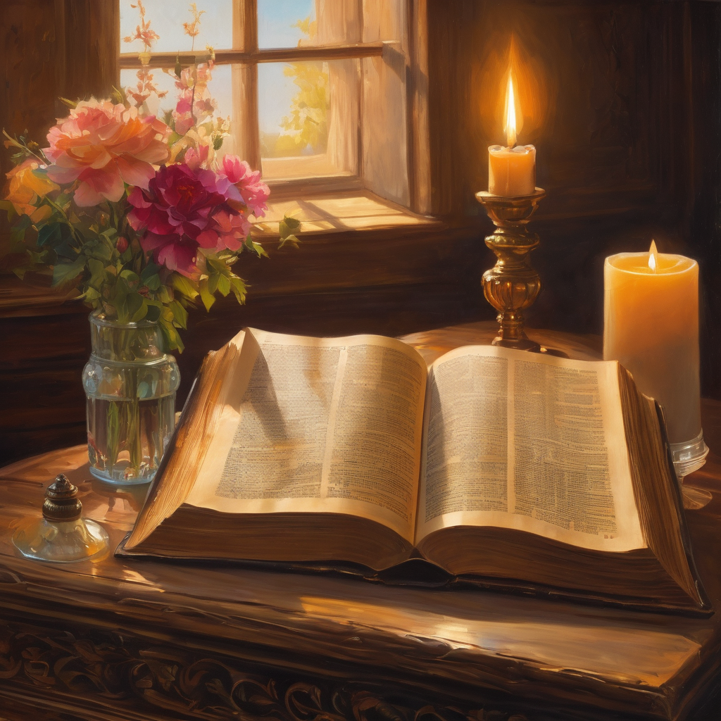
We pause
after ​the Gospel ​​

Slide 31
Leader: The Sermon is recorded to YouTube for sharing later.
Only the preacher's video and audio will be recorded.
The chat and other participants' feeds remain out of sight of the recording.
Leader and Cantor mute
Broadcaster exits screenshare
Preacher unmutes
Zoom buttons ”pins” preacher’s screen + selects “record to the cloud”
Sermon

Slide 32
[Leader unmutes]
Leader: Our next Hymn is
"For All the Saints"
https://www.youtube.com/watch?v=Rgwq7f2FpNk
Let us sing together or allow the music to nourish us.
We stay on mute.
[Leader and Cantor mute]

Slide 33
[Leader and Cantor unmute]
The Greeting of Peace
Leader: We are the body of Christ
All: God’s Spirit is with us
Leader: The peace of the Lord be always with you.
All: And also with you.
Leader: A sign of peace may be exchanged
You may like to type 'Peace' into the chat, use the 'raise hand’ or other reaction buttons, or just simply wave via the screen with your video turned on
(Broadcaster exits shared screen for a few moments for the exchange of peace)

Slide 34
Memorial Prayers
God our Father, we thank you that you have made each of us in your own image and given us gifts and talents with which to serve you.
We thank you for our dearly departed who we remember today, the times we shared with them, the good we saw in them and the memories we hold dear.
Now give us strength and courage to leave them in your care once again, confident in your promise of eternal life, through Jesus Christ our Lord.
Amen.

Slide 35
The Lord Jesus is the lover of his people
and our only sure hope.
Let us ask him to deepen our faith and sustain us in this life.
You became a little child for our sake, sharing our human life.
To you we pray:
Bless us and keep us, O Lord.
You grew in wisdom, age, and grace, and learned obedience through suffering.
To you we pray:
Bless us and keep us, O Lord.

Slide 36
You welcomed children, promising them your kingdom.
To you we pray:
Bless us and keep us, O Lord.
You comforted those who mourned the loss of friends.
To you we pray:
Bless us and keep us, O Lord.
You took upon yourself the suffering and death of us all.
To you we pray:
Bless us and keep us, O Lord.

Slide 37
You promised to raise up those who believe in you, just as you were raised up in glory by the Father.
To you we pray:
Bless us and keep us, O Lord.
Lord God, you entrusted our beloved ones to our care and now you embrace them in your love. Comfort us, your servants, who seek to do your will and to know your saving peace. Amen.

Slide 38
We thank you, our Father, that your Son Jesus Christ came to die for us. We thank you that you raised him from the dead. We thank you for the gift of life, and the life of the saints. Bring us, with those we miss and all your faithful people, to the fullness of life you promise to those who love you.
Lord, in your mercy,
hear our prayer.
We confess that we have not loved you with our whole heart. We have not loved our neighbours as ourselves. We repent and are sorry for all our sins. Grant us forgiveness and assure us of your love.
Lord, in your mercy,
hear our prayer.

Slide 39
Strengthen us to love and obey you, that we may live the rest of our lives in following your Son, and be ready when you call us to the fullness of eternal life.
Lord, in your mercy,
hear our prayer.
We pray for those who mourn. Especially those who are missing loved ones during all-hallow-tide.
Be close to them in their loss.
Increase their faith in your undying love.
Lord, in your mercy,
hear our prayer.

Slide 40
Show your mercy to the dying. Sustain them with hope and fill them with the peace and joy of your presence.
Lord, in your mercy
hear our prayer.
We praise you, Lord God, for your faithful servants in every age.
May we, with past Holy Hermits, Barbara, Dick and Don and all who have died in the faith of Christ, be brought to a joyful resurrection and the fulfilment of your eternal kingdom.
Amen.

Slide 41
Leader: Let us pray together the prayer which Jesus gave us saying:
All: Our Father in heaven,
hallowed be your name,
your kingdom come, your will be done,
on earth as in heaven.
Give us today our daily bread.
Forgive us our sins
as we forgive those who sin against us.
Save us from the time of trial
and deliver us from evil.
For the kingdom, the power,
and the glory are yours
now and for ever.
Amen.

Slide 42
Prayer of Remembrance
Living God, in whom there is no shadow or change, we thank you for the gift of life eternal, and for all those who having served you well, now rest from their labours.
We thank you for all the saints remembered and forgotten, for those dear souls most precious to us.
Today we give thanks for those who have died and entered into glory.

Slide 43
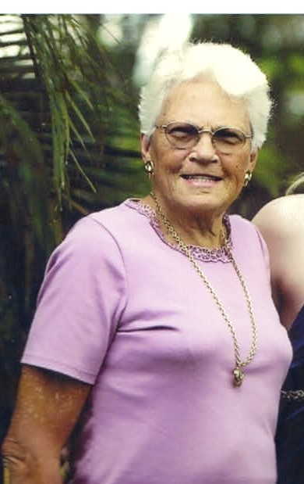
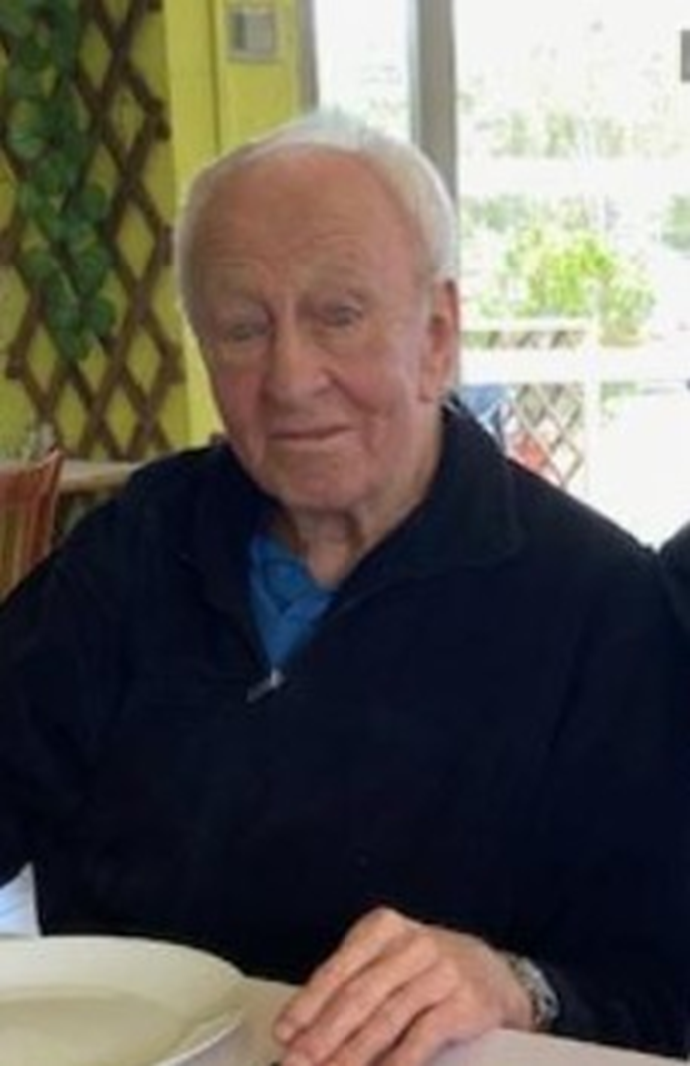
Jacqueline Stella Hanlon
7th Oct 1937 - 26th June 2018
Bill Hanlon
20th Nov 1935 – 17th August 2025​
Vanessa’s beloved Mum and Dad ​

Slide 44
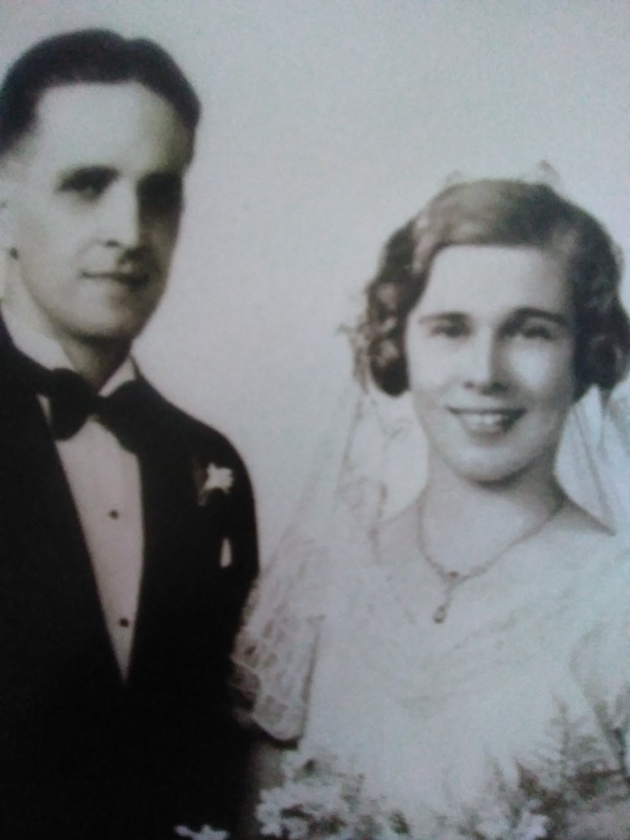
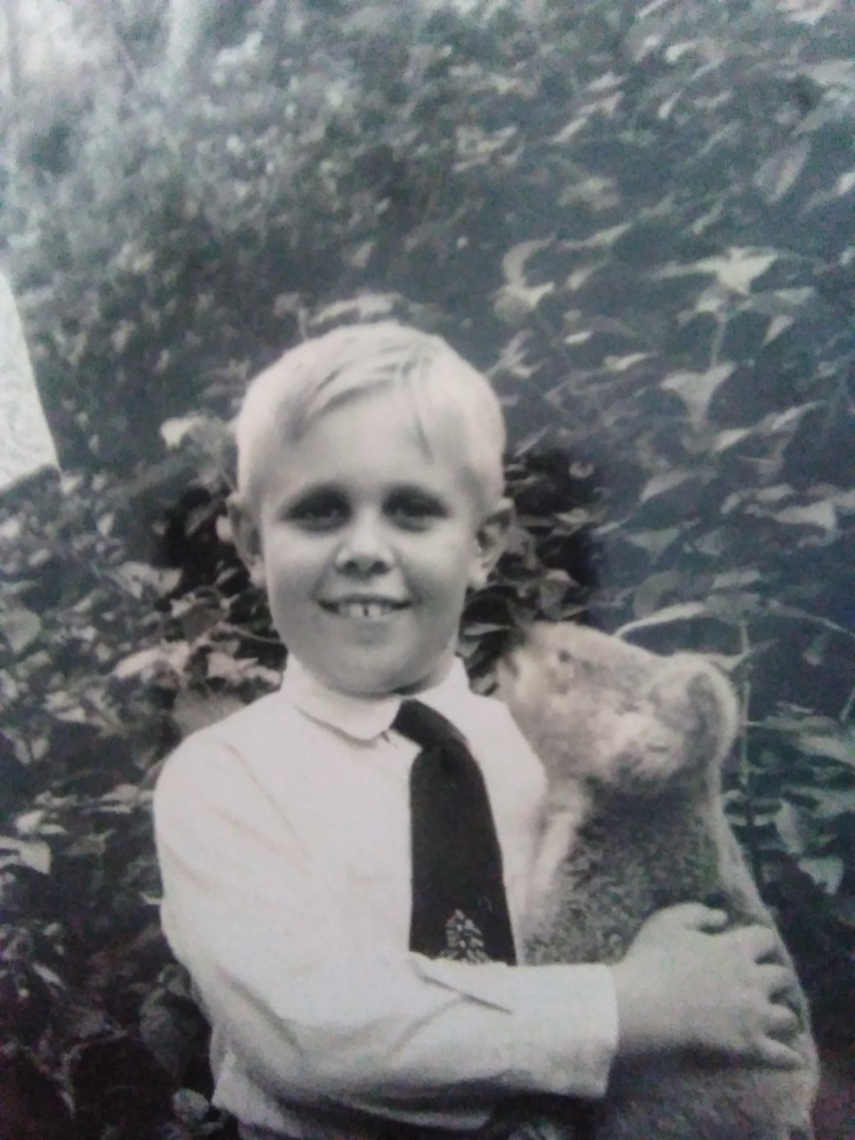
Eric (1910 – 1989) and Hilary (1914 – 2009)
David (1942 – 1958) died age 16
Marcia’s beloved Dad, Mum and big brother

Slide 45
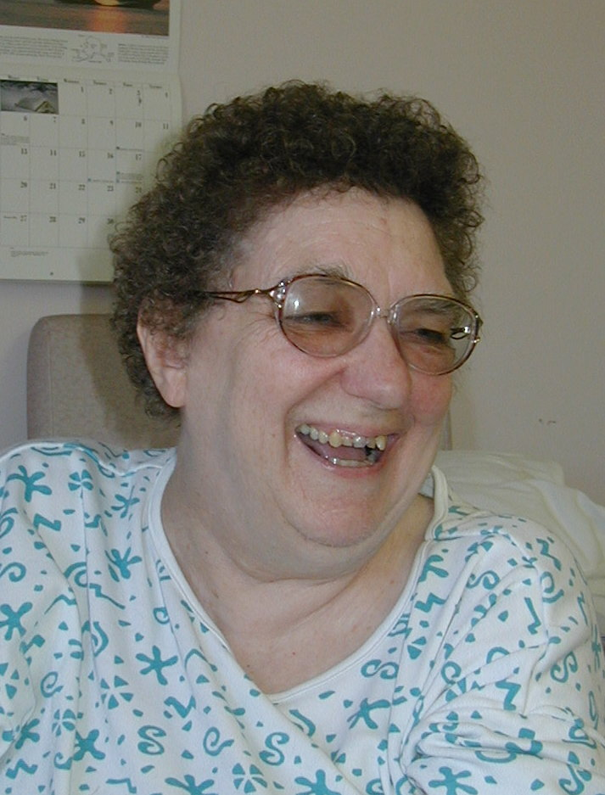
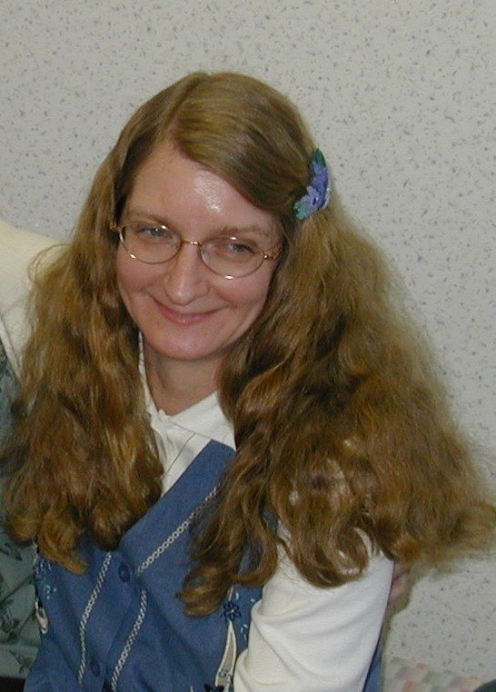
Louise
18th August 1940 – 31st March 2021
Becky
21st February 1953 - 11th February 2012
Paul’s beloved sisters

Slide 46
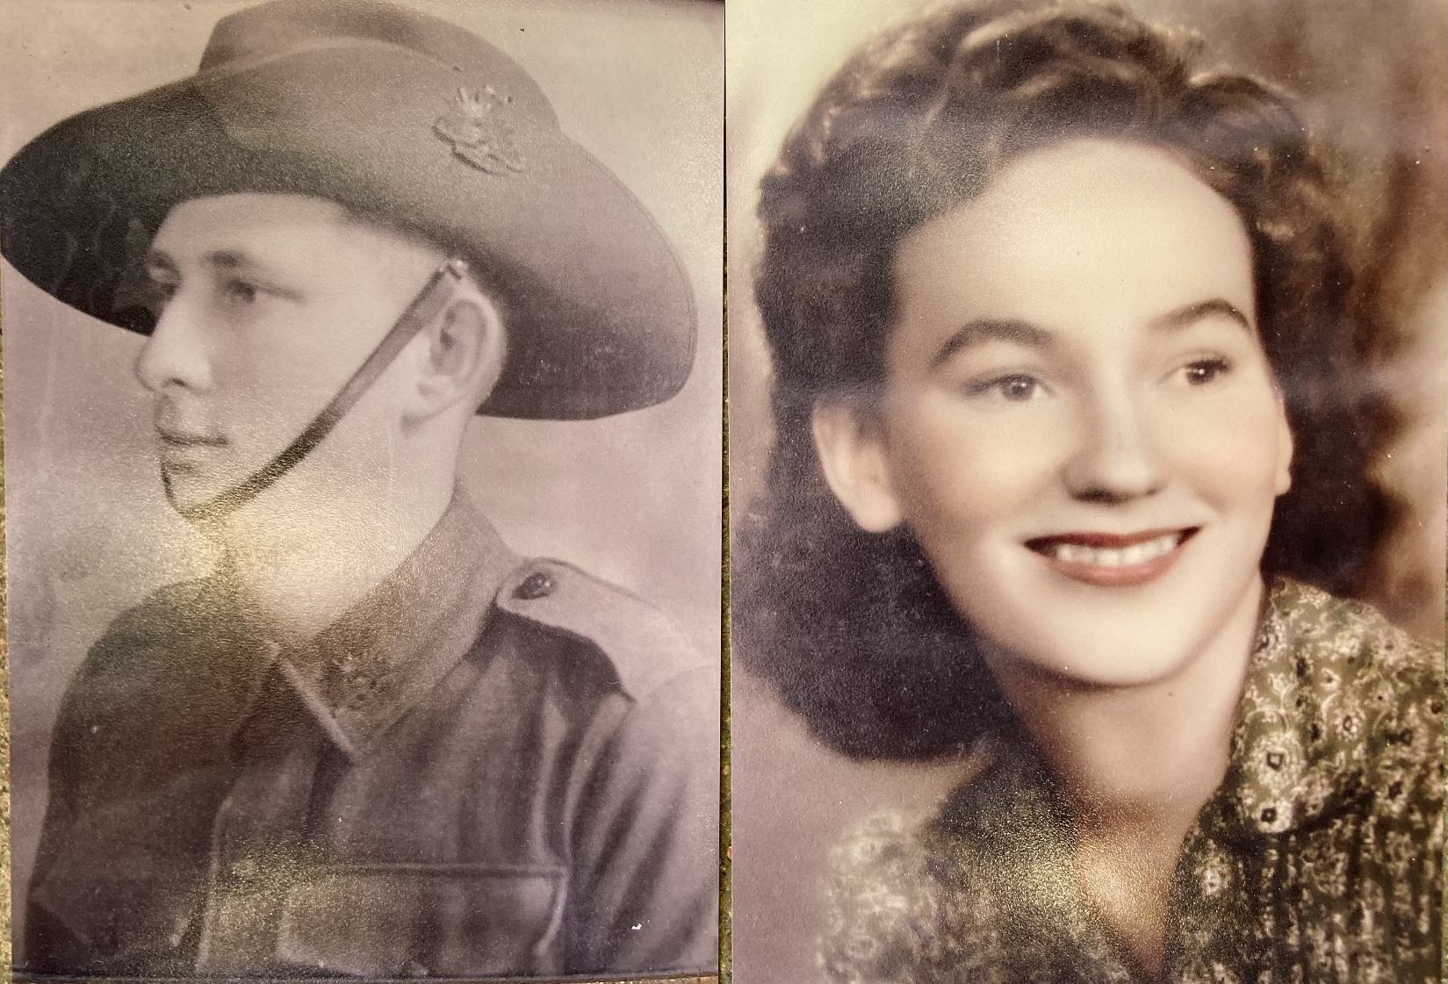
Cecil James Pearce
21st September 1921
to 4th February 2008
Gwen Pearce
5th June 1928
to 24th April 2011
Chris’s beloved Father and Mother

Slide 47
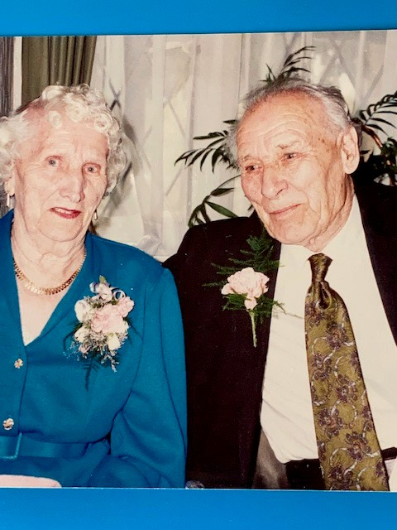
Maisie 16th December 1914 - 10th June 2005
and Bill 18th September 1910 - 15th September 2004
Viki’s beloved grandparents

Slide 48
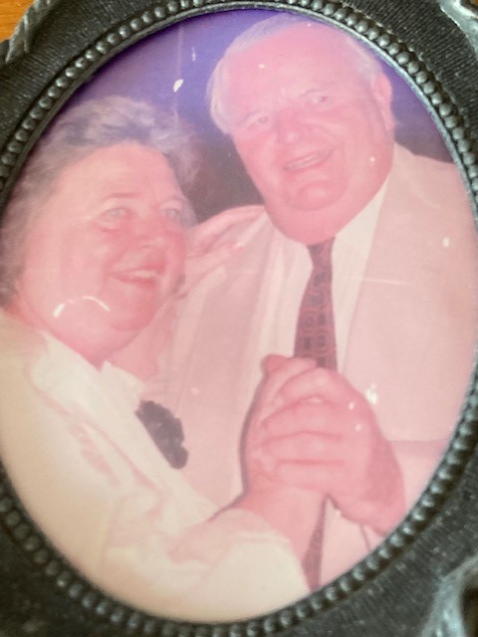
Pam 16th April 1930 - 7th March 2013
and John 16th February 1929 - 7th February 2014
Phil’s beloved parents

Slide 49
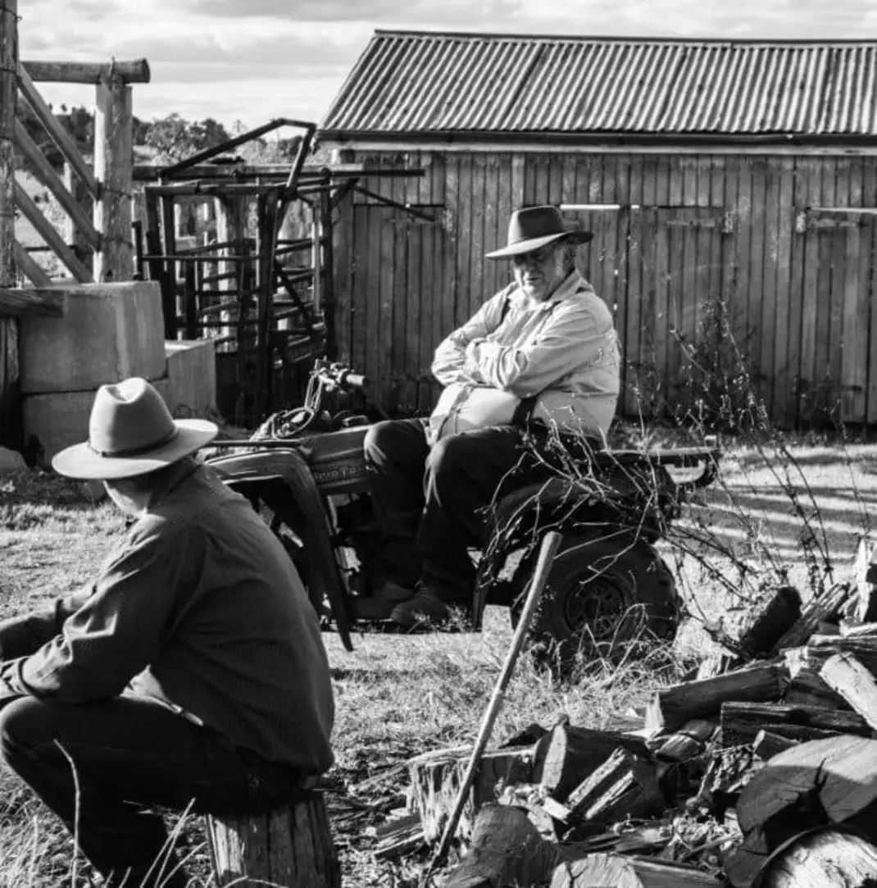
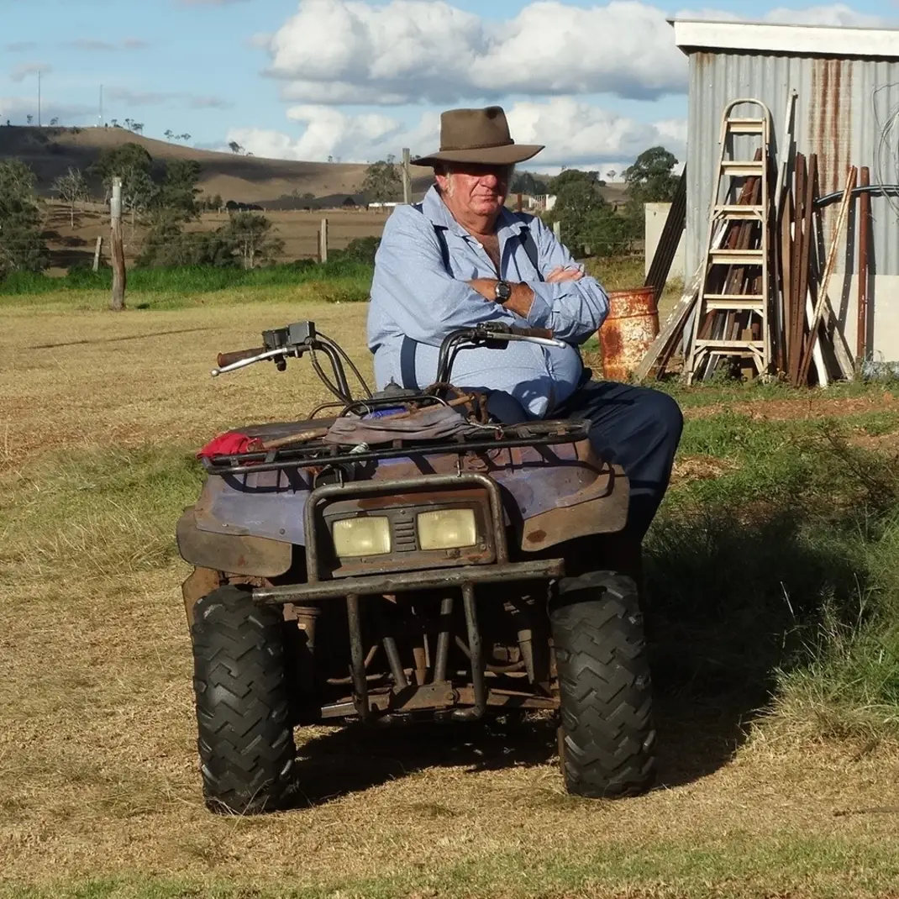
Graham Gossow 18th June 1951 – 28th August 2022
A much-loved man and like a big brother to Julie

Slide 50
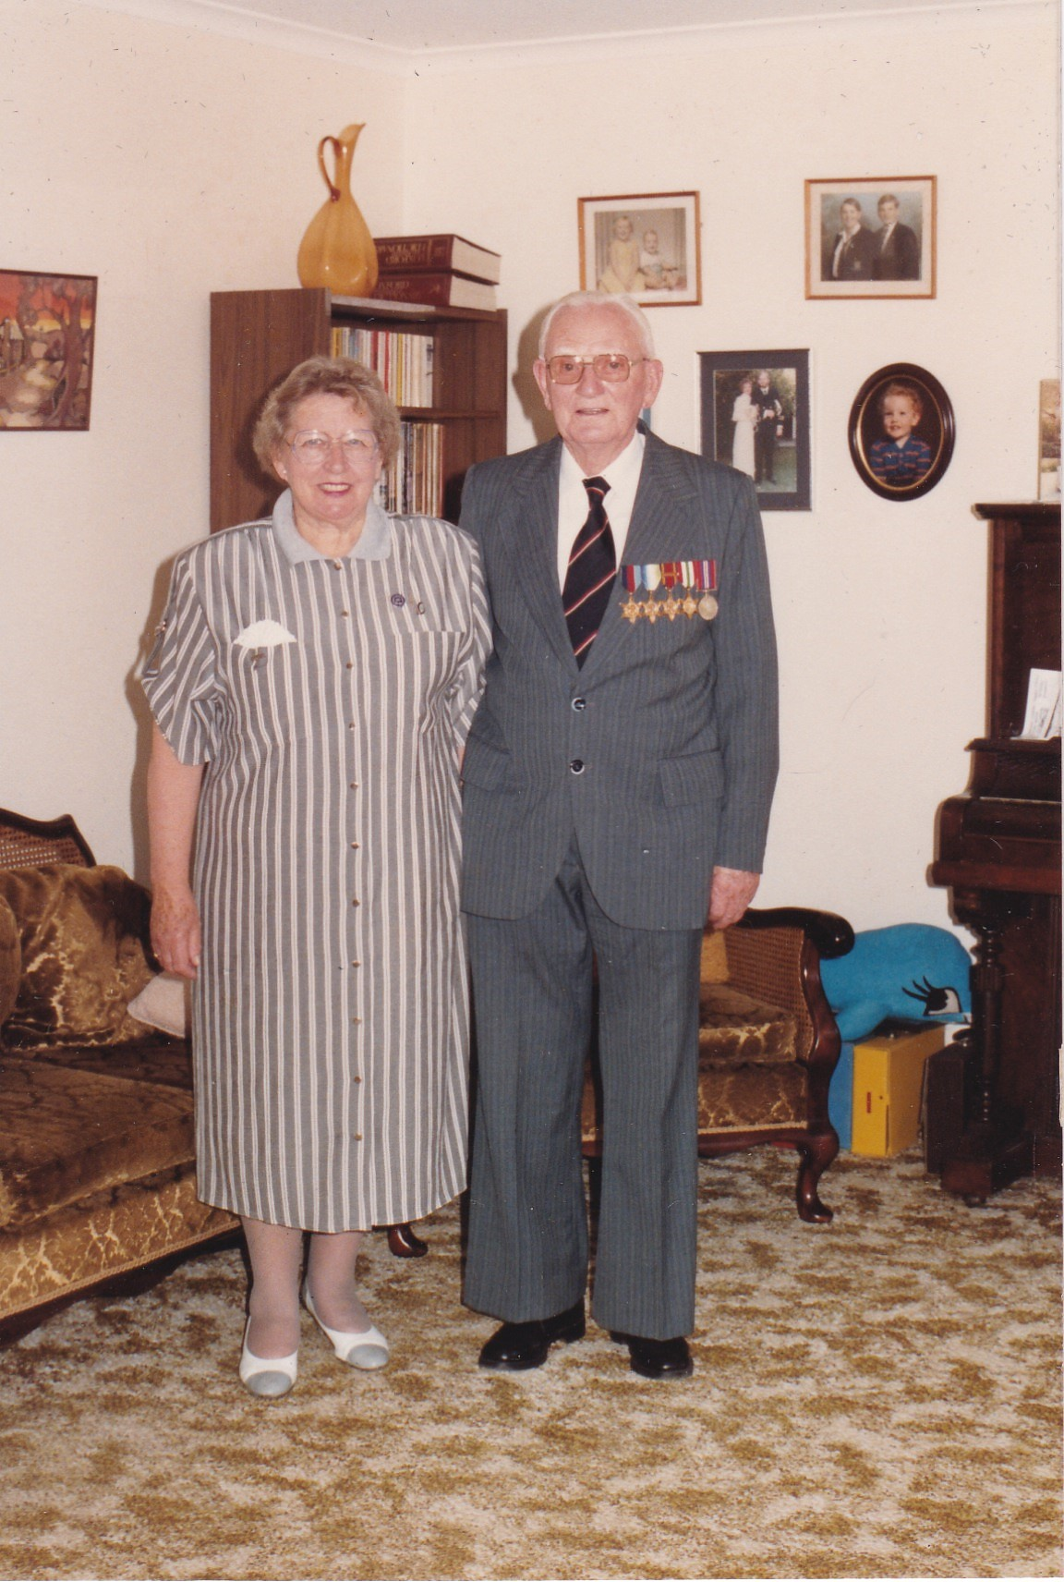
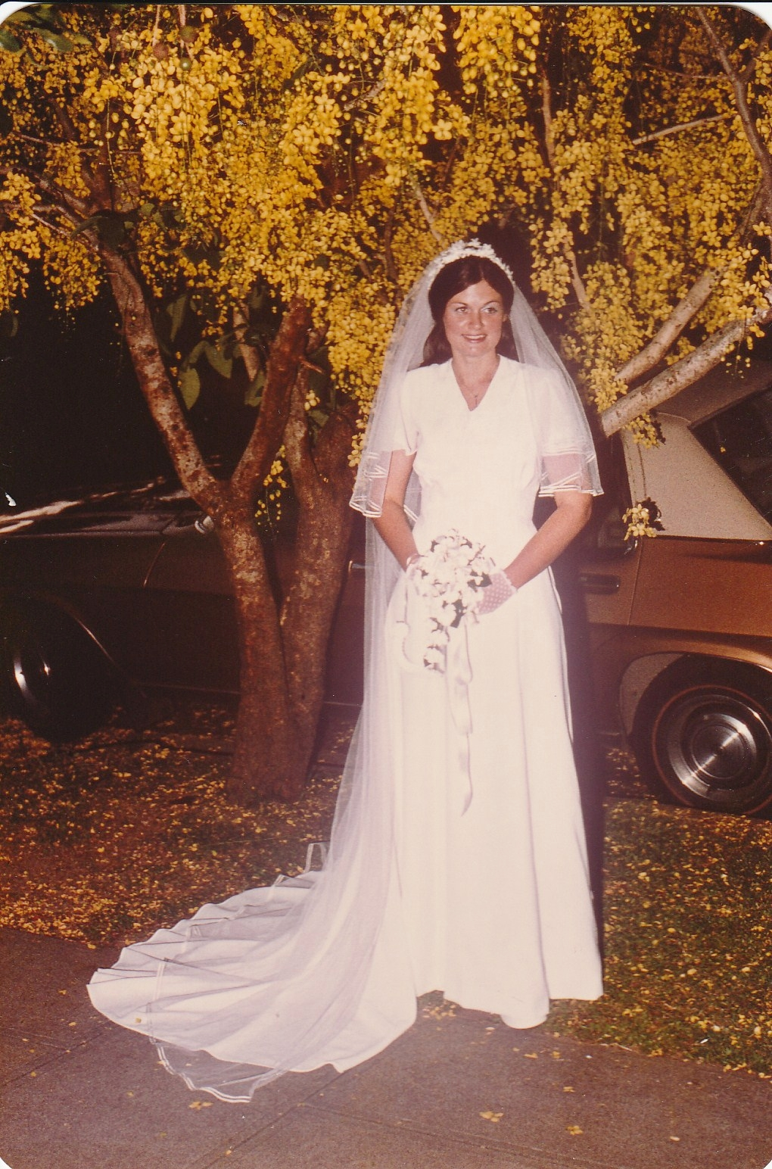
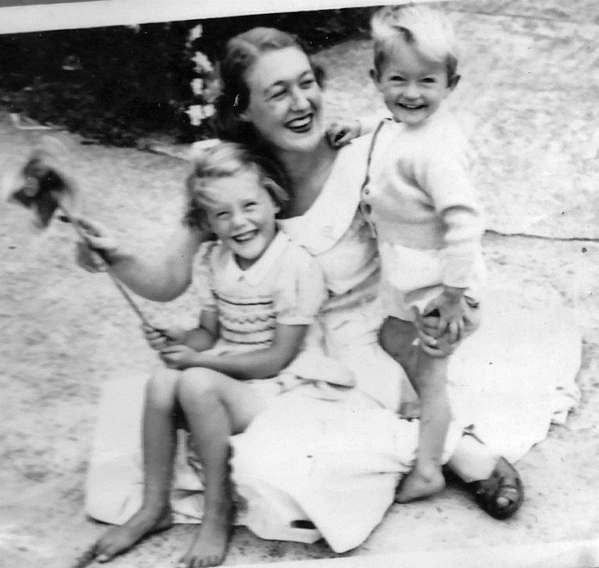
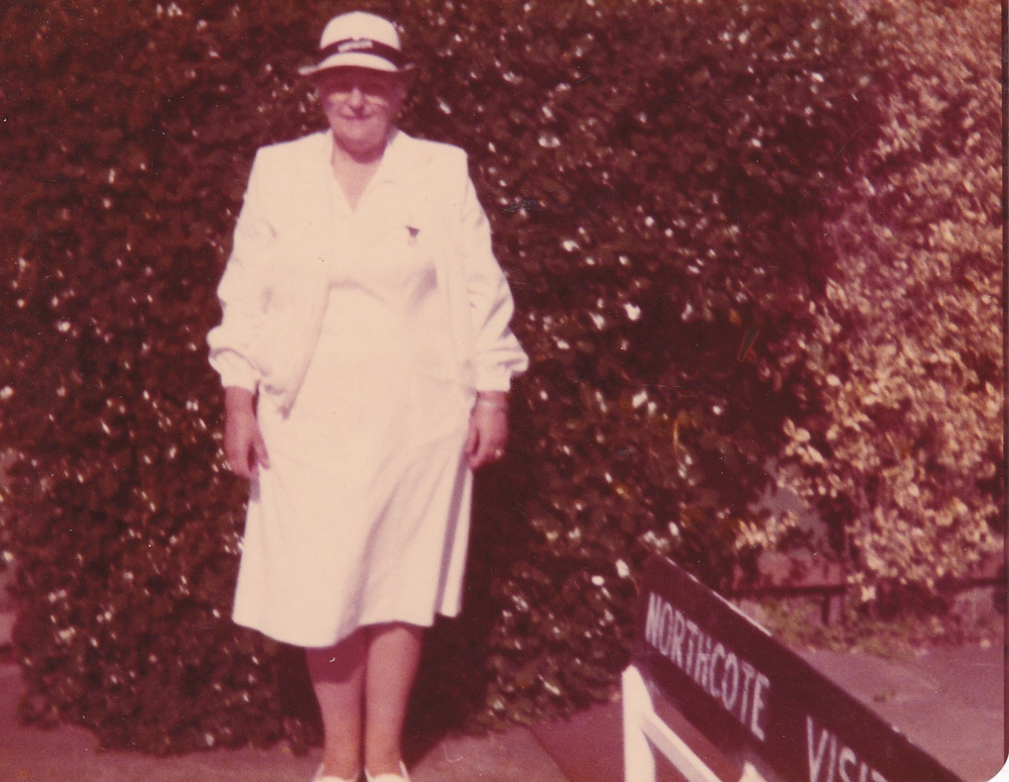
Pam (2021)
Liz's dear
Friend since
Grade 1
Liz's Aunt May (1969)
and cousins Helen (1997)
& Tony (2003)
Isabel (1993) & Bob Murray (2002)
Liz's much-loved parents
Molly Murray (2006)
Liz's beloved Aunt

Slide 51
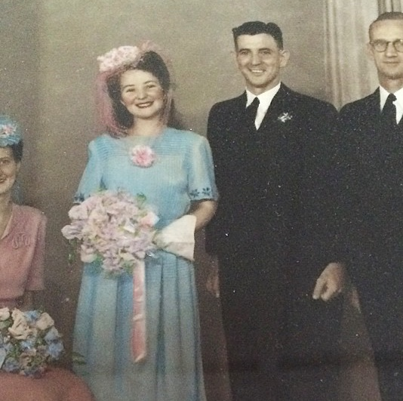
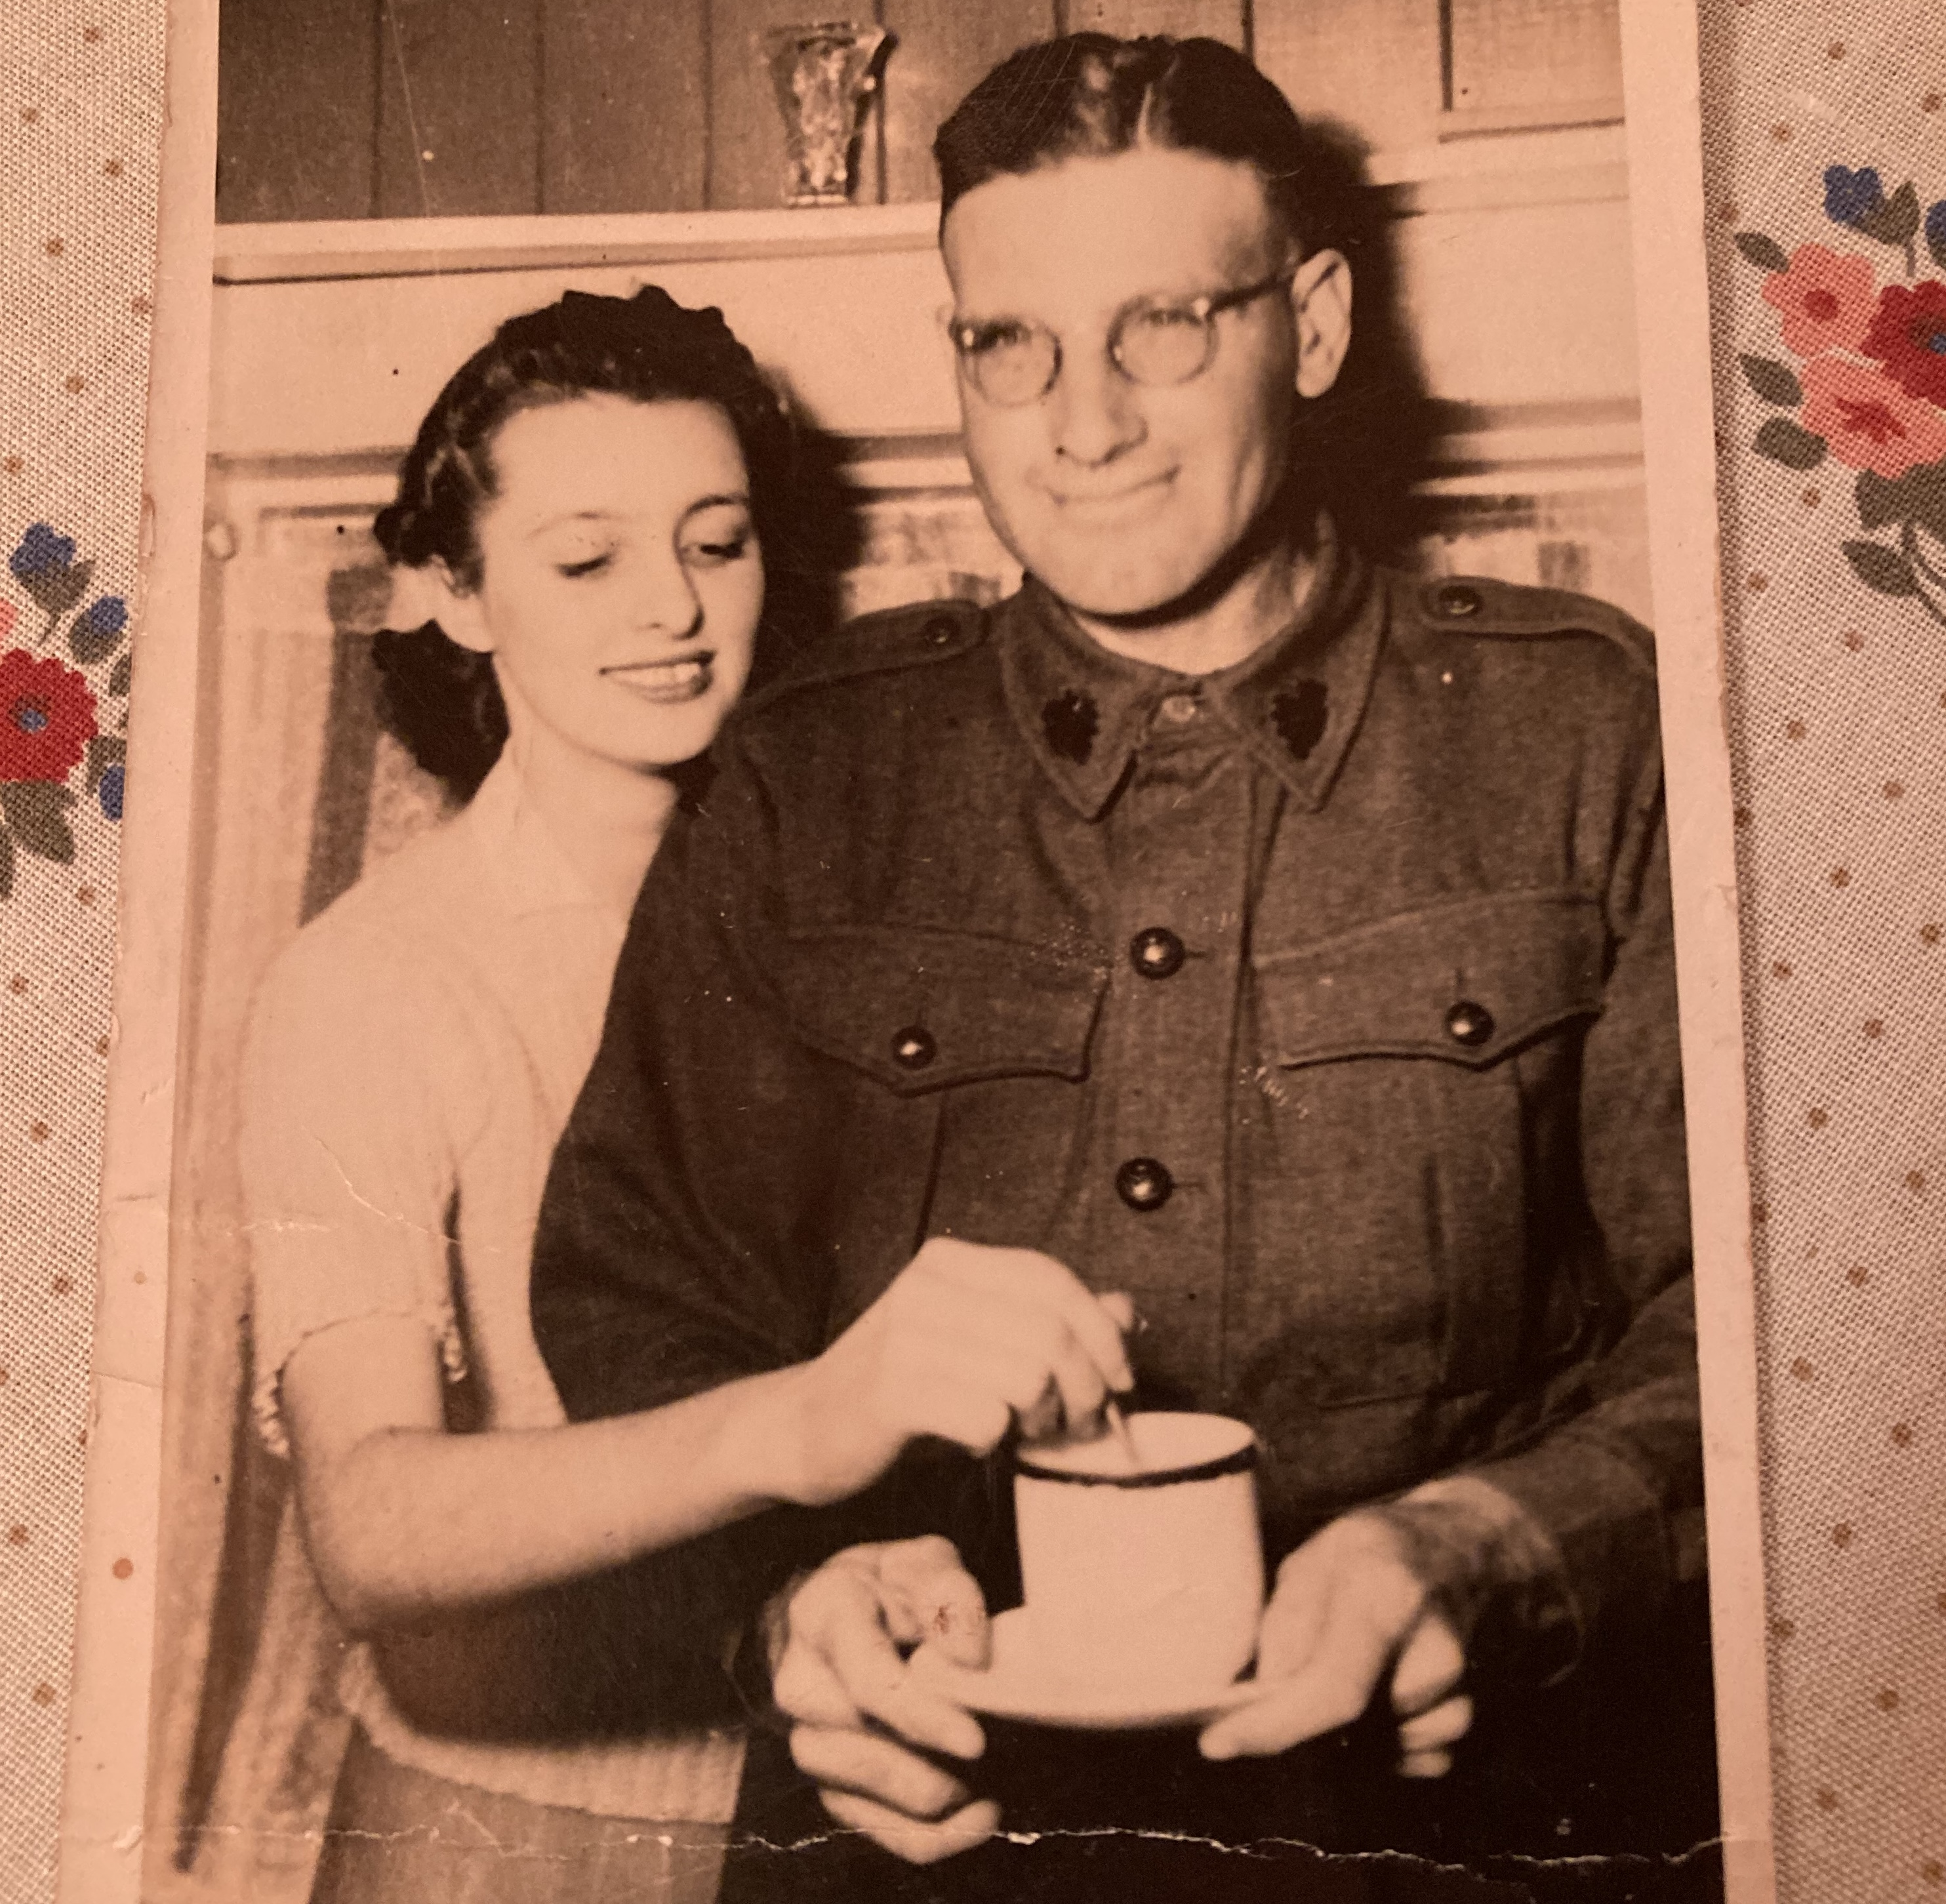
Marjorie Chinn 24th Oct 1924 – 1 Sep 2018
and Stan Chinn 25th Dec 1918 – 24th Dec 2000
Isabel Chaplin 13th Dec 1924 – 21st June 2003
and Bob Chaplin 28th Feb 1912 – 3rd July 1982
Kerrie-Anne’s beloved grandparents
51

Slide 52
Leader: We now name those others, not already remembered, who are precious to us, aloud or in our hearts.
We bless you for their life and love, and rejoice that for them “all is well, and all manner of things is well.”

Slide 53
[Leader unmutes]
Leader: Our next song is
"I Will See You Soon Again"
https://youtu.be/aP0adxf43I4
Let us sing together or allow the music to nourish us.
We stay on mute.
[Leader and Cantor mute]

Slide 54
All: Support us, O Lord, all the day long of this troublous life, until the shadows lengthen and the evening comes,
the busy world is hushed, the fever of life is over,
and our work is done.
Then, Lord, in your mercy grant us a safe lodging with our dearly departed, the Holy Hermits and all your Saints, a holy rest, and peace at the last;
through Christ our Lord.
Amen.

Slide 55
[Leader unmutes]
Leader: Our next Hymn is
"Love Divine, All Loves Excelling"
https://www.youtube.com/watch?v=dPbD2G3i-7Y
Let us sing together or allow the music to nourish us.
We stay on mute.
[Leader and Cantor mute]

Slide 56
[Leader and Cantor unmute]
Sending Prayer
Leader: May the word of God dwell in our hearts, in our minds and in our actions, every day of our lives. And let us pray for one another, saying together:
All: Almighty and everlasting God, who enkindles the flame of your love in the hearts of the saints, grant unto us the same faith and power of love; that as we rejoice in their triumphs, we may profit by their examples. Through Jesus Christ, our Lord. Amen.
Notes:
Roots: Sending out Prayer & (Gothic Missal, 7th Century)

Slide 57
A Benediction
Leader: Let us all invite God’s blessings together,
​
​All: May the Lord bless us and keep us.​
May the Lord’s face shine upon us and
be gracious to us.​
May the Lord’s countenance
be lifted upon us, ​
and bring us peace.
Amen.​

Slide 58
Notices
Tithing Online is accessible at holyhermits.com.au Give page.
Our Contemplative Service for All Hallows tonight, commences at 6pm – all welcome.
Don’t forget to share God's love with trick-or-treaters!
3D Dialogue: Join us in November for an at-home retreat, taken at your own pace. Reflecting on Henri Nouwen’s The Way of the Heart.

Slide 59
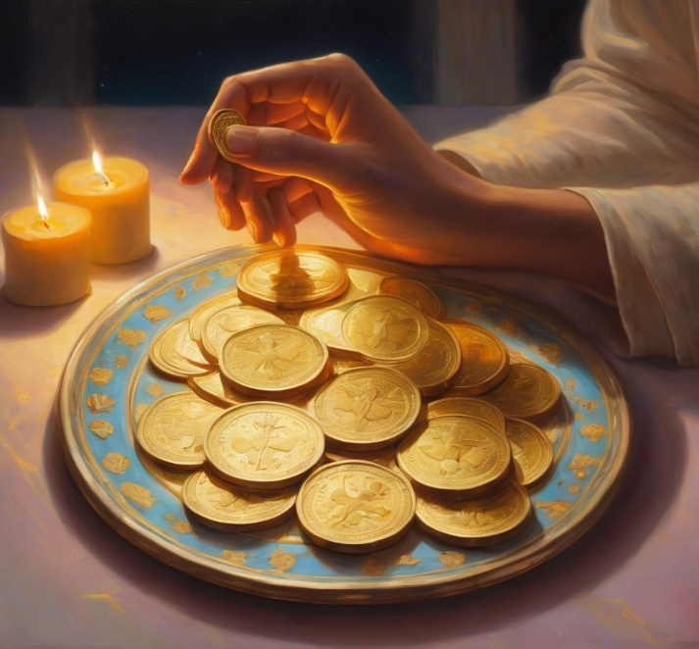
Offerings: Thank you for your regular gifts to this ministry
Offerings are most welcome via
Regular or one-off Direct Debit (International Direct Debit also available)
Bpoint credit card donation
The HHO App or Website via the Tithe.ly Give system
Leaving a legacy/bequest in will/estate
For further information go to HHO give page
https://holyhermits.com.au/give

Slide 60
Serving next week 9th November
22nd Sunday after Pentecost
9:00 am AEST
Service Prep: Leonie | Chat Host: Viki | Preacher: Troy
Music: Wiggles | Welcomer: Chris | Priest: N/A
Proof-reader: Kris | Leader: Troy | Deacon: N/A
Broadcaster: Barry | Cantor: Kieron | Fellowship: Julie
Backup Broadcaster: Paul | First Reader: Liz | Safety Officer: Leonie
Zoom Buttons: Viki | Second Reader: Jeremy | Attendance: Viki
Thank you for your ministry gifts 🙏
New servers are always welcome!
Please email holyhermits@anglicanchurchsq.org.au to get involved

Slide 61
Dismissal
Leader: May the light of Jesus shine in us.
All: Amen. Leader: May the light of Jesus shine through us to others.
All: Amen. Leader: May we all be saints for Jesus.
All: Amen.

Slide 62
Dismissal
Leader: I invite everyone to unmute for the Dismissal.
Leader: Go in peace to love and serve the Lord.
All: In the name of Christ, Amen.

Slide 63
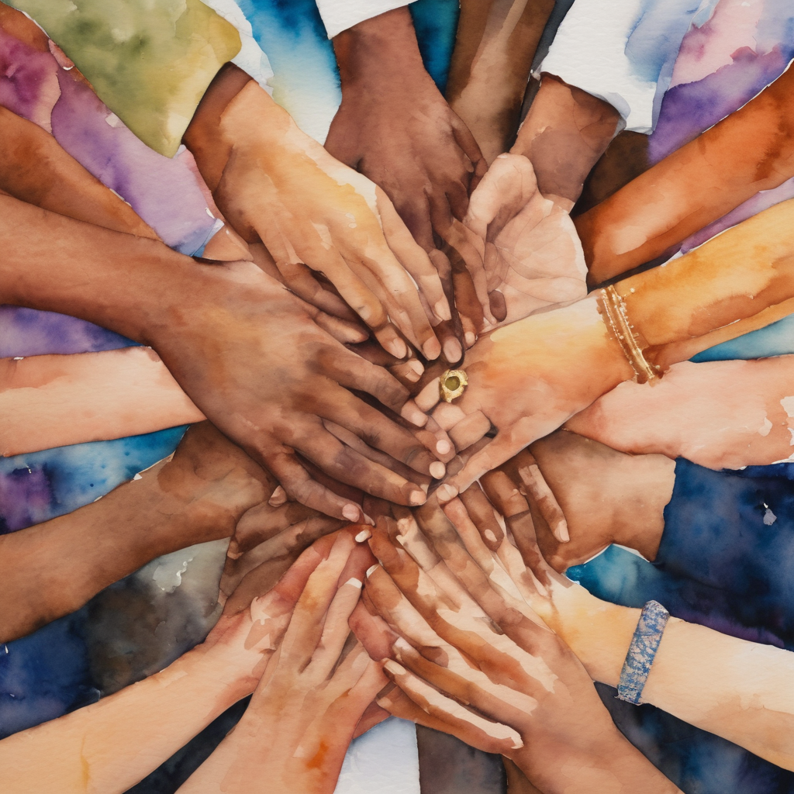
Fellowship time
Thank you, Julie for leading fellowship.
Please feel welcome to linger, pop a message in the chat, or just head off when you are ready.​
Extra resources developed
by Roots on the Web.

