Slide 1
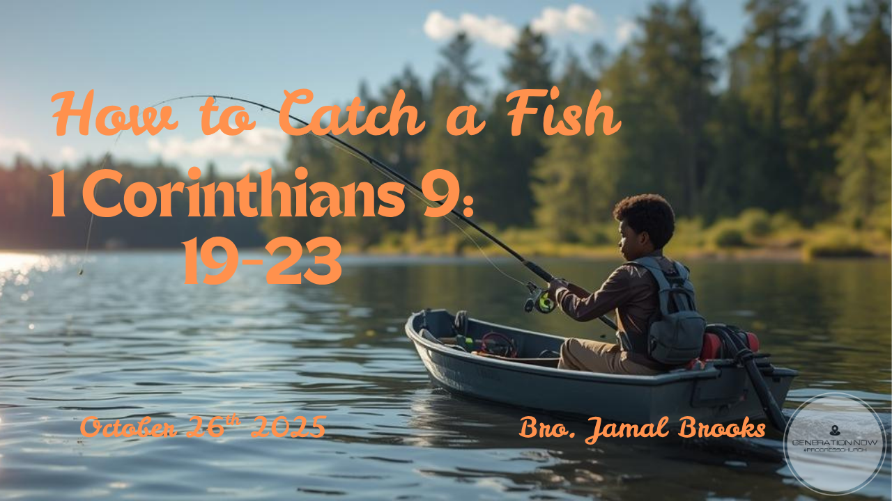

Slide 2

19 I am a free man, nobody's slave; but I make myself everybody's slave in order to win as many people as possible. 20 While working with the Jews, I live like a Jew in order to win them; and even though I myself am not subject to the Law of Moses, I live as though I were when working with those who are, in order to win them.
1 CORINTHIANS 9:19-23 GNT

Slide 3
21 In the same way, when working with Gentiles, I live like a Gentile, outside the Jewish Law, in order to win Gentiles. This does not mean that I don't obey God's law; I am really under Christ's law. 22 Among the weak in faith I become weak like one of them, in order to win them. So I become all things to all people, that I may save some of them by whatever means are possible. 23 All this I do for the gospel's sake, in order to share in its blessings.
1 CORINTHIANS 9:19-23 GNT

Slide 4

Why We Fish

Slide 5
Mark 1:17 NIV
“Come, follow me,” Jesus said, “and I will send you out to fish for people.”

Slide 6
Jesus doesn’t say, “Follow Me, and you’ll learn more about God,” but “Follow Me, and I will make you into someone who draws others to God.”
Discipleship begins with relationship, but it leads to mission

Slide 7
How To Fish

Slide 8
Fishing is not accidental — it requires planning, patience, and persistence.
Likewise, disciple-making requires:
  Casting the net → sharing the Gospel broadly.
  Using the right bait → connecting with people where they are
  Pulling the net in → walking with people toward maturity in Christ, not just a decision.

Slide 9
Our issue:
Ready made fish (aquarium/pet store)
Going to where the fish are
  Going where it uncomfortable
  Doing what is uncomfortable
  Equipping yourself with what you need, not just what you have

Slide 10
Different Nets, Same Mission
1 Corinthians 9:19-23

Slide 11
Self-Denial:
Paul denied his personal rights and privileges for the sake of the gospel, even for those who might seem "weak" in their faith or in their understanding of God's word.

Slide 12
  Paul laid down his own comfort, preferences, and even his rights so that nothing would get in the way of the Gospel
  Paul’s self-denial was not weakness, but willingness — the willingness to give up anything that might hinder someone from meeting Jesus
  Sacrificing self for someone’s salvation
  Putting mission before preference

Slide 13
Adaptability and Empathy:
Paul adapted his own life and conduct to suit different people and situations, even to the point of sharing in their weaknesses.

Slide 14
  Paul didn’t change the message, he changed his posture
  Not changing for approval — but adapting out of love so others could experience Christ
  Adapting for the mission
  Reaching by relating
  Understanding before converting

Slide 15
Becoming All Things to All People:
Paul explains his desire to be all things to all people to spread the gospel. His purpose in doing this was not for his own benefit but to win others to faith in Jesus Christ, making the effort to save as many people as possible.

Slide 16
  Meeting people where they are
  Reaching people on their level
  Bridging the gap
  Adapting without compromising

Slide 17
  Focus: winning souls, not winning arguments.
  Paul recognizes he can’t save everyone — but he will do everything possible to reach as many as he can.
  Key principle: the message never changes, but the method can.

Slide 18
Just like fishermen use different nets, lures, and techniques depending on the conditions, we must learn to approach people differently/uniquely.

Slide 19
Faith In The Fog

Slide 20
Why we doubt:
Because We See Our Limitations, Not God’s Strength
Because We Compare Ourselves to Others
Because We Struggle to Trust God’s Timing
Because of Past Failures or Wounds
Because We Forget Who’s With Us

Slide 21
God’s sovereignty, power, and presence aren’t dependent on our clarity or confidence.
He is God whether we fully trust, partially trust, or struggle to trust.

Slide 22
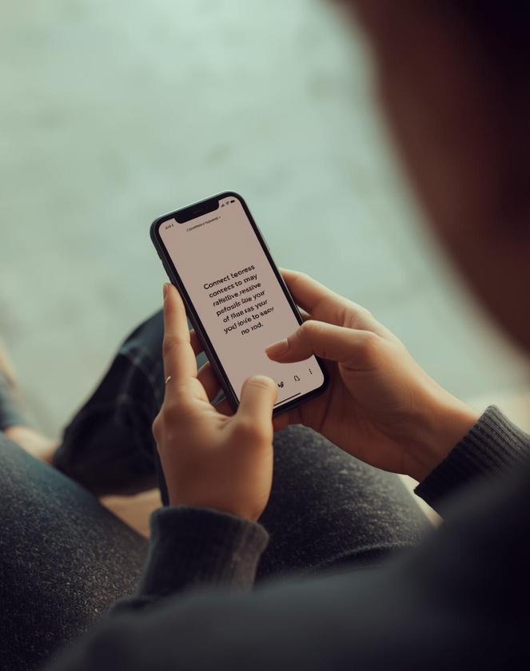
Get out of your own way
Sometimes you are your biggest obstacle
  Your thoughts
  Your habits
  Your schedule

Slide 23
Those Who Doubted
FOR ABRAHAM → DOUBTED THROUGH HUMAN LOGIC AND TIMING
FOR MOSES → DOUBTED HIS ABILITY AND CALLING
FOR GIDEON → DOUBTED GOD’S PRESENCE AND POWER
FOR THOMAS → DOUBTED THE RESURRECTION

Slide 24
DOUBT OFTEN FEELS LIKE TROUBLE IN OUR MINDS, BUT GOD DOESN’T LEAVE WHEN WE QUESTION.
HIS PRESENCE IS STEADY, EVEN WHEN OUR PERSPECTIVE IS NOT.

Slide 25
Those Who Doubted
FOR ABRAHAM → A SON
FOR MOSES → AN ENCOUNTER AT THE BURNING BUSH
FOR GIDEON → VICTORY WITH A SMALL ARMY
FOR THOMAS → A PERSONAL ENCOUNTER WITH JESUS

Slide 26
ISAIAH 41:13 NIV FOR I AM THE LORD YOUR GOD WHO TAKES HOLD OF YOUR RIGHT HAND AND SAYS TO YOU, DO NOT FEAR; I WILL HELP YOU.
HEBREWS 10:23 GNT LET US HOLD ON FIRMLY TO THE HOPE WE PROFESS, BECAUSE WE CAN TRUST GOD TO KEEP HIS PROMISE.
PSALM 94:19 GNT WHENEVER I AM ANXIOUS AND WORRIED, YOU COMFORT ME AND MAKE ME GLAD.

Slide 27

Two keys to move forward

Slide 28
Leaving the realm of potential

Slide 29
Potential is great but needs to be activated
  Exercising your gift - action
  Ministering - action
  Praying for others - action
  Fellowshipping - action
  Fishing for people - action

Slide 30
To be a fisher of men means to actively engage others with the Gospel.
  Discipleship is not passive; it’s outreach, mentoring, and multiplication.
  Every believer has a part to play — evangelizing, teaching, serving, or walking alongside someone in faith.
Ministry is movement — we don’t just receive the Gospel, we release it.

Slide 31
Partnership with Jesus

Slide 32
Jesus says, “I will make you…” — meaning it’s His work in us, not our own strength.

Slide 33
  We obey, He does the rest.
  We partner with Christ: He changes us, then uses us to reach others.
  Disciple-making is not about charisma or strategy alone but being empowered by the Spirit.

Slide 34
Ministry isn’t about instant ability; it’s about allowing Jesus to shape your character, heart, and priorities.

Slide 35
  This is a lifelong process of spiritual maturity — where your priorities align more with His
  Jesus doesn’t need perfect vessels — He needs willing ones.
  Before He works through you, He works in you.

Slide 36
2 CORINTHIANS 12:9-10 NIV
9 BUT HE SAID TO ME, “MY GRACE IS SUFFICIENT FOR YOU, FOR MY POWER IS MADE PERFECT IN WEAKNESS.” THEREFORE I WILL BOAST ALL THE MORE GLADLY ABOUT MY WEAKNESSES, SO THAT CHRIST’S POWER MAY REST ON ME. 10 THAT IS WHY, FOR CHRIST’S SAKE, I DELIGHT IN WEAKNESSES, IN INSULTS, IN HARDSHIPS, IN PERSECUTIONS, IN DIFFICULTIES. FOR WHEN I AM WEAK, THEN I AM STRONG.

Slide 37
PSALM 55:22 GNT LEAVE YOUR TROUBLES WITH THE LORD, AND HE WILL DEFEND YOU; HE NEVER LETS HONEST PEOPLE BE DEFEATED.
ROMANS 8:34 NIV WHO THEN IS THE ONE WHO CONDEMNS? NO ONE. CHRIST JESUS WHO DIED—MORE THAN THAT, WHO WAS RAISED TO LIFE—IS AT THE RIGHT HAND OF GOD AND IS ALSO INTERCEDING FOR US.

Slide 38


