Slide 1

1 Samuel 18-31
The Rise of David
– A Faithful Heart

Slide 2
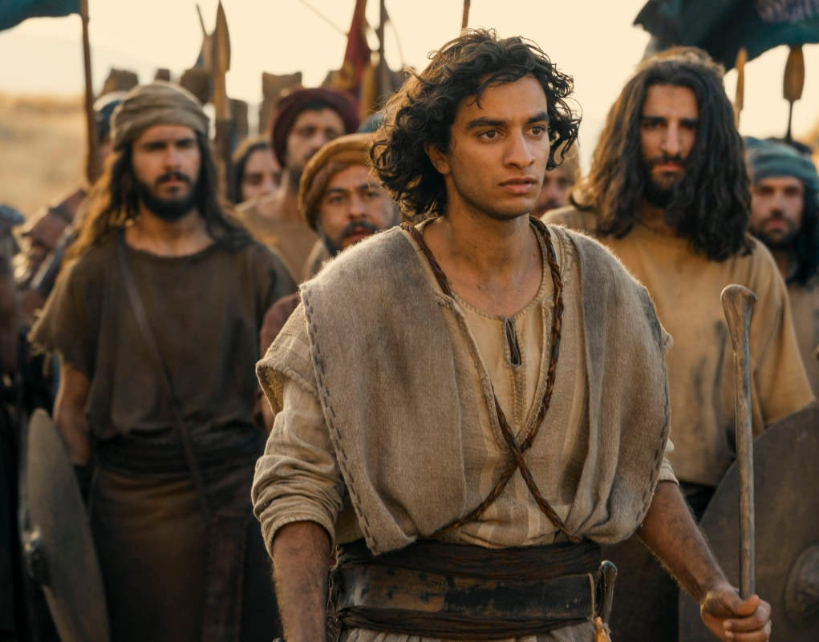
The Story
18:12 – Saul was afraid of David, because the Lord was with David but had departed from Saul.

Slide 3
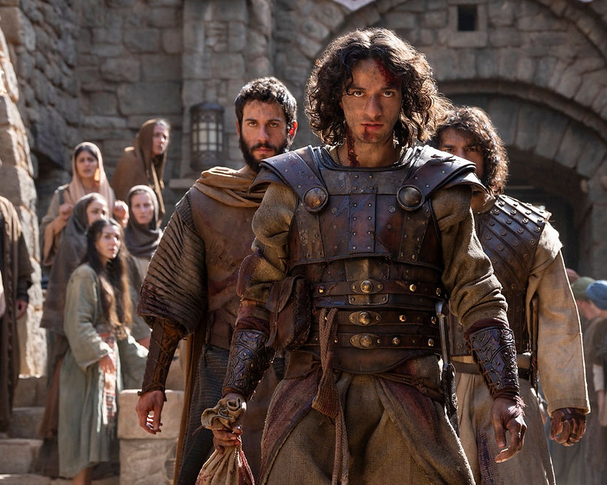
Revenge
26:8 – “Why is my lord pursuing his servant? What have I done, and what wrong am I guilty of?”

Slide 4
Two Struggles
GOD IS TOO SLOW
Psalm 38:22 – Come quickly to help me, my Lord and my Savior
Psalm 27:14 – Wait for the Lord; be strong and take heart and wait for the Lord
GOD IS NOT FAIR
Psalm 9:13 – Lord, see how my enemies persecute me! Have mercy and lift me up from the gates of death
Psalm 103:6 – The Lord works righteousness and justice for all the oppressed

Slide 5

God’s Time
2 Peter 3:9 – The Lord is not slow in keeping his promise, as some understand slowness. Instead he is patient with you, not wanting anyone to perish, but everyone to come to repentance.

Slide 6

God’s Way
1 Peter 2:19 – For it is commendable if someone bears up under the pain of unjust suffering because they are conscious of God.

Slide 7
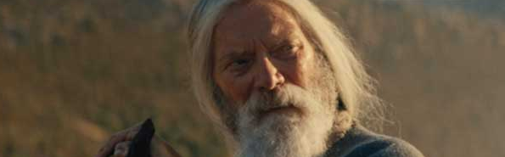
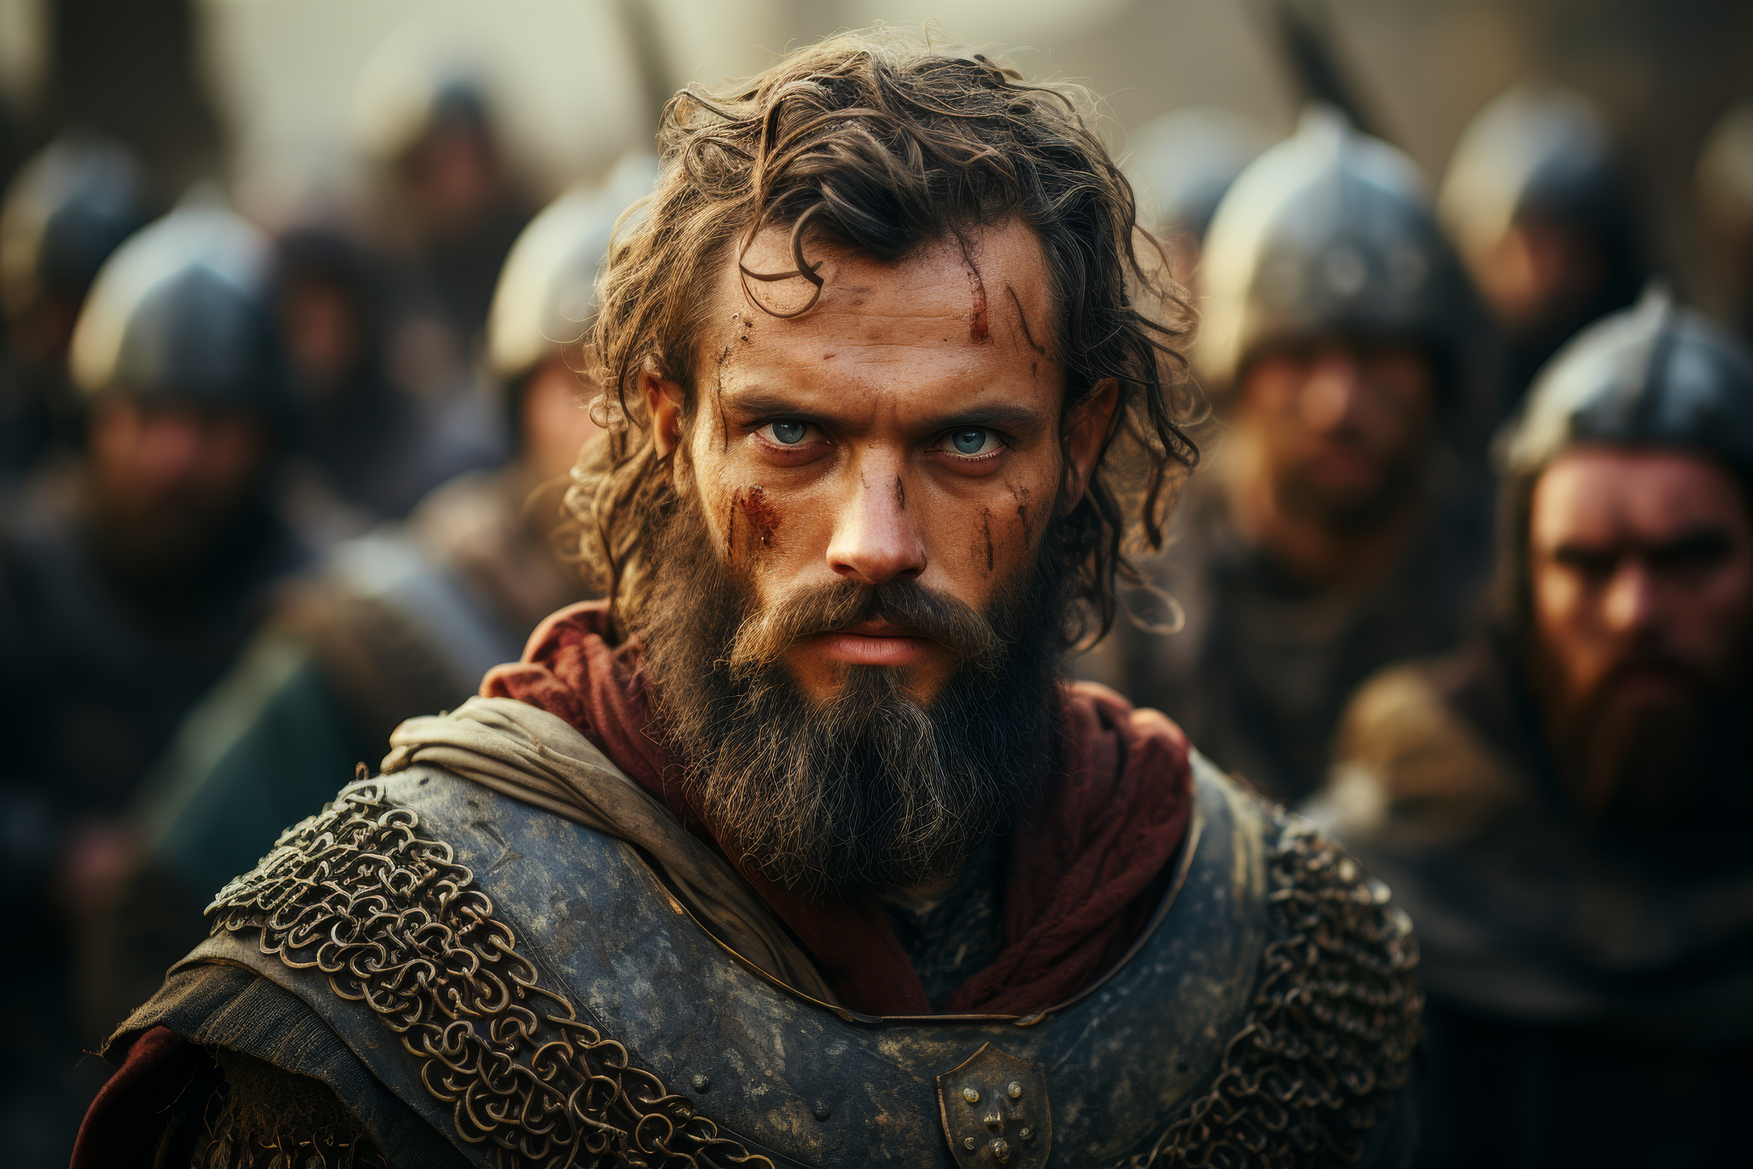
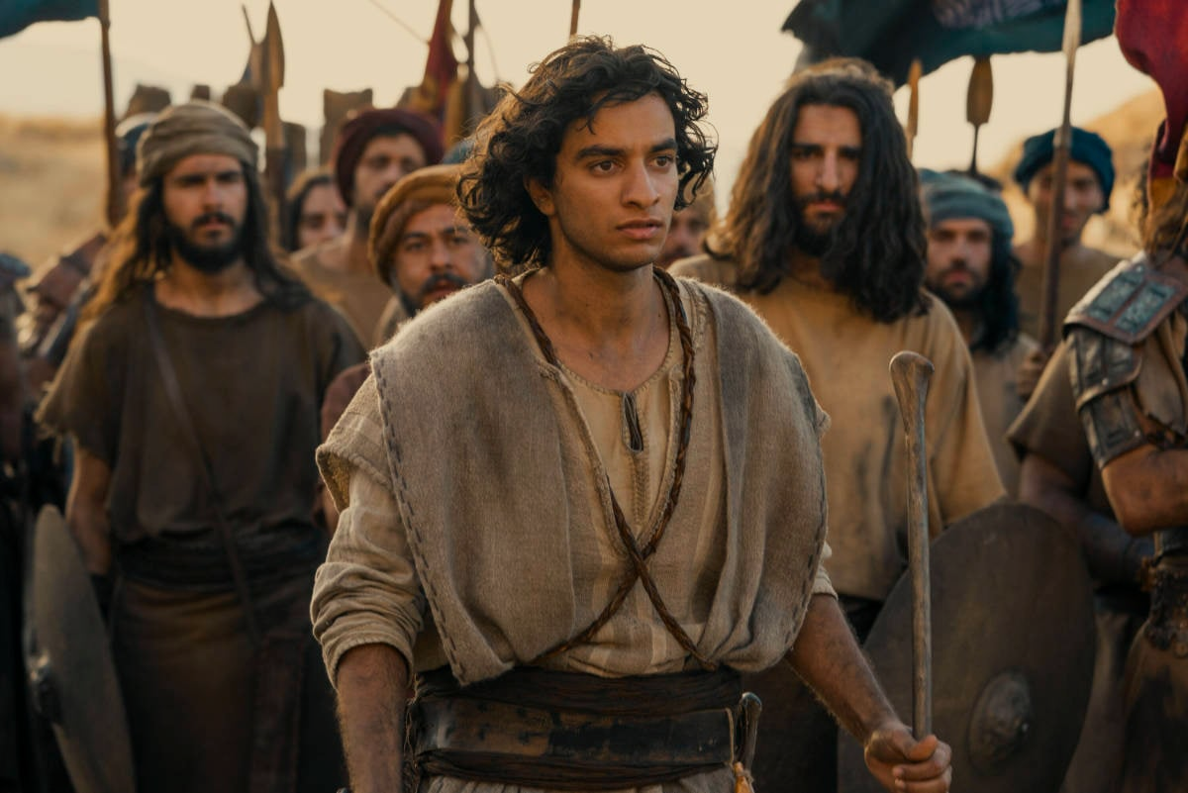
A Tale of Three Men
Samuel Saul David

Slide 8
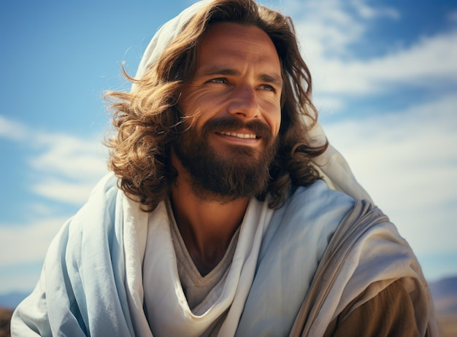
A Grand Plan
Romans 5:6 – You see, at just the right time, when we were still powerless, Christ died for the ungodly.

