Slide 1
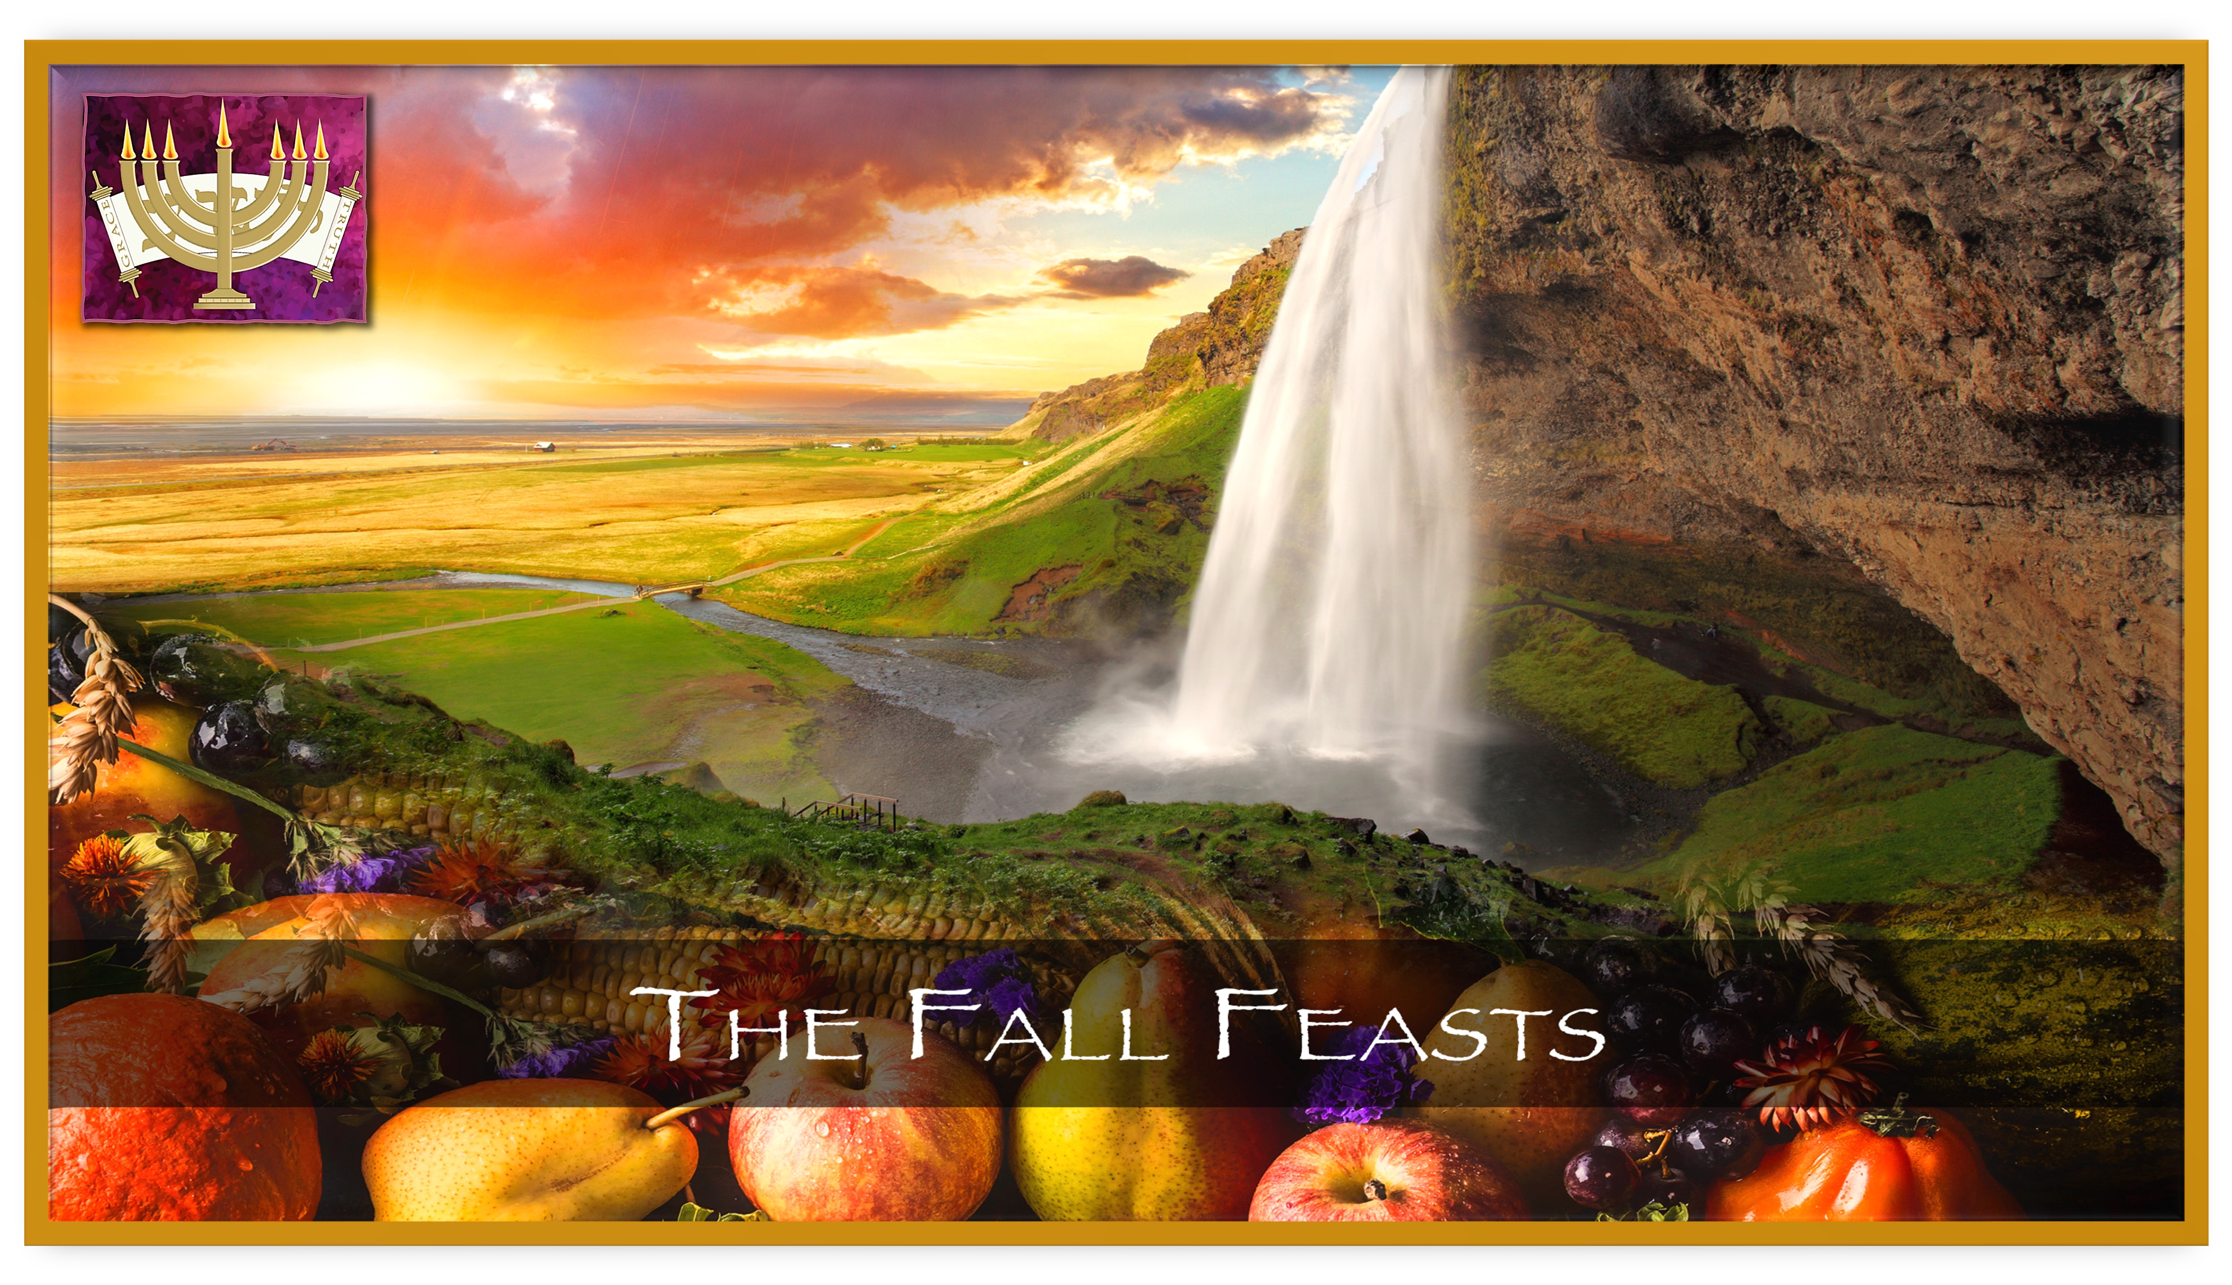
- Yom T’ruah -
Yom’im Nora’im
- Yom Kippur –
- Sukkot -
- Hoshana Raba - - Sh’mini Atzeret -

Slide 2
Genesis 1
¹⁴ God said, “Let there be lights in the dome of the sky to divide the day from the night; let them be for SIGNS, SEASONS, DAYS AND YEARS; ¹⁵ and let them be for lights in the dome of the sky to give light to the earth”; and that is how it was. ¹⁶ God made the two great lights — the larger light to rule the day and the smaller light to rule the night — and the stars.
1
2
3
Notes:
Sign – אות: a miraculous sign, proof
Seasons – מועד: designated/appointed time

Slide 3
Leviticus 23:1-2
Adonai said to Moshe, ² “Tell the people of Isra’el: ‘The DESIGNATED TIMES [FEASTS] OF ADONAI, which you are to proclaim as holy convocations are MY DESIGNATED TIMES [FEASTS].
Hebrew: יהוה מועדי – mo-eh-dey Adonai
The same word as in Genesis for “seasons” that the moon and sun will give witness to…
A time APPOINTED BY Adonai
An appointment WITH Adonai
Notes:
Just taking this statement merely at face value, the phrases “feasts of the Lord” and “My feasts” clearly point to Whom these feasts belong to. They are not Jewish feasts, nor do they merely belong to the Israelites who walked the desert for 40 years…they are the Lord’s feasts! If we take this passage for what it says: He declared them to be His feasts.

Slide 4
The Feasts of the Lord
God’s Plan of Redemption
THE GREAT SUMMER
‘HARVEST’
SPRING FEASTS
FALL FEASTS
COUNTING THE OMER
Days of Awe
PASSOVER
PESACH
FIRST FRUITS
HAG HABIKURIM
FEAST OF WEEKS
SHAVUOT
FEAST OF TRUMPETS
YOM T’RUAH
TABERNACLES
SUKKOT
Celebrating The Ingathering Of The Harvest
UNLEAVENED
BREAD
HAG HAMATZOT
DAY OF ATONEMENT
YOM KIPPUR
The Ruach HaKodesh Coming to Empower The Body of Messiah For The Harvest
1ST DAY 3RD DAY 50TH DAY 1ST DAY 10TH DAY 15TH – 22ND Day
Notes:
Through the fulfillment of the Spring Feasts, our Messiah Yeshua was sacrificed as the Passover Lamb, took upon Himself the fullness of judgment even though He was the perfect unleavened Bread of Life, and became the First Fruit of our resurrection when He was raised from the dead. In fulfilling the 1st three Feasts, Yeshua created a path for our sin nature to be purged and He prepared us to receive Torah implanted in our hearts and the infilling of the Holy Spirit on the 4th Feast – Shavuot.
We are now empowered to walk out His instructions and commands by the Power of His Spirit, which we could never to in our strength. Through the Messiah’s fulfillment of the Spring Feasts, and the invitation to be free of the nature of sin, God’s instruction (Torah) is made available to Gentiles as well – who are now joint heirs with the Children of Abraham as part of God’s family through the New Covenant. The redemption plan of God did not take a pause after Shavuot (Pentecost) and it continues to unfold right before our eyes. We are an intimate part of His plan through His call for us to be witnesses of that redemption and participate in the Great Summer Harvest. We must understand how His plan will continue to unfold, so that we can be prepared for whatever is in store. We are enlisted in God’s army, are born at THIS very time for a purpose, and we must seek Him earnestly, walk in obedience and in His strength, no matter what lies ahead.

Slide 5
The Bookends of the Summer Harvest
Deuteronomy 16
¹⁶ “Three times a year all your men are to appear in the presence of Adonai your God in the place which he will choose — at the festival of MATZAH, at the festival of SHAVU‘OT and at the festival of SUKKOT.
THEY ARE NOT TO SHOW UP BEFORE ADONAI EMPTY-HANDED, ¹⁷ but every man is to give what he can, in accordance with the blessing Adonai your God has given you.

Slide 6
John 4
³⁴ Yeshua said to them, “MY FOOD IS TO DO WHAT THE ONE WHO SENT ME WANTS AND TO BRING HIS WORK TO COMPLETION.
³⁵ Don’t you have a saying, ‘Four more months and then the harvest’? Well, what I say to you is: OPEN YOUR EYES AND LOOK AT THE FIELDS! THEY’RE ALREADY RIPE FOR HARVEST!
³⁶ The one who reaps receives his wages AND GATHERS FRUIT FOR ETERNAL LIFE, so that the reaper and the sower may be glad together –

Slide 7
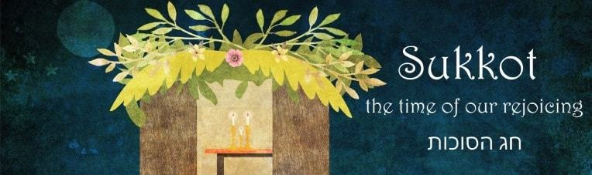
Sukkot In His Presence
Revelation 21
¹ Then I saw a new heaven and a new earth; for the first heaven and the first earth had passed away, and the sea was no more. ² I also saw the holy city—the New Jerusalem—coming down out of heaven from God, prepared as a bride adorned for her husband. ³ I also heard a loud voice from the throne, saying, “Behold, the dwelling of God is among men, and He shall TABERNACLE among them. They shall be His people, and God Himself shall be among them and be their God.
Notes:
Noun -
Verb -

Slide 8
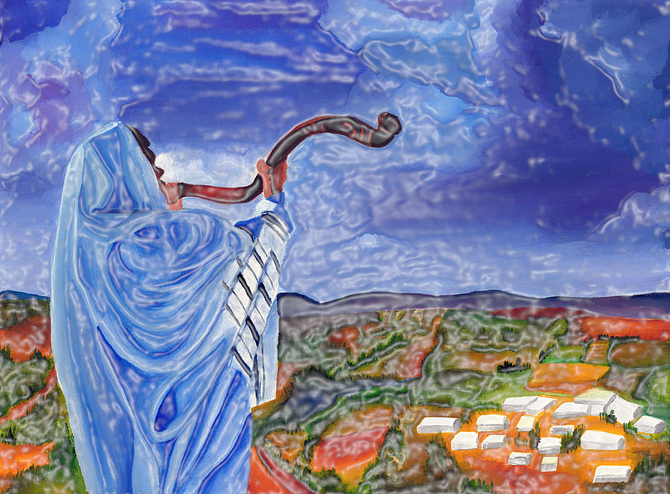
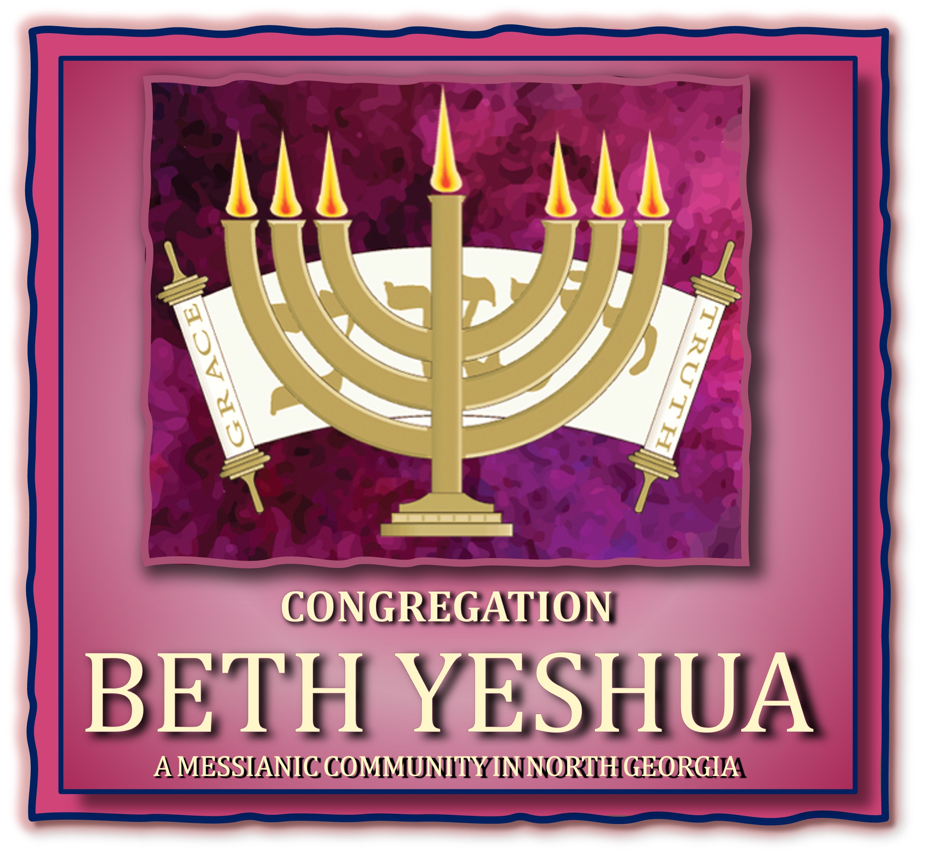
God’s Appointed Times
Hoshi’ana Rabah & Sh’mini Atzeret
All Things Are Made New

Slide 9
Sukkot Traditions
Most of what we do on Sukkot derives from rabbinic descriptions of the holiday. The Mishnah – tractate Sukkah – in addition to discussing the laws of the sukkah (chs. 1-2) and the four species (chs. 3-4), turns to other rituals, none of which are mentioned in the Bible:
The lulav and willow processions (4:4-6)
The recitation of Hallel (4:8) with accompanying shaking of the lulav (3:9)
The water libations (4:9-10) with the concomitant rejoicing at the place of the water-drawing (5:1-4) – culminating in Hosia’na Rabah
Notes:
The Mishnah is ostensibly describing the festival as it was observed in the late Second Temple period, during the time of Yeshua and until the destruction of the Temple. Nevertheless, we have earlier material which either references or alludes to the Sukkot practices in the Temple during this period. Three of these sources are in the New Testament—two in the Gospel of John and one in Revelation—where these Sukkot rituals play a vital theological role.

Slide 10
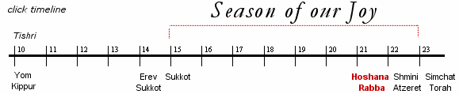
The Feast of Sukkot, Hoshia’na Rabbah & Sh’mini Atzeret

Slide 11
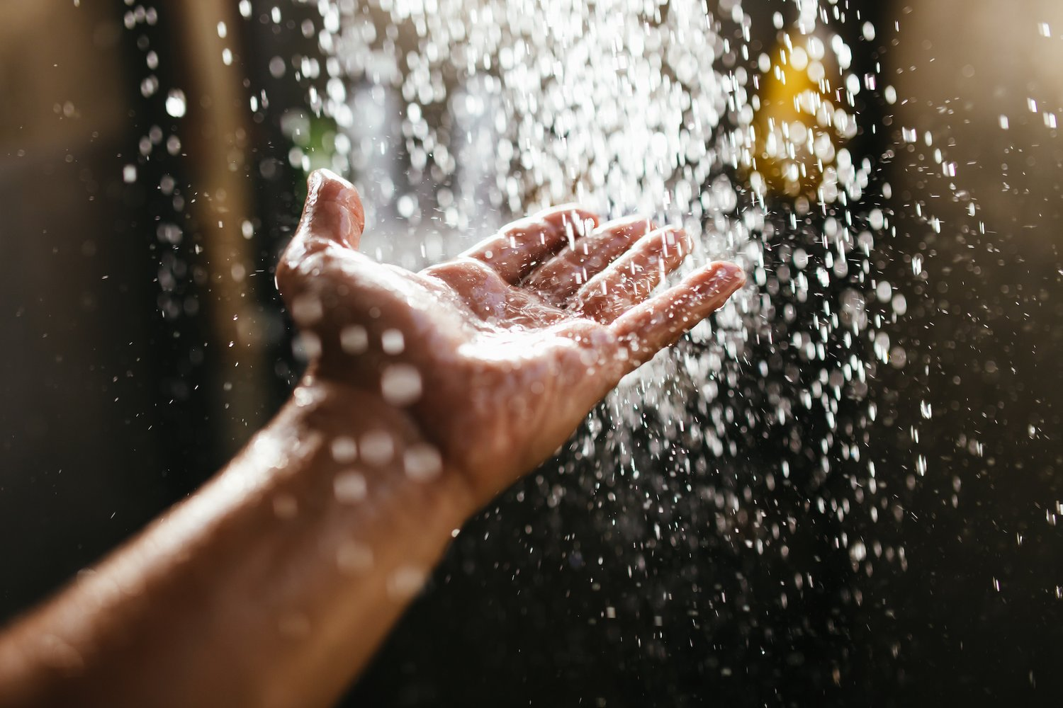
Hoshia’na rabah
God’s GREAT SALVATION

Slide 12
Hoshia’na Raba
The last and “great” day of the seven-day celebration of Sukkot

Slide 13
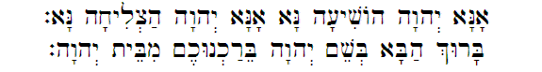
Psalm 118
It is derived from the last of the Hallel Psalms (Psalms of Praise: 113-118)
²⁵ Please, Adonai! Save us (Hoshia Na)! Please, Adonai! Rescue us! ²⁶ Blessed is he who comes in the name of Adonai. We bless you from the house of Adonai.

Slide 14
Hoshia’na Raba
Hebrew:
Hoshia’Na = Save, Please
Raba = Great
“Please Save Us With A Great Salvation”

Slide 15
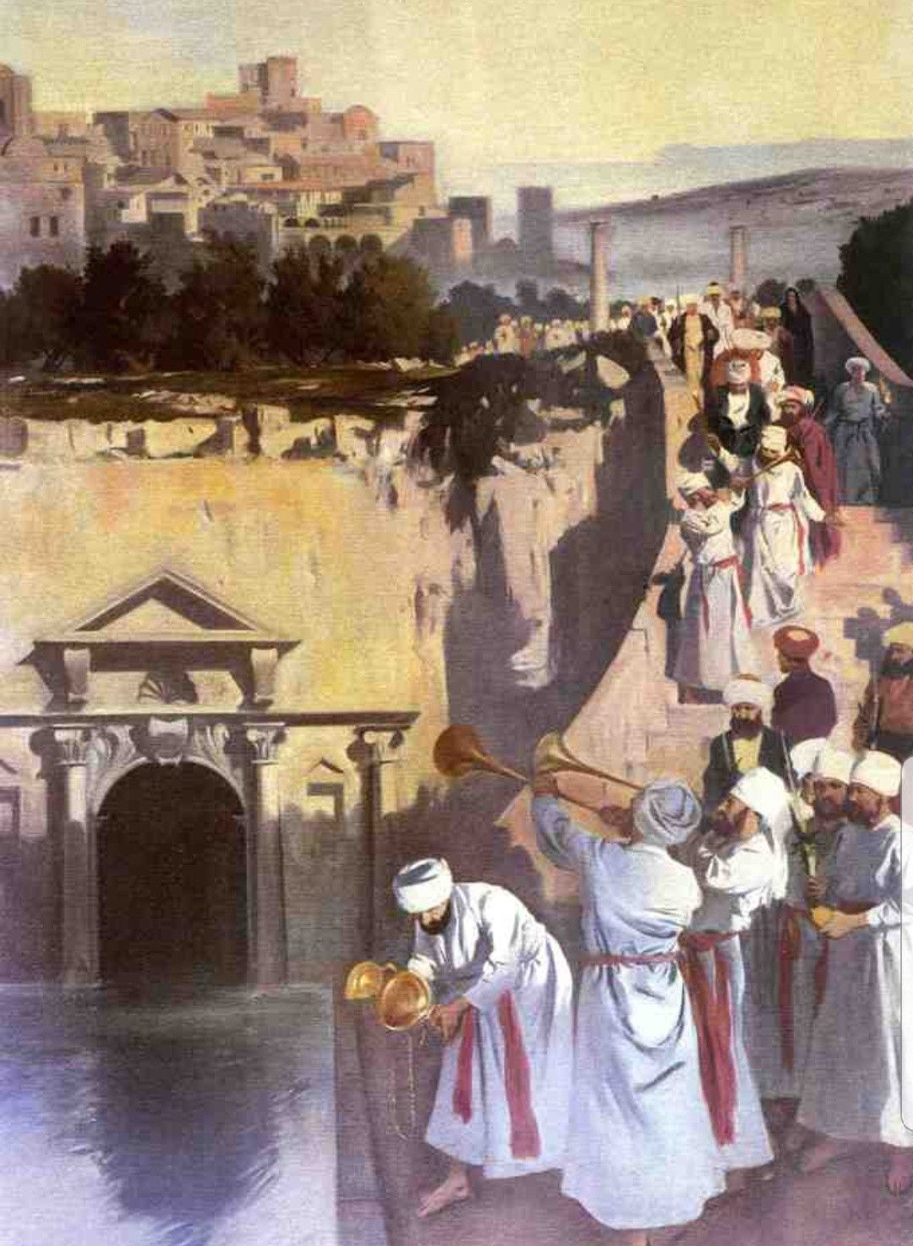
Simchat Beit Hashoavah
The water-drawing festival
Dates back centuries before the time of Yeshua
Notes:
the holiday of Sukkot is associated with water. Specifically, the Pharisees believed that the Oral Torah included a requirement for a ritual called nissuch ha-mayim, the pouring of the water, which was performed at the Temple from the second day of Sukkot through the seventh.^{[5]} This ritual is also the origin for the term the Rabbis use regarding the night time Sukkot celebrations that occurred in the Temple: Simchat Beit ha-Shoeavah, “The Celebration of the House of the Drawn Water.”

Slide 16
Simchat Beit Hashoavah
The ceremony refers to the passage in Isaiah 12
² Behold, God is my salvation; I will trust and will not be afraid; for the Lord God is my strength and my song, and he has become my salvation. ³ With joy you will draw water from the wells of salvation.”
Notes:
The priests would go down to the pool of Siloam in the City of David (just south of where the Western Wall is today) and they would fill a golden vessel with the water there. They would go up to the temple, through the Water Gate, accompanied by the sound of the shofar, and then they would pour the water so that it flowed over the altar, along with wine from another bowl. This would begin the prayers for rain in earnest, and there was much rejoicing at this ceremony.

Slide 17

Water Is About Survival
Sukkot marks the end of the dry season and the beginning of the rainy season in Israel
This transition from dry season to rainy season is so critical to the survival of Israel
Without water, there are no crops
Without crops, there is no harvest
Without harvest, there is no survival
Notes:
Considering the devastating nature of a drought, the desperation in the tone of the Hoshana Rabbah prayers begins to make more sense.

Slide 18
The End of The Fall Feasts
Jewish tradition also sees Hoshia’na Rabbah as the final day of the High Holiday cycle, the last day before the decrees go into effect
It is the day the “gates of heaven” are closed and the new beginning for those whose names are sealed in the Book of Life

Slide 19
John 7
1 After this, Yeshua traveled around in the Galil, intentionally avoiding Y’hudah because the Judeans were out to kill him. 2 But the festival of Sukkot in Y’hudah was near; 3 so his brothers said to him, “Leave here and go into Y’hudah, so that your talmidim can see the miracles you do; 4 for no one who wants to become known acts in secret. If you’re doing these things, show yourself to the world!” 5 (His brothers spoke this way because they had not put their trust in him.)
Notes:
Unlike the other gospels, John has Jesus coming to Jerusalem numerous times, and specifically for the holiday Sukkot. In John 7, Jesus is encouraged to go to Jerusalem for the holiday, since it is a major event where he could make his debut (John 7:2-4)
. Jesus then teaches at the Temple throughout the holiday, causing dissent among those who believe he is a prophet (7:40), those who believe he is a messiah (7:41), and others who think he is a fraud altogether (7:44–52).
Jesus’ Hoshana Rabbah
Jesus appears on Sukkot because this festival, already in the Second Temple period, was associated with messianic tropes.^{[7]} For example, the eschatological vision of Zechariah 14, which is one of the haftarah readings for Sukkot, culminates in the prophecy that all nations will eventually come to the Temple yearly, to worship YHWH, specifically on Sukkot: Zechariah 14:16
This lies in the background of Jesus’ speech at the end of the festival (John 7:37–39)
While some scholars identify “the great day” with Shemini Atzeret, the festival of the eighth day which follows Sukkot, it is more likely that it refers to Hoshanah Rabbah (the seventh day of Sukkot), which is specifically referred to as “great” (rabbah). Additionally, Jesus’ reference to the living waters is almost certainly meant as a play on the water libation ritual that, according to the Mishnah, took place in the Temple on each of the second through seventh days of Sukkot, culminating on Hoshana Rabbah.
By referring to “living waters” flowing from the believers’ hearts, Jesus also alludes to the eschatological (end time) waters that will flow from the Temple, described at length in one of Ezekiel’s final visions (Ezek 47:1-12)
These waters will become a powerful stream that will make brackish waters wholesome and give rise to fruit trees.^{[11]} More specifically, Jesus’ term “living waters” echoes the term used in Zechariah for this eschatological stream, described as flowing out of Jerusalem (Zech 14:8-9)
Revelation 7
Yeshua went to celebrate the feast of Sukkot in Jerusalem, and John chapter 7 describes what Yeshua said and did at this climactic time, two millennia ago…

Slide 20
John 7
6 Yeshua said to them, “My time has not yet come; but for you, any time is right. 7 The world can’t hate you, but it does hate me, because I keep telling it how wicked its ways are. 8 You, go on up to the festival; as for me, I am not going up to this festival now, because the right time for me has not yet come.” 9 Having said this, he stayed on in the Galil.
Notes:
Unlike the other gospels, John has Jesus coming to Jerusalem numerous times, and specifically for the holiday Sukkot. In John 7, Jesus is encouraged to go to Jerusalem for the holiday, since it is a major event where he could make his debut (John 7:2-4). Jesus then teaches at the Temple throughout the holiday, causing dissent among those who believe he is a prophet (7:40), those who believe he is a messiah (7:41), and others who think he is a fraud altogether (7:44–52).
Jesus’ Hoshana Rabbah
Jesus appears on Sukkot because this festival, already in the Second Temple period, was associated with messianic tropes.^{[7]} For example, the eschatological vision of Zechariah 14, which is one of the haftarah readings for Sukkot, culminates in the prophecy that all nations will eventually come to the Temple yearly, to worship YHWH, specifically on Sukkot: Zechariah 14:16
This lies in the background of Jesus’ speech at the end of the festival (John 7:37–39)
While some scholars identify “the great day” with Shemini Atzeret, the festival of the eighth day which follows Sukkot, it is more likely that it refers to Hoshanah Rabbah (the seventh day of Sukkot), which is specifically referred to as “great” (rabbah). Additionally, Jesus’ reference to the living waters is almost certainly meant as a play on the water libation ritual that, according to the Mishnah, took place in the Temple on each of the second through seventh days of Sukkot, culminating on Hoshana Rabbah.
By referring to “living waters” flowing from the believers’ hearts, Jesus also alludes to the eschatological (end time) waters that will flow from the Temple, described at length in one of Ezekiel’s final visions (Ezek 47:1-12)
These waters will become a powerful stream that will make brackish waters wholesome and give rise to fruit trees.^{[11]} More specifically, Jesus’ term “living waters” echoes the term used in Zechariah for this eschatological stream, described as flowing out of Jerusalem (Zech 14:8-9)
Revelation 7
Yeshua went to celebrate the feast of Sukkot in Jerusalem, and John chapter 7 describes what Yeshua said and did at this climactic time, two millennia ago…

Slide 21
John 7
10 But after his brothers had gone up to the festival, he too went up, not publicly but in secret. 11 At the festival, the Judeans were looking for him. “Where is he?” they asked. 12 And among the crowds there was much whispering about him. Some said, “He’s a good man”; but others said, “No, he is deceiving the masses.” 13 However, no one spoke about him openly, for fear of the Judeans. 14 Not until the festival was half over did Yeshua go up to the Temple courts and begin to teach.

Slide 22
John 7
28 Whereupon Yeshua, continuing to teach in the Temple courts, cried out, “Indeed you do know me! And you know where I’m from! And I have not come on my own! The One who sent me is real. But him you don’t know! 29 I do know him, because I am with him, and he sent me!” 30 At this, they tried to arrest him; but no one laid a hand on him; because his time had not yet come. 31 However, many in the crowd put their trust in him and said, “When the Messiah comes, will he do more miracles than this man has done?”
Notes:
Jesus then teaches at the Temple throughout the holiday, causing dissent among those who believe he is a prophet (7:40), those who believe he is a messiah (7:41), and others who think he is a fraud altogether (7:44–52).
Jesus’ Hoshana Rabbah
Jesus appears on Sukkot because this festival, already in the Second Temple period, was associated with messianic prophecies.^{[7]} The eschatological vision of Zechariah 14, which is one of the haftarah readings for Sukkot, culminates in the prophecy that all nations will eventually come to the Temple yearly, to worship the God of Abraham, Isaac & Jacob, specifically on Sukkot: Zechariah 14:16
This lies in the background of Jesus’ proclamation at the end of the festival (John 7:37–39)

Slide 23
John 7
³⁷ Now on the last day of the festival, Hoshana Rabbah, Yeshua stood and cried out, “IF ANYONE IS THIRSTY, LET HIM KEEP COMING TO ME AND DRINKING! ³⁸ WHOEVER PUTS HIS TRUST IN ME, AS THE SCRIPTURE SAYS, RIVERS OF LIVING WATER WILL FLOW FROM HIS INMOST BEING!” ³⁹ (Now he said this about the Spirit, whom those who trusted in him were to receive later — the Spirit had not yet been given, because Yeshua had not yet been glorified.)
Notes:
Jesus’ reference to the living waters is almost certainly meant as a play on the water libation ritual that, according to the Mishnah, took place in the Temple on each of the second through seventh days of Sukkot, culminating on Hoshana Rabbah.
By referring to “living waters” flowing from the believers’ hearts, Jesus also alludes to the eschatological (end time) waters that will flow from the Temple, described at length in one of Ezekiel’s final visions (Ezek 47:1-12)
These waters will become a powerful stream that will make brackish waters wholesome and give rise to fruit trees.^{[11]} More specifically, Jesus’ term “living waters” echoes the term used in Zechariah for this eschatological stream, described as flowing out of Jerusalem (Zech 14:8-9)
Revelation 7
Yeshua went to celebrate the feast of Sukkot in Jerusalem, and John chapter 7 describes what Yeshua said and did at this climactic time, two millennia ago…

Slide 24
Isaiah 55
¹ “All you who are thirsty, come to the water! You without money, come, buy, and eat! Yes, come! Buy wine and milk without money — it’s free! ² Why spend money for what isn’t food, your wages for what doesn’t satisfy? Listen carefully to me, and you will eat well, you will enjoy the fat of the land.

Slide 25
Isaiah 55
³ Open your ears, and come to me; listen well, and you will live — I will make an everlasting covenant with you, the grace I assured David. ⁴ I have given him as a witness to the peoples, a leader and lawgiver for the peoples. ⁵ You will summon a nation you do not know, and a nation that doesn’t know you will run to you, for the sake of Adonai your God, the Holy One of Isra’el, who will glorify you.”

Slide 26
Isaiah 55
⁶ Seek Adonai while he is available, call on him while he is still nearby. ⁷ Let the wicked person abandon his way and the evil person his thoughts; let him return to Adonai, and he will have mercy on him; let him return to our God, for he will freely forgive.

Slide 27
Zechariah 14
8 On that day, FRESH WATER WILL FLOW OUT FROM YERUSHALAYIM, half toward the eastern sea and half toward the western sea, both summer and winter. 9 Then Adonai will be king over the whole world. On that day Adonai will be the only one, and his name will be the only name. 10 All the land will be made like the ‘Aravah, from Geva to Rimmon in the Negev. Yerushalayim will be raised up and inhabited where she is, from Binyamin’s Gate to the place where the earlier gate stood, and on to the Corner Gate, and from the Tower of Hanan’el to the king’s winepresses. 11 People will live there, the curse will be broken, and Yerushalayim will live in safety.

Slide 28
Zechariah 14
12 Adonai will strike all the peoples who made war against Yerushalayim with a plague in which their flesh rots away while they are standing on their feet, their eyes rot away in their sockets, and their tongues rot away in their mouths.
16 Finally, everyone remaining from all the nations that came to attack Yerushalayim will go up every year to worship the king, Adonai-Tzva’ot, and TO KEEP THE FESTIVAL OF SUKKOT.

Slide 29
The Full Circle of God’s Plan of Redemption
Sh’mini Atzeret

Slide 30
Shemeni Atzeret – New Beginnings
Leviticus 23
³³ Adonai said to Moshe, ³⁴ “Tell the people of Isra’el, ‘On the fifteenth day of this seventh month is the feast of Sukkot for seven days to Adonai. ³⁵ On the first day there is to be a holy convocation; do not do any kind of ordinary work. ³⁶ For seven days you are to bring an offering made by fire to Adonai; ON THE EIGHTH DAY you are to have a HOLY CONVOCATION and bring an offering made by fire to Adonai; it is a day of PUBLIC ASSEMBLY; do not do any kind of ordinary [laborious] work.”
עָצַר ‛âtzar
To stop, close, retain, end, complete
Notes:
The final day of Fall Feasts comes after the 7-day Sukkot celebration – God commands one final Sabbath at the end of all the feasts: called Shemeni Atzeret or the eighth day. The number 8 has biblical significance, because it carries with it the symbolism of “new beginnings”

Slide 31
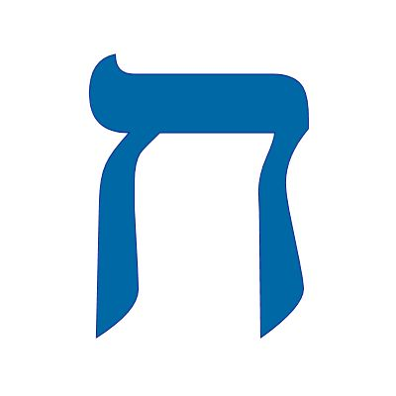
Eight – Sh’monah
Literally to “make fat”
New beginnings, not just completion (7), but overflowing (8)
Becoming “fat” is having more than enough
Moving from the temporary to the eternal, from natural time and space to the “Forever” realm.
Eight takes one through a full cycle of seven and begins anew: the First Day – Yom Echad – of creation [again]

Slide 32
Revelation 21
¹ Then I saw a NEW heaven and a NEW earth, for the old heaven and the old earth had passed away, and the sea was no longer there. ² Also I saw the holy city, NEW Yerushalayim, coming down out of heaven from God, prepared like a bride beautifully dressed for her husband.
Notes:
Revelation 21:1 Isaiah 65:17, 66:22
Revelation 21:3 – Leviticus 26:11–12; Isaiah 7:14; 8:8, 10; Jeremiah 31:33(34); Ezekiel 37:27; 2 Chronicles 6:18

Slide 33
Revelation 21
³ I heard a loud voice from the throne say, “See! God’s Sh’khinah is with mankind, and HE WILL LIVE WITH THEM. They will be His people, and He Himself, God-with-them, will be their God.
⁴ He will WIPE AWAY EVERY TEAR from their eyes.
There will NO LONGER BE ANY DEATH; and there will NO LONGER BE ANY MOURNING, CRYING OR PAIN;
BECAUSE THE OLD ORDER HAS PASSED AWAY.”
Notes:
Revelation 21:1 Isaiah 65:17, 66:22
Revelation 21:3 – Leviticus 26:11–12; Isaiah 7:14; 8:8, 10; Jeremiah 31:33(34); Ezekiel 37:27; 2 Chronicles 6:18

Slide 34
Revelation 21
⁵ Then the One sitting on the throne said, “LOOK! I AM MAKING EVERYTHING NEW!” Also, he said, “Write, ‘These words are true and trustworthy!’” ⁶ And he said to me, “IT IS DONE [completed: עָצַר – atzar]!
I am the ‘A’ and the ‘Z,’ the BEGINNING AND THE END.
TO ANYONE WHO IS THIRSTY I MYSELF WILL GIVE WATER FREE OF CHARGE FROM THE FOUNTAIN OF LIFE.
Notes:
Done – An allusion to the 8th day – Sh’mini Atzeret
Water – An allusion to Hoshana Rabah

Slide 35
Revelation 21
⁷ He who wins the victory will receive these things, and I will be his God, and HE WILL BE MY SON.
Notes:
Done – An allusion to the 8th day – Sh’mini Atzeret
Water – An allusion to Hoshana Rabah

Slide 36
Ephesians 1 – God’s Plan of Redemption
⁴ In the Messiah, HE CHOSE US IN LOVE BEFORE THE CREATION OF THE UNIVERSE TO BE HOLY AND WITHOUT DEFECT IN HIS PRESENCE.
⁵ HE DETERMINED IN ADVANCE THAT THROUGH YESHUA THE MESSIAH, WE WOULD BE HIS SONS — in keeping with his pleasure and purpose —
Romans 8
18 I don’t think the sufferings we are going through now are even worth comparing with the glory that will be revealed to us in the future. 19 The creation waits eagerly for the sons of God to be revealed

Slide 37
Sukkot
The Book of Revelation reveals the FINAL SUKKOT, HOSHANA RABBAH, & ATZERET
It will commence with God coming to TABERNACLE – to DWELL with His people and His people will DWELL with Him forevermore
And on the “Eighth Day,” He MAKES ALL THINGS NEW!!!!

Slide 38
The Time of Our Rejoicing
Z’man Simchatenu
The “Micrey Kodesh” [Holy Rehearsal] of Sukkot…
ALL THE FRUIT OF THE HARVEST HAS BEEN GATHERED!!!
…And of Sh’mini Atzeret
IT IS DONE!!!
THE BOOKS ARE CLOSED!!!
ALL THINGS ARE MADE NEW

Slide 39
Isaiah 66
(22) “For just as the new heavens and the new earth, which I will make, will endure before Me”—it is a declaration of Adonai—“so your descendants and your name will endure.”
(23) “And it will come to pass, that from one New Moon to another, and from one Shabbat to another, ALL FLESH WILL COME TO BOW DOWN BEFORE ME,” says Adonai.
Notes:
Remember the passage in the book of Isaiah that Yeshua did not read? Well, as I mentioned, the theme of the passage continues until the end of Isaiah – the last three verses of the book are as follows:

Slide 40
Ephesians 1 – God’s Plan of Redemption
⁷ In union with him, THROUGH THE SHEDDING OF HIS BLOOD, WE ARE SET FREE — OUR SINS ARE FORGIVEN; this accords with the wealth of the grace ⁸ he has LAVISHED on us.
In all his wisdom and insight ⁹ HE HAS MADE KNOWN TO US HIS SECRET PLAN, which by his own will he designed beforehand in connection with the Messiah

Slide 41
Ephesians 1 – God’s Plan of Redemption
¹⁰ and will put into effect WHEN THE TIME IS RIPE — HIS PLAN TO PLACE EVERYTHING IN HEAVEN AND ON EARTH UNDER THE MESSIAH’S HEADSHIP.
¹¹ Also in union with him WE WERE GIVEN AN INHERITANCE, we who were picked in advance according to the purpose of the One who effects everything in keeping with the decision of his will, ¹² so that we WHO EARLIER HAD PUT OUR HOPE IN THE MESSIAH WOULD BRING HIM PRAISE commensurate with his glory.

Slide 42
Ephesians 1 – God’s Plan of Redemption
¹³ Furthermore, you who heard the message of the truth, the Good News offering you deliverance, and PUT YOUR TRUST IN THE MESSIAH WERE SEALED BY HIM WITH THE PROMISED RUACH HAKODESH,
¹⁴ who guarantees our inheritance UNTIL WE COME INTO POSSESSION OF IT and thus bring him praise commensurate with his glory.

Slide 43
Redemption: The Ultimate Purpose of God
The goal of God's plan of redemption and the ultimate purpose of Yeshua’s second coming and the Fall Feasts:
1. The redemption of Israel, the Resurrection of the believer and the concomitant call to war – The final Yom T’ruah
2. The wrath of God poured out on evil – The Days of Awe
3. Opening the Scroll of Life: the final separation of good and evil, the eradication of all sin, the purifying of His people to fully become the promised Holy Nation – The final Yom Kippur
Notes:
– The Transition From This Age to The Age to Come

Slide 44
Redemption: The Ultimate Purpose of God
4. The celebration of the Ingathering of the Harvest on the Final Sukkot
5. The establishment of His Kingdom on the earth, the New Jerusalem – The Marriage Supper of the Lamb – so that Adonai may dwell with us, IN HIS FULL SH’CHINAH GLORY, and we with Him, with no possibility of sin and evil – Hoshana Raba into the Eighth Day Celebration

Slide 45
THE REDEMPTION PLAN OF GOD
THE
“EIGHTH” DAY
IT IS DONE!
Isaiah 61
“THE YEAR OF THE LORD’S FAVOR”
Isaiah 61
The Day of The Lord
THE GREAT SUMMER
‘HARVEST’
THE GREAT TRIBULATION
THE CRY OF
HOSHIA’NA WILL BE HEARD
SPRING FEASTS
FALL FEASTS
COUNTING THE OMER
Days of Awe
Gods Wrath Upon Evil
Tarrying In Jerusalem Until Power On High
FEAST OF TRUMPETS
YOM T’RUAH
TABERNACLES
SUKKOT
&
HOSHANA RABAH
PASSOVER
PESACH
FIRST FRUITS
HAG HABIKURIM
FEAST OF WEEKS
SHAVUOT
UNLEAVENED
BREAD
HAG HAMATZOT
The Redemption of Israel & The Resurrection The Second Coming of Messiah
DAY OF ATONEMENT
YOM KIPPUR
God Dwelling With Us
&
Water of Life
The Ruach HaKodesh Coming to Inhabit & Empower The Body of Messiah
Death, Burial And Resurrection of Messiah
The Judgment Seat:
Sheep & Goat
Opening the Scroll of Life
Notes:
Through the fulfillment of the Spring Feasts, our Messiah Yeshua was sacrificed as the Passover Lamb, took upon Himself the fullness of judgment even though He was the perfect unleavened Bread of Life, and became the First Fruit of our resurrection when He was raised from the dead
In fulfilling the 1st three Feasts, Yeshua created a path for our sin nature to be purged and He prepared us to receive His Spirit/His Torah implanted on our hearts and the empowering to carry on the great summer harvest on the 4th Feast - Shavuot
We are now empowered to walk out His instructions and commands by the Power of His Spirit, which we could never do in our strength
Through the Messiah’s fulfillment of the Spring Feasts, and the invitation to be holy as He is holy, God’s instruction (Torah) is made available to Gentiles as well – who are now joint heirs with the Children of Abraham as part of God’s family through the New Covenant
The redemption plan of God did not take a pause after Shavuot (Pentecost) and it continues to unfold right before our eyes
We are an intimate part of His plan through His call for us to be witnesses of that redemption and participate in the Great Summer Harvest
We must understand how His plan will continue to unfold, so that we can be prepared for whatever is in store
We are enlisted in God’s army, are born at THIS very time for a purpose, and we must seek Him earnestly, walk in obedience and in His strength, no matter what lies ahead
Through the direction that our world is taking, the manifestation of the “Great” time of tribulation for Israel, the Body of Messiah (and ultimately the world), we will see that God’s plan of redemption includes the exposing of sin and evil in its fullness for what it is and to expose those given over to it – there will be no excuse

Slide 46
Redemption: The Ultimate Purpose of God
HOSHIA’NA RABA – THE CULMINATION OF THE REDEMPTION PLAN OF GOD
Sh’mini Atzeret the culmination of all the other appointed times of God
THE NEW BEGINNING!!

Slide 47
Revelation 22
¹ Next the angel showed me the river of the water of life, sparkling like crystal, flowing from the throne of God and of the Lamb. ² Between the main street and the river was the Tree of Life producing twelve kinds of fruit, a different kind every month; and the leaves of the tree were for healing the nations — ³ no longer will there be any curses.

Slide 48
Revelation 22
The throne of God and of the Lamb will be in the city, and his servants will worship him; ⁴ they will see his face, and his name will be on their foreheads. ⁵ Night will no longer exist, so they will need neither the light of a lamp nor the light of the sun, because Adonai, God, will shine upon them. And they will reign as kings forever and ever.

Slide 49
Revelation 22
¹² “PAY ATTENTION!” [says Yeshua,] “I am coming soon, and my rewards are with me to give to each person according to what he has done. ¹³ I am the ‘A’ and the ‘Z,’ the First and the Last, the Beginning and the End.”

Slide 50
Revelation 22
¹⁴ How blessed are those who wash their robes, so that they have the right to eat from the Tree of Life and go through the gates into the city!

Slide 51
Revelation 22
¹⁶ I am the Root and Offspring of David, the bright Morning Star. ¹⁷ The Spirit and the Bride say, ‘Come!’ Let anyone who hears say, ‘Come!’ And let anyone WHO IS THIRSTY COME — LET ANYONE WHO WISHES, TAKE THE WATER OF LIFE FREE OF CHARGE.”

Slide 52
Revelation 22
²⁰ “THE ONE WHO IS TESTIFYING TO THESE THINGS SAYS, ‘YES, I AM COMING SOON!’”
AMEN! COME, LORD YESHUA!

