Slide 1

Preaching, Narrative, and Storytelling
Introductions
Session One: The Sermon and the Story
Session Two: The Speaker
Session Three: How Did Jesus Teach?
Session Four: Methods and Practices

Slide 2
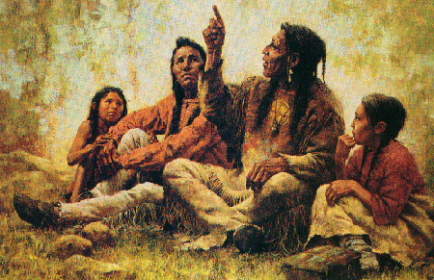

Preaching, Narrative, and Storytelling
Session One: The Sermon and the Story

Slide 3
What is your experience with the sermon?
Best sermon?
Worst sermon?
Most memorable?
What role have sermons played in your spiritual formation?
What do you look for in a sermon?
Strategy, spirituality, chemistry, imagination, learning, etc.

Slide 4
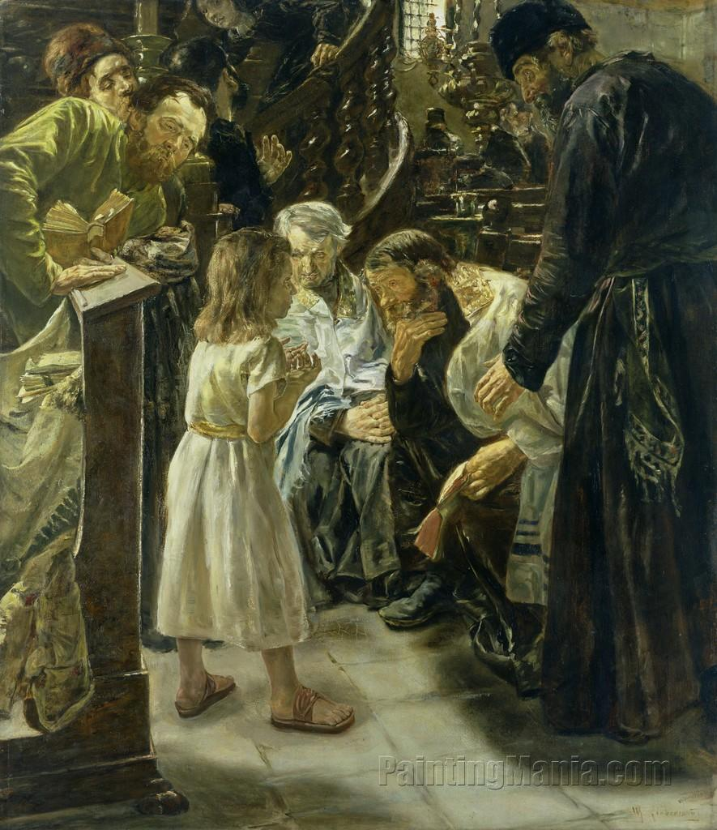
The history of the sermon
Tabernacle/Temple worship: the relationship between YHWH and Israel was revealed in the physical structure, the rituals enacted the story (sacrifices, cleansing, incense, feasts, etc.), psalms sung, reading of writings, laws, prophets, etc.
Synagogue (house of assembly): reading of text followed by interpretation/teaching, interactive discussion, a child allowed to engage in dialogue (Jesus at 12)

Slide 5
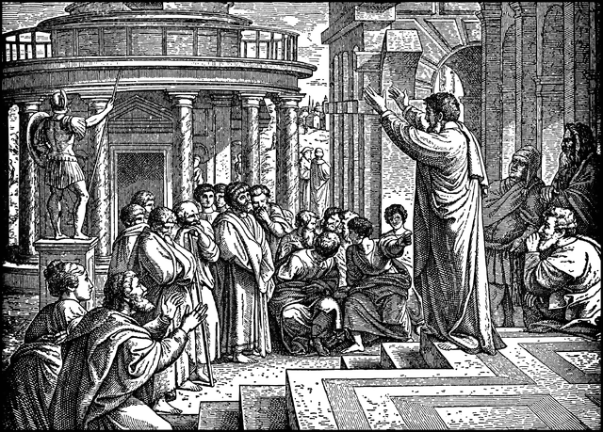
The history of the sermon
First century:
In the gathered assembly: every one could contribute: psalm, teaching, revelation, tongue, interpretation, etc. (1 Cor. 14:26), reading of letters to churches
Outside the church gathering: teachers gave discourses to their disciples, public/street speeches or declarations followed by discussion and debate
Post-apostolic churches:
started to formalize meetings, new elements added to synagogue format, sermons generally not interactive (preacher would sit, congregation would stand),
questions and dialogue happened in smaller settings (catechesis)
preaching in public, dialogue in evangelistic settings

Slide 6

The history of the sermon
As church became Romanized (church and state merged), it became less democratic; as church sought to adhere to and enforce orthodoxy, dialogue lessened; preaching on doctrine became the domain of the bishop
Augustine championed Greek form of rhetoric (thesis stated, proved, applied)
Dominicans (Order of Preachers, founded in France in 1216)
trained to publicly preach in vernacular languages, oppose heresy
fostered intellectual tradition, produced theologians and philosophers
Luther: encouraged preachers to use written sermons, though he preached mostly ex tempore, having worked a great deal with the texts in question, catechisms written (formalized what questions should be asked)
Circuit riders (late 1700s and early 1800s): preachers who traveled to preach at any place available, some notable examples are John Wesley (Britain) and Richard Allen, first black Methodist minister in USA

Slide 7
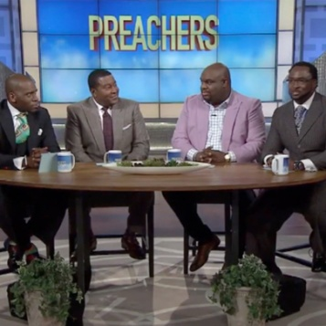
The history of the sermon
Itinerant evangelists: George Whitfield, Billy Sunday, Billy Graham, Kathryn Kuhlman, Benny Hinn
Media preaching: radio, television, multi-site congregations (remote sermon), recorded sermons
Different traditions:
Catholic homily (given by priest): around 10 minutes, following lectionary readings, explains some part of the reading, usually read
Orthodox homily (given by celebrant, priest, deacon, but not lay person): based on readings, usually read
North American Protestant sermon (usually given by pastor): 30-45 minutes, more extemporaneous
African American sermon: extemporaneous, involves listeners, incorporates music, lengthy

Slide 8
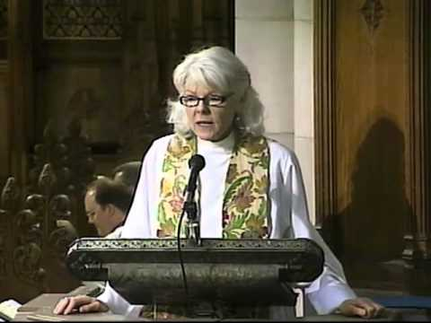
Homily vs. Sermon
Homily (from Greek homilia, meaning conversation, speaking with): Origen used it to mean a commentary on some part of sacred scripture (academic study of sermons is called homiletics); commentary following a reading of scripture
Sermon (Latin sermo meaning discourse, talk, speech): speech on religion or morals that the speaker chooses
Now used almost interchangeably

Slide 9
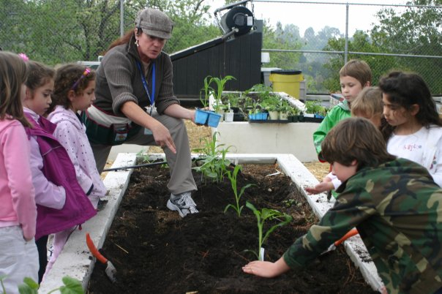
Teaching vs. Preaching
Teaching (didasko): 97 occurrences in NT, related to the word dao (to learn)
To cause to learn, to instruct, to impart knowledge.
Learning and teaching are closely related. A teacher is first a learner, desires to share knowledge, wisdom. Teacher and learner work together, sometimes no definitive answer/final conclusion is offered, but the learning process is seen as ongoing.
Teaching invites people to engage with the subject, to consider something together.

Slide 10
Teaching
Matt. 5:2,19: Now when Jesus saw the crowds, he went up on a mountainside and sat down. His disciples came to him, ² and he began to teach them…. Therefore anyone who sets aside one of the least of these commands and teaches others accordingly will be called least in the kingdom of heaven, but whoever practices and teaches these commands will be called great in the kingdom of heaven.
Matt. 7:28-29: When Jesus had finished saying these things, the crowds were amazed at his teaching, ²⁹ because he taught as one who had authority, and not as their teachers of the law.
Matt. 28:16-20: Then the eleven disciples went to Galilee, to the mountain where Jesus had told them to go. ¹⁷ When they saw him, they worshiped him; but some doubted. ¹⁸ Then Jesus came to them and said, “All authority in heaven and on earth has been given to me. ¹⁹ Therefore go and make disciples of all nations, baptizing them in the name of the Father and of the Son and of the Holy Spirit, ²⁰ and teaching them to obey everything I have commanded you. And surely I am with you always, to the very end of the age.”

Slide 11

Teaching vs. Preaching
Preaching (kerygma): 61 occurrences in the NT.
To be a herald, to proclaim, to announce with conviction, a suggestion of formality, gravity, and authority which must be listened to.
Biblical scholars use it to mean the core of the early church’s oral tradition about Jesus.
Preaching is proclaiming the gospel, the good news. It is not dialogue or interaction or discussion. It is usually persuasive, conclusive, perhaps even confrontational, challenging one to response and action.

Slide 12
Preaching
Matt. 3:1-2: In those days John the Baptist came, preaching in the wilderness of Judea ² and saying, “Repent, for the kingdom of heaven has come near.
Matt. 4:17,23: From that time on Jesus began to preach, “Repent, for the kingdom of heaven has come near.” … Jesus went throughout Galilee, teaching in their synagogues, proclaiming the good news of the kingdom, and healing every disease and sickness among the people.
Matt. 10:5-8: These twelve Jesus sent out with the following instructions: “Do not go among the Gentiles or enter any town of the Samaritans. ⁶ Go rather to the lost sheep of Israel. ⁷ As you go, proclaim this message: ‘The kingdom of heaven has come near.’ ⁸ Heal the sick, raise the dead, cleanse those who have leprosy, drive out demons. Freely you have received; freely give.
Acts 4:1-2: The priests and the captain of the temple guard and the Sadducees came up to Peter and John while they were speaking to the people. ² They were greatly disturbed because the apostles were teaching the people, proclaiming in Jesus the resurrection of the dead.

Slide 13
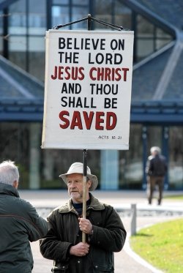
What does a sermon do?
Comfort
Encourage
Exhort
Convince
Challenge
Disturb
Proclaim (good news)
Reveal God (message from God)
Calls people to action (repentance, change of mind and heart)
Clarify (that which is unclear)

Slide 14
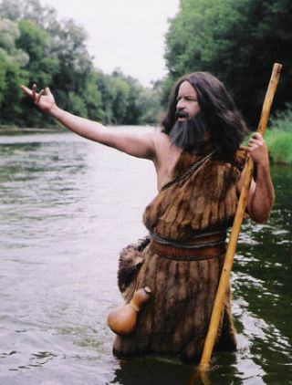
What is a sermon?
Preach the gospel, and if necessary, use words. (unknown origin)
Jesus did not write a word; he spoke, acted, lived.
Live, embodied interaction was a contrast to religious leaders’ focus on law
John the Baptist: Matt 3:1-12
confrontational, call to repentance, ritual of baptism, prophetic cry from the margins (wilderness)
Jesus: Matt. 4:23
proclaimed good news (preaching) and reshaped imaginations (teaching) and healed people: through conversation, public discourse, telling stories, commenting on life, posing puzzles, proximity, etc. (more on this later)
Prescriptive vs. Descriptive:
Delivering a moral lesson or transforming the imagination and the heart?
What is the perceived direction of transformation? Outside in or inside out?

Slide 15
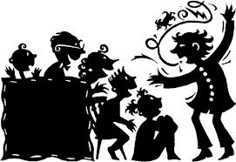
What does a story do?
Intrigues
Involves: characters, situation
Invokes another world
Requires imagination
Requires making judgments
Presents complexities (not black/white)
Communicates indirectly instead of directly
Sticks with you (memorable)
Does not resolve everything
Does not reveal everything
Invites reader/hearer on a journey

Slide 16
Exercise
The 6-word story
A cry rings out. Life begins.

Slide 17
The Six-Word Story
Painfully, he changed “is” to “was.”
Torched the haystack. Found the needle.
Jumped. Then I changed my mind.
Passenger, this isn’t your captain speaking.
I am the villain of this story.
I saw and I stayed quiet.

Slide 18

Narrative Structure
Beginning (setting): introduce characters, context, describe what world we are in
awaken curiosity, engage with reader/hearer
Middle (conflict): inciting incident, problem, tension, difficulties, victories and setbacks, characters go through changes, transformation, maturity
character development, bulk of story
End (resolution): final confrontation of problem, all elements of story come together
transformation of characters evident

Slide 19
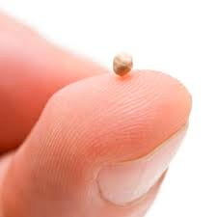
Narrative in the Bible
40% of the Hebrew Bible is narrative
The gospels are a mix of narrative and proclamation, Acts is historic narrative
Use of narratives as teaching tools:
Believable Story: realistic story which illustrates a point (man in ditch, shepherd with lost sheep, father with two sons)
Similitude: illustration taken from everyday life to elucidate something (the kingdom of heaven is like treasure, yeast, mustard seed, sower), often to shock or unsettle the hearers
Simile: compares two dissimilar things using words “like”, “as” or “than”. Psalm 1: the righteous man is like a tree planted by streams of water, both bear fruit and prosper.
Metaphor: direct comparison between two dissimilar things without using obvious words such as “like” or “as.” Jesus to Pharisees and Sadducees: “You brood of vipers!” (Matt. 3:7).
Hyperbole: expresses something in extreme terms to make a point. Jesus indicates that a judgmental person has a log in their eye and doesn’t know it.

Slide 20
Narrative Preaching
Form and content cannot be separated; what the text does is as important as what it says.
The story is the point; a preacher should show, not tell. (David Randolph)
A sermon isn't a lecture hall. (Charles Rice)
A sermon should weave together the Biblical story and our story. (Edmund Steimle)
Sermons should be approached organically, using poetic language and celebration. (Henry Mitchell)
A sermon should move from examples to a thesis, taking the congregation through an encounter with the text. (Fred Craddock)
In preaching, we construct an alternate world. (Walter Brueggemann)
We see the world the way we've been trained to see it through the stories we've been told, both large and small; how a person tells his or her stories defines how that person thinks. (Stanley Hauerwas)

Slide 21
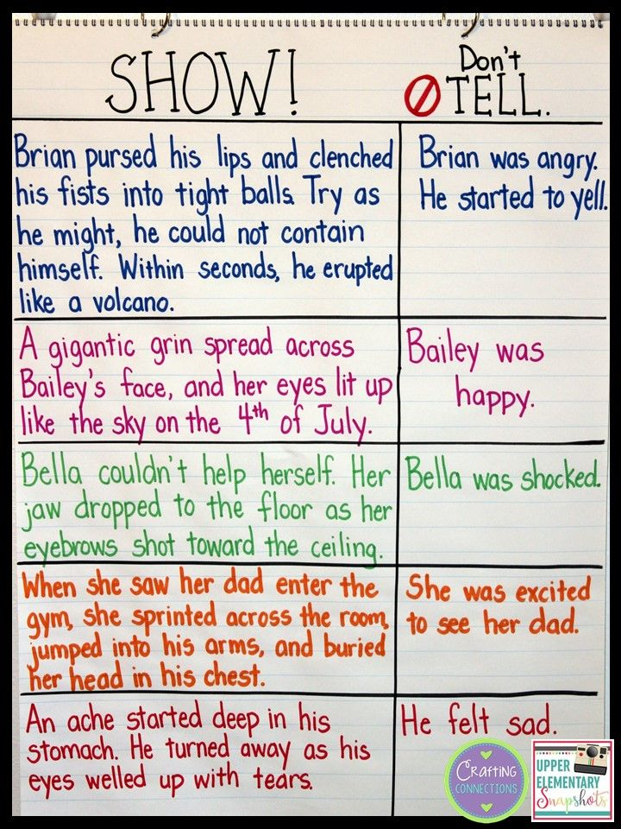
Exercise (Homework)
Show instead of tell
God is just
God is merciful
God is loving
God is a servant
Parables
The kingdom of heaven is like…
The Spirit is like…
Following Jesus is like…
People who want power are like…

