Slide 1
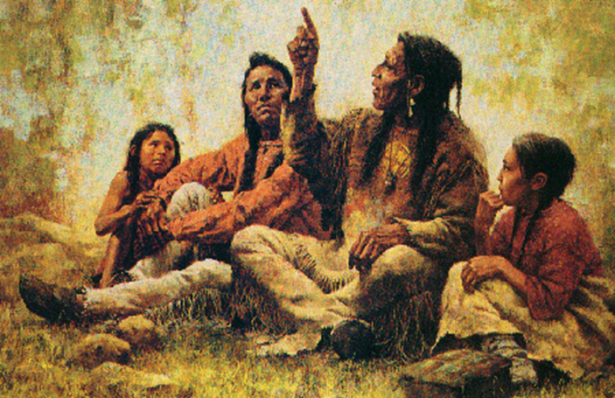

Preaching, Narrative, and Storytelling
Session Two: The Speaker

Slide 2
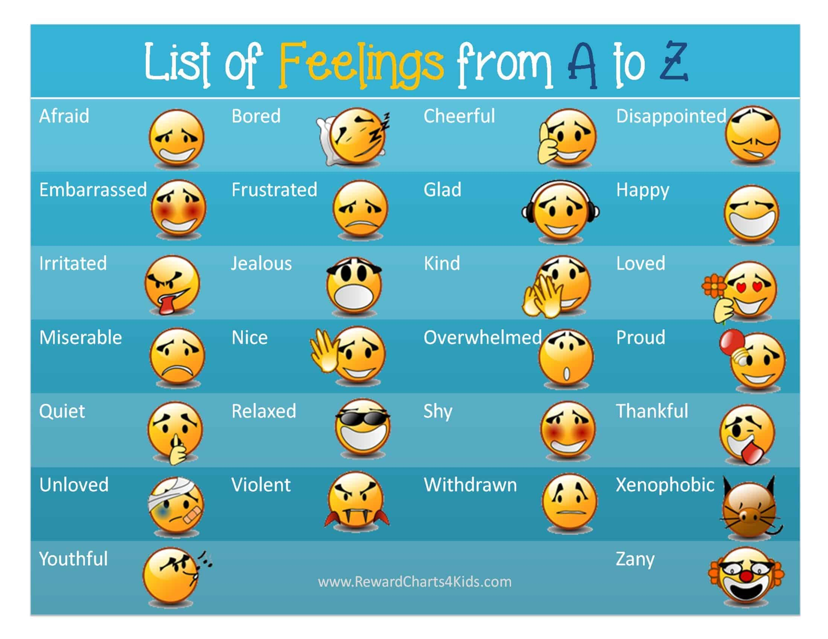
How are you coming into this space today?

Slide 3
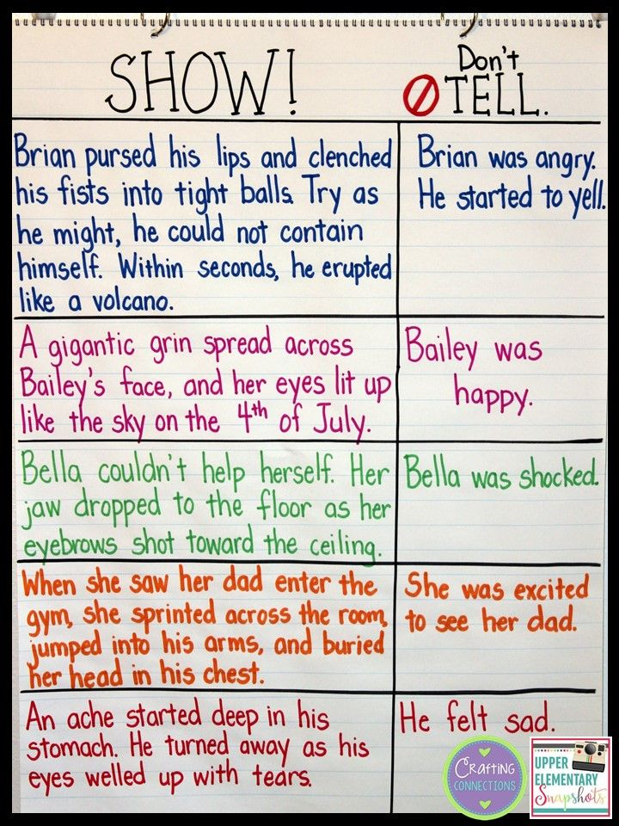
Exercise (Homework)
Show instead of tell
God is just
God is merciful
God is loving
God is a servant
Parables
The kingdom of heaven is like…
The Spirit is like…
Following Jesus is like…
People who want power are like…

Slide 4
Why do we preach/tell stories?
How would you describe your relationship to preaching/teaching?
Definitely called to it, love it
Consider it an act of service and worship
Love it/hate it
Feel some pressure within/without to do it
Unsure if I am called to it
Want to explore it more
Just part of the job, could take it or leave it
Enjoy certain settings but not others
Pretty scary thing to do
Would rather not

Slide 5
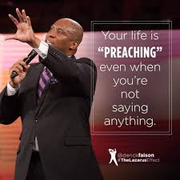
What do we preach/tell stories about?
God meets world
Catechesis is always happening (we are being formed and we are forming our world).
We are all proclaiming something with our lives, our relationships, and our words.
We preach/teach/tell stories about what we know, what we learn, our journey, our life, etc.

Slide 6
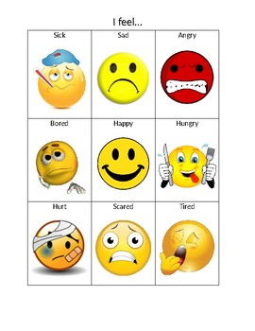
Listening to yourself
Self-awareness:
knowing yourself for who you really are, a process of becoming more and more comfortable with the true essence of you (looking inward)
“When you don’t take time out to notice and understand your emotions/thoughts, they have a strange way of resurfacing when you least expect or want them to. It’s their way of trying to bring something important to your attention.”
Self-management:
using awareness of your emotions/thoughts to actively choose what you say and do
asking: what is helpful to bring into the situation?

Slide 7
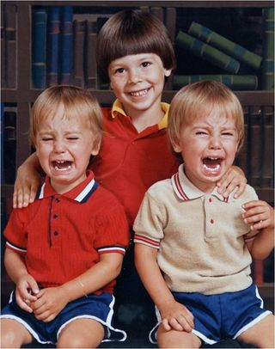
Listening to others
Social Awareness:
recognizing and understanding the moods/state of other individuals and entire groups of people (looking outward)
use your senses, be present, plan ahead (prepare), observe, listen, test for accuracy, step into their shoes
Relationship management:
all relationships take work
use self-management skills to express your feelings/thoughts and act in a way that benefits the relationship
use social awareness skills to better understand the other person’s needs and feelings/thoughts

Slide 8
Listening to self and listening to others
Have you ever heard a sermon where the content was good but the delivery got in the way? What was lacking?
Have you ever heard a sermon where the speaker was out of touch with the listeners? Or where they were overly affected by the situation? What area of listening could they have improved?
How can we as speakers bring something to the group/listeners that is both honest and beneficial to the others in the room?

Slide 9
Preaching as a communal act
“For me, to preach is first of all to immerse myself in the word of God, to look inside every sentence and underneath every phrase for the layers of meaning that have accumulated there over the centuries.
It is to examine my own life and the life of the congregation with the same care, hunting the connections between the word on the page and the word at work in the world. It is to find my own words for bringing those connections to life, so that others can experience them for themselves.
When that happens – when the act of preaching becomes a source of revelation for me as well as for those who listen to me – then the good news every sermon proclaims is that the God who acted is the God who acts, and that the Holy Spirit is alive and well in the world. Understood in this way, preaching becomes something the whole community participates in.”
- Brown Taylor, 33

Slide 10

Eugene Peterson: Congruence
“What kingfishers and falling stones and chiming bells do without effort requires development on our part, a formation into who we truly are, a becoming in which the means by which we live are congruent with the ends for which we live … [the] image is Christ, who lives and acts in us in such ways that our lives express the congruence of inside and outside, this congruence of ends and means, Christ as both the means and the end playing through our limbs and eyes to the Father through the features of our faces so that we find ourselves living, almost in spite of ourselves, the Christ life in the Christ way.”

Slide 11

Eugene Peterson: Congruence
“One of the unintended consequences of this [desire for congruence] … was that I was beginning to treat my congregation with far more dignity than I had been treating them. Impatience began to diminish; condescension slowly faded out. I was learning to embrace the congregation just as they were, not how I wanted them to be. They became an integral part of the sermon. Preaching became a corporate act. Common worship was the context: singing and praying, baptisms and Eucharist, silence and blessings. But soon I realized our common worship on Sundays was also developing tendrils that reached into home and workplaces, casual conversations and chance meetings on the street.”

Slide 12
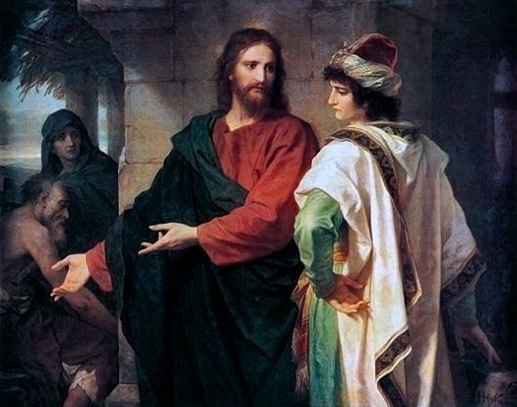
Exercise: What is Jesus responding to in these situations?
Luke 18:15-17
Luke 18:18-30
Luke 18:35-43
Luke 19:1-10
Luke 20:20-26
Which story draws you in the most?
Which story makes you say: I want learn how to do what Jesus did there?

Slide 13
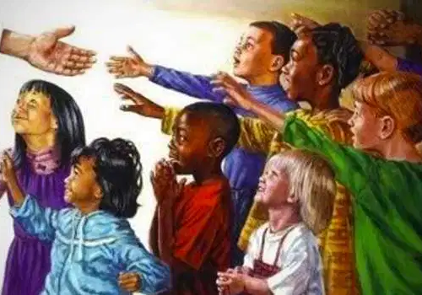
What is Jesus responding to?
Luke 18:15-17, CEB
¹⁵ People were bringing babies to Jesus so that he would bless them. When the disciples saw this, they scolded them. ¹⁶ Then Jesus called them to him and said, “Allow the children to come to me. Don’t forbid them, because God’s kingdom belongs to people like these children. ¹⁷ I assure you that whoever doesn’t welcome God’s kingdom like a child will never enter it.”

Slide 14
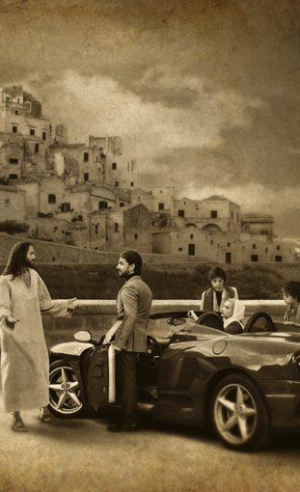
What is Jesus responding to?
Mark 10:17-27, CEB
¹⁷ As Jesus continued down the road, a man ran up, knelt before him, and asked, “Good Teacher, what must I do to obtain eternal life?”
¹⁸ Jesus replied, “Why do you call me good? No one is good except the one God. ¹⁹ You know the commandments: Don’t commit murder. Don’t commit adultery. Don’t steal. Don’t give false testimony. Don’t cheat. Honor your father and mother.”^{[a]}
²⁰ “Teacher,” he responded, “I’ve kept all of these things since I was a boy.”
²¹ Jesus looked at him carefully and loved him. He said, “You are lacking one thing. Go, sell what you own, and give the money to the poor. Then you will have treasure in heaven. And come, follow me.” ²² But the man was dismayed at this statement and went away saddened, because he had many possessions.
²³ Looking around, Jesus said to his disciples, “It will be very hard for the wealthy to enter God’s kingdom!” ²⁴ His words startled the disciples, so Jesus told them again, “Children, it’s difficult to enter God’s kingdom! ²⁵ It’s easier for a camel to squeeze through the eye of a needle than for a rich person to enter God’s kingdom.”
²⁶ They were shocked even more and said to each other, “Then who can be saved?”
²⁷ Jesus looked at them carefully and said, “It’s impossible with human beings, but not with God. All things are possible for God.”

Slide 15
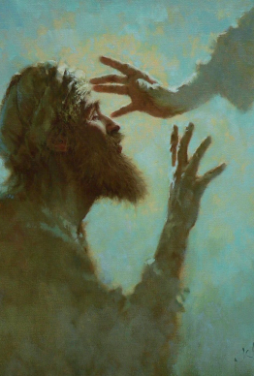
What is Jesus responding to?
Luke 18:35-43, CEB
³⁵ As Jesus came to Jericho, a certain blind man was sitting beside the road begging. ³⁶ When the man heard the crowd passing by, he asked what was happening. ³⁷ They told him, “Jesus the Nazarene is passing by.”
³⁸ The blind man shouted, “Jesus, Son of David, show me mercy.” ³⁹ Those leading the procession scolded him, telling him to be quiet, but he shouted even louder, “Son of David, show me mercy.”
⁴⁰ Jesus stopped and called for the man to be brought to him. When he was present Jesus asked, ⁴¹ “What do you want me to do for you?”
He said, “Lord, I want to see.”
⁴² Jesus said to him, “Receive your sight! Your faith has healed you.” ⁴³ At once he was able to see, and he began to follow Jesus, praising God. When all the people saw it, they praised God too.

Slide 16
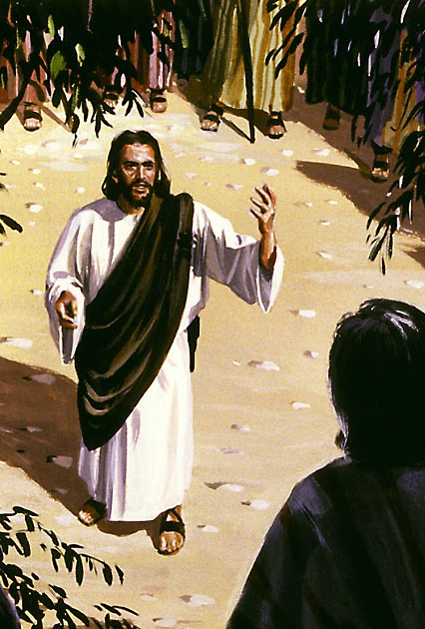
What is Jesus responding to?
Luke 19:1-10, CEB
Jesus entered Jericho and was passing through town. ² A man there named Zacchaeus, a ruler among tax collectors, was rich. ³ He was trying to see who Jesus was, but, being a short man, he couldn’t because of the crowd. ⁴ So he ran ahead and climbed up a sycamore tree so he could see Jesus, who was about to pass that way. ⁵ When Jesus came to that spot, he looked up and said, “Zacchaeus, come down at once. I must stay in your home today.” ⁶ So Zacchaeus came down at once, happy to welcome Jesus.
⁷ Everyone who saw this grumbled, saying, “He has gone to be the guest of a sinner.”
⁸ Zacchaeus stopped and said to the Lord, “Look, Lord, I give half of my possessions to the poor. And if I have cheated anyone, I repay them four times as much.”
⁹ Jesus said to him, “Today, salvation has come to this household because he too is a son of Abraham. ¹⁰ The Human One [Son of Man] came to seek and save the lost.”

Slide 17

What is Jesus responding to?
Luke 20:20-26, CEB
The legal experts and chief priests were watching Jesus closely and sent spies who pretended to be sincere. They wanted to trap him in his words so they could hand him over to the jurisdiction and authority of the governor. ²¹ They asked him, “Teacher, we know that you are correct in what you say and teach. You don’t show favoritism but teach God’s way as it really is. ²² Does the Law allow people to pay taxes to Caesar or not?”
²³ Since Jesus recognized their deception, he said to them, ²⁴ “Show me a coin. Whose image and inscription does it have on it?”
“Caesar’s,” they replied.
²⁵ He said to them, “Give to Caesar what belongs to Caesar and to God what belongs to God.” ²⁶ They couldn’t trap him in his words in front of the people. Astonished by his answer, they were speechless.

Slide 18
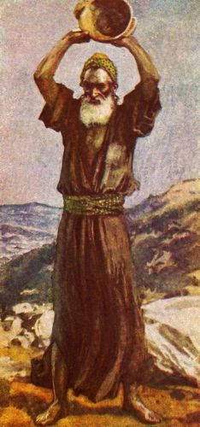
Different callings: different approaches to preaching
Apostle (sent one):
Motivation: plant new life, spark something, build, visionary
Style: fired up, emphasis on growth, driving things forward
Weakness: impatience, details
Prophet (messenger of God):
Motivation: declare God’s message, proclaim truth, uncover crooked ways, prepare a way for God
Style: direct, confrontational, confident, call to action
Weakness: unnuanced (black and white), not very pastoral
Evangelist (proclaims good news):
Motivation: desire for all to encounter Jesus
Style: outgoing, personable, one basic message, lots of stories
Weakness: tendency to talk and not listen

Slide 19

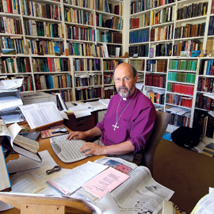
Different callings: different approaches to preaching
Pastor (caring for people):
Motivation: provide, protect, heal, concerned with wholeness and maturity of community
Style: gentle, caring, patient, desires to journey with people
Weakness: take on burdens of community, easily swayed by desires of community
Teacher (understanding and wisdom):
Motivation: foster life-long learning, introduce people to riches of God’s wisdom and wonder
Style: methodical, detailed, explaining and clarifying
Weakness: can value content over people

Slide 20
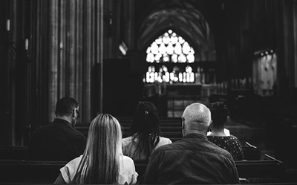
The Call (to be God’s person)
Taylor Brown, 24-25.
“[A person] hears the invitation to ministry as an invitation to do more – to lead the every member canvass, or cook supper for the homeless, or teach vacation church school. Or she hears the invitation to ministry as an invitation to be more – to be more generous, more loving, more religious. No one has ever introduced her to the idea that her ministry might involve being just who she already is and doing just what she already does, with one difference: namely, that she understand herself to be God’s person in and for the world.” – Brown Taylor, 29.

Slide 21

Vocation
Preaching one message
“Today I understand vocation quite differently – not as a goal to be achieved but as a gift to be received. Discovering vocation does not mean scrambling toward some prize just beyond my reach but accepting the treasure of true self I already possess. Vocation does not come from a voice ‘out there’ calling me to become something I am not. It comes from a voice ‘in here’ calling me to be the person I was born to be, to fulfill the original selfhood given me at birth by God. It is a strange gift, this birthright of self. Accepting it turns out to be even more demanding than attempting to become someone else!” – Parker Palmer, Let Your Life Speak, 10-11

Slide 22
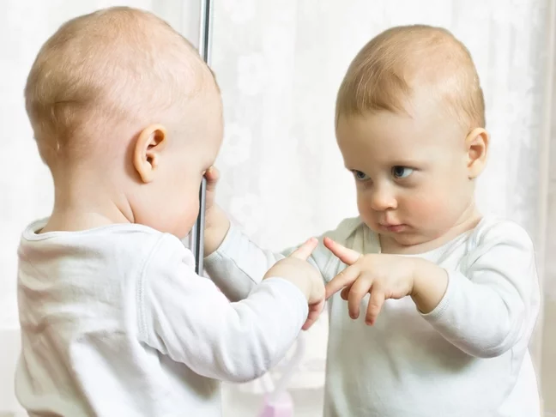
Vocation: potentials and limits
“Each of us arrives here with a nature, which means both limits and potentials. We can learn as much about our nature by running into our limits as by experiencing our potentials. … But when I consistently refuse to take no for an answer, I miss the vital clues to my identity that arise when way closes – and I am more likely both to exceed my limits and to do harm to others in the process.” Palmer, 39, 43

Slide 23
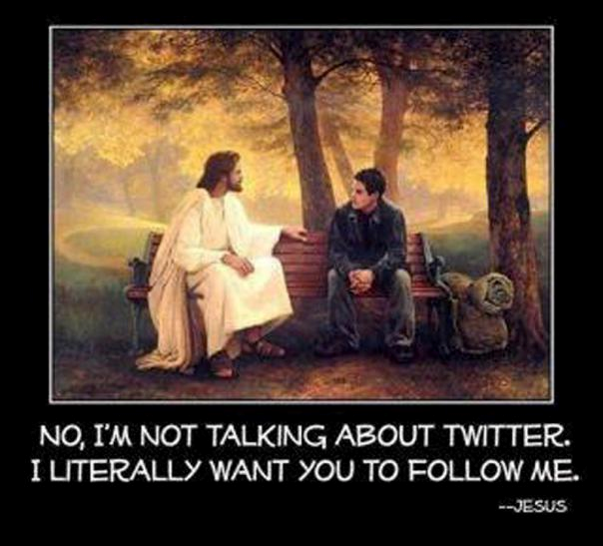
Exercise (homework): discerning your life
What are the limits you have encountered in your life?
Where do you feel chafed, trapped, stretched too thin?
What possibilities have turned into life-giving adventures?
Where do you feel energized, content, truly yourself?
What do you find yourself looking for on a consistent basis?
What do others indicate they have received from you?
What do you hear when you ask, “God, what do I bring to the world?”

