Slide 1
Into Proclaiming the Good News…
The part where you go into all the world and Jesus is with you.

Slide 2
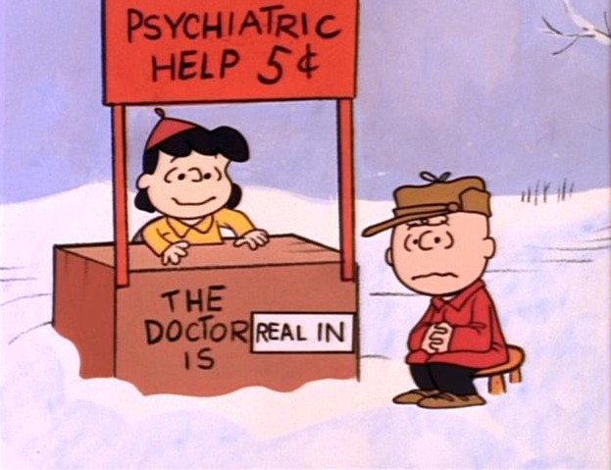
IN the great crisis of Ministry, which way do you open your deck chair?
Someone people face them to the back (stern) to see where they have been.
Some face them to the front (bow) to see where it is they may be going.
In the great crisis of ministry Charlie Brown, which way do you face your chair.
“I don’t know. I can’t get mine unfolded.”

Slide 3
Worship is missional
“Then the eleven disciples went to Galilee, to the mountain where Jesus had told them to go. When they saw him, they worshiped him; but some doubted. Then Jesus came to them and said, “All authority in heaven and on earth has been given to me. Therefore go and make disciples of all nations, baptizing them in the name of the Father and of the Son and of the Holy Spirit, and teaching them to obey everything I have commanded you. And surely I am with you always, to the very end of the age.” - Matthew 28.16-20 NIV

Slide 4
The importance of Why we are doing this…
Why do we worship?
To give God the glory, honour and praise due his name.
Why do we preach in worship?
To raise the level of ‘kerygma’ in the world

Slide 5


Three Attitudes of Successful ministry
1. Attitude of Altitude
- We’re seated with Christ in the heavenly realms – do we see things the way Jesus sees them?
2. Attitude of Gratitude
Need to have a theology of abundance rather than of poverty - Give thanks to God in all things! God knows our needs before we ask, and our ignorance in asking – still need to make the effort and ask!
3. Attitude of Fortitude
- Be bold, be strong for the Lord your God is with you!
- Be a ‘comforter’!

Slide 6
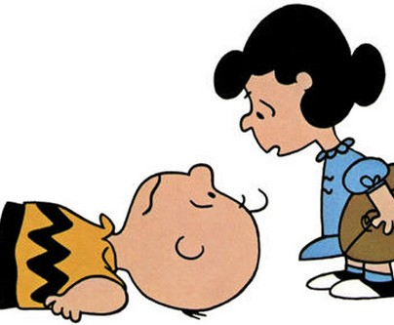
The import of a lively Personal prayer life
A person who leads in ministry must lead from the knees.
“A saint on his knees can see much further than the philosopher can see on his tip toes”
It is where we gain the “attitude of altitude” from. Spend time with God talking about people so that we can go and talk to people about God.
Learn to cultivate an active prayer life – action that we do and habit that we live in our everyday lives.
Learn to bring it to worship – making liturgy relevant.
Praying as a leader of the Church is not about you, but about God and his people and what God wants to do in them.

Slide 7

How do we share the Gospel?
Live what you preach and preach what you live.
Get the Story in.
Get the story straight.
Get the Story out.
Remember what Jesus said, “By this (sign), all will know you to be my disciples, by your love, one for another.”
How you live your life will be the loudest and longest sermon you will ever preach. You might get to use words. Preach carefully.
Notes:
Becky Pippert – Out of the Salt Shaker

Slide 8

Think its all too much?
Don’t worry, you will grow into this!
Sharing with your clergy and with other lay readers helps you to be accountable for what you are doing
and
Sharing enables you to be enthusiastic (Filled with the Spirit) in the process of doing
and
Sharing helps to spark the creativity in other people’s work as well.

