Slide 1
Lay Readers’ Training
Modules for the training of Lay Readers for the Ministry of the Diocese of Athabasca

Slide 2
The Introduction
So, you want to learn how to lead in worship and in ministry!
Welcome aboard!

Slide 3
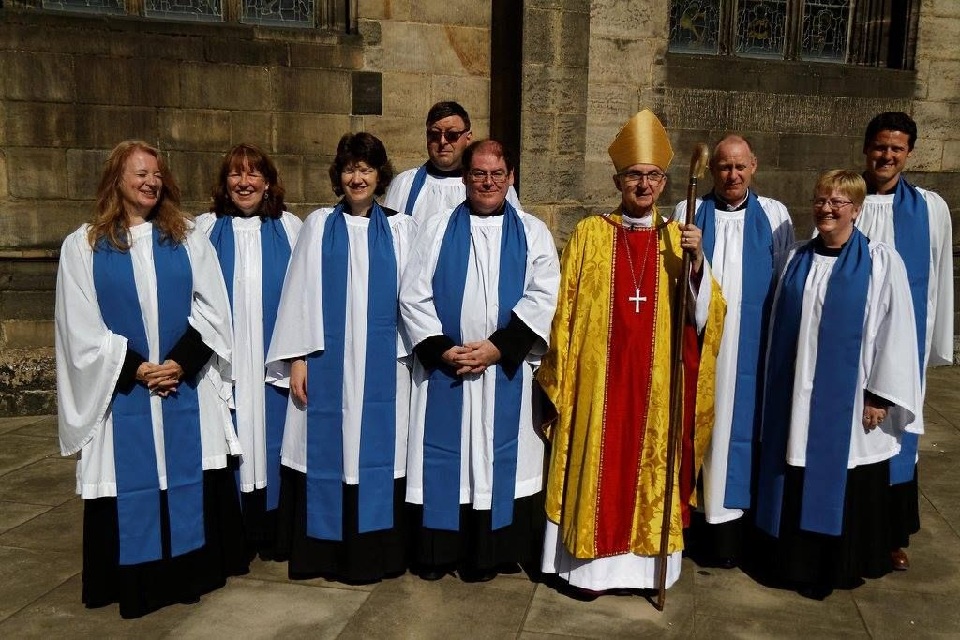
What is a Lay Reader?
A Lay Reader is a layperson authorized by the Bishop of Athabasca to officiate at services of worship or take a leadership role in certain parts of a service. The Lay Reader is also expected to carry out another form of ministry within the parish as well.
Lay Readers are licensed by the Bishop to work with a particular Clergy person, usually the Rector of the Parish, for a one-year term. Lay Readers require annual renewal of licenses through motions at the Parish’s Annual Meeting and recommendation by incumbent clergy to the Dean of Lay Readers and the Bishop.

Slide 4

What is a lay reader?
Lay Reader-in-Training: is someone who, under the direction of the parish clergy, the Regional Dean or Diocesan clergy, has completed a time of discernment and time to train for leadership, and has been approved by both the incumbent and Bishop can begin to perform the office of the Lay Reader in training.
The primary responsibility of a lay reader-in-training is to be part of the ministry team and to undertake a flexible period of training, to become a Lay Reader. Lay Reader. Training will include learning to assist during services as directed by clergy and the completion of core foundational curriculum which will include at least some of the following:
LRiT

Slide 5


Core of teaching
All Lay Readers in the Diocese need to have the following learning to be formed and to be licensed in the Diocese by the Bishop:
Reading scripture & leading liturgy in public
Anglican worship including leading corporate prayer
Biblical foundations
Christian doctrine
Church history
Leadership and Discipleship
Basic sermon preparation

Slide 6
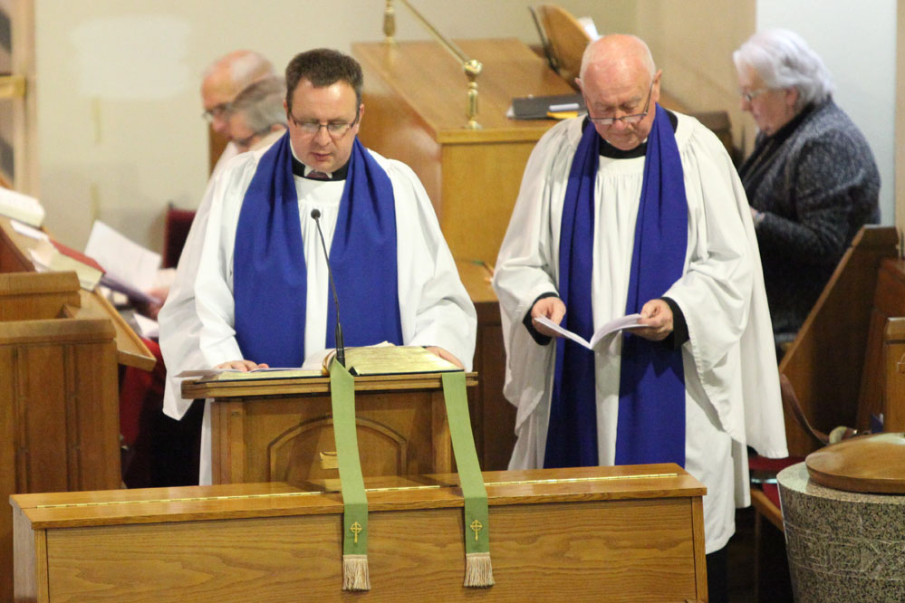
The Licenced Lay Reader
A Licenced Lay Reader is licensed in the Diocese by the Bishop to offer Lay Reader duties under the direction of the incumbent, Regional Dean or The Bishop. Their primary responsibility is to be an active member of the ministry team in their home parish and to support neighbouring parishes when asked to by the Rector of that parish.
A Licensed Lay Reader will have completed the Core of Teaching before a license will be issued. The Candidate’s name must be submitted to the Annual Congregation/Parish meeting for consideration and then a motion to request the Bishop to licence that the person as a Lay Reader.
Upon completion of training and at the clergy/bishop’s direction, the diocesan Lay Reader may lead services, prepare and deliver the homily/sermon and travel to parishes/churches requiring assistance.
Continuing education is required to maintain the Bishop’s License.

Slide 7
Whose involved in this?
The whose who in the Diocese of Athabasca

Slide 8
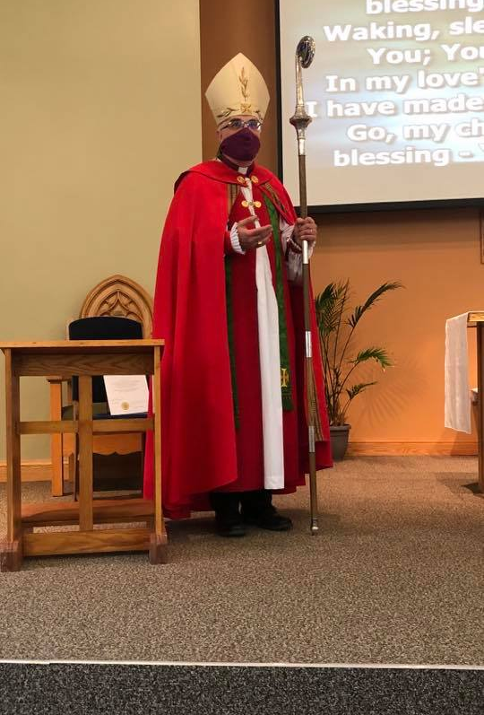
The Rt. Rev. David Greenwood, Bishop
Serves as the Bishop of Athabasca (Fox Creek to 60 Degrees Latitude and from the Saskatchewan border to the British Columbia border.)
He is your authority as a Licensed Lay Reader – he is the one who permits you to lead, preach and lead in public prayer within the Diocese.
He licenses you to a Rector (priest) in the Diocese who is responsible for looking after you and enabling you in your ministry.

Slide 9
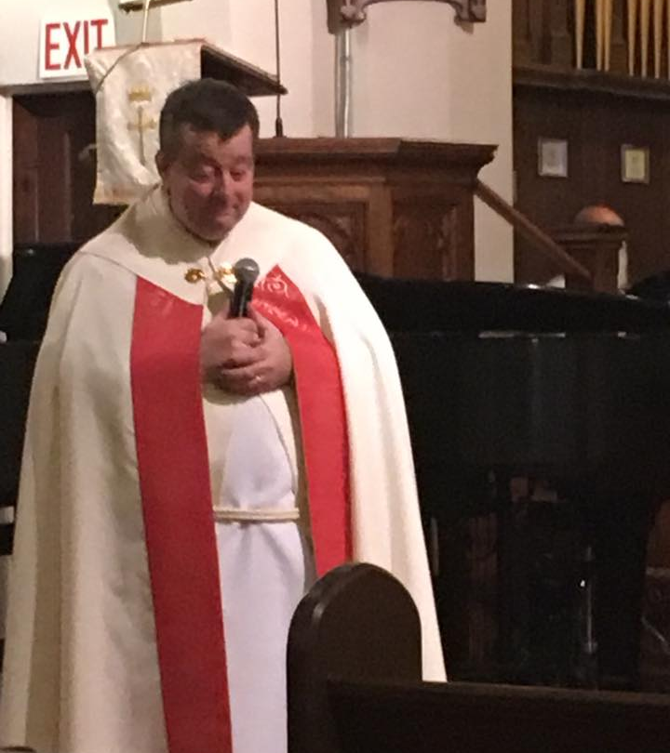
The Very Rev. Jason Haggstrom
The Dean of the Diocese of Athabasca
Pastor to the Clergy
The Dean of Lay Readers
Rector of Saint James’ Cathedral, Peace River

Slide 10
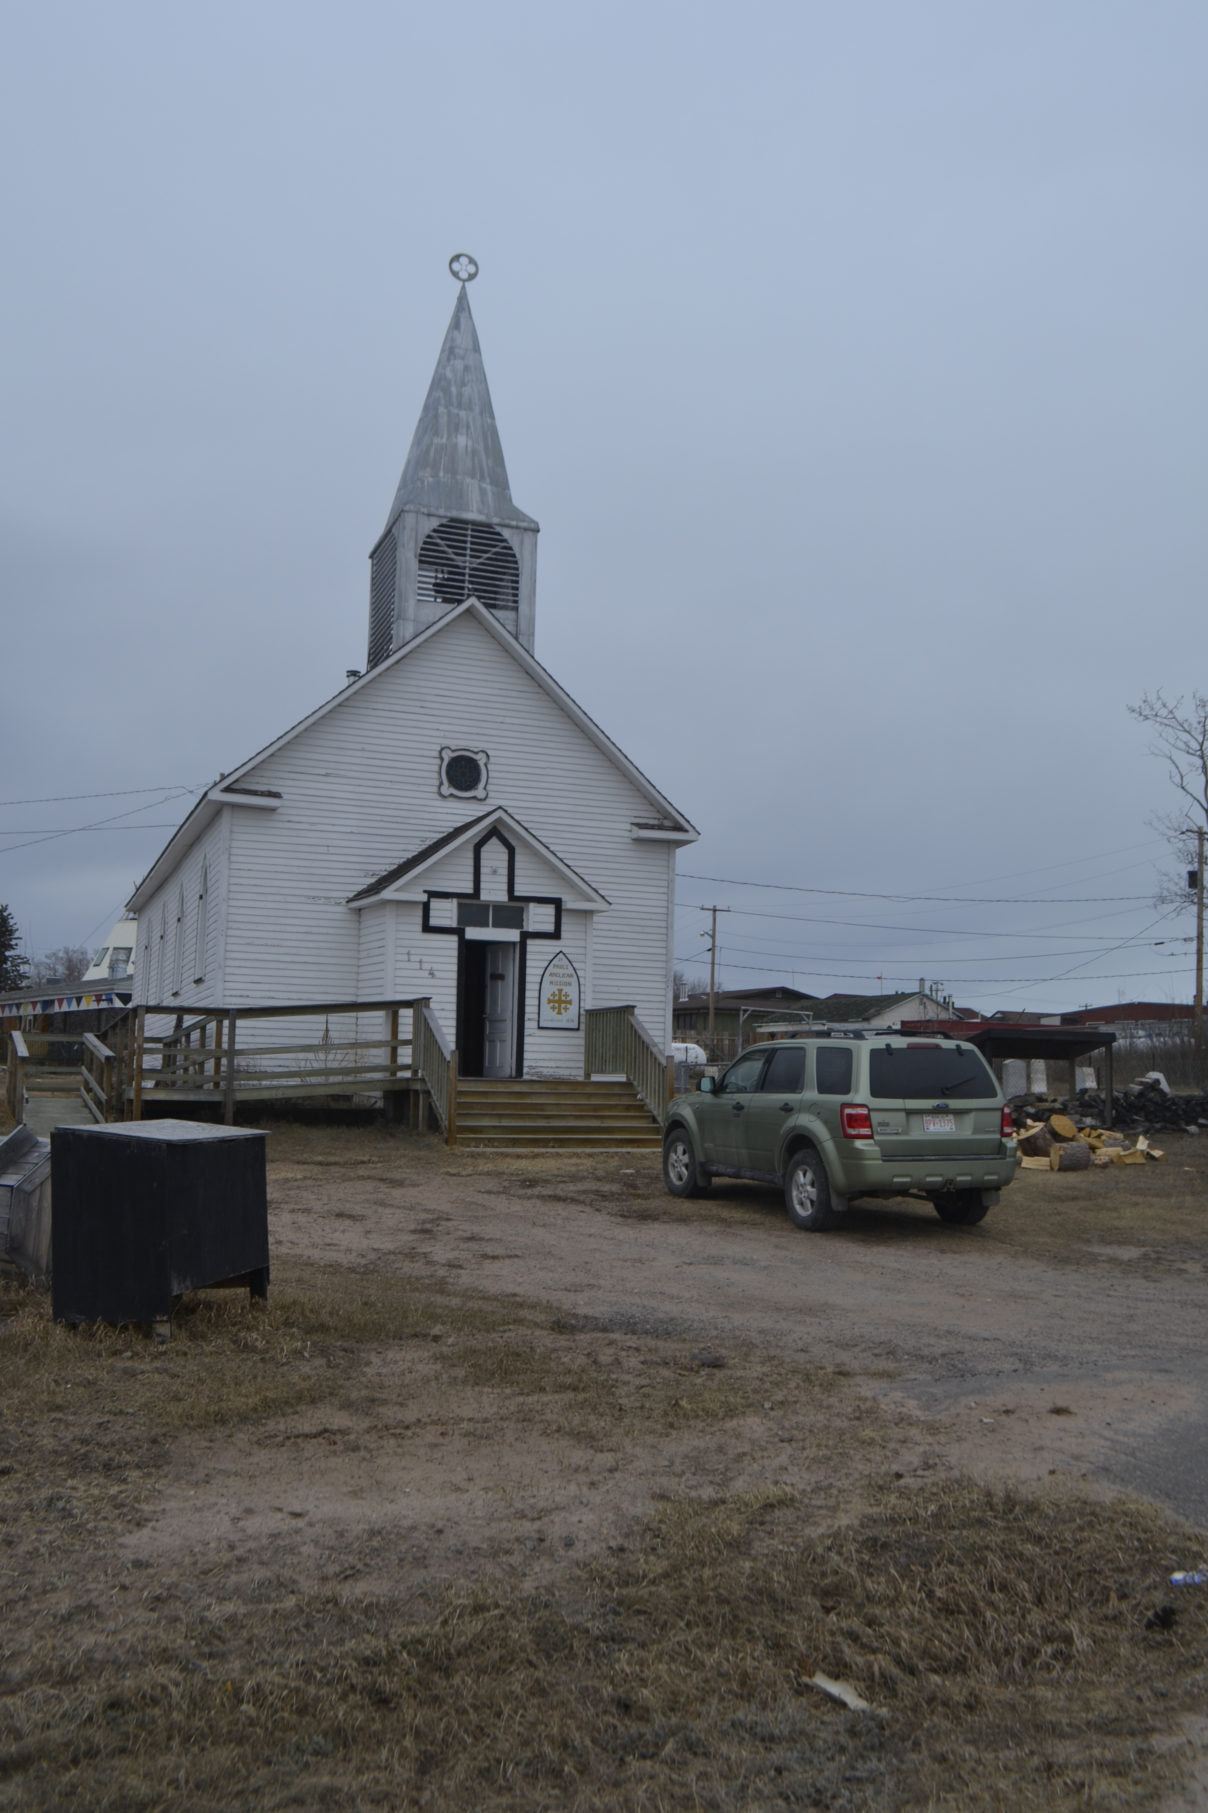
And
all
of you!

Slide 11
Learning to Lead in Divine worship
From the Book of Common Prayer (1962) and from the Book of Alternative Services (1986)

Slide 12
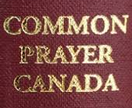
The Book of Common Prayer,1962 Canada
(aka the BCP)
Is still the Liturgy Book of the Anglican Church of Canada
Contains our most basic understanding of theology, ecclesiology, soteriology and worship, including principles for liturgical renewal.
Contains all of the Offices, Liturgies (especially Communion and Baptism) and the Ordinal.
Contains historical Documents which explain how we understand ourselves as Christian and as Anglicans
70% of it’s make up is straight up Scripture.

Slide 13
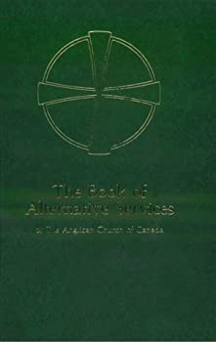
The Book of Alternative Services, Canada 1986
Came from the liturgical revisions and the liturgical renew that was started by Vatican II in the early 1960’s under Popes John XXIII and Paul VI.
Operates more and more as the BCP used to. Neverthess, it is a supplemental liturgy to the Book of Common Prayer.
Tries to move to more inclusive language and to adapt Canadian worship through the principles laid down in the Book of Common Prayer since 1662.
Lex ordandi, Lex crendeni, Lex vivendi (The Law of prayer is the Law of belief is the Law of life)
When you pray, you pray once. When you sing, you pray twice. Guard your prayers and your music carefully.
Stance in liturgy – everyone needs to adopt the stance of the officiant – Stand, sit kneel. Common work in a common position. (Stand to praise, sit to hear and kneel to pray and receive.)

Slide 14
Proclaiming the Christ and his Regin
Every Lay Reader will be taught how to preach and how to communicate the Good News of God in Christ to other people.
Lay Readers are to learn how to present the Gospel in such a way that people will repent, and accept Christ as Saviour and learning obey him as Lord in the fellowship of his Body the Church.
Good News! You are being asked to proclaim Jesus Christ and to learn the faith as we all need to.
I charge you in the presence of God and of Christ Jesus, who will judge the living and the dead, and in view of His appearing and His kingdom: Preach the word; be prepared in season and out of season; reprove, rebuke, and encourage with every form of patient instruction. For the time will come when men will not tolerate sound doctrine, but with itching ears they will gather around themselves teachers to suit their own desires. So they will turn their ears away from the truth and turn aside to myths. – 2 Tim. 4:1-4 ESV

Slide 15
Proclaiming Christ and his kingdom
John Wesley – founder of the Methodists: Preach about 42,000 sermons in his life time, many from horseback.
“When you set yourself on fire, people like to come and watch you burn.”
“God grant that I may never live to be useless!”
“Let your words be the genuine picture of your heart.”
“Passion and prejudice govern the world; only under the name of reason. It is our part, by religion and reason joined, to counteract them all we can.”
Proclaiming and preaching the Gospel is an art, assisted by science, not a science that is devoid of art.
Help from various sources – can and will provide a list of books and online resources for you. – Four Pages of the Sermon.
https://www.Biblehub.com is a great place to start.
Need to be able to sum up in one sentence what you are trying to say
Don’t be afraid to call or email your priest, the Archdeacon or I. All of us are willing to talk and to help.

Slide 16
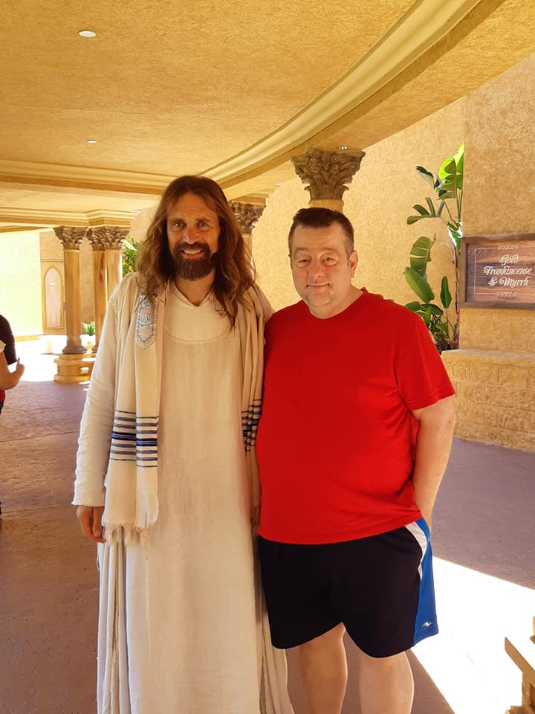
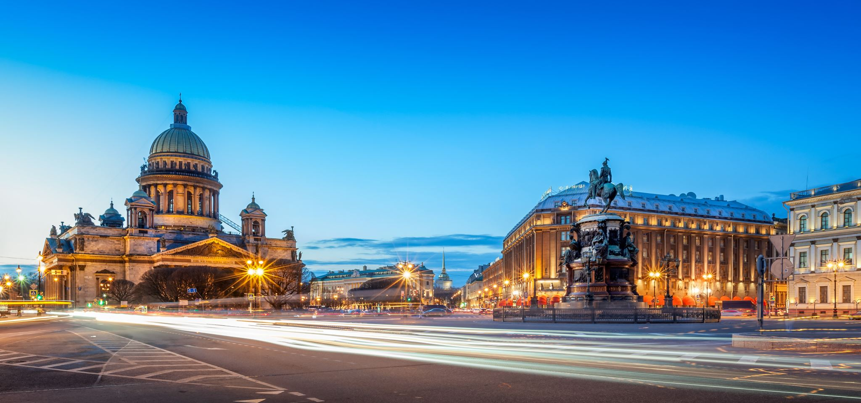
Learning what we believe (Doctrine)
Christology
Ecclesiology

Slide 17
Leading People in Prayer
Work on your own prayer life – Mother Teresa, “Good Morning, Jesus”
BCP – Page 75: Petitions and then the Intercessory Prayer
BAS – petitions
The necessity for both Silence and Words when you pray
Don’t take away the responsibility of the petitioner to pray
Take your time – it matters not just in the here and now but in the there and then.
Don’t allow prayer to become a laundry list or a second sermon! Liturgy is the work of the people of God.
Bring the things you need to pray about and actually pray about them!

Slide 18
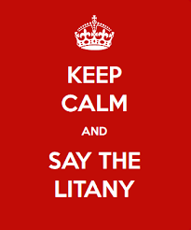

Slide 19
The Important work of Corporate Prayer
“Where prayer is focused, power falls.”
Flows from your own personal prayer life – need to have one and may need to find one – pray together.
Know that the Diocesan Staff pray together Tuesday through Friday together – welcome to join us if you are able.
Leading the Prayers of the People: remember that similar to preaching, speed in prayer kills.
  Remember that in the BAS, the litanies are petitions, there must be periods of silence to allow people to offer prayer for the various things that are on their hearts and minds.
  Remember that the petitions in the BCP are done first and may take some time to do – may need to be written down ahead of time. Space needs to be given for people to take things in. The Prayer of Intercession is then prayed.
  Where two or three are gathered, there am I in the midst of them… If you ask in my name, I will do it.
  Learn to pray the Scriptures and the Collects – and there are good books with prayers in them as well. – Guard your doctrine!
If my people who are called by my name humble themselves, and pray and seek my face and turn from their wicked ways, then I will hear from heaven and will forgive their sin and heal their land.
– 2nd Chronicles 7:14 ESV

Slide 20
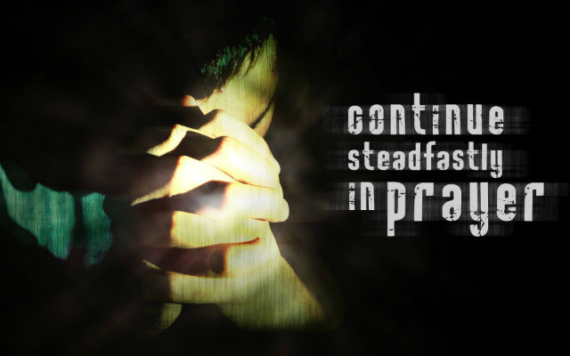
The Intercession in the Book of Common Prayer
Then shall one of the Ministers ask the prayers of the people, using always either the first or the last of the following Biddings, together with one or more others if so desired; and he may provide short periods for silent prayer.
Let us pray for Christ's holy Catholic Church.
Let us pray for peace on earth and for the
unity of all Christian people.
Let us pray for our missionaries at home and
abroad.
Let us remember before God those of our
brethren who have departed this life and are at rest.
Let us pray for the whole state of Christ’s Church militant here in earth.

Slide 21
The Intercession
Then the Priest shall say THE INTERCESSION.
ALMIGHTY and everliving God, who by thy holy Apostle hast taught us to make prayers and supplications, and to give thanks, for all men: We humbly beseech thee most mercifully to accept our alms and oblations, and to receive these our prayers, which we offer unto thy Divine Majesty; beseeching thee to inspire continually the universal Church with the spirit of truth, unity, and concord: And grant that all they that do confess thy holy Name may agree in the truth of thy holy Word, and live in unity and godly love. We beseech thee also to lead all nations in the way of righteousness; and so to guide and direct their governors and rulers, that thy people may enjoy the blessings of freedom and peace: And grant unto thy servant ELIZABETH our Queen, and to all that are put in authority under her, that they may truly and impartially administer justice, to the maintenance of thy true religion and virtue. Give grace, O heavenly Father, to all Bishops, Priests, and Deacons, and specially to thy servant David, our Bishop, that they may both by their life and doctrine set forth thy true and living Word, and rightly and duly administer thy holy Sacraments: Prosper, we pray thee, all those who proclaim the Gospel of thy kingdom among the nations: And to all thy people give thy heavenly grace, and specially to this congregation here present, that, with meek heart and due reverence, they may hear and receive thy holy Word; truly serving thee in holiness and righteousness all the days of their life. And we most humbly beseech thee of thy goodness, O Lord, to comfort and succour all them, who in this transitory life are in trouble, sorrow, need, sickness, or any other adversity, especially those for whom our prayers are desired. We remember before thee, O Lord, all thy servants departed this life in thy faith and fear: and we bless thy holy Name for all who in life and death have glorified thee; beseeching thee to give us grace that, rejoicing in their fellowship, we may follow their good examples, and with them be partakers of thy heavenly kingdom. Grant this, O Father, for Jesus Christ's sake, our only Mediator and Advocate, to whom, with thee and the Holy Ghost, be all honour and glory, world without end. Amen

Slide 22
A Litany of the BAS – the Rubrics
Litanies In the following litanies, petitions may be altered or omitted according to circumstances. Other petitions may be added.
For musical or other reasons, the response may be changed to a similar appropriate expression, such as Lord, have mercy; Lord, hear and have mercy; Lord, hear our prayer; Kyrie eleison.
The suffrages may also be changed to make them fit with another response. For instance, the opening petition and response in Litany No. 6 might be changed to: Let us pray for the whole People of God, that each one may be a true and faithful servant of Christ. Lord, hear our prayer.
When litanies are sung, they may be introduced by a cantor singing the response, which is then repeated by all before the first petition. When they are said, they may be introduced by an expression like Let us pray with confidence to the Lord, saying . . .

Slide 23
A BAS Litany (#1)
(In peace let us pray to the Lord, saying, “Lord, have mercy.”)
For peace from on high and for our salvation, let us pray to the Lord.
Lord, have mercy.
For the peace of the whole world, for the welfare of the holy
Church of God, and for the unity of all, let us pray to the Lord.
Lord, have mercy.
For our Bishop, David, for Gregory, our Metropolitan and for Linda, our Primate; for all the clergy and people of this Diocese, let us pray to the Lord.
Lord, have mercy.
For Elizabeth our Queen, for the leaders of the nations, and for all set in authority, let us pray to the Lord.
Lord, have mercy.
For this city (town, village, etc.), for every city and community, and for those who live in them in faith, let us pray to the Lord.
Lord, have mercy.
For good weather, and for abundant harvests for all to share, let us pray to the Lord.
Lord, have mercy.
For those who travel by land, water, or air, for the sick and the suffering (especially . . . ), for prisoners and captives, and for their safety, health, and salvation, let us pray to the Lord.
Lord, have mercy.

Slide 24
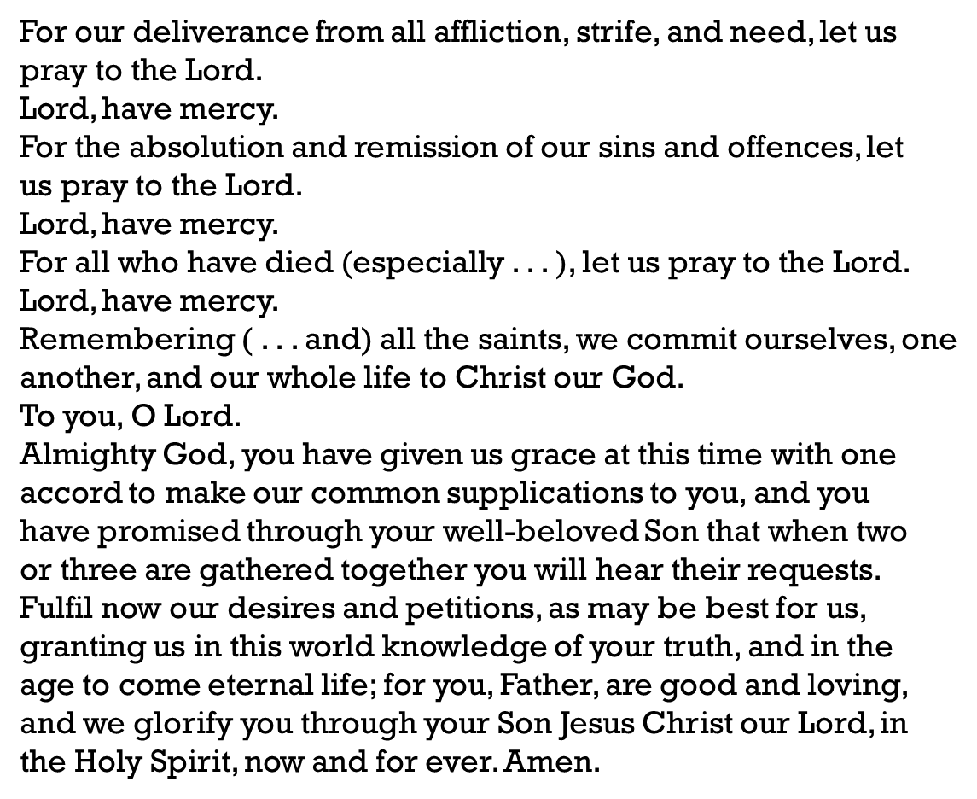
BAS Litnay #1 – Continued

Slide 25

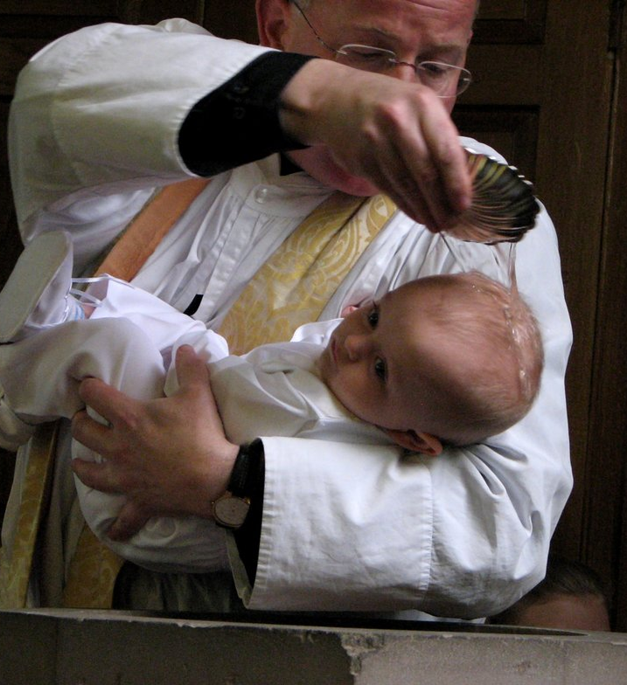
Prayers for the Candidates at the Time of Baptism
These are the Prayers of the People for the Service of Baptism and Holy Eucharist – this is the Litany.
You can add a petition or two for other needs, especially the sick but not more than two or three.
The focus of the liturgy needs to remain on the candidates and the prayer at the end of the Prayers for the Candidates must be done.

Slide 26
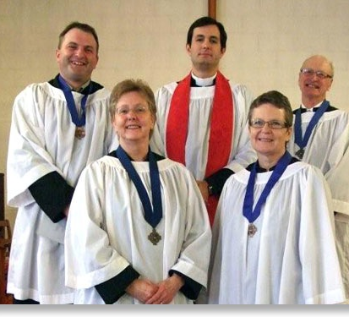
The Wearing of Vestments
Sacred work requires sacred clothing.
Being a licensed person means that you need to stand out; you have been called and chosen to serve.
Lay Readers are required to wear either a black cassock and white surplice or a white cassock alb. These should be supplied by the parish. After you are licensed, you will also wear the medallion supplied by the Diocese.
You are both invited and encouraged to vest and process with the Clergy at Diocesan Services (ie. Synods, Ordinations, etc...

Slide 27
The Curriculum of the Lay Readers Training
Leading in Public Worship
Preaching and witnessing (Evangelism)
Biblical knowledge – both Old Testament and New Testaments
Doctrine and theological topics of Christology (Who is Jesus) and Ecclesiology (What is the Church and what does the Church do?)
Leading in Prayer
Vesting for Worship
Assisting at the Eucharist
Doing Funerals and Pastoral Care for the grieving
You yourselves are our letter, inscribed on our hearts, known and read by everyone. It is clear that you are a letter from Christ, the result of our ministry, written not with ink but with the Spirit of the living God, not on tablets of stone but on tablets of human hearts.
– 2 Corinthians 3:2-3

Slide 28
Caring for others in times of grief and loss
What are the three biggest moments of loss in a person’s life?

Slide 29
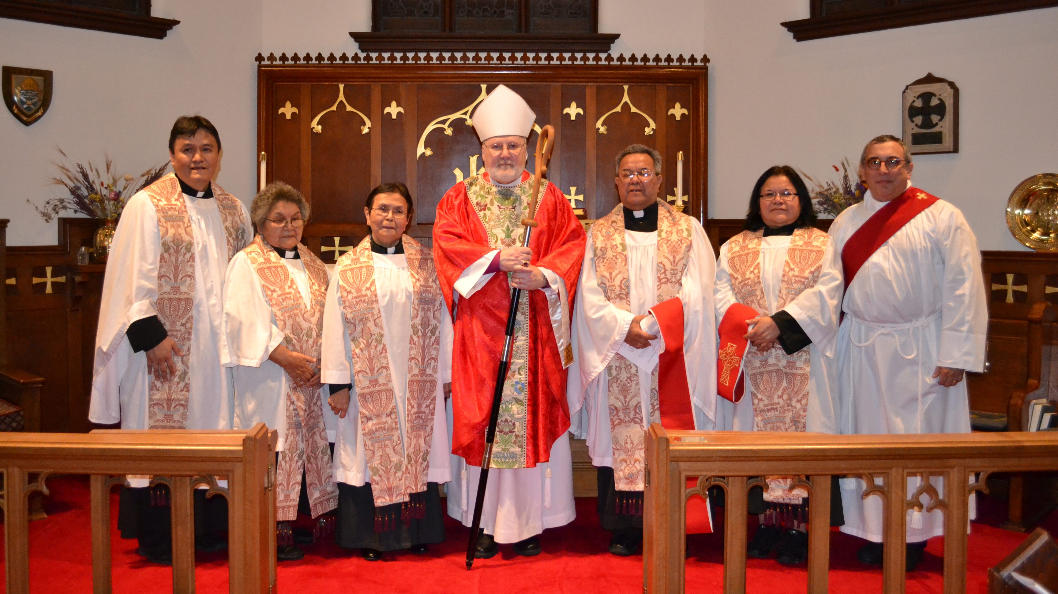
The heart of a Pastor (Shepherd) The core of Pastoral Ministry
What is pastoral ministry?
What is grief and how do I deal with it?
How do I help someone in grief?
How do I deal with grief? - Knowing about codependence and transference and what to do about it.
How can I begin to help? Learning to actively listen
Beware of the Social Worker’s high!

Slide 30
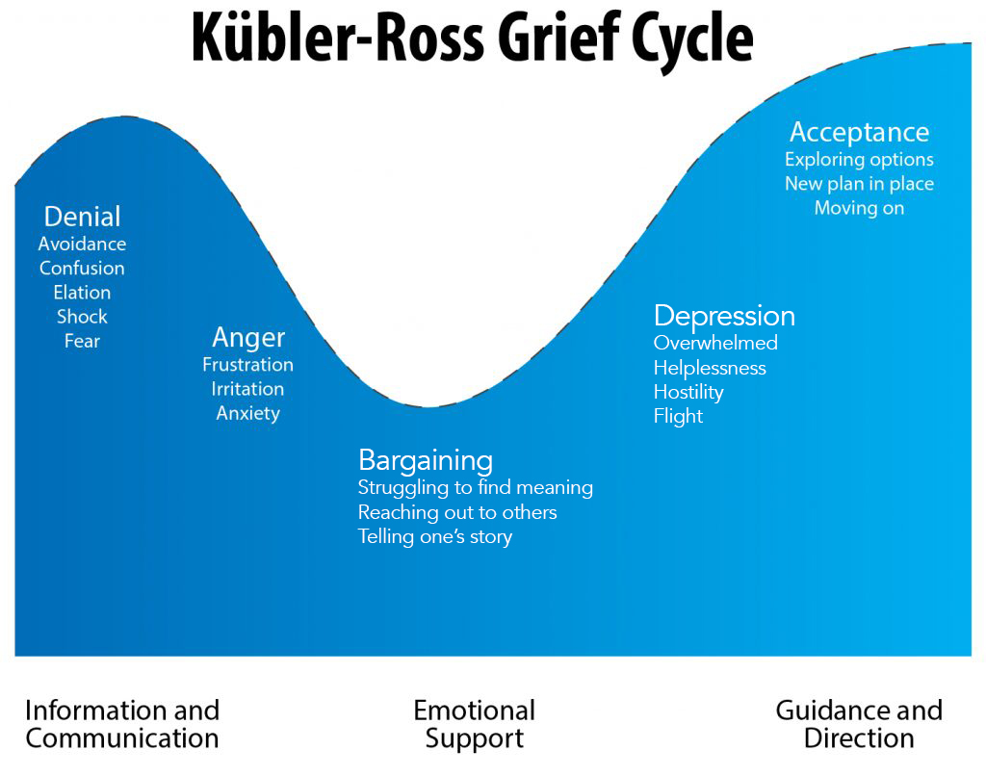
Stages of Grief according to Kubler-Ross
What are the stages of Grief?
    Denial, Anger, Depression, Bargaining, Acceptance
    Deliberately not numbered because there is no logical progression in dealing with grief and loss.
    Unresolved/Chronic Grief
    The necessity of the Skill of Active listening: Remember that you have two ears and one mouth, so remember to listen twice as you speak.

Slide 31


Self Care in times of Grief and loss
    Do not try to be Wonder woman or Superman – you need to care for yourself in doing ministry.
    Beware of the Social Worker’s High.

