Slide 1
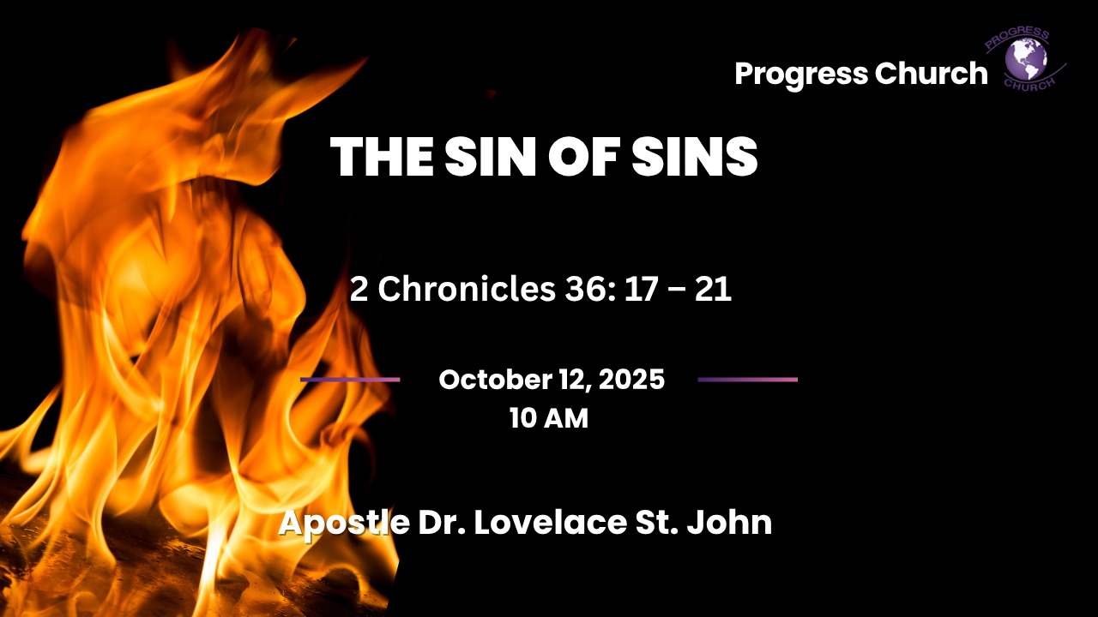

Slide 2



INTRODUCTION
The consequences of persistent disobedience to God.
It is not that God delights in judgment, He delights in mercy (Micah 7:18).
When His people continually ignore His voice, He allows discipline to bring them back to Himself.
Today is Thanksgiving Sunday and also a Communion Service, two moments that perfectly complement each other.

Slide 3
INTRODUCTION cont
Thanksgiving is about remembering God’s goodness with a grateful heart; Communion is about remembering Christ’s sacrifice with a humble heart.
Together, they call us to remember the past, reflect on God’s mercy, and renew our covenant with Him.

Slide 4
1. God Warns Before He Acts
For years, God sent prophets like Jeremiah, pleading with the people: “Turn from your evil ways!” (Jeremiah 25:4–5).
But they mocked the messengers, despised His words, and misused His prophets (2 Chronicles 36:16).
How many times has God spoken to you, through Scripture, sermons, or even life circumstances, yet you’ve brushed it aside?
God’s patience is long, but it is not endless

Slide 5
2. God’s House Was Not a Guarantee of Safety
Jerusalem thought, “We have the temple, God’s house is here, He won’t let it be destroyed.” But God allowed the Babylonians to burn the temple.
Proving that His presence is not tied to buildings but to obedience.

Slide 6
2. God’s House Was Not a Guarantee of Safety cont
Church attendance, religious symbols, or Christian titles cannot protect us if our hearts remain far from God.
What matters is genuine obedience

Slide 7

3. God Allows Consequences to Fulfill His Word
Judah’s seventy years in Babylon were to fulfill Jeremiah’s prophecy and to give the land its rest.
God had commanded Israel to let the land rest every seventh year (Leviticus 25:4), but for nearly 490 years, they ignored it. God said, “If you won’t give My land rest, I will.”
We cannot bypass God’s Word.
Ignoring His commands may bring temporary gain, but eventually His truth stands.

Slide 8
3. God Allows Consequences to Fulfill His Word
Maybe you are in a season of consequences right now.
It may feel like exile, but God’s mercy is still at work.
He disciplines to restore, not to destroy.

Slide 9
5. When we Remember God’s Mercy, It Restores Our Gratitude
Exile was not the end, it was a pause, a discipline, a reminder that God’s word is sure.
Out of the ashes, God would bring restoration.
We are here today because of mercy.
If God gave us what we deserved, none of us would be here.
Like Judah, we have failed, rebelled, and wandered. Yet God has preserved us

Slide 10
5. When we Remember God’s Mercy, It Restores Our Gratitude
We give thanks not only for blessings received but for mercies we did not deserve.
Judah had prophets, priests, a temple, and promises, but they forgot the Giver.
On Thanksgiving, we must remember that gratitude is not about one day of celebration but a lifestyle of honoring God daily.
Even in loss, there is reason to thank God.

Slide 11
5. When we Remember God’s Mercy, It Restores Our Gratitude
The exile seemed like the end, but it became a pathway to renewal.
Some of our hardest seasons are actually God’s hand turning us back to Him.
We can thank Him not only for what He has given but also for how He has kept us through trials.

Slide 12
6. Communion Reflections
As we move to the Lord’s Table, this passage also points us to Christ:
Christ bore our judgment.
Judah faced destruction for its sins, but at the cross, Jesus bore the ultimate judgment for ours.
The exile pointed forward to the greater deliverance Christ would bring.
.

Slide 13
6. Communion Reflections
Christ secures our restoration.
Just as God brought His people back from exile, Christ brings us back to God through His blood.
Communion is our reminder that restoration is possible because of the cross.
Christ calls us to remember.
The people forgot God’s warnings and fell. Communion is Jesus’ command: “Do this in remembrance of me.”
Thanksgiving fades when we forget; gratitude flourishes when we remember.
.

Slide 14
CONCLUSION cont
2 Chronicles 36:17–21 teaches us these key lessons:
God always warns before judgment.
Religion without obedience is empty.
God’s Word will always be fulfilled.
Even in discipline, God’s mercy prepares the way for restoration.

Slide 15
CONCLUSION cont
Though Judah was broken, God reshaped them.
And though you may feel broken by sin or consequences, the Potter has not thrown you away.
Let us not wait until God allows consequences to wake us up.
Today, if you hear His voice, harden not your heart (Hebrews 3:15).

Slide 16
CONCLUSION cont
Repent where needed, obey His Word, and trust that even in discipline, His mercy is at work.
2 Chronicles 36 is both a warning and a hope. The warning: never ignore God’s mercy. The hope: God’s covenant love endures, even through judgment.
We serve a God who turns exile into restoration, ashes into beauty, and judgment into mercy through the blood of His Son.
“Thanks be to God for His indescribable gift!” (2 Corinthians 9:15).

