Slide 1
Leader: Welcome to Holy Hermits Online Worship
18th Sunday after Pentecost
Today we remember Holy Hermit
St. Therese of Lisieux
Service Prep: Kristine | Chat Host: Kerrie-Anne | First Reader: Roselyn
Music: Wiggles 🐶 | Priest: | Second Reader: Bob
Proof-reader: Viki 🌸 | Deacon: Lauren | Preacher: Lauren
Broadcaster: Paul | Welcomer: Chris | Fellowship: Lauren
Backup Broadcaster: Barry | Leader: Jeremy | Safety Officer: Leonie
Zoom Buttons: Kerrie-Anne | Cantor: Julie | Attendance: Kerrie-Anne

Slide 2






Hospitality
Leader: Please mute for the service unless invited to offer your voice as part of the service ministry
Have the video camera on or off and turn the volume and brightness up or down on your device if things are too loud 🔉🔊or too bright🔅🔆
Our Cantor acts as our voice, offering the responses, in Bold Text, which we say together
Feel welcome to use the chat and reaction emojis 👍
🙏 Please take care of yourself in this space. 🙏 Come and go as you need
😴 It is great to take rest in this space, so falling asleep is also OK 😴
👂️ Remember, pastoral care is available to all in the community, if you'd like to speak to someone about anything spiritual. ❤️ Visit the help page at the website to reach out 🌐
Our Being Together ethos and safeguarding practices can also be accessed on the website 🫶​
🙌 Come as you are – we are all here together! 🙌
Notes:
Used Lent 2022

Slide 3
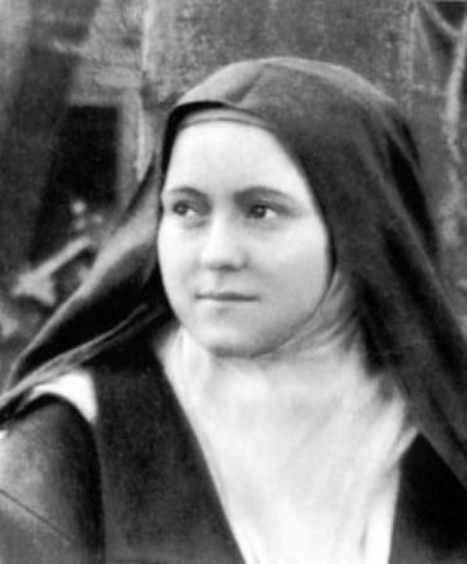
Leader: Our Holy Hermit Highlights for today – St. Therese of Lisieux
Thérèse of Lisieux, born Marie Françoise-Thérèse Martin in Alençon, France on 2 January 1873, was the youngest daughter of a devout Catholic family. A sickly child from birth, she faced early loss when her mother died at age four, and her older sisters gradually entered convents, leaving her feeling abandoned. After a serious illness, Thérèse experienced a vision of the Virgin Mary and was miraculously healed, deepening her spiritual life. Despite being considered too young and immature, she was determined to join the Carmelite convent and even appealed directly to the Pope during a trip to Rome. Her persistence paid off, and she was admitted in 1889.

Slide 4
Leader:
Life in the convent was marked by humility and quiet devotion, especially as concerns arose about her family's influence within the community. In 1896, Thérèse developed tuberculosis and began writing her spiritual reflections, which were later compiled by her sister Pauline. She died at age 24 in 1897. Her simple yet profound approach to spirituality, known as the “Little Way,” emphasized trust in Jesus and small daily sacrifices, inspiring countless people seeking holiness in ordinary life.
To read more about our hermits please click the link​​ in the send out

Slide 5
Invitation
Leader: As we settle into worship let your breath be soft, your mind be still, and your heart be open to the presence of God.
https://www.youtube.com/watch?v=y-PT2TCLOa8

Slide 6
Leader and Cantor unmute
The Greeting
Leader:
The Grace of the lord Jesus Christ,
and the love of God,
and the fellowship of the Holy Spirit,
be with you all.
All: And also with you.

Slide 7
Gathering Prayer
Leader: Let us come together to worship our Lord –
let us fix our eyes upon God,
listen to God’s Word
and give our minds to God’s teaching.
For we are God’s people.
All: We humbly gather in God’s presence,
our creator, redeemer and sustainer.
We thank you, God, for the breath that sustains us
and the community that surrounds us.
Let us come and worship you with hearts thankful
for all your blessings to us.
Amen.

Slide 8
Sentence
Leader: I invite our Cantor to proclaim the sentence for today.
Cantor:
What shall I return to the Lord for all his bounty to me? I will lift up the cup of salvation and call on the name of the Lord, I will pay my vows to the Lord in the presence of all his people.
Psalm 116.12-14

Slide 9
Prayer of Approach
Leader: We pray the prayer of approach together.
All:Lord God, as we come before you today,
our thoughts are still chained to worldly matters.
We have hurried from homes that need tidying;
we have food to prepare, bills to pay,
a living to earn – so many cares and concerns.
But now, as we gather, we shrug off these chains
in order to concentrate on you, O Lord.
May our love for you be unchained,
just as your love for us always is.
Amen.

Slide 10
Leader:
Our First Hymn is
To God Be The Glory
Let us sing together or allow the music to nourish us
https://www.youtube.com/watch?v=-15v9iworAU
We stay on mute
Leader and Cantor mute

Slide 11
The Deacon or LA Introduces Confession​
​Hear, O Israel, the Lord our God, the Lord is one; you shall love the Lord your God with all your heart, and with all your soul, and with all your mind, and with all your strength.' Jesus said: 'This is the great and first commandment. And a second is like it: you shall love your neighbour as yourself.'
Silence may be kept.
Let us therefore bring our sins before the one true God, in penitence and faith.

Slide 12
All: ​Merciful God, our maker and our judge, ​we have sinned against you ​in thought, word, and deed, ​and in what we have failed to do: ​we have not loved you with our whole heart; ​we have not loved our neighbours as ourselves; ​ we repent, and are sorry for all our sins.​ Father, forgive us. Strengthen us to love and obey you in newness of life; ​through Jesus Christ our Lord. ​
Amen.​

Slide 13
​Words of Assurance offered by Deacon or LA
​
These words of assurance from the First Letter of John declare
that: ​
If anyone sins, we have an advocate with the Father, Jesus Christ
the righteous. He is the perfect offering for our sin, and not for
ours only, but for the sins of the whole world. (1 John 2: 1-2) ​
In this is love, not that we loved God, but that God loved us and sent the Son to be the perfect offering for our sins. (1 John 4:10)​. ​
The absolution may now be offered by a priest if present.
​

Slide 14
Collect
Leader:
O God,
you have made heaven and earth and all that is good:
help us to delight in simple things
and to rejoice always in the richness of your bounty;
through Jesus Christ our Lord,
who lives and reigns with you in the unity of the Holy Spirit,
one God, for ever and ever.
Amen.

Slide 15
Prayer for sustainability
Leader:
Generous God, We hold before you the financial stability and future sustainability of Holy Hermits Online. Guide us as we seek to grow our community’s giving, so we may continue the work you have called us to—being together in this digital space. Show us where to place our energy as we explore new funding sources and fresh opportunities. Be present with us and those we meet as we reach out to charitable trusts and foundations, inviting their support for our outreach—especially to those unable to get to Church in person.
Continue…

Slide 16
Stir the hearts of all who believe in this mission to greater generosity, creativity, and commitment. We thank you for the partnerships you have already blessed us with, especially our home base at St John’s Cathedral.
We pray in the name of Jesus, who lived on mission and said,
If in my name you ask me for anything, I will do it.
Amen.

Slide 17
The 1st reader unmutes
Leader: I invite the 1st Reader to unmute and offer the 1st reading when ready.
Reader 1: The first reading is from Jeremiah 29.1, 29.4-7
¹ These are the words of the letter that the prophet Jeremiah sent from Jerusalem to the remaining elders among the exiles, and to the priests, the prophets, and all the people, whom Nebuchadnezzar had taken into exile from Jerusalem to Babylon. ⁴ Thus says the Lord of hosts, the God of Israel, to all the exiles whom I have sent into exile from Jerusalem to Babylon: ⁵ Build houses and live in them; plant gardens and eat what they produce. ⁶ Take wives and have sons and daughters; take wives for your sons, and give your daughters in marriage, that they may bear sons and daughters; multiply there, and do not decrease. ⁷ But seek the welfare of the city where I have sent you into exile, and pray to the Lord on its behalf, for in its welfare you will find your welfare.
For the word of the Lord. Thanks be to God.​

Slide 18
Leader: We now say the psalm antiphonally, I invite the first reader to lead and we will all respond with the Response in Bold along with our cantor as our voice.
¹ O shout with joy to God, all the earth:
sing to the honour of his name,
and give him glory as his praise.
² Say to God ‘How fearful are your works:
because of your great might
your enemies shall cower before you.’
³ All the earth shall worship you:
and sing to you, and sing praises to your name.
⁴ Come then and see what God has done:
how terrible are his dealings with the children of Adam.
Psalm 66.1-11
Continue…

Slide 19
⁵ He turned the sea into dry land,
they crossed the river on foot:
then were we joyful because of him.
⁶ By his power he rules for ever,
his eyes keep watch on the nations:
and rebels shall never rise against him.
⁷ O bless our God, you peoples:
and cause his praises to resound,
⁸ Who has held our souls in life:
who has not suffered our feet to slip.
Continue…

Slide 20
⁹ For you have proved us, O God:
you have tried us as silver is tried.
¹⁰ You brought us into the net:
you laid sharp torment on our loins.
¹¹ You let our enemies ride over our heads,
we went through fire and water:
but you brought us out into a place of liberty.

Slide 21
The 2nd reader unmutes
Leader: Thank you, 1st reader. I invite the 2nd Reader to unmute and offer the 2nd reading when ready.
Reader 2: The 2nd Reading is from 2 Timothy 2.8-15
⁸ Remember Jesus Christ, raised from the dead, a descendant of David—that is my gospel, ⁹ for which I suffer hardship, even to the point of being chained like a criminal. But the word of God is not chained.
¹⁰ Therefore I endure everything for the sake of the elect, so that they may also obtain the salvation that is in Christ Jesus, with eternal glory.
¹¹ The saying is sure:
If we have died with him, we will also live with him;
Continue…

Slide 22
¹² if we endure, we will also reign with him;
if we deny him, he will also deny us;
¹³ if we are faithless, he remains faithful— for he cannot deny himself.
¹⁴ Remind them of this, and warn them before God that they are to avoid wrangling over words, which does no good but only ruins those who are listening.
¹⁵ Do your best to present yourself to God as one approved by him, a worker who has no need to be ashamed, rightly explaining the word of truth.
For the word of the Lord. Thanks be to God.

Slide 23

We pause before
​the Gospel ​​

Slide 24
The Gospel of our Lord Jesus Christ according to St Luke Chapter 17 beginning at the 11th verse
All: Glory to you Lord Jesus Christ.
¹¹ On the way to Jerusalem Jesus was going through the region between Samaria and Galilee. ¹² As he entered a village, ten lepers approached him. Keeping their distance, ¹³ they called out, saying, ‘Jesus, Master, have mercy on us!’ ¹⁴ When he saw them, he said to them, ‘Go and show yourselves to the priests.’ And as they went, they were made clean. ¹⁵ Then one of them, when he saw that he was healed, turned back, praising God with a loud voice.
Continue…

Slide 25
¹⁶ He prostrated himself at Jesus’ feet and thanked him. And he was a Samaritan. ¹⁷ Then Jesus asked, ‘Were not ten made clean? But the other nine, where are they? ¹⁸ Was none of them found to return and give praise to God except this foreigner?’ ¹⁹ Then he said to him, ‘Get up and go on your way; your faith has made you well.’​
This is the Gospel of the Lord. All: Praise to you Lord Jesus Christ.

Slide 26
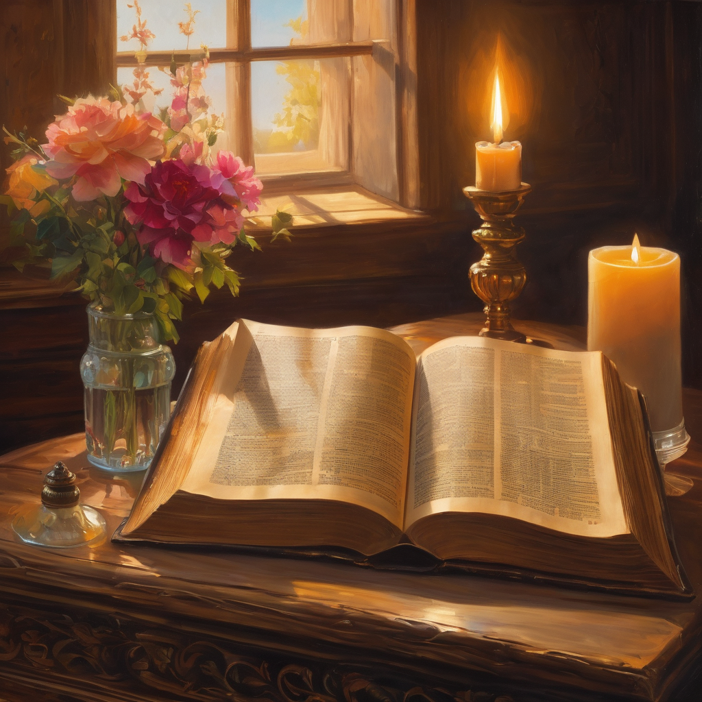
We pause
after ​the Gospel ​​

Slide 27
Leader: The Sermon is recorded to YouTube for sharing later.
Only the preacher's video and audio will be recorded.
The chat and other participants' feeds remain out of sight of the recording.
Leader and Cantor mute
Broadcaster exits screenshare
Preacher unmutes
Zoom buttons ”pins” preacher’s screen + selects “record to the cloud”
Sermon

Slide 28
Leader unmutes
Leader: Our next Hymn is
I Sing Praise To Your Name
Let us sing together or allow the music to nourish us
https://www.youtube.com/watch?v=7dIueIja2oY
We stay on mute
Leader mutes

Slide 29
The Leader and Cantor unmute
The Greeting of Peace
Leader: We are the body of Christ
All: God’s Spirit is with us
Leader: The peace of the Lord be always with you.
All: And also with you.
Leader: A sign of peace may be exchanged
You may like to type 'Peace' into the chat, use the 'raise hand’ or other reaction buttons, or just simply wave via the screen with your video turned on
(Broadcaster exits shared screen for a few moments for the exchange of peace)

Slide 30
Prayer of Thanksgiving before Intercessions
Leader: As we enter prayer, I invite the second reader to unmute to lead our intercessions which follow the prayer of thanksgiving. Please feel free to change your body position as you need.
Lord, we praise you for your unfettered gospel.
Your Word was not silenced by chaining Paul
or any others who have suffered for proclaiming it.
Your Word has escaped all bounds of language
and custom imposed by human hands and minds,
so that it might be freely shared and understood by all.
Your gospel is the unchained melody that runs through our lives,
freeing us to be the people you mean us to be.
Amen.

Slide 31
Intercessions
Reader 2: We pray for creation and communities we share our lives with. We pause for a few moments to name either in our hearts, or out loud, or in the chat, those environments and communities we bring to the Lord in prayer.
PAUSE…
We entrust to you the community of Holy Hermits Online and our ministry partners:
Prosper the work of our hands and show us the way to your new creation.
Creator God, Hear our prayer.
St John's Cathedral Brisbane The Anglican Diocese of Southern Queensland St Gabriel’s, Carindale Benedictus Contemplative Church, Canberra The Episcopal Diocese of Texas Anglican Focus and Tithe.ly

Slide 32
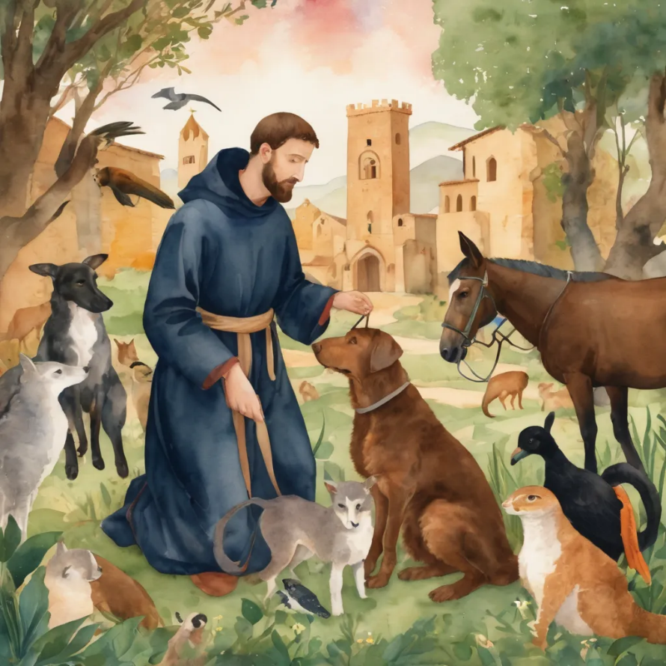
Reader 2: Loving Creator, we entrust to you all animals, especially those who are sick, anxious, ageing, lost, at risk, lonely, sad, hungry, in pain, homeless, abused, living in fear, encountering violence of any kind, in need of comfort, rehabilitation or transformation.
We invite your loving compassion for:
Jasmine,
Leese(y),
Sid,Toots and Lulu
Polly and Suki
Fred, George and Percy
Koshka,
Lambert
Kala, Nigel and Little One
Toby
Taco
Paddy and Jax
We name in our hearts, out loud or in the chat,
the animals we bring to the Lord in prayer. PAUSE…

Slide 33
Reader 2: Eternal Trinity of Love, we uphold to you the people we love and carry cares for:
We name in our hearts, out loud or in the chat, those we bring to the Lord in prayer.
PAUSE…
Lord in your mercy, Hear our prayers.
Amen.
Kerry and Les, Jake,​​ Dr Julie, ​​ Julie and Ray, Tracey, Shane Jess and Leah ​​ May ​​ Kirsten, Greg, Daphne & Beau​​ Tanya​ Matthew & Nicholas​ Alan & Gaylene​ Susan Bonnie and girls | Barry​​ Dilys and Tony, Paul and Darhon Judy and Mary​​ Mark, Desley and Bob ​​ Ruth​​ Josephine P Carol McD Phil​ Rachel, Mervyn & Gillian Liz’s Godchildren | Bill and Marjorie​​ Rev'd Shane & Janette​​ Alecia, Martin and Aidan​​ Aaron and Andrea ​​ Neva​ Bob and Di​ Steven, Vanessa and Craig Miriam Judy, Kim and Angie Barry and Gwen Pat and Julie

Slide 34
Pray Daily Cycle of Prayer
Leader: Loving God, joining with the Church in our cycle of prayer, we ask your blessings on:
The Church of the Province of Uganda
The Diocese of Grafton: †Murray; Clergy and People
The Parish of Quilpie:
Converge International Industrial Chaplain
St John’s Anglican College, Forest Lake: Principal – Maria; Chaplain – Juliana; Chair of College Council – Carla; members of College Council; staff & students

Slide 35
Commitment prayer for the week: People in Need
Leader:
God who gives shelter, we give thanks for opportunities to offer support and prayers for those that are struggling at this time to put a permanent roof over their heads and to shelter those they love.
Please shine a light on homelessness for the people and animals experiencing this and provide away for homes to be found and others to help, especially governments and churches.
Please protect all living rough and give safety and security to families and young people, and those who are supporting them.
Continue…

Slide 36
Commitment prayer for the week: People in Need
Please help us channel and inspire the hospitality that Jesus and his followers sought and encouraged in their day and especially strengthen those already offering this ministry.
Awaken compassion in the hearts of all people to reach out with a loving hand. When we feel disheartened by this unfolding situation, please refocus our energies to keep praying and finding small ways to help so we don't feel so overwhelmed.
Usher in a wave of change for systems to be transformed and ways made for largescale transformation. Amen.

Slide 37
Leader: Let us pray together the prayer which Jesus gave us saying:
All: Our Father in heaven,
hallowed be your name,
your kingdom come, your will be done,
on earth as in heaven.
Give us today our daily bread.
Forgive us our sins
as we forgive those who sin against us.
Save us from the time of trial
and deliver us from evil.
For the kingdom, the power,
and the glory are yours
now and for ever.
Amen.

Slide 38
Devotions

Slide 39
Hermit Stories

Slide 40
Leader: Teachings from St. Therese of Lisieux
“I said to myself: God cannot inspire unrealizable desires. I can, in spite of my littleness, aspire to holiness. It is impossible for me to grow up, and so I must bear with myself such as I am with all my imperfections. But I want to seek out a means of going to heaven by a little way, a way that is very straight, very short, and totally new. "
"We must not be discouraged by our faults, for children fall frequently"
“I (pray) like children who do not know how to read, I say very simply to God what I wish to say, without composing beautiful sentences, and He always understands me.”
“Jesus, help me to simplify my life by learning what you want me to be and becoming that person.”

Slide 41
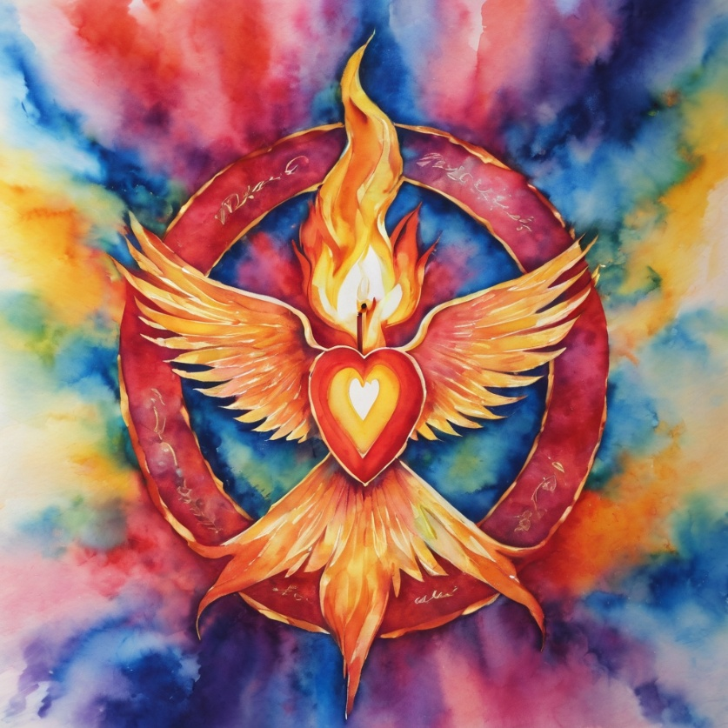
Leader: ​As we enter a few minutes of silence together, you are invited to pray this prayer of adoration and/or spend this time in contemplation. ​
The Spiritual Communion prayer follows
on the next slide. Let us be still.
Leader and Cantor Mute.
O Father, who loves us even when we deny you:
We worship and adore you!
O Son of God, Word made flesh, love incarnate:
We worship and adore you!
O Holy Spirit, breath of God, free as the wind:
We worship and adore you!
Amen.
​

Slide 42
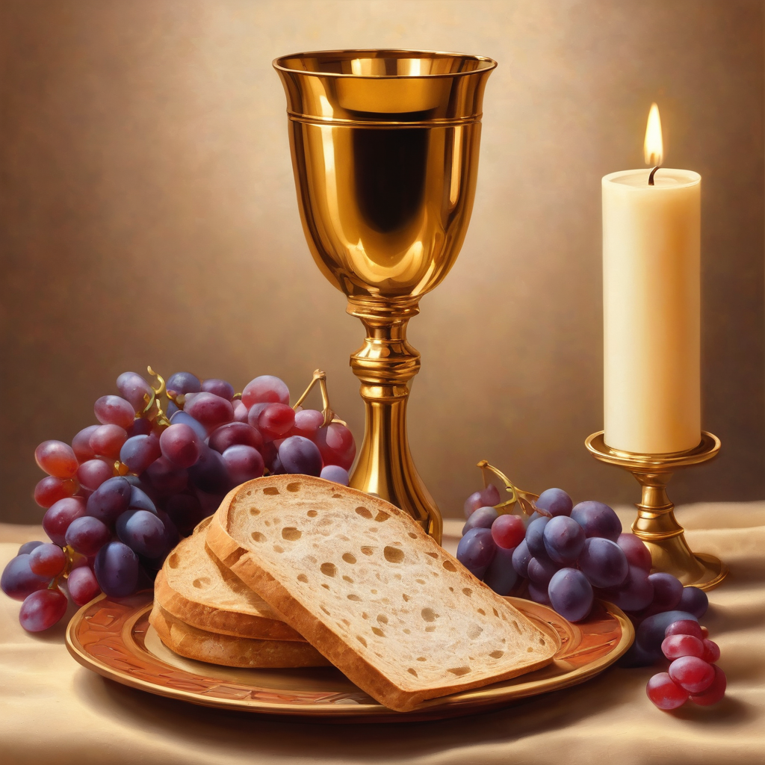

Oh, my Lord Jesus I turn to you present at the Altar and in the Tabernacle. I believe that you are present in the Holy Sacrament of your most Sacred Body and Blood.
I love you above all things and I desire to receive you into my Soul. I cannot at this moment receive you Sacramentally in Holy Communion.
Come spiritually into my heart.
Purify it, Sanctify it. Render my heart like your own heart.
I embrace you as if you were already there and unite myself wholly with you.
Never permit me to be separated from you.
Lord, I am not worthy to receive you, but only say the word and I shall be healed. Amen
Making a
Spiritual Communion
(Prayed in silence)

Slide 43
Leader: Our final song is
Unchained Melody
Let us sing together or allow the music to nourish us
https://www.youtube.com/watch?v=y4A_CBJiAWs
​We stay on mute
Leader and Cantor mute

Slide 44
Leader and cantor unmute
Sending Prayer
Leader: We pray our sending prayer together.
All:
Go with the love and power of God,
to be the best that you can be
and to be God’s faithful servant
in the weeks ahead.
Amen.

Slide 45
>If there is no priest present this slide is skipped<​
The Priest offers the Blessing
The peace of God which passes all understanding, keep your hearts and minds in the knowledge and love of God, and of God's Son Jesus Christ our Lord; and the blessing of God Almighty, the Father, the Son, and the Holy Spirit, be amongst you, and remain with you always.​
Amen.

Slide 46
A Benediction
Leader: Let us all invite God’s blessings together,​
​All:
May the Lord bless us and keep us.​
May the Lord’s face shine upon us and
be gracious to us.​
May the Lord’s countenance
be lifted upon us, ​
and bring us peace.
Amen.​

Slide 47
Notices
Today at 11am everyone is invited to come along to the second Christmastide Subscription planning workshop
Later today at 6pm it's our Franciscan Contemplative Service
Prayer and Praise with our Animal Friends is coming up this Thursday (16th Oct) at 6pm
We have the Teddy Bear service to look forward to next week at 9am worship 🐻- don’t forget to bring a bear
Then at 6pm next Sunday we will be recording the Blue Christmas service to upload as a resource to YouTube, all are welcome
Please see HHO Events page for further upcoming events HHO Events

Slide 48
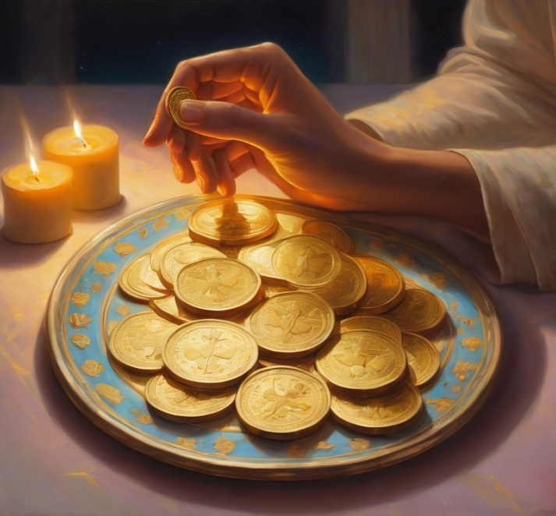
Offerings: Thank you for your regular gifts to this ministry
Offerings are most welcome via
Regular or one-off Direct Debit (International Direct Debit also available)
Bpoint credit card donation
The HHO App or Website via the Tithe.ly Give system
Leaving a legacy/bequest in will/estate
For further information go to HHO give page
https://holyhermits.com.au/give

Slide 49
Serving next week 19th September
19th Sunday of Pentecost
9:00 am AEST
Service Prep: Paul | Chat Host: Viki | First Reader: Helen
Music: Paul | Priest: | Second Reader: Vanessa
Proof-reader: Chris | Deacon: Lauren | Preacher: Lauren
Broadcaster: Kieron | Welcomer: Lauren | Fellowship: Julie
Backup Broadcaster: Lauren | Leader: Julie | Safety Officer: Chris
Zoom Buttons: Viki | Cantor: Jeremy | Attendance: Viki
Thank you for your ministry gifts
New servers are always welcome!
Please email Kerrie-Anne to get involved
holyhermits@anglicanchurchsq.org.au

Slide 50
Leader: I invite everyone to unmute for the Dismissal
Leader: Go in peace to love and serve the Lord.
All: In the name of Christ, Amen.

Slide 51

Fellowship time
Thank you, Lauren for leading fellowship
Please feel welcome to linger or pop a message in the chat and head off when you are ready.​
AI Image: seeking freedom and light from darkness and chains.
Extra resources developed
by Roots on the Web

