Slide 1
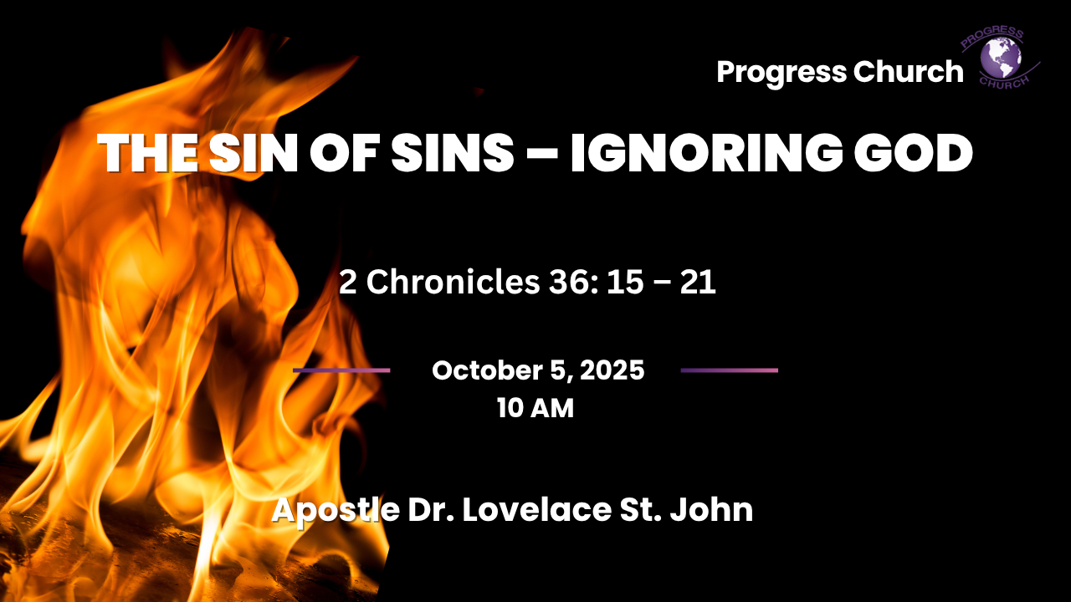

Slide 2



SCRIPTURE
2 Chronicles 36: 15 – 17

Slide 3
INTRODUCTION
When there is no remedy for the body, it dies; when there is no remedy for the soul, the soul dies.
John 16:8–9
Hebrews 3:12
1 John 5:10–12
Every sin is offensive to God. From the smallest lie to the darkest act of rebellion, sin separates humanity from a holy Creator.
The sin of sins is the refusal to believe God, to Ignore God, to take lightly God’s Compassionate warning.

Slide 4
The Sin of Sins in Scripture
The Bible highlights unbelief repeatedly as the most grievous sin:
Israel in the wilderness: Hebrews 3:12.
Israel saw miracles in Egypt, manna from heaven, water from the rock, yet they doubted and perished in the wilderness.
Nazareth in Jesus’ day: Mark 6:6.
It was not the lack of His power but their refusal to believe that shut the door to miracles.

Slide 5
2. The Danger of Ignoring God
“But they mocked the messengers of God, despised His words, and scoffed at His prophets, until the wrath of the LORD arose against His people, till there was no remedy.” --2 Chronicles 36:16
One of the greatest tragedies in life is not when God is silent, but when we ignore Him while He is still speaking.
God is not distant or careless, He speaks through His Word, through His Spirit, through His servants, and even through circumstances.
Ignoring God is not simply indifference; it is a slow road to destruction.

Slide 6

3. Ignoring God
A. Ignoring God is Rejecting His Compassion
2 Chronicles 36:15, we read that God sent messengers “because He had compassion on His people.”
When we ignore God, we are rejecting His compassion and love.
God warns us not because He delights in judgment, but because He longs to save us. Every warning is an act of mercy.

Slide 7
3. Ignoring God Cont
B. Ignoring God Hardens the Heart
The people in Judah didn’t just ignore God once; they mocked His messengers repeatedly. Each time they refused to listen, their hearts grew harder, until “there was no remedy” (2 Chronicles 36:16).
Every time you ignore God’s Word, your heart becomes a little less sensitive. Over time, you may not even notice His voice. That is the danger.

Slide 8
3. Ignoring God Cont
C. Ignoring God Leads to Consequences
Judah ignored God until judgment came: the temple was burned, the city walls destroyed, and the people carried into captivity (2 Chronicles 36:17–20).
Ignoring God doesn’t make His Word disappear, it simply brings consequences closer.
The consequences of ignoring God may come as broken relationships, loss of peace, bondage to sin, or even judgment. God is not mocked; what we sow, we reap (Galatians 6:7).

Slide 9
4. The Danger of Ignoring God is Real
One of the greatest tragedies in human life is when men and women choose to ignore God.
“The fool says in his heart, there is no God” (Psalm 14:1).
Ignoring God is not just about rejecting His existence, it is living daily as if He does not matter, disregarding His Word, His warnings, and His will.
This is not a light matter; it is a dangerous path with eternal consequences.
When we ignore God’s counsel, we become desensitized to His Spirit.

Slide 10
Conclusion:
The danger of ignoring God is real.
It hardens the heart.
Brings judgment.
Robs us of blessings.
Leads to eternal separation from Him.
“Seek the Lord while He may be found; call on Him while He is near” (Isaiah 55:6).
Let us not ignore His Word, His Spirit, or His call. Instead, let us respond with repentance, faith, and obedience.
For in heeding His voice, there is life, peace, and eternal hope.

