Slide 1
Intentional Prayer
Psalm 27:13-14-"I believe that I shall look upon the goodness of the Lord in the land of the living! Wait for the Lord; be strong, and let your heart take courage; wait for the Lord!"

Slide 2
Prayer Prompts
-Lord you are good. Help me to see your goodness.
-Lord help us to wait patiently and joyfully for your return.
-Lord, give me the strength and courage I need As I wait on you to…

Slide 3
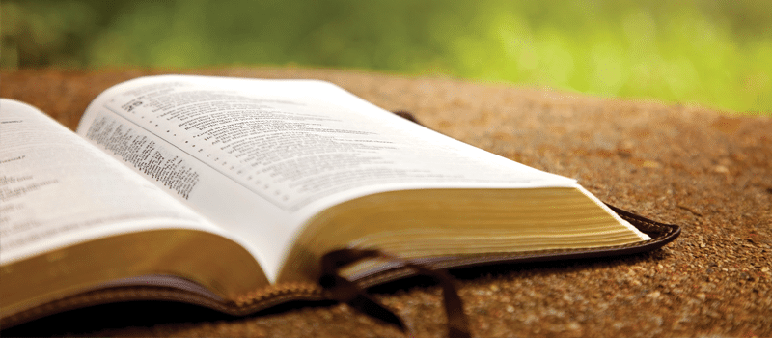
James
Ch 2:1-13

Slide 4
Saved or not, we are all image bearers of the most high god.

Slide 5
Faith in Jesus is incompatible with partiality.

Slide 6
Partiality creates division.

Slide 7
Partiality is the result of evil or deceptive thoughts.

Slide 8
To be rich in faith is to know God well.

Slide 9
Believers are called to see people the way Jesus sees them.

Slide 10
Our love for god is made evident through our love for people.

Slide 11
The sin of partiality divides dishonors and degrades.

Slide 12
We cannot show partiality to God’s word.

Slide 13
Let the Gospel be the standard by which you live your life.

Slide 14
Showing mercy to others is evidence of faithful obedience.

Slide 15
We show mercy not based on merit but because of the Mercy god has shown us.

Slide 16
The world is looking for evidence that god is merciful. The evidence of God’s mercy is displayed in how we treat others.

