Slide 1

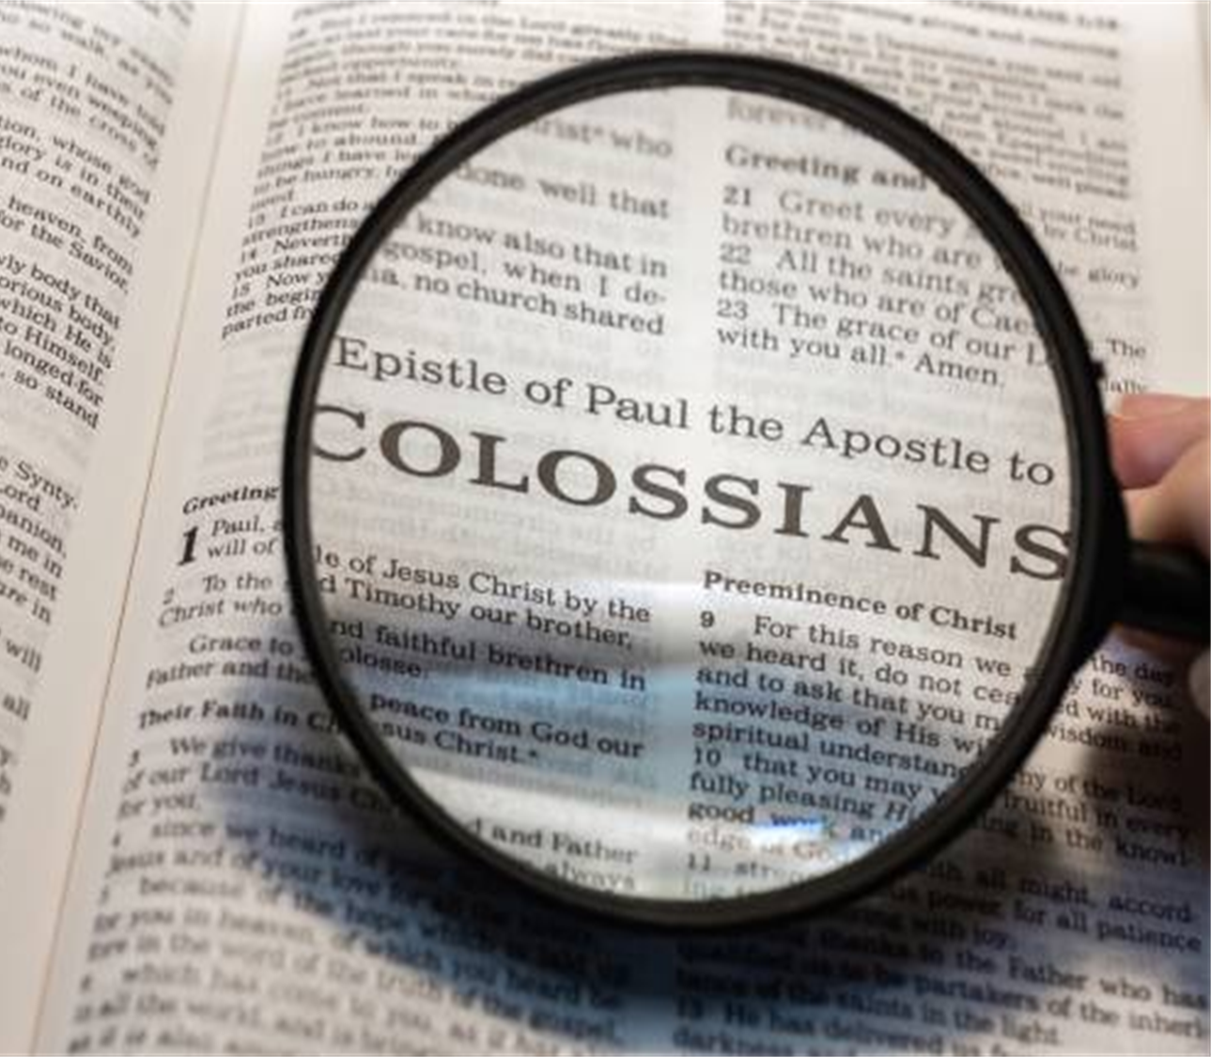
THE POSITION & PROSPECT OF THE BELIEVER:
Seeking the Things Above
COLOSSIANS
3: 1 - 4
Message 7 of 12 in series “Encountering Christ through Colossians”
CLIC @ FEDERATION UNI BERWICK
5th October 2025

Slide 2


THE LESSON SO FAR..
WHAT WAS THE CHALLENGE THAT THE CHURCH AT COLOSSAE WAS FACING?

Slide 3
THE LESSON SO FAR..
DOCTRINAL CONFUSION & MORAL CHAOS
FALSE TEACHERS WERE OFFERING THE BELIEVERS
A MAN-MADE RELIGION
WHICH
THREATENED TO ROB THE CHURCH OF THE SUPREMACY AND ALL-SUFFICENCY OF CHRIST.

Slide 4
THE LESSON SO FAR..
IN THE FIRST 2 CHAPTERS OF COLOSSIANS,
PAUL HAS BEEN MAKING IT VERY CLEAR THAT
TRYING TO LIVE THE CHRISTIAN LIFESTYLE
WITHOUT
FIRST DISCOVERING THE SOURCE OF LIFE
IS IMPOSSIBLE.

Slide 5
THE LESSON SO FAR..
PAUL IS NOT JUST CALLING PEOPLE TO A LIFESTYLE.
HE IS PRESENTING TO US
THE PERSON OF CHRIST,
THE POWER OF THE SPIRIT,
SO THAT KNOWING THAT IN OUR LIVES,
WE MAY THEN LIVE LIFE
ACCORDING TO THIS LIFESTYLE

Slide 6
THE LESSON SO FAR..
OUR FAITH
MUST ALWAYS BE
A FAITH THAT FUNCTIONS.
OUR DOCTRINE
MUST INEVITABLY RESULT IN PRACTICAL DISCIPLESHIP.
THE HEAD AND THE HEART MUST BE INVOLVED

Slide 7
BUT NOW..
..A TURNING POINT
PAUL MOVES
FROM DOCTRINE TEACHING
TO
A PRACTICAL APPLICATION OF THE GOSPEL.
IT IS A CLASSIC, CONCISE OUTLINE OF PRACTICAL CHRISTIANITY

Slide 8
LOOKING FORWARD
COLOSSIANS 3: 1 – 4:6
THE CHRISTIAN IN HIS RELATIONSHIP TO..
CHRIST,
THE LOCAL CHURCH,
THE FAMILY,
HIS DAILY WORK,
THOSE OUTSIDE OF CHRIST

Slide 9
EPHESIANS 4: 1 (NASB, 1999)
“THEREFORE I, THE PRISONER OF THE LORD, IMPLORE YOU TO
WALK IN A MANNER WORTHY OF THE CALLING WITH WHICH YOU HAVE BEEN CALLED”
IF WE ARE TO LIVE OUT OUR LIVES PRACTICALLY
AS BELIEVERS IN CHRIST,
WE NEED TO TRULY KNOW THAT WE HAVE BEEN CALLED OF THE LORD AND HAVE COME TO KNOW HIM

Slide 10

POINT
OUR POSITION IN CHRIST
https://stock.adobe.com/

Slide 11
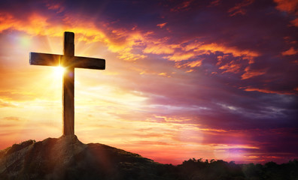
Col. 3 v.1 THEREFORE, IF YOU HAVE BEEN RAISED WITH CHRIST, KEEP SEEKING THE THINGS ABOVE, WHERE CHRIST IS, SEATED AT THE RIGHT HAND OF GOD.
Col. 3 v.2 SET YOUR MIND ON THE THINGS ABOVE, NOT ON THE THINGS THAT ARE ON EARTH
NASB, 1999
https://stock.adobe.com/

Slide 12

THE POSITION OF THE BELIEVER
RAISED WITH CHRISTT
https://www.gettyimages.com.au/

Slide 13
THE POSITION OF THE BELIEVER #1
“YOU HAVE BEEN RAISED WITH CHRIST”
=
A DESCRIPTION OF WHAT IT MEANS
TO BE A TRUE BELIEVER

Slide 14
THE POSITION OF THE BELIEVER #1
EPHESIANS 2: 5, 6 (NASB)
“EVEN WHEN WE WERE DEAD IN OUR TRANSGRESSIONS,
[GOD] MADE US ALIVE TOGETHER WITH CHRIST
(BY GRACE YOU HAVE BEEN SAVED),
AND
RAISED US UP WITH HIM IN THE HEAVENLY PLACES IN CHRIST JESUS.

Slide 15

THE POSITION OF THE BELIEVER
KEEP SEEKING
(PERSISTENCE)
https://www.gettyimages.com.au/

Slide 16
THE POSITION OF THE BELIEVER #2
“KEEP SEEKING”
Original word is a present imperative verb which means “ a continous, ongoing effort”
WE ARE CALLED TO
PERSISTENTLY SEEK AND
TO KEEP ON SEEKING

Slide 17


THERE ARE MANY STORIES OF HUMAN PERSISTENCE…
WHEN VERY YOUNG, HIS PARENTS WORRIED HE HAD A LEARING DISABILITY BECAUSE HE WAS SLOW TO LEARN TO TALK
DISMISSED FROM SCHOOL IN MUNICH BECAUSE HE APPEARED TO LACK INTEREST IN HIS STUDIES
APPLIED TO ENTER A POLYTECHNIC IN ZURICH BUT FAILED TO GAIN ADMISSION.
BECAME A TUTOR FOR THE BOYS IN A BOARDING HOUSE IN ZURICH BUT WAS SOON FIRED.
CONTINUED TO PERSIST IN HIS ENDEAVOURS AND FINALLY GAINED A TEACHING DIPLOMA & SOME 5 YEARS LATER A PhD FROM THE UNIVERSITY OF ZURICH.

Slide 18
THE POSITION OF THE BELIEVER #2
History is full of stories about the persistence of people through seemingly insurmountable odds, discouragement and ridicule. But such persistence is often focused on the rewards and acclaim of man which ultimately cannot hold a flame to “the things that are above”
WE ARE CALLED TO
PERSISTENTLY SEEK AND TO KEEP ON SEEKING

Slide 19
THE POSITION OF THE BELIEVER #2
OUR HEAVENLY SEEKING IS FIRST & FOREMOST TO BE ACHIEVED THROUGH PRAYER –
AS WE ASK, SEEK AND KNOCK
FOR THE THINGS ABOVE (MATTHEW 7:7; LUKE 18: 1-5)
THIS SEEKING SHOULD PERVADE OUR CONVERSATIONS, FRIENDSHIPS, STUDIES, WORK , PLAY.
WHEN IT DOES, IT WILL ENHANCE OUR FULLNESS IN CHRIST.

Slide 20

THE POSITION OF THE BELIEVER
SET YOUR MIND
(CONCENTRATE)

Slide 21
THE POSITION OF THE BELIEVER #3
COLOSSAINS 3: 2 (NASB)
“SET YOUR MINDS ON THE THINGS ABOVE,
NOT ON THE THINGS THAT ARE ON EARTH”
THE ACT OF SEEKING DEPENDS ON
WHERE OUR THE MIND IS SET ON

Slide 22
THE “THINGS ABOVE” ARE NOT THE PHYSICAL THINGS OF HEAVEN e.g. CHRIST’S LITERAL THRONE.
THEY HAVE TO DO WITH CHRIST’S SOVEREIGN REIGN OVER THE UNIVERSE AS HE FILLS ALL THINGS WITH HIS POWER. THE ‘THINGS ABOVE’ INCLUDE CHRIST’S CHARACTER, PRESENCE & HEAVENLY JOY.
WE ARE MEANT TO SEEK THE ONE WHO DWELLS ABOVE ALL

Slide 23

THE “THINGS ON EARTH” ARE NOT JUST MATERIAL POSSESSIONS,
BUT ALSO
THE IMMATERIAL THINGS OF THE WORLD, e.g. POSITION, PROMOTION, EARTHLY HONOURS
IT DOES NOT MEAN THAT CHRISTIANS ARE NOT INVOLVED IN THE WORLD & ANY POSSIBILITY OF PROMINENCE OR ACHIEVEMENT

Slide 24
AS CHRISTIANS WE ARE NOT TO SEE EARTHLY REWARDS AND POSITION AS OUR PRIORITY & SOLE AMBITION.
THE THINGS OF EARTH, ALL OUR POSSESSIONS WILL FADE AWAY & DECAY.
OUR MIND-SET SHOULD BE DOMINATED
BY “THE THINGS ABOVE”

Slide 25
PAUL IS VERY PRECISE IN HIS COMMAND:
“SET YOUR MINDS AND KEEP THEM SET ON WHAT IS ABOVE – THE HIGHER THINGS – NOT ON THE THINGS THAT ARE ON THE EARTH.”
IMPLICIT IN PAUL’S STATEMENT IS THAT WE MUST
CONCENTRATE

Slide 26
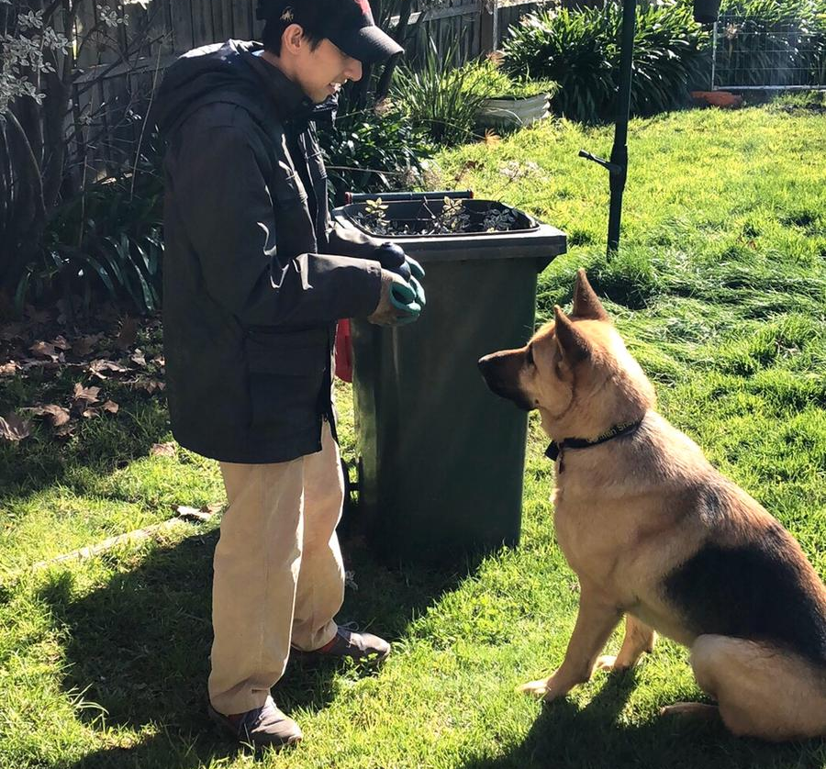
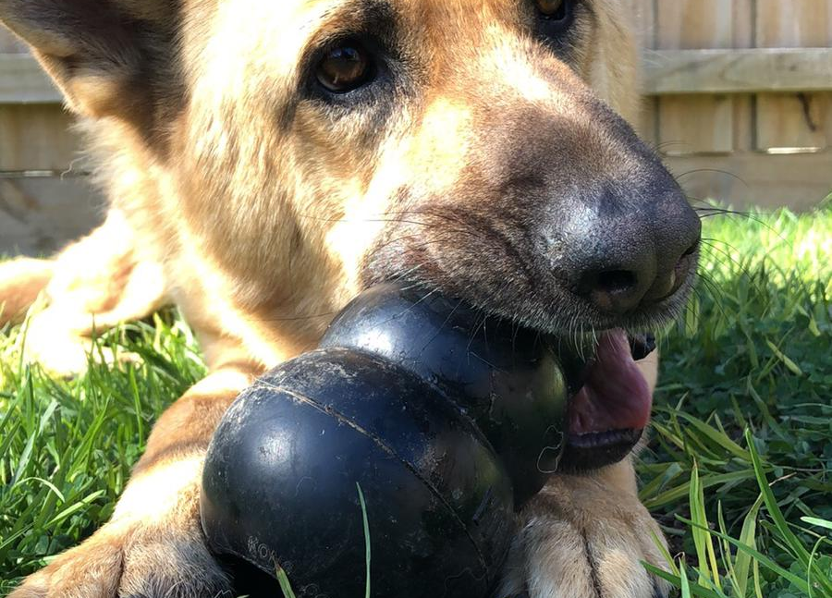
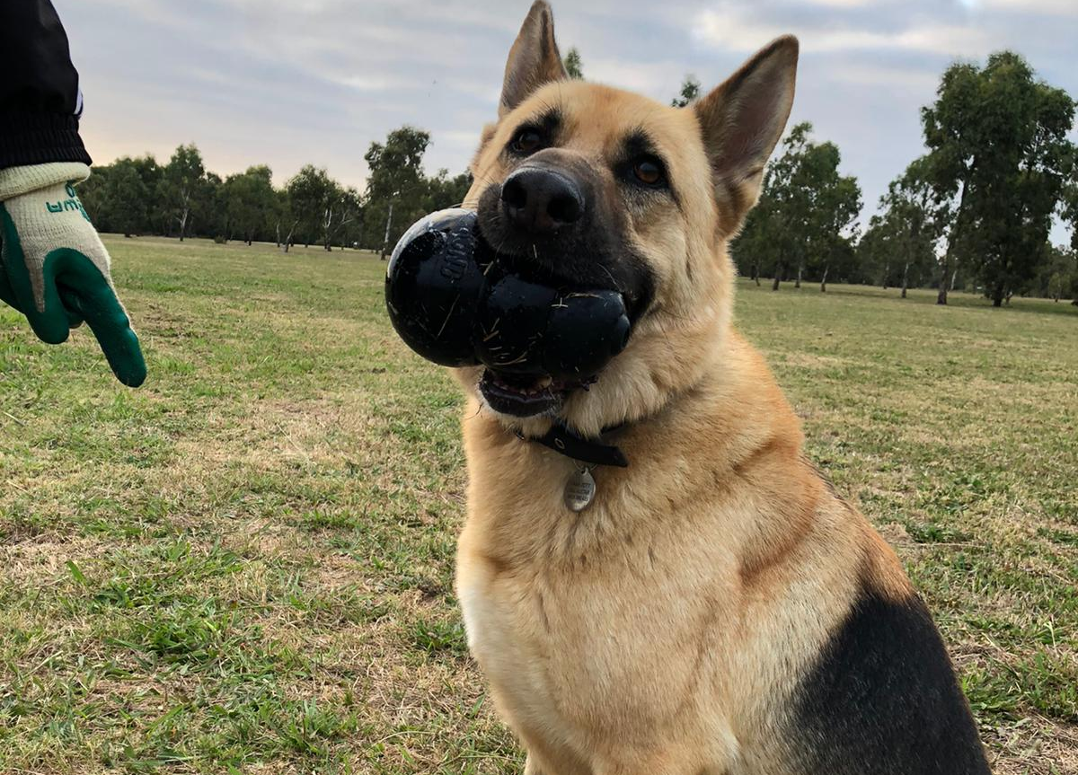

Slide 27

WHAT DO YOU THINK ABOUT WHEN YOU ARE GOING ABOUT YOUR DAILY LIFE?

Slide 28
WHAT WE SET OUR MINDS ON
DETERMINES OUR SEEKING
AND
THEREFORE
THE DIRECTION OF OUR CHRISTIAN LIVES
(e.g. Nehemiah 1: 1 -11)

Slide 29
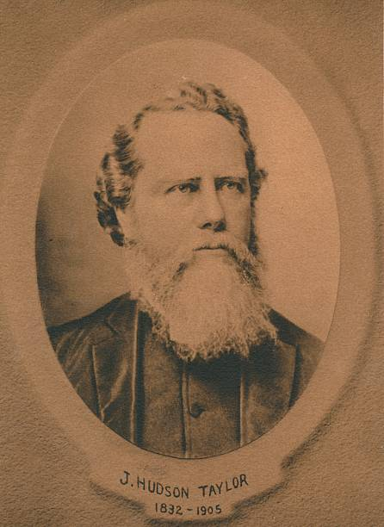
“I am no longer anxious about anything, as I realize that He is able to carry out His will for me. It does not matter where He places me, or how. That is for Him to consider, not me, for in the easiest positions He will give me grace, and in the most difficult ones His grace is sufficient.”
“God's work done in God's way will never lack God's supply.”

Slide 30
JAMES HUDSON TAYLOR HAD TO LEARN THAT COURAGE, INITIATIVE, AND PASSION FOR SOULS ARE NOT ENOUGH¹.
HE HAD TO LEARN THROUGH BITTER EXPERIENCE THAT HE HAD TO SURRENDER THE INITIATIVE, THE CONTROL COMPLETELY TO CHRIST .
THAT IS WHAT GOD IS WAITING FOR.
¹ “Fistful of Heroes. Christians at the Forefront of Change” by John Pollock. Christian Focus Publications 2008

Slide 31
LUKE 12: 34, MATTHEW 6:21 (NASB)
“FOR WHERE YOUR TREASURE IS,
THERE YOUR HEART WILL BE ALSO”
JOHN 15:7 (NASB)
“IF YOU ABIDE IN ME, AND MY WORDS ABIDE IN YOU, ASK WHATEVER YOU WISH, AND IT WILL BE DONE FOR YOU”

Slide 32
Col. 3 v.1 (AMPLIFIED)
IF THEN YOU HAVE BEEN RAISED WITH CHRIST
[TO A NEW LIFE, THUS SHARING HIS RESURRECTION FROM THE DEAD],
AIM AT AND SEEK [THE RICH ETERNAL TREASURES] THAT ARE ABOVE,
WHERE CHRIST IS,
SEATED AT THE RIGHT HAND OF GOD.

Slide 33
ALWAYS REMEMBER
THAT
THE SETTING OF OUR MINDS IS
A DELIBERATE ACT OF OUR WILL.

Slide 34


POINT
THE CHRISTIAN’S PROSPECTS
https://stock.adobe.com/

Slide 35
Col. 3 v.3 FOR YOU HAVE DIED AND YOUR LIFE IS HIDDEN WITH CHRIST IN GOD
Col. 3 v.4 WHEN CHRIST, WHO IS OUR LIFE, IS REVEALED, THEN YOU WILL ALSO BE REVEALED WITH HIM IN GLORY.
NASB, 1999
https://stock.adobe.com/

Slide 36

PAST
FUTURE
https://www.istockphoto.com/

Slide 37

THE PROSPECT OF THE BELIEVER IS BASED ON
The past
As well as
The future
History of all true believers

Slide 38
THE PAST HISTORY OF A TRUE BELIEVER (i)
“FOR YOU HAVE DIED …”
COLOSSIANS 3: 3a
DO YOU REALISE THAT
YOU HAVE ACTUALLY DIED?
IT HAPPENED WHEN YOU WERE BAPTISED THROUGH WATER
INTO THE BODY OF CHRIST BY THE HOLY SPIRIT
ROMANS 6: 1 – 5; 1 CORINTHIANS 12: 13

Slide 39
“IF ANYONE WISHES TO COME AFTER ME,
HE MUST DENY HIMSELF, AND TAKE UP HIS CROSS AND FOLLOW ME .
FOR WHOEVER WISHES TO SAVE HIS LIFE WILL LOSE IT; BUT WHOEVER LOSES HIS LIFE FOR MY SAKE WILL FIND IT.”
MATTHEW 16: 24 -25 (NASB)

Slide 40
“OR DO YOU NOT KNOW THAT ALL OF US WHO HAVE BEEN BAPTISED INTO CHRIST JESUS HAVE BEEN BAPTISED INTO HIS DEATH?
THEREFORE, WE HAVE BEEN BURIED WITH HIM THROUGH BAPTISM INTO DEATH, SO THAT AS CHRIST WAS RAISED FROM THE DEAD THROUGH THE GLORY OF THE FATHER, SO WE TOO MIGHT WALK IN NEWNESS OF LIFE.
FOR IF WE HAVE BECOME UNITED WITH HIM IN THE LIKENESS OF HIS DEATH, CERTAINLY WE SHALL ALSO BE IN THE LIKENESS OF HIS RESURRECTION”
ROMANS 6 : 3 – 5 (NASB)

Slide 41
THE PAST HISTORY OF A TRUE BELIEVER (ii)
“ …AND YOUR LIFE IS HIDDEN* IN CHRIST”
COLOSSIANS 3: 3
THE IMPLICATION HERE IS THAT OUR LIVES HAVE BEEN
“HIDDEN WITH CHRIST IN GOD” (NIV)
AND THEY REMAIN HIDDEN.
OUR SECURITY COMES FROM THE FACT THAT OUR LIVES ARE PART OF THE “ABOVE” – WE ARE IN CHRIST AND CHRIST IS IN GOD – WE ARE INSEPERABLE.
* IMPERFECT TENSE IN ORIGINAL

Slide 42
“YET HE HAS NOW RECONCILED YOU IN HIS FLESHLY BODY THROUGH DEATH, IN ORDER TO PRESENT YOU BEFORE HIM HOLY AND BLAMELESS AND BEYOND REPROACH –
IF INDEED YOU CONTINUE IN THE FAITH FIRMLY ESTABLISHED AND STEADFAST, AND NOT MOVED AWAY FROM THE HOPE OF THE GOSPEL THAT YOU HAVE HEARD, WHICH WAS PROCLAIMED IN ALL CREATION UNDER HEAVEN, AND OF WHICH I, PAUL, WAS MADE A MINISTER”
COLOSSIANS 1 : 22 – 23 (NASB)

Slide 43
THE FUTURE HISTORY OF A TRUE BELIEVER (i)
“WHEN CHRIST, WHO IS OUR LIFE, IS REVEALED, THEN YOU WILL ALSO BE REVEALED WITH HIM IN GLORY”
COLOSSIANS 3: 4
AT PRESENT OUR LIVES ARE
“HIDDEN WITH CHRIST IN GOD” (NIV)
BUT WHEN CHRIST IS REVEALED IN HIS GLORIOUS BODY
AT HIS COMING, WE WILL ALSO BE REVEALED BECAUSE WE WILL HAVE BODIES LIKE HIS.

Slide 44
“FOR OUR CITIZENSHIP IS IN HEAVEN,
FROM WHICH ALSO WE EAGERLY WAIT FOR A SAVIOUR,
THE LORD JESUS CHRIST;
WHO WILL TRANSFORM THE BODY OF OUR HUMBLE ESTATE INTO CONFORMITY WITH THE BODY OF HIS GLORY,
BY THE EXERTION OF THE POWER THAT HE HAS EVEN TO SUBJECT ALL THINGS TO HIMSELF.”
PHILIPPIANS 3 : 20 – 21 (NASB)

Slide 45
THE FUTURE HISTORY OF A TRUE BELIEVER (ii)
BELOVED,
THE LORD JESUS CHRIST WILL TRANSFORM
OUR FRAIL, DYING BODIES TO BE LIKE HIS GLORIOUS BODY!!
THOSE WITHOUT CHRIST CANNOT NOW UNDERSTANDSTAND THIS FOR IT IS HIDDEN IN CHRIST,
BUT THEN, ON THAT DAY,
IT WILL BE PERFECTLY CLEAR TO ALL!

Slide 46
“FOR THOSE WHOM HE FOREKNEW, HE ALSO PREDESTINED TO BECOME CONFORMED TO THE IMAGE OF HIS SON, SO THAT HE WOULD BECOME THE FIRSTBORN AMONG MANY BRETHREN;
AND THOSE WHOM HE PREDESTINED, HE ALSO CALLED; AND THOSE WHOM HE CALLED, HE ALSO JUSTIFIED; AND THOSE WHOM HE JUSTIFIED, HE ALSO GLORIFIED.
WHAT THEN SHALL WE SAY TO THESE THINGS?
IF GOD IS FOR US, WHO IS AGAINST US?”
ROMANS 8 : 29 – 31 (NASB)

Slide 47

https://stock.adobe.com/

Slide 48
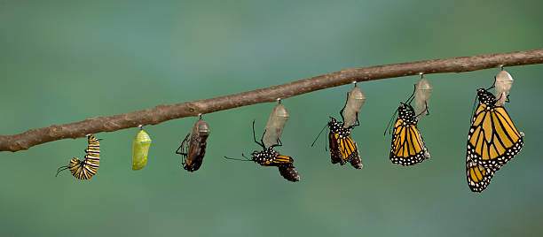
TRANSFORMATION TAKES TIME
https://www.gettyimages.com.au/

Slide 49
“IT IS A TRUSTWORTHY STATEMENT:
FOR IF WE DIED WITH HIM, WE WILL ALSO LIVE WITH HIM;
IF WE ENDURE, WE WILL ALSO REIGN WITH HIM;
IF WE DENY HIM, HE WILL ALSO DENY US;
IF WE ARE FAITHLESS, HE REMAINS FAITHFUL,
FOR HE CANNOT DENY HIMSELF.”
2 TIMOTHY 2: 11 – 13 (NASB)

Slide 50


https://stock.adobe.com/
https://www.gettyimages.com.au/

Slide 51

WE PRAY THAT OUR MINDS MAY BE SET ON THINGS ABOVE,
MAY WE NOT FOCUS ON THE MATERIAL & IMMATERIAL THINGS OF THE WORLD,
MAY WE HOLD THE SCRIPTURES CLOSE TO OUR HEARTS, MAY WE REFLECT ON OUR PAST HISTORY & MAY WE REJOICE IN OUR ANTICIPATION OF OUR FUTURE IN CHRIST
LESSON#3
LORD GOD ALMIGHTY
MAKER OF HEAVEN & EARTH;
THE ONE WHO CREATED THE STARS & NUMBERED & NAMED EACH ONE
https://www.istockphoto.com/

Slide 52
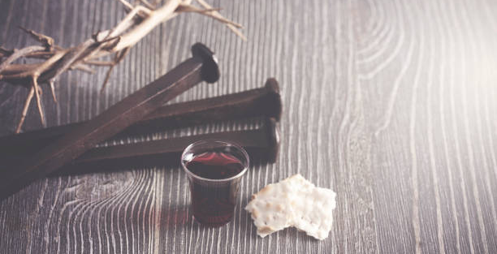

Slide 53
WWW.CLICHURCH.COM

