Slide 1
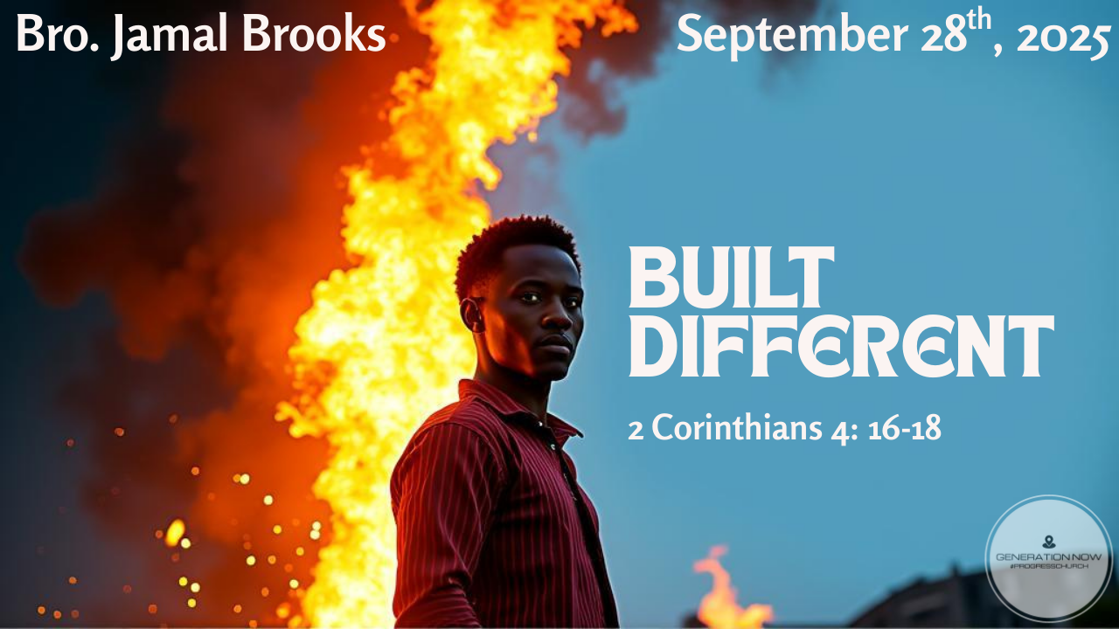

Slide 2


16 For this reason we never become discouraged. Even though our physical being is gradually decaying, yet our spiritual being is renewed day after day. 17 And this small and temporary trouble we suffer will bring us a tremendous and eternal glory, much greater than the trouble. 18 For we fix our attention, not on things that are seen, but on things that are unseen. What can be seen lasts only for a time, but what cannot be seen lasts forever.
2 Corinthians 4: 16-18 GNT

Slide 3

What does it mean to be “Built Different”

Slide 4
FIRE

Slide 5
Characteristics of Fire
Source of heat/warmth
Consuming
Refining
Purifying
Power to transform
Energy source
Holds destructive power

Slide 6
What are fires:
Trials and hardships - tough seasons like loss, rejection, sickness, or family struggles
Pressure to conform - peer pressure, culture, or systems pushing us to compromise
Temptations - battles with sin, desires, or distractions that test our loyalty to God
Testing of faith - moments where your trust in God is stretched

Slide 7
What are fires:
Purification process - situations that strip away pride, selfishness, or problems with character
Spiritual warfare - opposition, attacks, or unseen battles that challenge your faith
Uncertainty and waiting - seasons where the future feels unclear and we must rely on God’s timing
Criticism or persecution - being mocked, excluded, or targeted for standing up for God

Slide 8


Everybody Faces Fires

Slide 9
And the quality of each person's work will be seen when the Day of Christ exposes it. For on that Day fire will reveal everyone's work; the fire will test it and show its real quality
1 Corinthians 3:13 GNT

Slide 10
But he knows the way that I take; when he has tested me, I will come forth as gold
Job 23:10 NIV

Slide 11
In fact, everyone who wants to live a godly life in Christ Jesus will be persecuted,
2 Timothy 3:12 NIV

Slide 12

How We Add to Fires
Disobedience / Sin - walking outside God’s will often creates unnecessary struggles
Compromise - bowing to culture or peer pressure creates more inner conflict and spiritual heat.
Pride / Stubbornness - refusing correction or humility can make small issues bigger flames.
Lack of Prayer / Word - neglecting spiritual fuel leaves us weaker in the flames.

Slide 13
How We Add to Fires
Oxygen (chat too much)
Pouring alcohol rather than water
Same look different properties
Counterfeit
Wood (sustaining it too much)
Negativity, idle thoughts, malice, sorrow, fear and doubt

Slide 14
Built Different

Slide 15



Jonah vs Joseph

Slide 16
Jonah and Joseph
Running from a problem v. Running for a purpose
Jonah (Jonah 1:1–3)
Joseph (Genesis 39:7–12)

Slide 17
Jonah and Joseph
Jonah: Ran away from God.
Joseph: Ran toward God.

Slide 18
Jonah and Joseph
Jonah’s running teaches us:
Avoiding God’s call only leads to storms, delay, and unnecessary struggle.

Slide 19
Jonah and Joseph
Joseph’s running teaches us:
Sometimes the most spiritual thing you can do is literally flee from temptation. Running can be righteous if it’s away from sin.

Slide 20
Faith Under Fire

Slide 21
Daniel 3

Slide 22
The king built a massive golden statue and commanded everyone to bow down and worship it when music played.
Anyone refusing would be thrown into a blazing furnace.
Certain officials accused Shadrach, Meshach, and Abednego of not worshipping Nebuchadnezzar’s golden image.
The king summoned them and gave them a final chance to bow or face the fiery furnace.
They boldly refused, declaring they would not serve the king’s gods or worship the image.

Slide 23
They expressed faith that God could deliver them — but even if He didn’t, they would still remain faithful.
Nebuchadnezzar became furious and ordered the furnace heated seven times hotter.
The strongest soldiers threw them in, but the soldiers themselves were killed by the flames.
The three men fell bound into the furnace — yet were unharmed.
Shocked, he called them out of the furnace. They emerged without even the smell of smoke

Slide 24
29 “And now I command that if anyone of any nation, race, or language speaks disrespectfully of the God of Shadrach, Meshach, and Abednego, he is to be torn limb from limb, and his house is to be made a pile of ruins. There is no other god who can rescue like this.”
30 And the king promoted Shadrach, Meshach, and Abednego to higher positions in the province of Babylon.
Daniel 3:29 - 30

Slide 25
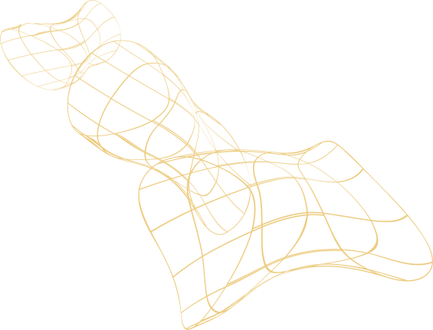
Lessons Learned
Fire Tests Faith
Just like Shadrach, Meshach, and Abednego, we face “fires” — pressure, peer influence, tough situations.
These moments reveal what we truly believe.

Slide 26
Fire Purifies
They went in bound, but came out free.
Sometimes God allows the fire to burn away fear, doubt, or distractions so we come out stronger in Him.
Fire Reveals God’s Presence
In the hottest moment, they saw the fourth man in the fire.
Our struggles can become the place we encounter Jesus most clearly.

Slide 27
Fire Becomes a Witness
Their trial showed everyone around them how powerful God is.
Your faith under pressure can speak louder than words to your friends, family, or community.
Fire Leads to Promotion
What was meant to destroy them actually positioned them for greater influence.
God can use your hardest season to open new doors.

Slide 28
Two keys to move forward

Slide 29
Not all running is the same

Slide 30
Running reveals your heart posture
Jonah’s running exposed his pride and reluctance to obey
Joseph’s running revealed his integrity and devotion to God
What you run from (or toward) shows what matters most to you

Slide 31
Hebrews 12:1 GNT
As for us, we have this large crowd of witnesses around us. So then, let us rid ourselves of everything that gets in the way, and of the sin which holds on to us so tightly, and let us run with determination the race that lies before us.

Slide 32
Remember the Fourth Man

Slide 33
God uses trials not to trap us, but to burn away what holds us back
God doesn’t just bring us through; He brings us out without the evidence of destruction

