Slide 1



Slide 3




Slide 4



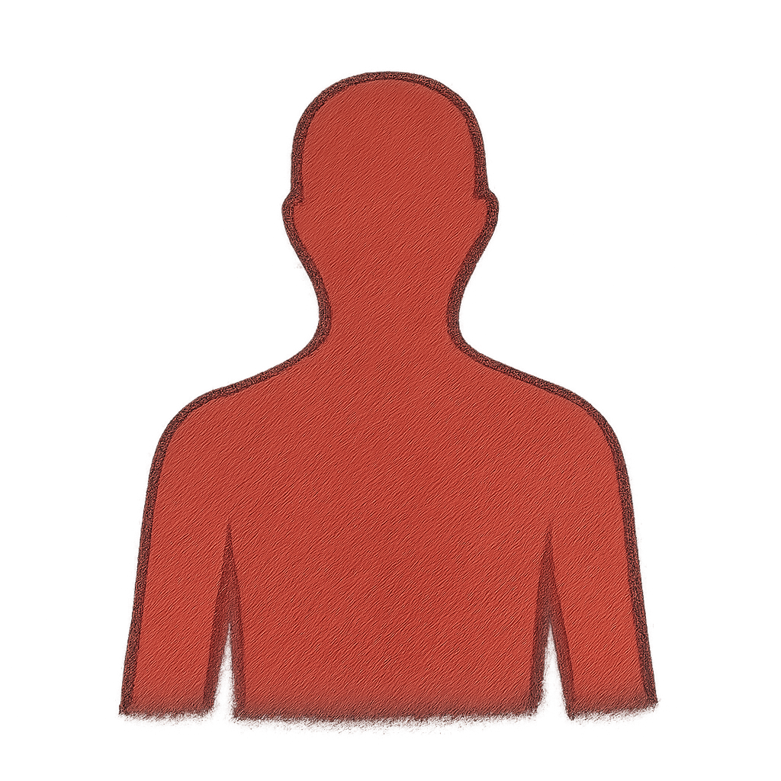


Slide 5


Slide 6


Slide 7
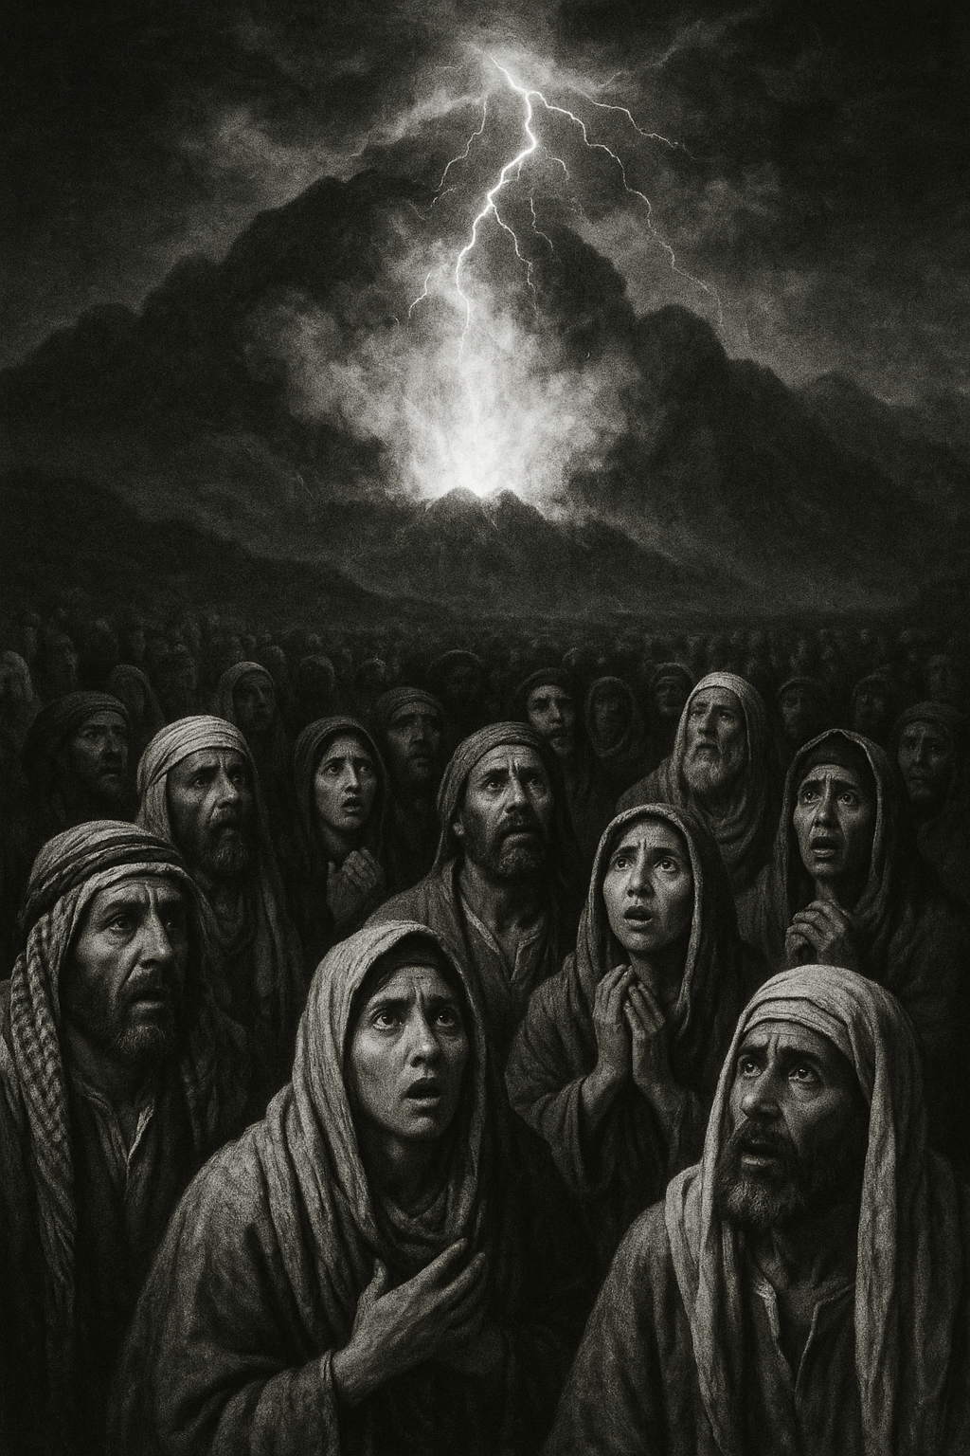
The vivid manifestation of God descending on Mount Sinai is a profound moment where heaven touches earth, where the divine touches human hearts with holiness.

Slide 8
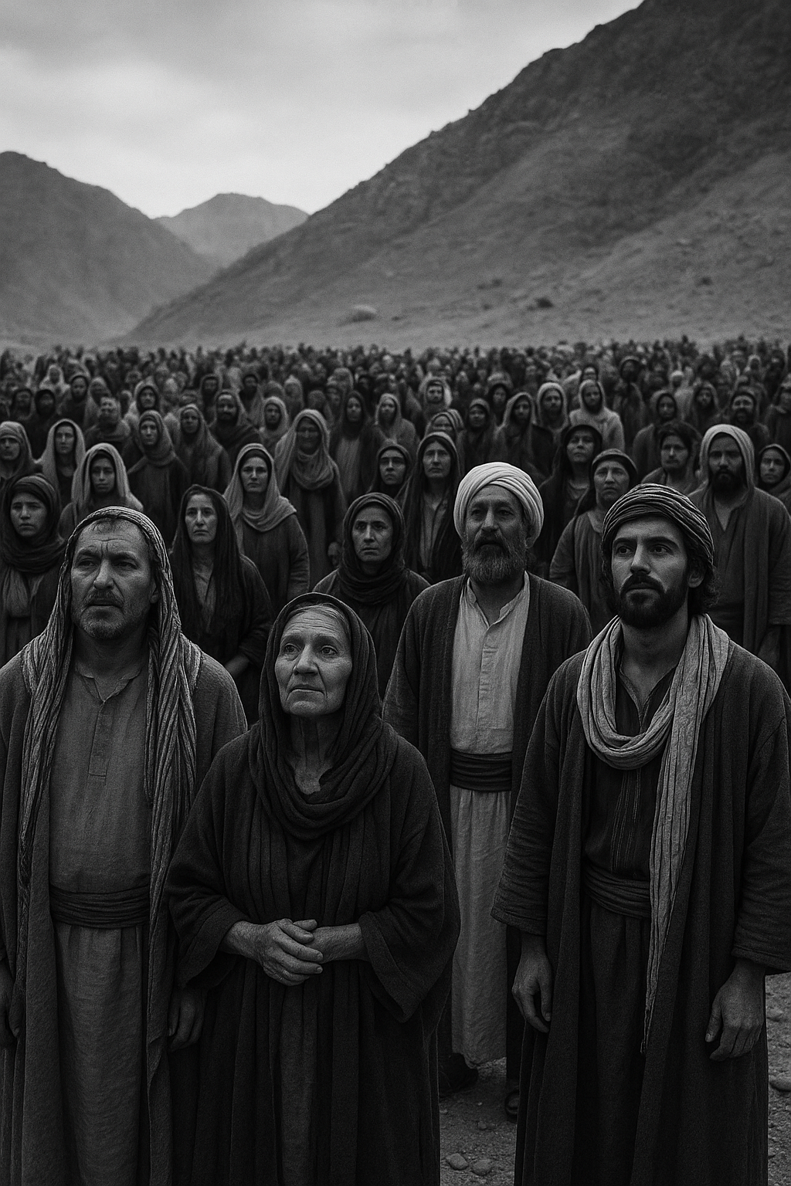
God's plan to make His people a holy people implies a mission of blessing and service, loving God and neighbor more than following a set of rules.

Slide 9
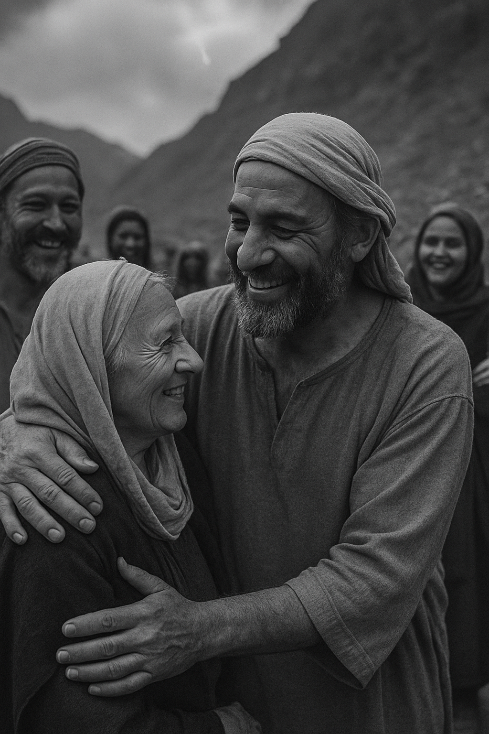
Similarly, Methodist general rule #1, "do no harm" is rooted more in an inward transformation of the heart rather than external law-keeping.

Slide 10
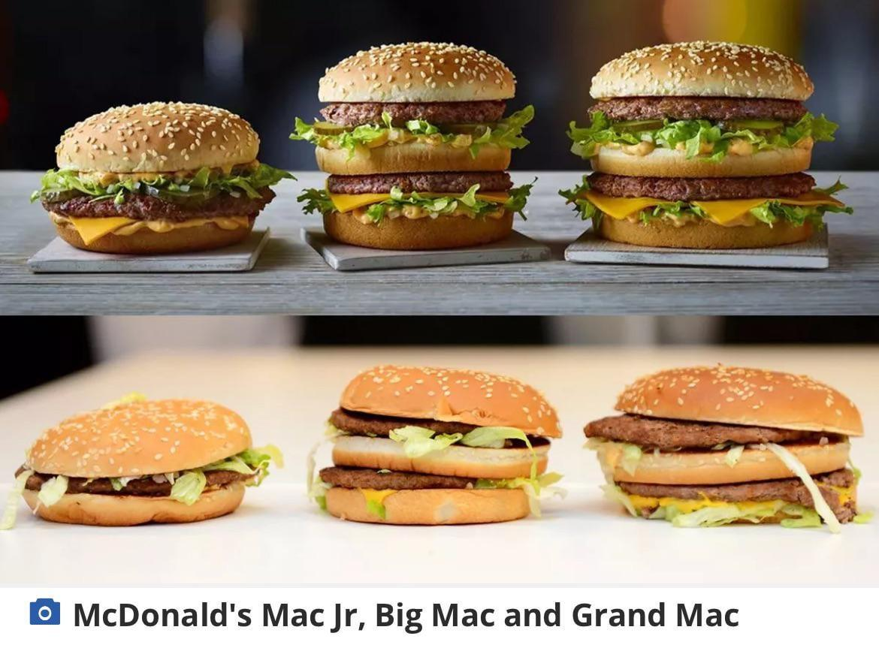

Slide 11
(spirit → soul → body)
When Heaven touches our spirit, The Spirit/our spirit leads our soul (mind & heart), which then leads our body.
The transformed mind awakens a renewed heart.
From there, the renewal flows into the body, which bears the fruit of love (peace, patience, kindness, etc… ) in tangible actions and the resolve to “Do No Harm.”
In this way, heaven touches earth through a transformed person whose love overflows into daily relationships.

Slide 12

SPIRITUAL RENEWAL
Romans 12:1-2
Therefore, I urge you, brothers and sisters, in view of God’s mercy, to offer your BODIES as a living sacrifice, holy and pleasing to God—this is your true and proper worship. Do not conform to the pattern of this world, but be transformed by the renewing of your MIND. Then you will be able to test and approve what GOD’S WILL is—his good, pleasing and perfect will.

Slide 13

SPIRITUAL RENEWAL
Romans 12:1-2
Do not conform to the pattern of this world, but be transformed by the renewing of your MIND.
RENEWAL OF THE MIND enables people to experience God's will, presence, and purpose -where divine reality intersects with everyday life.

Slide 14
SPIRITUAL RENEWAL
Romans 12:1-2
Do not conform to the pattern of this world, but be transformed by the renewing of your MIND.
RENEWAL OF THE MIND is more than intellect—it is a heart conversion that opens us to God’s truth, grace, and choices of love, mercy, and compassion - where heaven touches earth.

Slide 15

SPIRITUAL RENEWAL
Romans 12:1-2
Do not conform to the pattern of this world, but be transformed by the renewing of your MIND.

Slide 16


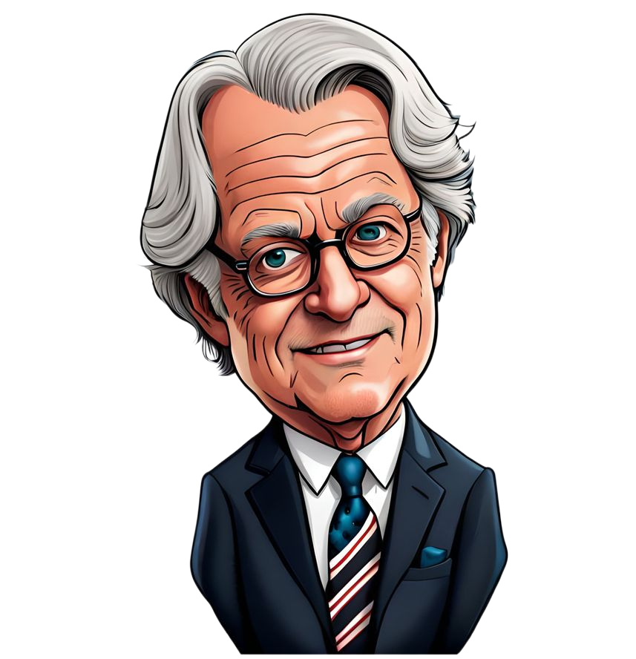









Event
Thought
Emotion
Behavior

Slide 17

Event
Thought
Emotion
Behavior

Slide 18
(spirit → soul → body)
When Heaven touches our spirit, The Spirit/our spirit leads our soul (mind & heart), which then leads our body.
The transformed mind awakens a renewed heart.
From there, the renewal flows into the body, which bears the fruit of love (peace, patience, kindness, etc… ) in tangible actions and the resolve to “Do No Harm.”
In this way, heaven touches earth through a transformed person whose love overflows into daily relationships.

Slide 19

Response to the Word
How have I experienced God’s Spirit stirring within me, leading my mind and heart toward renewal?
In what ways do my thoughts and desires shape the actions my body carries out each day?
Where is God calling me to bear tangible fruit—such as kindness, patience, and peace—in my relationships so that heaven touches earth through me?

Slide 20
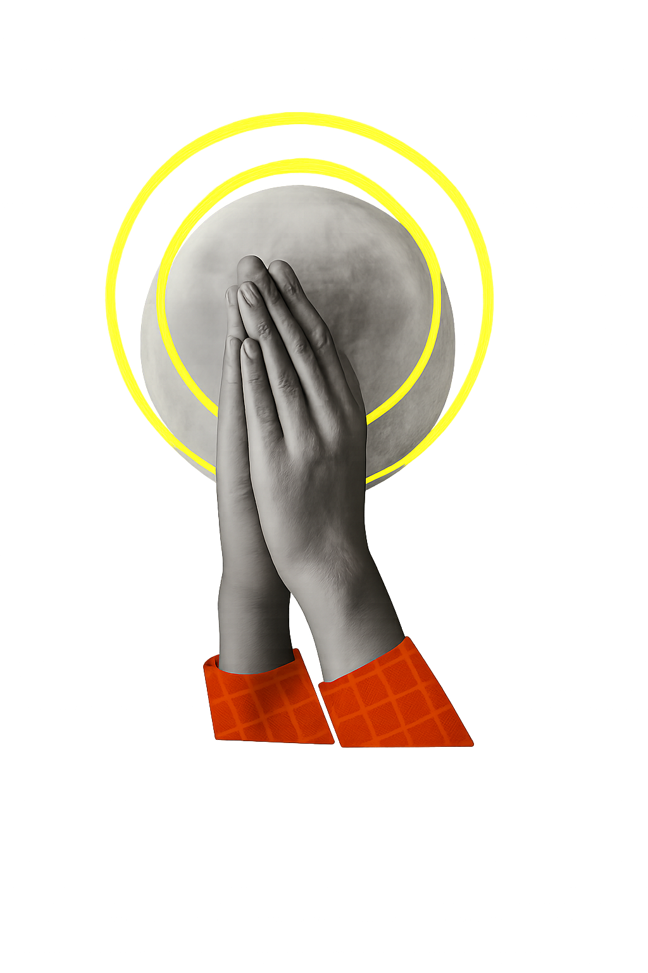
Response to the Word
Leader: Spirit of the Living God, fall afresh on us. People: Fall afresh on us, O Lord.
Leader: Touch our spirits with your holy presence, People: Transform our minds and renew our hearts.
Leader: Let this renewal overflow into our bodies, People: That our actions may bear the fruit of love.
Leader: Guide us to walk in peace, speak with kindness, act with patience, People: Lead us always to choose the way of no harm.
Leader: May heaven’s touch through me bring hope and blessing to those around me, People: May our love be made visible in this world. Amen.

