Slide 1

Leader: Welcome to Holy Hermits Online Worship
16th Sunday after Pentecost
The 4th week in the Season of Creation
Service Prep: Paul | Chat Host: Kerrie-Anne | First Reader: Jeremy
Music: Paul | Priest: Jamee | Second Reader: Bob
Proof-reader: Chris | Deacon: Lauren | Preacher: Lauren
Broadcaster: Troy | Welcomer: Chris | Fellowship: Troy
Backup Broadcaster: Barry | Leader: Julie | Safety Officer: Leonie
Zoom Buttons: Kerrie-Anne | Cantor: Vanessa | Attendance logger: Viki

Slide 2


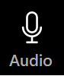



Hospitality
Leader: Please mute for the service unless invited to offer your voice as part of the service ministry
Have the video camera on or off and turn the volume and brightness up or down on your device if things are too loud 🔉🔊or too bright🔅🔆
Our Cantor acts as our voice, offering the responses, in Bold Text, which we say together
Feel welcome to use the chat and reaction emojis 👍
🙏 Please take care of yourself in this space. 🙏 Come and go as you need
😴 It is great to take rest in this space, so falling asleep is also OK 😴
👂️ Remember, pastoral care is available to all in the community, if you'd like to speak to someone about anything spiritual. ❤️ Visit the help page at the website to reach out 🌐
Our Being Together ethos and safeguarding practices can also be accessed on the website 🫶​
🙌 Come as you are – we are all here together! 🙌
Notes:
Used Lent 2022

Slide 3
Invitation
Leader: As we settle into worship let your breath be soft, your mind be still, and your heart be open to the presence of God.
Stilling video
https://vimeo.com/839956120

Slide 4
Leader and Cantor unmute
The Greeting
Leader:
The Grace of the lord Jesus Christ,
and the love of God,
and the fellowship of the Holy Spirit,
be with you all.
All: And also with you.
1

Slide 5
Gathering Prayer
Leader:
Let us come together now in God’s presence,
as those who want to praise God
and in pursuit of righteousness, godliness, faith,
love, endurance and gentleness.
Amen.

Slide 6
Sentence
Leader: I invite our Cantor to proclaim the sentence for today.
Cantor: Confess your sins to one another, and pray for one another, so that you may be healed. The prayer of the righteous is powerful and effective
James 5.16

Slide 7
Prayer of Approach
Leader: We pray the prayer of approach together.
All: As we come before you today, Creator God,
we prepare to contemplate the treasure contained in your Word, and world
and immerse ourselves in the riches of your love.
This abundance is all we require for this sacred time
when we lay our worldly thoughts aside to worship you.
We are blessed indeed.
Amen.

Slide 8
The Deacon or LA Introduces Confession
​All Creation is full of God’s praise, and we are called to join in with joy, righteousness and peacefulness.
Yet as we look around us, we see conflict and destruction.
We acknowledge: We ourselves cause conflict and destruction, and often fail to walk the path of peace.
Everywhere on the planet, humans cause great harm, even as we know that the scope of destruction varies, and that everywhere human beings are among the victims of our deep conflict with Creation.
All too often, we fail to live as we are called to live.
We fail to be ambassadors of peace, righteousness and reconciliation.

Slide 9
​Silence may be kept.
Let us confess our sins.
Let us come before the Triune God for forgiveness and renewal.

Slide 10
All: ​Merciful God, our maker and our judge, ​we have sinned against you ​in thought, word, and deed, ​and in what we have failed to do: ​we have not loved you with our whole heart; ​we have not loved our neighbours as ourselves; ​ we repent, and are sorry for all our sins.​ Father, forgive us. Strengthen us to love and obey you in newness of life; ​through Jesus Christ our Lord. ​
Amen.​

Slide 11
​
The Deacon or LA offers the Proclamation of Forgiveness in the Season of Creation​
​
May our God have mercy on us, forgive us our trespasses and give us new life.
Indeed, God has promised grace and forgiveness to us: “My people will abide in a peaceful habitation, in secure dwellings, and in quiet resting places.” (Isaiah 32:18)
Let us rejoice and trust in our calling, live as we are called to live, reconciled with the Father, ambassadors for Christ, filled with the Holy Spirit.
Amen. ​

Slide 12
>If there is no priest present this slide is skipped<
​
The Priest offers Absolution
​
Almighty God who has promised forgiveness
to all who turn to God in faith;
pardon you and set you free from all your sins,
strengthen you in all goodness
and keep you in eternal life,
through Jesus Christ our Lord.
Amen.
​

Slide 13
Leader: Our First Hymn is
Touch the earth lightly
https://www.youtube.com/watch?v=XGHU2F2g3K0
Let's sing or enjoy the music together
We stay on mute
Leader and Cantor mute

Slide 14
Collect in the Season of Creation
Leader:
God Most High,
maker of heaven and earth,
you created humankind in your own image
and entrusted the whole world to human care:
give us grace to serve you faithfully,
that we might be trustworthy stewards of your creation,
through Jesus Christ our Lord,
who lives and reigns with you and the Holy Spirit,
one God, now and for ever.
Amen.

Slide 15
The 1st reader unmutes
Leader: I invite the 1st Reader to unmute and offer the 1st reading when ready.
Reader 1: The first reading is from Jeremiah 32.1-3a, 6-15
¹ The word that came to Jeremiah from the Lord in the tenth year of King Zedekiah of Judah, which was the eighteenth year of Nebuchadrezzar. ² At that time the army of the king of Babylon was besieging Jerusalem, and the prophet Jeremiah was confined in the court of the guard that was in the palace of the king of Judah, ³ where King Zedekiah of Judah had confined him. Zedekiah had said, ‘Why do you prophesy and say: Thus says the Lord : I am going to give this city into the hand of the king of Babylon, and he shall take it; ⁶ Jeremiah said, The word of the Lord came to me:
Continue…

Slide 16
⁷ Hanamel son of your uncle Shallum is going to come to you and say, ‘Buy my field that is at Anathoth, for the right of redemption by purchase is yours.’ ⁸ Then my cousin Hanamel came to me in the court of the guard, in accordance with the word of the Lord , and said to me, ‘Buy my field that is at Anathoth in the land of Benjamin, for the right of possession and redemption is yours; buy it for yourself.’ Then I knew that this was the word of the Lord . ⁹ And I bought the field at Anathoth from my cousin Hanamel, and weighed out the money to him, seventeen shekels of silver. ¹⁰ I signed the deed, sealed it, got witnesses, and weighed the money on scales.
Continue…

Slide 17
¹¹ Then I took the sealed deed of purchase, containing the terms and conditions, and the open copy; 12 and I gave the deed of purchase to Baruch son of Neriah son of Mahseiah, in the presence of my cousin Hanamel, in the presence of the witnesses who signed the deed of purchase, and in the presence of all the Judeans who were sitting in the court of the guard. ¹³ In their presence I charged Baruch, saying, ¹⁴ Thus says the Lord of hosts, the God of Israel: Take these deeds, both this sealed deed of purchase and this open deed, and put them in an earthenware jar, in order that they may last for a long time. ¹⁵ For thus says the Lord of hosts, the God of Israel: Houses and fields and vineyards shall again be bought in this land.
For the word of the Lord. Thanks be to God.​

Slide 18
Leader: We now say the psalm antiphonally, I invite the first reader to lead and we will all respond with the Responses in Bold along with our cantor as our voice.
Psalm
91.1-6, 14-16
¹ Those who dwell in the shelter of the Most High:
who abide under the shadow of the Almighty,
² They will say to the Lord
‘You are my refuge and my stronghold:
my God in whom I trust.’
³ For he will deliver you from the snare of the hunter:
and from the destroying curse.
Continue…

Slide 19
⁴ He will cover you with his wings,
and you will be safe under his feathers:
his faithfulness will be your shield and defence.
⁵ You shall not be afraid of any terror by night:
or of the arrow that flies by day,
⁶ Of the pestilence that walks about in darkness:
or the plague that destroys at noonday.
Continue…

Slide 20
¹⁴ ‘You have set your love upon me,’ says the Lord,
‘and therefore I will deliver you:
I will lift you out of danger,
because you have known my name.
¹⁵ ‘When you call upon me I will answer you:
I will be with you in trouble,
I will rescue you and bring you to honour.
¹⁶ ‘With long life I will satisfy you:
and fill you with my salvation.’

Slide 21
The 2nd reader unmutes
Leader: Thank you, 1st reader. I invite the 2nd Reader to unmute and offer the 2nd reading when ready.
Reader 2: The 2nd Reading is from 1 Timothy 6.6-19
⁶ Of course, there is great gain in godliness combined with contentment; ⁷ for we brought nothing into the world, so that we can take nothing out of it; ⁸ but if we have food and clothing, we will be content with these. ⁹ But those who want to be rich fall into temptation and are trapped by many senseless and harmful desires that plunge people into ruin and destruction. ¹⁰ For the love of money is a root of all kinds of evil, and in their eagerness to be rich some have wandered away from the faith and pierced themselves with many pains.
Continue…

Slide 22
¹¹ But as for you, man of God, shun all this; pursue righteousness, godliness, faith, love, endurance, gentleness. ¹² Fight the good fight of the faith; take hold of the eternal life, to which you were called and for which you made the good confession in the presence of many witnesses. ¹³ In the presence of God, who gives life to all things, and of Christ Jesus, who in his testimony before Pontius Pilate made the good confession, I charge you ¹⁴ to keep the commandment without spot or blame until the manifestation of our Lord Jesus Christ, ¹⁵ which he will bring about at the right time—he who is the blessed and only Sovereign, the King of kings and Lord of lords. ¹⁶ It is he alone who has immortality and dwells in unapproachable light, whom no one has ever seen or can see; to him be honour and eternal dominion. Amen.
Continue…

Slide 23
¹⁷ As for those who in the present age are rich, command them not to be haughty, or to set their hopes on the uncertainty of riches, but rather on God who richly provides us with everything for our enjoyment. ¹⁸ They are to do good, to be rich in good works, generous, and ready to share, ¹⁹ thus storing up for themselves the treasure of a good foundation for the future, so that they may take hold of the life that really is life.
For the word of the Lord. Thanks be to God.

Slide 24
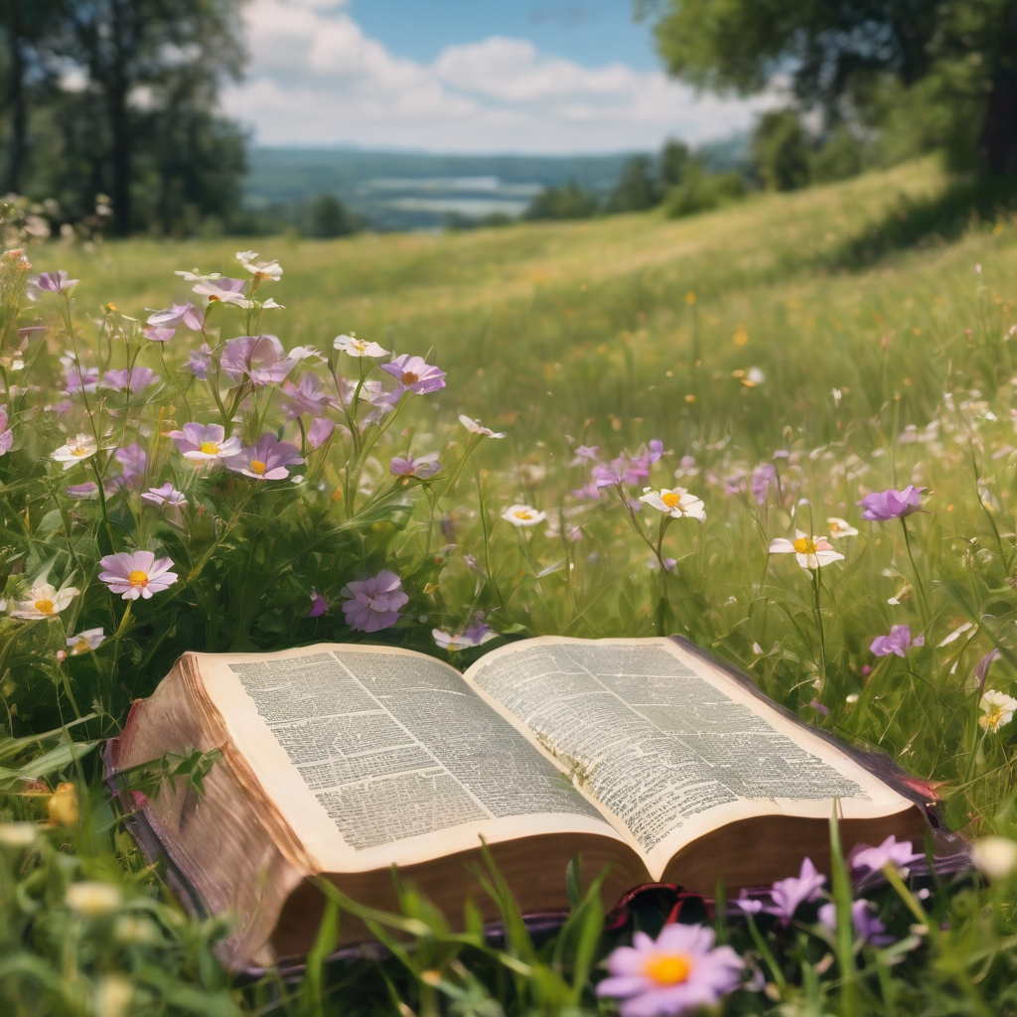
We pause before
​the Gospel ​​

Slide 25
The Gospel of our Lord Jesus Christ according to St Luke Chapter 16 beginning at the 19th verse
All: Glory to you Lord Jesus Christ.
¹⁹ ‘There was a rich man who was dressed in purple and fine linen and who feasted sumptuously every day. ²⁰ And at his gate lay a poor man named Lazarus, covered with sores, ²¹ who longed to satisfy his hunger with what fell from the rich man’s table; even the dogs would come and lick his sores. ²² The poor man died and was carried away by the angels to be with Abraham. The rich man also died and was buried. ²³ In Hades, where he was being tormented, he looked up and saw Abraham far away with Lazarus by his side.
Continue…

Slide 26
²⁴ He called out, “Father Abraham, have mercy on me, and send Lazarus to dip the tip of his finger in water and cool my tongue; for I am in agony in these flames.” ²⁵ But Abraham said, “Child, remember that during your lifetime you received your good things, and Lazarus in like manner evil things; but now he is comforted here, and you are in agony. ²⁶ Besides all this, between you and us a great chasm has been fixed, so that those who might want to pass from here to you cannot do so, and no one can cross from there to us.” ²⁷ He said, “Then, father, I beg you to send him to my father’s house—
Continue…

Slide 27
²⁸ for I have five brothers—that he may warn them, so that they will not also come into this place of torment.” ²⁹ Abraham replied, “They have Moses and the prophets; they should listen to them.” ³⁰ He said, “No, father Abraham; but if someone goes to them from the dead, they will repent.” ³¹ He said to him, “If they do not listen to Moses and the prophets, neither will they be convinced even if someone rises from the dead.” ’
This is the Gospel of the Lord. All: Praise to you Lord Jesus Christ.

Slide 28
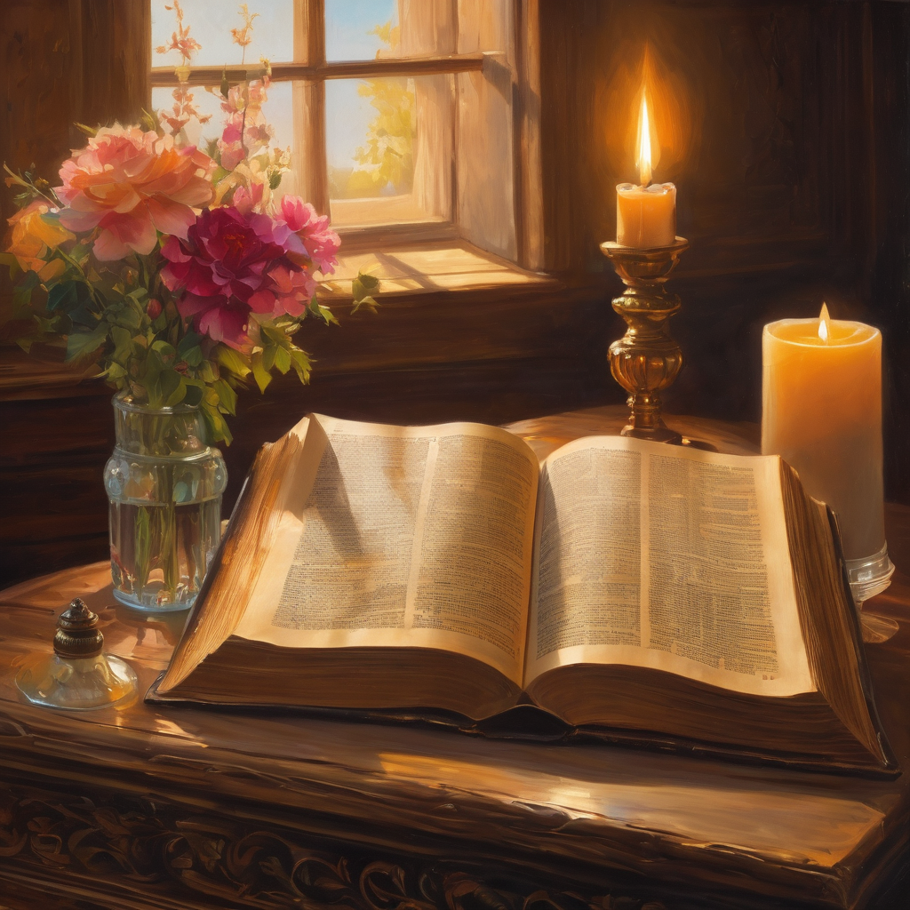
We pause
after ​the Gospel ​​

Slide 29
Leader: The Sermon is recorded to YouTube for sharing later.
Only the preacher's video and audio will be recorded.
The chat and other participants' feeds remain out of sight of the recording.
Leader and Cantor mute
Broadcaster exits screenshare
Preacher unmutes
Zoom buttons ”pins” preacher’s screen + selects “record to the cloud”
Sermon

Slide 30
Leader: Our next Hymn is
All Things Bright and Beautiful
https://www.youtube.com/watch?v=VgqKfGRT0PM
Let's sing or enjoy the music together
We stay on mute
Leader mutes

Slide 31
The Leader and Cantor unmute
The Greeting of Peace
Leader: We are the body of Christ
All: God’s Spirit is with us
Leader: The peace of the Lord be always with you.
All: And also with you.
Leader: A sign of peace may be exchanged
You may like to type 'Peace' into the chat, use the 'raise hand’ or other reaction buttons, or just simply wave via the screen with your video turned on
(Broadcaster exits shared screen for a few moments for the exchange of peace)

Slide 32
Prayer of Thanksgiving in the Season of Creation
Leader: As we enter prayer, I invite the second reader to unmute to lead our intercessions which follow the prayer of thanksgiving. Please feel free to change your body position as you need.
God of life, God of love, God of Creation. Thank You for all the wonderful,
great and immense creatures that You created.
We thank You that we have the opportunity to inhabit and enjoy the wonders of this world.
Thank you for giving us forests that provide our air and give us the shade we need on hot days.
Thank you for giving us the sun that shines brightly with its energy, as well as the rains to refresh and nourish the earth bringing a special scent.
Continue…

Slide 33
Thank you for giving us the fertile soil to provide us with food and sustenance for many animals.
Allow us to recognize that the community of the earth is a democracy of life as a whole that is based on the living economies that are the local economies of those who work the land.
Give us the strength to defend diversity in nature and in the culture of each place by putting the common good first, knowing that all beings have a natural right to their sustenance.
Help us to value each species, people and culture, knowing that each has intrinsic value.
Continue…

Slide 34
Help us to walk in this world with faith and hope. Sustain us to protect
and care for your creation, respectful of the resources it provides for us and
aware of the finiteness of Creation.
Give us the courage to fight for life and be resilient in the face of those
who destroy Creation and those who profit from it for their own business.
Thank you for each of our lives which we give to you, through Jesus Christ our Lord, who lives and reigns with you and the Holy Spirit. Amen

Slide 35
Intercessions
Reader 2: We pray for creation and communities we share our lives with. We pause for a few moments to name either in our hearts, or out loud, or in the chat, those environments and communities we bring to the Lord in prayer.
PAUSE…
We entrust to you the community of Holy Hermits Online and our ministry partners:
Prosper the work of our hands and show us the way to your new creation.
Creator God, Hear our prayer.
St John's Cathedral Brisbane The Anglican Diocese of Southern Queensland St Gabriel’s, Carindale Benedictus Contemplative Church, Canberra The Episcopal Diocese of Texas Anglican Focus and Tithe.ly

Slide 36
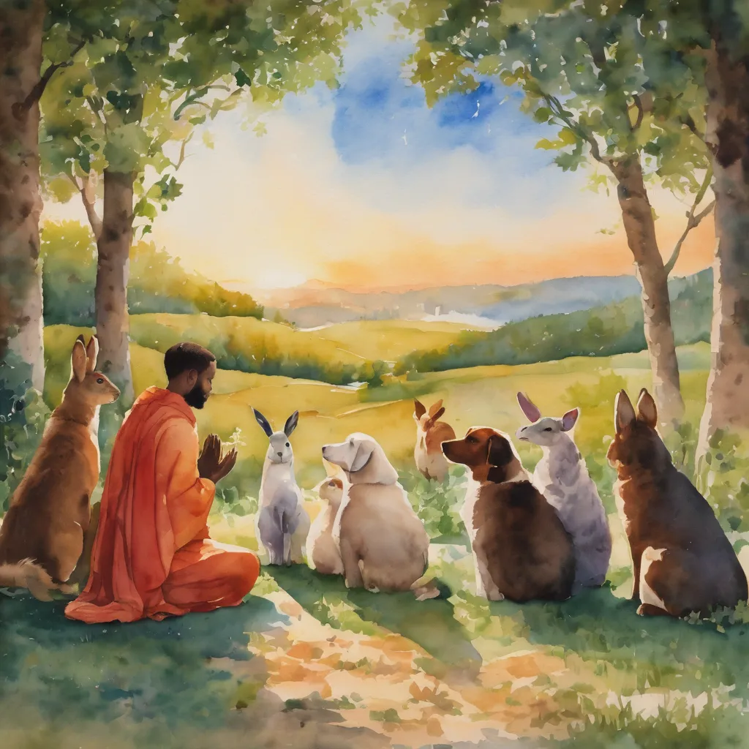
Reader 2: Loving Creator, we entrust to you all animals, especially those who are sick, anxious, ageing, lost, at risk, lonely, sad, hungry, in pain, homeless, abused, living in fear, encountering violence of any kind, in need of comfort, rehabilitation or transformation.
We invite your loving compassion for: Jasmine,
Leese(y),
Sid, Toots and Lulu, Polly and Suki
Fred, George and Percy
Koshka,
Lambert
Kala, Nigel and Little One
Toby
Taco
Paddy and Jax
We name in our hearts, out loud or in the chat, the animals we bring to the Lord in prayer.
PAUSE…
Amen.

Slide 37
Reader 2: Eternal Trinity of Love, we uphold to you the people we love and carry cares for:
We name in our hearts, out loud or in the chat, those we bring to the Lord in prayer.
PAUSE… We entrust to you those who have died, those who have died peacefully and those who have died tragically, the old and the young. Receive them into your kingdom. Amen.
Kerry and Les, Jake,​​ Dr Julie, ​​ Julie and Ray, Tracey, Shane,​​ Jess and Leah ​​ May ​​ Kirsten, Greg, Daphne & Beau​​ Tanya​ Matthew & Nicholas​ & Sharyn Alan & Gaylene​ Susan Bonnie and girls | Barry​​ Dilys and Tony,​​ Paul and Darhon Judy and Mary​​ Mark, Desley and Bob ​​ Ruth​​ Leonie Phil​ Rachel, Mervyn & Gillian Liz’s Godchildren Pat and Julie | Bill and Marjorie​​ Rev'd Shane & Janette​​ Alecia, Martin and Aidan,​​ Aaron and Andrea ​​ Neva​ Bob and Di​ Steven and Vanessa, Craig Miriam Barry and Gwen Bram Zach and family

Slide 38
Pray Daily Cycle of Prayer
Leader: Loving God, joining with the Church in our cycle of prayer, we ask your blessings on:
The Province of the Episcopal Church of Sudan
The Parish of Morningside: Martyn Hope, Warwick Humphries
Anglicare SQ Out of Home Care, South West Region
Roma Foster & Kinship Care and Family Intervention

Slide 39
The Commitment prayer for the week is: Natural Disaster
​All things look to you, O Lord, to give them their food in due season: look in mercy on your people, and hear our prayer for those whose lives and possessions have been affected by natural disaster.
We ask that all our first responders, volunteers and emergency service workers be given strength and care, rest and recuperation.
We uphold the vulnerable ones, children and animals, people living rough and in financial distress; that they be given courage and the appropriate support.
Please empower community groups and organisations as they step up. Encourage neighbours as they look out for one another. Inspire communities to support and resource animal organisations as they offer sanctuary and care for displaced animals—domestic, farm and wild.
Continue…

Slide 40
The Commitment prayer (cont.):
​Give courage to all who work in ongoing trauma recovery; support workers, doctors, nurses, social workers, psychologists, veterinarians, counselling services, chaplains, clergy and local ministers. May they be enabled to sustain good self-care practices, access resources, find
strength and resilience, peace and rest.
May all who suffer survivor guilt, be compassionate towards themselves and find grace in you. Holy Spirit please gently lead their energy into prayer, loving service and gratitude, so they can experience and share peace.
We entrust the rebuilding efforts into your care Lord. May the resources needed become available, the trades people offering their skills be honest and diligent.
Continue…

Slide 41
The Commitment prayer (cont.):
​We hold before you Lord, local council and governments especially politicians and leaders as they represent people and places. Give them inspiration, wisdom and discernment.
In your mercy restore your creation and heal our lands, air and waterways, regenerate all that has been destroyed and inspire people to help with that new growth and restoration.
So guide and bless your people, that we may enjoy the fruits of the earth and give you thanks with grateful hearts, through our Lord Jesus Christ.
Amen.​

Slide 42
Leader: We are using a different form of the Lord's prayer in the Season of Creation, from the New Zealand common prayer book, let us pray
All: Eternal Spirit, Earth-maker, Pain-bearer, Life-giver,
​Source of all that is and that shall be,
Father and Mother of us all,​ Loving God, in whom is heaven: ​
The hallowing of your name echo through the universe! ​
The way of your justice be followed by the peoples of the world! ​
Your heavenly will be done by all created beings! ​
Your beloved community of peace and freedom sustain our hope and come on earth.​
Continue…

Slide 43
All: With the bread we need for today, feed us.
In the hurts we absorb from one another, forgive us.
In times of temptation and test, strengthen us.
From trials too great to endure, spare us.
From the grip of all that is evil, free us.
For you reign in the glory of the power that is love, now and forever. Amen.

Slide 44

Devotions

Slide 45
Leader: The Prayer for Creation 2025
PEACE WITH CREATION
Creator of all, we praise you for the gift of life and for the faith that unites us in care for our common home. We confess how estranged we have become—from one another, from your Creation, and from our truest selves. We acknowledge that our greed and destructive impulses have fractured our relationships with you, with others, and with the Earth. Fertile fields have become barren, forests lie desolate, oceans and rivers are polluted. Thriving communities have become places of suffering, and the earth cries out.
Continue…

Slide 46
Beloved Christ, who spoke “Shalom” to frightened hearts, stir us to compassionate action. Inspire us to work for the end of conflict, and for the full restoration of broken relationships— with you, with the ecumenical community, with the human family, and with all Creation.
Continue…

Slide 47
Prince of Peace, through your wounds, teach us to stand in solidarity with the woundedness of others, of creation, and of the world. Through your resurrection, make us people of hope— with a vision of swords turned into ploughshares and tears transformed into joy. May we come together as one family, to labor for your peace— a shalom where all your people may dwell in safety, and rest in quiet places. Amen.

Slide 48
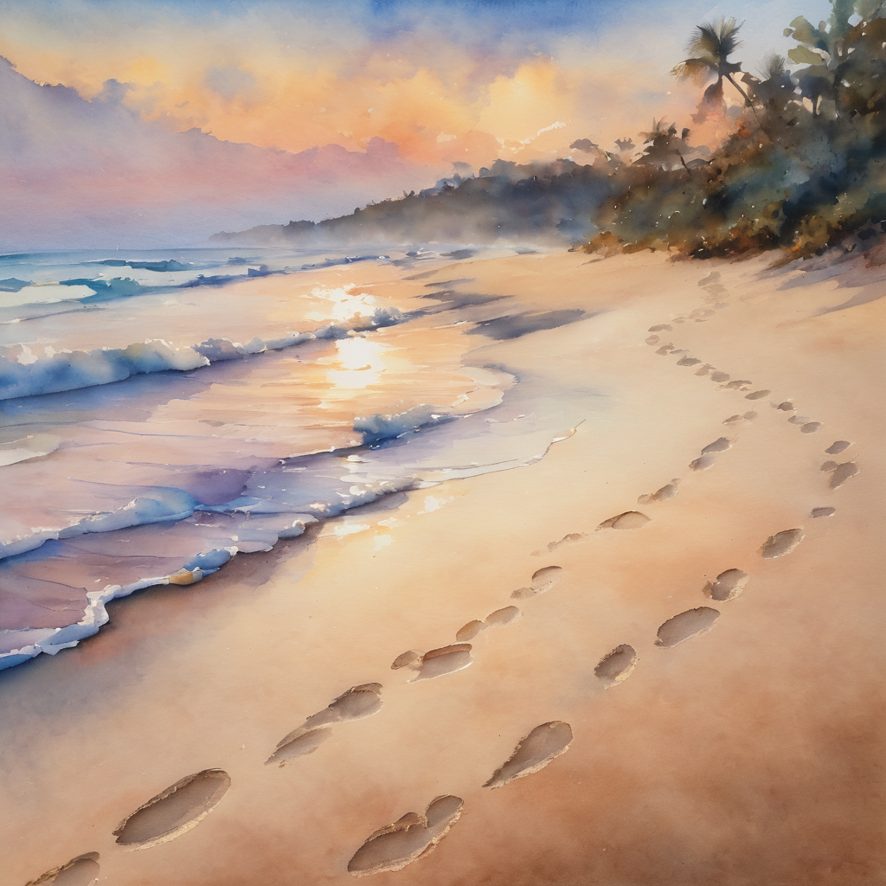
Leader: ​As we enter a few minutes of silence together, you are invited to pray this prayer of adoration and/or spend this time in contemplation. ​
The Spiritual Communion prayer follows on the next slide. Let us be still.
Leader and Cantor Mute.
​
Lord, you came among us in lowliness
and simplicity.
We adore you as the babe born in a stable,
as the boy raised a refugee in Egypt,
as the wandering preacher with no possessions.
You show us what true riches are.
Lord, we adore you, and humbly bow before you. Amen.

Slide 49
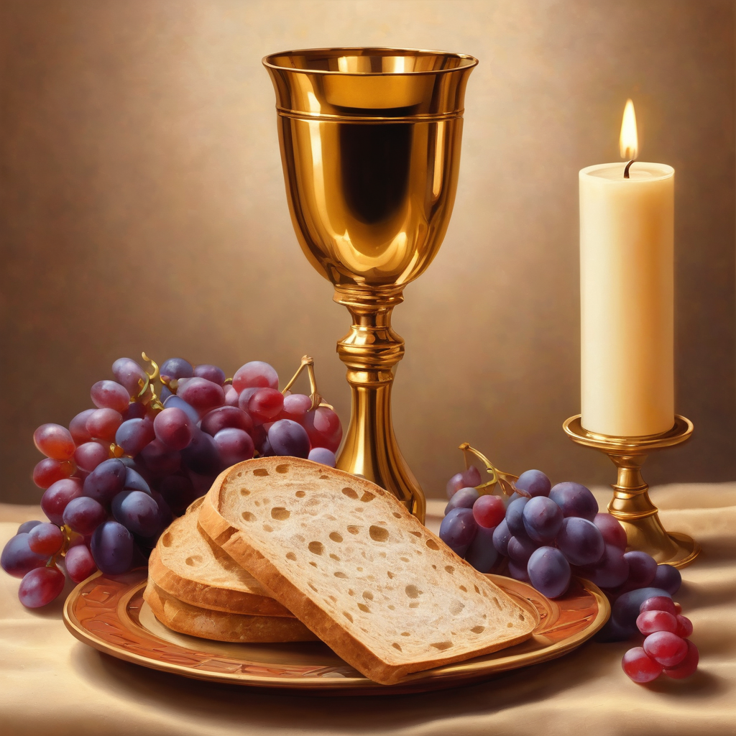

Oh, my Lord Jesus I turn to you present at the Altar and in the Tabernacle. I believe that you are present in the Holy Sacrament of your most Sacred Body and Blood.
I love you above all things and I desire to receive you into my Soul. I cannot at this moment receive you Sacramentally in Holy Communion.
Come spiritually into my heart.
Purify it, Sanctify it. Render my heart like your own heart.
I embrace you as if you were already there and unite myself wholly with you.
Never permit me to be separated from you.
Lord, I am not worthy to receive you, but only say the word and I shall be healed. Amen
Making a
Spiritual Communion
(Prayed in silence)

Slide 50
Leader: Our final song is
The Trees of The Field
https://youtu.be/Qb7ES_ZDje8?si=rSVhSDnvmm525Nmg
Let's sing or enjoy the music together
​We stay on mute
Leader and Cantor mute

Slide 51
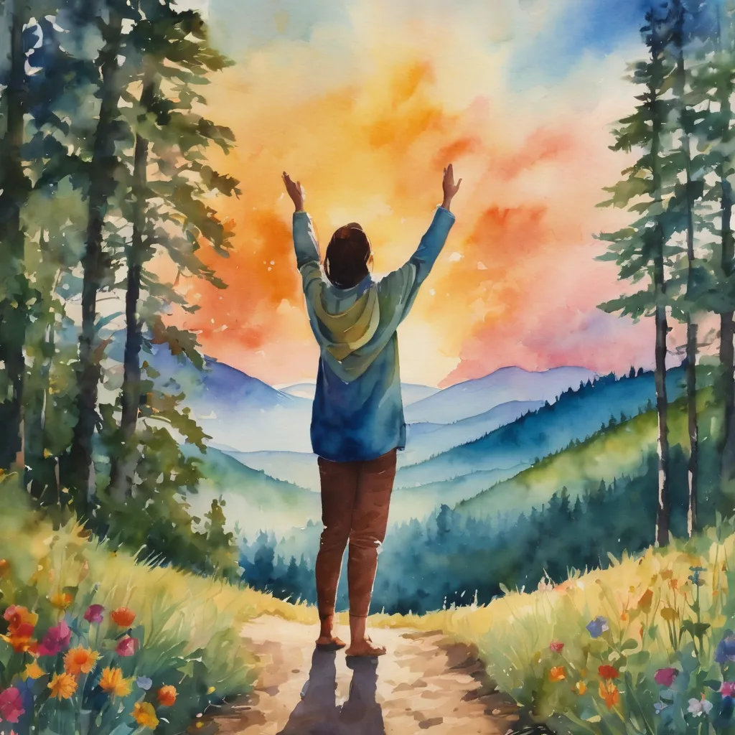
Leader and cantor unmute
Sending Prayer
Leader: We pray our sending prayer together.
All:
We go in the knowledge and confidence of God’s love for us,
trusting that Christ Jesus is with us. Amen.

Slide 52
>If there is no priest present this slide is skipped<​
The Priest offers the Blessing
Go in peace, brothers and sisters, live in peace with Creation.
And may the blessing of the Most Holy Trinity accompany you: The Father, and the Son, and the Holy Spirit,
the one God, to whom be glory, for ever.
Amen.

Slide 53
The Benediction
Leader: Let us all invite God’s blessings together,​
​
All: May the Lord bless us and keep us.​
May the Lord’s face shine upon us and
be gracious to us.​
May the Lord’s countenance be lifted upon us, ​
and bring us peace.
Amen

Slide 54
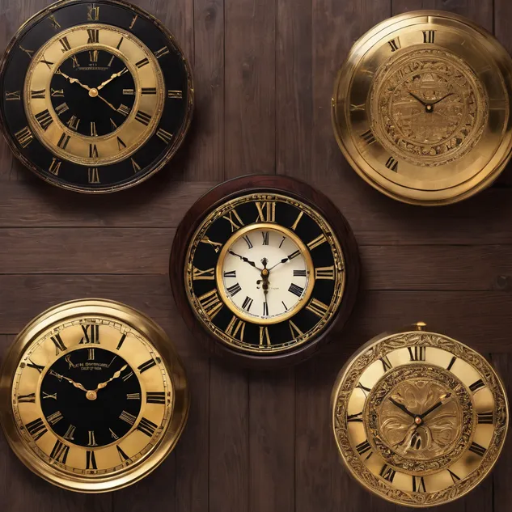
Notices
Wednesday study @ 6pm, A Pilgrimage of the Heart continues, and is led by Troy, please sign up to receive the study link
Big doings next Sunday with 5th Birthday of Holy Hermits Online, Animal Blessing Service, Thanks for Rev Jamee’s guidance, and Agape Feast
5th Birthday Hat Party next Sunday 5:00 pm
The theme for our 2025 Christmastide Subscription will be "Christmastide narrated by the inn keeper's cat" - 12 days of journeying with all the characters of the nativity. Look out for more info in the weeks ahead
See HHO Events page for further upcoming events HHO Events

Slide 55
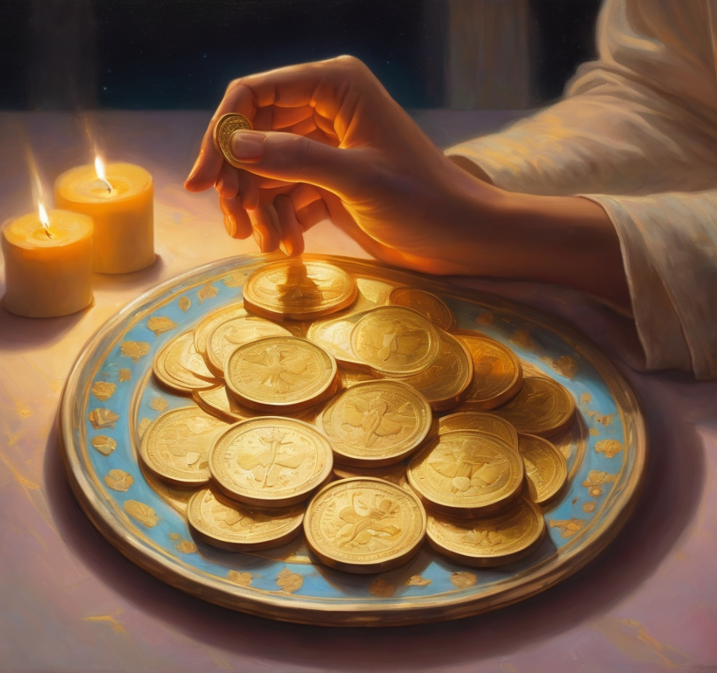
Offerings: Thank you for your regular gifts to this ministry
Offerings are most welcome via
the HHO App
Direct Debit
International Direct Debit
Please consider a one-off donation
or leaving a legacy in your Will
For further information go to HHO give page
https://holyhermits.com.au/give

Slide 56
Serving next week 5th October
17th Sunday of Pentecost 9:00 am AEST
5th Birthday of Holy Hermits Online
Animal Blessing Service
Agape Feast
Service Prep: Lauren | Chat Host: Viki | First Reader: Liz
Music: Wiggles | Priest: Jamee | Second Reader: Margo
Proof-reader: Jamee | Deacon: Lauren | Preacher: Jamee
Broadcaster: Barry | Welcomer: Julie | Fellowship: Jamee
Backup Broadcaster: Lauren | Leader: Troy | Safety Officer: Chris
Zoom Buttons: Viki | Cantor: Paul | Attendance logger: Viki
Thank you for your ministry gifts
New servers always welcome! Please email Kerrie-Anne to get involved holyhermits@anglicanchurchsq.org.au

Slide 57
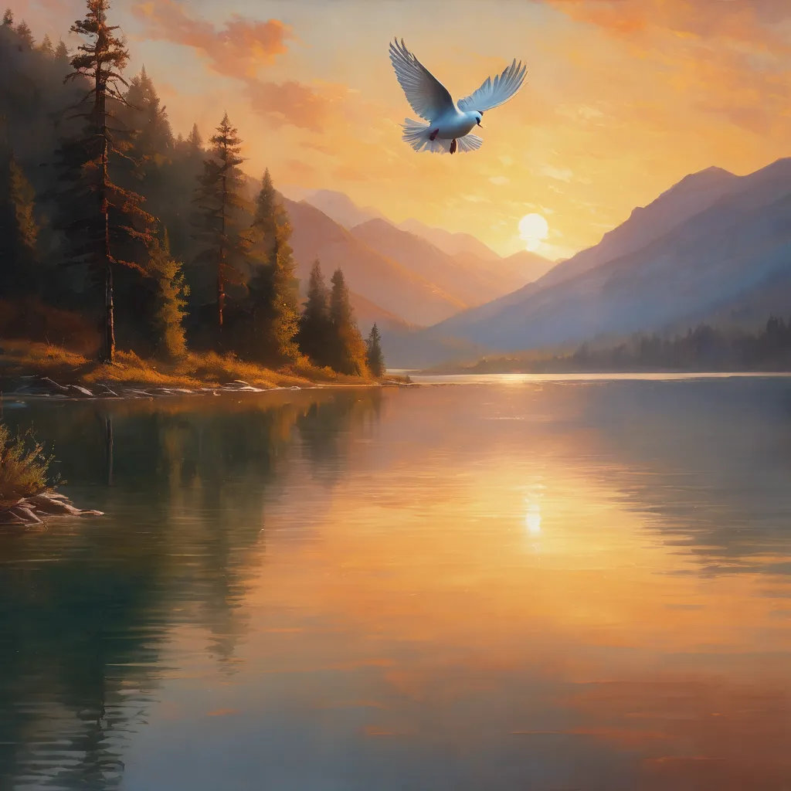
Leader: I invite everyone to unmute for the Dismissal
Leader: Go in peace to love and serve the Lord.
All: In the name of Christ, Amen.
Today’s Background — God’s Peace

Slide 58

Fellowship time
Thank you, Troy for leading fellowship
Please feel welcome to linger or pop a message in the chat and head off when you are ready.​
Extra resources developed
by Roots on the Web and Season for Creation 2025 resources
Artwork by Padlet

