Slide 1
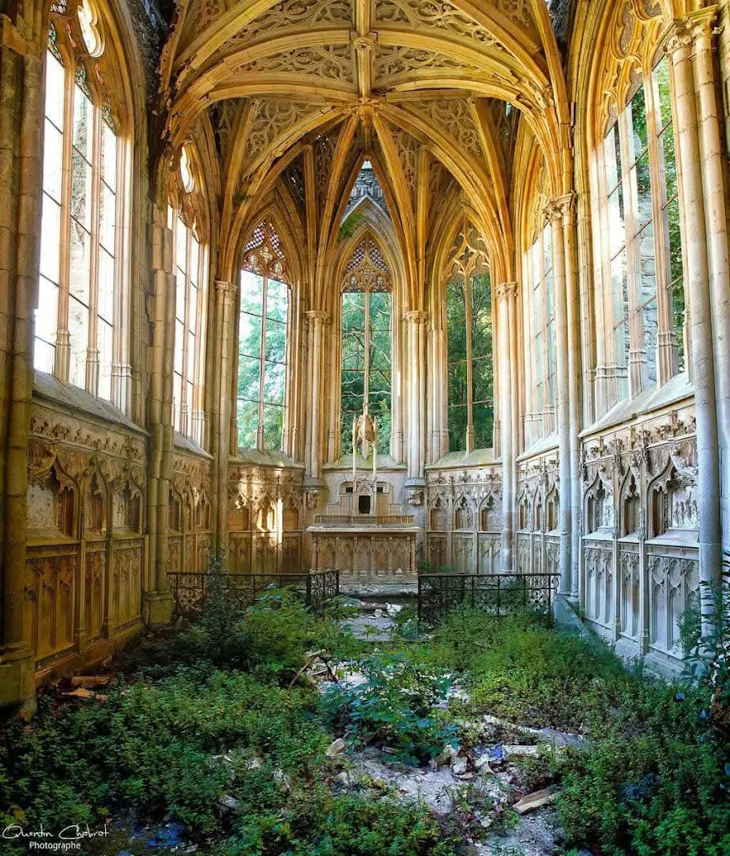






道德淪亡
的結局(2)
當信仰漸褪色
士師記19:1-30節
Notes:
法國一所教堂 Chapelle du Chateau de Vic
The chapel of Vic is nicknamed “the Chapel of the Angel with the Violin”, after a superb sculpture that adorns the place.
Built in 1885 for Camille Don de Cépian, owner of the Vic estate, it is erected in a 15th century Gothic style.
Still privately owned, its roof was restored in 2016 to avoid fatal deterioration.
Unfortunately, the current state of the chapel does not allow it to be visited. It is strictly forbidden to enter it.

Slide 2


第十七, 十八章
第十九章
結局(2) 道德淪亡
這人離開猶大的伯利恆城……。
他來到以法蓮山區米迦的家 (v.8)
那時，以色列中沒有王……(v.6)
當以色列中沒有王的時候……(v.1)
以法蓮山區有一個人，名叫米迦。(v.1)
有一個利未人寄居以法蓮山區
的邊界……(v.1)
我們從猶大的伯利恆過來…… (v.1)
猶大的伯利恆有一個年輕人……是利未人，寄居在那裏。 (v.7)
他娶了一個猶大伯利恆的女子為妾。 (v.1)
Notes:
1. 那時，以色列中沒有王……(v.6)
2. 同樣發生在以法蓮山區, 同樣提及猶大的伯利恒城（彌迦書 5:2＝為小，「糧食之家」（House of Bread）
3. 兩個都是利未人, 提到他們都是”寄居的”; 多以農耕、牧羊為生，屬於平民百姓的生活型態。
4. 年輕的利末人離開 猶大的伯利恒——去到以法蓮找工作 ( 後來做了祭司)
5. 寄居在以法蓮山區的利未人，娶了一個離開了猶大伯利恒城的一個女子（為妾） 19章
6. 一個成為“高級及尊貴”祭司, 一個成為受害者（被強暴）
** 他們並沒有分配土地或產業，因為神自己是他們的產業（民數記18:20-23; 民35:1-5, 從支派中得城及逃城35: 6-8, 共48座）但是讓其他十二支派來供應利未人的需要，再由利未人去供應其他以色列人靈性的需要，彼此之間互補互相照應，實在完美。

Slide 3
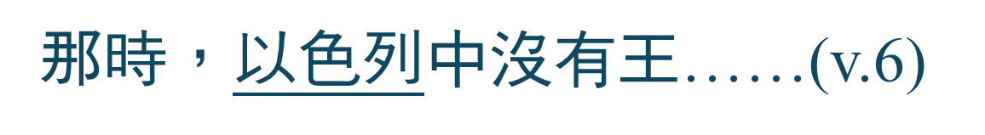

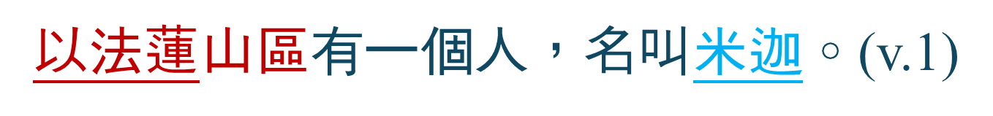
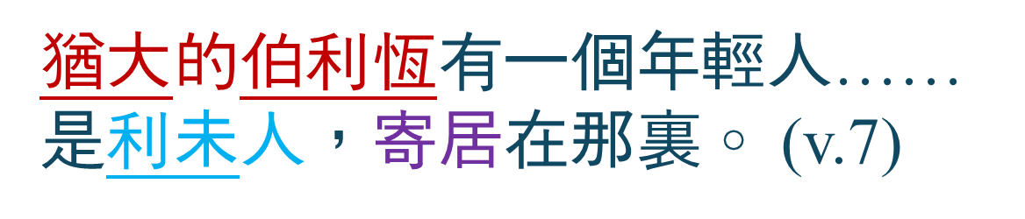
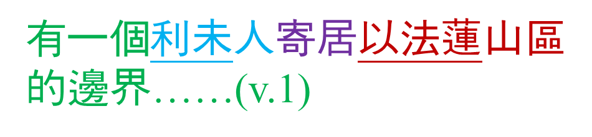
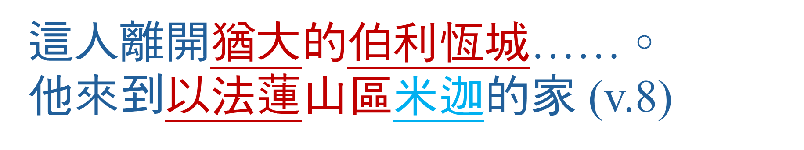
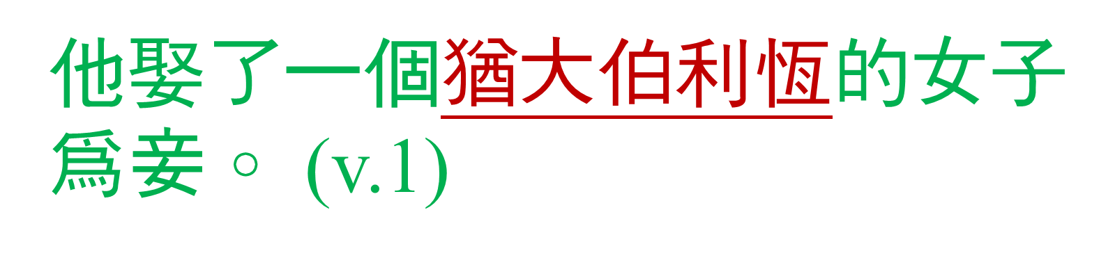
第十七, 十八章
第十九章
這人離開猶大的伯利恆城……。
他來到以法蓮山區米迦的家 (v.8)
那時，以色列中沒有王……(v.6)
當以色列中沒有王的時候……(v.1)
以法蓮山區有一個人，名叫米迦。(v.1)
有一個利未人寄居以法蓮山區
的邊界……(v.1)
我們從猶大的伯利恆過來…… (v.1)
猶大的伯利恆有一個年輕人……是利未人，寄居在那裏。 (v.7)
他娶了一個猶大伯利恆的女子為妾。 (v.1)
Notes:
1. 那時，以色列中沒有王……(v.6)
2. 同樣發生在以法蓮山區, 同樣提及猶大的伯利恒城（彌迦書 5:2＝為小，「糧食之家」（House of Bread）
3. 兩個都是利未人, 提到他們都是”寄居的”; 多以農耕、牧羊為生，屬於平民百姓的生活型態。
4. 年輕的利末人離開 猶大的伯利恒——去到以法蓮找工作 ( 後來做了祭司)
5. 寄居在以法蓮山區的利未人，娶了一個離開了猶大伯利恒城的一個女子（為妾） 19章
6. 一個成為“高級及尊貴”祭司, 一個成為受害者（被強暴）
** 他們並沒有分配土地或產業，因為神自己是他們的產業（民數記18:20-23; 民35:1-5, 從支派中得城及逃城35: 6-8, 共48座）但是讓其他十二支派來供應利未人的需要，再由利未人去供應其他以色列人靈性的需要，彼此之間互補互相照應，實在完美。

Slide 4

士師記 19:1-2
¹當以色列中沒有王的時候，有一個利未人寄居以法蓮山區的邊界，他娶了一個猶大伯利恆的女子為妾。 ²這妾對丈夫生氣，離開丈夫，回到猶大伯利恆的父家，在那裏住了
四個月。
Notes:
有一個利未人的故事
1. 以色列中沒有王
2. 利未人寄居以法蓮山區的邊界
3. 聚了一個猶大伯利恒的女子為妾
19 In those days Israel had no king. Now a Levite who lived in a remote area in the hill country of Ephraim took a concubine from Bethlehem in Judah. ² But she was unfaithful to him. She left him and went back to her parents’ home in Bethlehem, Judah. After she had been there four months

Slide 5

士師記 19:3
她的丈夫起來，帶著一個僕人、兩匹驢跟著她去，要用好話勸她回來。女子就帶丈夫進到父親家裏。女子的父親看見了他，就歡歡喜喜地迎接他。
Notes:
³ her husband went to her to persuade(勸服妾回家) her to return. He had with him his servant and two donkeys. She took him into her parents’ home, and when her father saw him, he gladly welcomed him.
聖經大部分是用希伯來文寫的，後來因為居住外邦的新一代以色列人不懂希伯來文，就用當時世界通行的文字——希臘文來翻譯，就是後來的《七十士譯本》。在那個年代妾侍 ”行淫” 是難以想像的，翻譯的人就將經文軟化，變成妾侍「激怒」了丈夫。今日的英文譯本也有兩個版本，一個是“unfaithful”，即不忠、行淫；另一個按照《七十士譯本》譯作激怒了丈夫。
郭文池. (2012). (朱美美, Ed.; 初版, p. 195). 明道社.
郭文池. (2012). 誰是我王？：從士師記看敬虔人生 (朱美美, Ed.; 初版, p. 195). 明道社.

Slide 6

士師記 19:4-5
⁴這岳父，就是女子的父親，留他住了三天。他們在那裏吃喝，住宿。 ⁵第四日，他們清早起來，利未人起身要走，女子的父親對女婿說：「先吃點東西，加添心力，然後你們才走。」
Notes:
⁴ His father-in-law, the woman’s father, prevailed on him to stay; so he remained with him three days, eating and drinking, and sleeping there. ⁵ On the fourth day they got up early and he prepared to leave, but the woman’s father said to his son-in-law, “Refresh yourself with something to eat; then you can go.”

Slide 7

士師記 19:6-7
⁶於是二人坐下，一同吃喝。女子的父親對那人說：「請你答應再住一夜，使你的心舒暢。」⁷那人起身要走，他岳父挽留他，他就留下，在那裏又住了一夜。
Notes:
⁶ So the two of them sat down to eat and drink together. Afterward the woman’s father said, “Please stay tonight and enjoy yourself.” ⁷ And when the man got up to go, his father-in-law persuaded him, so he stayed there that night.

Slide 8

士師記 19:8
第五日，他清早起來要走，女子的父親說：「來，請加添心力，留到太陽偏西吧。」於是二人一同再吃。
Notes:
⁸ On the morning of the fifth day, when he rose to go, the woman’s father said, “Refresh yourself. Wait till afternoon!” So the two of them ate together.

Slide 9
士師記 19:9
那人同他的妾和僕人起身要走，但他岳父，就是女子的父親，對他說：「看哪，太陽下山，天快晚了，你們再住一夜吧。看哪，太陽偏西了，就在這裏住宿，使你的心舒暢，明天你們一早起來上路，回你的帳棚去。」
Notes:
⁹ Then when the man, with his concubine and his servant, got up to leave, his father-in-law, the woman’s father, said, “Now look, it’s almost evening. Spend the night here; the day is nearly over. Stay and enjoy yourself. Early tomorrow morning you can get up and be on your way home.”

Slide 10

士師記 19:10-11
¹⁰那人不願再住一夜，就備上兩匹驢，帶著他的妾起身走了，來到耶布斯的對面，耶布斯就是耶路撒冷。 ¹¹將近耶布斯的時候，太陽快下山了，僕人對主人說：「來吧，我們進這耶布斯人的城，在這裏住宿。」
Notes:
¹⁰ But, unwilling to stay another night, the man left and went toward Jebus (that is, Jerusalem), with his two saddled donkeys and his concubine.
¹¹ When they were near Jebus and the day was almost gone, the servant said to his master, “Come, let’s stop at this city of the Jebusites and spend the night.”

Slide 11
士師記 19:12-13
¹²主人對他說：「我們不可進入
外邦人的城，那不是以色列人的地方，我們越過這裏到基比亞去吧。」¹³他又對僕人說：「來，讓我們到基比亞或拉瑪的一個地方住宿。」
Notes:
¹² His master replied, “No. We won’t go into any city whose people are not Israelites. We will go on to Gibeah.” ¹³ He added, “Come, let’s try to reach Gibeah or Ramah and spend the night in one of those places.”

Slide 12

士師記 19:14-15
¹⁴於是他們越過那裏往前走，將到便雅憫的基比亞的時候，太陽已經下山了。 ¹⁵他們進入基比亞要在那裏住宿。他來坐在城裏的廣場上，但沒有人接待他們到家裏住宿。
Notes:
¹⁴ So they went on, and the sun set as they neared Gibeah in Benjamin. ¹⁵ There they stopped to spend the night. They went and sat in the city square, but no one took them in for the night.

Slide 13
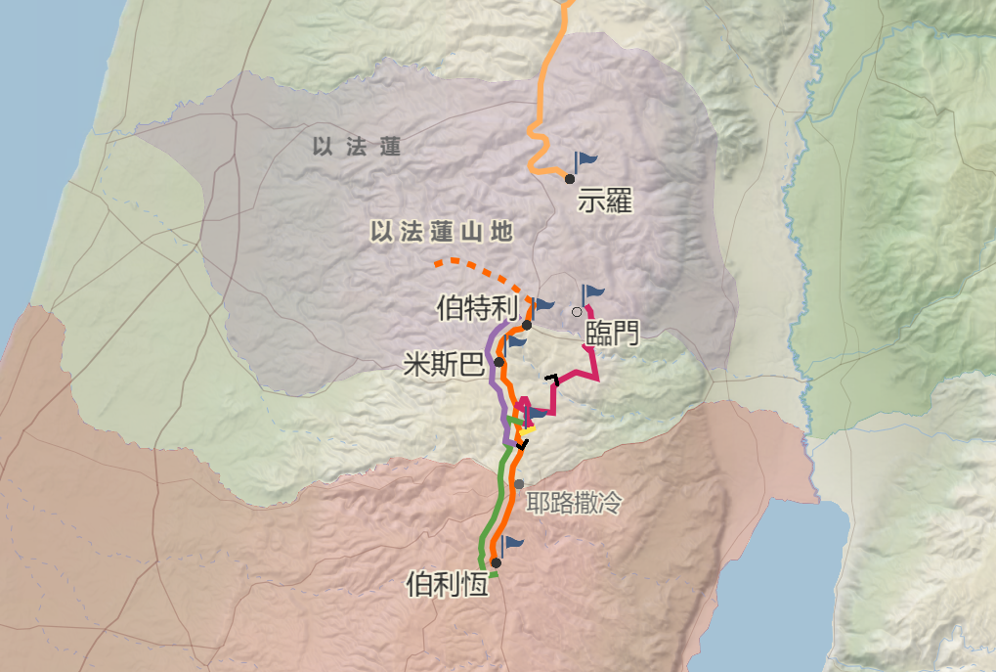



以法蓮
山地
便雅憫
基比亞
便 雅 憫
基比亞
耶布斯
(耶布斯)
猶 大
猶 大
鹽 海
伯利恆
Notes:
^{彌5: 2} 伯 利 恆 、 以 法 他 啊 ， 你 在 猶 大 諸 城 中 為 小 (you are small) ， 將 來 必 有 一 位 從 你 那 裡 出 來 ， 在 以 色 列 中 為 我 作 掌 權 的 ； 他 的 根 源 從 亙 古 ， 從 太 初 就 有 。

Slide 14
士師記 19:1-2
¹當以色列中沒有王的時候，有一個利未人寄居以法蓮山區的邊界，他娶了一個猶大伯利恆的女子為妾。 ²這妾對丈夫生氣，離開丈夫，回到猶大伯利恆的父家，在那裏住了四個月。
² But she was unfaithful to him. She left him….(NIV)
² But his concubine became angry with^{[a]} him, and she went away from him….(NRSV updated edition) ^{[a] :} prostituted herself against
Notes:
有一個利未人的故事
1. 以色列中沒有王
2. 利未人寄居以法蓮山區的邊界
3. 聚了一個猶大伯利恒的女子為妾
But his concubine became angry with prostituted herself against him, and she went away from him
原文希伯來語含義比較模糊，因此在翻譯上存在爭議。
19 In those days Israel had no king. Now a Levite who lived in a remote area in the hill country of Ephraim took a concubine from Bethlehem in Judah. ² But she was unfaithful to him. She left him and went back to her parents’ home in Bethlehem, Judah. After she had been there four months.

Slide 15
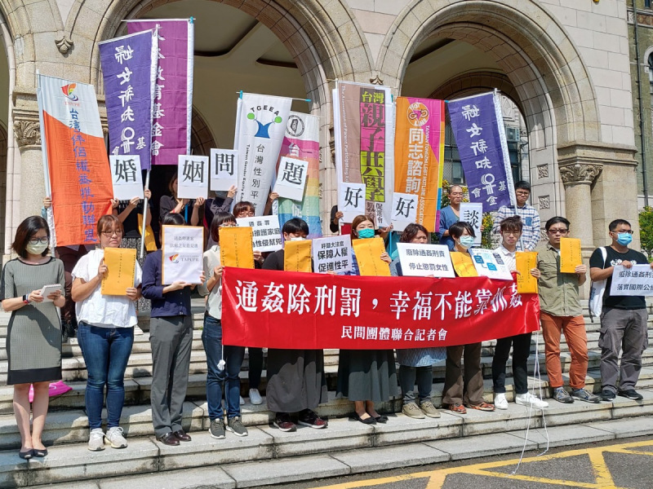
Notes:
通姦罪釋憲 下週二言詞辯論 民團籲廢除：懲罰女性、無助護婚姻 | 苦勞網
通姦除刑罰，幸福不能靠捉姦
【記者會】通姦除刑罰，幸福不能靠捉姦 | 婦女新知基金會
https://www.awakening.org.tw/news/5376
https://www.coolloud.org.tw/node/94149
每處罰100位通姦罪女性，就只有81個男性受罰。
希望大法官可以宣告通姦罪違憲，讓婚姻關係「始於民法終於民法」，有紛爭就回到伴侶間的溝通，不要再用國家刑罰介入。
刑法通姦罪無助於維護婚姻家庭，還成為性侵害的壓迫工具

Slide 16



1. 家庭關係矛盾，感情破產

Slide 17
士師記 19:16-17
¹⁶看哪，晚上有一個老人從田間做工回來。他是以法蓮山區的人，寄居在基比亞；那地方的人是便雅憫人。¹⁷老人舉目看見那過路的人在城裏的廣場上，就說：「你從哪裏來？要到哪裏去？」
Notes:
¹⁶ That evening an old man from the hill country of Ephraim, who was living in Gibeah (the inhabitants of the place were Benjamites), came in from his work in the fields. ¹⁷ When he looked and saw the traveler in the city square, the old man asked, “Where are you going? Where did you come from?”

Slide 18
士師記 19:18
他對他說：「我們從猶大的伯利恆過來，要到以法蓮山區的邊界去。我是那裏的人，去了猶大的伯利恆，現在要到耶和華的家去，卻沒有人接待我到他的家。
Notes:
我們從猶大的伯利恆過來，要到以法蓮山區的邊界去。
¹⁸ He answered, “We are on our way from Bethlehem in Judah to a remote area in the hill country of Ephraim where I live. I have been to Bethlehem in Judah and now I am going to the house of the Lord.^{[a]} No one has taken me in for the night.
a. Hebrew, Vulgate, Syriac and Targum; Septuagint ”going home”

Slide 19
士師記 19:19
其實我有飼料草料可以餵驢，我和你的使女，以及與我們在一起的僕人都有餅有酒，甚麼都不缺。」
Notes:
¹⁹ We have both straw and fodder for our donkeys and bread and wine for ourselves your servants—me, the woman and the young man with us. We don’t need anything.”

Slide 20
士師記 19:20-21
²⁰老人說：「願你平安！你所需用的我都會給你們，只是不可在廣場上過夜。」 ²¹於是老人領他到家裏，餵上驢。他們洗了腳，就吃喝起來。
Notes:
²⁰ “You are welcome at my house,” the old man said. “Let me supply whatever you need. Only don’t spend the night in the square.” ²¹ So he took him into his house and fed his donkeys. After they had washed their feet, they had something to eat and drink.

Slide 21

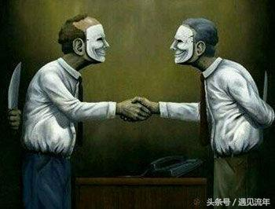
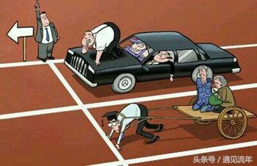
2. ⁠社會道德淪喪，人性醜惡

Slide 22
士師記 19:22
他們心裏歡樂的時候，看哪，城中的無賴圍住房子，連連叩門，對老人，這家的主人說：「把那進你家的人帶出來，我們要與他交合。」
Notes:
²² While they were enjoying themselves, some of the wicked men of the city surrounded the house. Pounding on the door, they shouted to the old man who owned the house, “Bring out the man who came to your house so we can have sex with him.”

Slide 23

士師記 19:23
這家的主人出來對他們說：「弟兄們，不要做這樣的惡事。這人既然進了我的家，你們就不要做這樣可恥的事。
Notes:
²³ The owner of the house went outside and said to them, “No, my friends, don’t be so vile. Since this man is my guest, don’t do this outrageous thing.

Slide 24
士師記 19:24
看哪，我有個女兒還是處女，還有這人的妾，我把她們領出來任由你們污辱她們，就照你們看為好的對待她們吧！但對這人你們不要做這樣可恥的事。」
Notes:
²⁴ Look, here is my virgin daughter, and his concubine. I will bring them out to you now, and you can use them and do to them whatever you wish. But as for this man, don’t do such an outrageous thing.”

Slide 25
士師記 19:25
那些人卻不肯聽從他。那人抓住他的妾，把她拉出去給他們。他們強姦了她，整夜凌辱她，直到早晨，天色快亮才放她走。
Notes:
²⁵ But the men would not listen to him. So the man took his concubine and sent her outside to them, and they raped her and abused her throughout the night, and at dawn they let her go.

Slide 26
士師記 19:26-27
²⁶到了早晨，婦人回來，仆倒在留她主人住宿的那人的家門前，直到天亮。²⁷早晨，她的主人起來開了門，出去要上路。 看哪，那婦人，他的妾倒在屋子門前，雙手搭在門檻上。
Notes:
²⁶ At daybreak the woman went back to the house where her master was staying, fell down at the door and lay there until daylight. ²⁷ When her master got up in the morning and opened the door of the house and stepped out to continue on his way, there lay his concubine, fallen in the doorway of the house, with her hands on the threshold.

Slide 27
士師記 19:28-29
²⁸他對婦人說：「起來，我們走吧！」婦人卻沒有回應。那人就將她馱在驢上，起身回自己的地方去了。²⁹到了家裏，他拿刀，抓住他的妾，把她的屍身切成十二塊，分送到
以色列全境。
Notes:
²⁸ He said to her, “Get up; let’s go.” But there was no answer. Then the man put her on his donkey and set out for home.
²⁹ When he reached home, he took a knife and cut up his concubine, limb by limb, into twelve parts and sent them into all the areas of Israel.

Slide 28




Slide 29
士師記 19:30
凡看見的人都說：「自從以色列人離開埃及地上來，直到今日，像這樣的事還沒有發生過，也沒有見過。大家應當想一想，商討一下再說。」
Notes:
³⁰ Everyone who saw it was saying to one another, “Such a thing has never been seen or done, not since the day the Israelites came up out of Egypt. Just imagine! We must do something! So speak up!”

Slide 30
默 想
你可曾想起自己的信仰光景是否漸褪色? 內心有何發現…….
道德淪亡
在哪裏跌倒…..! 就在那裏站起來, 有需要在信仰上作出甚麼改變…….!
的結局(2)
當信仰漸褪色
士師記19:1-30節
Notes:
法國一所教堂 Chapelle du Chateau de Vic
The chapel of Vic is nicknamed “the Chapel of the Angel with the Violin”, after a superb sculpture that adorns the place.
Built in 1885 for Camille Don de Cépian, owner of the Vic estate, it is erected in a 15th century Gothic style.
Still privately owned, its roof was restored in 2016 to avoid fatal deterioration.
Unfortunately, the current state of the chapel does not allow it to be visited. It is strictly forbidden to enter it.

