Slide 1
Leader: Welcome to Holy Hermits Online Worship
15th Sunday after Pentecost
The 3rd week in the Season of Creation
We welcome Andrew from the Mission Amplification Team in Texas, ahead of our Digital Mission Program handover in just over a week's time. It's great to have you here with us today, seeing our ministry in action.
Service Prep: Kristine | Chat Host: Viki | First Reader: Barry
Music: Wiggles 🐶 | Priest: Jamee | Second Reader: Helen
Proof-reader: Viki | Deacon: Lauren | Preacher: Lauren
Broadcaster: Lauren | Welcomer: Chris | Fellowship: Chris
Backup Broadcaster: Paul | Leader: Jeremy | Safety Officer: Chris
Zoom Buttons: Viki | Cantor: Roselyn | Attendance logger: Viki

Slide 2


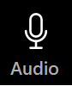



Hospitality
Leader: Please mute for the service unless invited to offer your voice as part of the service ministry
Have the video camera on or off and turn the volume and brightness up or down on your device if things are too loud 🔉🔊or too bright🔅🔆
Our Cantor acts as our voice, offering the responses, in Bold Text, which we say together
Feel welcome to use the chat and reaction emojis 👍
🙏 Please take care of yourself in this space. 🙏 Come and go as you need
😴 It is great to take rest in this space, so falling asleep is also OK 😴
👂️ Remember, pastoral care is available to all in the community, if you'd like to speak to someone about anything spiritual. ❤️ Visit the help page at the website to reach out 🌐
Our Being Together ethos and safeguarding practices can also be accessed on the website 🫶​
🙌 Come as you are – we are all here together! 🙌
Notes:
Used Lent 2022

Slide 3

Invitation
Leader: As we settle into worship let your breath be soft, your mind be still, and your heart be open to the presence of God.
Stilling video
https://vimeo.com/715765340

Slide 4
Leader and Cantor unmute
The Greeting
Leader:
The Grace of the lord Jesus Christ,
and the love of God,
and the fellowship of the Holy Spirit,
be with you all.
All: And also with you.

Slide 5
Gathering Prayer
Leader:
Heavenly Father, we come before you today
with gratitude for the gifts of community and fellowship.
As we gather in your name, we invite your Holy Spirit
to be among us, guiding our thoughts, words, and actions.
Open our ears to hear your voice,
and our eyes to see your work among us.
Amen.

Slide 6
Sentence
Leader: I invite our Cantor to proclaim the sentence for today.
Cantor: You know the grace of our Lord Jesus Christ, that though he was rich, yet for your sake he became poor, so that by his poverty you might become rich.
2 Corinthians 8.9

Slide 7
Prayer of Approach
Leader: We pray the prayer of approach together.
All: Heavenly Father, we come into your presence
from a corrupt and confusing world.
We seek the calm of your house and your guidance.
We come as children to the knee of a trusted parent,
to hear your words of wisdom, comfort and encouragement.
Amen.

Slide 8
The Deacon or LA Introduces Confession
​All Creation is full of God’s praise, and we are called to join in with joy, righteousness and peacefulness.
Yet as we look around us, we see conflict and destruction.
We acknowledge: We ourselves cause conflict and destruction, and often fail to walk the path of peace.
Everywhere on the planet, humans cause great harm, even as we know that the scope of destruction varies, and that everywhere human beings are among the victims of our deep conflict with Creation.
All too often, we fail to live as we are called to live.
We fail to be ambassadors of peace, righteousness and reconciliation.

Slide 9
​Silence may be kept.
Let us confess our sins.
Let us come before the Triune God for forgiveness and renewal.

Slide 10
All: ​Merciful God, our maker and our judge, ​we have sinned against you ​in thought, word, and deed, ​and in what we have failed to do: ​we have not loved you with our whole heart; ​we have not loved our neighbours as ourselves; ​ we repent, and are sorry for all our sins.​ Father, forgive us. Strengthen us to love and obey you in newness of life; ​through Jesus Christ our Lord. ​
Amen.​

Slide 11
​
The Deacon or LA offers the Proclamation of Forgiveness in the Season of Creation​
​
May our God have mercy on us, forgive us our trespasses and give us new life.
Indeed, God has promised grace and forgiveness to us: “My people will abide in a peaceful habitation, in secure dwellings, and in quiet resting places.” (Isaiah 32:18)
Let us rejoice and trust in our calling, live as we are called to live, reconciled with the Father, ambassadors for Christ, filled with the Holy Spirit.
Amen. ​

Slide 12
>If there is no priest present this slide is skipped<
​
The Priest offers Absolution
​
Almighty God who has promised forgiveness
to all who turn to God in faith;
pardon you and set you free from all your sins,
strengthen you in all goodness
and keep you in eternal life,
through Jesus Christ our Lord.
Amen.
​

Slide 13
Leader: Our First Hymn is
As The Deer Pants
https://www.youtube.com/watch?v=1Y2_63qfUkg
Let's sing or enjoy the music together
We stay on mute
Leader and Cantor mute

Slide 14
Collect in the Season of Creation
Leader:
God Most High,
maker of heaven and earth,
you created humankind in your own image
and entrusted the whole world to human care:
give us grace to serve you faithfully,
that we might be trustworthy stewards of your creation,
through Jesus Christ our Lord,
who lives and reigns with you and the Holy Spirit,
one God, now and for ever.
Amen.

Slide 15
The 1st reader unmutes
Leader: I invite the 1st Reader to unmute and offer the 1st reading when ready.
Reader 1: The first reading is from Jeremiah 8.18-9.1
8 ¹⁸ My joy is gone, grief is upon me,
my heart is sick.
¹⁹ Hark, the cry of my poor people
from far and wide in the land:
‘Is the Lord not in Zion?
Is her King not in her?’
(‘Why have they provoked me to anger with their images,
with their foreign idols?’)
Continue…

Slide 16
²⁰ ‘The harvest is past, the summer is ended,
and we are not saved.’
²¹ For the hurt of my poor people I am hurt,
I mourn, and dismay has taken hold of me.
²² Is there no balm in Gilead?
Is there no physician there?
Why then has the health of my poor people
not been restored?
9 ¹ O that my head were a spring of water, and my eyes a fountain of tears,
so that I might weep day and night for the slain of my poor people!
For the word of the Lord. Thanks be to God.​

Slide 17
Leader: We now say the psalm antiphonally, I invite the first reader to lead and we will all respond with the Responses in Bold along with our cantor as our voice.
Psalm
79.1-9
¹ O God, the heathen have come into your land:
they have defiled your holy temple,
they have made Jerusalem a heap of stones.
² They have given the dead bodies of your servants
as food to the birds of the air:
and the flesh of your faithful ones
to the wild beasts of the earth.
³ Their blood they have spilt like water
on every side of Jerusalem:
and there is none to bury them.

Slide 18
⁴ We have become a mockery to our neighbours:
the scorn and laughing-stock of those about us.
⁵ How long, O Lord, shall your anger be so extreme:
will your jealous fury burn like fire?
⁶ Pour out your wrath on the nations that do not know you:
on the kingdoms that have not called upon your name.
⁷ For they have devoured Jacob:
and made his dwelling-place a desolation.
Continue…

Slide 19
⁸ Do not remember against us the sin of former times:
but let your compassion hasten to meet us,
for we are brought very low.
⁹ Help us, O God our saviour,
for the honour of your name:
O deliver us and expiate our sins, for your name’s sake

Slide 20
The 2nd reader unmutes
Leader: Thank you, 1st reader. I invite the 2nd Reader to unmute and offer the 2nd reading when ready.
Reader 2: The 2nd Reading is from 1 Timothy 2.1-10
¹ First of all, then, I urge that supplications, prayers, intercessions, and thanksgivings should be made for everyone,
² for kings and all who are in high positions, so that we may lead a quiet and peaceable life in all godliness and dignity.
³ This is right and is acceptable in the sight of God our Saviour,
⁴ who desires everyone to be saved and to come to the knowledge of the truth.
Continue…

Slide 21
⁵ For there is one God;
there is also one mediator between God and humankind, Christ Jesus, himself human,
⁶ who gave himself a ransom for all—this was attested at the right time.
⁷ For this I was appointed a herald and an apostle (I am telling the truth, I am not lying), a teacher of the Gentiles in faith and truth.
⁸ I desire, then, that in every place the men should pray, lifting up holy hands without anger or argument;
⁹ also that the women should dress themselves modestly and decently in suitable clothing, not with their hair braided, or with gold, pearls, or expensive clothes,
¹⁰ but with good works, as is proper for women who profess reverence for God.
For the word of the Lord. Thanks be to God.

Slide 22
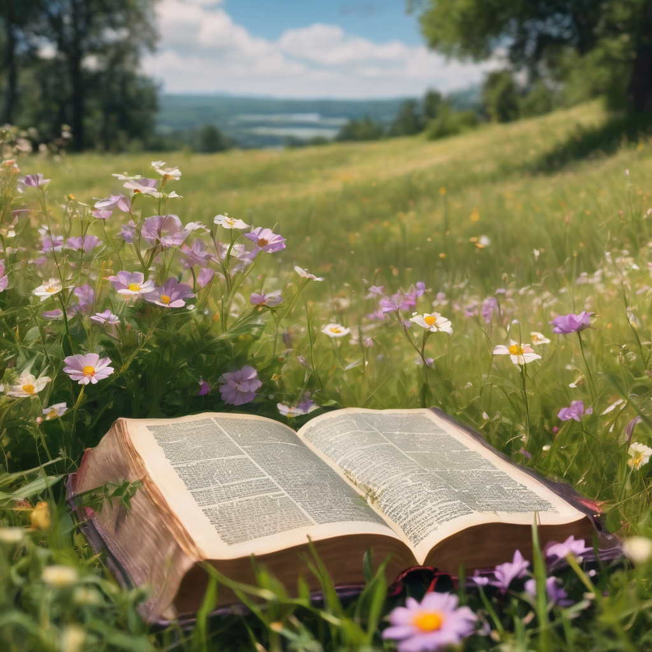
We pause before
​the Gospel ​​

Slide 23
The Gospel of our Lord Jesus Christ according to St Luke Chapter 16 beginning at the 1st verse
All: Glory to you Lord Jesus Christ.
¹ Then Jesus said to the disciples, ‘There was a rich man who had a manager, and charges were brought to him that this man was squandering his property. ² So he summoned him and said to him, “What is this that I hear about you? Give me an account of your management, because you cannot be my manager any longer.” ³ Then the manager said to himself, “What will I do, now that my master is taking the position away from me? I am not strong enough to dig, and I am ashamed to beg.
Continue…

Slide 24
⁴ I have decided what to do so that, when I am dismissed as manager, people may welcome me into their homes.” ⁵ So, summoning his master’s debtors one by one, he asked the first, “How much do you owe my master?” ⁶ He answered, “A hundred jugs of olive oil.” He said to him, “Take your bill, sit down quickly, and make it fifty.” ⁷ Then he asked another, “And how much do you owe?” He replied, “A hundred containers of wheat.” He said to him, “Take your bill and make it eighty.” ⁸ And his master commended the dishonest manager because he had acted shrewdly; for the children of this age are more shrewd in dealing with their own generation than are the children of light.

Slide 25
⁹ And I tell you, make friends for yourselves by means of dishonest wealth so that when it is gone, they may welcome you into the eternal homes. ¹⁰ ‘Whoever is faithful in a very little is faithful also in much; and whoever is dishonest in a very little is dishonest also in much. ¹¹ If then you have not been faithful with the dishonest wealth, who will entrust to you the true riches? ¹² And if you have not been faithful with what belongs to another, who will give you what is your own? ¹³ No slave can serve two masters; for a slave will either hate the one and love the other, or be devoted to the one and despise the other. You cannot serve God and wealth.’
This is the Gospel of the Lord. All: Praise to you Lord Jesus Christ.

Slide 26
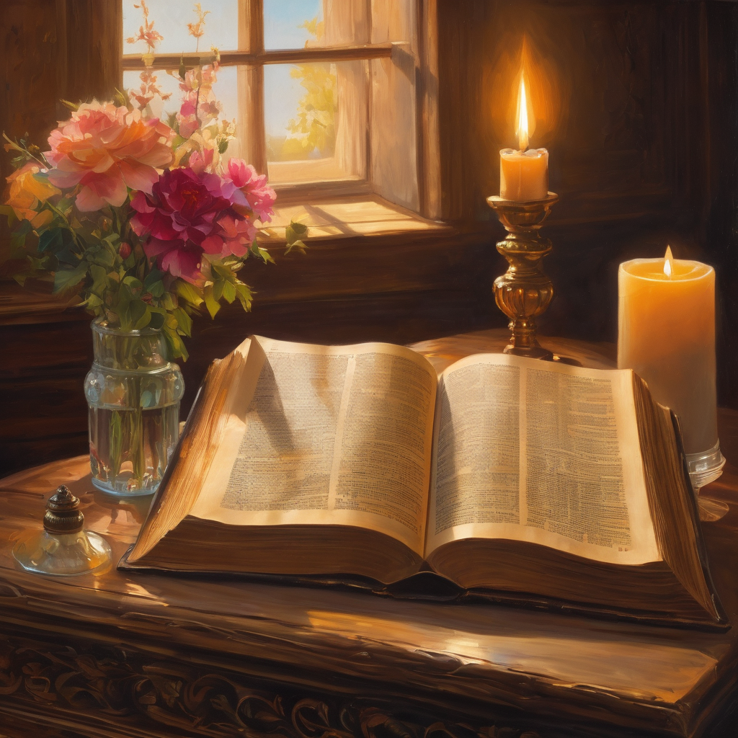
We pause
after ​the Gospel ​​

Slide 27
Leader: The Sermon is recorded to YouTube for sharing later.
Only the preacher's video and audio will be recorded.
The chat and other participants' feeds remain out of sight of the recording.
Leader and Cantor mute
Broadcaster exits screenshare
Preacher unmutes
Zoom buttons ”pins” preacher’s screen + selects “record to the cloud”
Sermon

Slide 28
Leader: Our next Hymn is
For the Beauty of the Earth
https://www.youtube.com/watch?v=6qIqF4PDxPY
Let's sing or enjoy the music together
We stay on mute
Leader mutes

Slide 29
The Leader and Cantor unmute
The Greeting of Peace
Leader: We are the body of Christ
All: God’s Spirit is with us
Leader: The peace of the Lord be always with you.
All: And also with you.
Leader: A sign of peace may be exchanged
You may like to type 'Peace' into the chat, use the 'raise hand’ or other reaction buttons, or just simply wave via the screen with your video turned on
(Broadcaster exits shared screen for a few moments for the exchange of peace)

Slide 30
Prayer of Thanksgiving in the Season of Creation
Leader: As we enter prayer, I invite the second reader to unmute to lead our intercessions which follow the prayer of thanksgiving. Please feel free to change your body position as you need.
God of life, God of love, God of Creation. Thank You for all the wonderful,
great and immense creatures that You created.
We thank You that we have the opportunity to inhabit and enjoy the wonders of this world.
Thank you for giving us forests that provide our air and give us the shade we need on hot days.
Thank you for giving us the sun that shines brightly with its energy, as well as the rains to refresh and nourish the earth bringing a special scent.
Continue…

Slide 31
Thank you for giving us the fertile soil to provide us with food and sustenance for many animals.
Allow us to recognize that the community of the earth is a democracy of life as a whole that is based on the living economies that are the local economies of those who work the land.
Give us the strength to defend diversity in nature and in the culture of each place by putting the common good first, knowing that all beings have a natural right to their sustenance.
Help us to value each species, people and culture, knowing that each has intrinsic value.
Continue…

Slide 32
Help us to walk in this world with faith and hope. Sustain us to protect
and care for your creation, respectful of the resources it provides for us and
aware of the finiteness of Creation.
Give us the courage to fight for life and be resilient in the face of those
who destroy Creation and those who profit from it for their own business.
Thank you for each of our lives which we give to you, through Jesus Christ our Lord, who lives and reigns with you and the Holy Spirit. Amen

Slide 33
Intercessions
Reader 2: We pray for creation and communities we share our lives with. We pause for a few moments to name either in our hearts, or out loud, or in the chat, those environments and communities we bring to the Lord in prayer.
PAUSE…
We entrust to you the community of Holy Hermits Online and our ministry partners:
Prosper the work of our hands and show us the way to your new creation.
Creator God, Hear our prayer.
St John's Cathedral Brisbane The Anglican Diocese of Southern Queensland St Gabriel’s, Carindale Benedictus Contemplative Church, Canberra The Episcopal Diocese of Texas Anglican Focus and Tithe.ly

Slide 34
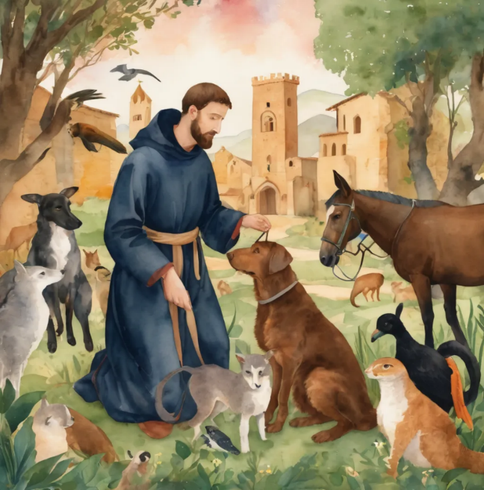
Reader 2: Loving Creator, we entrust to you all animals, especially those who are sick, anxious, ageing, lost, at risk, lonely, sad, hungry, in pain, homeless, abused, living in fear, encountering violence of any kind, in need of comfort, rehabilitation or transformation.
We invite your loving compassion for:
Jasmine,
Leese(y),
Sid,Toots and Lulu, Polly and Suki
Fred, George and Percy
Koshka,
Lambert
Kala, Nigel and Little One
Toby
Taco
Paddy and Jax
We name in our hearts, out loud or in the chat, the animals we bring to the Lord in prayer.
PAUSE…. Amen.

Slide 35
Reader 2: Eternal Trinity of Love, we uphold to you the people we love and carry cares for:
We name in our hearts, out loud or in the chat, those we bring to the Lord in prayer.
PAUSE… We entrust to you those who have died, those who have died peacefully and those who have died tragically, the old and the young. Receive them into your kingdom.
Amen.
Kerry and Les, Jake,​​ Dr Julie ​​ Julie and Ray, Tracey, Shane Jess and Leah ​​ May ​​ Kirsten, Greg, Daphne & Beau​​ Tanya​ Matthew & Nicholas​ & Sharyn Alan & Gaylene​ Susan Bonnie and girls | Barry​​ Dilys and Tony​​ Paul and Darhon Judy and Mary​​ Mark, Desley and Bob ​​ Ruth​​ Phil​ Rachel, Mervyn & Gillian Liz’s Godchildren Pat and Julie | Bill and Marjorie​​ Rev'd Shane & Janette​​ Alecia, Martin and Aidan Aaron and Andrea ​​ Neva​ Bob and Di​ Steven and Vanessa, Craig Miriam Barry and Gwen Robbie Bram

Slide 36
Pray Daily Cycle of Prayer
Leader: Loving God, joining with the Church in our cycle of prayer, we ask your blessings on:
The Province of the Episcopal Church of South Sudan
The Diocese of Rockhampton: †Peter; Clergy and People •
The Parish of Maleny: Ingrid, Kaye
Liturgical Assistants in parishes and schools
All Saints Anglican School, Merrimac: Headmaster – Matthew; Chaplain - Ann; Chair of School Council - John; members of School Council; staff & students

Slide 37
The Commitment prayer for the week is:
Episcopal Diocese of Texas
​​​Holy Trinity, source of all creativity, mission and pioneering partnerships,​
Please encourage and inspire us as we partner with the Episcopal Diocese of Texas and the Mission Amplification Team to establish a mutually successful collaboration with Holy Hermits Online.​
We pray that you will provide encouragement to the leaders and organisers of our mission, in the partnership phases which we fluidly move through building foundations, creating resources and experimenting bravely.​
Continue…

Slide 38
The Commitment prayer (cont.):
​We look forward to making new friends and connections over this next exciting time of ministry and outreach together. Please prepare us to open our hearts to our brothers and sisters in Texas and beyond. We especially look forward to welcoming and loving all companion animals across each end of our beautiful world and sharing our Companion Animal and other ministries from our community life.​
O God, you have made of one blood all the peoples of the earth and sent your son to preach peace to those who are far off and to those who are near: grant that people everywhere may seek after you and find you in our online communities. Please help us find the remote, the lonely, the sick and the sad that need your help and your heavenly word. ​
Raise up more people in your worldwide church to pray and to work, to care and to understand, to give to you and to go for you, that your church may grow, your will be done, your kingdom come, and your glory be revealed; Through Jesus Christ our Lord. Amen.
Amen.​

Slide 39
Leader: We are using a different form of the Lord's prayer in the Season of Creation, from the New Zealand common prayer book, let us pray
All: Eternal Spirit, Earth-maker, Pain-bearer, Life-giver,
​Source of all that is and that shall be,
Father and Mother of us all,​ Loving God, in whom is heaven: ​
The hallowing of your name echo through the universe! ​
The way of your justice be followed by the peoples of the world! ​
Your heavenly will be done by all created beings! ​
Your beloved community of peace and freedom sustain our hope and come on earth.​
Continue…

Slide 40
All: With the bread we need for today, feed us.
In the hurts we absorb from one another, forgive us.
In times of temptation and test, strengthen us.
From trials too great to endure, spare us.
From the grip of all that is evil, free us.
For you reign in the glory of the power that is love, now and forever. Amen.

Slide 41
Devotions

Slide 42
Leader: The Prayer for Creation 2025
PEACE WITH CREATION
Creator of all, we praise you for the gift of life and for the faith that unites us in care for our common home. We confess how estranged we have become—from one another, from your Creation, and from our truest selves. We acknowledge that our greed and destructive impulses have fractured our relationships with you, with others, and with the Earth. Fertile fields have become barren, forests lie desolate, oceans and rivers are polluted. Thriving communities have become places of suffering, and the earth cries out.
Continue…

Slide 43
Beloved Christ,
who spoke “Shalom” to frightened hearts,
stir us to compassionate action.
Inspire us to work for the end of conflict,
and for the full restoration of broken relationships—
with you, with the ecumenical community,
with the human family,
and with all Creation.
Continue…

Slide 44
Prince of Peace,
through your wounds, teach us to stand in solidarity
with the woundedness of others,
of creation, and of the world.
Through your resurrection, make us people of hope—
with a vision of swords turned into ploughshares
and tears transformed into joy.
May we come together as one family, to labor for your peace—
a shalom where all your people may dwell in safety, and rest in quiet places.
Amen.

Slide 45
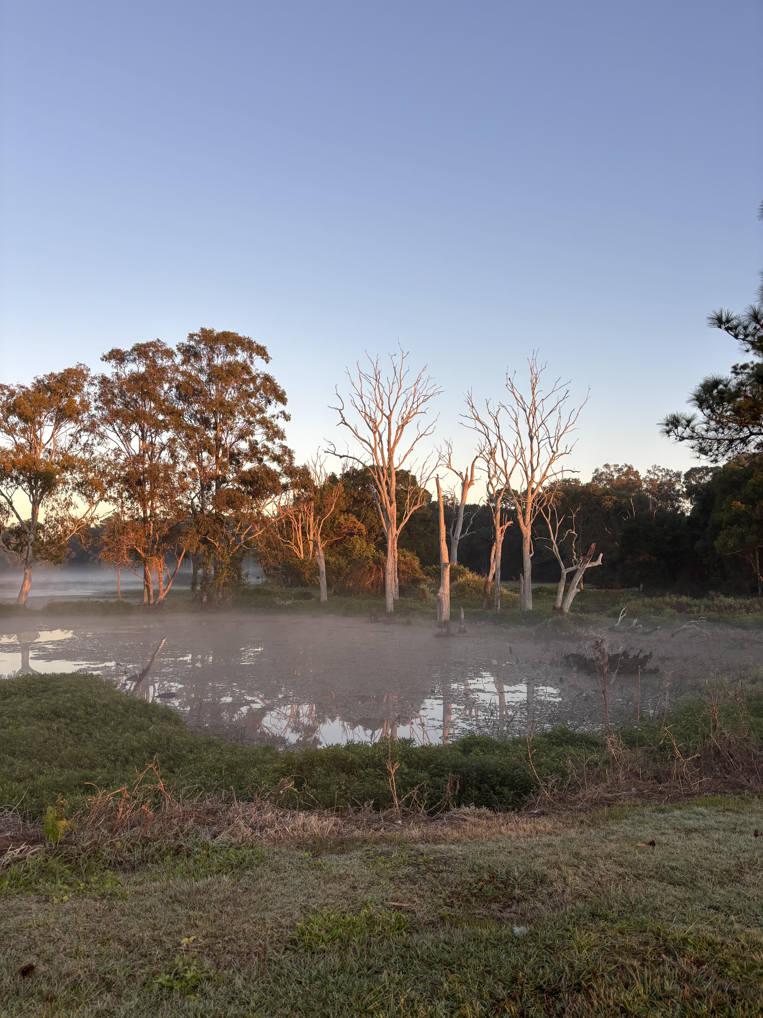
Leader: ​As we enter a few minutes of silence together, you are invited to pray this prayer of adoration and/or spend this time in contemplation. ​
The Spiritual Communion prayer follows on the next slide. Let us be still.
Leader and Cantor Mute.
​
Lord God, we thank you for those in our communities and nations
who seek positions with the power to make decisions
that most of us would prefer not to face.
We thank you for democracy, and the right to vote.
We thank you for those who decide how money is distributed
and we pray that their decisions will be wise and never self-serving.
On this United Nations International Day of Peace, we give thanks
and pray for those committed to achieving and keeping peace.
We thank and praise you, O Lord, for guiding us through the confusion
of a corrupt world – you are the One who keeps us grounded.
Amen.

Slide 46
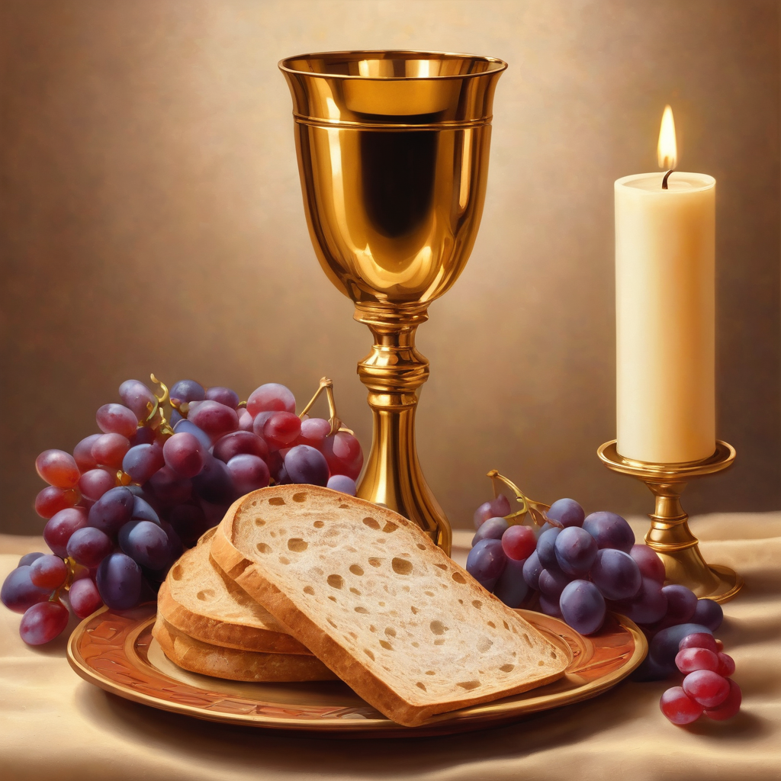

Oh, my Lord Jesus I turn to you present at the Altar and in the Tabernacle. I believe that you are present in the Holy Sacrament of your most Sacred Body and Blood.
I love you above all things and I desire to receive you into my Soul. I cannot at this moment receive you Sacramentally in Holy Communion.
Come spiritually into my heart.
Purify it, Sanctify it. Render my heart like your own heart.
I embrace you as if you were already there and unite myself wholly with you.
Never permit me to be separated from you.
Lord, I am not worthy to receive you, but only say the word and I shall be healed. Amen
Making a
Spiritual Communion
(Prayed in silence)

Slide 47
Leader: Our final song is
In The Garden
https://www.youtube.com/watch?v=zx5VsSkjP0w
Let's sing or enjoy the music together
​We stay on mute
Leader and Cantor mute

Slide 48
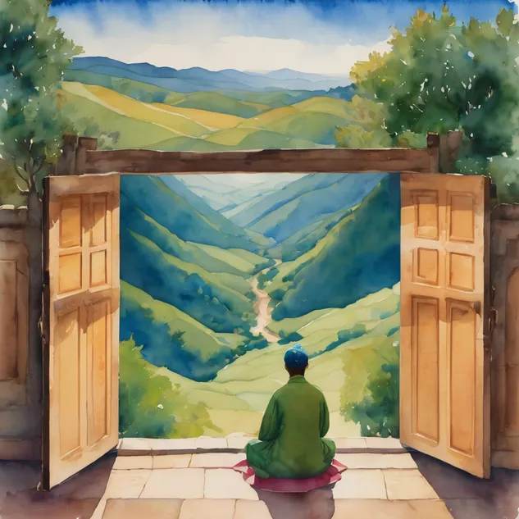
Leader and cantor unmute
Sending Prayer
Leader: We pray our sending prayer together.
All:
We go in the knowledge and confidence of God’s love for us,
trusting that Christ Jesus is with us. Amen.

Slide 49
>If there is no priest present this slide is skipped<​
The Priest offers the Blessing
Go in peace, brothers and sisters, live in peace with Creation.
And may the blessing of the Most Holy Trinity accompany you: The Father, and the Son, and the Holy Spirit,
the one God, to whom be glory, for ever.
Amen.

Slide 50
The Benediction
Leader: Let us all invite God’s blessings together,​
​
All: May the Lord bless us and keep us.​
May the Lord’s face shine upon us and
be gracious to us.​
May the Lord’s countenance be lifted upon us, ​
and bring us peace.
Amen

Slide 51
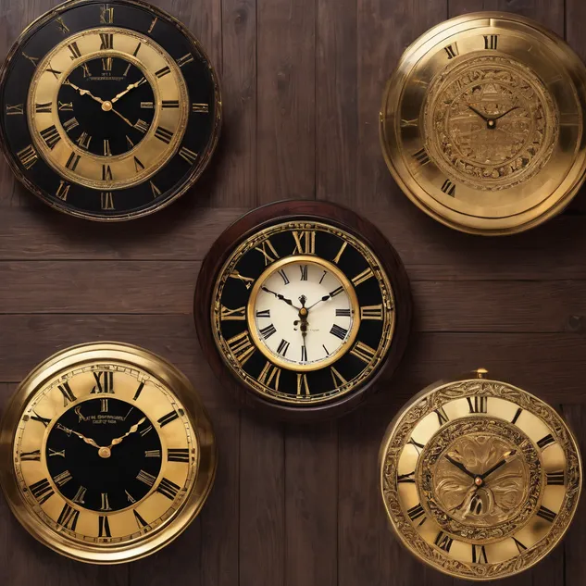
Notices
Today @ 11am we have our Christmas Contemplative Service Prep Workshop, all are welcome
Wednesday study @ 6pm, A Pilgrimage of the Heart continues, and is led by Troy, please sign up to receive the study link
The theme for our 2025 Christmastide Subscription will be "Christmastide narrated by the inn keeper's cat" - 12 days of journeying with all the characters of the nativity. Look out for more info in the weeks ahead
See HHO Events page for further upcoming events HHO Events

Slide 52
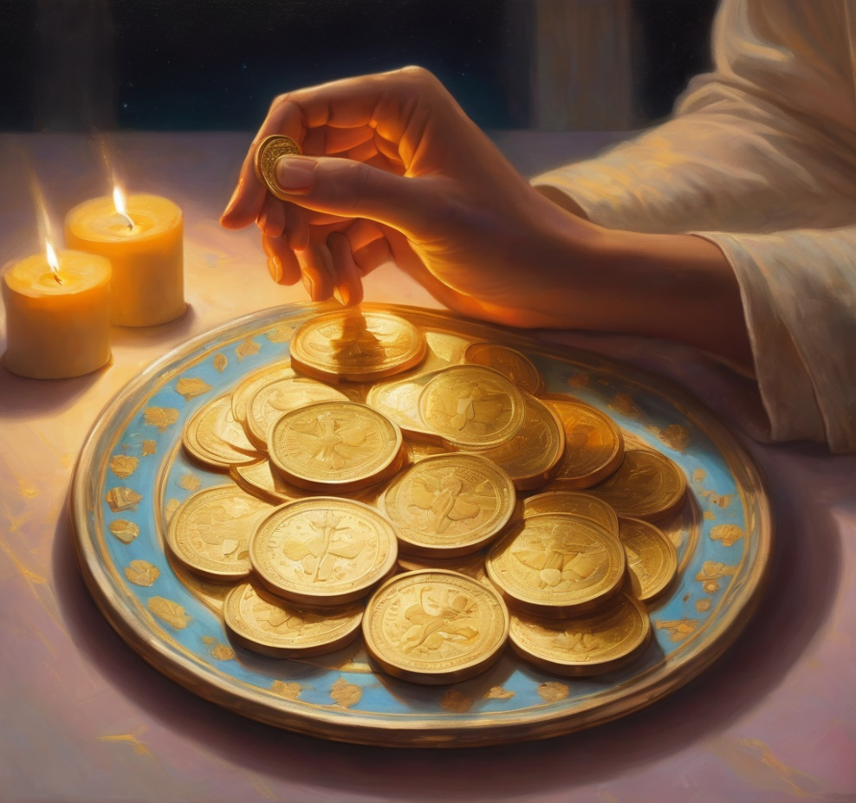
Offerings: Thank you for your regular gifts to this ministry
Offerings are most welcome via
the HHO App
Direct Debit
International Direct Debit
Please consider a one-off donation
or leaving a legacy in your Will
For further information go to HHO give page
https://holyhermits.com.au/give

Slide 53
Serving next week 28th September
16th Sunday of Pentecost
9:00 am AEST
Service Prep: Paul | Chat Host: Kerrie-Anne | First Reader: Jeremy
Music: Paul | Priest: Jamee | Second Reader: Bob
Proof-reader: Chris | Deacon: Lauren | Preacher: Lauren
Broadcaster: Troy | Welcomer: Chris | Fellowship: Troy
Backup Broadcaster: Barry | Leader: Julie | Safety Officer: Leonie
Zoom Buttons: Kerrie-Anne | Cantor: Vanessa | Attendance logger: Viki
Thank you for your ministry gifts
New servers always welcome!
Please email Kerrie-Anne to get involved holyhermits@anglicanchurchsq.org.au

Slide 54
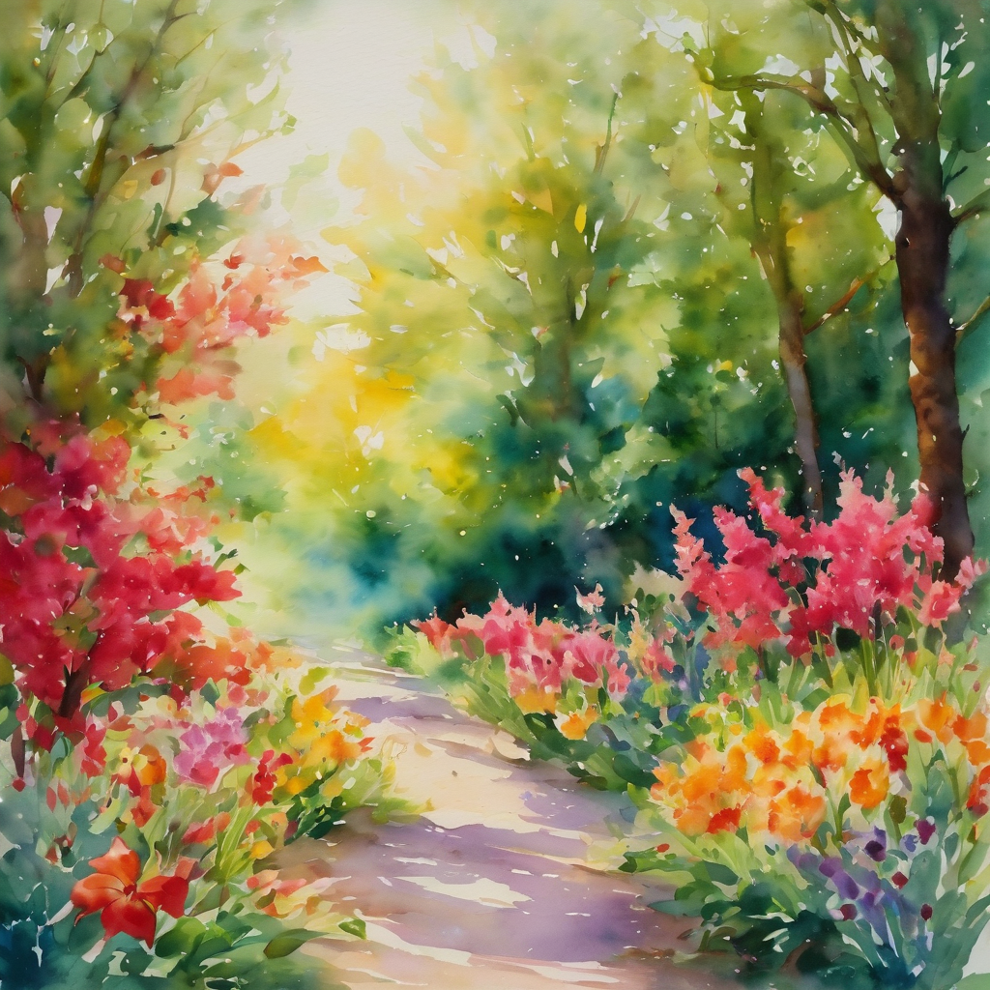
Leader: I invite everyone to unmute for the Dismissal
Leader: Go in peace to love and serve the Lord.
All: In the name of Christ, Amen.

Slide 55

Fellowship time
Thank you, Chris for leading fellowship
Please feel welcome to linger or pop a message in the chat and head off when you are ready.​
Extra resources developed
by Roots on the Web and Season for Creation 2025 resources
Artwork by Padlet

