Slide 1
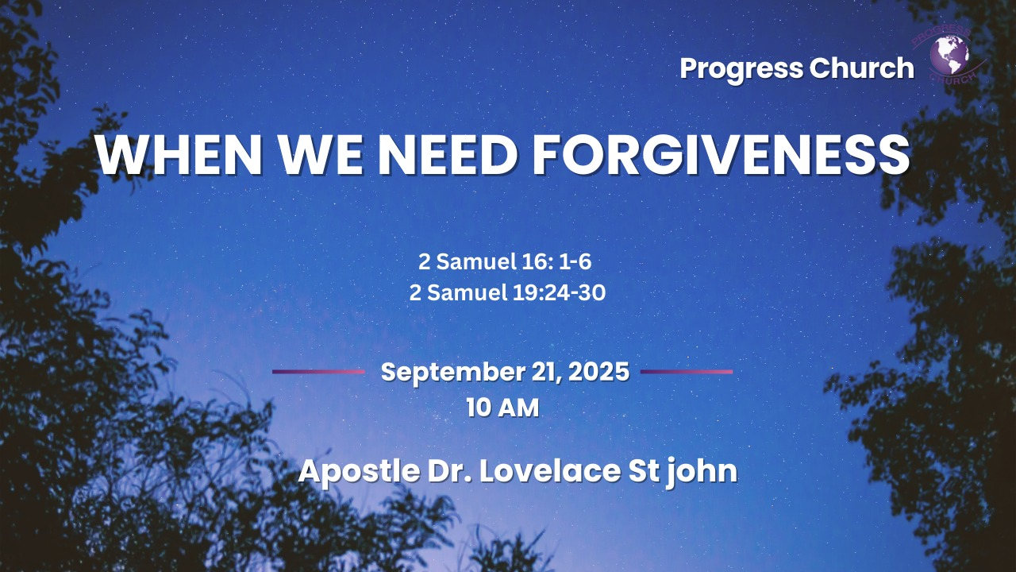

Slide 2



SCRIPTURE
2 Samuel 16: 1 -6;
2 Samuel 19:24–30

Slide 3
INTRODUCTION
Forgiveness is one of the deepest needs of the human soul.
Every one of us, at some point in life, will either need to receive forgiveness or extend it to others.
Past hurt is one of the heaviest weights a person can carry.
If we don’t let go of past hurt, it can keep us living in bitterness, self-pity, or anger.
In the story of Mephibosheth, we see a powerful lesson about forgiveness.

Slide 4
The Life and Deeds of Ziba in the Book of 1 and 2 Samuel.
Ziba’s Early Role as a Servant of Saul
Stewardship of Saul’s Estate.
He is entrusted with significant responsibility and expected to serve Mephibosheth faithfully.

Slide 5
2. A Season of Misunderstanding.
(2 Samuel 16:3).
Sometimes in life, misunderstandings, lies, or misrepresentation make us look guilty even when our intentions are pure.
Mephibosheth’s Choice, (Releasing The Offense)
Instead of clinging to bitterness or fighting for revenge, Mephibosheth said: “Let him take it all, since my lord the king has returned safely.”

Slide 6

3. A Cry for Forgiveness.
(2 Samuel 19:24).
He had not trimmed his beard, washed his feet, or taken care of himself the whole time David was away, signs of mourning and loyalty.
David, caught between Ziba’s earlier story and Mephibosheth’s defense, divided the land between them.
Instead of fighting back or demanding his rights, Mephibosheth said: “Let him take it all, since my lord the king has come back in peace to his house”

Slide 7
4. Christ, Our Greater Forgiveness
Just as Mephibosheth depended on David’s mercy, we depend on Christ’s mercy for our forgiveness.
At the cross, Jesus took our guilt, bore our shame, and extended to us the forgiveness we could never earn.
The cross is God’s ultimate declaration: Your past hurt does not define you, My grace does.
Through Christ, we not only receive forgiveness but also gain the power to forgive others and let go of pain.

Slide 8
CONCLUSION:
When you are misunderstood, trust God to reveal the truth in time. Don’t fight with bitterness.
When you need forgiveness, come humbly. Don’t rely on excuses; rely on mercy.
When you are wronged, choose to forgive. Value relationships more than revenge.
When you feel unworthy, remember the King’s grace. God’s forgiveness covers your past and secures your future.

