Slide 1
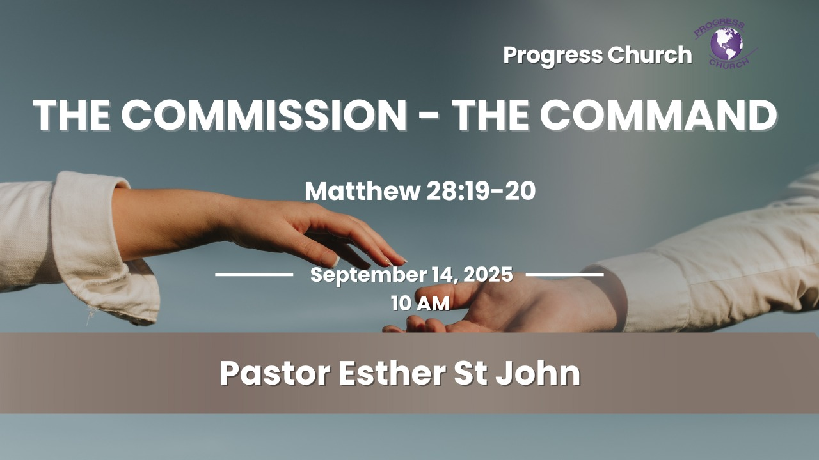

Slide 2



SCRIPTURE
MATTHEW.28: 19-20

Slide 3
INTRODUCTION
Matthew chapter 28 is the final chapter of the Gospel of Matthew, detailing the discovery of Jesus's empty tomb by the women.
(Mary Magdalene and Mary the mother of James and Joseph or Joses), were among the first women to visit the tomb on the morning of the resurrection.

Slide 4
INTRODUCTION Con’t
An angel's announcement of His resurrection, and the Great Commission where Jesus commands his disciples to make disciples of all nations, baptizing them and teaching them all he commanded, and promising to be with them always.
The chapter also describes the actions of the Roman guards at the tomb, who are bribed to spread a false story about the disciples stealing the body.

Slide 5
The Great Commission-Matt. 28:19-20
"Therefore go and make disciples of all nations, baptizing them in the name of the Father and of the Son and of the Holy Spirit, and teaching them to obey everything I have commanded you. And surely I am with you always, to the very end of the age.” Jesus gave this command to the apostles shortly before He ascended into heaven.”
What stands out in these two verses of Matthew 28 is:
The Commission, the Command and the Promise

Slide 6
The problem lies in the understanding of the commission and command Jesus gave to his disciples, and the willing obedience to that command when we become Converts of Christ.
The primary purpose of a Christian life is to glorify God and enjoy Him forever by becoming more like Christ. This involves developing a heart of genuine worship, living according to God's word, spreading the gospel to others, and serving them with love and compassion.

Slide 7
By practices like prayer, reading, studying, memorizing scriptures, and being apart of your faith community, Christians are transformed by the Spirit to live a life of purpose, ultimately fulfilling their potential as fully human beings in God's image.
This can only become possible by presenting yourself to be discipled.

Slide 8

The Early Disciples
The early disciples was first called Christians in the city of Antioch. When people saw the disciples actions and lifestyle (Acts 11:25).
But before the title of being Christian was widely accepted, the early followers of Christ was simply called “disciples.”
Firstly, we see in Matthew 28, Jesus gave the commission to his disciples "to go make disciples"
.

Slide 9
Who Are Disciples
In the Bible, a disciple is a dedicated follower and learner of a teacher or master.
A disciple is one who disciplines himself in the teachings and practices of another.
The Greek word for "disciple" is(mathētḗs), which means "learner" or "pupil" and is related to the verb "to learn". It refers to someone who learns through instruction from another, such as an apprentice or a student under a teacher.

Slide 10
Who Are Disciples
The Greek word for disciple, mathētēs, implies a deeper, more intimate relationship where the follower imitates their master, leading to spiritual growth and transformation.
A disciple is a student and a disciple has to learn to discipline oneself in the things of God.
Acts 2:42 says
"They devoted themselves to the apostles' teaching and to fellowship, to the breaking of bread and to prayer".
Being a disciple of Jesus identify you as one who has made that decision to enter life in Christ Jesus and to be like Him.

Slide 11
Jesus' Radical Discipleship:
Matthew 16:24, "Then Jesus said to his disciples, "Whoever wants to be my disciple must deny themselves and take up their cross and follow me.”
Jesus's call to "deny oneself and take up your cross and follow him" is a demand for radical discipleship, meaning a total commitment to His will above all else. Denying oneself means setting aside personal ambitions and desires in favor of God's will.

Slide 12
Jesus' Radical Discipleship:
"taking up your cross" symbolizes a willingness to accept hardship and even death for Christ, much like a condemned criminal accepting the instrument of their own execution.
Following Him means disowning your own agenda and committing to His leadership, ultimately leading to a life of submission, humility, and obedience to God.

Slide 13
Secondly, Jesus gave a Commission and a Command
A Commission is a formal appointment, often documented, that grants official authority or status to a person or entity.
A Command is a directive or instruction given by someone in authority to another.
This Commission of Jesus is a formal appointment to the Church, Christ body, to go and make disciples of people of every nations.

Slide 14
Thirdly, The disciples' Identity
Baptizing them in the name of the Father and the Son and the Holy Spirit?
This new identity in baptism is in the Godhead!
A disciple has his identity in the God head. You're not your own, you've been bought with a price and carry this identification to the world. The blood of Jesus purchased you.

Slide 15
Thirdly, The disciples' Identity
Galatians 2:22(ESV)
I have been crucified with Christ. It is no longer I who live, but Christ who lives in me. And the life I now live in the flesh I live by faith in the Son of God, who loved me and gave himself for me.
Romans 6:22(Esv)
But now that you have been set free from sin and have become slaves of God, the fruit you get leads to sanctification and its end, eternal life.
A disciple has his identity in Godhead and carries that identity to world that he's under divine authority and speak on behalf of the kingdom of heaven.

Slide 16
Lastly, Jesus told the disciples, "I'm going to be with you as you always."
Meaning:
We will never be left in the work of his ministry on our own.
We will never be abandoned, even when we may feel like we're all alone. We can't allow our feelings to discredit the Word of God because his Word will stand through the test of time.

Slide 17
Lastly, Jesus told the disciples, "I'm going to be with you as you always."
Meaning:
The Holy Spirit will be working with us and through us, when we receive the Spirit presence and the Spirit’s baptism to empower us for his service.
Jesus gave us his abiding presence by sending the Holy Spirit.
St. John 14:16 "Then I will ask My Father and He will give you another Helper. He will be with you forever."

Slide 18
Five keys to be a Disciple
Learning and Obedience:
A disciple doesn't just hear the teachings of their master but actively learns them and then puts them into practice in their daily life.
Imitation:
The goal of a disciple is to become like their master, imitating Christ's example in their own conduct and way of life.
Commitment and Transformation:
Discipleship is described as a lifelong journey of spiritual growth, where the followers is continually changed by Jesus and becomes more like him.

Slide 19
Five keys to be a Disciple cont’d
Relationship:
Being a disciple involves an intimate, instructive, and imitative relationship with the master.
Mission:
Disciples are also expected to share their faith and invite others to become followers, continuing the process of making new disciples.

Slide 20
CLOSING
Some questions that all believers need to answer for themselves to be Christ disciple.
Are you willing to follow Jesus if it means losing your closest friends?
Are you willing to follow Jesus if it means alienation from your family?
Are you willing to follow Jesus if it means losing your reputation?

Slide 21
CLOSING cont’d
Are you willing to follow Jesus if it means losing your job?
Are you willing to follow Jesus if it means losing your life?

