Slide 1

Leader: Welcome to Holy Hermits Online Worship
14th Sunday after Pentecost
The 2nd week in the Season of Creation
Service Prep: Troy | Chat Host: Kerrie-Anne | First Reader: Viki
Music: Troy | Priest: Jamee | Second Reader: Paul
Proof-reader: Jamee | Deacon: Lauren | Preacher: Troy
Broadcaster: Barry | Welcomer: Chris | Fellowship: Leonie
Backup Broadcaster: Lauren | Leader: Troy | Safety Officer: Leonie
Zoom Buttons: Kerrie-Anne | Cantor: Julie

Slide 2


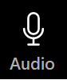



Hospitality
Leader: Please mute for the service unless invited to offer your voice as part of the service ministry
Have the video camera on or off and turn the volume and brightness up or down on your device if things are too loud 🔉🔊or too bright🔅🔆
Our Cantor acts as our voice, offering the responses, in Bold Text, which we say together
Feel welcome to use the chat and reaction emojis 👍
🙏 Please take care of yourself in this space. 🙏 Come and go as you need
😴 It is great to take rest in this space, so falling asleep is also OK 😴
👂️ Remember, pastoral care is available to all in the community, if you'd like to speak to someone about anything spiritual. ❤️ Visit the help page at the website to reach out 🌐
Our Being Together ethos and safeguarding practices can also be accessed on the website 🫶​
🙌 Come as you are – we are all here together! 🙌
Notes:
Used Lent 2022

Slide 3
Invitation
Leader: As we settle into worship let your breath be soft, your mind be still, and your heart be open to the presence of God.
Stilling video
https://vimeo.com/858071576?share=copy

Slide 4
Leader and Cantor unmute
The Greeting
Leader:
The Grace of the lord Jesus Christ,
and the love of God,
and the fellowship of the Holy Spirit,
be with you all.
All: And also with you.

Slide 5
Gathering Prayer
Leader:
Lord, in a broken and hurting world,
we come to worship you as people in need of repair.
Be with us as we worship you,
open our hearts and minds to your grace,
love and forgiveness.
Amen.

Slide 6
Sentence
Leader: I invite our Cantor to proclaim the sentence for today.
Cantor: I tell you, there is joy in the presence of the angels of God over one sinner who repents.
Luke 15.10

Slide 7
Prayer of Approach
Leader: We pray the prayer of approach together.
All: Ever-loving Father, we come before you
as children created and called by you.
Humbly we bow before you, as those deemed worthy of being sought and found by you when we have become lost. May our worship be worthy of your all-redeeming love.
Amen.

Slide 8
The Deacon or LA Introduces Confession
​All Creation is full of God’s praise, and we are called to join in with joy, righteousness and peacefulness.
Yet as we look around us, we see conflict and destruction.
We acknowledge: We ourselves cause conflict and destruction, and often fail to walk the path of peace.
Everywhere on the planet, humans cause great harm, even as we know that the scope of destruction varies, and that everywhere human beings are among the victims of our deep conflict with Creation.
All too often, we fail to live as we are called to live.
We fail to be ambassadors of peace, righteousness and reconciliation.

Slide 9
​Silence may be kept.
Let us confess our sins.
Let us come before the Triune God for forgiveness and renewal.

Slide 10
All: ​Merciful God, our maker and our judge, ​we have sinned against you ​in thought, word, and deed, ​and in what we have failed to do: ​we have not loved you with our whole heart; ​we have not loved our neighbours as ourselves; ​ we repent, and are sorry for all our sins.​ Father, forgive us. Strengthen us to love and obey you in newness of life; ​through Jesus Christ our Lord. ​
Amen.​

Slide 11
​
The Deacon or LA offers the Proclamation of Forgiveness in the Season of Creation​
​
May our God have mercy on us, forgive us our trespasses and give us new life.
Indeed, God has promised grace and forgiveness to us: “My people will abide in a peaceful habitation, in secure dwellings, and in quiet resting places.” (Isaiah 32:18)
Let us rejoice and trust in our calling, live as we are called to live, reconciled with the Father, ambassadors for Christ, filled with the Holy Spirit.
Amen. ​

Slide 12
>If there is no priest present this slide is skipped<
​
The Priest offers Absolution
​
Almighty God who has promised forgiveness
to all who turn to God in faith;
pardon you and set you free from all your sins,
strengthen you in all goodness
and keep you in eternal life,
through Jesus Christ our Lord.
Amen.
​

Slide 13
Leader: Our First Hymn is
The Lord is My Shepherd
Let's sing or enjoy the music together
https://youtu.be/Kor3IjrTd58?si=UNBp_vzqyjYkcRBl
We stay on mute
Leader and Cantor mute

Slide 14
Collect in the Season of Creation
Leader:
God Most High,
maker of heaven and earth,
you created humankind in your own image
and entrusted the whole world to human care:
give us grace to serve you faithfully,
that we might be trustworthy stewards of your creation,
through Jesus Christ our Lord,
who lives and reigns with you and the Holy Spirit,
one God, now and for ever.
Amen.

Slide 15
The 1st reader unmutes
Leader: I invite the 1st Reader to unmute and offer the 1st reading when ready.
Reader 1: The first reading is from Jeremiah 4. 11-12, 22-28
¹¹ At that time it will be said to this people and to Jerusalem: A hot wind comes from me out of the bare heights in the desert towards my poor people, not to winnow or cleanse—
¹² a wind too strong for that. Now it is I who speak in judgement against them.
²² ‘For my people are foolish, they do not know me;
they are stupid children, they have no understanding.
They are skilled in doing evil, but do not know how to do good.’
Continue…

Slide 16
²³ I looked on the earth, and lo, it was waste and void;
and to the heavens, and they had no light.
²⁴ I looked on the mountains, and lo, they were quaking,
and all the hills moved to and fro.
²⁵ I looked, and lo, there was no one at all,
and all the birds of the air had fled.
²⁶ I looked, and lo, the fruitful land was a desert,
and all its cities were laid in ruins
before the Lord , before his fierce anger.
Continue…

Slide 17
²⁷ For thus says the Lord : The whole land shall be a desolation; yet I will not make a full end.
²⁸ Because of this the earth shall mourn,
and the heavens above grow black;
for I have spoken, I have purposed;
I have not relented, nor will I turn back.
For the word of the Lord. Thanks be to God.​

Slide 18
Leader: We now say the psalm antiphonally, I invite the first reader to lead and we will all respond with the Responses in Bold along with our cantor as our voice.
Psalm
14
¹ Fools have said in their hearts ‘There is no God’:
they have all become vile and abominable in their doings,
there is not one that does good.
² The Lord looked down from heaven upon the children of Adam: to see if there were any who would act wisely
and seek after God.
³ But they have all turned out of the way, they have all alike become corrupt: there is none that does good, no not one.

Slide 19
⁴ Are all the evildoers devoid of understanding:
who eat up my people as they eat bread,
and do not pray to the Lord?
⁵ They shall be struck with terror:
for God is with the company of the righteous.
⁶ Though they frustrate the poor in their hopes:
surely the Lord is their refuge.
⁷ O that deliverance for Israel might come forth
from Zion: when the Lord turns again the fortunes of his people,
then shall Jacob rejoice, and Israel be glad.
Continue…

Slide 20
The 2nd reader unmutes
Leader: Thank you, 1st reader. I invite the 2nd Reader to unmute and offer the 2nd reading when ready.
Reader 2: The 2nd Reading is from 1 Timothy 1: 1–2, 12–19a
¹ Paul, an apostle of Christ Jesus by the command of God our Saviour and of Christ Jesus our hope, ² To Timothy, my loyal child in the faith: Grace, mercy, and peace from God the Father and Christ Jesus our Lord. ¹² I am grateful to Christ Jesus our Lord, who has strengthened me, because he judged me faithful and appointed me to his service, ¹³ even though I was formerly a blasphemer, a persecutor, and a man of violence. But I received mercy because I had acted ignorantly in unbelief, ¹⁴ and the grace of our Lord overflowed for me with the faith and love that are in Christ Jesus.
Continue…

Slide 21
¹⁵ The saying is sure and worthy of full acceptance, that Christ Jesus came into the world to save sinners—of whom I am the foremost. ¹⁶ But for that very reason I received mercy, so that in me, as the foremost, Jesus Christ might display the utmost patience, making me an example to those who would come to believe in him for eternal life. ¹⁷ To the King of the ages, immortal, invisible, the only God, be honour and glory for ever and ever. Amen. ¹⁸ I am giving you these instructions, Timothy, my child, in accordance with the prophecies made earlier about you, so that by following them you may fight the good fight, ¹⁹ having faith and a good conscience. By rejecting conscience, certain persons have suffered shipwreck in the faith;
For the word of the Lord. Thanks be to God.

Slide 22
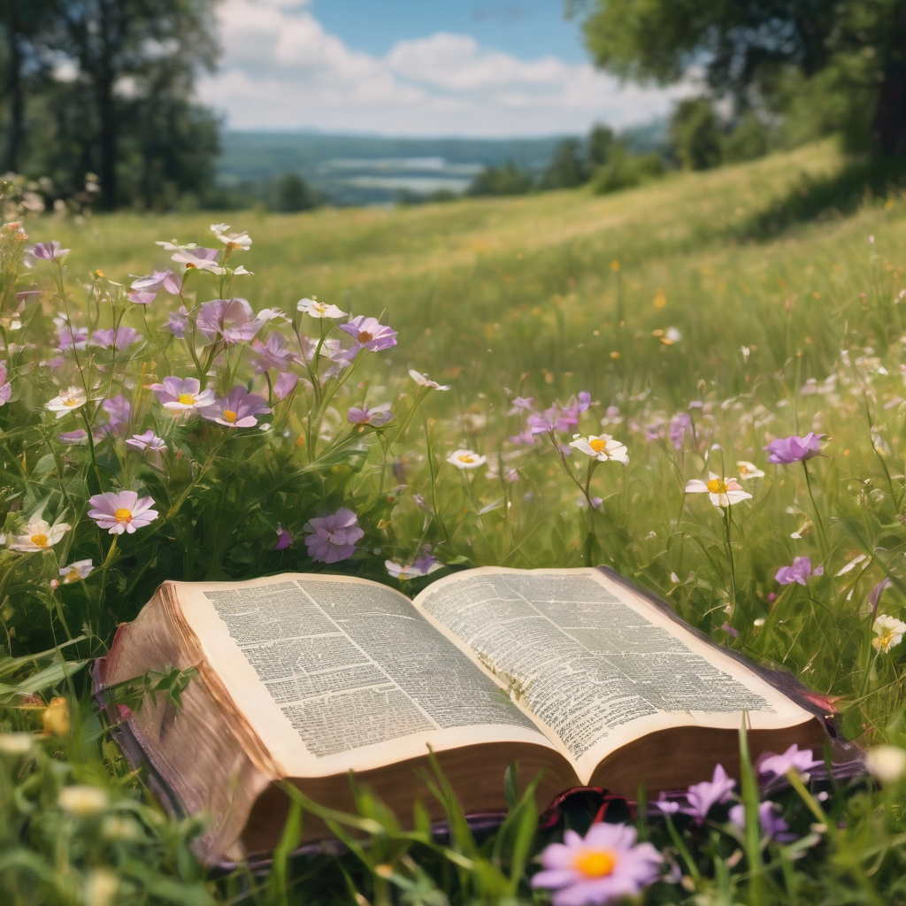
We pause before
​the Gospel ​​

Slide 23
The Gospel of our Lord Jesus Christ according to St Luke Chapter 15 beginning at the 1st verse
All: Glory to you Lord Jesus Christ.
¹ Now all the tax-collectors and sinners were coming near to listen to him. ² And the Pharisees and the scribes were grumbling and saying, ‘This fellow welcomes sinners and eats with them.’ ³ So he told them this parable: ⁴ ‘Which one of you, having a hundred sheep and losing one of them, does not leave the ninety-nine in the wilderness and go after the one that is lost until he finds it? ⁵ When he has found it, he lays it on his shoulders and rejoices. ⁶ And when he comes home, he calls together his friends and neighbours, saying to them, “Rejoice with me, for I have found my sheep that was lost.”
Continue…

Slide 24
⁷ Just so, I tell you, there will be more joy in heaven over one sinner who repents than over ninety-nine righteous people who need no repentance. ⁸ ‘Or what woman having ten silver coins, if she loses one of them, does not light a lamp, sweep the house, and search carefully until she finds it? ⁹ When she has found it, she calls together her friends and neighbours, saying, “Rejoice with me, for I have found the coin that I had lost.” ¹⁰ Just so, I tell you, there is joy in the presence of the angels of God over one sinner who repents.’
This is the Gospel of the Lord. All: Praise to you Lord Jesus Christ.

Slide 25
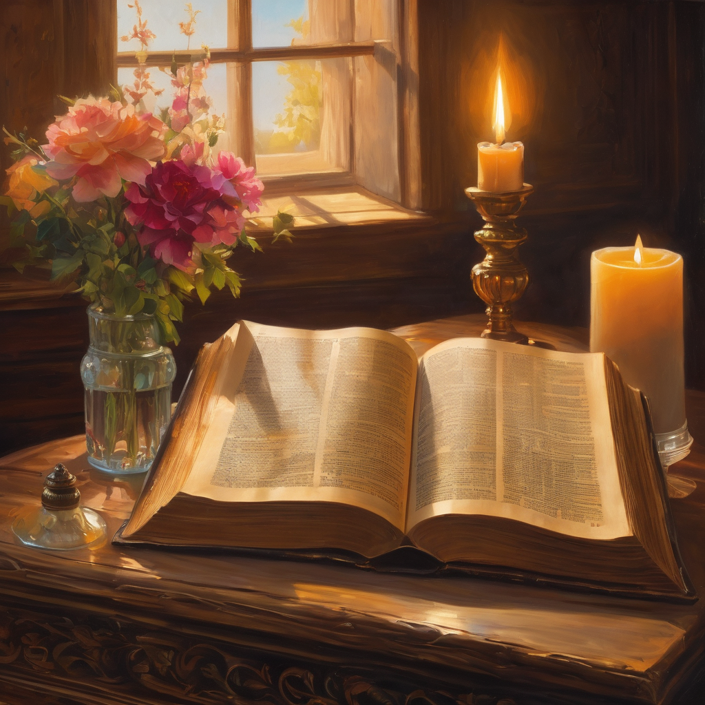
We pause
after ​the Gospel ​​

Slide 26
Leader: The Sermon is recorded to YouTube for sharing later.
Only the preacher's video and audio will be recorded.
The chat and other participants' feeds remain out of sight of the recording.
Leader and Cantor mute
Broadcaster exits screenshare
Preacher unmutes
Zoom buttons ”pins” preacher’s screen + selects “record to the cloud”
Sermon

Slide 27
Leader: Our next Hymn is
He’s Got the Whole World In His Hands
Let's sing or enjoy the music together
https://youtu.be/bjMlDwZ5swc?si=DjYrFbTewDVQbsPA
We stay on mute
Leader mutes

Slide 28
The Leader and Cantor unmute
The Greeting of Peace
Leader: We are the body of Christ
All: God’s Spirit is with us
Leader: The peace of the Lord be always with you.
All: And also with you.
Leader: A sign of peace may be exchanged
You may like to type 'Peace' into the chat, use the 'raise hand’ or other reaction buttons, or just simply wave via the screen with your video turned on
(Broadcaster exits shared screen for a few moments for the exchange of peace)

Slide 29
Prayer of Thanksgiving in the Season of Creation
Leader: As we enter prayer, I invite the second reader to unmute to lead our intercessions which follow the prayer of thanksgiving. Please feel free to change your body position as you need.
God of life, God of love, God of Creation. Thank You for all the wonderful,
great and immense creatures that You created.
We thank You that we have the opportunity to inhabit and enjoy the wonders of this world.
Thank you for giving us forests that provide our air and give us the shade we need on hot days.
Thank you for giving us the sun that shines brightly with its energy, as well as the rains to refresh and nourish the earth bringing a special scent.
Continue…

Slide 30
Thank you for giving us the fertile soil to provide us with food and sustenance for many animals.
Allow us to recognize that the community of the earth is a democracy of life as a whole that is based on the living economies that are the local economies of those who work the land.
Give us the strength to defend diversity in nature and in the culture of each place by putting the common good first, knowing that all beings have a natural right to their sustenance.
Help us to value each species, people and culture, knowing that each has intrinsic value.
Continue…

Slide 31
Help us to walk in this world with faith and hope. Sustain us to protect
and care for your creation, respectful of the resources it provides for us and
aware of the finiteness of Creation.
Give us the courage to fight for life and be resilient in the face of those
who destroy Creation and those who profit from it for their own business.
Thank you for each of our lives which we give to you, through Jesus Christ our Lord, who lives and reigns with you and the Holy Spirit. Amen

Slide 32
Intercessions
Reader 2: We pray for creation and communities we share our lives with. We pause for a few moments to name either in our hearts, or out loud, or in the chat, those environments and communities we bring to the Lord in prayer.
PAUSE…
We entrust to you the community of Holy Hermits Online and our ministry partners:
Prosper the work of our hands and show us the way to your new creation.
Creator God, Hear our prayer.
St John's Cathedral Brisbane The Anglican Diocese of Southern Queensland St Gabriel’s, Carindale Benedictus Contemplative Church, Canberra The Episcopal Diocese of Texas Anglican Focus and Tithe.ly

Slide 33
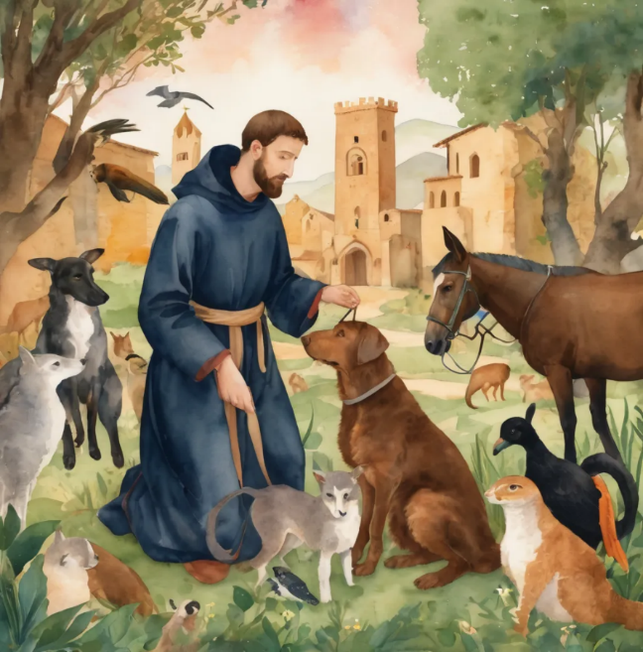
Reader 2: Loving Creator, we entrust to you all animals, especially those who are sick, anxious, ageing, lost, at risk, lonely, sad, hungry, in pain, homeless, abused, living in fear, encountering violence of any kind, in need of comfort, rehabilitation or transformation.
We invite your loving compassion for:
Jasmine,
Leese(y),
Sid and Toots, Polly and Suki
Fred, George and Percy
Koshka,
Lambert
Kala, Nigel and Little One
Toby
Taco
Paddy and Jax
We name in our hearts, out loud or in the chat, the animals we bring to the Lord in prayer. PAUSE…
We remember Meggsie today and her companionship for Leonie, Sid, Toots, and Polly. We pray she may rest in peace with you. Amen.

Slide 34
Reader 2: Eternal Trinity of Love, we uphold to you the people we love and carry cares for:
We name in our hearts, out loud or in the chat, those we bring to the Lord in prayer.
PAUSE… We entrust to you those who have died, those who have died peacefully and those who have died tragically, the old and the young. Receive them into your kingdom.
Amen.
Kerry and Les, Jake,​​ Dr Julie, ​​ Julie and Ray, Tracey, Shane,​​ Jess and Leah ​​ May ​​ Kirsten, Greg, Daphne & Beau​​ Tanya​ Matthew & Nicholas​ & Sharyn Alan & Gaylene​ Susan Bonnie and girls | Barry​​ Dilys and Tony,​​ Paul and Darhon Judy and Mary​​ Mark, Desley and Bob ​​ Ruth​​ Leonie Phil​ Rachel, Mervyn & Gillian Liz’s Godchildren Pat and Julie | Bill and Marjorie​​ Rev'd Shane & Janette​​ Alecia, Martin and Aidan,​​ Aaron and Andrea ​​ Neva​ Bob and Di​ Steven and Vanessa, Craig Miriam Barry and Gwen

Slide 35
Pray Daily Cycle of Prayer
Leader: Loving God, joining with the Church in our cycle of prayer, we ask your blessings on:
The Anglican Church of South America
Ministry with the Torres Strait Island People of Australia – Rose
The Parish of Kilcoy: Jilleen
FSG (Family Support Group)
St Margaret’s Anglican Girls School, Ascot: Principal - Roslyn; Chaplain - Jasmine; Chair of School Council – Lisa; School Council members; staff & students

Slide 36
The Commitment prayer for the week is:
​Deliverance
Come Holy Spirit and make the hearts of your servants, Reverend Claye and the deliverance ministry team, your dwelling place and home. ​May darkness be dispelled by your light, and troubles calmed by
your peace. ​​​
Lord Jesus, we ask that you protect, guide and strengthen them, and all
whom they encounter. ​​Give them courage, ability, wisdom and
discernment. ​​​
Continue…

Slide 37
The Commitment prayer (cont.):
​
Surround them with sound advice and support, that they may have insight
and discretion. ​​Drawing on the Holy Spirit may they be strong in vocation
and trust in you. ​​​
​We pray for those in need of healing and their ongoing relationship with
you, as they journey towards the fullness and freedom of eternal life.
​May all evil and pain be transformed through the suffering of Christ and
all dying glorified by your risen life. ​
Amen.​

Slide 38
Leader: We are using a different form of the Lord's prayer in the Season of Creation, from the New Zealand common prayer book, let us pray
All: Eternal Spirit, Earth-maker, Pain-bearer, Life-giver,
​Source of all that is and that shall be,
Father and Mother of us all,​ Loving God, in whom is heaven: ​
The hallowing of your name echoes through the universe! ​
The way of your justice be followed by the peoples of the world! ​
Your heavenly will be done by all created beings! ​
Your beloved community of peace and freedom sustain our hope and come on earth.​
Continue…

Slide 39
All: With the bread we need for today, feed us.
In the hurts we absorb from one another, forgive us.
In times of temptation and test, strengthen us.
From trials too great to endure, spare us.
From the grip of all that is evil, free us.
For you reign in the glory of the power that is love, now and forever. Amen.

Slide 40
Devotions

Slide 41
Leader: The Prayer for Creation 2025
PEACE WITH CREATION
Creator of all, we praise you for the gift of life and for the faith that unites us in care for our common home. We confess how estranged we have become—from one another, from your Creation, and from our truest selves. We acknowledge that our greed and destructive impulses have fractured our relationships with you, with others, and with the Earth. Fertile fields have become barren, forests lie desolate, oceans and rivers are polluted. Thriving communities have become places of suffering, and the earth cries out.
Continue…

Slide 42
Beloved Christ,
who spoke “Shalom” to frightened hearts,
stir us to compassionate action.
Inspire us to work for the end of conflict,
and for the full restoration of broken relationships—
with you, with the ecumenical community,
with the human family,
and with all Creation.
Continue…

Slide 43
Prince of Peace,
through your wounds, teach us to stand in solidarity
with the woundedness of others,
of creation, and of the world.
Through your resurrection, make us people of hope—
with a vision of swords turned into ploughshares
and tears transformed into joy.
May we come together as one family, to labor for your peace—
a shalom where all your people may dwell in safety, and rest in quiet places.
Amen.

Slide 44
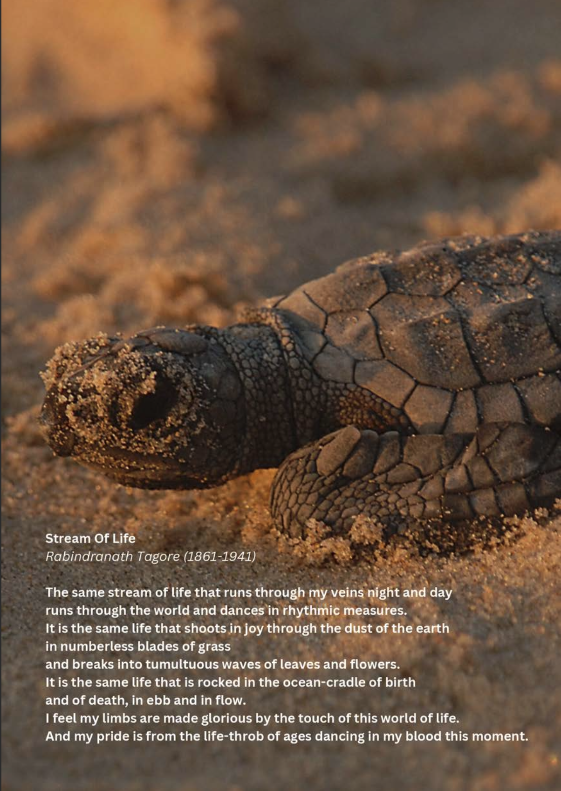
Leader: ​As we enter a few minutes of silence together, you are invited to pray this prayer of adoration and/or spend this time in contemplation. ​
The Spiritual Communion prayer follows
on the next slide. Let us be still.
Leader and Cantor Mute.
Stream of Life
The same stream of life that runs through my veins night
and day runs through the world and dances in rhythmic
measures. It is the same life that shoots in joy
through the dust of the earth in numberless
blades of grass and breaks into tumultuous waves
of leaves and flowers. It is the same life that is
rocked in the ocean-cradle of birth and of death, in
ebb and in flow. I feel my limbs are made glorious by the touch of this world of life. And my pride is from the life-
throb of aged dancing in my blood this moment.
​

Slide 45
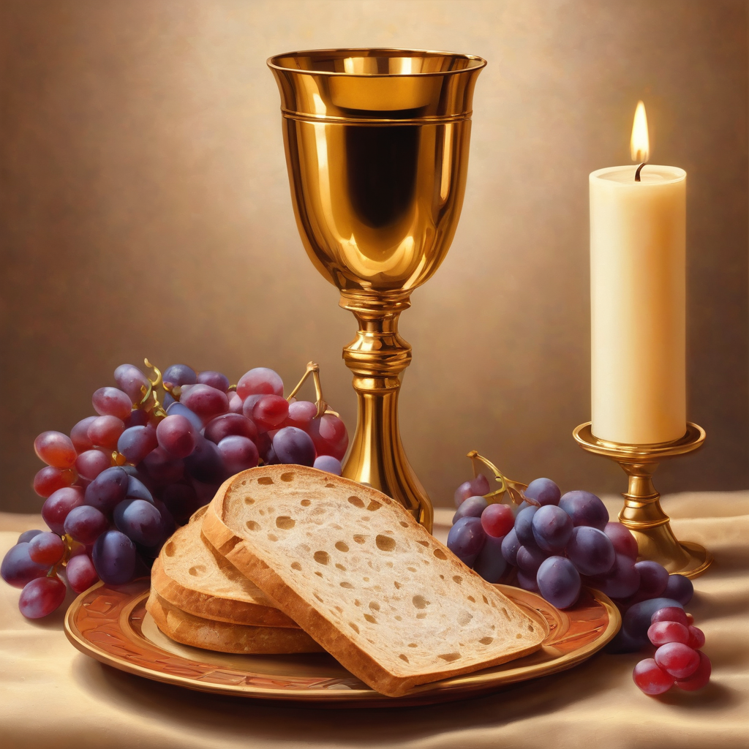

Oh, my Lord Jesus I turn to you present at the Altar and in the Tabernacle. I believe that you are present in the Holy Sacrament of your most Sacred Body and Blood.
I love you above all things and I desire to receive you into my Soul. I cannot at this moment receive you Sacramentally in Holy Communion.
Come spiritually into my heart.
Purify it, Sanctify it. Render my heart like your own heart.
I embrace you as if you were already there and unite myself wholly with you.
Never permit me to be separated from you.
Lord, I am not worthy to receive you, but only say the word and I shall be healed. Amen
Making a
Spiritual Communion
(Prayed in silence)

Slide 46
Leader: Our final song is
What a Wonderful World
Let's sing or enjoy the music together
https://youtu.be/eI2Z8LXIfNU
​We stay on mute
Leader and Cantor mute

Slide 47
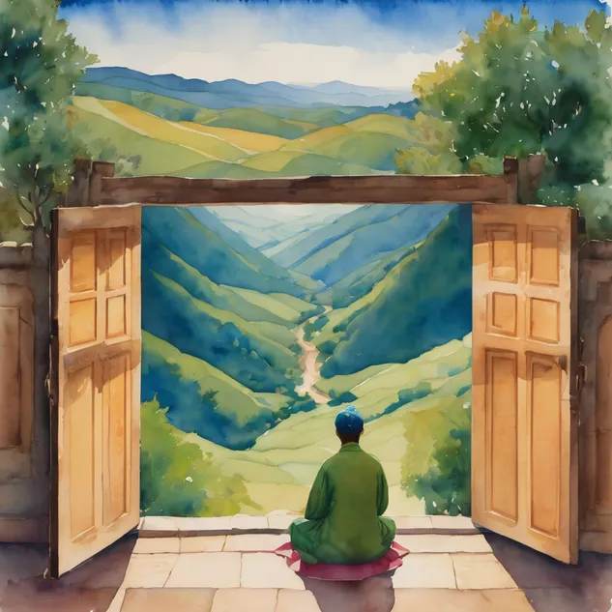
Leader and cantor unmute
Sending Prayer
Leader: We pray our sending prayer together.
All:
We go in the knowledge and confidence of God’s love for us,
trusting that Christ Jesus is with us. Amen.

Slide 48
>If there is no priest present this slide is skipped<​
The Priest offers the Blessing
Go in peace, brothers and sisters, live in peace with Creation.
And may the blessing of the Most Holy Trinity accompany you: The Father, and the Son, and the Holy Spirit,
the one God, to whom be glory, for ever.
Amen.

Slide 49
The Benediction
Leader: Let us all invite God’s blessings together,​
​
All: May the Lord bless us and keep us.​
May the Lord’s face shine upon us and
be gracious to us.​
May the Lord’s countenance be lifted upon us, ​
and bring us peace.
Amen

Slide 50
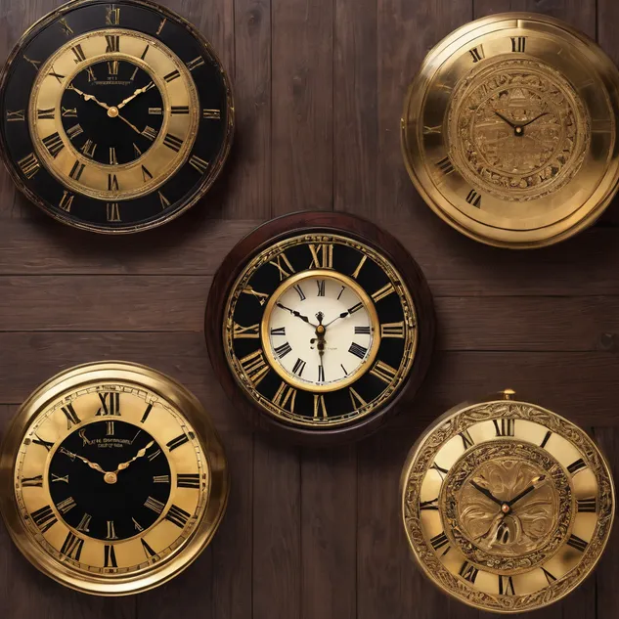
Notices
Today @ 11am Christmastide Planning Workshop, please come along and share your ideas
Wednesday study @ 6pm, A Pilgrimage of the Heart continues, and is led by Troy, please sign up to receive the study link
See HHO Events page for further upcoming events HHO Events

Slide 51
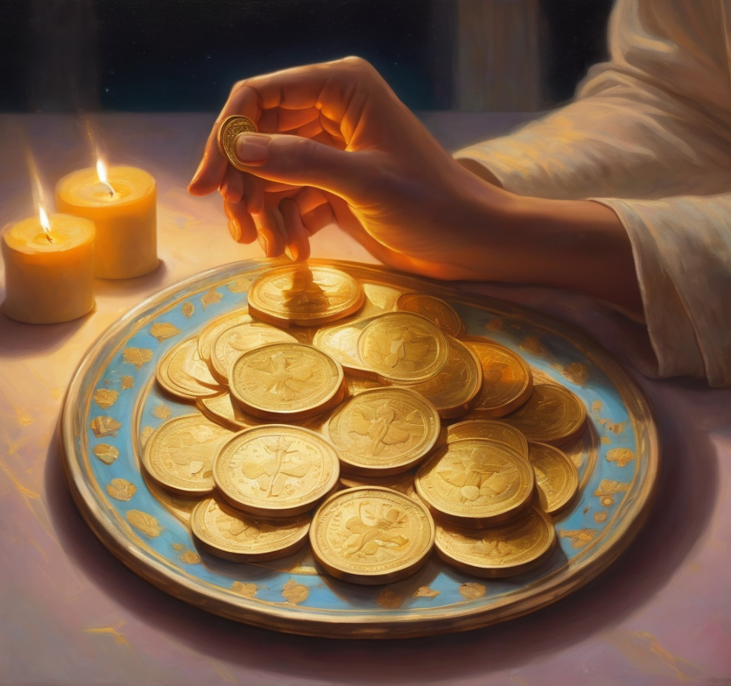
Offerings: Thank you for your regular gifts to this ministry
Offerings are most welcome via
the HHO App
Direct Debit
International Direct Debit
Please consider a one-off donation
or leaving a legacy in your Will
For further information go to HHO give page
https://holyhermits.com.au/give

Slide 52
Serving next week 21st September
15th Sunday of Pentecost
9:00 am AEST
Service Prep: Kristine | Chat Host: Viki | First Reader: Barry
Music: Wiggles | Priest: Jamee | Second Reader: Helen
Proof-reader: Viki | Deacon: Lauren | Preacher: Lauren
Broadcaster: Lauren | Welcomer: Julie | Fellowship: Julie
Backup Broadcaster: Paul | Leader: Jeremy | Safety Officer: Chris
Zoom Buttons: Viki | Cantor: Roselyn
Thank you for your ministry gifts
New servers always welcome!
Please email Kerrie-Anne to get involved holyhermits@anglicanchurchsq.org.au

Slide 53
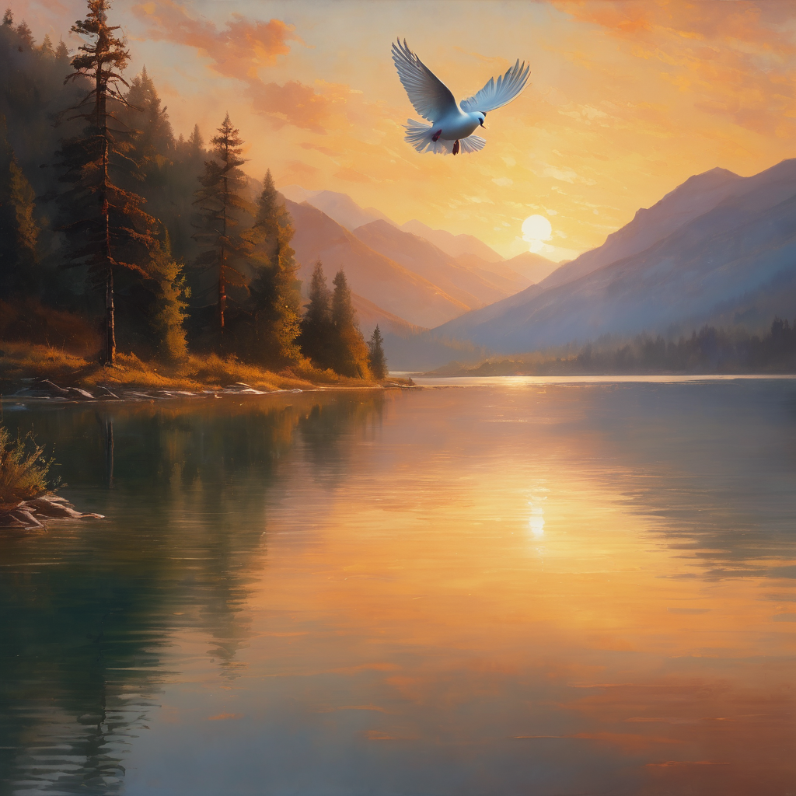
Leader: I invite everyone to unmute for the Dismissal
Leader: Go in peace to love and serve the Lord.
All: In the name of Christ, Amen.

Slide 54

Fellowship time
Thank you, Leonie for leading fellowship
Please feel welcome to linger or pop a message in the chat and head off when you are ready.​
Extra resources developed
by Roots on the Web and Season for Creation 2025 resources
Artwork by Padlet

