Slide 1
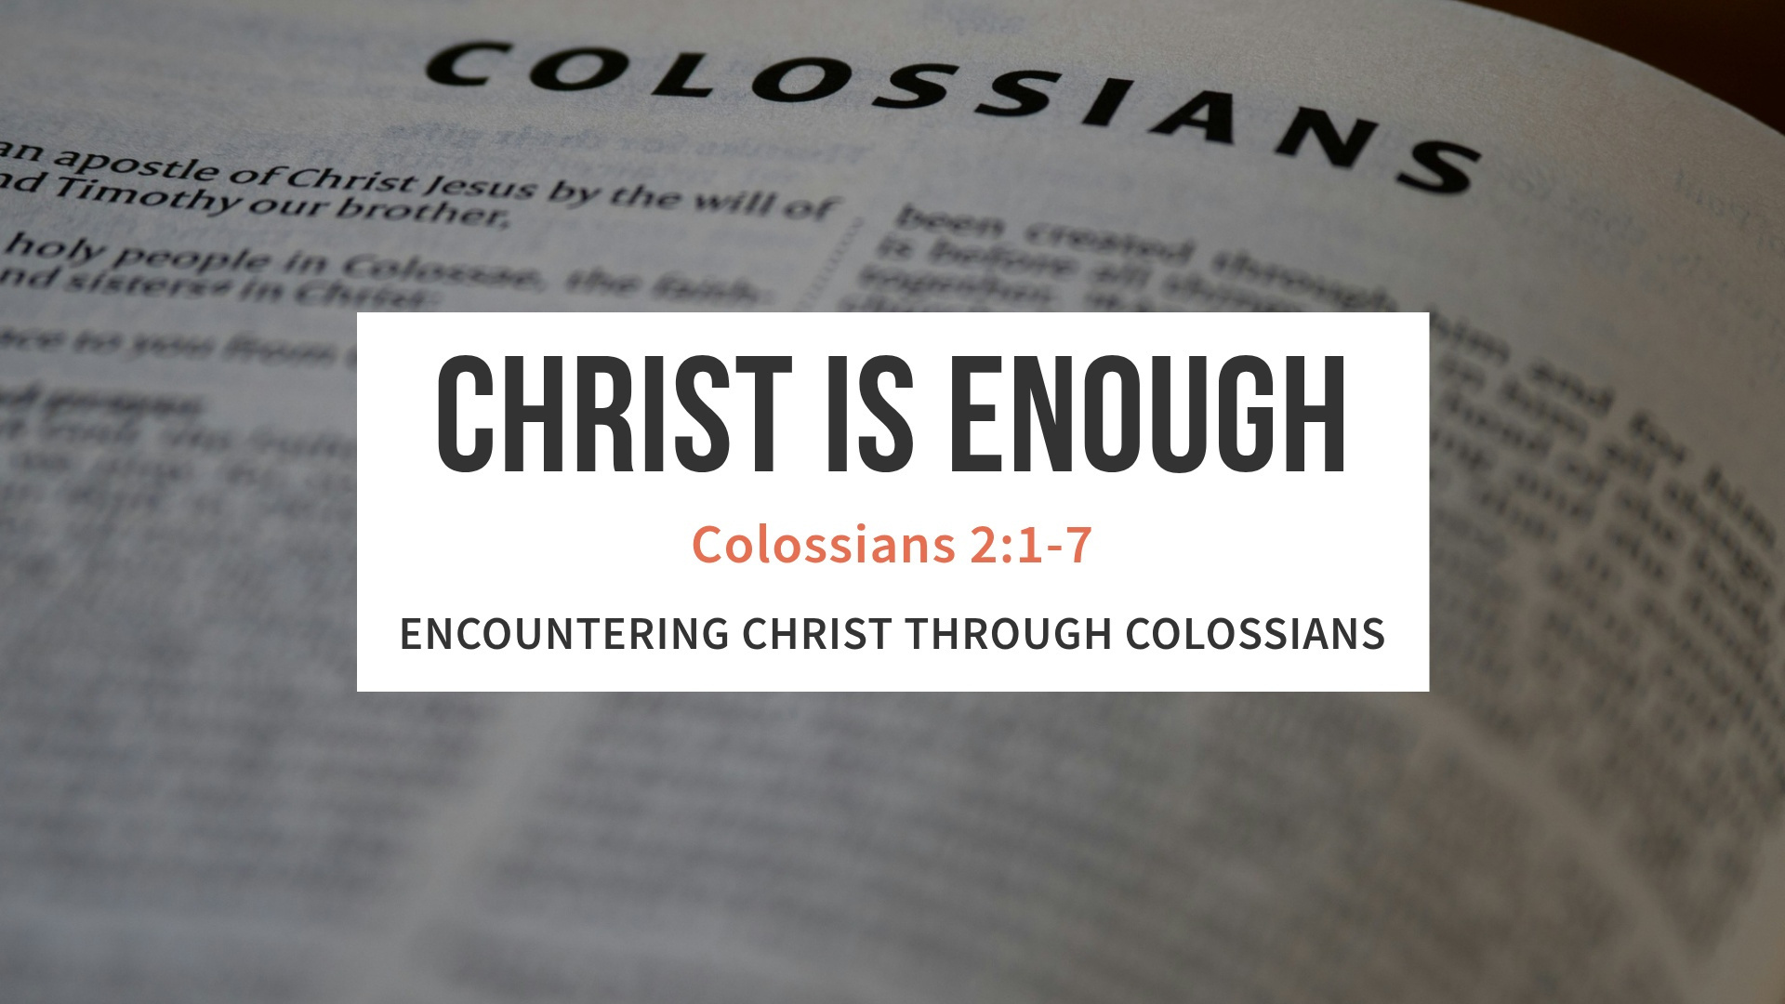

Slide 2
COLOSSIANS 2:1–7
I want you to know how hard I am contending for you and for those at Laodicea, and for all who have not met me personally. 2 My goal is that they may be encouraged in heart and united in love, so that they may have the full riches of complete understanding, in order that they may know the mystery of God, namely, Christ,

Slide 3
COLOSSIANS 2:1–7
3 in whom are hidden all the treasures of wisdom and knowledge. 4 I tell you this so that no one may deceive you by fine-sounding arguments.

Slide 4
COLOSSIANS 2:1–7
. 5 For though I am absent from you in body, I am present with you in spirit and delight to see how disciplined you are and how firm your faith in Christ is.
6 So then, just as you received Christ Jesus as Lord, continue to live your lives in him, 7 rooted and built up in him, strengthened in the faith as you were taught, and overflowing with thankfulness.

Slide 5



Is Christ enough for you?

Slide 6

The Christ Plus Deception
Point 1

Slide 7



Colossians 2:1 I want you to know how much I have agonized for you and for the church at Laodicea, and for many other believers who have never met me personally.
NLT

Slide 8
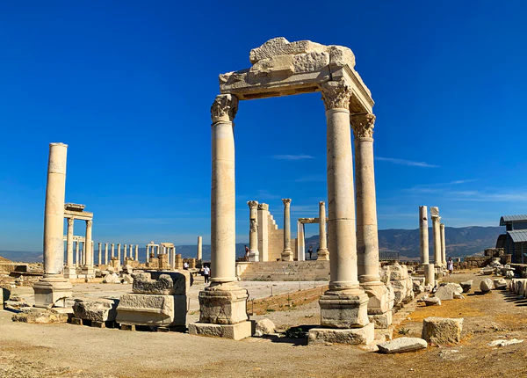
Colossae and Laodicea were trade cities, right on the crossroads of culture.

Slide 9

Christ plus Jewish legalism
Verse 16
Christ plus angel worship
Verse 18
Christ plus holiness
Verse 21

Slide 10
Gen 3:1 Now the serpent was more crafty than any of the wild animals the Lord God had made. He said to the woman, “Did God really say, ‘You must not eat from any tree in the garden’?
NIV

Slide 11
Colossians 2:4 I am telling you this so no one will deceive you with well-crafted arguments.
NLT

Slide 12
Christ plus success
Christ plus approval
Christ plus works

Slide 13
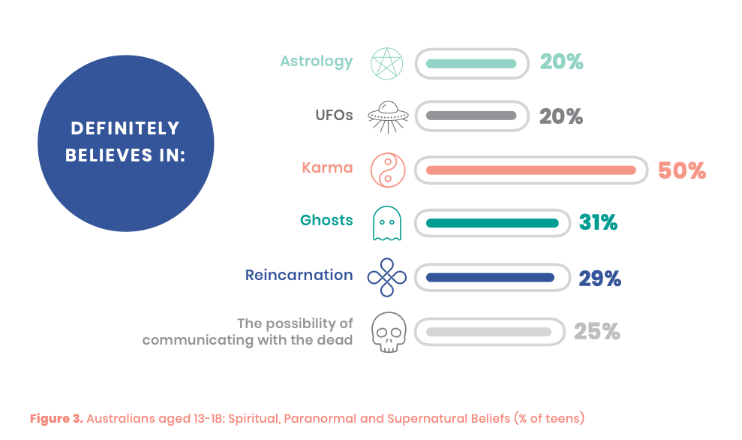


Slide 14
Christ is sufficient. Christ is complete. Christ is all we need.

Slide 15
Knit Together, Stand Strong Together
Point 2

Slide 16
Colossians 2:2 I want them to be encouraged and knit together by strong ties of love. I want them to have complete confidence that they understand God’s mysterious plan, which is Christ himself. NLT

Slide 17
Greek Word
sumbibazō, means “to be held fast, joined together.”

Slide 18
We bear one another’s burdens
1 Corinthians 12:26, ‘When one suffers, we all suffer; when one rejoices, we all rejoice.’

Slide 19
When we are together we reflect Christ.
John 13:35, By this everyone will know that you are my disciples, if you love one another.

Slide 20
“When we are knit together in love, we cannot be torn apart by lies.”

Slide 21
Living under the Lordship of Christ
Point 3

Slide 22
Colossians 2:6 And now, just as you accepted Christ Jesus as your Lord, you must continue to follow him.
NLT

Slide 23
Philippians 2:9-11 (NIV)
“Therefore God exalted him to the highest place and gave him the name that is above every name, that at the name of Jesus every knee should bow, in heaven and on earth and under the earth, and every tongue acknowledge that Jesus Christ is Lord, to the glory of God the Father.”

Slide 24
Lordship of Christ
In our families
In our finances
Our everday life

Slide 25

If Christ is not Lord of all, He is not Lord at all.

Slide 26
Thankful Because Christ Is Enough
Point 4

Slide 27
Colossians 2:7 Let your roots grow down into him, and let your lives be built on him. Then your faith will grow strong in the truth you were taught, and you will overflow with thankfulness.
NLT

Slide 28
Rooted in Christ
Be built on Him
We begin overflowing with thankfulness

Slide 29

when we follow Christ, we are not missing out on anything.

Slide 30
Romans 12:2 (NIV)
"Do not conform to the pattern of this world, but be transformed by the renewing of your mind. Then you will be able to test and approve what God’s will is—his good, pleasing and perfect will."

Slide 31
Greek word eucharistia, means gratitude and praise.

Slide 32

Romans 6:23 For the wages of sin is death, but the gift of God is eternal life in Christ Jesus our Lord.

Slide 33
2 Corinthians 5:18 says, “All this is from God, who reconciled us to Himself through Christ.” Because of Him, we are not separated from God. We are accepted, loved, and held secure.

Slide 34
He gives us everything we need for life and godliness.
2 Peter 1:3 says, “His divine power has given us everything we need for a godly life.” Spiritually, emotionally, practically—Christ is enough for every part of our lives.

Slide 35
Christ is enough. He is my Lord. He is my all in all.

