Slide 1


Slide 2
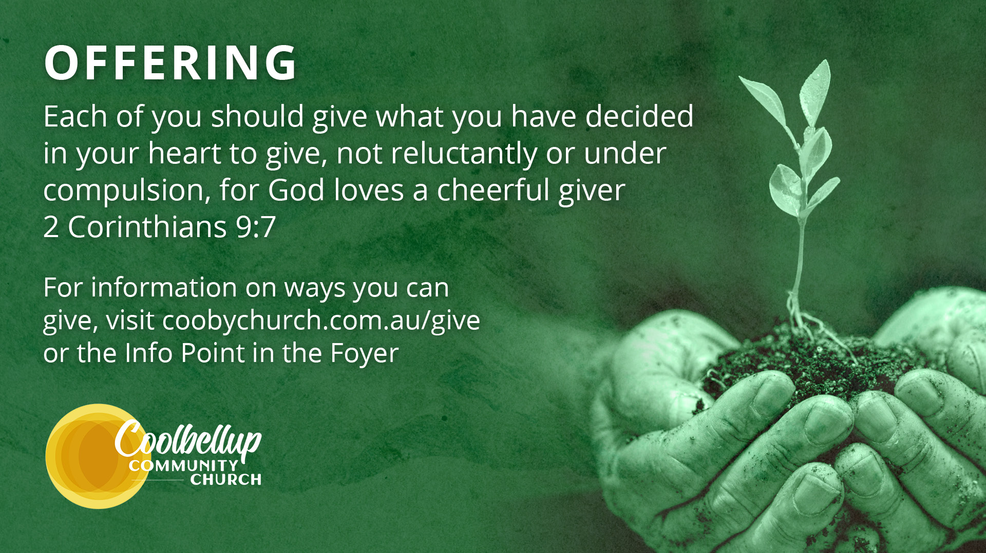

Slide 3


The Danger of Tolerating Sin:
Conforming vs. Transforming
Sara De Souza
Imitate Christ
Speaker’s Name

Slide 4



Australia is coming apart – Steve McAlpine
Left: https://stephenmcalpine.com/australia-is-coming apart
Right: By TwitchingMovie - Own work, CC BY-SA 4.0, https://commons.wikimedia.org/w/index.php?curid=174071921

Slide 5
For those God foreknew he also predestined to be conformed to the image of his Son, that he might be the firstborn among many brothers and sisters.
- ROMANS 8:29

Slide 6
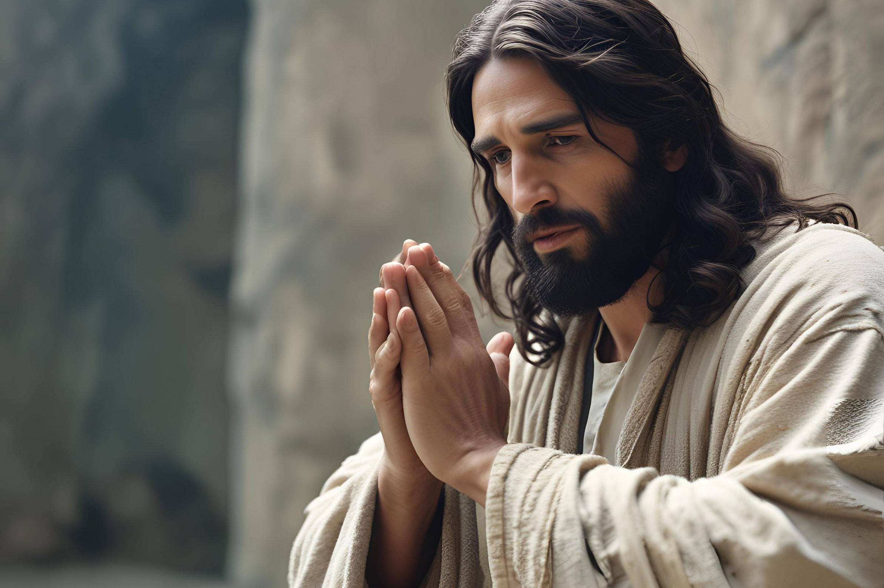

Slide 7
1 Corinthians 8:1-13
¹ Now about food sacrificed to idols: We know that “We all possess knowledge.” But knowledge puffs up while love builds up. ² Those who think they know something do not yet know as they ought to know. ³ But whoever loves God is known by God.

Slide 8
⁴ So then, about eating food sacrificed to idols: We know that “An idol is nothing at all in the world” and that “There is no God but one.” ⁵ For even if there are so-called gods, whether in heaven or on earth (as indeed there are many “gods” and many “lords”), ⁶ yet for us there is but one God, the Father, from whom all things came and for whom we live; and there is but one Lord, Jesus Christ, through whom all things came and through whom we live.

Slide 9
⁷ But not everyone possesses this knowledge. Some people are still so accustomed to idols that when they eat sacrificial food they think of it as having been sacrificed to a god, and since their conscience is weak, it is defiled.
⁸ But food does not bring us near to God; we are no worse if we do not eat, and no better if we do.

Slide 10
⁹ Be careful, however, that the exercise of your rights does not become a stumbling block to the weak.
¹⁰ For if someone with a weak conscience sees you, with all your knowledge, eating in an idol’s temple, won’t that person be emboldened to eat what is sacrificed to idols? ¹¹ So this weak brother or sister, for whom Christ died, is destroyed by your knowledge.

Slide 11
¹² When you sin against them in this way and wound their weak conscience, you sin against Christ.
¹³ Therefore, if what I eat causes my brother or sister to fall into sin, I will never eat meat again, so that I will not cause them to fall.

Slide 12
1 CORINTHIANS 10:23-11:1
²³ “I have the right to do anything,” you say—but not everything is beneficial. ²⁴ “I have the right to do anything”—but not everything is constructive. No one should seek their own good, but the good of others...

Slide 13
³¹ So whether you eat or drink or whatever you do, do it all for the glory of God. ³² Do not cause anyone to stumble, whether Jews, Greeks or the church of God— ³³ even as I try to please everyone in every way. For I am not seeking my own good but the good of many, so that they may be saved. 11 ¹ Follow [imitate] my example, as I follow [imitate] the example of Christ.

Slide 14
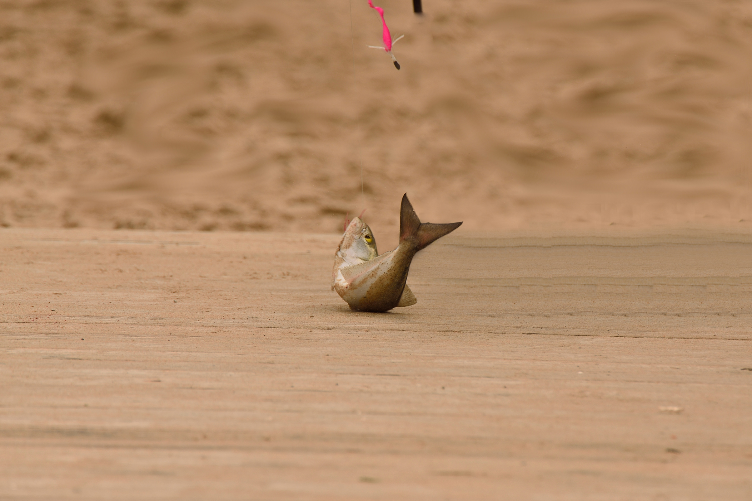

Slide 15
In many areas of life, freedom is not so much the absence of restrictions as finding the right ones, the liberating restrictions. Those that fit with the reality of our nature and the world produce greater power and scope for our abilities and a deeper joy and fulfillment.
TIM KELLER
The Reason for God: Belief in an Age of Scepticism

Slide 16
Legalism? Licence? Love!
Now about food sacrificed to idols: We know that “We all possess knowledge.” But knowledge puffs up while love builds up. Those who think they know something do not yet know as they ought to know. But whoever loves God is known by God.
- 1 CORINTHIANS 8:1-3

Slide 17


Slide 18


Slide 19
If I have the gift of prophecy and can fathom all mysteries and all knowledge, and if I have a faith that can move mountains, but do not have love, I am nothing.
- 1 CORINTHIANS 13:2

Slide 20
Will this cause others to stumble?
Be careful, however, that the exercise of your rights does not become a stumbling block to the weak. For if someone with a weak conscience sees you, with all your knowledge, eating in an idol’s temple, won’t that person be emboldened to eat what is sacrificed to idols? So this weak brother or sister, for whom Christ died, is destroyed by your knowledge…
- 1 CORINTHIANS 8:9-13

Slide 21
You cannot have a part in both the Lord’s table and the table of demons… if someone says to you, “This has been offered in sacrifice”, then do not eat it.
- 1 CORINTHIANS 10:21, 28

Slide 22
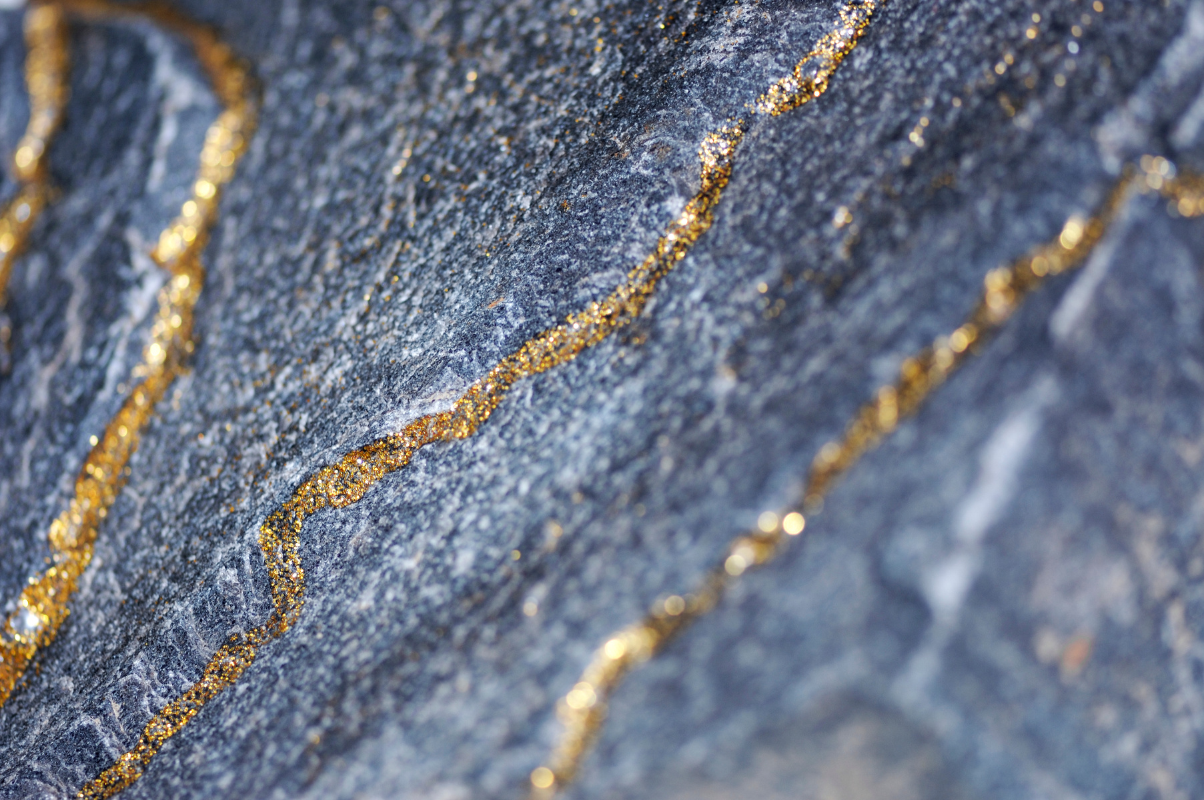

Slide 23
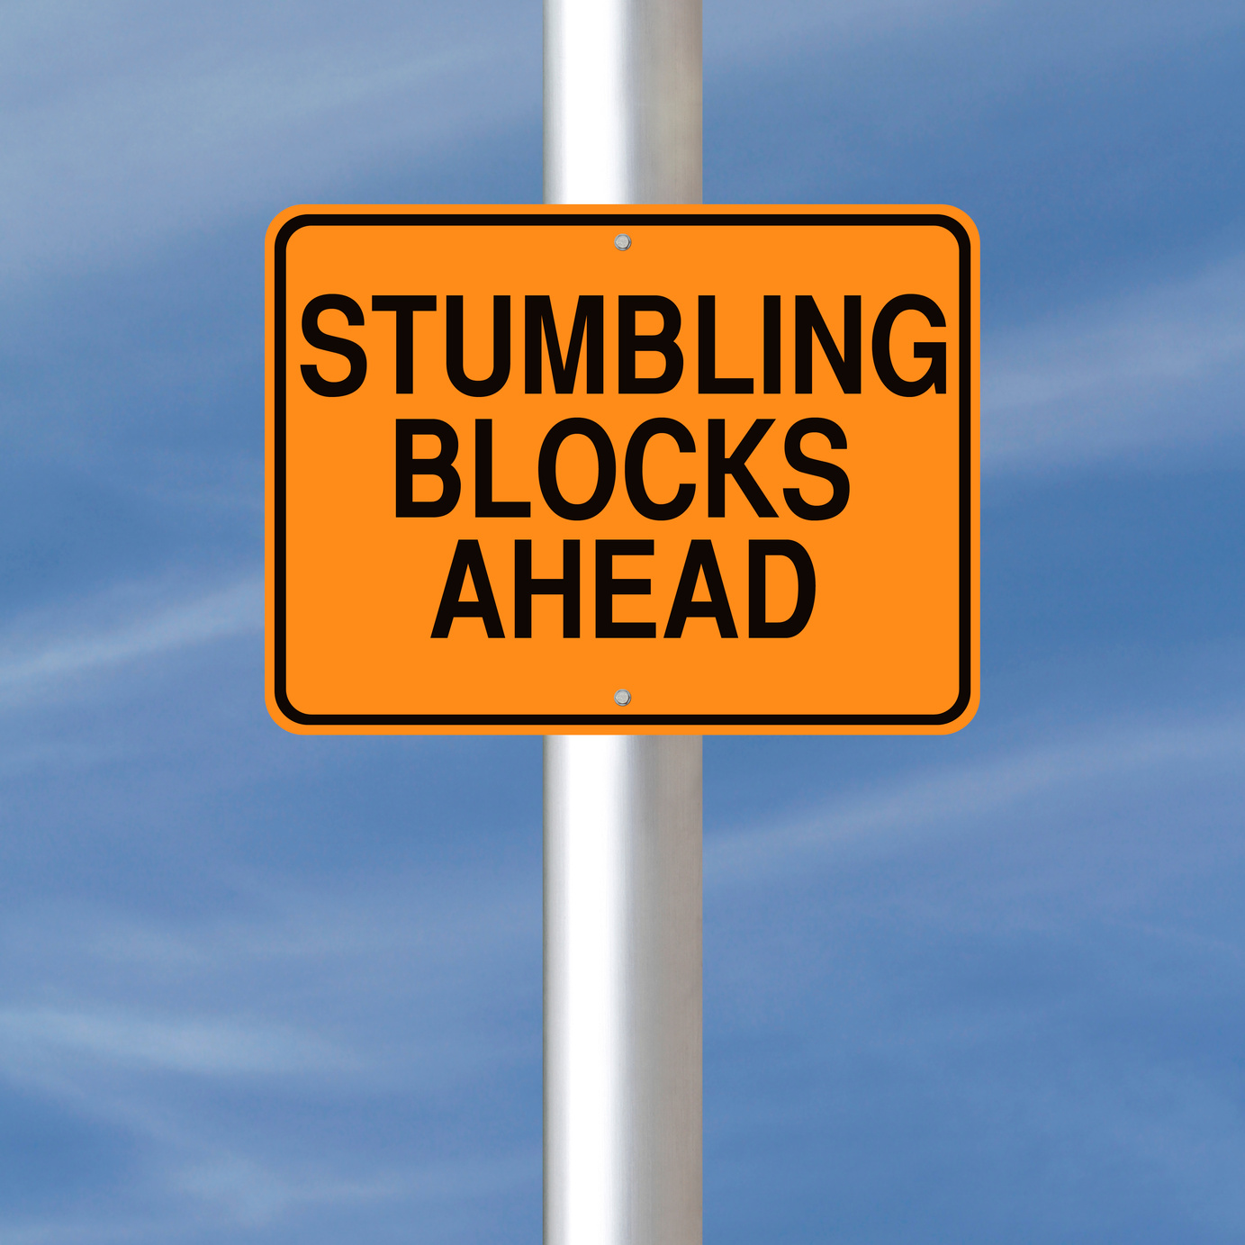

Slide 24
Whatever you did for one of the least of these brothers and sisters of mine, you did for me… whatever you did not do for one of the least of these, you did not do for me.
- MATTHEW 25:40, 45

Slide 25
We who are strong ought to bear with the failings of the weak and not to please ourselves... accept one another, then, just as Christ accepted you, in order to bring praise to God.
- ROMANS 15:1, 7

Slide 26
My Rights or my Witness?
“I have the right to do anything”—but not everything is constructive. No one should seek their own good, but the good of others... So whether you eat or drink or whatever you do, do it all for the glory of God. Do not cause anyone to stumble, whether Jews, Greeks or the church of God—even as I try to please everyone in every way. For I am not seeking my own good but the good of many, so that they may be saved. Follow my example, as I follow the example of Christ.
- 1 CORINTHIANS 10:23-24, 31-11:1

Slide 27


Slide 28
What are you really living for? It’s crucial to realize that you either glorify God, or you glorify something or someone else. You’re always making something look big.
- KEN SANDE

Slide 29


Slide 30


Slide 31


Slide 32


Slide 33


Slide 34
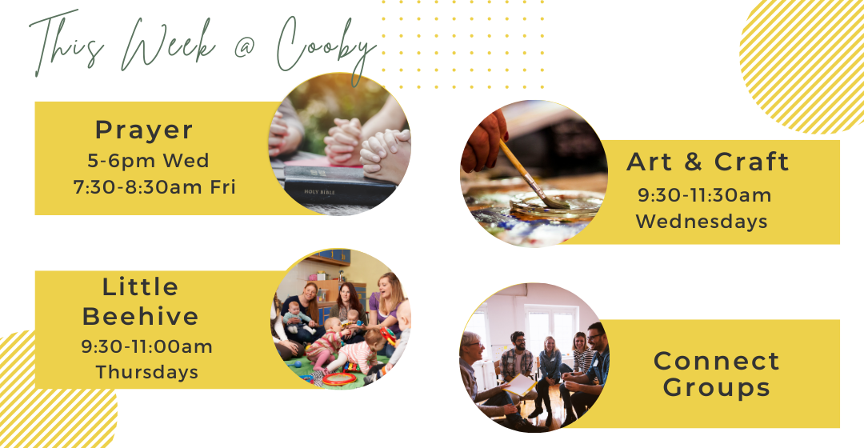

Slide 35


