Slide 1
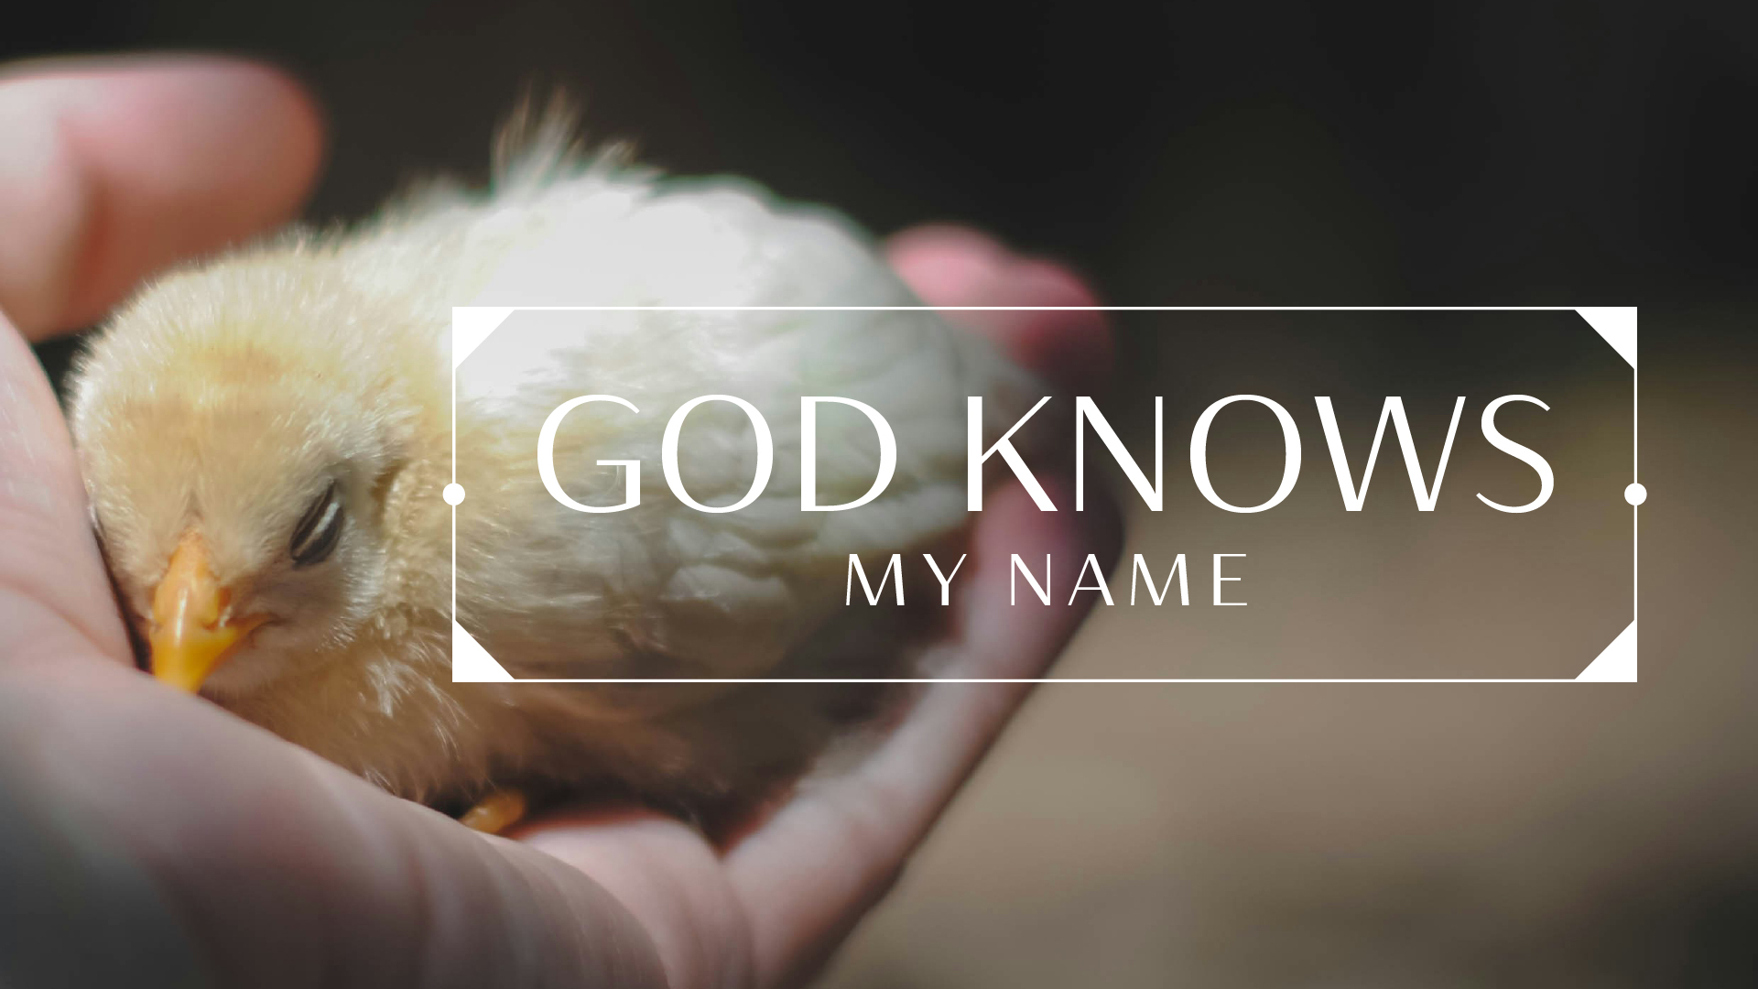
https://www.youtube.com/watch?v=rq6sa7NCYFc
Gathering Music

Slide 2
https://www.farwellumc.com/
Welcome and Announcements

Slide 3
Prelude

Slide 4
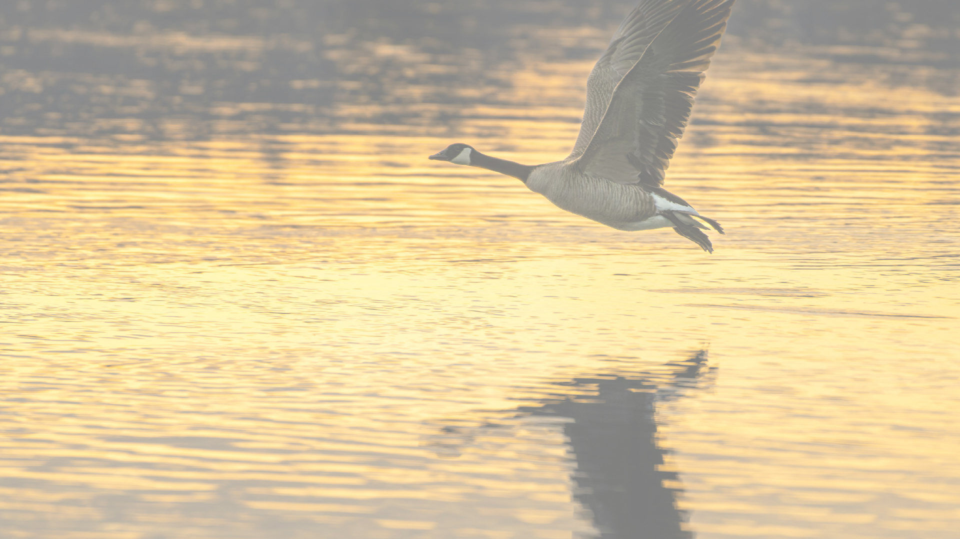
I will call upon the Lord,
Who is worthy to be praised.
So shall I be saved from my enemies.
I will call upon the Lord.
Notes:
Doxology

Slide 5
The Lord liveth, and blessed be the Rock; and let the God of my salvation be exalted.
The Lord liveth, and blessed be the Rock; and let the God of my salvation be exalted.
Notes:
Doxology

Slide 6
I will call upon the Lord,
Who is worthy to be praised.
So shall I be saved from my enemies.
I will call upon the Lord.
Notes:
Doxology

Slide 7
The Lord liveth, and blessed be the Rock; and let the God of my salvation be exalted.
The Lord liveth, and blessed be the Rock; and let the God of my salvation be exalted.
Notes:
Doxology

Slide 8
Opening Prayer

Slide 9

Psalm 1
Pg. 843 Scripture

Slide 10

Blessed is the one who does not walk in step with the wicked or stand in the way that sinners take or sit in the company of mockers,
² but whose delight is in the law of the Lord, and who meditates on his law day and night.

Slide 11
³ That person is like a tree planted by streams of water, which yields its fruit in season and whose leaf does not wither— whatever they do prospers.
⁴ Not so the wicked! They are like chaff
that the wind blows away.
⁵ Therefore the wicked will not stand in the judgment,

Slide 12
nor sinners in the assembly of the righteous.
⁶ For the Lord watches over the way of the righteous,
but the way of the wicked leads to destruction.

Slide 13
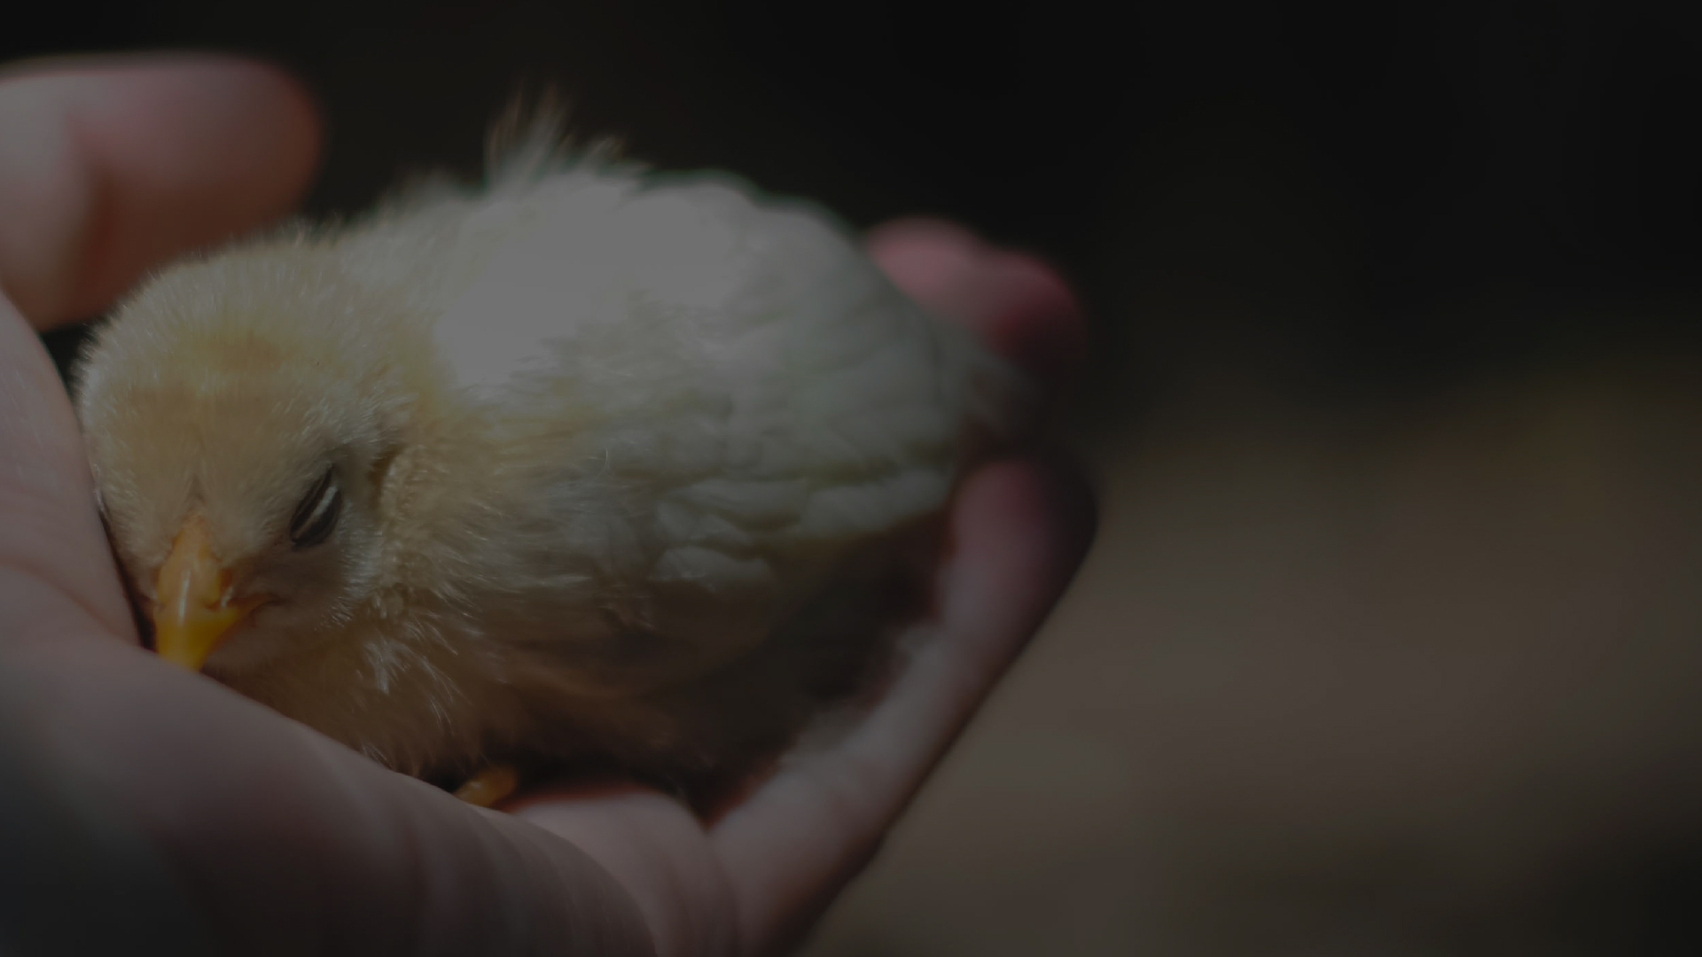
Where he Leads me
UMH #338
Singing from the Hymnal

Slide 14
Luke 14:25-33
Pg. 1623 Scripture

Slide 15
Large crowds were traveling with Jesus, and turning to them he said: ²⁶ “If anyone comes to me and does not hate father and mother, wife and children, brothers and sisters—yes, even their own life—such a person cannot be my disciple. ²⁷ And whoever does not carry their cross and follow me cannot be

Slide 16
my disciple.
²⁸ “Suppose one of you wants to build a tower. Won’t you first sit down and estimate the cost to see if you have enough money to complete it? ²⁹ For if you lay the foundation and are not able to finish it, everyone who sees it will ridicule you, ³⁰ saying,

Slide 17
‘This person began to build and wasn’t able to finish.’
³¹ “Or suppose a king is about to go to war against another king. Won’t he first sit down and consider whether he is able with ten thousand men to oppose the one coming against him with twenty thousand?

Slide 18
³² If he is not able, he will send a delegation while the other is still a long way off and will ask for terms of peace. ³³ In the same way, those of you who do not give up everything you have cannot be my disciples.

Slide 19
This is the word of God for the people of God.
All: Thanks be to God.

Slide 20
Call To Worship

Slide 21
Wherever you go, from the top of the highest mountain or into the deep abysses of the earth, God knows you.
Wherever we go, God knows our name.

Slide 22
Whatever you do, from the time you wake up until you lay your head down again, God knows you.
Whatever we do, God knows our name.

Slide 23
However you live, from your inner thoughts to your public acts and everything in between, God knows you.
However we live, God knows our name.

Slide 24
We gather to worship God, who loves us, knows us, and calls us by name.
We gather to worship God, for we are fearfully and wonderfully made by God who knows our name! Amen

Slide 25
I Have Decided To Follow Jesus
TFWS #2129
Please stand if able

Slide 26
I have decided to follow Jesus,
I have decided to follow Jesus,
I have decided to follow Jesus
No turning back,
No turning back.
I Have Decided To Follow Jesus
TFWS#2129
Notes:
Praise Song

Slide 27
The world behind me,
The cross before me.
The world behind me,
The cross before me.
The world behind me,
The cross before me.
No turning back,
No turning back.
I Have Decided To Follow Jesus
TFWS#2129
Notes:
Praise Song

Slide 28
Though none go with me,
Still I will follow.
Though none go with me,
Still I will follow.
Though none go with me,
Still I will follow.
No turning back,
No turning back.
I Have Decided To Follow Jesus
TFWS#2129
Notes:
Praise Song

Slide 29
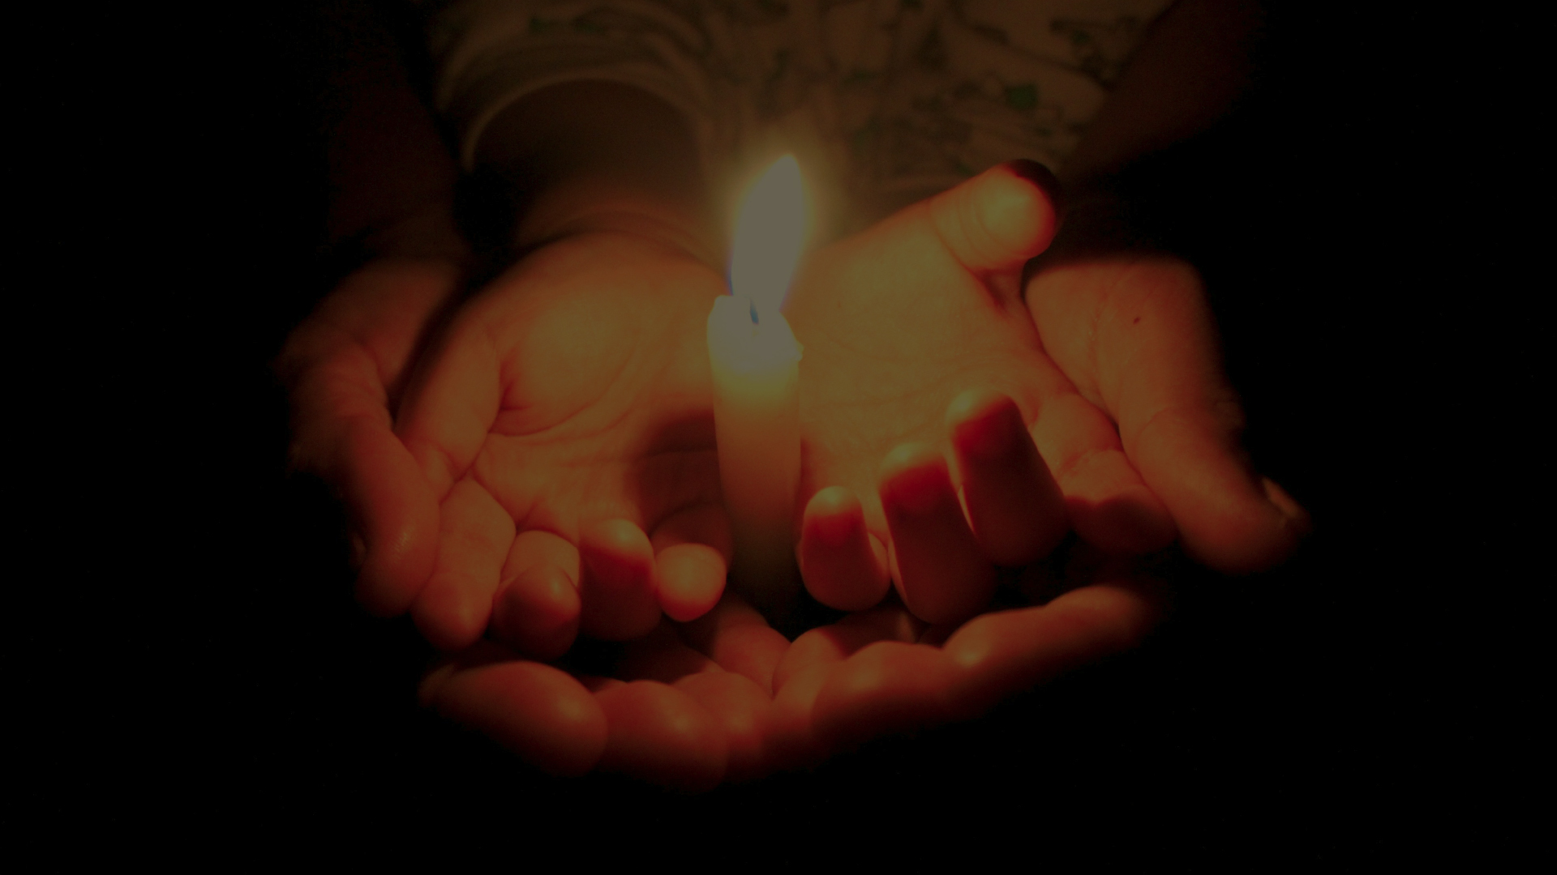
Joys and Prayer Requests

Slide 30
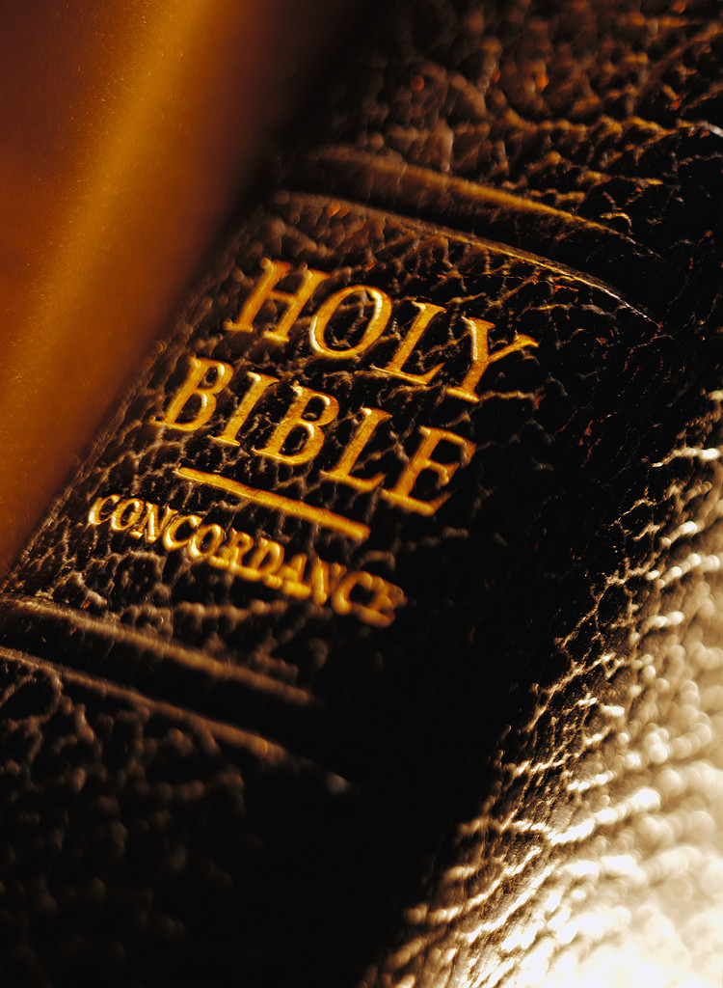
The Lord’s Prayer
Our father,
Who art in heaven
Hallowed be thy name.
Thy kingdom come,
Thy will be done
Notes:
Lord’s Prayer

Slide 31
The Lord’s Prayer
On earth
As it is in heaven.
Give us this day
Our daily bread
And forgive us
Our trespasses
Notes:
Lord’s Prayer

Slide 32
The Lord’s Prayer
As we forgive those
Who trespass against us.
And lead us not into
Temptation
But deliver us from evil
Notes:
Lord’s Prayer

Slide 33
The Lord’s Prayer
For thine is the kingdom
And the power,
And the glory forever.
Amen
Notes:
Lord’s Prayer

Slide 34
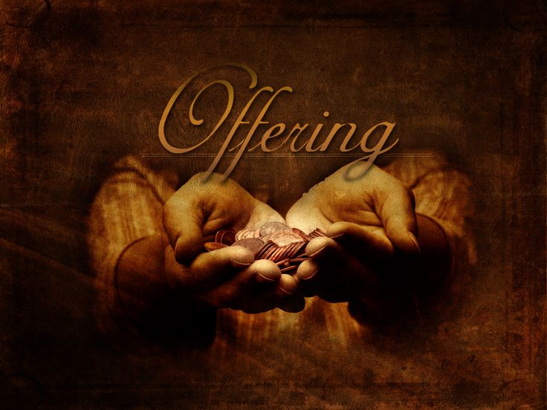
Notes:
Offering

Slide 35


Praise the Lord who reigns above and
Keeps his court below;
Praise the holy God of love and
All his greatness show;
Doxology
Notes:
Doxology lyrics

Slide 36
praise him for his noble deeds,
Praise him for his matchless power;
Him from whom all good proceeds let
Earth and heaven adore.
Doxology
Notes:
Doxology lyrics

Slide 37
Tender and knowing God, you have searched us and known us—every thought, every fear, every hope that stirs within. You wove us together with care, claiming us before we could speak your name. Receive these gifts, offered

Slide 38
not from perfection but from hearts seeking you. Use them to shape a world more reflective of your love and shape us, too, into a people more open, more generous, more faithful.

Slide 39
May our giving become a response to your knowing and our generosity a reflection of your grace. In the name of the one who knows us still. Amen.

Slide 40
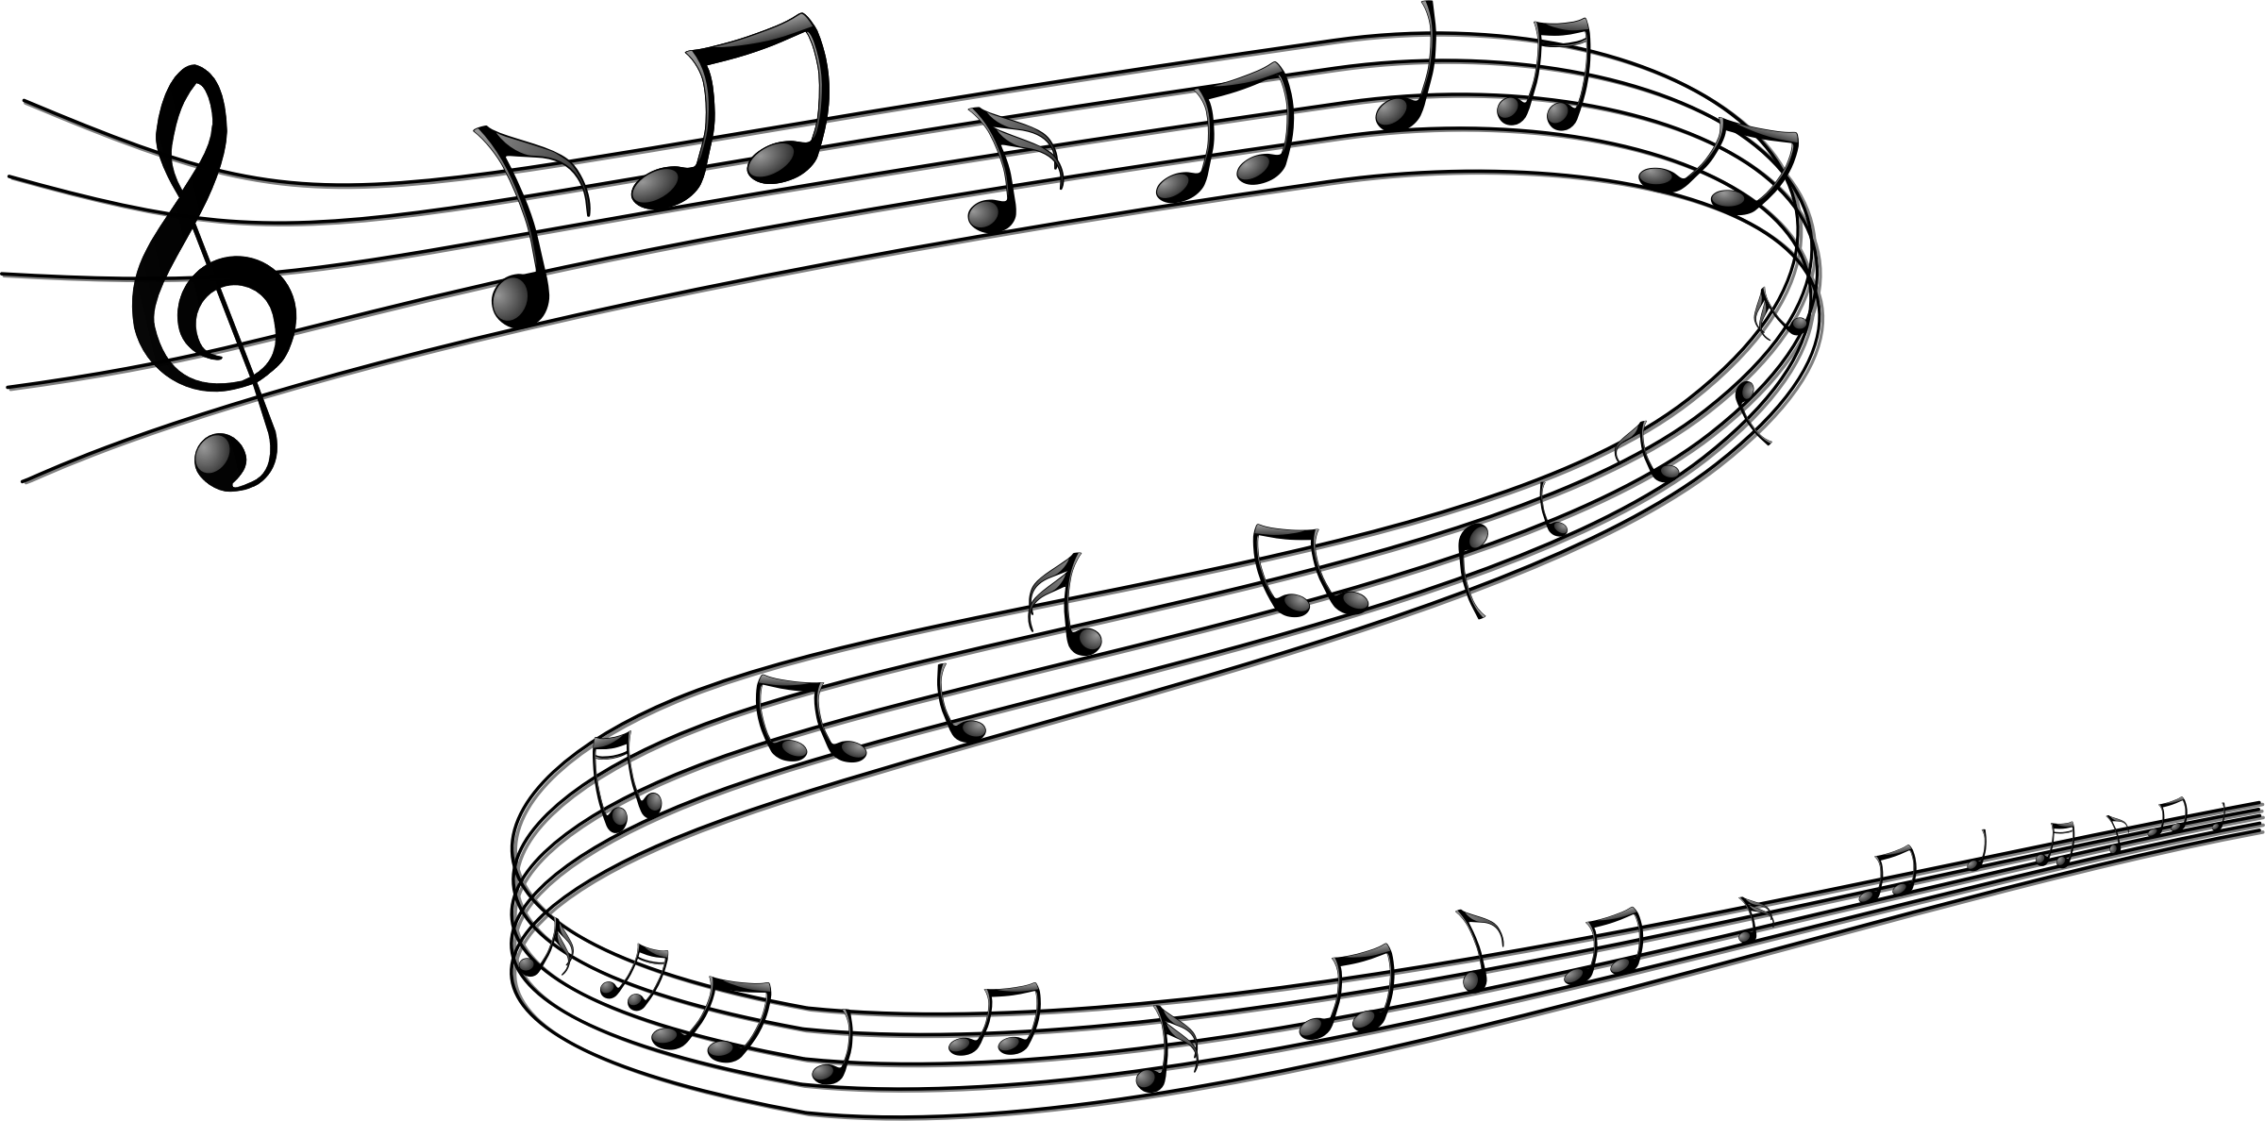

Choir
Anthem

Slide 41
Dr Ray Francis

Slide 42


Slide 43
HOLY COMMUNION
Lift up your hearts and give thanks to God.
Blessed are you, O God, who with your Word and Holy Spirit created all things and called them good.
In Jesus Christ your Word became flesh and dwelt among us.

Slide 44
HOLY COMMUNION
Through Jesus' suffering and death
you took upon yourself our sin and death and destroyed their power for ever.
You raised from the dead this same Jesus, who now reigns with you in glory, and poured upon us your Holy Spirit, making us the people of your new covenant.

Slide 45
HOLY COMMUNION
On the night before meeting with death
Jesus took bread, gave thanks to you, broke the bread,
gave it to the disciples, and said:
"Take, eat; this is my body which is given for you.
Do this in remembrance of me."
When the supper was over Jesus took the cup,
gave thanks to you, gave it to the disciples, and said:
"Drink from this, all of you; this is my blood of the new covenant, poured out for you and for many for the forgiveness of sins. Do this, as often as you drink it, in remembrance of me."

Slide 46
And so, in remembrance of these your mighty acts in Jesus Christ,
we offer ourselves in praise and thanksgiving as a holy and living sacrifice, in union with Christ's offering for us.

Slide 47
Pour out your Holy Spirit on us gathered here, and on these gifts, that in the breaking of this bread and the drinking of this wine we may know the presence of the living Christ
and be renewed as the body of Christ for the world, redeemed by Christ's blood, until Christ comes in final victory and we feast at your table for ever.

Slide 48
Through Christ,
With Christ,
In Christ, and in the unity of the Holy Spirit,
all honor and glory is yours, almighty God, now and for ever.
Amen.

Slide 49
Cry Of My Heart
TFWS #2165
Notes:
Doxology

Slide 50
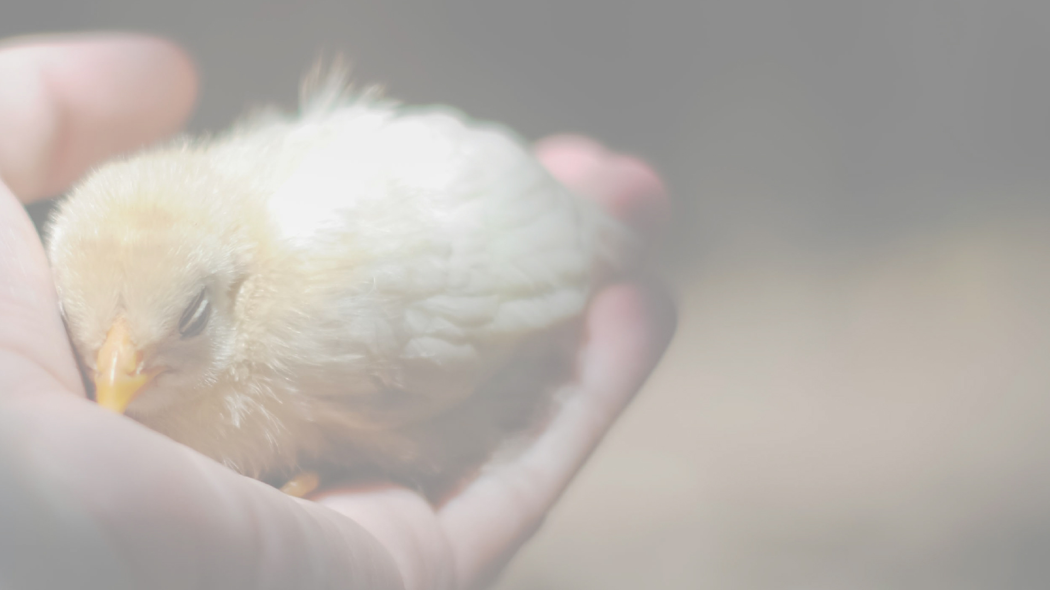
It is the cry of my heart
To follow you.
It is the cry of my heart
To be close to you.
It is the cry of my heart
To follow
All of the days of my life.

Slide 51
Teach me your holy ways,
O Lord,
So I can walk in your truth.
Teach me your holy ways,
O lord, and make me wholly devoted to you.

Slide 52
It is the cry of my heart
To follow you.
It is the cry of my heart
To be close to you.
It is the cry of my heart
To follow
All of the days of my life.

Slide 53
Open my eyes so I can see
The wonderful things that you do.
Open my heart up more and more,
And make me wholly devoted to you.

Slide 54
It is the cry of my heart
To follow you.
It is the cry of my heart
To be close to you.
It is the cry of my heart
To follow
All of the days of my life.

Slide 55
May you go from this place carrying the blessing and assurance that the Triune God, Creator of the universe, knows your name. Amen

Slide 56
