Slide 1
Intentional Prayer
Psalm 79:9-11- Help us, O God of our salvation, for the glory of your name; deliver us, and atone for our sins, for your name's sake! Why should the nations say, “Where is their God?” Let the avenging of the outpoured blood of your servants be known among the nations before our eyes! Let the groans of the prisoners come before you; according to your great power, preserve those doomed to die!"

Slide 2
Prayer Prompts
God, you are our helper, our salvation , and our glorious deliver!
Lord, even in dark times we remember You are…….
Lord, use me today to show others that You are…….

Slide 3
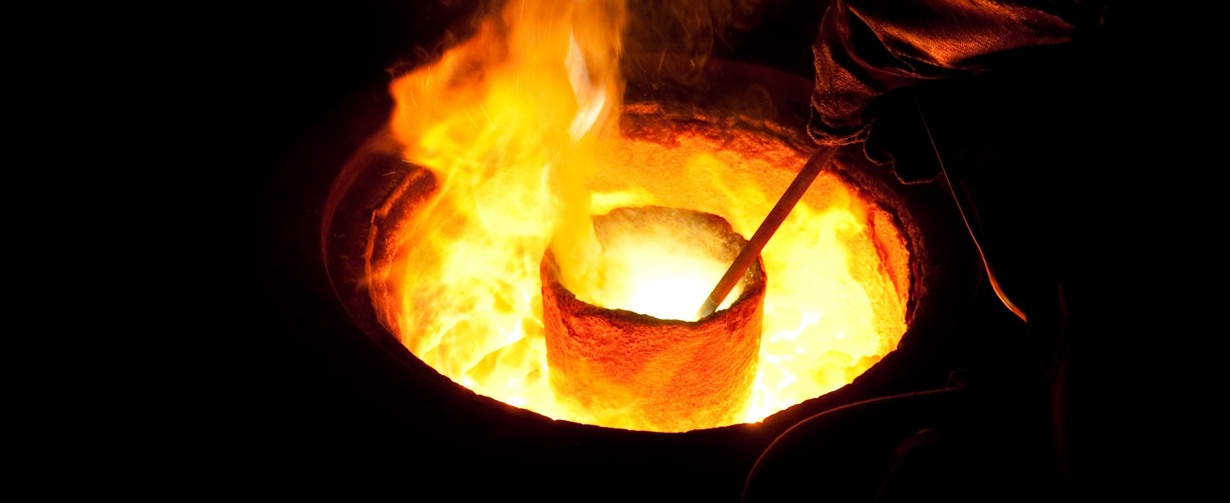
Book of James

Slide 4
In the kingdom of God roles are reversed.

Slide 5
In our poverty we are tempted to covet and wallow in self pity.

Slide 6
Even when we have nothing, we still possess everything because we have Jesus.

Slide 7
In our earthly lack we must keep our hearts focused on our eternal inheritance!

Slide 8
We can see our situation as a joyful opportunity to depend upon and grow in the Lord.

Slide 9
We are more likely to be drawn away from Christ in our wealth than in our poverty.

Slide 10
We would be wise to recognize the transient nature of our lives.

Slide 11
True wealth lies in developing our spiritual lives and the hope of God’s eternal promises.

Slide 12
In God’s kingdom the poor and the wealthy are equals.

Slide 13
Success
Spiritual Growth
Deep abiding intimacy with Jesus
An increasing love for God, love for people, and love for His word.

Slide 14
We know and are known by God!

Slide 15
Our love for God is manifested in our faithful obedience to the Lord.

