Slide 1

YOU ARE BLESSED & HIGHLY FAVORED!

Slide 2

ACCOMPLISH MORE IN (Phil 3:13-14)

Slide 3
FORGETTING THOSE THINGS BEHIND
RESOLVE THE UNFINISHED BUSINESS IN YOUR PAST
UNGRIEVED LOSSES
UNCONFESSED SINS
UNRECONCILED DIFFERENCES
UNHEALED WOUNDS
UNFORGIVEN RELATIONSHIPS

Slide 4

BE WILLING TO STRETCH PAST YOUR LIMITATIONS

Slide 5
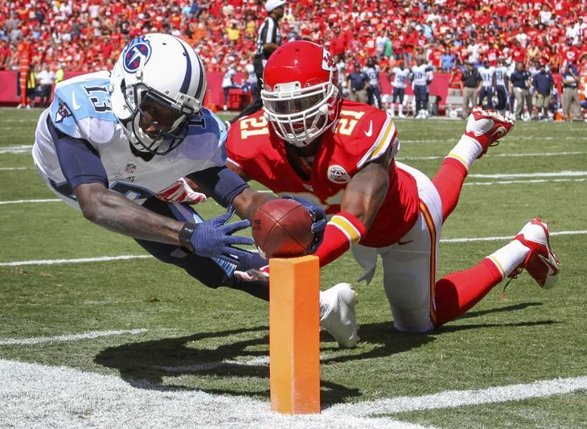
PRESSING TOWARDS THE MARK

