Slide 1


Slide 2


Slide 3


Slide 4


The Danger of Tolerating Sin:
Conforming vs. Transforming
Sara De Souza
How Now Do We Live
Robyn Christie

Slide 5
“The function of Christianity was not to give a man a new life but to make his old life new”
William Barclay

Slide 6
1 Corinthians 6:19 -20
Do you not know that your bodies are temples of the Holy Spirit, who is in you, whom you have received from God?
You are not your own; you were bought at a price. Therefore honor God with your bodies.

Slide 7
1 Corinthians 7:1
Now for the matters you wrote about: “It is good for a man not to have sexual relations with a woman.”

Slide 8
1 Cor 7:17 -24
Nevertheless, each person should live as a believer in whatever situation the Lord has assigned to them, just as God has called them.
This is the rule I lay down in all the churches. Was a man already circumcised when he was called? He should not become uncircumcised.

Slide 9
Was a man uncircumcised when he was called? He should not be circumcised. Circumcision is nothing and uncircumcision is nothing.
Keeping God’s commands is what counts.
Each person should remain in the situation they were in when God called them.

Slide 10
Were you a slave when you were called? Don’t let it trouble you—although if you can gain your freedom, do so.
For the one who was a slave when called to faith in the Lord is the Lord’s freed person; similarly, the one who was free when called is Christ’s slave.

Slide 11
23 You were bought at a price; do not become slaves of human beings.
Brothers and sisters, each person, as responsible to God, should remain in the situation they were in when God called them.

Slide 12
1 Corinthians 7:17 The Message
17 And don’t be wishing you were someplace else or with someone else. Where you are right now is God’s place for you. Live and obey and love and believe right there. God, not your marital status, defines your life. Don’t think I’m being harder on you than on the others. I give this same counsel in all the churches.

Slide 13
17Nevertheless, each person should live as a believer in whatever situation the Lord has assigned to them, just as God has called them.
20 Each person should remain in the situation they were in when God called them.
24 Brothers and sisters, each person, as responsible to God, should remain in the situation they were in when God called them.

Slide 14
1 Corinthians 7:19
Circumcision is nothing and uncircumcision is nothing. Keeping God’s commands is what counts.
Galatians 5:6
For in Christ Jesus neither circumcision nor uncircumcision has any value. The only thing that counts is faith expressing itself through love.

Slide 15
1 Corinthians 7:35
I am saying this for your own good, not to restrict you, but that you may live in a right way in undivided devotion to the Lord.

Slide 16
1 Corinthians 7:21 -24
Were you a slave when you were called? Don’t let it trouble you—although if you can gain your freedom, do so. For the one who was a slave when called to faith in the Lord is the Lord’s freed person; similarly, the one who was free when called is Christ’s slave.

Slide 17
You were bought at a price; do not become slaves of human beings. Brothers and sisters, each person, as responsible to God, should remain in the situation they were in when God called them.

Slide 18
1 Corinthians 7:7
I wish that all of you were as I am. But each of you has your own gift from God; one has this gift, another has that.

Slide 19
Ephesians 2:4 -8
4 But because of his great love for us, God, who is rich in mercy, 5 made us alive with Christ even when we were dead in transgressions—it is by grace you have been saved. 6 And God raised us up with Christ and seated us with him in the heavenly realms in Christ Jesus,

Slide 20
7 in order that in the coming ages he might show the incomparable riches of his grace, expressed in his kindness to us in Christ Jesus. 8 For it is by grace you have been saved, through faith—and this is not from yourselves, it is the gift of God—

Slide 21
“To pray ’thy will be done,’ I must be willing, if the answer requires it, that my will be undone.”
Elisabeth Elliot

Slide 22
Matthew 7:17 -24
24 “Therefore everyone who hears these words of mine and puts them into practice is like a wise man who built his house on the rock. 25 The rain came down, the streams rose, and the winds blew and beat against that house; yet it did not fall, because it had its foundation on the rock.

Slide 23
But everyone who hears these words of mine and does not put them into practice is like a foolish man who built his house on sand. The rain came down, the streams rose, and the winds blew and beat against that house, and it fell with a great crash.”

Slide 25


Slide 26


Slide 27
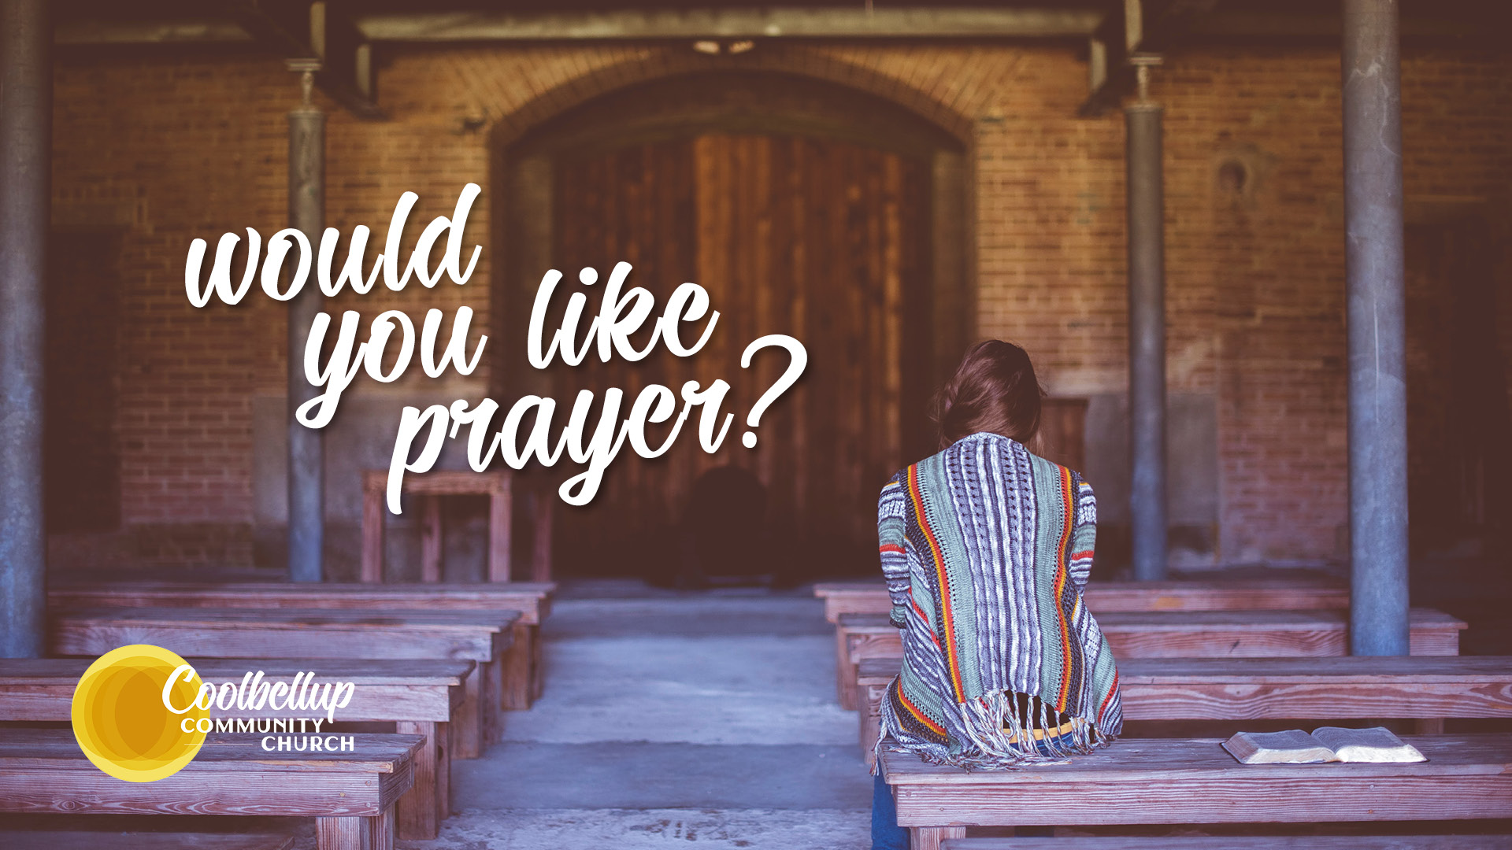

Slide 28


