Slide 1

ANNOUNCEMENTS
If you are new to our Church, please know, we are so blessed you are with us.

Slide 2
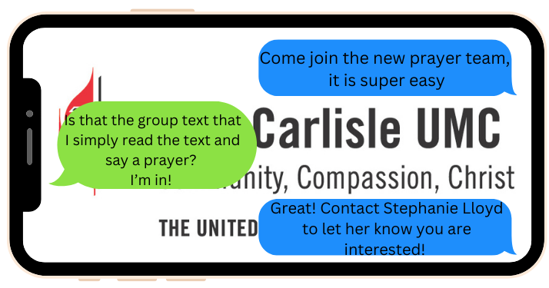
Prayer Team

Slide 3
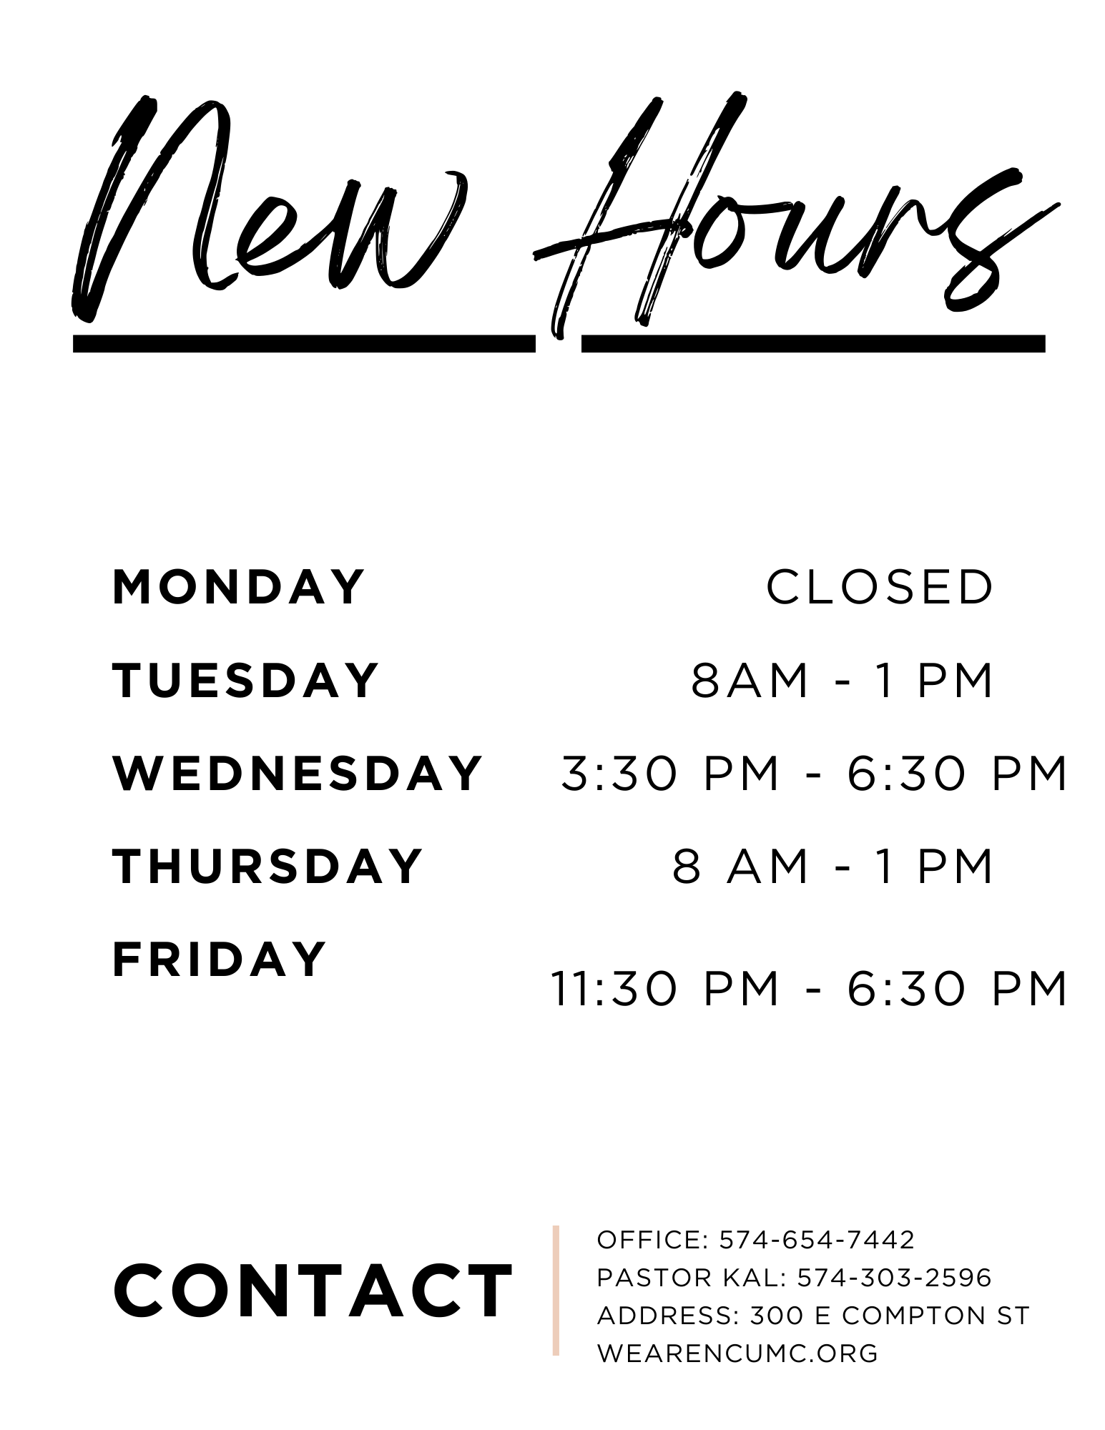
New hours begin!

Slide 4


Slide 6
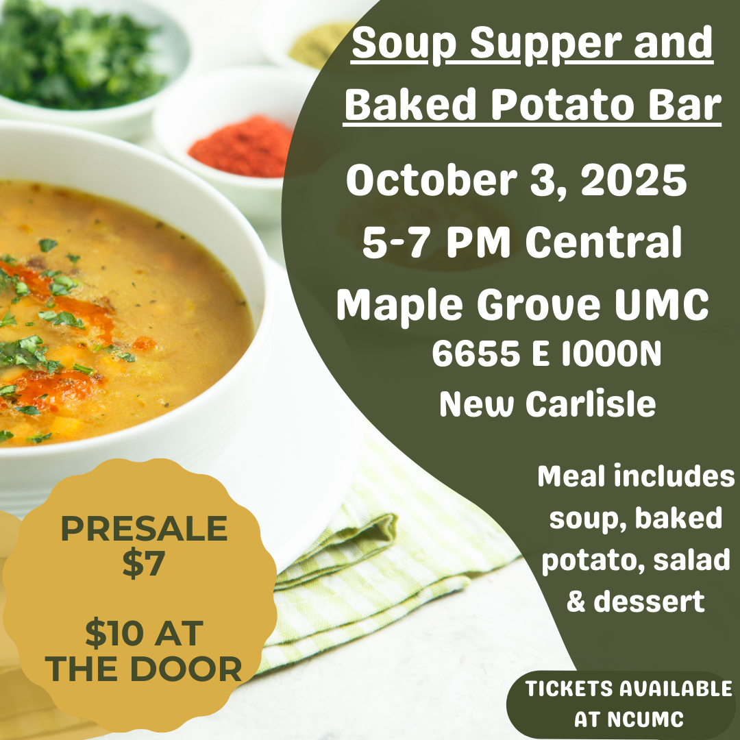

Slide 7


Slide 8
Charge Conference
October 4th
12 cst / 1 est
Salem Chapel UMC
See Pastor Kal for info

Slide 9
Bishop’s Rally
Crown Point UMC
September 6th

Slide 10
Broadway Christian Parish Update
June $79
July $ 25
August $ 25
YTD $470

Slide 11
Meetings
Sept 2 – Finance 6:30
Sept 9 – Ad Council 6:30
Sept 16 – Trustees 6:30

Slide 12
COMMUNITY RESERVE NEEDS
Silverware
Kitchen Utensils
Pots and Pans
Small Appliances
Living Room Furniture
Bedroom Furniture
Dining Tables and Chairs

Slide 13
Cookie Bakers for Sunday Morning
We would appreciate more volunteers to provide Sunday morning cookies. Sign up sheet is in the Fellowship Hall.

Slide 14
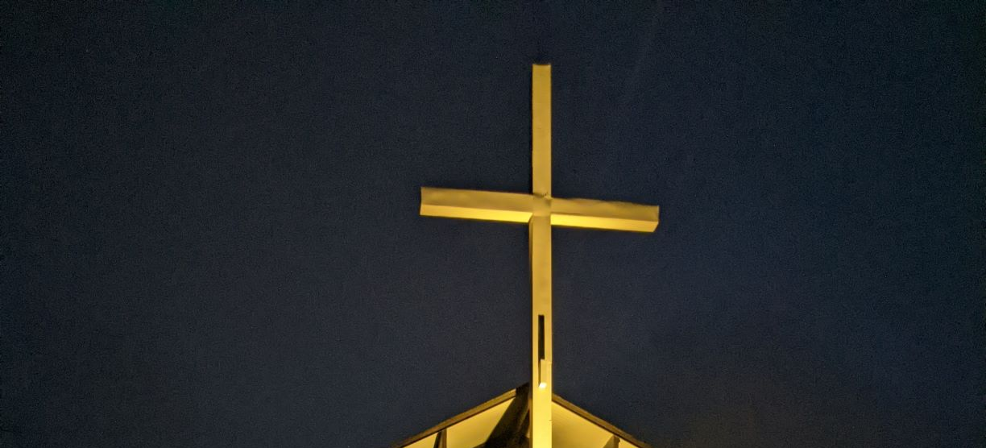
CROSS LIGHTING
The cross is being lit in honor of Jesus Christ, our Lord, who saved us from our sins.
Notes:
And

Slide 15
If you would like the cross lit in memory or in honor of someone, please let the office know. It is $10.00 a week.

Slide 16

LOOK AT NCUMC ON FACEBOOK
If you need help or would like to see something listed, please contact Ann Morrison

Slide 17
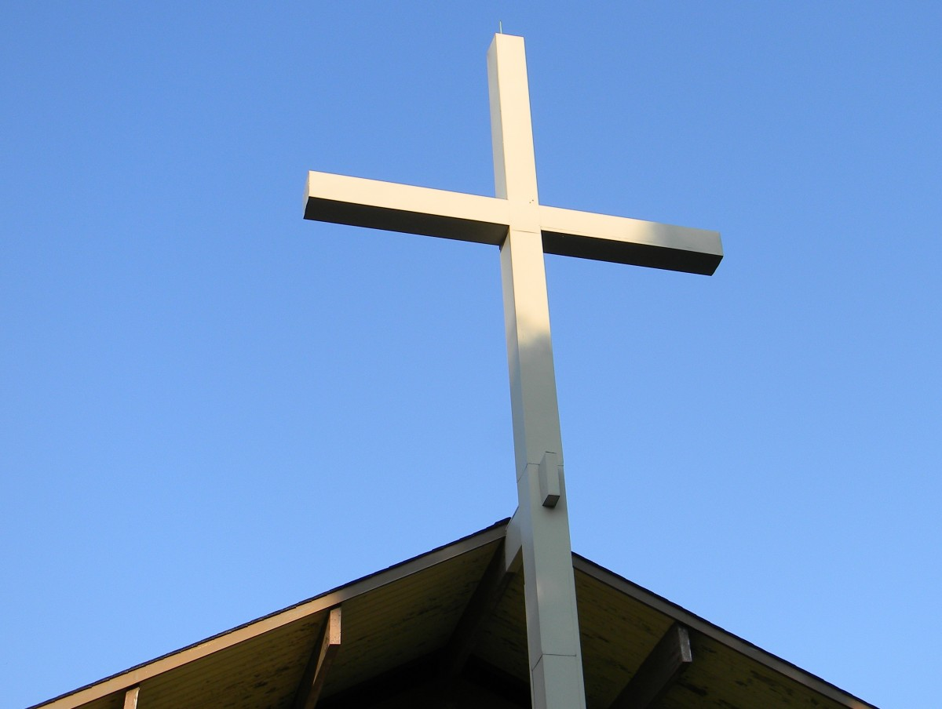
OUR WEBSITE www.wearencumc.org

Slide 18

It does not take long to ask GOD for help for someone you know or don’t know.
If you have a request, message us on Facebook, or you can text Pastor Kal or Stephanie Lloyd or call the church office and we will share it with our prayer chain.

