Slide 1

https://music.youtube.com/watch?v=uN465yP7XfM
Gathering Music

Slide 2
LINK
Labor Day Reminder

Slide 3
Welcome and Announcements
https://www.farwellumc.com/

Slide 4
https://music.youtube.com/watch?v=iFk2iYq4Zjk&list=RDATge
Prelude

Slide 5
Opening Prayer

Slide 6

Hebrews 13:1,5-13
Notes:
Scripture

Slide 7

Keep on loving one another as brothers and sisters. Keep your lives free from the love of money and be content with what you have, because God has said,
“Never will I leave you;
never will I forsake you.”^{[a]}
⁶ So we say with confidence,

Slide 8
“The Lord is my helper; I will not be afraid.
What can mere mortals do to me?”^{[b]}
⁷ Remember your leaders, who spoke the word of God to you. Consider the outcome of their way of life and imitate their faith. ⁸ Jesus Christ is the same yesterday and today and forever.

Slide 9
⁹ Do not be carried away by all kinds of strange teachings. It is good for our hearts to be strengthened by grace, not by eating ceremonial foods, which is of no benefit to those who do so. ¹⁰ We have an altar from which those who minister at the tabernacle have no right to eat.

Slide 10
¹¹ The high priest carries the blood of animals into the Most Holy Place as a sin offering, but the bodies are burned outside the camp. ¹² And so Jesus also suffered outside the city gate to make the people holy through his own blood. ¹³ Let us, then, go to him outside the camp, bearing the disgrace he bore.

Slide 11

How Majestic Is Your Name
TFWS #2023

Slide 12
O Lord, our Lord,
How majestic is your
Name in all the earth.
O Lord, our Lord,
How majestic is your
Name in all the earth.
How Majestic Is Your Name
TFWS #2023
Notes:
Praise Song

Slide 13
O Lord,
We praise Your name.
O Lord,
We magnify your name:
Prince of peace, mighty God;
O Lord God Almighty.
How Majestic Is Your Name
TFWS #2023
Notes:
Praise Song

Slide 14
O Lord, our Lord,
How majestic is your
Name in all the earth.
O Lord, our Lord,
How majestic is your
Name in all the earth.
How Majestic Is Your Name
TFWS #2023
Notes:
Praise Song

Slide 15
O Lord,
We praise Your name.
O Lord,
We magnify your name:
Prince of peace, mighty God;
O Lord God Almighty.
How Majestic Is Your Name
TFWS #2023
Notes:
Praise Song

Slide 16
Luke 14:1,7-14
Notes:
Scripture

Slide 17
One Sabbath, when Jesus went to eat in the house of a prominent Pharisee, he was being carefully watched. When he noticed how the guests picked the places of honor at the table, he told them this parable: ⁸ “When someone invites you to a wedding feast, do not take the place of honor,

Slide 18
for a person more distinguished than you may have been invited. ⁹ If so, the host who invited both of you will come and say to you, ‘Give this person your seat.’ Then, humiliated, you will have to take the least important place. ¹⁰ But when you are invited, take the lowest place, so that when your host comes,

Slide 19
he will say to you, ‘Friend, move up to a better place.’ Then you will be honored in the presence of all the other guests. ¹¹ For all those who exalt themselves will be humbled, and those who humble themselves will be exalted.”

Slide 20
¹² Then Jesus said to his host, “When you give a luncheon or dinner, do not invite your friends, your brothers or sisters, your relatives, or your rich neighbors; if you do, they may invite you back and so you will be repaid. ¹³ But when you give a banquet,

Slide 21
¹³ But when you give a banquet, invite the poor, the crippled, the lame, the blind, ¹⁴ and you will be blessed. Although they cannot repay you, you will be repaid at the resurrection of the righteous.”

Slide 22
This is the Word of God for the people of God.
Thanks Be to God.

Slide 23
Call To Worship

Slide 24

Children of God, when we witness the needs of strangers and listen to the struggles of our friends, remember:
Let mutual love continue.

Slide 25
When we hear the struggles of those in prison and recognize the suffering of people near and far, remember:
Let mutual love continue.

Slide 26
When temptations to hoard more money, more power, and more influence surround us on every side, remember:
Let mutual love continue.

Slide 27
As we gather for worship, remember: God is here among us, surrounding us with love and forming us to live in love everywhere we go.

Slide 28
We choose to cooperate with God’s love today and every day so that mutual love will continue wherever we go and whatever we do. Amen.

Slide 29
For The Beauty Of The Earth
UMH #92
Please stand if able

Slide 30

For the beauty of the Earth,
For the glory of the skies,
For the love which from our birth
Over and around us lies;

Slide 31
Lord of all,
To thee we raise
This our hymn
Of grateful praise.

Slide 32
For the beauty of each hour
Of the day and of the night,
Hill and vale,
and tree and flower,
Sun and moon,
and stars of light;

Slide 33
Lord of all,
To thee we raise
This our hymn
Of grateful praise.

Slide 34
For thyself, best Gift Divine,
To the world so freely given,
For that great, great
love of thine,
Peace on earth,
and joy in heaven:

Slide 35
Lord of all,
To thee we raise
This our hymn
Of grateful praise.

Slide 36

Joys and Prayer Requests

Slide 37

The Lord’s Prayer
Our father,
Who art in heaven
Hallowed be thy name.
Thy kingdom come,
Thy will be done
Notes:
Lord’s Prayer

Slide 38
The Lord’s Prayer
On earth
As it is in heaven.
Give us this day
Our daily bread
And forgive us
Our trespasses
Notes:
Lord’s Prayer

Slide 39
The Lord’s Prayer
As we forgive those
Who trespass against us.
And lead us not into
Temptation
But deliver us from evil
Notes:
Lord’s Prayer

Slide 40
The Lord’s Prayer
For thine is the kingdom
And the power,
And the glory forever.
Amen
Notes:
Lord’s Prayer

Slide 41
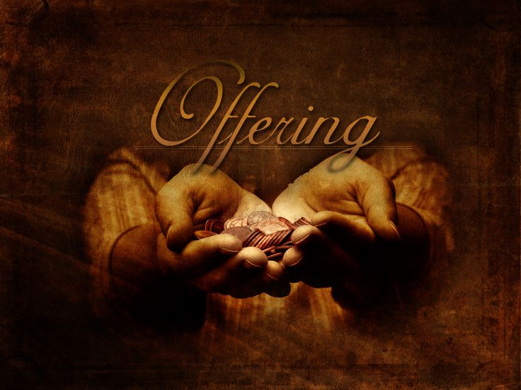
Notes:
Offering

Slide 42


Praise the Lord who reigns above and
Keeps his court below;
Praise the holy God of love and
All his greatness show;
Doxology
Notes:
Doxology lyrics

Slide 43
praise him for his noble deeds,
Praise him for his matchless power;
Him from whom all good proceeds let
Earth and heaven adore.
Doxology
Notes:
Doxology lyrics

Slide 44

Faithful and Unchanging God, in a world that shifts and sways, you remain our firm foundation. You have called us into a life of mutual love, teaching us to serve, to welcome, and to give with generous hearts. Bless these gifts we offer today, that they may extend your love to those who hunger, who seek justice, and who

Slide 45
long for hope. Shape us into a people whose generosity reflects your own, that through our giving, we may proclaim your unshakable kingdom. In the name of Jesus Christ, our constant and faithful guide. Amen.

Slide 46
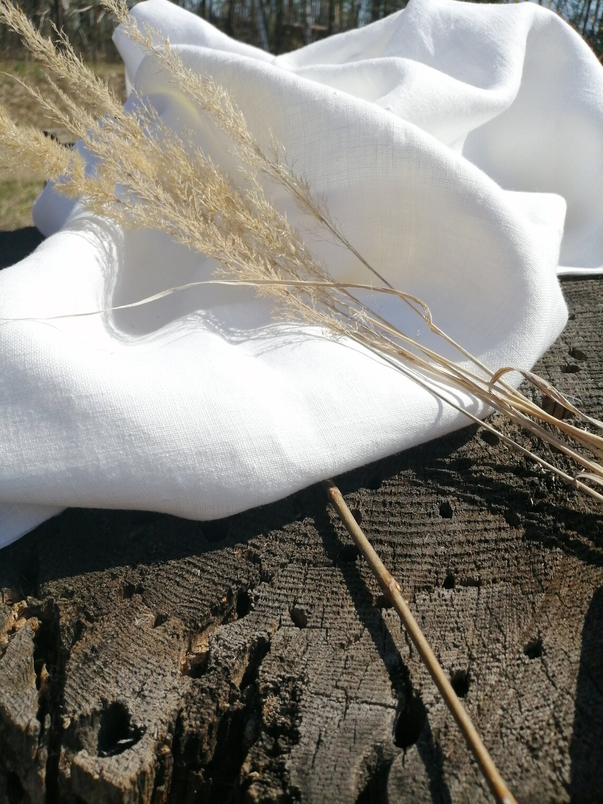
https://music.youtube.com/watch?v=T1LRsp8qBY0

Slide 47
Dr Ray Francis

Slide 48
Shout To The Lord
TFWS #2074
Notes:
Doxology

Slide 49
Shout to the Lord, all the earth, let us sing
Power and majesty, praise to the King.
Notes:
Doxology

Slide 50
Mountains bow down and the seas will roar at the sound of your name.
I sing for joy at the work of your hands,
Notes:
Doxology

Slide 51
Forever I’ll love you, forever I’ll stand.
Nothing compares to the promise I have in you.
Notes:
Doxology

Slide 52
Children of God, go from this place in the blessing of the Triune God, our Helper and our Friend, offering your sacrifice of praise and sharing what you have as you spread the love of God in mutuality and care to the ends of the earth and back again. Amen.

Slide 53
