Slide 2


Slide 3

GROWING UP OR SIMPLY GROWING OLD?
1 Corinthians 3:1-17

Slide 4
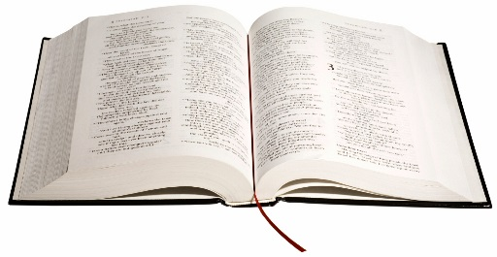
WHAT SPIRITUAL MATURITY IS NOT?
Spiritual age
Instantaneous and final
Automatic
Possession of spiritual gifts
Copying Christ
Notes:
Colossians 3:5-11 (READ)

Slide 5
WHAT IS SPIRITUAL MATURITY?
Spiritual Maturity Is Moving On From Being Dominated By Flesh To Being Dominated By The Spirit
(1 Cor. 3:1)
Notes:
Colossians 3:5-11 (READ)

Slide 6
WHAT IS SPIRITUAL MATURITY?
Spiritual Maturity Is Moving On From Spiritual Infancy To Spiritual Adulthood
(1 Cor. 3:2)
Notes:
Colossians 3:5-11 (READ)

Slide 7
WHAT IS SPIRITUAL MATURITY?
Spiritual Maturity Is Moving On From Being A Student To Being A Teacher (Hebrews 5:12)
Notes:
Colossians 3:5-11 (READ)

Slide 8
WHAT IS SPIRITUAL MATURITY?
Spiritual Maturity Is When The Body (The Church) Grows In Proportion To The Head (Christ)
(Ephesians 4:11-16)
Notes:
Colossians 3:5-11 (READ)

Slide 9
SPIRITUAL MATURITY
Spiritual Maturity Is Determined By The Mindset In Which We Operate Our Lives
Notes:
Colossians 3:5-11 (READ)

Slide 10
SPIRITUAL MATURITY
A Mature Christian Focuses On The Purpose Rather Than The Process
(1 Corinthians 3:3-9)
Notes:
Colossians 3:5-11 (READ)

Slide 11
For since there is jealousy and quarreling among you, are you not worldly? Are you not acting like mere humans? For when one says, “I follow Paul,” and another, “I follow Apollos,” are you not mere human beings?
(1 Corinthians 3:3-4)

Slide 12
What, after all, is Apollos? And what is Paul? Only servants, through whom you came to believe—as the Lord has assigned to each his task. I planted the seed, Apollos watered it, but God has been making it grow. So neither the one who plants nor the one who waters is anything, but only God, who makes things grow. The one who plants and the one who waters have one purpose, and they will each be rewarded according to their own labor. For we are co-workers in God’s service; you are God’s field, God’s building.
(1 Corinthians 3:5-9)

Slide 13
SPIRITUAL MATURITY
A Mature Christian Builds Their Life With Eternity In Mind
(1 Corinthians 3:10-16)
Notes:
Colossians 3:5-11 (READ)

Slide 14
By the grace God has given me, I laid the foundation as an expert builder, and someone else is building on it. But each be careful how he builds. For no one can lay any foundation other than the one already laid, which is Jesus Christ.
(1 Corinthians 3:10-11)

Slide 15
If anyone builds on this foundation using gold, silver, costly stones, wood, hay, or straw, their work will be shown for what it is, because the Day will bring it to light. It will be revealed with fire, and the fire will test the quality of each man’s work.
(1 Corinthians 3:12-13)

Slide 16

SPIRITUAL MATURITY
Notes:
Colossians 3:5-11 (READ)

Slide 17
If what he has built survives, he will receive his reward. If it is burned up, he will suffer loss; he himself will be saved, but only as one escaping through the flames.
(1 Corinthians 3:14-15)

Slide 18
SPIRITUAL MATURITY
God’s Ownership Of Our Lives Motivates Us To Be Wise Builders
“Don’t you know that you yourselves are God’s temple and that God’s spirit lives in you?” (1 Cor. 3:16)
Notes:
Colossians 3:5-11 (READ)

Slide 19
THE UNSAVED CHRISTIAN – Cultural Christianity
Attend Church regularly
Christian Heritage
Uphold moral standards
Identify as Christians
Align with Christian ethics
Misconception of Salvation – Good works as a means to go to Heaven

Slide 20

SPIRITUAL MATURITY – Questions to Reflect On
Do I have a personal relationship with Christ?
What eternal causes am I engaged in?
What will remain for eternity once my journey on this earth is over?
Notes:
Colossians 3:5-11 (READ)

